Slide 1
A Classification and Comparison of Data Mining Algorithms for Wireless Sensor Networks, and of Concept Modeling Approaches for Systems of Wireless Sensor Networks (based on Natural Language Processing)
Nemanja Kojić Goran Rakočević
Dragan Milićev Veljko Milutinović
School of Electrical Engineering
University of Belgrade
Staša Vujičić Stanković
School of Mathematics
University of Belgrade

Slide 2
Wireless Sensor Networks
Wireless Sensor Networks (WSN) have matured enough, so that the relevant information (for a number of applications) can be generated in a way which is economical, because sensors have become inexpensive.
Data Mining (DM) techniques can be effectively applied to WSN systems, to improve the results.

Slide 3
Data Mining
On the level of a single (e.g., national) Wireless Sensor Network, the major research problems are related to Data Mining, along the following four problem areas:
Classification
Clustering
Regression, and
Association rule mining

Slide 4
Natural Language Processing & Concept Modeling
Once the set of single (e.g., national) Wireless Sensor Networks is connected into a system of Wireless Sensor Networks, the major research problems are related to Natural Language Processing (NLP) and Concept Modeling (CM):
Different Wireless Sensor Networks utilize different terminologies (or even different ontologies) to refer to the same concepts.

Slide 5
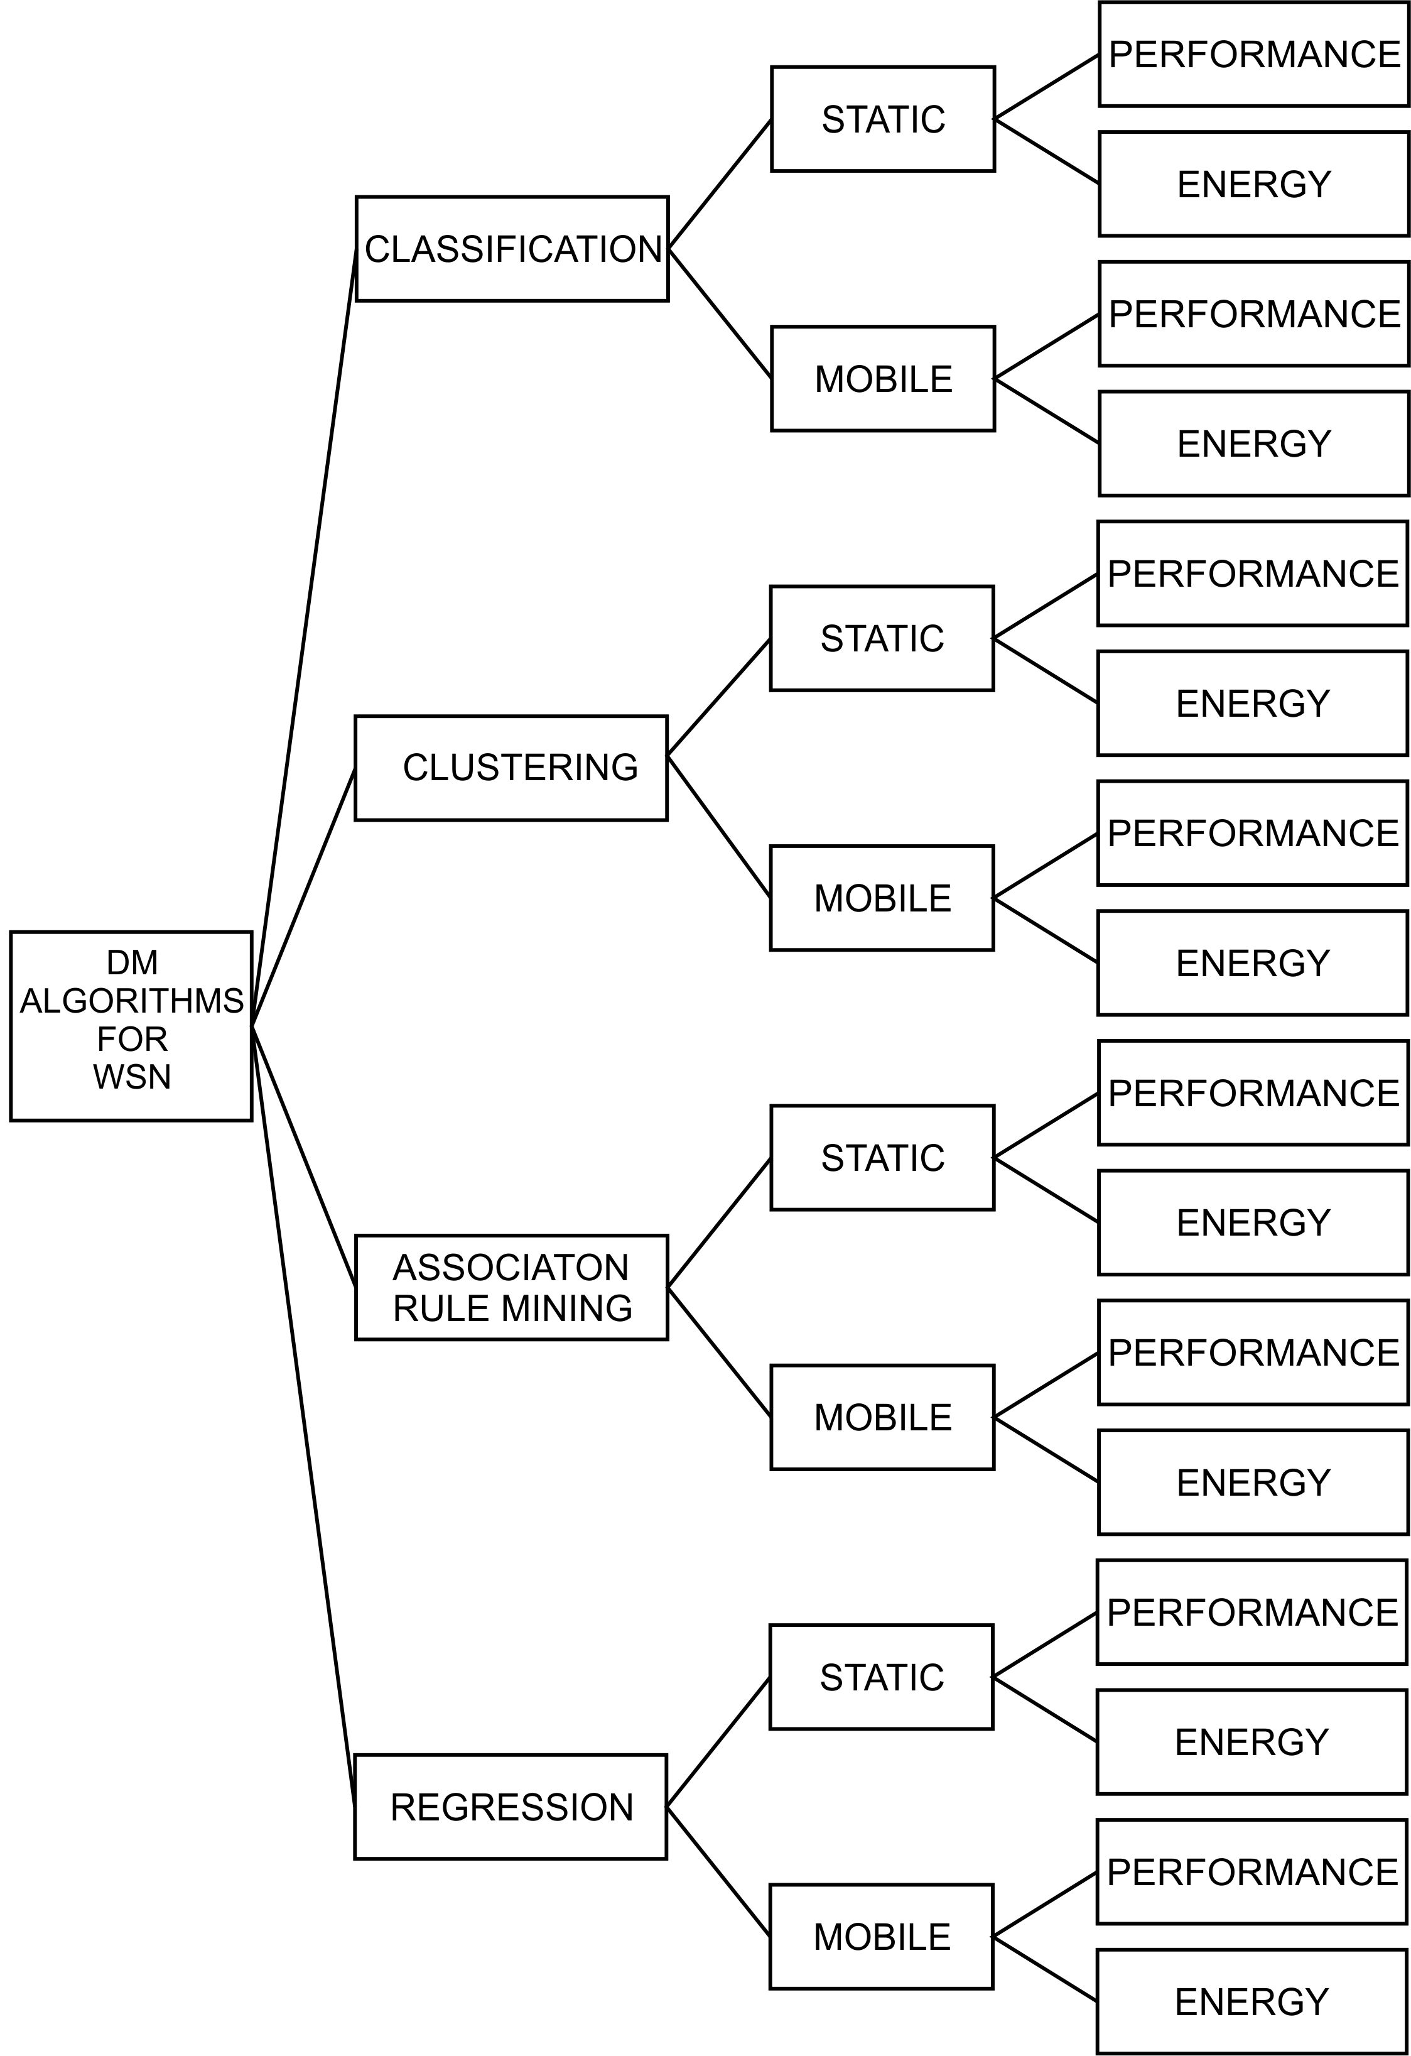
Classification Tree (DM@WSNs)

Slide 6
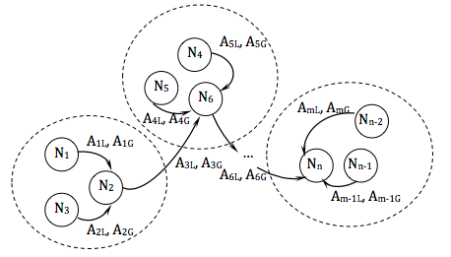
1. Classification Static Performance: ClaSP

Slide 7
Communication pattern in a WSN of the type ClaSP
Legend:
N_{x} – A WSN node parameterized by a couple [N_{xG,} N_{xL}].
N_{xG} – Node’s global parameter: The cluster a node belongs to.
N_{xL} – Node’s local parameter: Set of features observable through the node’s sensors.
A_{x} – An arch denoting a communication line in the network, parameterized by a couple [A_{xG,} A_{xL}].
A_{xL} – Arch’s local parameter: A couple [N_{s}, N_{d}], denoting the source and destination node, respectively.
A_{xG} – Arch’s global parameter: Defining whether the arch denotes communication within the cluster, or between two different clusters.

Slide 8


Training Algorithm in a Wireless Sensor Network of the Type ClaSP
DISTIRBUTED FIXED-PARTITION SVM TRAINING DFP-SVM | WEIGHTED DISTIRBUTED FIXED-PARTITION SVM TRAINING WDFP-SVM
Divide samples into clusters, where each cluster is of the same size. For every cluster do Define the cluster head (A sensor which receives data from all other sensors in the cluster, performs data fusion, and transmits the results to the base station.) Each sensor transmits its measurement sample vector to the cluster head. Cluster head combines the measurement sample vector with an estimation calculated (equations 1, 4) for the previous cluster head, to make a new SVM. Cluster head sends the estimated SVM to the cluster head that is the next one in order.
Cost function for estimation, equation for DFP-SVM: where the parameter C defines the cost of constraint violation giving weight to measurements in the set. | Cost function for estimation, Equation for WDFP-SVM: where the parameter L increases the cost for the old support vectors giving more weight to former measurements.

Slide 9
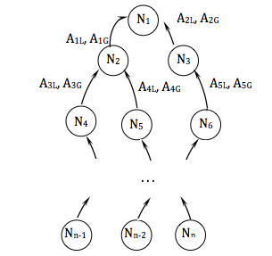
2. Classification Mobile Performance: ClaMP

Slide 10
Communication Pattern in a Wireless Sensor Network of the Type ClaMP
Legend:
N_{x} – A WSN node parameterized by a couple [N_{xG,} N_{xL}]
N_{xG} – Node’s global parameter: The set of weights in weighted voting schemes. N/A in the simple voting scheme
N_{xG} – Node’s local parameter: Set of features observable through the node’s sensors
A_{x} – An arch denoting a communication line in the network parameterized by a couple [A_{xG,} A_{xL}]
A_{xL} – Arch’s local parameter: a couple [N_{s}, N_{d}], denoting the source and destination node, respectively
A_{xG} – Arch’s global parameter: N/A.

Slide 11
Training Algorithm in a Wireless Sensor Network of the Type ClaMP
TRAINING A DISTRIBUTED WSN CLASSIFICATOR
For each node do The node takes the readings from its local sensors. The node’s local predictor is used with the readings to make a local prediction. The node sends the local prediction to the central server. If Voting scheme other than Simple voting is used Find the appropriate weight associated with the node and its local prediction. End If End For Sum the votes across all of the nodes to reach a global prediction.

Slide 12
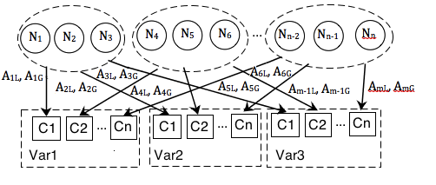
3. Clustering Mobile Energy: CluME

Slide 13
Communication pattern in a Wireless Sensor Network of the type CluME
Legend:
N_{x} – A WSN node parameterized by a couple [N_{xG,} N_{xL}]
N_{xG} – Node’s global parameter: The cluster a node belongs to
N_{xL} – Node’s local parameter: Set of features observable through the node’s sensors
A_{x} – An arch denoting that the readings from the sensors in the originating node cluster belong to the appropriate cluster of values [A_{xG,} A_{xL}]
A_{xL} – Arch’s local parameter: A couple [N_{s}, N_{d}], denoting the source and destination node, respectively
A_{xG} – Arch’s global parameter: Defining whether the arch denotes communication within the cluster, or between two different clusters

Slide 14
Training Algorithm in a Wireless Sensor Network of the Type CluME
Calculating Principals Componets from streaming data (SPIRIT approach)
Cluster the sensor data along each sensor attribute separatly Construct a bipartite graph, with the set of sensor nodes and the set of the data cluster as vertex sets, so that a vertiex form a node to a cluster denotes that the vaules from the node belong to the cluster Find all complete bipartite subgraphs

Slide 15
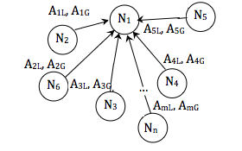
4. Regression Mobile Performance: RMP

Slide 16
Communication pattern in a WSN of the Type RMP
Legend:
N_{x} – A WSN node parameterized by a couple [N_{xG,} N_{xL}]
N_{xG} – Weights corresponding to the node’s readings
N_{xL} – Node’s local parameter: Set of features observable through the node’s sensors
A_{x} – A_{Y} – An arch denoting a communication line in the network

Slide 17
Training Algorithm in a Wireless Sensor Network of the type RMP
Calculating Principals Componets from streaming data (SPIRIT approach)
Initialise the k hidden variables W to unit vectors w₁ = [10···0]T, w₂ = [010···0]T, etc. Initialise di (i = 1, ...k) to a small positive value. While x_{t+1} arrives Update x ́₁ = x_{t+1}. For 1 ≤ i ≤ k. Calculate y_{i}, d_{i}, e_{i}, w_{i}, x_{t+1.} End_For Update x ́_{i+1} = x_{i} - y_{i} w_{i.} End_While
y_{i} = w_{i}^{T} x ́_{i} (y_{t+1,i} = projection onto w_{i}) d_{i} = λ d_{i} + y_{i}² (energy ∝ i-th eigenval. of X^{T}_{t} X_{t}) e_{i} = x ́_{i} - w_{i} y_{i} (error, ei ⊥ wi) w_{i =} w_{i} + w_{i} e_{i}/ d_{i} (update PC estimate)

Slide 18
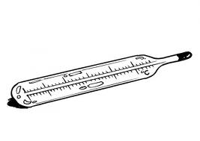
5. Clustering Static Energy: CluSE

Slide 19
Communication pattern in a WSN of the type ClaSP
Legend:
N_{x} – A WSN node parameterized by a couple [N_{xG,} N_{xL}]
N_{xG} – Node’s global parameter: The cluster a node belongs to
N_{xL} – Node’s local parameter: Set of features observable through the node’s sensors
A_{x} – An arch denoting a communication line in the network, parameterized by a couple [A_{xG,} A_{xL}]
A_{xL} – Arch’s local parameter: A couple [N_{s}, N_{d}], denoting the source and destination node, respectively
A_{xG} – Arch’s global parameter: Defining whether the arch denotes communication within the cluster, or between two different clusters.

Slide 20
Training Algorithm in a Wireless Sensor Network of the type CluSE
BASIC ALGORITHM
For each node do sensor becomes a volunteer clusterhead – VC with probability p. If node became VC node advertises itself as a clusterhead – CH to the sensors within its radio range. For (all the sensors that are no more than k hops away from the CH) do forward the advertisement End_For End_If If a node that receives a CH advertisements is not itself a CH the node joins the cluster of the closest CH. Else_If the node is not a clusterhead and sensor has not joined any cluster the node becomes a forced clusterhead – FCH. End_If If node does not receive a CH advertisement within time duration t the node become a FCH. End_If End_For where t units is the time required for data to reach the clusterhead from any sensor k hops away.

Slide 21
HIERARCHICAL ALGORITHM
For each node do the node becomes a level-1 clusterhead – level-1 CH with probability p₁. If node became VC node advertises itself as a clusterhead – CH to the sensors within its radio range. For (all the sensors that are no more than k hops away from the CH) do forward the advertisement End_For End_If End_For For each node that receives an advertisement do sensors joins the cluster of the closest level-1CH End_For For each node that does not receive an advertisement do the sensors become forced level-1 CHs. End_For For each node do communicate the gathered data to level-1 CHs. End_For

Slide 22
i:=1; while (i<h) do for each (level-i CH) do level-i CH elect themselves as level-(i+1) CHs with a probability pi+1 and broadcast their decision of becoming a level-(i+1) CH to all the sensors within ki+1 hops. End_For For (all the level-i CHs that receive the advertisements from level-(i+1) CHs) do level-i CHs joins the cluster of the closest level-(i+1) CH. End_For For (all the level-i CHs do not receive an advertisement from level-(i+1) CHs) do the level-i CHs become forced level-(i+1) CHs. End_For For (all the level-i CHs) do aggregate the data and communicate the aggregated data or estimates based on the aggregated data to level-(i+1) CHs End_For i:=i+1; End_While The level-h CHs communicate the aggregated data or estimates based on this aggregated data to the processing center. where h is the number of levels in the clustering hierarchy with level 1 being the lowest level and level h being the highest.

Slide 23
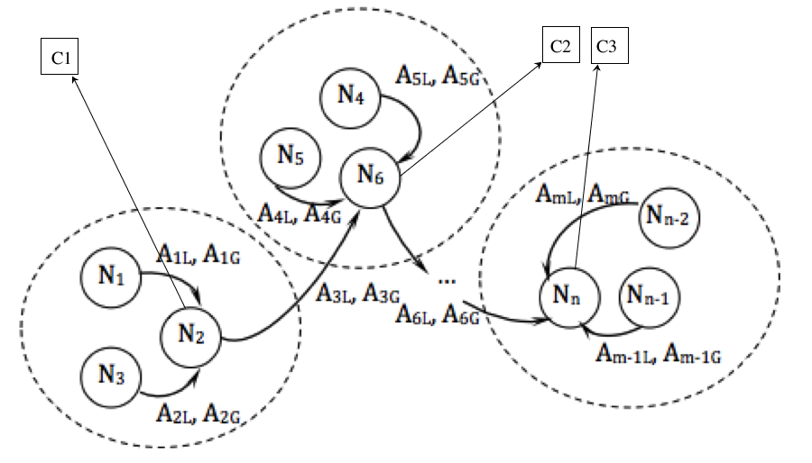
6. Clustering Static Energy: CluSE

Slide 24
Communication pattern in a WSN of the type CluSE
Legend:
Nx – A WSN node parameterized by a couple [NxG, NxL]
NxG – Node’s global parameter: The cluster a node belongs to
NxL – Node’s local parameter: Set of features observable through the node’s sensors
Ax – An arch denoting a communication line in the network, parameterized by a couple [AxG, AxL]
AxL – Arch’s local parameter: A couple [Ns, Nd], denoting the source and destination node, respectively
AxG – Arch’s global parameter: Defining whether the arch denotes communication within the cluster, or between two different clusters.
C_{x} – gateway to the internet/outside world

Slide 25
Training Algorithm in a Wireless Sensor Network of the Type CluSE
Generating Clusters in a static, energy aware, clustering apporach
The clusterhead (CH) generates a prediction-model inside a prediction model unit. While next time unit do The CH sends a prediction-model to all the sensors in the cluster. while (the prediction-model is valid) do For each node do recieve a prediction-model from the CH compare the sensor’s reading with the reading predicted by the prediction-model. If they differ for more than some preconfigured margin of error send sensor’s readings to the CH. End_If End_for The CH collects updates from the sensors and the prediction model generation unit computes new prediction model. End_while

Slide 26
If the prediction-model resulted in fewer update CH sends encoded set of prediction models, followed by the updates necessary to override wrong predictions to an access point. End_If The access points collectively maintain a database of current readings of all the sensors in the sensor fields, so the user interest in monitoring a query may register its interest with the appropriate access point.

Slide 27

7. Association rule mining Static Energy: ArmSE

Slide 28
Communication pattern in a WSN of the type ClaSP.
Legend:
N_{x} – A WSN node parameterized by a couple [N_{xG,} N_{xL}]
N_{xG} – Node’s global parameter: The cluster a node belongs to
N_{xL} – Node’s local parameter: Set of features observable through the node’s sensors
A_{x} – An arch denoting a communication line in the network, parameterized by a couple [A_{xG,} A_{xL}]
A_{xL} – Arch’s local parameter: A couple [N_{s}, N_{d}], denoting the source and destination node, respectively
A_{xG} – Arch’s global parameter: Defining whether the arch denotes communication within the cluster, or between two different clusters.

Slide 29
Training Algorithm in a Wireless Sensor Network of the Type ArmSE
Static, energy aware, Associaation Rule Mining Alghoritam
for (all rounds of sensor readings) do begin checkBuffer(); update(); estimateValue(); end. checkBuffer() while (the current session lasts) do record the data received from a particular sensor to corresponding field in the Buffer for (all fields in the Buffer) do check if there is a missing value if missing value exists estimateValue() for that missing value Else send OK signal to queries update() End_If The Buffer is the data structure to store the arriving readings associated with the corresponding sensors.

Slide 30
update() // The purpose of this algorithm is to update the Cube and the Counter every time a new round (without missing values) of sensor readings is stored in the Buffer. For all sensor readings in the Buffer do update 1-itemsets add new nodes at the front of the Cube discard the oldest nodes at the back of the Cube update the Counter End_for For all sensor readings in the Buffer do generate 2-itemsets between the sensor readings in the particular round add new nodes at the front of the Cube discard the oldest nodes at the back of the Cube update the Counter End_For The Cube keep track of all existing 1- and 2-itemsets in each round, which are stored in the corresponding nodes and slices. The Counter data structure speeds up the estimation of a missing value. estimateValue() for all missing values do estimate the missing value store it in the Buffer End_For update()

Slide 31

Thank you for your attention!

Slide 32
A Classification and Comparison of Data Mining Algorithms for Wireless Sensor Networks, and of Concept Modeling Approaches for Systems of Wireless Sensor Networks (based on Natural Language Processing)
Nemanja Kojić Goran Rakočević
Dragan Milićev Veljko Milutinović
School of Electrical Engineering
University of Belgrade
Staša Vujičić Stanković
Duško Vitas
University of Belgrade

