Slide 1
Maxeler University program: The idea
What can we do for the academic groups?
Provide dataflow HPC hardware and software free or at strongly reduced cost
Share our expertise in dataflow implementation of computational algorithms
Help in securing research funding for projects involving dataflow computing
How can we profit from the interaction with academic groups?
We would like to see major, non-incremental scientific results being achieved with dataflow technology – we consider this as the best possible advertising
We would like to expand the use of dataflow systems to entirely new areas where their commercial potential is not at all clear
We would like to create an expertise base in dataflow system programming, especially in the key scientific centres in the world
“The exciting thing about this program is that it covers a wide spectrum of application areas in high performance computing and brings together centres of excellence in HPC using FPGA in USA, Europe, Japan and China into a powerful community”
(Ram Subramanian, Worldwide Manager of the Xilinx University Program)

Slide 2
Maxeler University Program Members

Slide 3
Maxeler University Program Members

Slide 4
Maxeler University Program Members
Tsinghua University
University of Tokyo
Technion-Israel Institute of Technology
University of Oslo
University of Hamburg
Nanyang Technological University
National University of Singapore
Korea University
Japan Advanced Institute of Science and Technology
University of Kaiserslautern
Universität Erlangen-Nürnberg
Manchester Metropolitan University
Politecnico di Milano
Hunan University
Stanford University
Universität Paderborn
Universität Hamburg
Goethe-Universität Frankfurt am Main
Tohoku University
University of Lisbon
Chalmers University of Technology
Northeastern University
University of Edinburgh
Heriot-Watt University
Delft University of Technology
University of Oxford
Hong Kong University
University of Illinois at Chicago
The Chinese University of Hong Kong
Max-Planck-Institut für molekulare Genetik
Karlsruhe Institute of Technology
Nagasaki University
University of California Berkeley
University of British Columbia
Imperial College London
University of Brlgrade
University of Novi Sad
Kragujevac University
AGH University of Science and Technology
University of Windsor, Ontario
Manchester Business School
Fudan University
Hong Kong Polytechnic University
Univ. Sts Cyril and Methodius
TU Crete
UCL
UCLA
UBC-EOS
Chosun University
Ludwig-Maximilians Universität
München

Slide 5
MAX-UP: The scope of subjects
Financial modelling
Quantum chemistry
Bio-chemical engineering
Geophysics
Atmospheric physics
Strong-field laser physics
Virtual reality and computer gaming

Slide 6
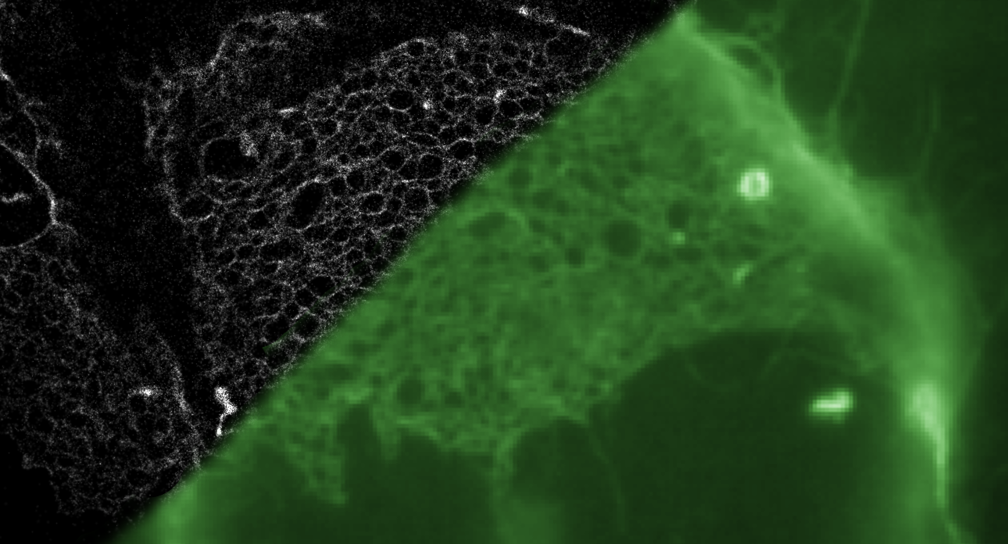
Localization microscopy enhances the resolution of fluorescence light microscopy (shown in green) by about an order of magnitude. Single fluorescent molecules act as switchable markers. Their detected signals can be fitted with a two-dimensional Gaussian distribution and thus located with sub-pixel resolution. Using MaxCompiler we achieved a hardware acceleration of 225 in signal detection and fitting.

Slide 7
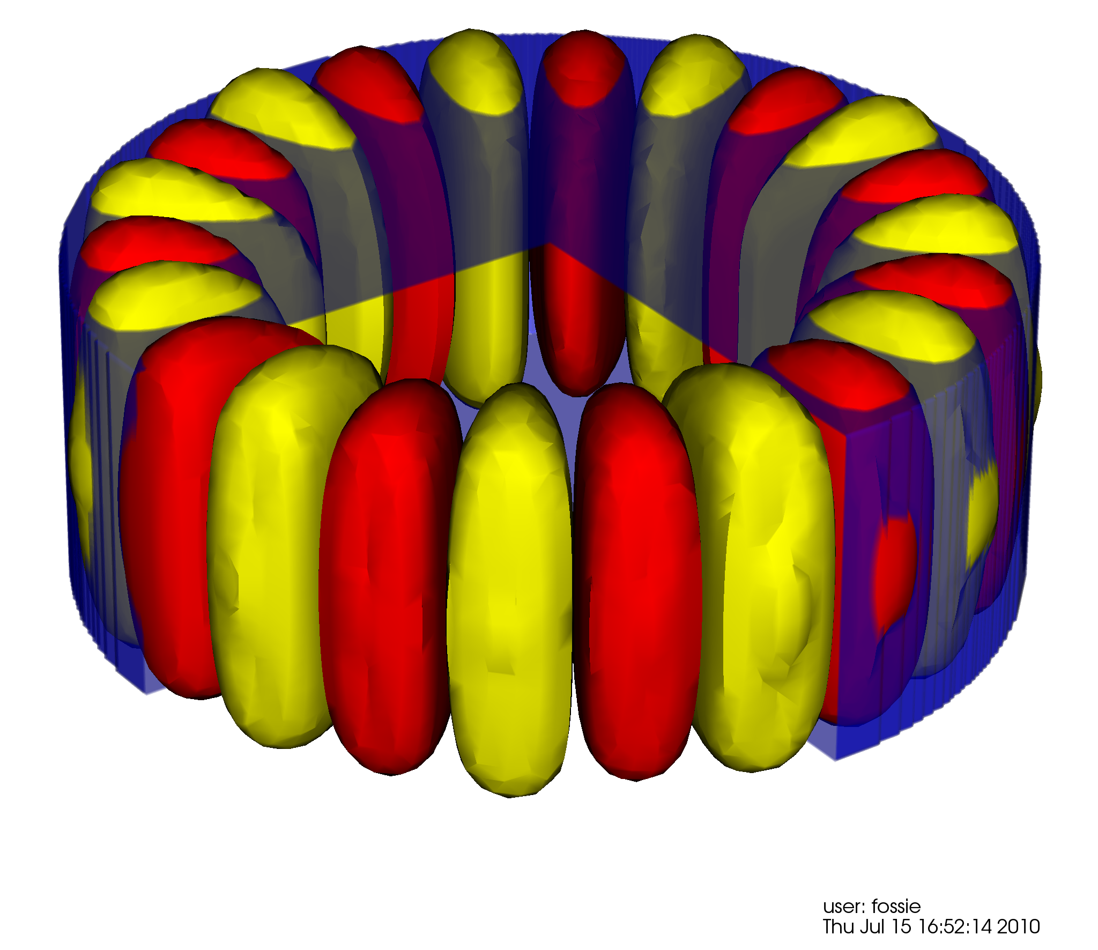
Acceleration of simulations of computational nanophotonics using Maxeler MaxGenFD Finite Difference Compiler for dataflow

Slide 8
Brain network analysis Dynamic community analysis on corpus callosum to identify functional regions. By accelerating the linear correlation calculation, Maxeler dataflow engines can build brain networks on-the-fly while the lab experiment is running.

Slide 9
Simulation-Aided Design and Synthesis of Bio inspired Membranes for Water Desalination and Purification

Slide 10
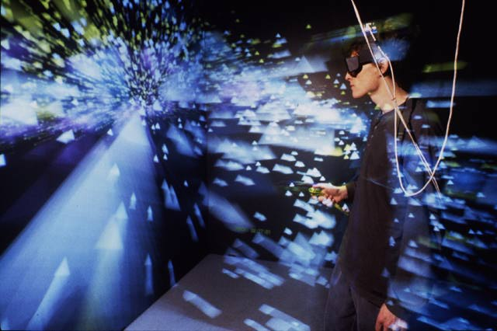
CAVE
automatic
virtual
environment
This project will investigate the use of dataflow architectures in creation of high-end immersive virtual reality. The goal is to build a proof of concept simulator with extremely low latency.

Slide 11
A MAX-UP project example
W Vigor, A Thom*, M Bearpark, Chemistry, Imperial College; R Bruce, Maxeler
*now at Cambridge

Slide 13
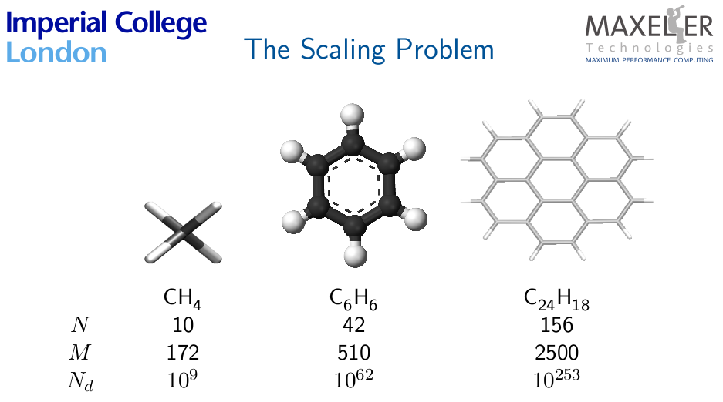

Slide 18
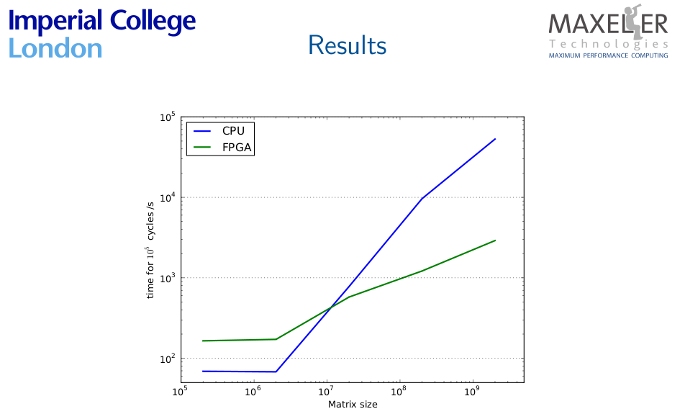

Slide 19
What next?
2D Hubbard model
Real life FCI for molecules, such as polycyclic
aromatic hydrocarbons (PAHs)

Slide 20
MAX-UP: The future
Strengthening existing subjects: bio-informatics,
quantum chemistry, … with new collaborations
Bringing new subjects: chemical engineering, bio-
engineering, …
Strengthening the existing UK, German, US bases
of MAX-UP
Expansion to Eastern Europe, South America,
Australia, …
Research funding applications with MAX-UP
members: iCASE PhD studentships (UK), ERC
synergy grants, …

Slide 21
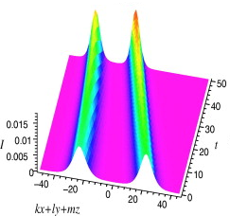
Acceleration of an algorithm based on
the Gross Pitaevskii equation.
Execution time for two iterations:
CPU execution time: 50s
Dataflow execution time: 4.9s
Achieved speedup: 10.2x
Programmer:
Sasha Stojanovic
stojsasa@etf.bg.ac.rs
Advisor:
Veljko Milutinovic
vm@etf.bg.ac.rs
Note: Comparison is made between a single core CPU without using any of extensions available in today’s modern processors and a single dataflow implementation on the oldest and smallest MAX 2 Maxeler card. Using modern CPUs equiped with several cores, each one with extensions for parallel processing of data, and modern Maxeler card with higher capacity, bandwidth to memory and host, and working frequency, will result in decreased execution times in both cases, but it is expected that the speedup will not change significantly.

