Slide 1
1 Down Place
Hammersmith
London UK
530 Lytton Ave.
Palo Alto
CA USA

Slide 2
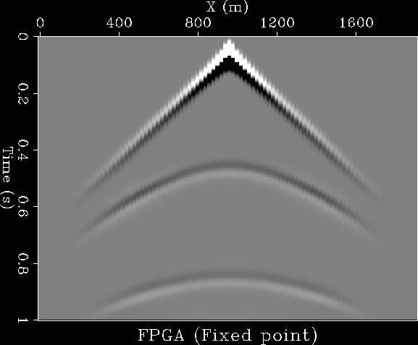
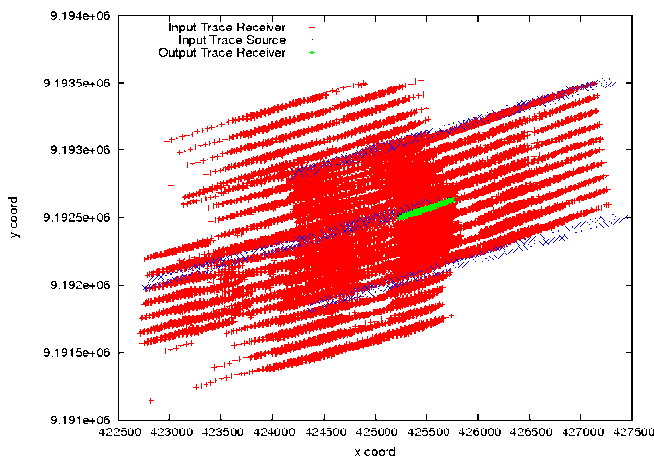
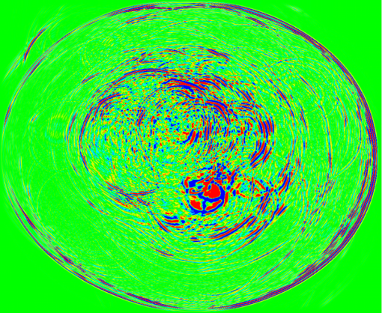
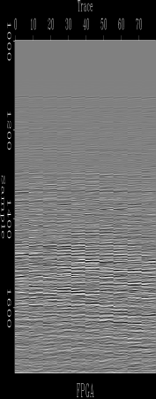
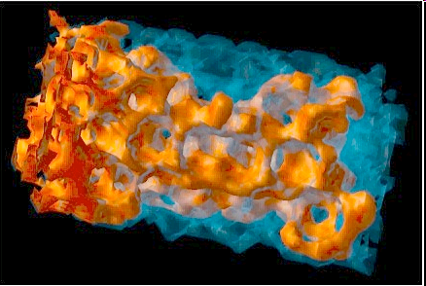
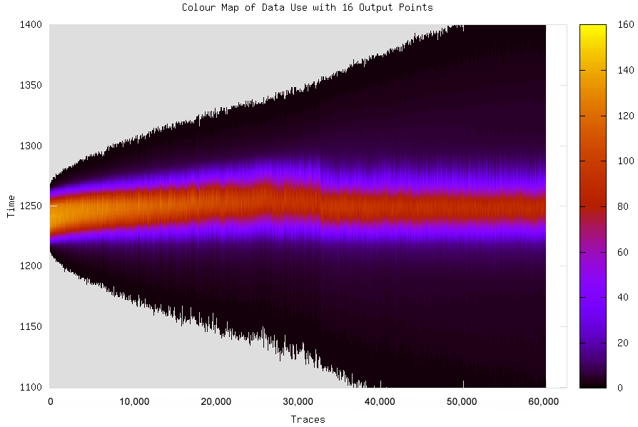
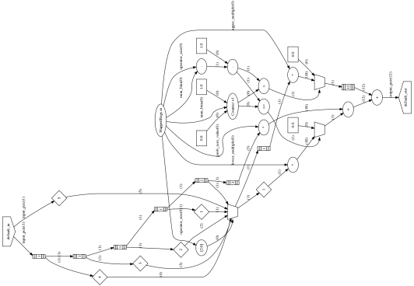
Deployed Maximum Performance Computing customers comparing 1 box from Maxeler (in a deployed system) with 1 box from Intel
Customer 1
App1 19x and App2 25x
Customer 2
1.2GB/s per card
Customer 3
App1 22x, App2 22x
Customer 4
App 32x and App2 29x
Customer 5
30x
Customer 6
App1 26x and App2 30x

Slide 3
What Maxeler Does
Maxeler delivers bespoke dataflow HPC solutions
=> An HPC Computing Appliance for “structured Big Data”
Building the HPC compute fabric based on the application in a
multi-disciplinary, data-centric approach
Hardware
Building 1U boxes, Workstations and the cards inside.
Building custom large memory systems to deal with Big Data
Integrating rack system with networking and storage.
Software
Integrated environment brings bespoke dataflow computing
to high end HPC users
Dataflow programming in Java and Eclipse IDE
Consulting
HPC System Performance Architecture
Algorithms and Numerical Optimization
Integration into business and technical processes

Slide 4
Dataflow Computing

Slide 5
Technology
MAXELER DATAFLOW COMPUTING
One result
per clock cycle
Dynamic (switching) Power Consumption:
Minimal frequency f achieves maximal performance, thus for a
given power budget, we get Maximum Performance Computing (MPC)!

Slide 6

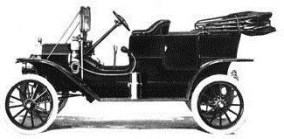

Explaining Control Flow versus Data Flow
Analogy 1: The Ford Production Line
Experts are expensive and slow (control flow)
Many specialized workers are more efficient (data flow)

Slide 7
Example Accelerated Applications

Slide 8
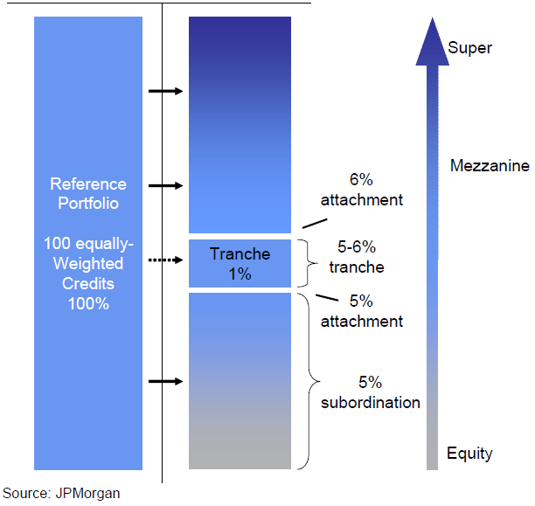
JP Morgan Credit Derivatives Pricing
O. Mencer and S. Weston, 2010
Compute value of complex financial derivatives (CDOs)
Typically run overnight, but beneficial to compute in real-time
Many independent jobs
Speedup: 220-270x
Power consumption per node drops from 250W to 235W/node

Slide 9

3000³ Modeling
Compared to 32 3GHz x86 cores parallelized using MPI
*presented at SEG 2010.
8 Full Intel Racks ~100kWatts => Single 3U Maxeler System <1kWatt

Slide 10
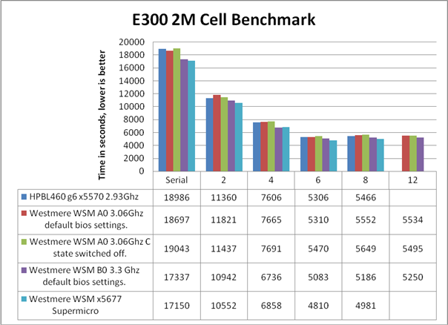

Sparse Matrix Solving with Maxeler
O. Lindtjorn et al, HotChips 2010
Given matrix A, vector b, find vector x in Ax = b.
DOES NOT SCALE BEYOND 6 x86 CPU CORES
MAXELER SOLUTION: 20-40x in 1U
Domain Specific Address and Data Encoding (*Patent Pending)

