Slide 1
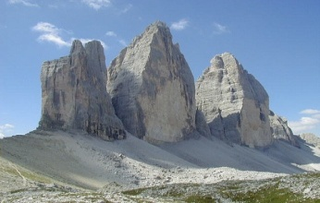
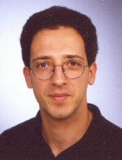
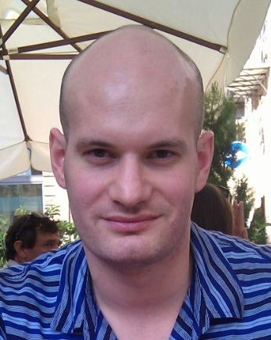
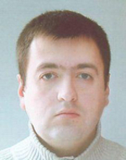
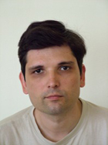
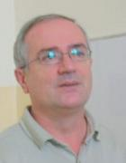
The Current Challenges in DataFlow Supercomputer Programming Tel Aviv, June 24, 2013

Slide 2
A Classification of Supercomputer Systems

Slide 3
Intel Nehalem E5520 Quad-core CPU
Computation Capacity |  |  |  |  |  |  |  |  |  |  | Memory Capacity
# cores |  |  | Clock frequency |  |  | Peak performance |  | Power |  |  | L1 cache |  |  |  |  |  |  |  |  | Memory
 |  |  |  |  |  |  |  |  |  |  | Size |  |  | Bandwidth |  |  |  |  |  | Size |  |  |  | Bandwidth
4 |  |  | 2.27 GHz |  |  | 36 GFLOPs |  | 80W |  |  | 128 kB |  |  | 291 GB/s |  |  |  |  |  | not limited |  |  |  | 25 GB/s
Cell/B.E
Computation Capacity |  |  |  |  |  |  |  |  |  | Memory Capacity
# cores |  | Clock frequency |  |  |  | Peak performance |  | Power |  | CPU cache |  |  |  |  |  | Local store |  |  |  |  |  |  | Memory size |  | Bandwidth
 |  |  |  |  |  |  |  |  |  | Size |  |  | Bandwidth |  |  | Size |  |  | Bandwidth
1+8 hetero |  | 3.2 GHz |  |  |  | 230.4 GFLOPs |  | 135W |  | 512kB |  |  | 44 GB/s |  |  | 8*256KB |  |  | 204.8 GB/s |  |  |  | 16 GB |  | 25 GB/s
ClearSpeed CSX700
Computation Capacity |  |  |  |  |  |  |  |  |  | Memory Capacity
# cores |  | Clock frequency |  |  |  | Peak performance |  | Power |  | CPU cache |  |  |  |  | Local store |  |  |  |  |  | Memory |  |  |  |  | Bandwidth to host
 |  |  |  |  |  |  |  |  |  | Size |  |  |  |  | Size |  |  | Bandwidth |  |  | Size |  | Bandwidth
2+192 hetero |  | 250 MHz |  |  |  | 96 GFLOPS |  | 11.4W |  | 24KB |  |  |  |  | 2*128KB |  |  | 192 GB/s |  |  | 2*8 GB |  | 2*4 GB/s |  |  | 4 GB/s
SGI RASC Accelerator board (2 x Virtex4 LX200) max 120W
Computation Capacity |  |  |  |  |  |  |  |  |  |  |  | Memory Capacity
# LUTs | # FFs |  |  | # DSP48E | Clock frequency |  | Peak performance |  | Power |  |  | Block RAMs |  |  |  |  | On board memory |  |  |  |  | Bandwidth to host
 |  |  |  |  |  |  |  |  |  |  |  | # |  |  | Size |  | Size |  |  | Bandwidth
200448 x2 | 200448 x2 |  |  | 96 x2 | 200 MHz |  | 47 GFLOPs |  | 120W |  |  | 336 |  |  | 0.7 MB |  | 40 MB |  |  | 16 GB/s |  | 6.4 GB/s

Slide 4
Maxeler Max2 FPGA Acceleration Card
Computation Capacity |  |  |  |  |  |  |  | Memory Capacity
# LUTs | # FFs | # DSP48Es |  | Clock frequency |  | Peak performance | Power | Block RAMs |  |  |  |  | On board memory |  |  |  | Bandwidth to host
 |  |  |  |  |  |  |  | # | Size |  | Bandwidth |  | Size |  |  | Bandwidth
414720 | 414720 | 384 |  | 150MHz |  | 116 GFLOPs | 55W | 648 | 2.8 MB |  | 1519 GB/s |  | 12GB |  |  | 28GB/s | 4GB/s
Convey coprocessor HC-1
Computation Capacity |  |  |  |  |  |  |  | Memory Capacity
# LUTs | # FFs | # DSP48E |  | clock frequency |  | peak performance | Power | Block RAMs |  |  |  |  |  | On board memory |  |  | bandwidth to host
 |  |  |  |  |  |  |  | # | Size |  | bandwidth |  |  | size |  | bandwidth
4* 207360 | 4* 207360 | 4* 192 |  | n/a |  | 80 GFLOPs | 100W | 4*288 | 4*1.25 MB |  | n/a |  |  | 8 GB |  | 80 GB/s | 1066 MT/s
NVidia GTX580
Computation Capacity |  |  |  |  |  |  |  | Memory Capacity
# Multiprocessors |  | # cores | clock frequency |  | peak performance |  | Power | shared memory |  |  |  | on board memory |  |  |  |  |  | bandwidth to host
 |  |  |  |  |  |  |  | Size |  | bandwidth |  | size |  |  | bandwidth
16 |  | 512 | 1.54 GHz |  | 1.58 TFLOPs |  | 244W | 768 KB |  | N/A |  | 6 GB |  |  | 192.4 GB/s |  |  | 8 GB/s
AMD ATI HD5870
Computation Capacity |  |  |  |  |  |  |  | Memory Capacity
# Multiprocessors |  | # cores | clock frequency |  | peak performance |  | Power | shared memory |  |  |  | on board memory |  |  |  |  |  | bandwidth to host
 |  |  |  |  |  |  |  | size |  | Bandwidth |  | size |  |  | bandwidth
20 |  | 1600 | 850 MHz |  | 2.72 TFLOPs |  | 188W | 640 KB |  | 2176 GB/s |  | 6 GB |  |  | 153.6 GB/s |  |  | 8 GB/s

Slide 5
Table of Contents
0. Classification.pptx
1. Anegdotic.pptx
2. MaxelerAlabamaSlidesWoVeljkoFinal.pptx
3. Maxeler-examples1.pptx
4. 01_Introduction.pptx
5. 02_ProgrammingMaxCompiler.pptx
6. 03_MoreMaxCompiler.pptx
7. 04_Numerics.pptx
8. 05_Scheduling.pptx
9. 06_LoopsAndCyclicGraphs.pptx
10. 07_ElementaryFunctions.pptx
11. Maxeler-examples.pptx
12. StudentsWorldwide.pptx
13. AlgGrossPitaevskii-real.pptx
14. paperCACM.pdf
15. Discusion.pptx

