Slide 1
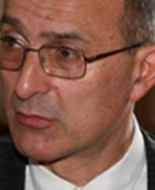
The Forum Technology and Artificial Intelligence
Veljko Milutinovic
Adjunct Professor at the University of Indiana in Bloomington Life Fellow of the IEEE
Adjunct Professor at Graz University of Technology f Honorary Treasurer of Academia Europaea
Special Thanks to Hermann Maurer
Professor at Graz University of Technology f Board Member of Academia Europaea
Leader of the Forum Project
Notes:
1

Slide 2
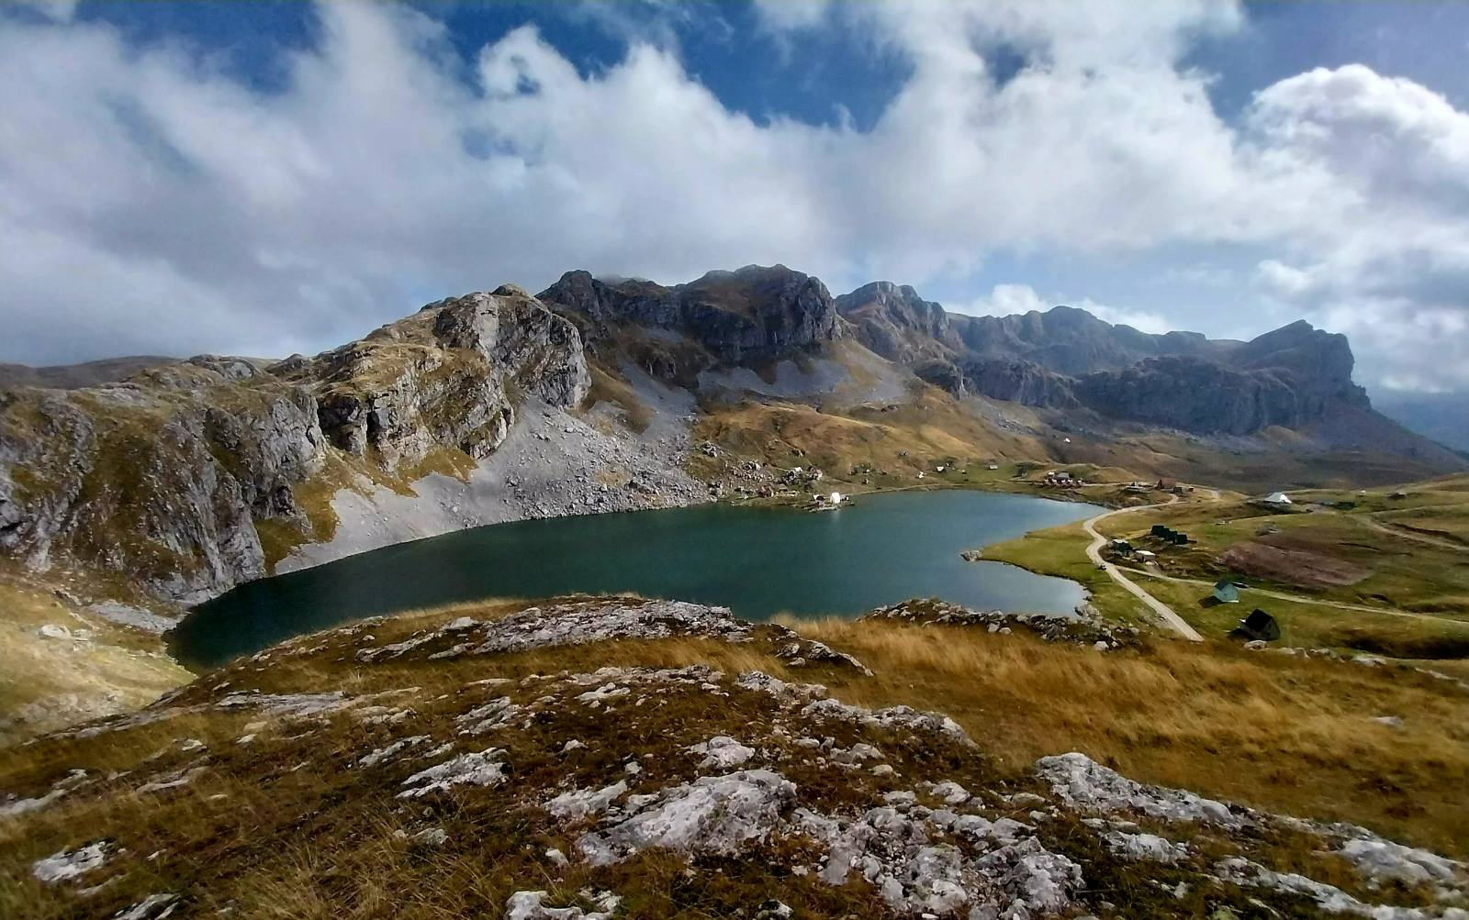

Slide 3
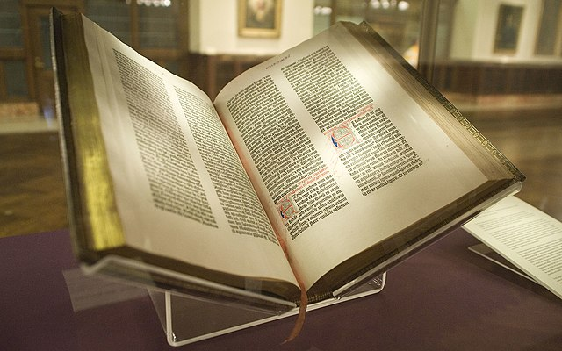
Effective Scientific Dialogue Prerequisites:
Reliable database
Effective interface for cultural heritage
Data mining and data analytics
Intelligent Q&A

Slide 4
Wikipedia: A Valuable Resource to get up-to-date Information
Available in many languages:
English: ~ 4,000.000 entries
German: ~2,000.000 entries
Serbian: ~200.000 entries
However,
most entries in the Serbian Wikipedia
do not (!) concentrate on Serbia and are quite incomplete.
Our destiny must be in our hands!
4/40

Slide 5
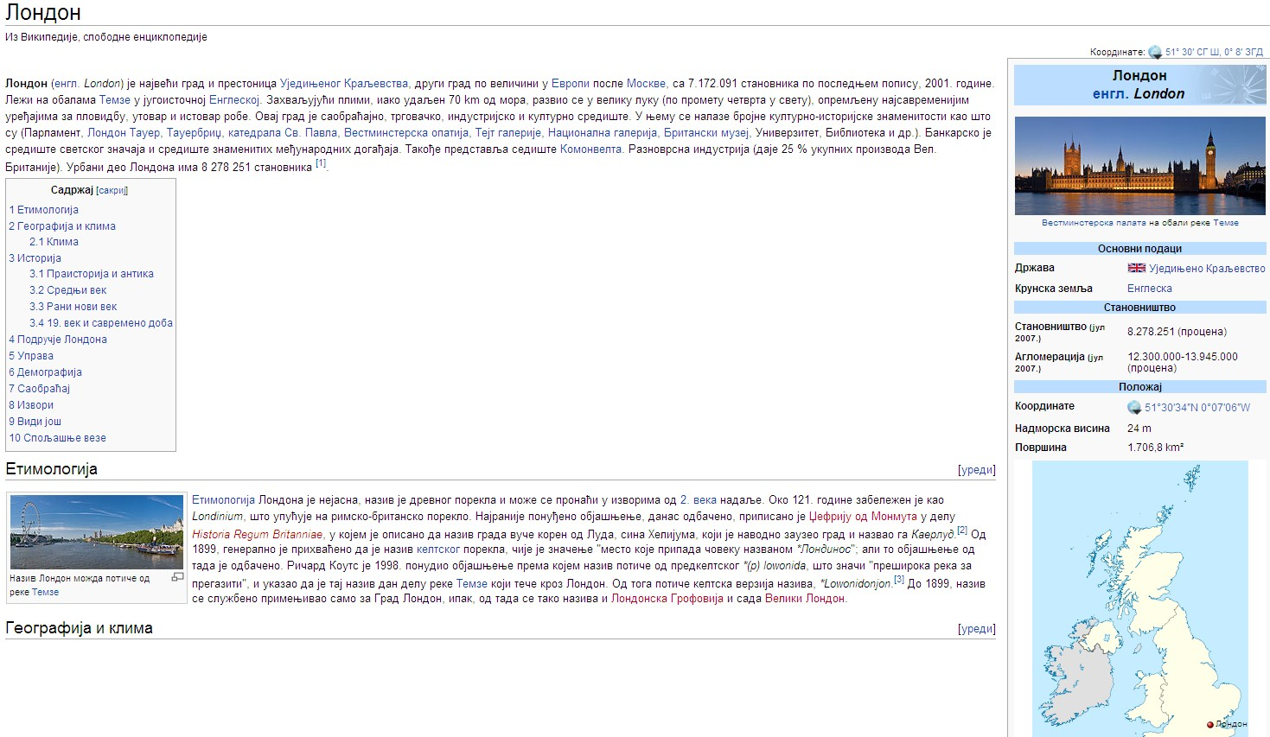
The majority of topics on the Serbian Wikipedia does not deal with Serbia (like the above) and is incomplete (links missing) as the red entries show.
5/40

Slide 6
Forum: Important Points of Heritage Servers
(1) Information must be semantically searchable, by metadata (both, in Forum, and via Google).
Next page shows: We are searching for someone whose name we don‘t know, but we know he was born in Vienna (Wien), was working in physics (Physik),
and died in Italy (Italien).
The one person fitting the description, Ludwig Boltzmann, is indeed found.
6/40

Slide 7
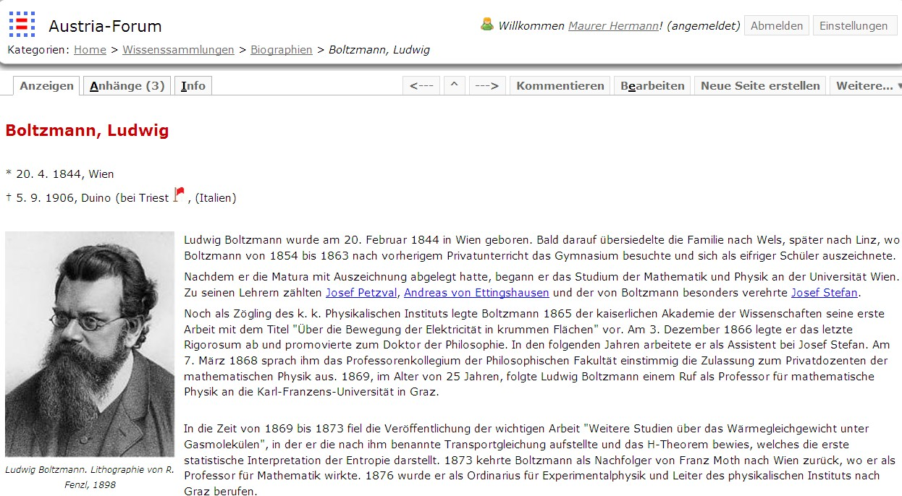
7/40

Slide 8
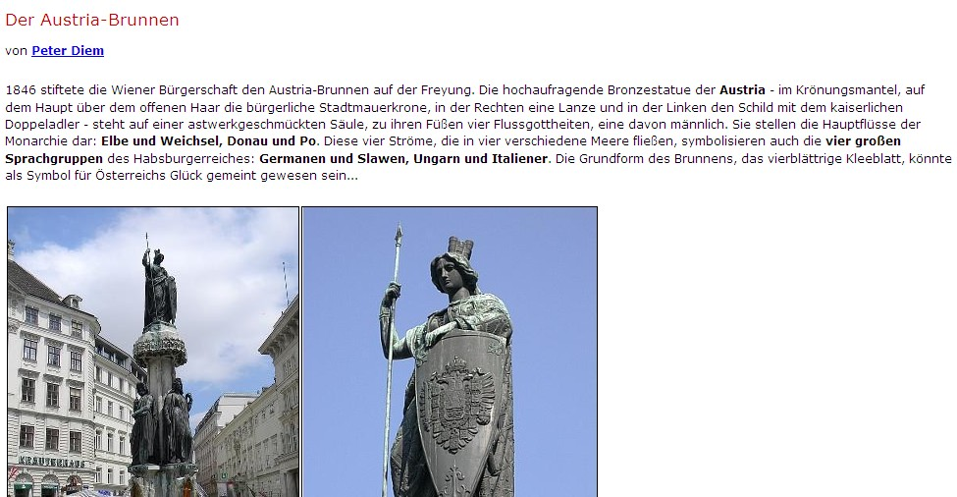
(2) Author visibility: The source of the text must be always known!
Either the name of the author including CV, or the book/archive it comes from!
8/40

Slide 9
(3) Evolution tracking
Updating is dangerous:
It destroys previous information and hence history.
When, e.g. an old building is „updated“ (renovated), one cannot experience what it was like before.
The same is true of information! We believe in preservation of information, allowing „time-travel“ by reading about the subject, at various points in time.
9/40

Slide 10
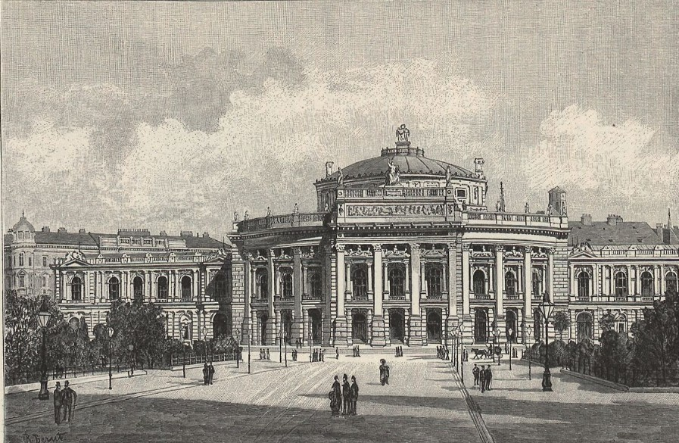
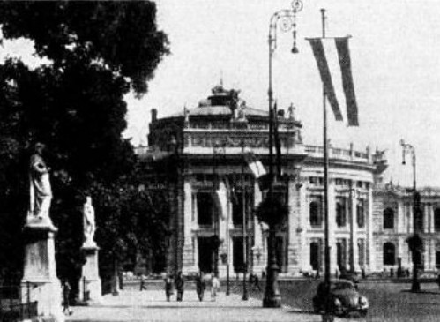
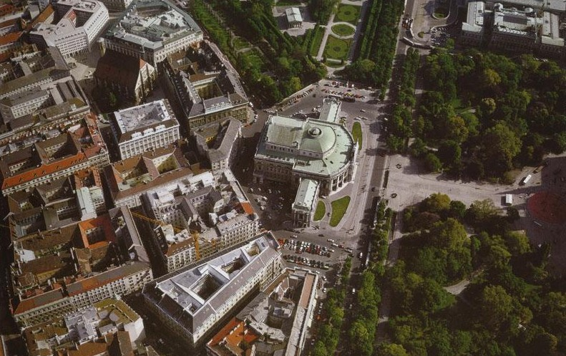
BurgTheaterWien
1900
1965
2000
10/40

Slide 11
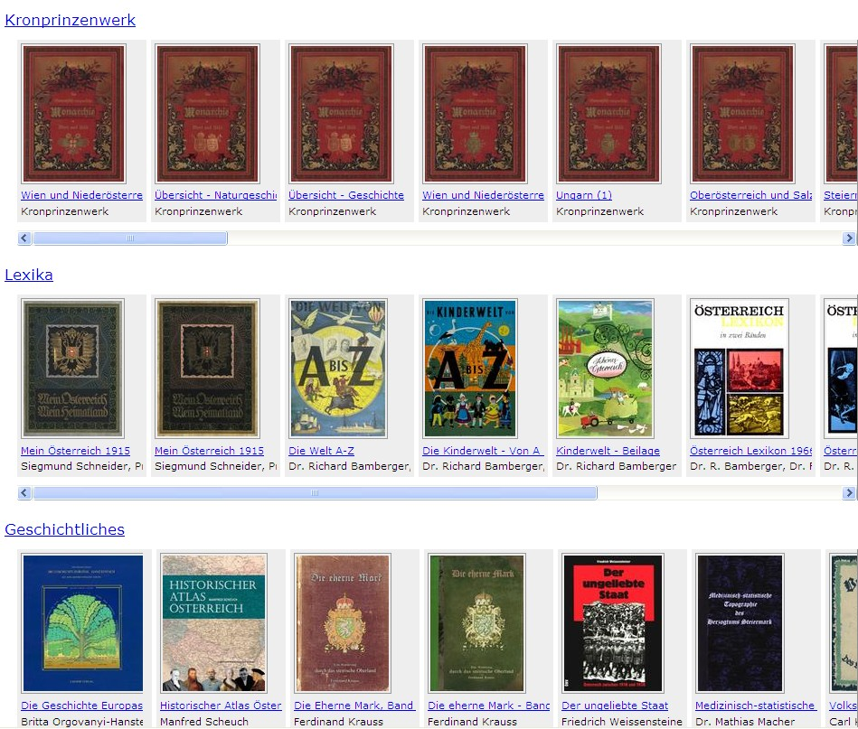
(4) Books are not just a source of information!
Web books behave like printed books but also offer some new functions: links, bookmarks, …
11/40

Slide 12
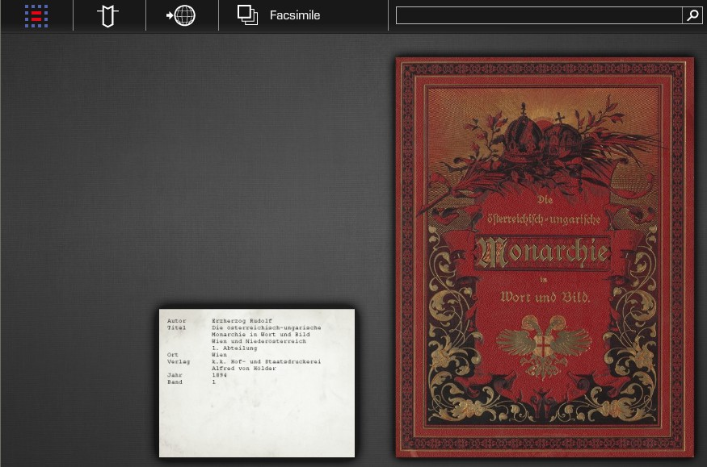
Clicking at book opens it. Then one can turn pages or jump to an arbitrary page.
12/40

Slide 13
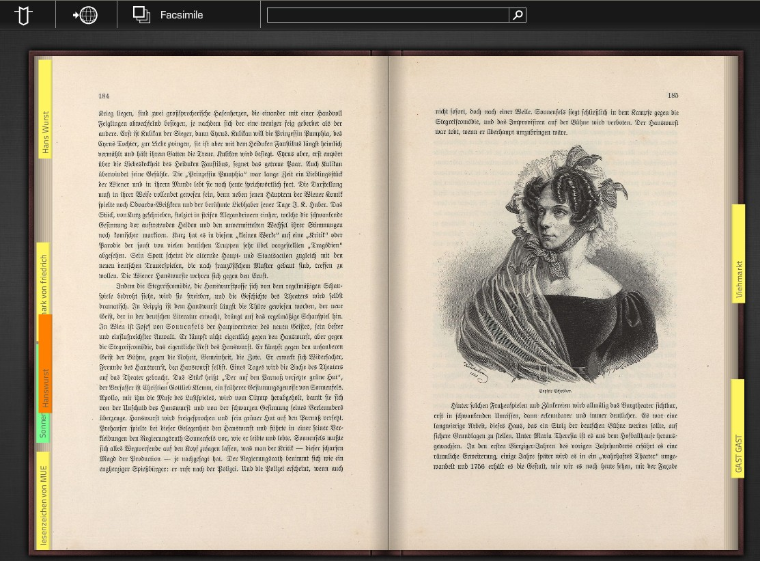
This screen-shot shows some bookmarks. This icon allows a switch, to an ordinary font. Clicking at one page, only that one is shown, and one can then zoom in (see next page)
13/40

Slide 14
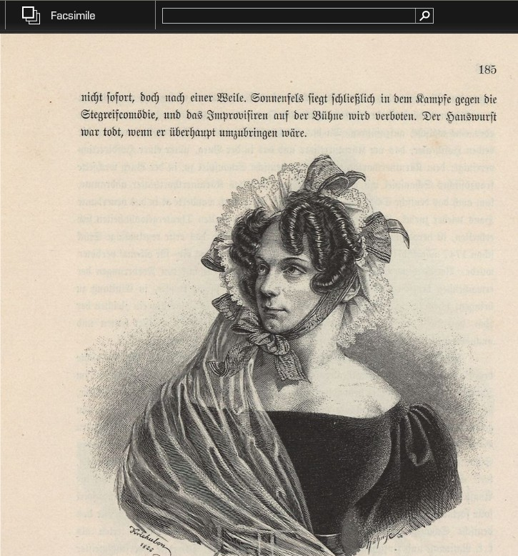
When choosing a
single page it can
be zoomed and moved
around arbitrarily
The enlarged picture. Note the field that allows full-text search!
14/40

Slide 15
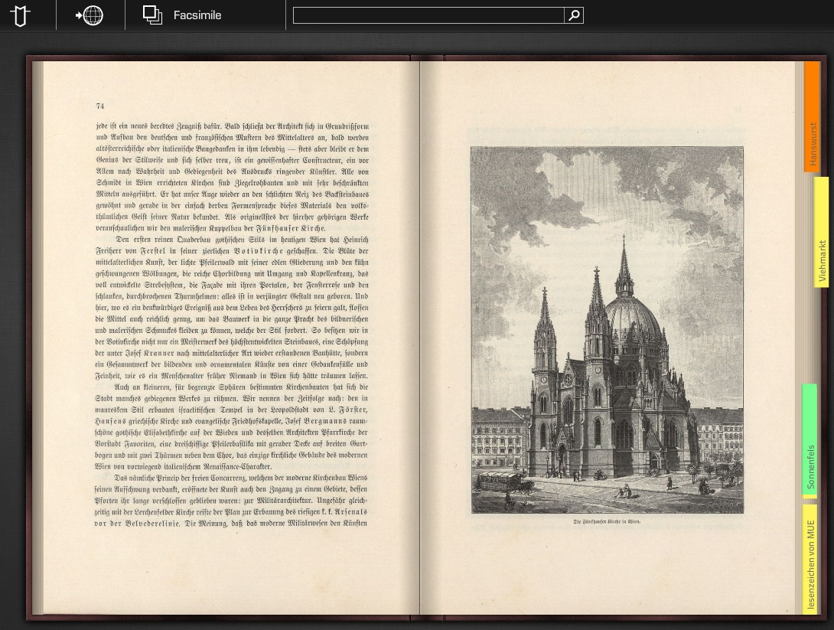
Bookmark and Link Creation
15

Slide 16
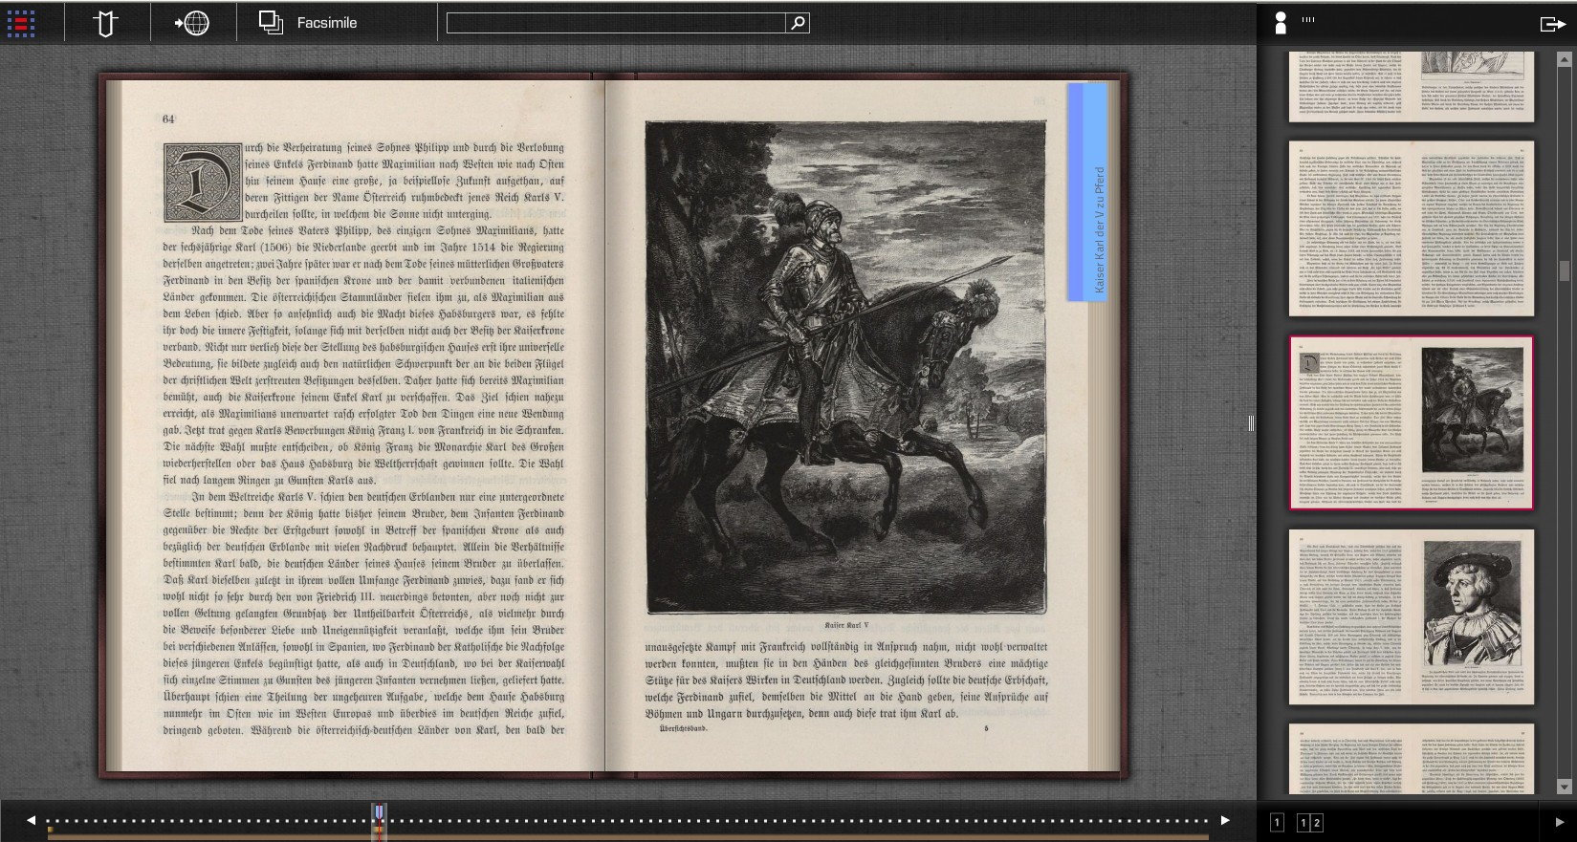
Full view of Web Book with other features:
Click here to see page number and preview
Preview of all pages (single page or double page as shown)
16/40

Slide 17
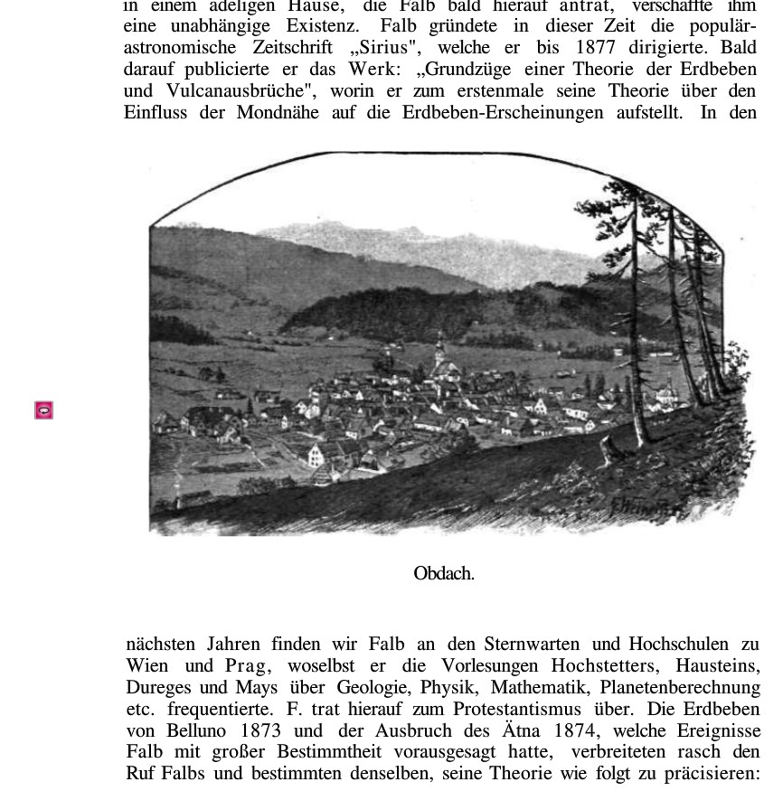
Page from old
book on a
village Obdach.
Clicking here
gives panoramic
view in our days
(next page)
17

Slide 18
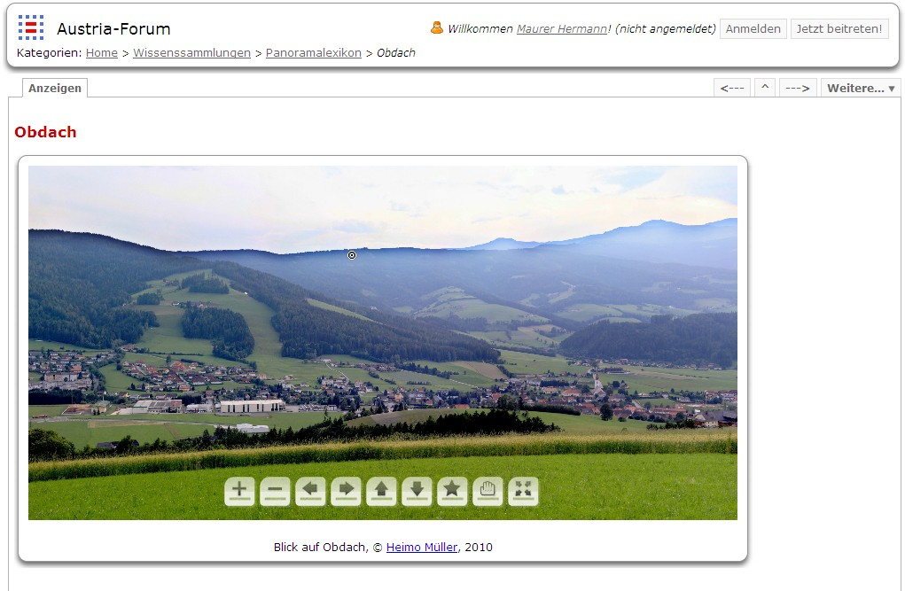
Of Course, Panoramic Pictures, Zoomable, and Movable
18

Slide 19
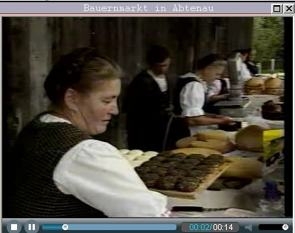
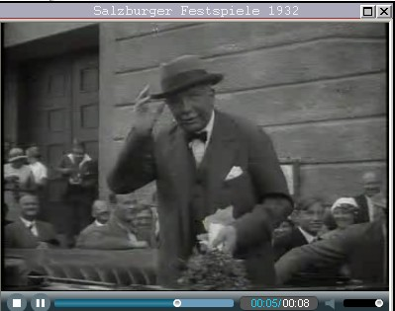
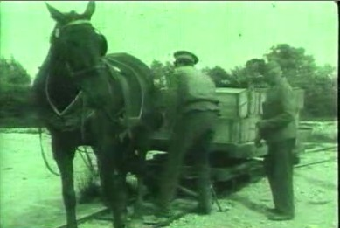
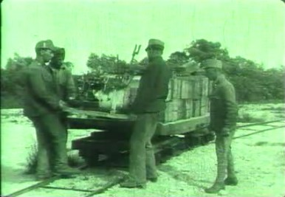
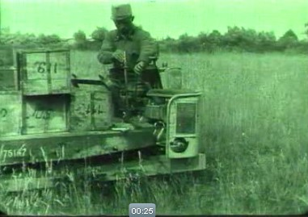
Of Course Heritage Forums Must Also Contain: Videoclips
Farmer‘s Market
Famous
person in
1932
Changing from horse-railway to motorized railway cars (1914)
19
(Examples taken from the heritage server called www.austria-forum.org)

Slide 20
Of Course Heritage Forums Must Also Contain:
Samples of Music
20/40

Slide 21
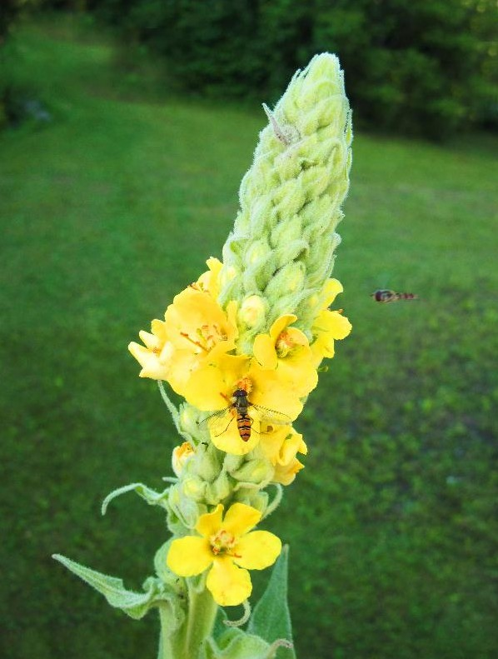
Of Course Heritage Forums Must Also Contain:
Zooming of Pictures
21/40

Slide 22
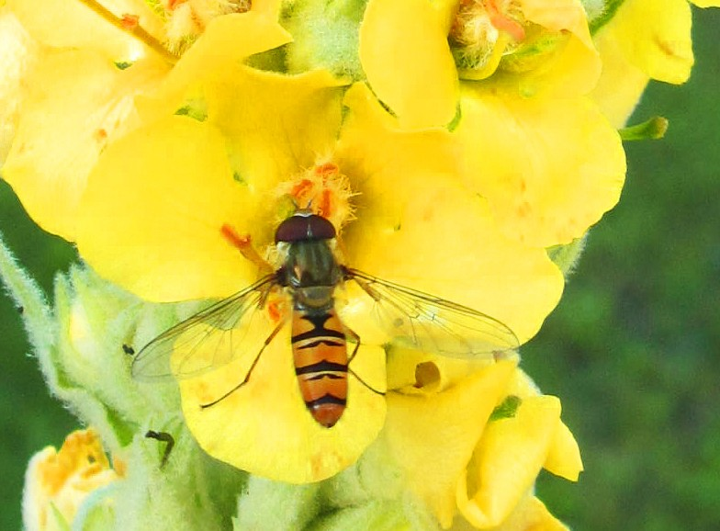
22

Slide 23
Fori Worldwide, Fully Operational:
Academia Europaea, fully operational!
(2) Austria, fully operational, national!
(3) Serbia, fully operational, national!
(4) England, institutional
(5) Germany, institutional
(6) Italy, institutional
(7) Spain, institutional
(8) France, institutional
(9) Slovenia, institutional
(10) Montenegro, in works
Also: Pakistan, Bangladesh, Malesia, Indonesia
23/40

Slide 26
Axioms of Serbia Forum:
Secondary
Primary
26/40

Slide 27
Secondary Axioms of Serbia Forum:
Temporary Differences Compared to Wikipedia!
May disappear over time!
(1) Semantic search
(2) Author visibility
(3) Evolution tracking
(4) Original commodities
27/40

Slide 28
Primary Axioms of Serbia Forum: Essential Differences Compared to Wikipedia!
Will stay forever!
(1) National heritage owned by national institutions, exposed by servers under control of these institutions!
(2) National heritage falls into a number of different legal regulatories, not only CC!
(3) Stress on quality and ranking,
not quantity and chaos!
(4) Possible semantic culture-oriented translation into a number of relevant foreign languages!
28/40

Slide 29
Heritage Mining: Four Example Cases
Examples are only illustrative, to set ground for a rigorous statistically proven scientific analysis.
(1) 11 (5, 6, 7, 11)
(2) 27 (1804, 1831, 1858, 1885, 1912, 1939, 1966, 1993, 2020, 2047)
(3) 72
(4) 612
Condition: Based on data with time-related and space-related labels!
New editions: NID + ChatGPT(NID)

Slide 30
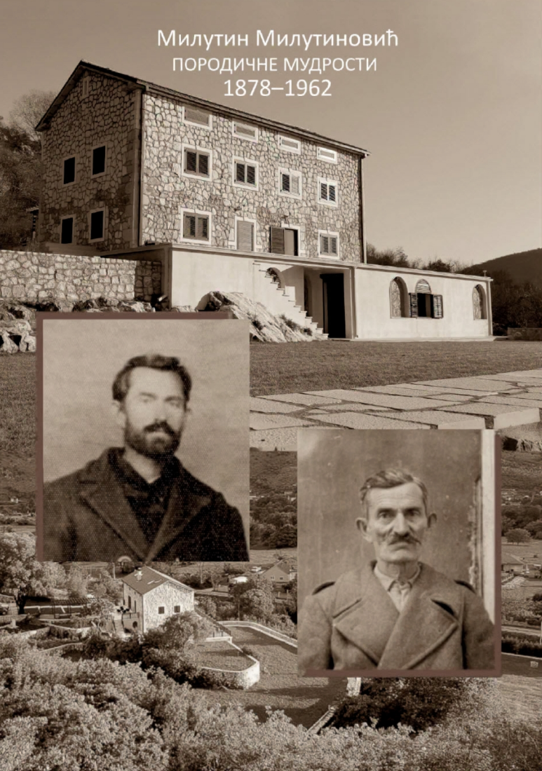
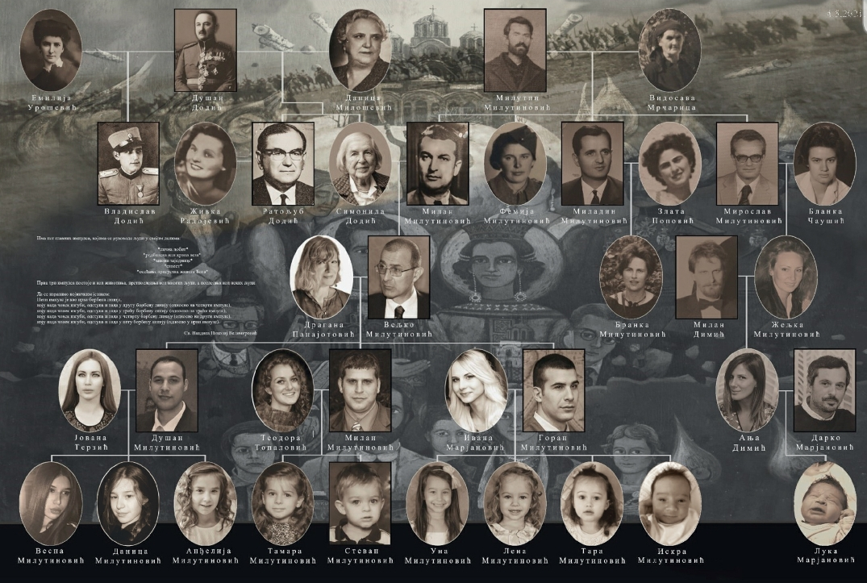
Layers of Heritage Include Family Heritage

Slide 31
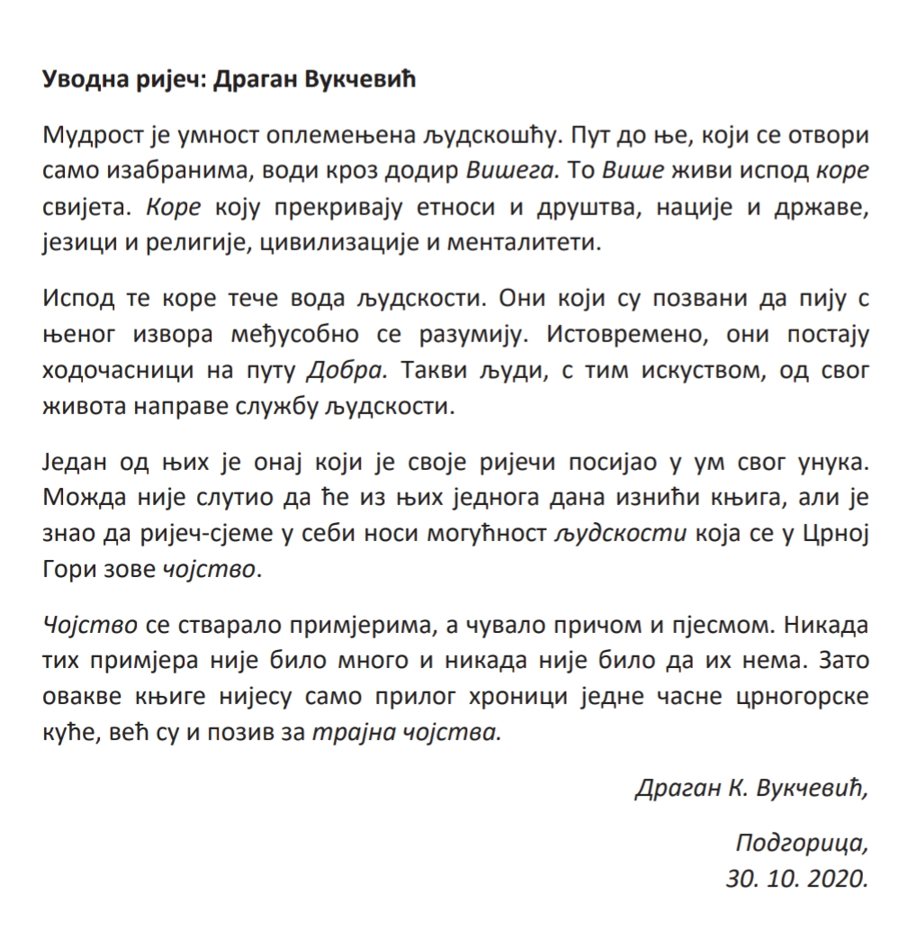

Slide 32
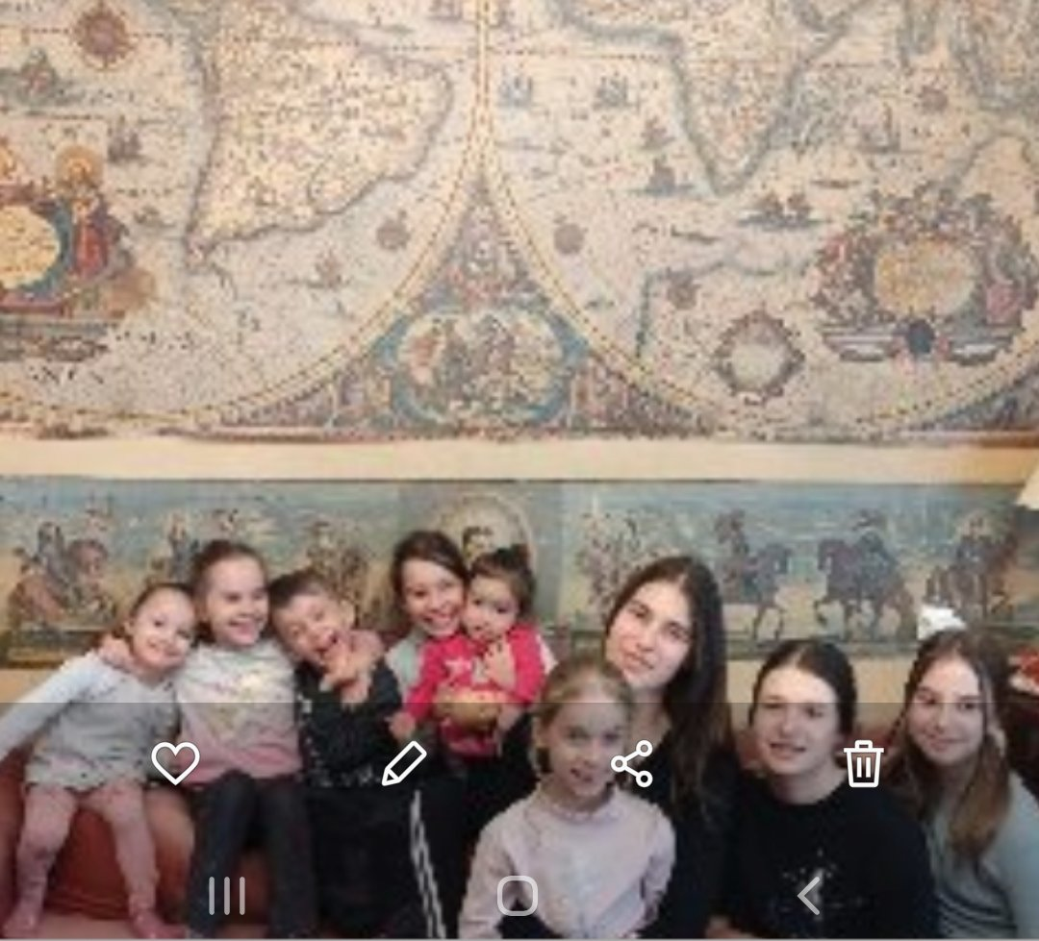
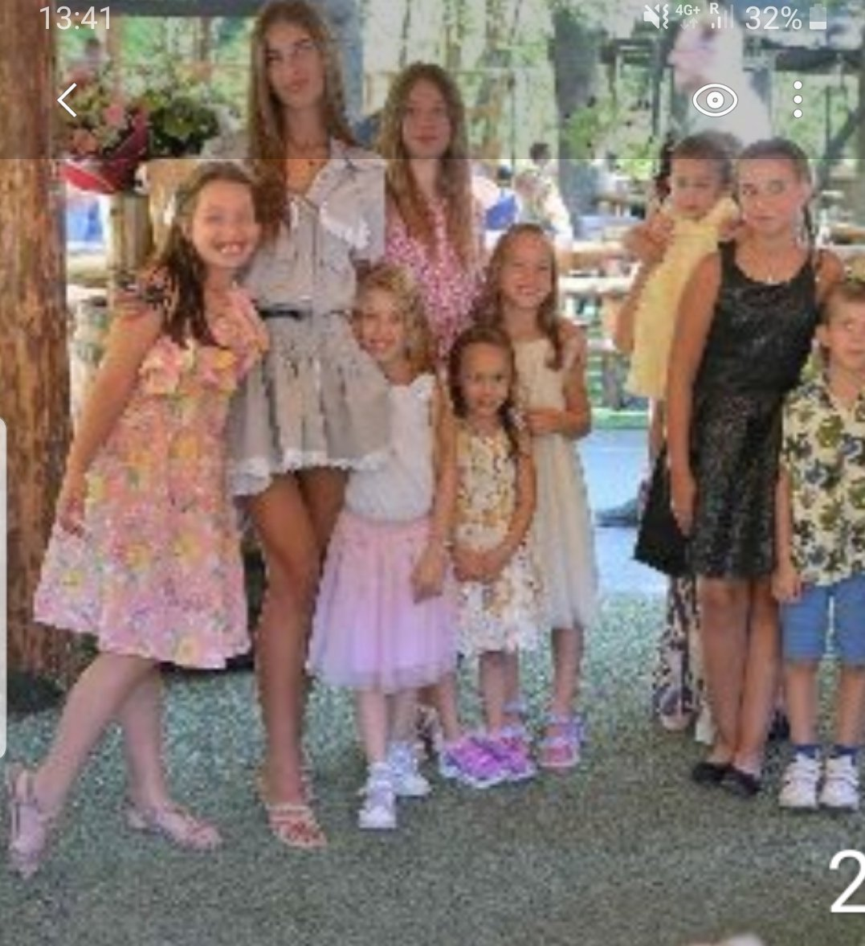
Intended for the Next Generation of the Family
How to make them read?

Slide 33
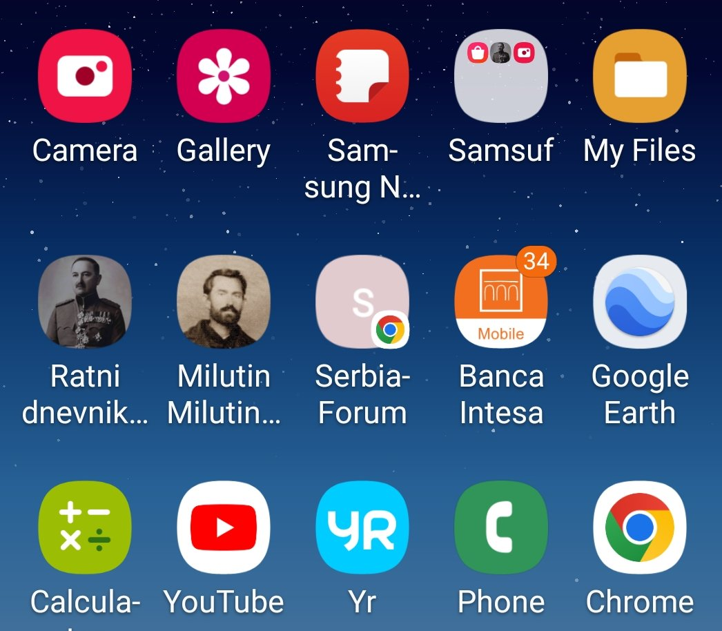
How to Make the Next Generation to Read about Heritage?
A possible solution is in Google Play Store or the iPhone App Store, but only that is not enough! They have problems and need solutions!

Slide 34
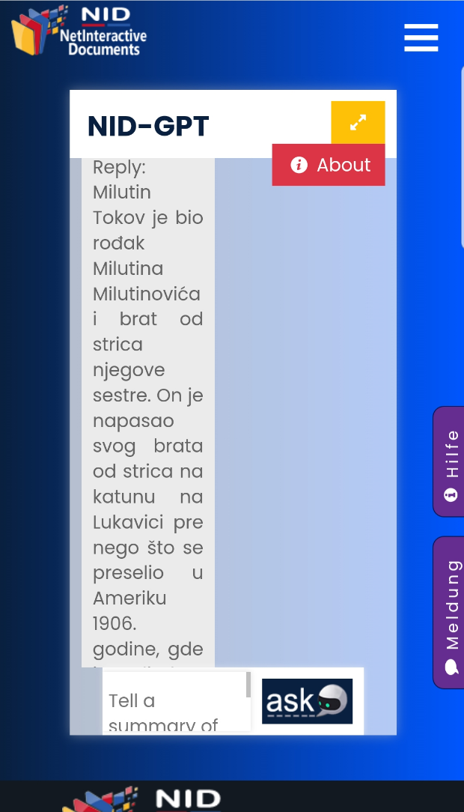
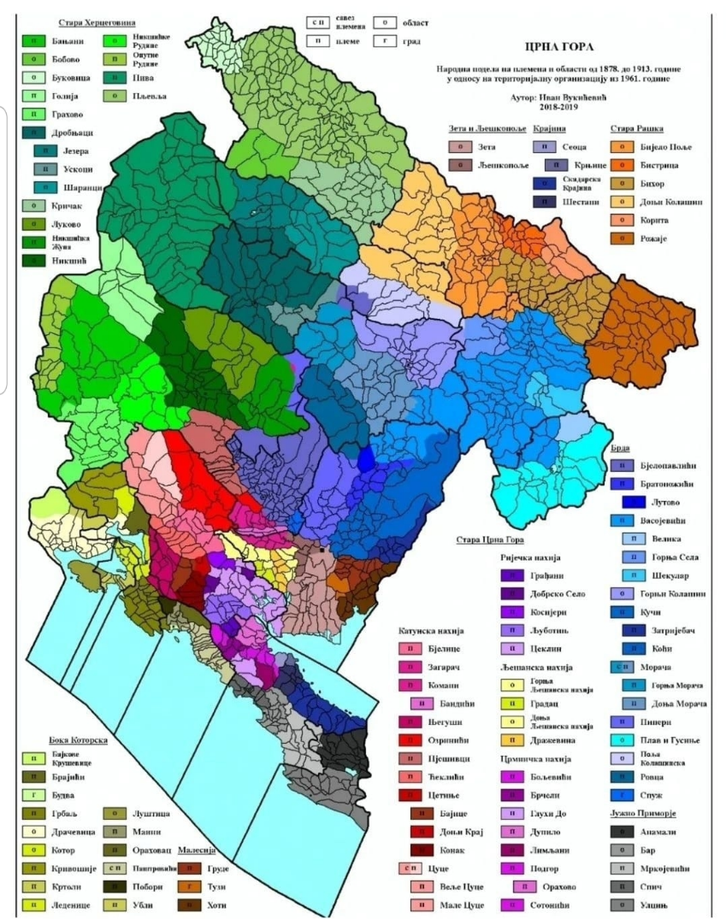
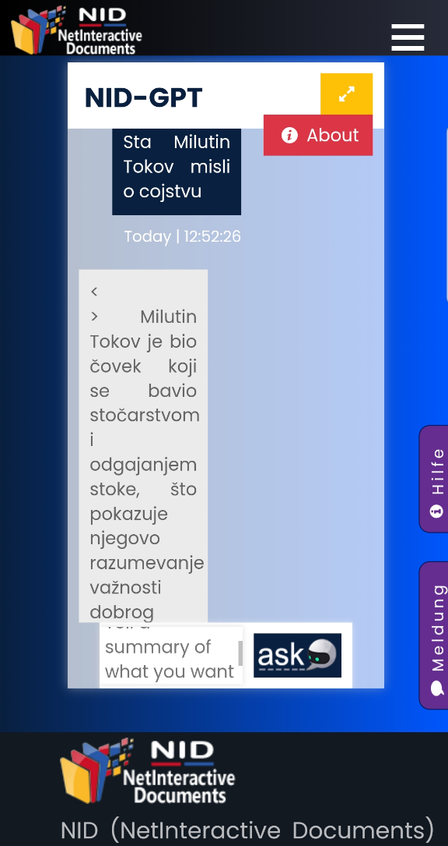
The AI and NID (ChatGPT) in Action:
Questions: About a Person or About the Person‘s Opinions (Greek Wisdom)

Slide 35
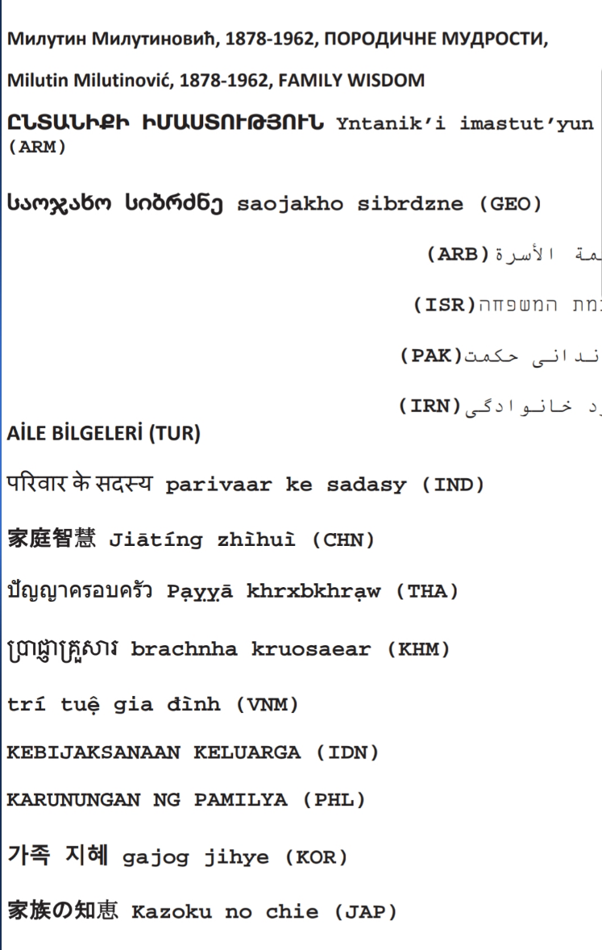
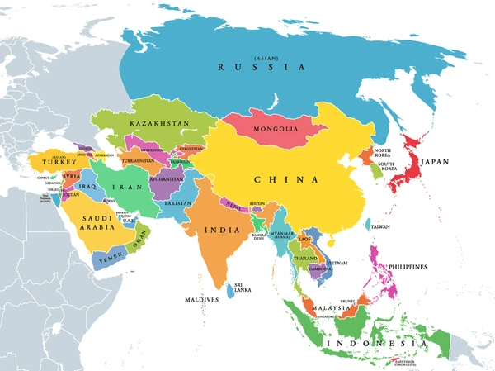
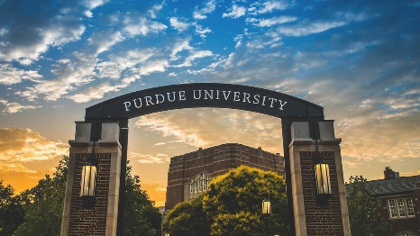
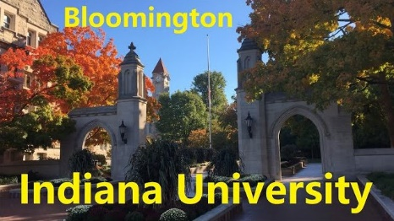
Guess Where Most Readers Come From?

Slide 36
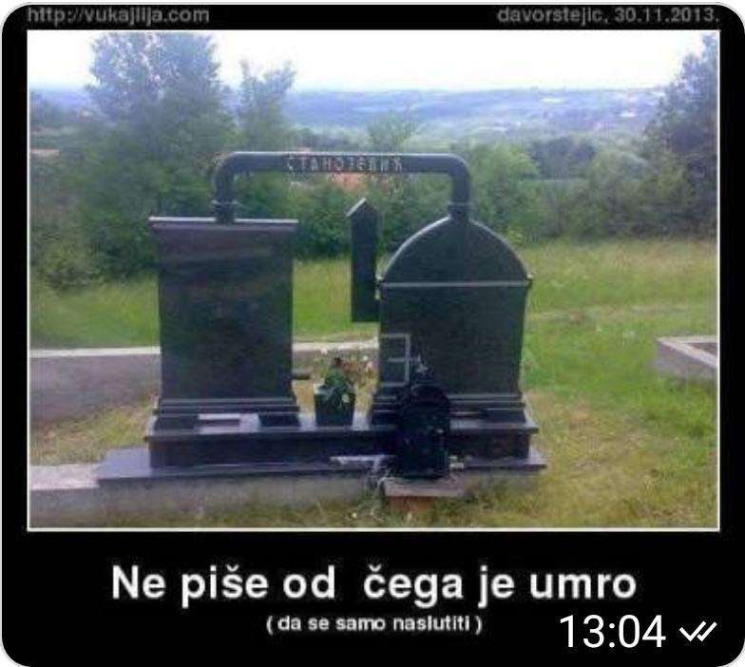
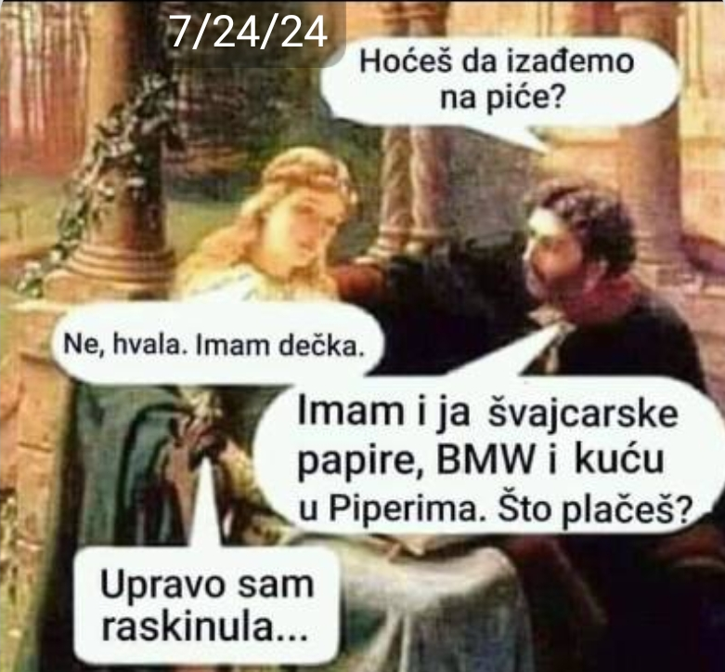
The Next Step for AI and NID: Heritage Mining from Images or Video Clips

Slide 37
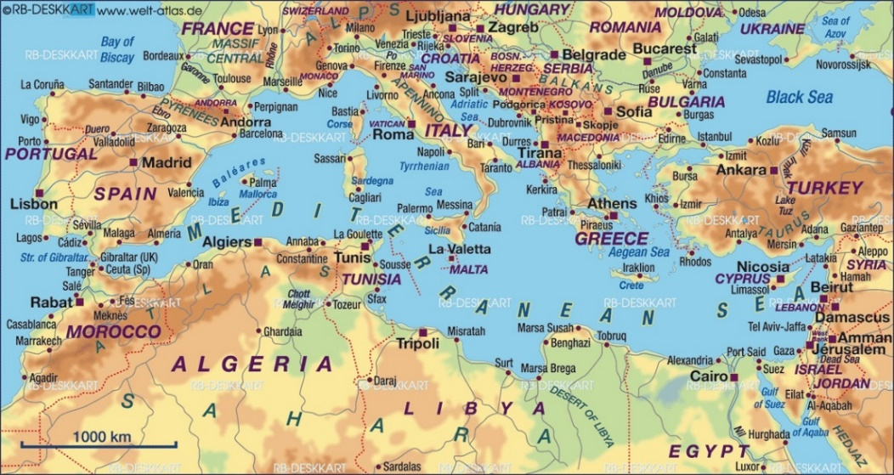
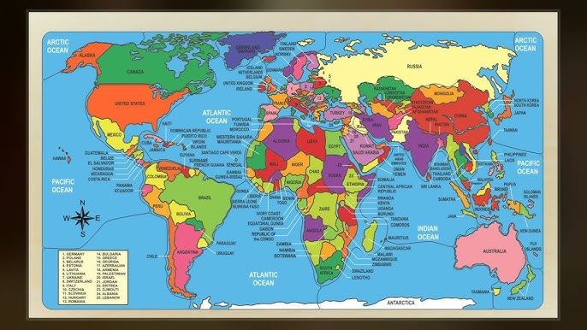
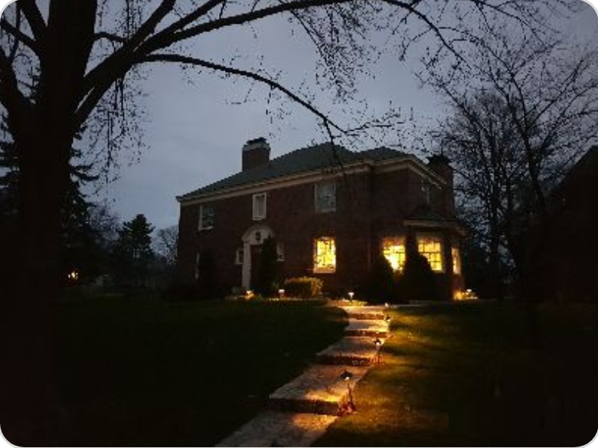
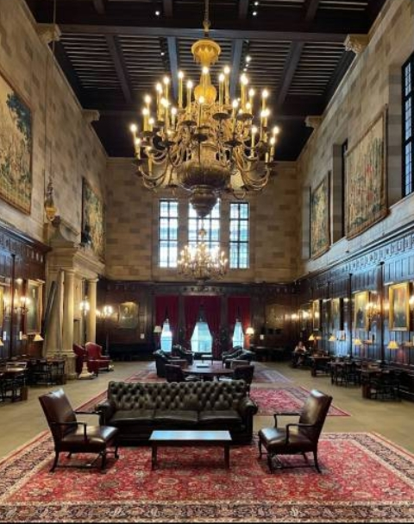
The Key is in BrainStorming!
... and in Synergizing the Cultures, from Mediterranean to Planetarian, and from MIT or Harvard to Stijena Piperska and Lukavica Mountain

Slide 38
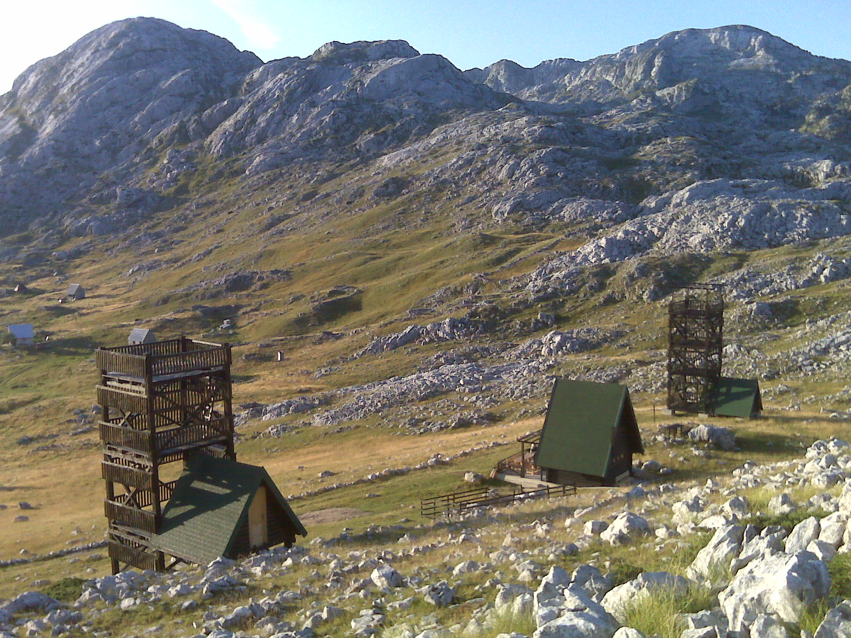
38

Slide 39
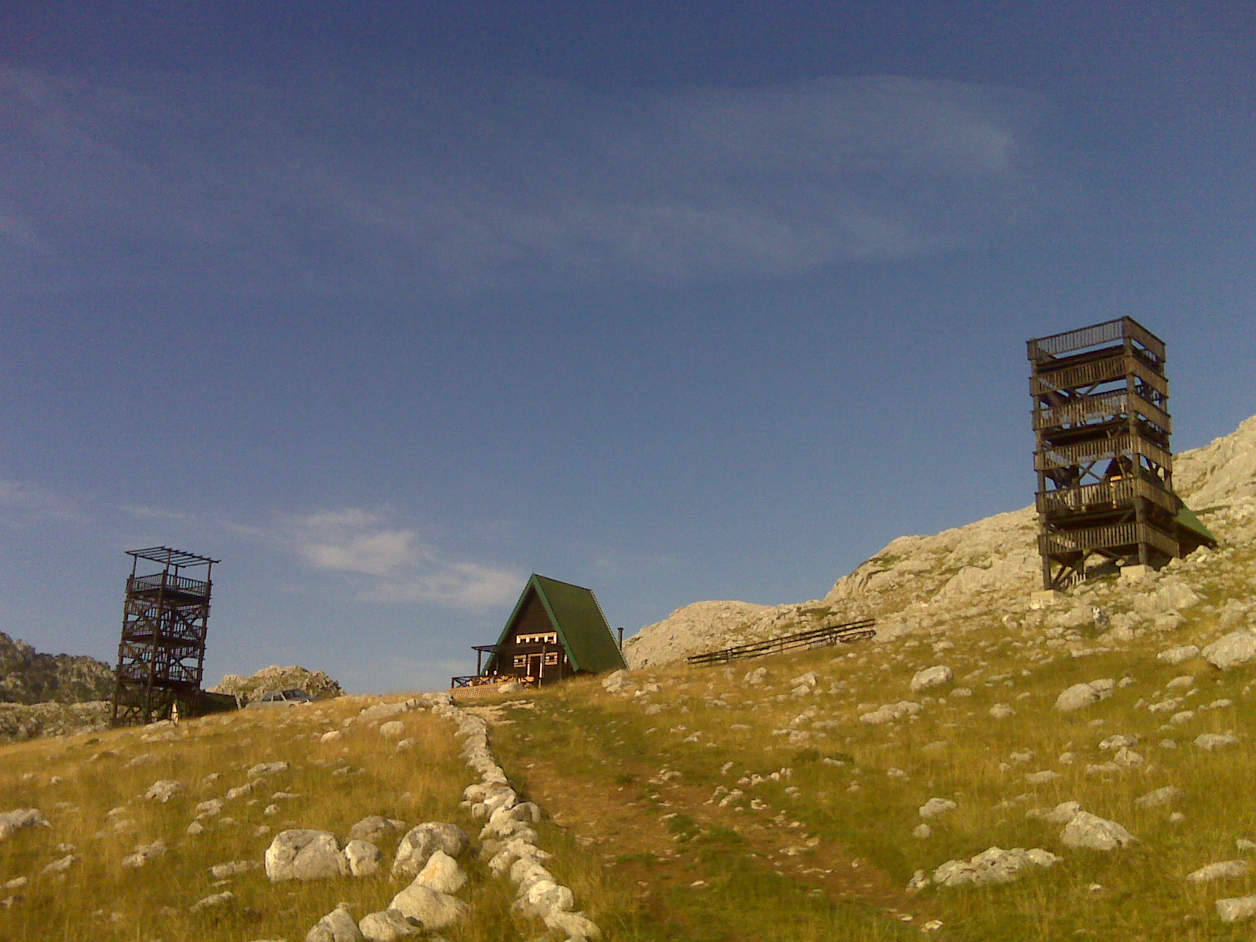

Slide 40
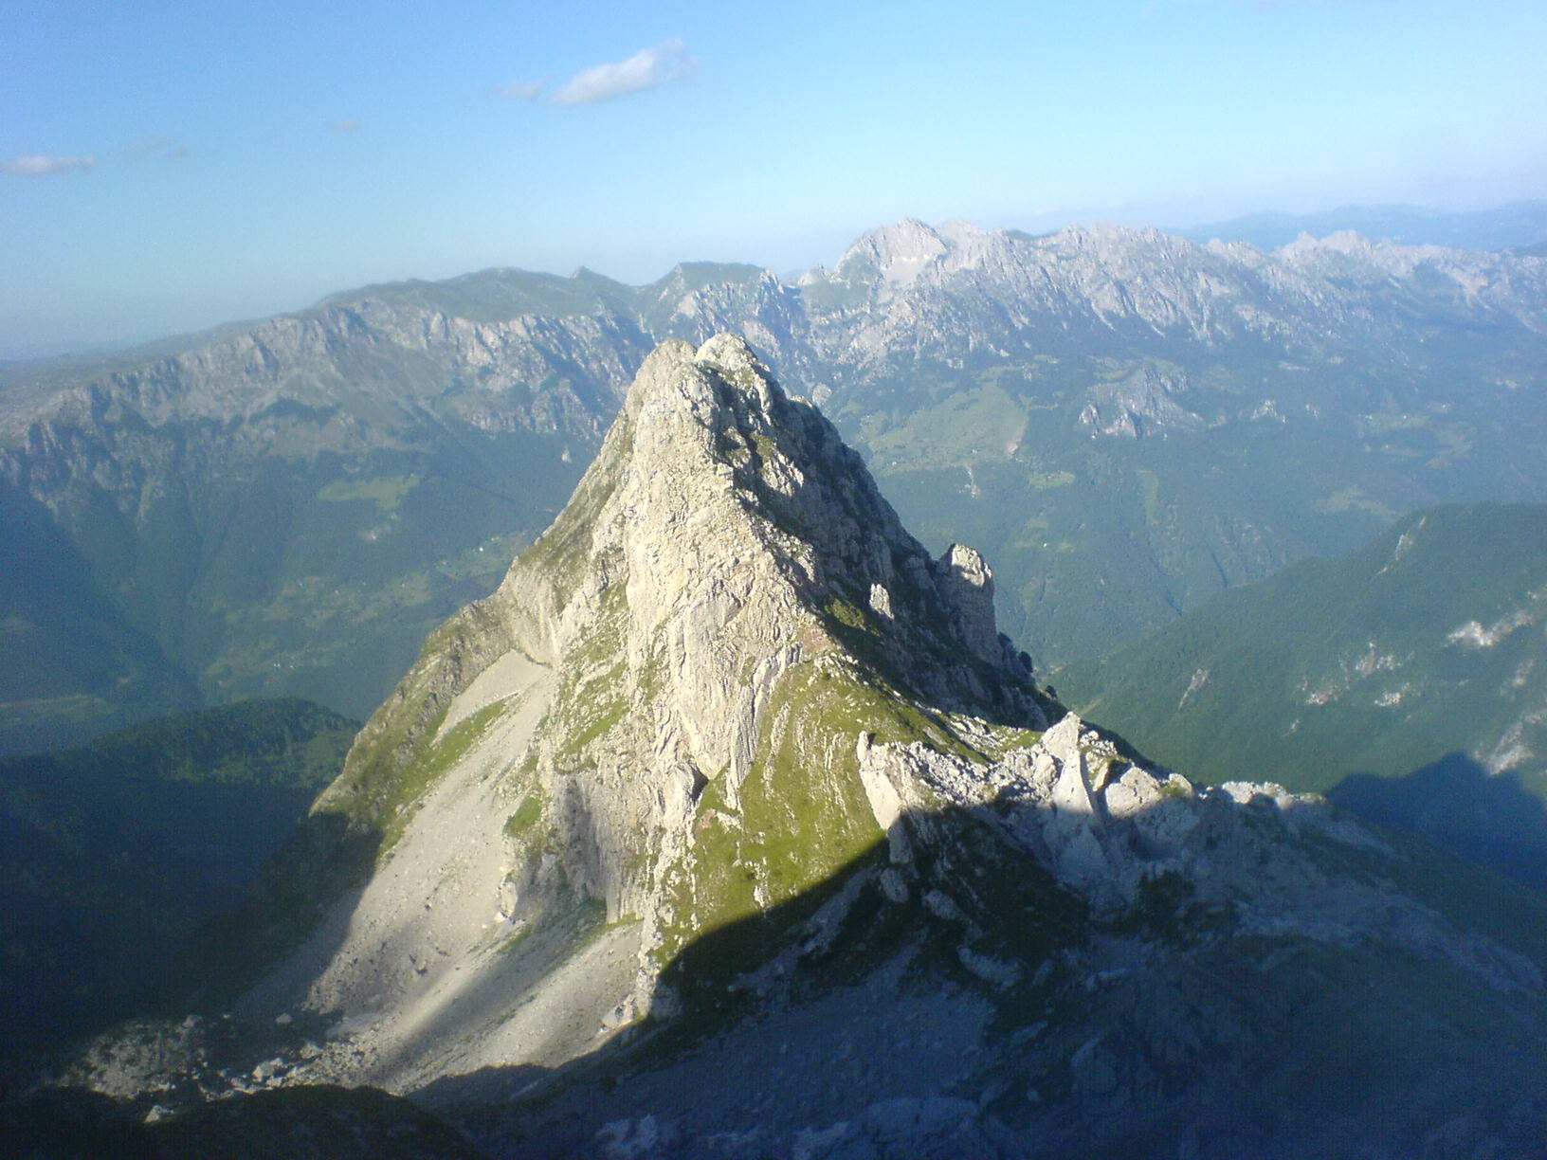

Slide 41
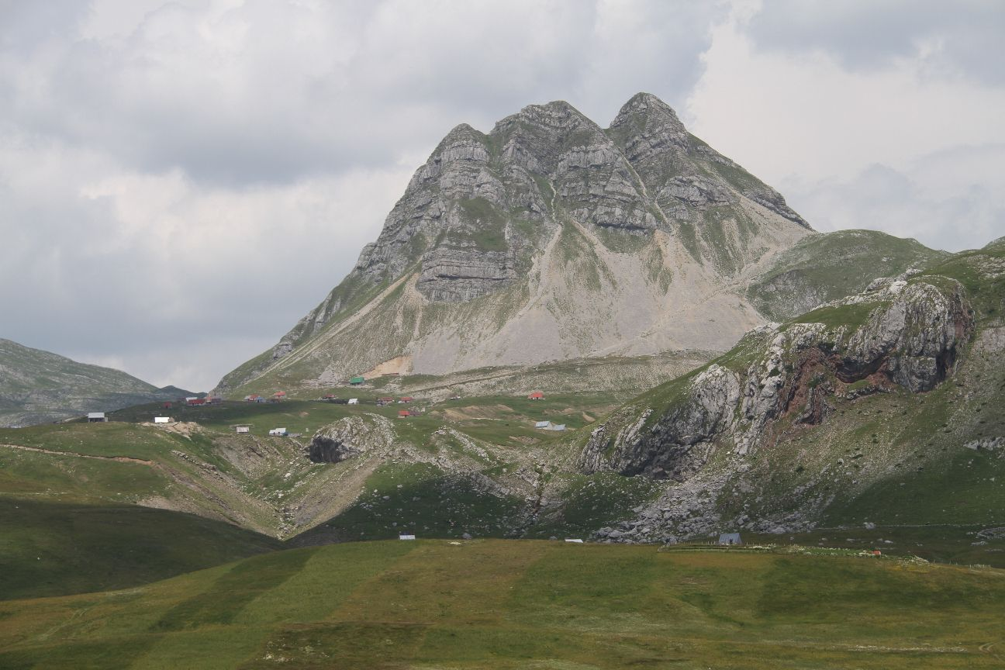
Q&A
vm@etf.rs

