Slide 1
The Ultimate SuperComputer-on-a-Chip for Massive Big Data and Highly Iterative Algorithms
Veljko Milutinović

Slide 2
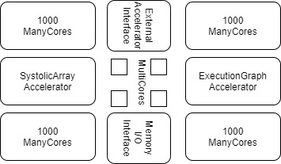
The Optimal Architecture
ControlFlow:
N MultiCore CPUs
1000N ManyCore GPUs
DataFlow:
An ASIC SystolicArray (Fixed)
An FPGA ExecutionGraph (Reconfigurable)
w Peripherals for External Accelerators (EnergyFlow):
Chemical
Molecular
Opto
Quantum
+ w Memory and I/O (DiffusionFlow)

Slide 3
Optimal Distribution of Transistor Budget
Ceiling-Dependent:
VLSI: 100BTr
WSI: 1TTr
Application-Dependent:
SW DataFlow
ML ControlFlow
Strategy-Dependent:
CF-Oriented
DF-Oriented
Memory-Dependent!

Slide 4
Pioneering Efforts (Before BIREN and CEREBRAS)
Company | Product name | Country | City | Number of CPU cores | Number of GPU cores | CPU clock rate | Launched
Alibaba | XT910 | China | Hangzhou | 1/2/4 per cluster | N/A | 2.0 – 2.5 GHz | 2020
RISC-V | Micro Magic RISC-V Core [39] | US | San Francisco | 1 | N/A | 4.25 – 5.19 GHz | 2020
SiFive | FU740 RISC-V SoC [25] | US | San Francisco | 4 | 1 | 1.4 – 1.5 GHz | 2020
AMD | AMD Ryzen™ 5 3400G with Radeon™ RX Vega 11 Graphics [24] | US | Santa Clara | 4 | 11 | 3.7 – 4.2 GHz | 2019
Nvidia | Tegra Xavier [28] | US | Santa Clara | 8 | 512 CUDA | N/A | 2019
Esperanto Technologies | N/A | US | Mountain View | 16 ET-Maxion cores | 4096 ET-Minion cores + ET-Graphics [26,27] | 2+GHz | 2018
Intel | Intel Sandy Bridge [23] | US | Santa Clara | 1-4 (4-6 Extreme, 2-8 Xeon) | 6 | 1.60 – 3.60 GHz | 2011
Moscow Center of SPARC Technologies (MCST) | Elbrus-2S+ (1891ВМ7Я) [29] | Russia | Moscow | 2 Elbrus 2000 cores | 4 DSP Elcore-09 cores | 300 – 800 MHz | 2011

Slide 5
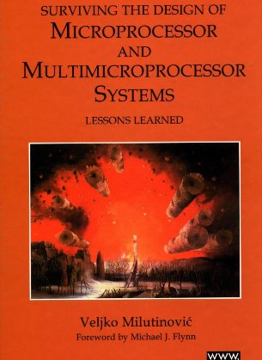
Past Experiences: MultiCore
Split Cache
Milutinovic, V. (1996). The Split Temporal/Spatial Cache: Initial Performance Analysis. SCIzzL-5, March 1996, 63-69.

Slide 6
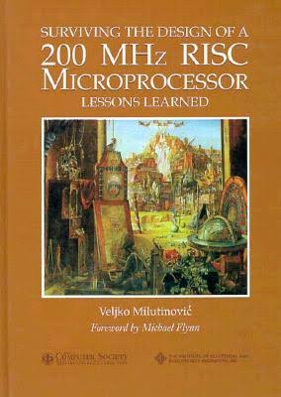
Past Experiences: ManyCore
GaAs Microprocessor
Milutinovic, V., Fura, D., & Helbig, W. (1986). An Introduction To GaAs Microprocessor Architecture for VLSI. Computer, (3), 30-42.

Slide 7
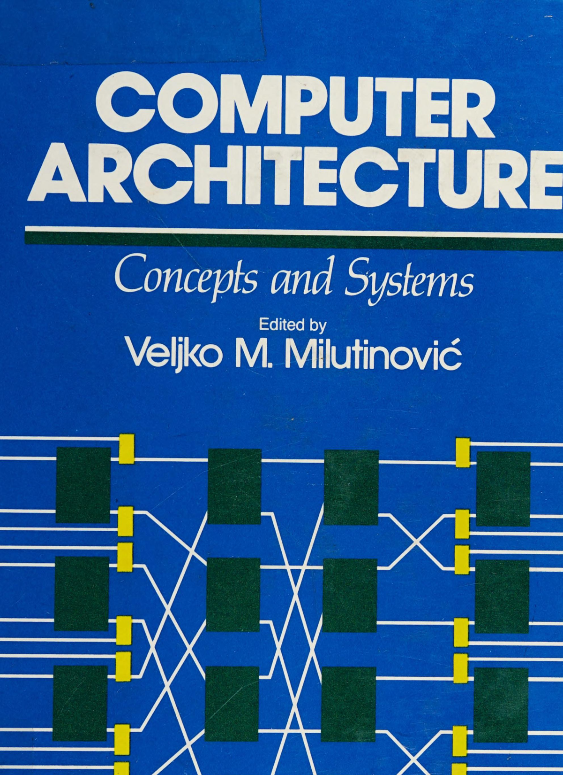
Past Experiences: SystolicArrays
GaAs Systolics
Fortes, J. A., Milutinovic, V., (1986, January). A High-Level Systolic Architecture for GaAs. In Proc. 19th Ann. Hawaii Int'l Conf. System Sciences (pp. 253-258).

Slide 8
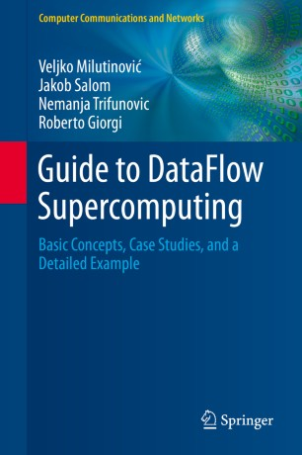
Past Experiences: ExecutionFlow
DataFlow
Milutinović, V., Salom, J., Trifunović, N., & Giorgi, R. (2015). Guide to DataFlow Supercomputing. Cham: Springer Nature.

Slide 10
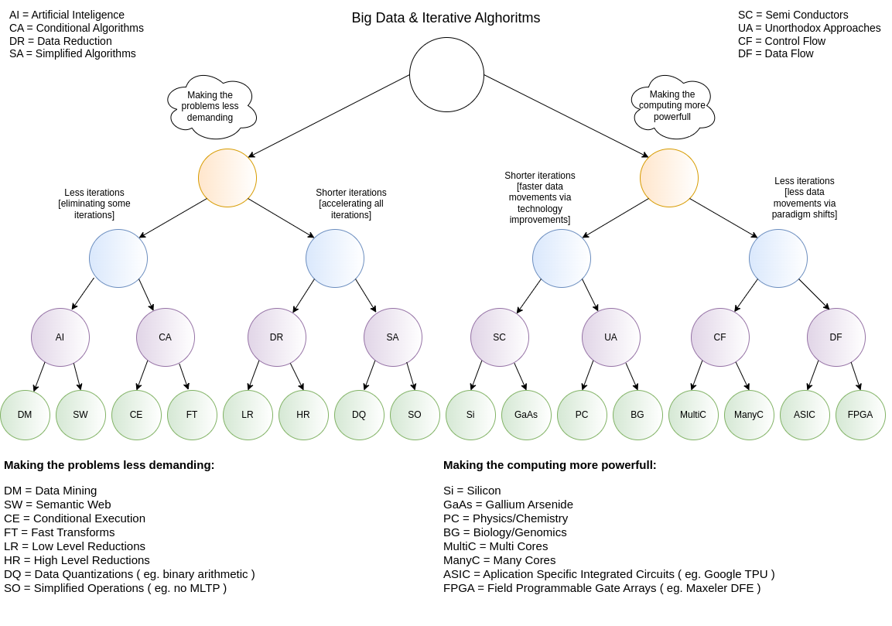
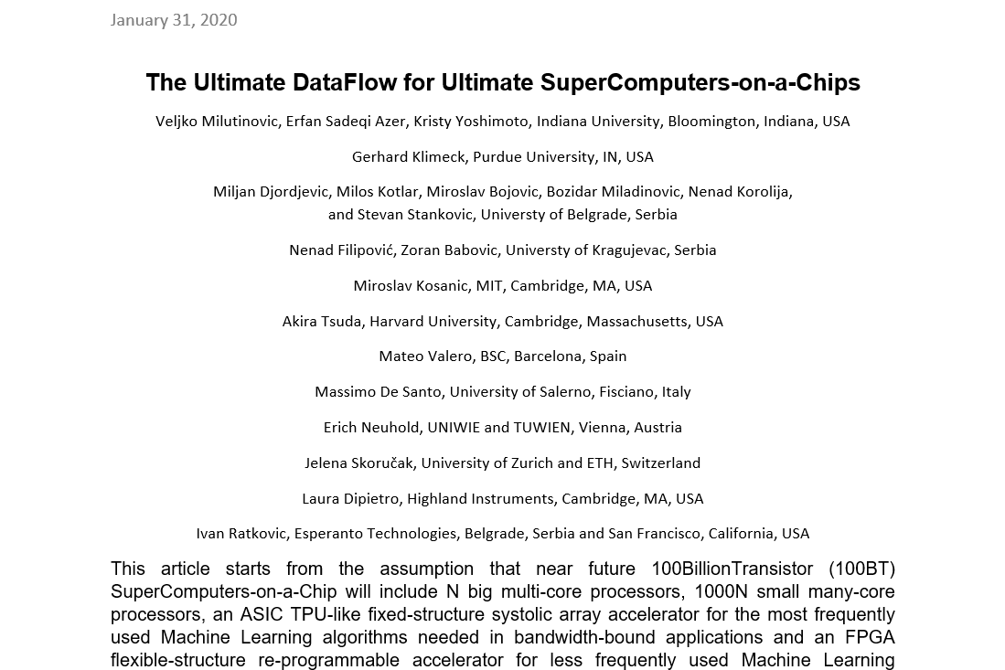
Current Research:

Slide 11
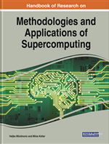
Handbook of Research on Methodologies and Applications of Supercomputing

Slide 12
Table of Contents #1
An introduction to Controlflow and Dataflow Supercomputing
Introduction to Control Flow
Optimal Scheduling of Parallel Jobs With Unknown Service Requirements
Intelligent Management of Mobile Systems Through Computational Self-Awareness
Paradigms for Effective Parallelization of Inherently Sequential Graph Algorithms on Multi-Core Architectures
Introduction to Dataflow Computing
Data Flow Implementation of Erosion and Dilation
Transforming the Method of Least Squares to the Dataflow Paradigm
Forest Fire Simulation: Efficient Realization Based on Cellular Automata
High Performance Computing for Understanding Natural Language
Deposition of Submicron Particles by Chaotic Mixing in the Pulmonary Acinus: Aciner Chaotic Moxing

Slide 13
Table of Contents #2
Recommender Systems in Digital Libraries Using Artificial Intelligence and Machine Learning: A Proposal to Create Automated Links Between Different Articles Dealing With Similar Topics
Unified Modeling for Emulating Electric Energy Systems: Toward Digital Twin That Might Work
A Backtracking Algorithmic Toolbox for Solving the Subgraph Isomorphism Problem
AI Storm ... From Logical Inference and Chatbots to Signal Weighting, Entropy Pooling...: Future of AI in Marketing
Efficient End-to-End Asynchronous Time-Series Modeling With Deep Learning to Predict Customer Attrition
Mind Genomics With Big Data for Digital Marketing on the Internet
Supercomputing in the Study and Stimulation of the Brain
An Experimental Healthcare System: Essence and Challenges
What Supercomputing Will Be Like in the Coming Years
The Ultimate Data Flow for Ultimate Super Computers-on-a-Chip

Slide 14
Reviews and Testimonials of 8 Nobel Laureates

Slide 15
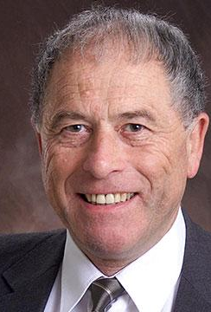
"I want to commend Dr. Veljko Milutinovic and Dr. Milos Kotlar for having completed this volume in the timely field of supercomputing in these difficult times, and I want to share their optimism regarding its use as a textbook around the world."
– Prof. Kurt Wüthrich, Nobel Laureate, Switzerland

Slide 16
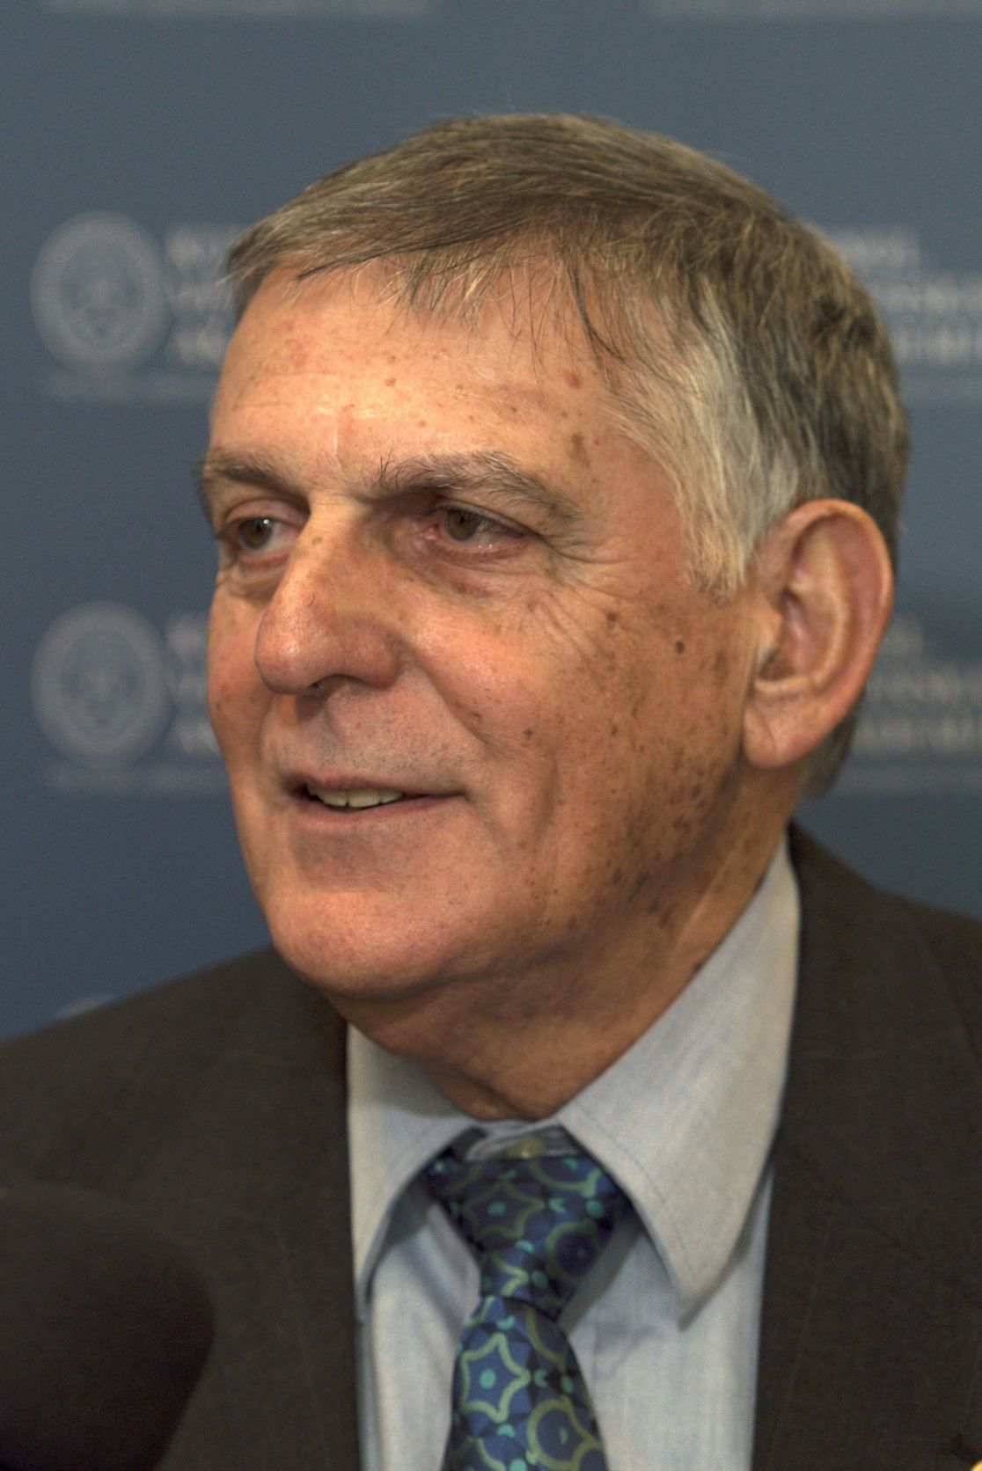
"Our complex and fast-moving world meets big data issues that call for reliable, efficient analysis and prompt response. A most advanced approach to dealing with these issues is presented in this book where algorithms of Control Flow represent the host architecture of supercomputers and Data Flow represents the acceleration architecture. A comprehensive list of applications is illustrated in the book including natural language processing, medical research, customer-oriented studies, and many more.“
– Prof. Dan Shechtman, Nobel Laureate, Israel

Slide 17
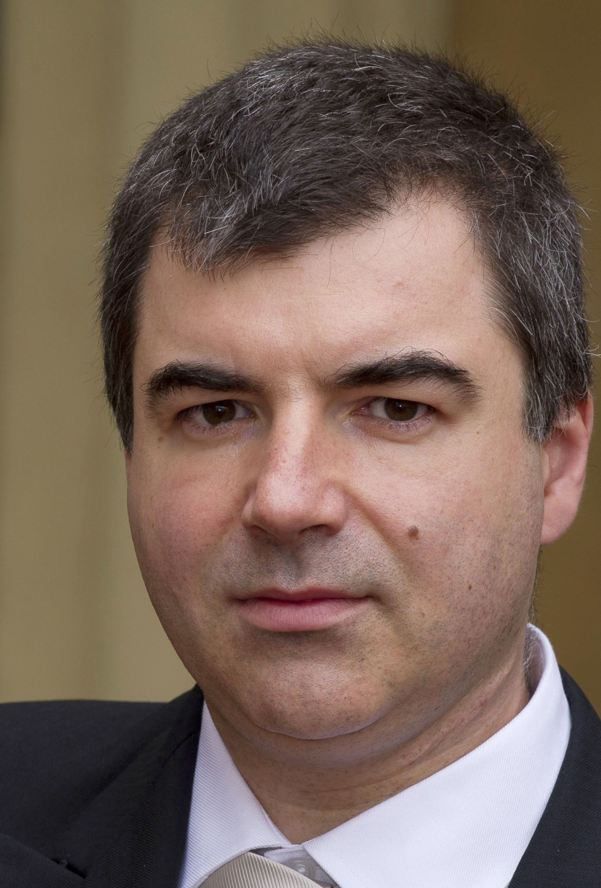
"Supercomputers have become a ubiquitous instrument in many areas of science and technology. Very hard to imagine modern physics, biology or chemistry without the use of this versatile tool. The breakthroughs in the development of supercomputers expand the range of problems we can tackle. Supercomputers, as well as specialised computers will undoubtedly contribute significantly to the overall landscape of discoveries in many different disciplines in the future."
– Prof. Konstantin Novoselov, Nobel Laureate, National University of Singapore, Singapore– Prof. Kurt Wüthrich, Nobel Laureate, Switzerland

Slide 18
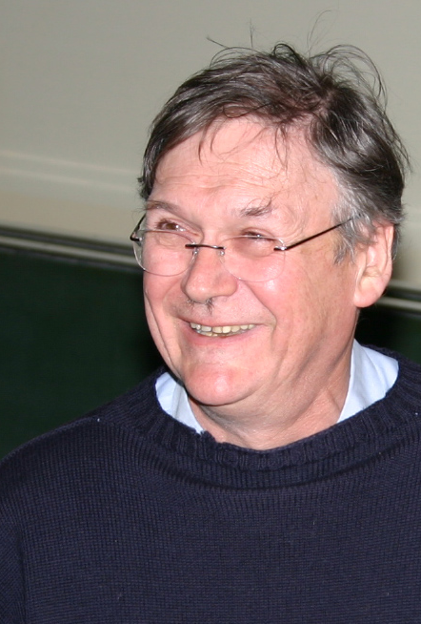
"It’s clear that computers can do anything, as the pioneers already recognised, and it’s probably only a matter of time before they can perform any of the kinds of tasks we humans take for granted quicker than blinking. I guess this book represents a stage on this exciting and very important journey."
– Prof. Tim Hunt, Nobel Laureate, UK

Slide 19
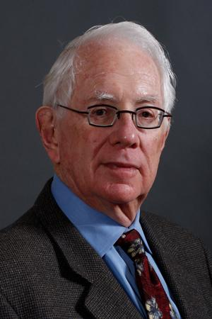
"Computers have become essential tools for the pursuit of both experimental and theoretical physics, as well as synthetic chemistry, paleontology, the medical sciences, economics the social sciences and so much more. Science, being the most international of all endeavors, will be well served by this important book, which honors the golden anniversary of the creation of Montinegro’s Academy of Science."
– Prof. Sheldon Glashow, Nobel Laureate, Boston University and Harvard University, USA

Slide 20
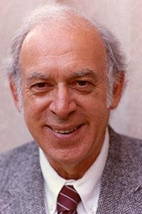
"Humankind’s continuing quests to uncover, understand, and utilize the secrets of nature have been greatly enhanced and will be further extended by the power of supercomputers."
– Prof. Jerome I Friedman, Nobel Laureate, USA

Slide 21
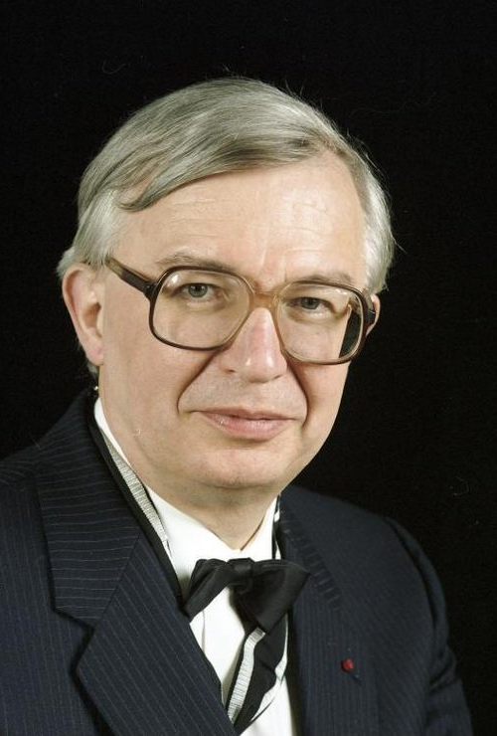
"I wish to congratulate very warmly the Montenegrin Academy of Arts and Sciences on the occasion of its 50th Anniversary and wish the CANU a highly successful future. Science shapes the Future of Mankind."
– Prof. Jean-Marie Lehn, Nobel Laureate, France

Slide 22
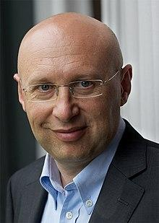
"Aim high, stay grounded! These four crisp words of wisdom accompany the best wishes for the 50th anniversary of the Montenegrin Academy of Sciences and Arts."
– Prof. Stefan Hell, Nobel Laureate, Germany

Slide 23
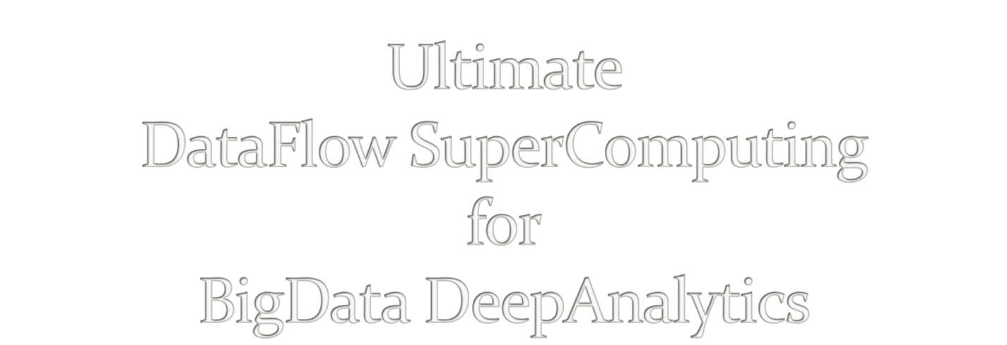
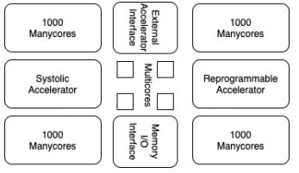
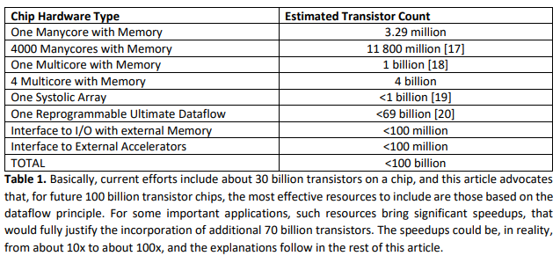
V. Milutinovic, University of Indiana, Bloomington, USA
Acknowledgements: O. Mencer, Imperial College, London, GBR, M.J. Flynn, Stanford University, Palo Alto, USA,
M. Kotlar, School of Electrical Engineering, University of Belgrade, SRB

Slide 24
A. Richard Feynman: Impact of logic/arithmetic and memory/IO Compiler-generated execution graph
Ilya Prigogine: Impact of energy, entropy, order, and optimization Compiler-generated data separation
Daniel Kahneman: Impact of approximate computing on precision Compiler-controlled approx computing
Tim Hunt: Impact of system latency on precision Compiler-controlled system latency

Slide 25
A. Whenever the Technology changes, the Fundamental Paradigm of Computer Architecture has to change, too.
aSoG (not: FPGA)
B. If several paradigms are available, the most suitable paradigm for adoption is the one most effective for modern Applications.
BrontoData (not: ExaBigData)
Is the von Neumann Paradigm still the most effective one?
A. MultiCores?
B. ManyCores?

Slide 26
Architecture
Size
Power
Speedup
Precision
Technology

Slide 29
The Power Challenge
State of the Art in Technology Today
The Data Movement Challenge
 | 2015 | 2020
Double precision FLOP | 100pj | 10pj
Moving data on-chip: 1mm | 6pj
Moving data on-chip: 20mm | 120pj
Moving data to off-chip memory | 5000pj | 2000pj
Moving data off-chip will use 200x more energy than computing!
Moving data in 1940s was using 1/60x ...
Conclusion: We are getting close to the Feynman Asymptote!
Important: Power and speed could be traded!
7/60
Notes:
So what is dataflow buying us? Predictable performance, simpler architecture (no OOO – with its power & area overhead), and less data movement

Slide 30
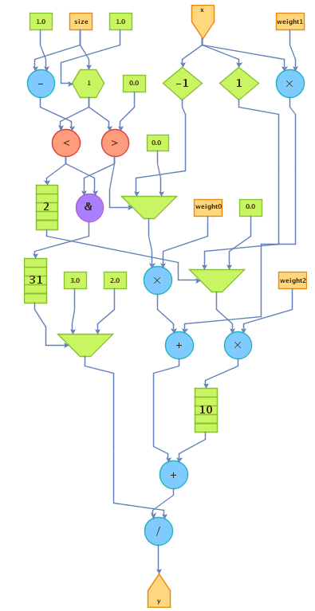
The Maxeler Technology Vision: MultiScale DataFlow
Space
Thinking in space rather than in time
Difficult change in mindset to overcome
Transformation of data through flow over time
Instructions are parallelized across the available space
Flow / Time
Optimal Solution: Execution Graph

Slide 31
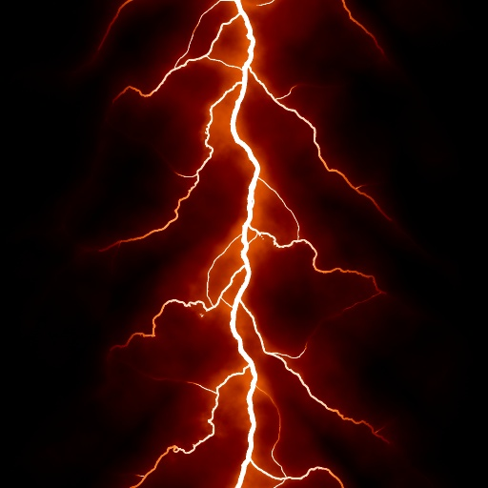
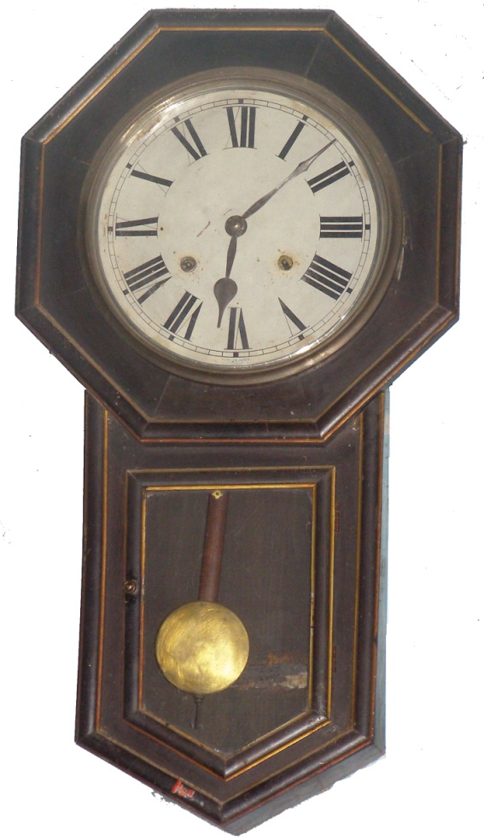
The Von-Neumann paradigm resembles an old wall clock
The Feynman paradigm resembles lightning!
Why?

Slide 32
von Neumann:
The Program Moves Data
Feynman:
The Program Configures Hardware
What moves data?
External sources till input.
Voltage difference through aSoG!
Voltage difference moves the important stuff!

Slide 33
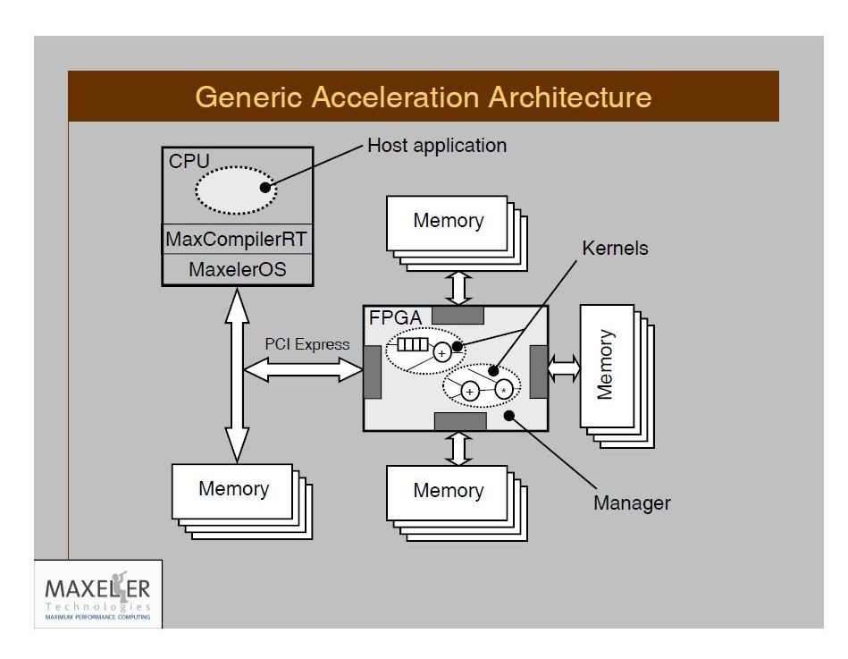
The Maxeler Generic Architecture Application
+ Tests
aSoG
Simulator builder
Hardware builder
2n+3
Important: Supporting any CL and any OS!
11/60

Slide 34
Nobel Laureate Ilya Prigogine: Injecting Energy to Decrease Entropy!
Corollary: Burning energy to split spatial and temporal decreases the entropy of computing and enables the DataFlow compiler to create a maximally effective execution graph.
Final goal: The execution graph with the minimal length of edges.

Slide 35
13/60

Slide 36
Intel acquired Altera
Qualcomm and IBM teaming up with Xilinx
However:
C C C
OpenCL(I) OpenCL(A) MaxCompiler
Intel Altera Altera@MaxZ
1 X>>1 Y>>X

Slide 37
Invisible on the DataFlow Concept Level
Invisible to DataFlow Programmers
Visible to the MaxCompiler
The MaxCompiler knows how to utilize them Best protected by two aSoG (now FPGA) protection levels and two Vendor (e.g., Maxeler) protection levels!

Slide 38
Publications of Interest for NanoAcceleration
========================================================================================================
Flynn, M., Mencer, O., Milutinovic, V., Rakocevic, G., Stenstrom, P., Trobec, R., Valero, M., Moving from Petaflops (on Simple Benchmarks) to Petadata per Unit of Time and Power (On Sophisticated Benchmarks), Communications of the ACM (nano-acceleration), May 2013.
2. Trobec, R., Vasiljevic, R., Tomasevic, M., Milutinovic, V., Beiveide, M., Valero, M., Interconnection Networks for SuperComputing, ACM Computing Surveys (nano-acceleration) , 2017.
------------------------------------------------------------------------------------------------------------------------------------------------------------------------------
3. Milutinovic, V., Tomasevic, M., Markovic, B., Tremblay, M., The Split Temporal/Spatial Cache: Initial Performance Analysis, Proceedings of the SCIzzL-5, Santa Clara, California, USA, March 26, 1996, pp 72-78.
4. Milutinovic, V., Tomasevic, M., Markovic, B., Tremblay, M., The Split Temporal/Spatial Cache: Initial Complexity Analysis, Proceedings of the SCIzzL-5, Santa Clara, California, USA, September, 1996.
------------------------------------------------------------------------------------------------------------------------------------------------------------------------------
5. Milutinovic, V., A Comparison of Suboptimal Detection Algorithms Applied to the Additive Mix of Orthogonal Sinusoidal Signals, IEEE Transactions on Communications, Vol. COM-36, No. 5, May 1988, pp. 538-543.
6. Milutinovic, V., Mapping of Neural Networks on the Honeycomb Architectures, Proceedings of the IEEE, Vol. 77, No 12, December 1989, pp. 1875-1878.
------------------------------------------------------------------------------------------------------------------------------------------------------------------------------
7. Helbig, W., Milutinovic, V., The RCA's DCFL E/D MESFET GaAs 32-bit Experimental RISC Machine, IEEE Transactions on Computers, Vol. 36, No. 2, February 1989, pp. 263-274.
8. Jovanovic, Z., Milutinovic, V., FPGA Accelerator for Floating-Point Matrix Multiplication, IEE Computers & Digital Techniques (nano-acceleration), 2012, 6, (4), pp. 249-256. The IET 2014 Premium Award for Computing & Digital Techniques.
========================================================================================================
Inspired by:
Feynman
Inspired by:
Prigogine
Inspired by:
Kahneman
Inspired by:
Hunt

Slide 39
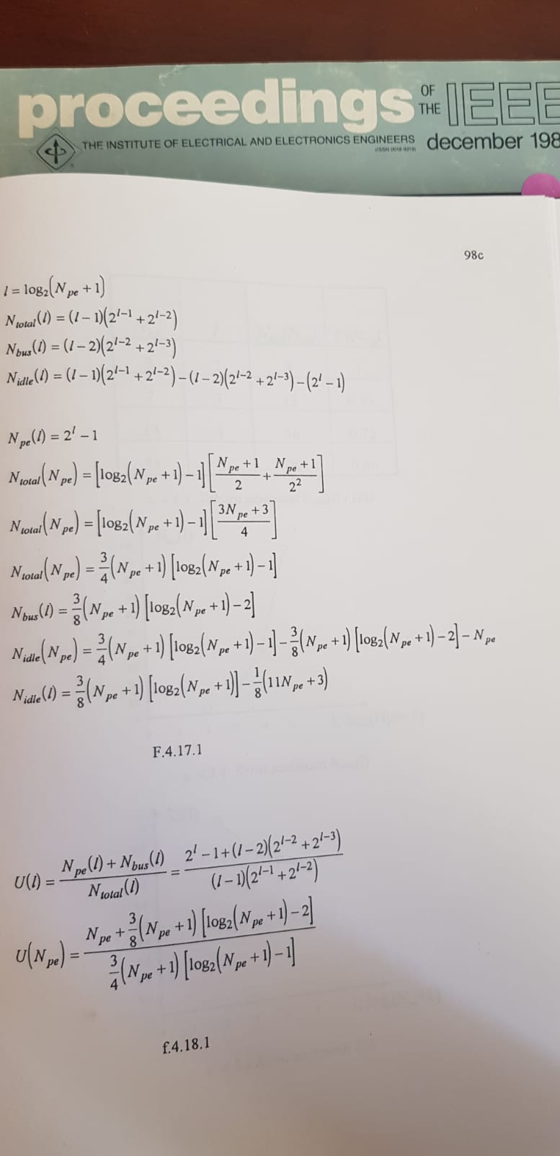
Feynman

Slide 40
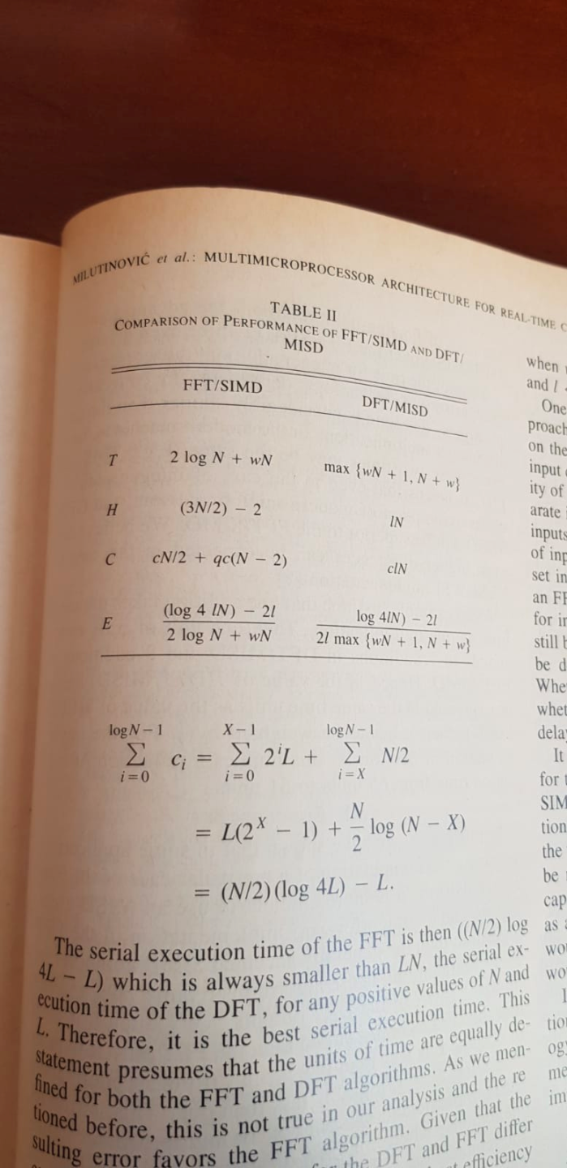
Prigogine

Slide 41
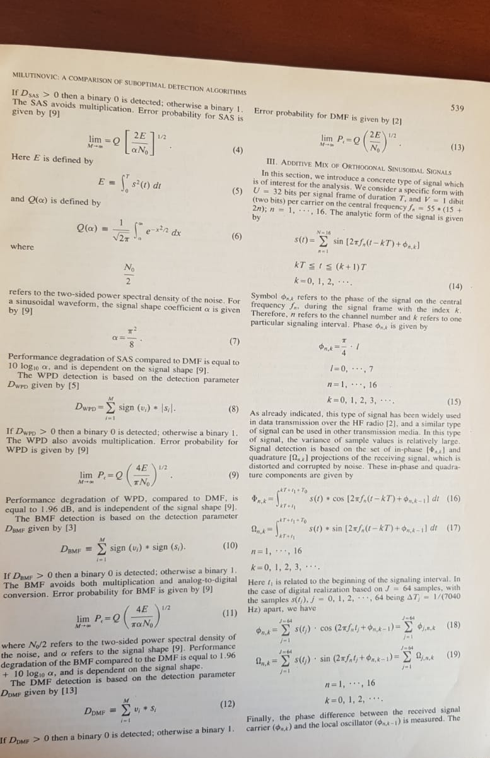
Kahneman

Slide 42
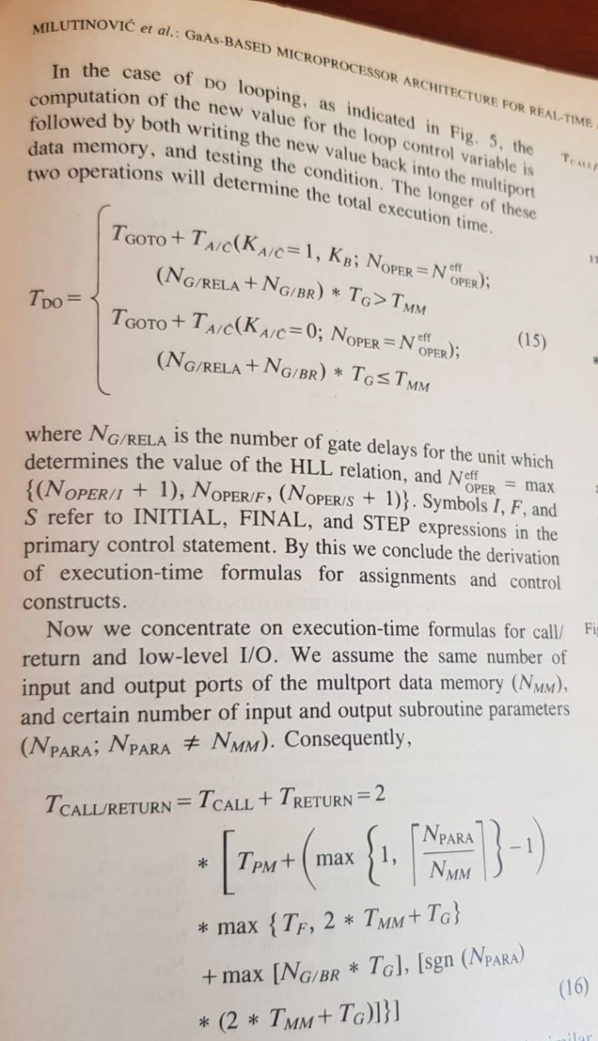
Hunt

Slide 43
Special Acknowledgements to: Simon Aglionby, Georgi Gaydadjiev, Itay Greenspon, and Nemanja Trifunovic
IF(2012)=3.80

Slide 44
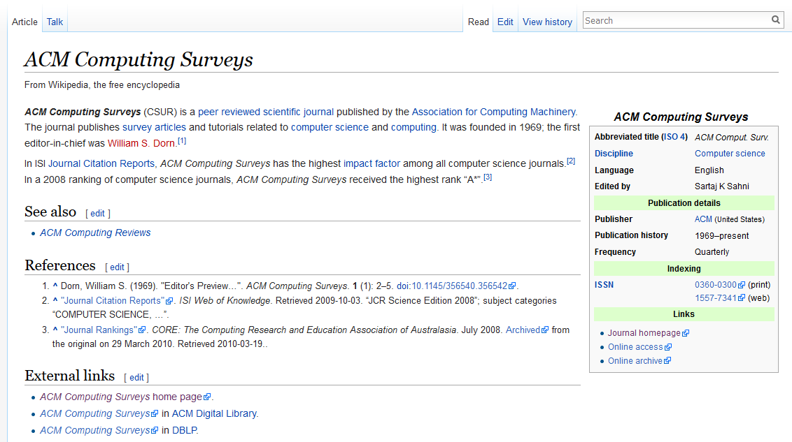
IF (2007) = 15

Slide 45
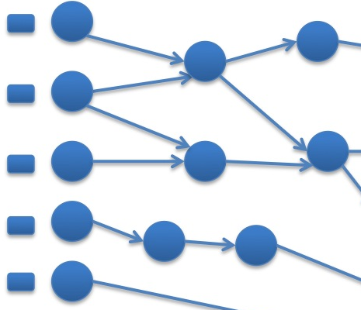
Essence: Feynman Enabled by Prigogine
PU
PM
DM
TALU possible at zero power (Arithmetic+Logic)
TCOMM not possible at zero power (MEM+MPS)

Slide 46
Essence: Feynman
PU
PM
DM
TALU possible at zero power (Arithmetic+Logic)
TCOMM not possible at zero power (MEM+MPS)

Slide 47
Essence: Feynman
PU
PM
DM
TALU possible at zero power (Arithmetic+Logic)
TCOMM not possible at zero power (MEM+MPS)

Slide 48
a DSL acting as a SuperSet of classical Java: A. A vector of built-in domain-specific classes B. Two sets of variables: SW + HW
MaxJ is a SubSet of OpenSPL,
created by the Imperial-Stanford-Tokyo-Tsinghua consortium.
Possible Future Mutations of OpenSPL: MaxPython and/or MaxR (lower Kolmogorov complexity) MaxHaskel and/or MaxScala (easier extension to approximate computing).
MaxJ, the Maxeler Java,

Slide 49
Note: Small approximations in one domain
may bring large benefits in another domain
Example: Weather forecast
A 15-bit computational precision (rather than the 64-bit precision)
may decrease the forecast precision for only 2%,
and at the same time,
may increase the grid precision 25 times,
and the forecast precision at grid intersections up to 10⁴.
Easily doable in DataFlow, difficult to do in ControlFlow.

Slide 50
Note: Small latencies in time domain
may bring large benefits in precision domains
Example: Optimal utilization of internal DataFlow pipelines
Compiler optimizations create internal pipelines
that experienced DataFlow programmers know how to utilize

Slide 51
Existing Maxeler-based publications:
Ultimate aSoG-based future:
20 [Size]
20 [Power]
20, 200 [Speedup]
20 [Precision]
20-200 [Size]
20-200 [Power]
20, 200, 2000, 20000 [Speedup]
20+ [Precision]
Applications
Architecture
Technology

Slide 52
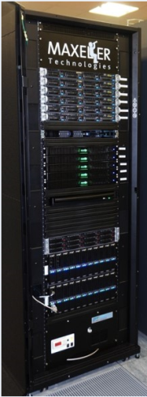
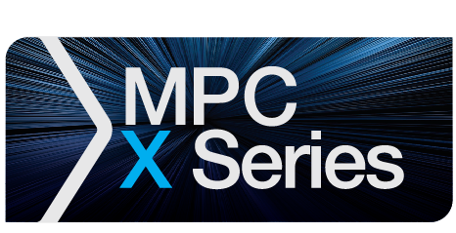
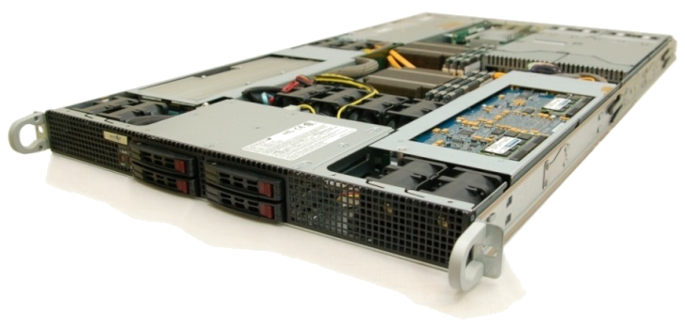
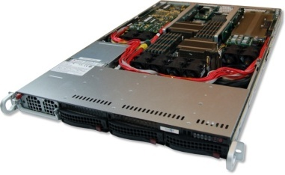
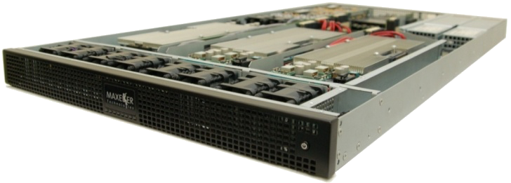
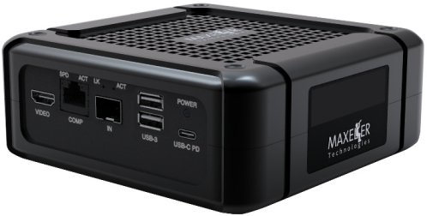
Maxeler Dataflow Appliance
40U: Good for Cloud
Software Based Solution
Dataflow Computing in the Datacentre
The CPU Conventional CPU cores and up to 6 DFEs with 288GB of RAM
The Dataflow Appliance
Dense compute with 8 DFEs, 768GB of RAM and dynamic allocation of DFEs to CPU servers with zero-copy RDMA access
The Networking Appliance
Intel Xeon CPUs and 4 DFEs with direct links to up to twelve 40Gbit Ethernet connections
1U: Good for Fog
MicroMAX.5: Good for Dew (Edge Processing of IoT Data)

Slide 53
The Major Application Successes
Finances:
Credit derivatives
Risk assessment
Stability of economical systems
Evaluation of econo-political mechanisms
GeoPhysics:
Oil&Gas
Weather forecast
Astronomy
Climate changes
Science:
Physics
Chemistry
Biology
Genomics
Engineering: Synergy of all the Above (ML, etc...)

Slide 54
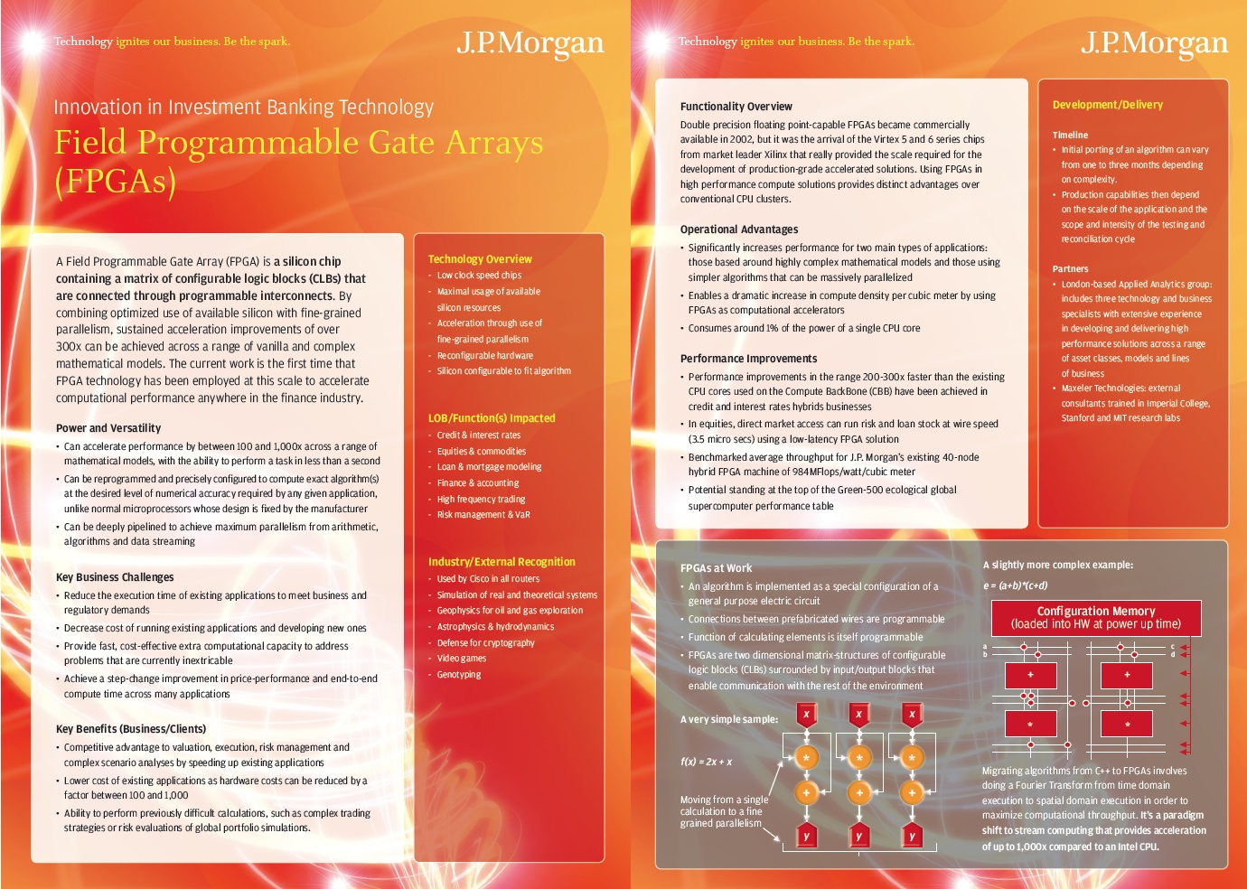

Slide 55
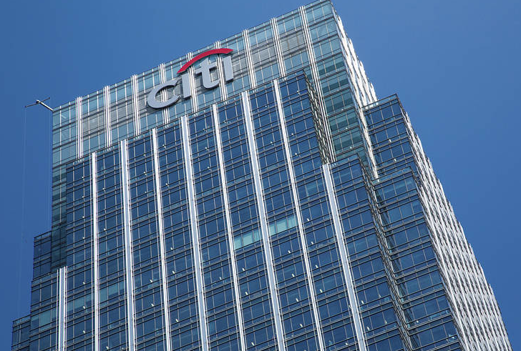
The know-how needed for deep security!

Slide 56
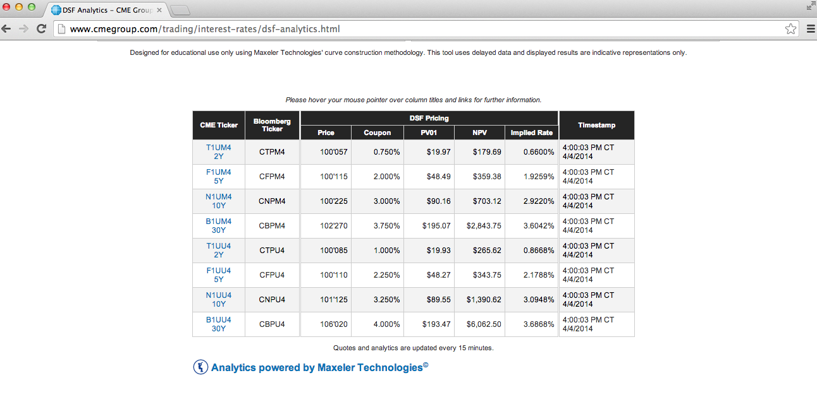

Slide 57
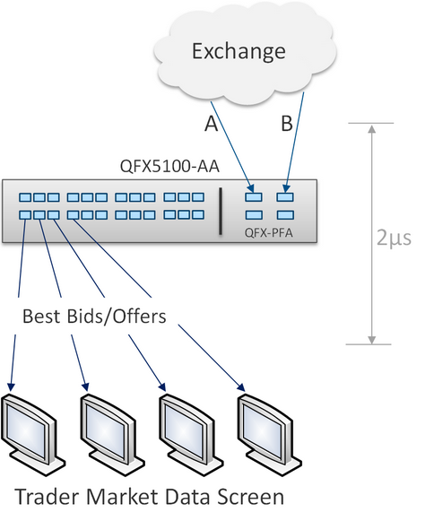
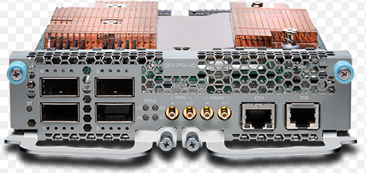
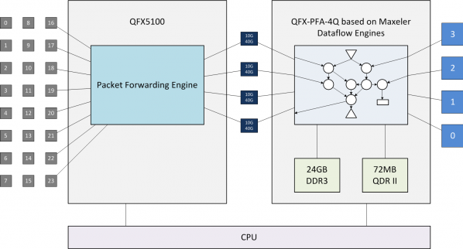
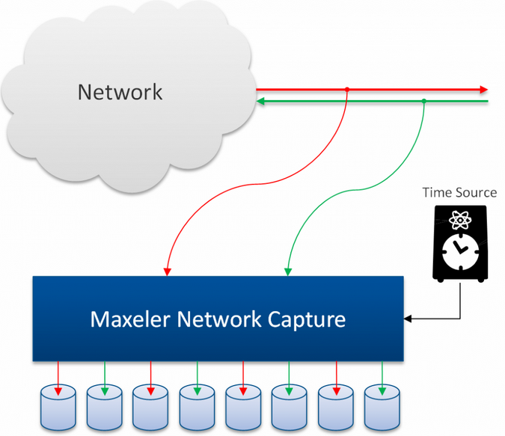
Juniper for Online Trading
NASDAQ

Slide 59
Seismic Imaging
Running on MaxNode servers - 8 parallel compute pipelines per chip - 10x less power: 150MHz vs 1.5GHz - 30x faster than microprocessors
An Implementation of the Acoustic Wave Equation on FPGAs T. Nemeth†, J. Stefani†, W. Liu†, R. Dimond‡, O. Pell‡, R.Ergas§ †Chevron, ‡Maxeler, §Formerly Chevron, SEG 2008

Slide 60
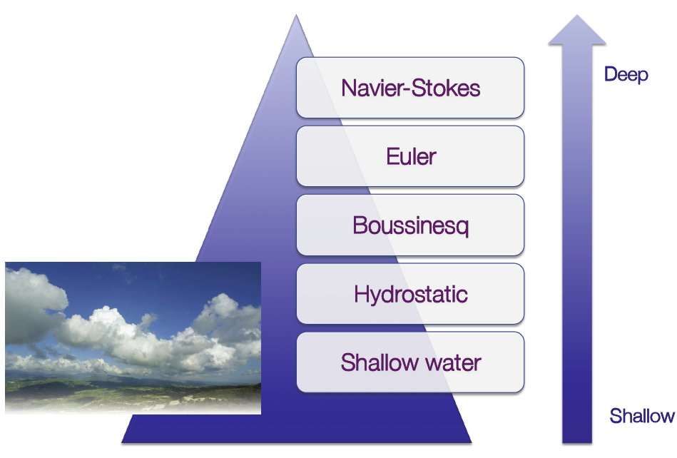
Global Weather Simulation: Size is Relevant
Atmospheric equations
Equations: Shallow Water Equations (SWEs)
[L. Gan, H. Fu, W. Luk, C. Yang, W. Xue, X. Huang, Y. Zhang, and G. Yang, Accelerating solvers for global atmospheric equations through mixed-precision data flow engine, FPL2013]
Tsinghua

Slide 61
Weather Model – Performance Gain
Platform | Performance () | Speedup
6-core CPU | 4.66K | 1
Tianhe-1A node | 110.38K | 23x
MaxWorkstation | 468.1K | 100x
MaxNode | 1.54M | 330x
14x

Slide 62
Weather Model -- Power Efficiency
Platform | Power Efficiency ( ) | Speedup
6-core CPU | 20.71 | 1
Tianhe-1A node | 306.6 | 14.8x
MaxWorkstation | 2.52K | 121.6x
MaxNode | 3K | 144.9x
9 x

Slide 63
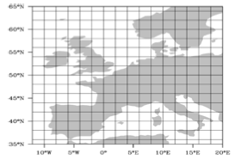
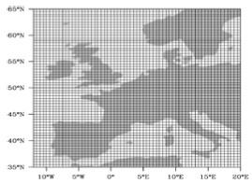
Weather and Climate Models: Precision
Which one is better?
Finer grid and higher precision are obviously preferred but the computational requirements will increase ➔ Power usage 🡪 $$
What about using reduced precision? (15 bits instead of 64 double precision FP)

Slide 64
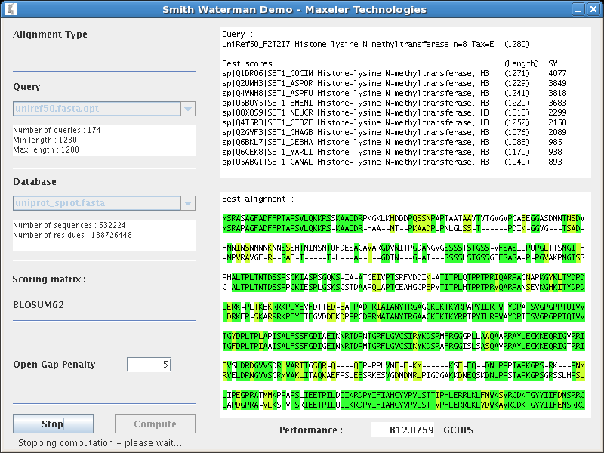
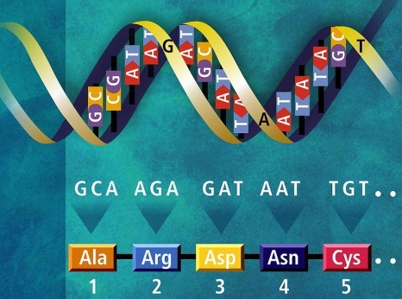
Maxeler Running Smith Waterman

Slide 65
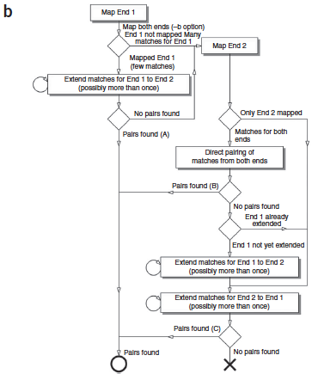
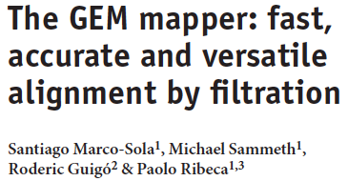
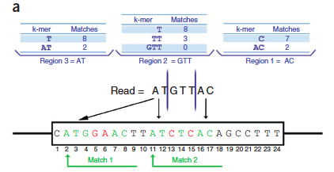
Niederman-Wuensch

Slide 66
Analysis of the Tensor Calculus Operations on DataFlow (PhD Thesis by Miloš Kotlar, on DataFlow-based Machine Learning)
The speedup of 6.75x achieved as early as for KiloData (Perceptron),
with 10x less on-chip transistors and the power savings of 4.6x
8/11

Slide 67
Conditions for the Y-Chart-Based “Kernelization” of Loops @ML (PhD Thesis by Nenad Korolija, on the Mapping of Algorithms onto DataFlow)
1. | BigData (RAM vs. STREAM) | O(n²)
2. | Code reusability (WORO vs. WORM) | +
3. | Overall application tolerance to latency | +
4. | Over 95% of run time in loops | ++
5. | Reusability of the data in loops | ++
6. | Potential for utilization of pipes | O(n)
Essentials for speedup:
algorithmic modifications,
pipeline utilization,
data choreography,
decision making on precision

Slide 68
Value profiling
PDE(FE) for risk assessment
PDE(FD) for emergency warnings
BOTH for complex simulations
ML for intelligence upgrade (TENSOR CALCULUS)
Input: Output:
vectors to analyse min-max values

Slide 69
Reducing precision
+, -, *, / operators overloading with custom (reduced precision).

Slide 70
Example output
generate_statistics.sh allows:
Elements range:
per iteration, or
per simulation.
Visually comparing outputs
for various input parameters (helps in choosing the best one).

Slide 71
appgallery.maxeler.com
http://www.mi.sanu.ac.rs/~appgallery.maxeler/

Slide 74
appgallery.maxeler.com
http://www.mi.sanu.ac.rs/~appgallery.maxeler/

Slide 75
webide.maxeler.com
https://maxeler.mi.sanu.ac.rs

Slide 76
webide.maxeler.com
https://maxeler.mi.sanu.ac.rs

Slide 77
48/60

Slide 78
49/60

Slide 79
MultiCore
Which way are the horses going?
DualCore?

Slide 80
ManyCore
Is it possible to use 2000 chicken instead of two horses?
?
==
What is better, real and anecdotic?

Slide 81
DataFlow
Data
How about 2 000 000 ants?

Slide 82
DataFlow
Big Data Input

Slide 83
DataFlow
aSoG
Big Data Input

Slide 84
DataFlow
aSoG
Big Data Input
Results
Bronto
Marmelade

Slide 85
An Edited Book Covering the Applications
http://www.amazon.com/Dataflow-Processing-Volume-Advances-Computers/dp/0128021349
http://www.elsevier.com/books/dataflow-processing/milutinovic/978-0-12-802134-7 Indexed by: WoS (SCI)
Contributions welcome for the follow-ups: Vol. 102 + Vol. 104 + etc…

Slide 86
An Original Book Covering the Essence
http://www.amazon.com/Guide-DataFlow-Supercomputing-Concepts-Communications/dp/3319162284
http://www.springer.com/gp/book/9783319162287
The first source to use the term the Feynman Paradigm in contrast with the Von Neumann Paradigm

Slide 87
Alibaba recently did the same!

Slide 88
Intel says logic is faster than GPUs
Alibaba recently claimed the same!

Slide 89
QoL
Maxeler is one of the Top 10 HPC projects to impact QoL in the World :) Scientific Computing [www.scientificcomputing.com/articles/2014/11] by Don Johnson of Lawrence Livermore National Labs [editor@ScientificComputing.com]

Slide 90
How About QoL?

Slide 91
DataFlow
SW
HW
AW

Slide 92
Essence of the Paradigm:
For Big Data algorithms and for the same hardware price as before, achieving:
a) speed-up, 20-200
b) monthly electricity bills, reduced 20 times
c) size, 20 times smaller
d) precision, X times better
The major issues of engineering are: design cost and design complexity.
Remember, economy has its own rules: production count and market demand!

Slide 93
Why is DataFlow so Much Faster?
Factor: 20 to 200
MultiCore/ManyCore
DataFlow
Machine Level Code
Gate Transfer Level

Slide 94
Why are Electricity Bills so Small?
Factor: 20
MultiCore/ManyCore
DataFlow

Slide 95
Why is the Cubic Foot so Small?
Process Control
Data Processing
Data Processing
Process Control
Factor: 20
MultiCore/ManyCore
DataFlow

Slide 96
Why is the Precision Better?
Factor: X

Slide 97
Endorsed by Jerome Friedman
Special thanks to: Jerome Friedman, Dan Shechtman, Tim Hunt, and Sheldon Glashow

Slide 98
Q&A
vm@etf.rs
© H. Maurer

Slide 100
BQCD on a Maxeler Dataflow Computer

Slide 101
BQCD on a Dataflow Computer
Porting BQCD from BlueGene to a Maxeler Dataflow Computer
Quantum Chromodynamics (QCD): models interactions of subatomic particles
Lattice QCD (LQCD): its discretisation, suitable for numerical computation
Berlin QCD (BQCD): most popular implementation of the LQCD algorithm
Conjugate Gradient (CG): Majority of the compute time (benchmark: 68%)
CG iteratively solves linear algebra problem of form Mx = b
Operator M contains Wilson-dslash and Clover operators
PROJECT TARGET 40x speedup of CG part of BQCD, followed by speedup of the entire application by 20x comparing same size boxes Dataflow vs BlueGene/Q

Slide 102
Maxeler QCD - Deployment
Maxeler QCD solution is deployed at Jülich Supercomputing Center, running on a Maxeler Dataflow system.
 | 2 racks of Jülich BlueGene/Q machine | On-premise Maxeler Dataflow system: scale to 1PF equivalent | Factor
Volume | 6.75 m³ | 0.87 m³ | 7.76
Overall Time to Solution | 1576.60 s | 689 s | 2.29
Overall Energy to Solution | 169.6 kWh | 4.42 kWh | 38.4
Volume x TTS | 10,642.05 m³s | 599.43 m³s | 17.8

Slide 103
Maxeler QCD on Amazon EC2 F1
74

Slide 104
QCD Demo
75

Slide 105
QCD Demo
76

Slide 106
subEdge: microMAX₅

Slide 107
Purdue, IU, MIT, Harvard, Boston, NEU, Dartmouth, U of Massachusetts at Amherst, USC, UCLA, Columbia, NYU, Princeton, NJIT, CMU, Temple U, UIUC, Michigan, Wisconsin, Minnesota, FAU, FIU, Miami, Central Florida, U of Alabama, U of Kentucky, GeorgiaTech, Ohio State, Imperial, King's, Manchester, Huddersfield, Cambridge, Oxford, Dublin, Cork, Cardiff, Edinburgh, EPFL, ETH, TUWIEN, UNIWIE, Graz, Linz, Karlsruhe, Stuttgart, Bonn, Frankfurt, Heidelberg, Aachen, Darmstadt, Dortmund, KTH, Uppsala, Karlskrona, Karlstad, Napoli, Salerno, Siena, Pisa, Barcelona, Madrid, Valencia, Oviedo, Ankara, Bogazici, Koc, Istanbul, Technion, Haifa, BerSheba, Eilat, Belgrade, Podgorica, Koper, Ljubljana, Maribor, Nova Gorica, etc, etc. Also at the World Bank in Washington DC, IMF, the Telenor Bank of Norway, the Raiffeisen Bank of Austria, Brookhaven National Laboratory, Lawrence Livermore National Laboratory, IBM TJ Watson, HP Encore Labs, Intel Oregon, Qualcomm VP, NCR, RCA, Fairchild, Honeywell, Yahoo NY, Google CA, Microsoft, Finsoft, ABB Zurich, Oracle Zurich, and many other industrial labs, as well as at Tsinghua University, Shandong, NIS of Singapore, NTU of Singapore, Tokyo, Sendai, Seoul, Pusan, Sydney University of Technology, University of Sydney, Hobart, Auckland, Toronto, Montreal, Durango, MontereyTech, Cuernavaca, UNAM...

Slide 109
Design of Systolic Arrays: An SIMD MultiMicroprocessor for DARPA
GaAs Systolic Array Based on 4096 Node Processor Elements
Adaptive signal processing is of crucial importance for advanced radar and communications
Systems. In order to achieve real time throughput and latencies, one is forced to use advanced semiconductor technologies (e.g., gallium arsenide, or similar) and advanced parallel architectures (e.g.,systolic arrays, or similar).
The systolic array described here was designed to support two important applications :
(a) adaptive antenna array beamforming, and (b) adaptive Doppler spectral filtering. In both cases, in theory, the system output is calculated as the product of the signal vector x (complex
N-dimensional vector) and the weight vector w (optimal N-dimensional vector).
Complex vector x is obtained by multiplying N input samples with the corresponding window weighting function consisting of N discrete values. Optimal vector w is obtained as:

Slide 110
Symbol R refers to the N-by-N inverse convariance matrix of the signal with the (i,j) -th component defined as:
and symbol refers to N-dimensional vector which defines the antenna direction (in the case of adaptive antena beamforming) or Doppler peak (in the case of adaptive Doppler spectral filtering).
Symbols M and v represent scaled values of R and s, respectively. In practice, the scaled values M and v may be easier to obtain, and consequently the remaining explanation is adjusted.
The core of the processing algorithm is the inversion of a N-by-N matrix in real time. This problem can be solved in a number of alternative ways which are computationally less complex. The one chosen here includes the operations explained in Figure Y1a.

Slide 111
Positive semi definite matrix M can be defined as:
M = U D U^{T}
Matrices U and D are defined using the formula:
which is recursively updated using the formula:
a.
Figure Y1: Basic Operational Structure
Legend:
SAA1 – Cells involved in root covariance update, and the first step of back substitution;
SAA2 - Cells involved in root covariance update, and in both steps of back substitution;
U – Lower triangular matrix with unit diagonal elements
D – Diagonal matrix with positive or zero diagonal elements
b – A scalar initially set to 1
K – Iteration count.

Slide 115
Veljko Milutinović
VLSI for SuperComputing: From Applications and Algorithms to Masks and Chips

Slide 116
World Top Foundries in VLSI for SuperComputing
#1?

Slide 117
World Top Foundries in VLSI for SuperComputing
#1? Qualcomm

Slide 118
World Top Foundries in VLSI for SuperComputing
#1? Qualcomm
#2?

Slide 119
World Top Foundries in VLSI for SuperComputing
#1? Qualcomm
#2? Intel

Slide 120
World Top Foundries in VLSI for SuperComputing
#1? Qualcomm
#2? Intel
#3?

Slide 121
World Top Foundries in VLSI for SuperComputing
#1? Qualcomm
#2? Intel
#3? TSM (Taiwan Semiconductor Manufacturing)

Slide 122
World Top Foundries in VLSI for SuperComputing
#1? Qualcomm
#2? Intel
#3? TSM
The Qualcomm VP/TD started from this course (first as my PhD student and later as the course TA)

Slide 123
World Top Foundries in VLSI for SuperComputing
#1? Qualcomm
#2? Intel
#3? TSM
The Qualcomm VP/TD started from this course (first as my PhD student and later as the course TA)
An Intel VP/TD took the IR4RVL in-a-nut-shell (at my past IEEE/ACM tutorial)

Slide 124
World Top Foundries in VLSI for SuperComputing
#1? Qualcomm
#2? Intel
#3? TSM
The Qualcomm VP/TD started from this course (first as my PhD student and later as the course TA)
An Intel VP/TD took the IR4RVL in-a-nut-shell (at my past IEEE/ACM-HICSS conference tutorial)
Maybe, a Next Gen VP/TD comes from ETF ☺

Slide 125
World Top Foundries in VLSI for SuperComputing
#1? Qualcomm
#2? Intel
#3? TSM
The Qualcomm VP/TD started from this course (first as my PhD student and later as the course TA)
An Intel VP/TD took the IR4RVL in-a-nut-shell (at my past IEEE/ACM-HICSS conference tutorial)
Maybe, a next TSM VP/TD comes from ETF ☺ or MF ☺

Slide 126
World Top Foundries in VLSI for SuperComputing
#1? Qualcomm
#2? Intel
#3? TSM
The Qualcomm VP/TD started from this course (first as my PhD student and later as the course TA)
An Intel VP/TD took the IR4RVL in-a-nut-shell (at my past IEEE/ACM-HICSS conference tutorial)
Maybe, a next TSM VP/TD comes from ETF ☺ or MF ☺ or FFH ☺

Slide 127
World Top Foundries in VLSI for SuperComputing
#1? Qualcomm
#2? Intel
#3? TSM
The Qualcomm VP/TD started from this course (first as my PhD student and later as the course TA)
An Intel VP/TD took the IR4RVL in-a-nut-shell (at my past IEEE/ACM-HICSS conference tutorial)
Maybe, a next TSM VP/TD comes from ETF ☺ or MF ☺ or FFH ☺ or FON

Slide 128
Who works here?

Slide 129
The Holistic Foundry (R&DFab) in VLSI for SuperComputing
Phase#1: From Applications to Algorithms Phase#2: From Algorithms to Masks Phase#3: From Masks to Chips Phase#4: From Chips to Applications

Slide 130
The Holistic Foundry (R&DFab) in VLSI for SuperComputing
Phase#1: From Applications to Algorithms Phase#2: From Algorithms to Masks Phase#3: From Masks to Chips
Verification is crucial in each one of these phases, and related teaching is done in coop with ELSYS or HDLDH!

Slide 131
The Holistic Foundry (R&DFab) in VLSI for SuperComputing
Phase#1: From Applications to Algorithms Phase#2: From Algorithms to Masks Phase#3: From Masks to Chips Phase#4: From Chips to Applications
Verification is crucial in each one of these phases, and related teaching is done in coop with ELSYS or HDLDH!
Management issues of importance for an R&D Fab are covered in the accompanying course: IR4USP (including 12 related homework assignments)!

Slide 132
Contents: From Algorithms to Masks
Part#1: VLSI for ControlFlow SuperComputing
Part#2: VLSI for DataFlow SuperComputing
Part#3: VLSI for WirelessFlow SuperComputing
Part#4: VLSI for EnergyFlow SuperComputing (QMOC)

Slide 133
VLSI for ControlFlow SuperComputing
ManyCore Systems:
Enabler Technology: VHDL vs Verilog (0.5 weeks)
Design and Programming of a 200MHz RISC Microprocessor (2.5 weeks) + HW#1
MultiCore Systems:
Enabler Technology: Verification by Elsys (2 weeks) + Lab#1
Design of MicroProcessor and MultiMicroProcessor Systems by Wiley (1 week)

Slide 136
VLSI for DataFlow SuperComputing
FineGrain DataFlow:
Enabler Technology: Altera vs Xilinx (0.5 weeks)
Design and Programming of the 200MHz Maxeler Machine (3.5 weeks) + HW#2
SystolicArray DataFlow:
Enabler Technology: Systolic Array Architectures (0.5 weeks)
Design of DARPA Systolic Architectures (0.5 weeks) + Lab#2

Slide 137
On Flexible DataFlow:
Advances in Computer Architecture (North Holland) by Veljko M. Milutinovic with a contribution from John Hennessy

Slide 138
On Fixed DataFlow:
High-Level Language Computer Architecture (Elsevier Computer Science Press) by Veljko M. Milutinovic with a contribution from Michael Flynn

Slide 139
VLSI for WirelessFlow SuperComputing
WSNs: Part#1
Hardware (0.25 weeks)
Software (0.25 weeks)
WSNs: Part#2
Systems (SUN+Slimmer) (0.25 weeks)
Applications (UbiComputing@WSN+DataMining@WSN) (0.25 weeks)
The stress is on integration of WSNs, IoT, Ethernet, and Internet: Z. Babovic et al., “Web Performance Evaluation of Internet of Things Applications,” IEEE Access 2016.

Slide 141
opt.html

Slide 142
VLSI for Quantum, Molecular, Optical, and Chemical SuperComputing
Basics:
Hardware (N weeks)
Software (N weeks)
Advances:
Systems (N weeks)
Applications (N weeks)
Optional class projects for extra points!

Slide 143
Quantum Computing
A quantum computer uses qubits to run multidimensional quantum algorithms.
Their processing power increases exponentially as qubits are added.
A classical processor uses bits to operate various programs.
Their power increases linearly as more bits are added.

Slide 144
Potentials:
Quantum computing is 158 million times faster than the most sophisticated supercomputer we have in the world today.
It is a device that could do in four minutes what it would take a traditional supercomputer 10,000 years to accomplish.

Slide 145
Reality:

Slide 146
The First Eight Companies in Quantum Computing:
Atom Computing
Xanadu
IBM
ColdQuanta
Zapata Computing
Azure Quantum
D-Wave
Strangeworks

Slide 147
Beginnings:

Slide 148
The Best Quantum Computing Stocks:
IBM (NYSE: IBM)
Alphabet (Nasdaq: GOOG, Nasdaq: GOOGL)
Intel (Nasdaq: INTC)
Microsoft (Nasdaq: MSFT)
Amazon (Nasdaq: AMZN)
Quantum Computing (OTC: QUBT)

Slide 149
Libraries:
TensorFlow Quantum (TFQ) is a quantum machine learning library for rapid prototyping of hybrid quantum-classical ML models.
Interfacing for control-flow.

Slide 150
Tensor Flow Quantum:
TensorFlow Quantum focuses on quantum data and building hybrid quantum-classical models.
It integrates quantum computing algorithms and logic designed in Cirq, and provides quantum computing primitives compatible with existing TensorFlow APIs, along with high-performance quantum circuit simulators.

Slide 151
A Programming Example:
# A hybrid quantum-classical model. model = tf.keras.Sequential ([ # Quantum circuit data comes in inside of tensors. tf.keras.Input(shape=(), dtype=tf.dtypes.string), # Parametrized Quantum Circuit (PQC) provides output # data from the input circuits run on a quantum computer. tfq.layers.PQC(my_circuit, [cirq.Z(q1), cirq.X(q0)]), # Output data from quantum computer passed through model. tf.keras.layers.Dense(50) ])

Slide 152
Molecular Computing
Molecular computing is a branch of computing that uses DNA, biochemistry, and molecular biology hardware, instead of traditional silicon-based computer technologies, to achieve dense computing!
Applications for dense computing are many!

Slide 153
Who invented DNA computing?
Leonard Adleman, professor of computer science and molecular biology at the University of Southern California, USA, who pioneered the field when he built the first DNA based computer.
L. M. Adleman, Science 266, 1021–102; 1994.

Slide 154
Essence:
With DNA, the way the molecules can be triggered to bind with each other can be used to create a circuit of logic gates in test tubes.
Compatible with nature based computing!

Slide 155
Techniques:
Many gates can be combined in a circuit:
Each output DNA will bind to the next logic gate until some predictable terminal output strand is liberated, to produce an intermediate or final result.

Slide 156
N.B.:
In DNA computing, information is represented using the four-character genetic alphabet: A [adenine], G [guanine], C [cytosine], and T [thymine].
The core advantage of molecular computing is its potential to pack vastly more circuitry onto a microchip than silicon will ever be capable of—and to do it cheaply.

Slide 157
Miniaturization:
Molecules are only a few nanometers in size.
Making it possible to manufacture chips that contain billions, even trillions, of switches and components.

Slide 158
Can DNA be programmed?
Researchers at The University of Texas at Austin have programmed DNA molecules to follow specific instructions to create sophisticated molecular machines that could be capable of communication, signal processing, problem-solving, decision-making, and control of motion in living cells.
Libraries under construction at MIT.

Slide 159
How does DNA computing work?
In one method, called DNA strand displacement, the input of DNA that binds to a DNA logic gate displaces a strand of DNA that serves as the output.
Many gates can be combined in a circuit: Each output DNA will bind to the next logic gate until some predictable terminal output strand is liberated.

Slide 160
An Experiment:

Slide 161
Flexibility:
With the flexible molecular algorithms on the rise, one might be able to assemble a complex entity on the nanoscale with the reprogrammable tile set.
Flexibility is the issue for a great number of applications!

Slide 162
Do DNA computers exist?
The DNA Computing Technology is in the research phase.
DNA computers can't be found at your local electronics store yet.
The technology is still in development; it didn't even exist as a concept a decade ago.

Slide 163
Optical Computing
Optical computing or photonic computing uses light waves produced by lasers or incoherent sources for data processing, data storage or data communication for computing.
For decades, photons have shown promise to enable a higher bandwidth than the electrons used in conventional computers.

Slide 164
Essence:
“Computation-by-propagation, where the computation takes place as the wave propagates through a medium, can perform computation at the speed of light!”
Speed of light = 300.000km/sec

Slide 165
Applications:
Application-specific devices, such as synthetic-aperture radar (SAR) and optical correlators, have been designed to use the principles of optical computing.
Correlators can be used, for example, to detect and track objects, and to classify serial time-domain optical data.

Slide 166
Techniques:
Techniques have been developed that can perform continuous Fourier Transform optically, by utilizing the natural Fourier transforming property of lenses.
The input is encoded using a liquid crystal spatial light modulator.

Slide 167
Artificial Neural Network with Optical Components:
Early optical neural networks used a photorefractive Volume Hologram to interconnect arrays of input neurons to arrays of output.
With synaptic weights in proportion to the multiplexed hologram's strength.

Slide 168
Optical Neural Networks:
Some artificial neural networks that have been implemented as optical neural networks include the Hopfield neural network.
Also the Kohonen map with liquid crystal spatial light modulators.

Slide 169
Do Photonic Chips Exist?
Now scientists have developed a deep neural network on a photonic microchip that can classify images in less than a nanosecond, roughly the same amount of time as a single tick of the kind of clocks found in state-of-the-art electronics.
A lot more effective compared to microprocessor based design!

Slide 170
An Application:

Slide 171
Chemical Computing
Computing with real molecules like programming electronic devices, but using principles taken from chemistry and appropriate chemical processes.
Effective for simulations in chemistry and physical chemistry!

Slide 172
An Example:

Slide 173
A chemical computer, also called a reaction-diffusion computer:
Belousov–Zhabotinsky (BZ) computer, or gooware computer, is an unconventional computer based on a semi-solid chemical "soup" where data are represented by varying concentrations of chemicals.
The computations are performed by naturally occurring chemical reactions.

Slide 174
Origins:
Originally chemical reactions were seen as a simple move towards a stable equilibrium which was not very promising for computation.
This was changed by a discovery made by Boris Belousov, a Soviet scientist, in the 1950s.

Slide 175
Belousov:
Belousov created a chemical reaction between different salts and acids that swing back and forth between being yellow and clear.
This is because the concentration of the different components changes up and down in a cyclic way.

Slide 176
Adamatzky:
Andrew Adamatzky at the University of the West of England has demonstrated simple logic gates using reaction–diffusion processes.
An important step towards programmability.

Slide 177
An Implementation:

Slide 178
European Projects
ESF:
RoMoL: Riding on Moore's Law (0 weeks)
HiPeac: Parallel Programming Models (0 weeks)
FP7/H20:
FP7: ProSense (0 weeks)
FP7: BalCon (0 weeks)

Slide 179
USA Projects
Nature Based Construction and Computing:
Purdue (X weeks)
Indiana University (X weeks)
Nature Based Media and Computing:
MIT (X weeks)
Harvard (X weeks)

Slide 180
Example Algorithms for Practical Implementations
Engineering:
Computer Engineering (M weeks)
Financial Engineering (M weeks)
Science:
Physical Chemistry (M weeks)
Computer Science (M weeks)

Slide 181
SOME PREVIOUS OFFERINGS OF THIS TECH COURSE
Purdue, Indiana;
MIT, Harvard;
Imperial, Kings;
ETH, EPFL;
UNIWIE, TUWIEN;
Siena, Salerno, Barcelona, Madrid;
Ljubljana, Koper, Zagreb, Rijeka, Podgorica, UBG;
Technion, Jerusalem
Bogazici, Koc;
Tsinghua, Shandong.
Previous offerings of the related MGMT course: Purdue, Dartmouth, HarvardCNY, Barcelona, Pisa, Ljubljana.

Slide 182
BOTTOM LINE: BRINGING ADVANCED INDUSTRIAL EXPERIENCE INTO THE CLASSROOM

Slide 183
BOTTOM LINE: BRINGING ADVANCED INDUSTRIAL EXPERIENCE INTO THE CLASSROOM

Slide 184
BOTTOM LINE: BRINGING ADVANCED INDUSTRIAL EXPERIENCE INTO THE CLASSROOM

Slide 185
BOTTOM LINE: BRINGING ADVANCED INDUSTRIAL EXPERIENCE INTO THE CLASSROOM (2)

Slide 186
BOTTOM LINE: BRINGING ADVANCED INDUSTRIAL EXPERIENCE INTO THE CLASSROOM (2)

Slide 187
BOTTOM LINE: BRINGING ADVANCED INDUSTRIAL EXPERIENCE INTO THE CLASSROOM (2)

Slide 188
BOTTOM LINE: BRINGING ADVANCED INDUSTRIAL EXPERIENCE INTO THE CLASSROOM (3)

Slide 189
BOTTOM LINE: BRINGING ADVANCED INDUSTRIAL EXPERIENCE INTO THE CLASSROOM (3)

Slide 190
BOTTOM LINE: BRINGING ADVANCED INDUSTRIAL EXPERIENCE INTO THE CLASSROOM (3)
Wireless Sensor Networks: ApplicationDesign and DataMining

Slide 191
SUGGESTED READINGS:
Z. Babovic, V. Milutinovic, “Novel System Architectures for Semantic-Based Integration of Sensor Networks,” Elsevier, Advances in Computers, 2013.
Z. Babovic, “DataFlow systems: From their origins to future applications in data analytics, deep learning, and the Internet of Things,” In V. Milutinovic et al. “DataFlow Supercomputing Essentials,” Springer, 2017.
Special Issues of Elsevier – Advances in Computers 2024.
Special Issues of Springer – Journal of Big Data, 2024.
IPSI TIR (Transactions on Internet Research)
IPSI TAR (Transactions on Advanced Research)

