Slide 1
Veljko Milutinović: An Introduction to Acceleration and Entrepreneurship (BIRT)
1951
1970-1975 = ETF
1975-1983 = Michael Pupin Institute, Line Modems and HF Modems, VTI/JNA
1983-1995 = Purdue University, GaAs Microprocessors and Systolic Arrays, DARPA
1989-2016 = ETF
2016-… = Indiana University and Purdue University
Potentials (… ):
Business = Networking [… 20NLs, uniVPs(MidWest), industrialVPs(6), studentsA16Z]
Industry = Consulting [… DARPA(GaAs+DataFlow)]
Research = Publishing [… 6000+(Nat65/Sci45/acmCSURx28/ieeeACCESSxEigen/SJBD/SNMI)]
Teaching = A + E [… 12(Purdue/IU/MediaMIT/HarvardCS/UNIWIE/TUWIEN/Ita/Esp)]
1/56

Slide 2
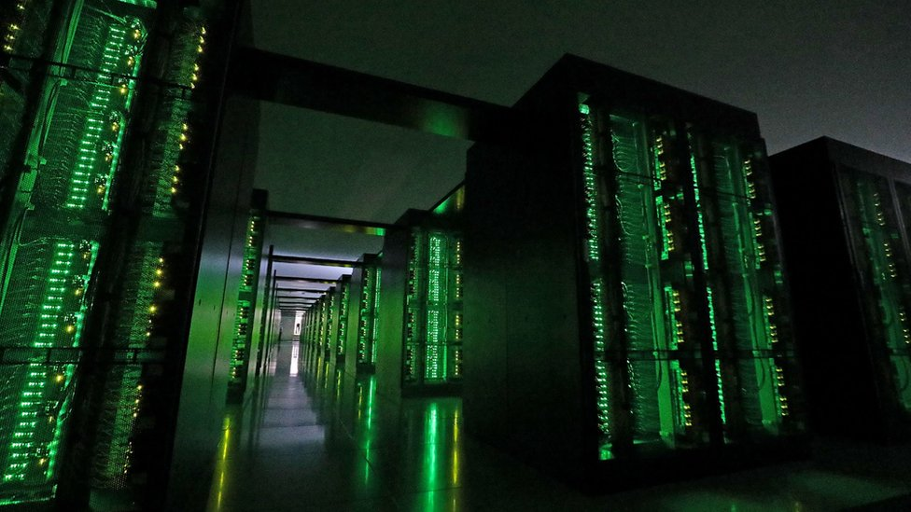
The
Ultimate SuperComputing-on-a-Chip for Acceleration of
Massive Big Data and Highly Iterative Algorithms
Veljko Milutinović
Special Thanks to Oskar Mencer, Honorary Treasurer of Academia Europaea

Slide 3
Classification of Acceleration Approaches (12):
Criteria: Technology + Paradigm
T=NOT + P=NOT (2): Brute Force
Faster silicon + more cores (Multicore CPUs + Manycore GPUs)=> . Memory-oriented vs Messaging-oriented progModels (DSM + MPC)
T=YES + P=NOT (2): Reincarnated progModels
GaAs3rd5th(vonNeumannISA85)/CdTe2nd6th(TuringMachine)=>
ControlFlow for Special Missions (SpeedUp + RadiationHardness)
T=NOT + P=YES (4): ExecutionGraph progModels for min/max edges
Silicon + DataFlow (MaxDFE + GoogleTPU) or DataFly (IoT/WSN)
Programming models based on creation of topological computing!
T=YES + P=YES (4): Creating New Algebras for New Basic Operations
PhysMat (Optical + Quantum) + BioChem (Chemical + Molecular)
Programming models based on creation of new algebras!
Creativity: From Turing and vonNeumann till Łukasiewicz and Hinton.
3/56

Slide 4
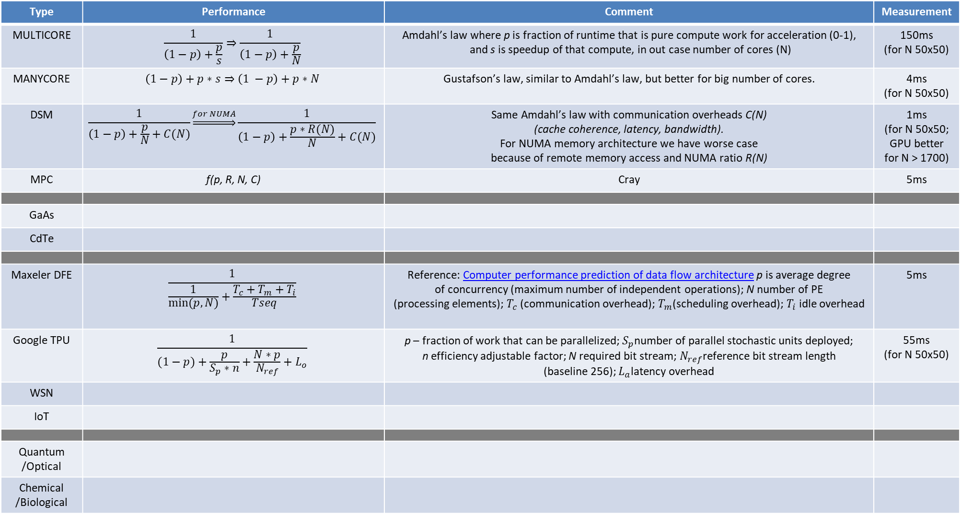
Analysis of the Algorithm X in the Context of Selected Emerging Computing Paradigms:
[Acceleration vs Entrepreneurship, A vs E]
Type | Performance | Comment | Measurement
MULTI CORE |  | Amdahl’s law where p is fraction of runtime that is pure compute work for acceleration (0-1), and s is speedup of that compute, in out case number of cores (N) | 100ms (for N 50x50)
MANY CORE |  | Gustafson’s law, similar to Amdahl’s law, but better for big number of cores. | 4ms (for N 50x50)
DSM |  | Same Amdahl’s law with communication overheads C(N) (cache coherence, latency, bandwidth). For NUMA memory architecture we have worse case because of remote memory access and NUMA ratio R(N) | 2ms (for N 50x50; GPU better for N > 1700)
MPC | f(p, R, N, C) | Cray | 1ms
Orthodox approaches!
4/56

Slide 5
GaAs | Σπ | Von Neumann
GaAs CdTe | lim Σπ vs proto | vonNeumann vs Turing | 100ns
Maxeler DFE |  |  | 10ns
Google TPU |  |  | 1ns (for N 50x50)
IoT | SP |  | 10ps
WSN | lim SP |  | 1ps
Quantum /Optical | α | Ivan Boskovic, Stefan Bukorovic, Mladen Colakovic, Vuk Djordjevic, David Milinkovic | 1fs (femtosec)
Chemical /Biologic | β | Nikola Nikolic, Lazar Radosavljevic, Nikola Ristic, Pavle Sarenac, Uros Savurdic | 1as (attosecs)
Unorthodox approaches!
5/56

Slide 6
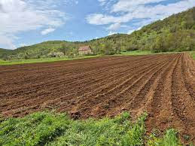
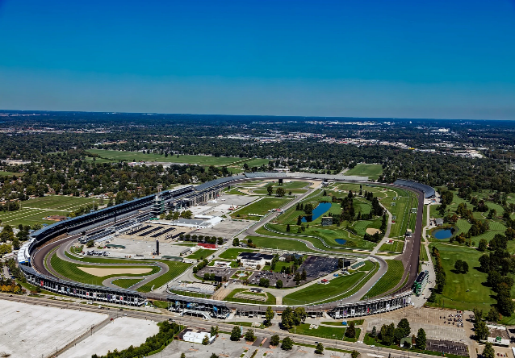


Research: QC vs GaAs vs DF vs ALL
[Synergizing the Paradigms: 12A + 12E]
DARPA [A12]
A16Z [E12]
6/56

Slide 7
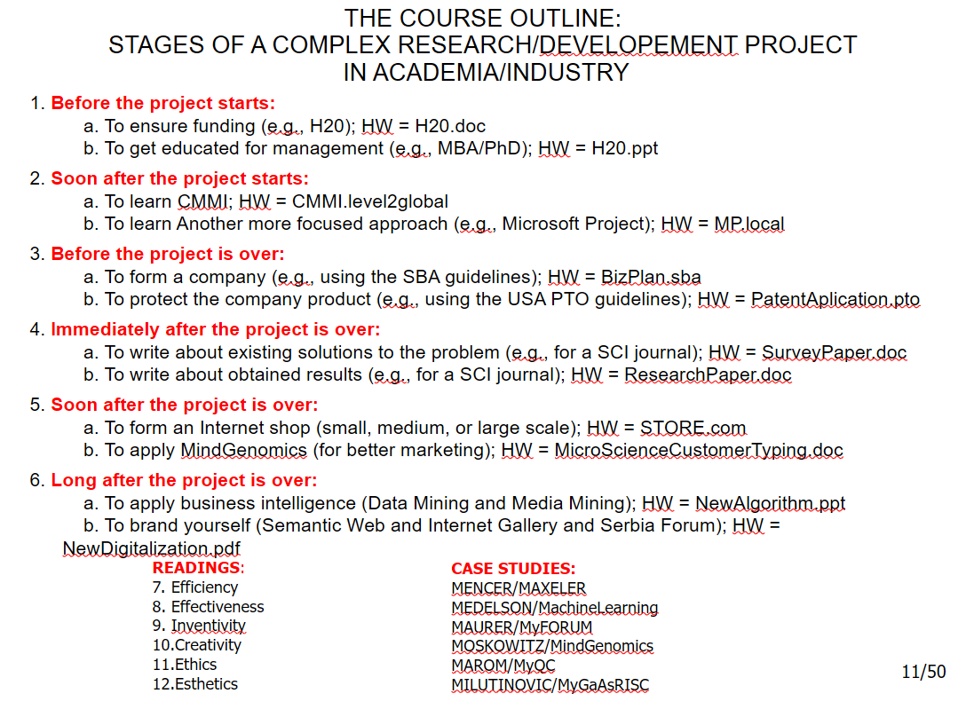
ENTERPREUNERSHIP:
7/56

Slide 8

8/56

Slide 9
One Good Strategy!
NSF/H30
MBA/MSc/PhD/PhEng
hw=b1/b2
9/56

Slide 10
One Good Strategy!
NSF/H30
MBA/MSc/PhD/PhEng
hw=b1/b2
CMMI
AgileMethods
10/56

Slide 11
One Good Strategy!
NSF/H30
MBA/MSc/PhD/PhEng
hw=b1/b2
CMMI
AgileMethods
hw=e1/e2
SBA/A16Z
PTO
11/56

Slide 12
One Good Strategy!
NSF/H30
MBA/MSc/PhD/PhEng
hw=b1/b2
CMMI
AgileMethods
hw=e1/e2
SBA/A16Z
PTO
SCI.Surveys
SCI.Research
12/56

Slide 13
One Good Strategy!
NSF/H30
MBA/MSc/PhD/PhEng
hw=b1/b2
CMMI
AgileMethods
hw=e1/e2
SBA/A16Z
PTO
SCI.Surveys
SCI.Research
eShop
MindGenomics
13/56

Slide 14
One Good Strategy!
NSF/H30
MBA/MSc/PhD/PhEng
hw=b1/b2
CMMI
AgileMethods
hw=e1/e2
SBA/A16Z
PTO
SCI.Surveys
SCI.Research
eShop
MindGenomics
DataMining
HeritageBranding
hw=i1/i2
14/56

Slide 15
One Good Strategy!
NSF/H30
MBA/MSc/PhD/PhEng
hw=b1/b2
CMMI
AgileMethods
hw=e1/e2
SBA/A16Z
PTO
SCI.Surveys
SCI.Research
eShop
MindGenomics
DataMining
HeritageBranding
hw=i1/i2
Lloyd
Drucker
Inventivity
Creativity
15/56

Slide 16
Acronyms
NSF = National Science Foundation
H30 = Horizon 2030
MBA = Master of Business Administration
CMMI = Capability Maturity Model Integration
SBA = Small Business Administration
A16Z = Andreessen Horowitz
PTO = Patent and Trademark Office
SCI = Science Citation Index
STREP = Specific Targeted Research Projects
IP = Integrated Projects
GRE = Graduate Record Examinations
GMAT = Graduate Management Admission Test
JBD = Springer Journal of Big Data
PAMI = IEEE Transactions on Pattern Analysis and Machine Intelligence
16/56

Slide 17
1: NSF/H20/CALLn/ClosingDate/E1M->E4M(STREP)/E40M(IP)
CH (challenges)
15=ST(5)+MF(5)+ED(5)
12
10
1:1
PP (proposal) ST
OBJ (objectives)
OBJ₁-OBJ_{Y} [SC (success criteria)_{1-N}]
1:1
1:1
WP (work packages)
WP₀-WP_{Y} [MM (measurable milestones)_{1-N}]
1:M
Legend:
ST = Science + Technology
MF = Management + Finances
ED = European Dimension
Tasks
1:K
Deliverables
If x>=10 and each{ST,MF,ED}>=3
Then: E10K, if leader
E4K, if WP leader
E1K, if partner
Risks must be elaborated! Why?
Case studies: Moyers + Mencer
17/56

Slide 18
2: GRE/GMAT (MBA/PHD)
Verbal reasoning (input),
important for teaching schools
Quantitative reasoning (CPU);
tough to compete with zillions
Analytical writing (output),
important for research schools
Why?
Case studies: Marinov + Mojsilovic
18/56

Slide 19
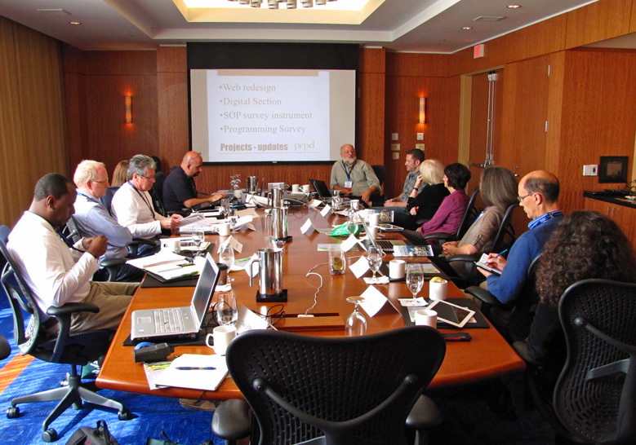
3: Pro Life Management
The holistic approach: CMMI by CMU
Case studies:
Singapore + Raiffeisen
Legend:
CMMI = Capability Maturity Model Integration
19/56

Slide 20
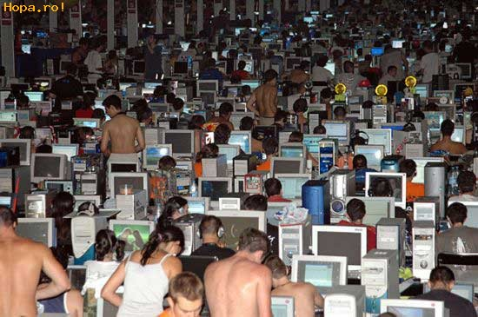

4: Pro Life Management
The specific approach: Agile Methodologies
Case studies of methodologies:
Scrum + Kanban
Case studies of tools:
Trello + Jira (a truncation of “Gojira”)
20/56

Slide 21
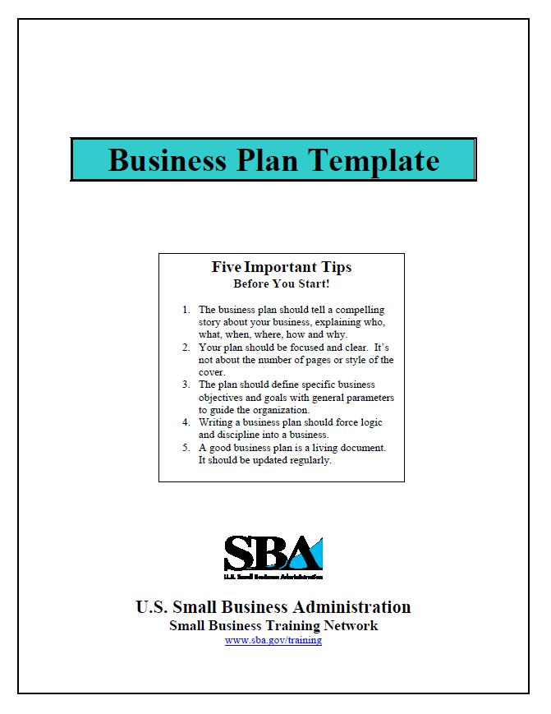
5: Harvard Business Plan Template
Case studies of methodologies:
Venture Capital + Business Angel
Case studies of successes:
Endeca + SupplyFrame
21/56

Slide 22
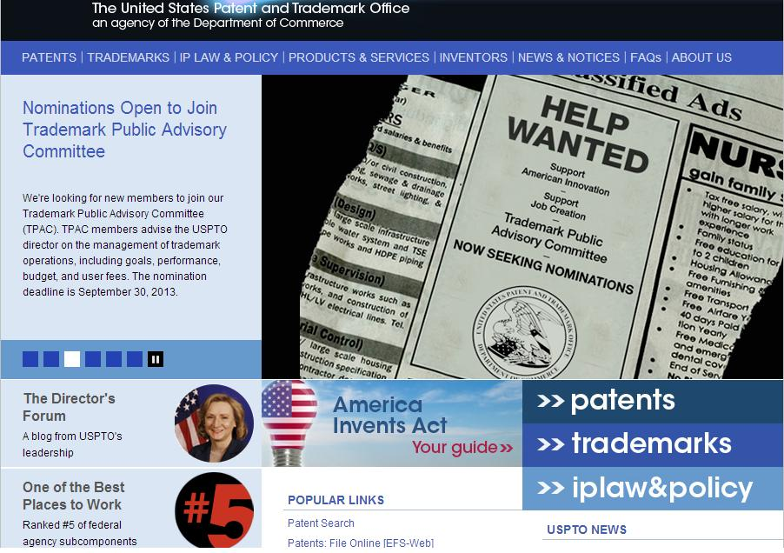
6: US Patent and Trademark Office
Case studies:
Marvel + ModComp
22/56

Slide 23
7: WRITING A SURVEY/OVERVIEW PAPER
23/56
Good method .ppt
Over one billion hits at Google

Slide 24
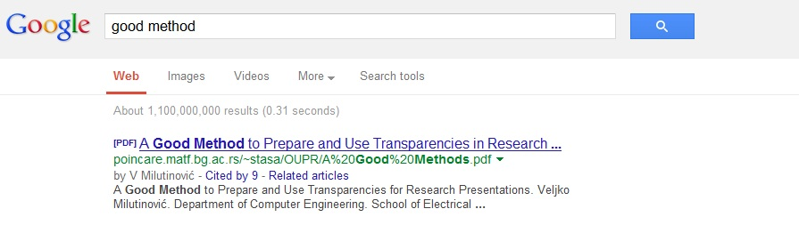
7: WRITING A SURVEY/OVERVIEW PAPER
02.10.2013
Case studies:
Tafa + Capuni / ETF + MATF
24/56
Good method .ppt [ACM/CSUR]
Over one billion hits at Google

Slide 25
8: WRITING A RESEARCH/DEVELOPMENT PAPER
Best method .doc
Over one million hits at Google
Major points:
  Problem statement
  Existing solutions
  Proposed solution
  Rigorous analysis
  (better, for how much, under what conditions, and performance/price)
Nota Bene:
  Better
  For how much
  Under what conditions
  Not more complex
Case studies:
Springer JBD + Springer NMI
Also:
VIPSI Conferences + IPSI Transactions
25/56

Slide 26
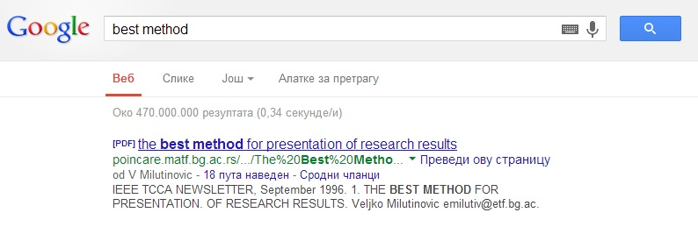
8: WRITING A RESEARCH/DEVELOPMENT PAPER
Best method .doc
Over one million hits at Google
02.10.2013
Case studies:
ACM/CSUR + IEEE/ACCESS
26/56

Slide 27
9! How to Make Your Own E-Commerce Site: Step by Step
YAHOO! Store
  The easiest way to make your business Internet-enabled,
  effective and efficient.
ecBuilder
  Software package, intended for more advanced eCommerce solutions,
  still very easy to use.
Microsoft Site Server Commerce Edition
  The most powerful tool,
  for the large and most advanced e-commerce solutions.
Case studies:
Hermann Maurer Forum Technologies
27/56

Slide 28
10: MindGenomics and LinearRegression
Case studies by Howard Moskowitz:
Horizontal Segmentation + Mind Genomics + Bimi Leap + Splendid Montenegro
Phase#1: Determining mind types
Phase#2: Value exchange offers
Phase#3: Public domain cloud
Phase#4: Dissemination
28/56

Slide 29
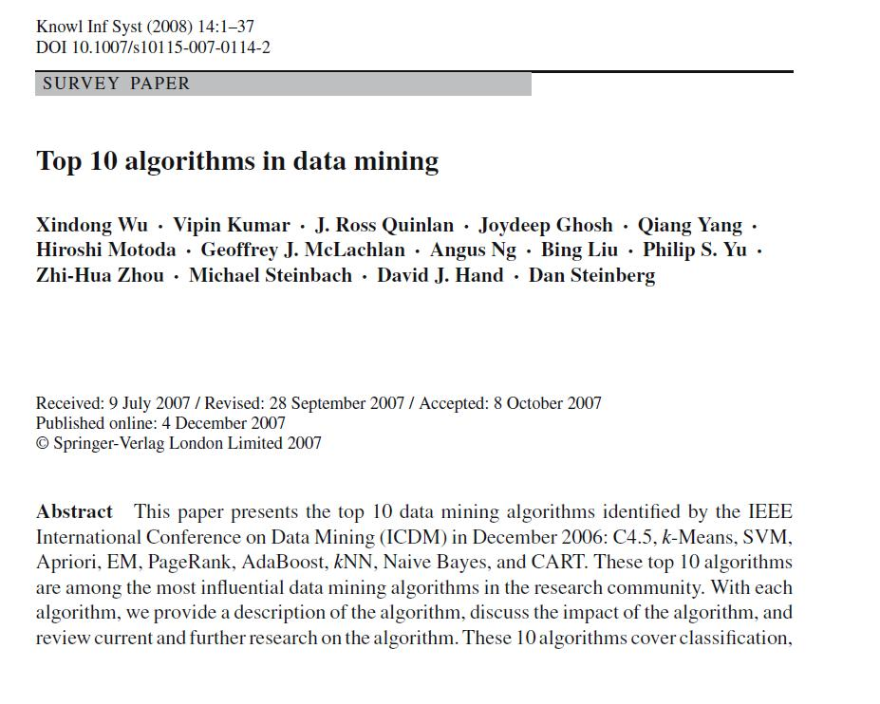
11: DataMining
Case studies:
SemanticWeb + HeritageMining JPMorgan + BlackRock
29/56

Slide 30

12: Making a Brand
Case studies of methodologies:
Transposed Branding + Terra Incognita
Case studies of successes:
Qualcomm Aleksic + Intel Scepanovic
30/56

Slide 31
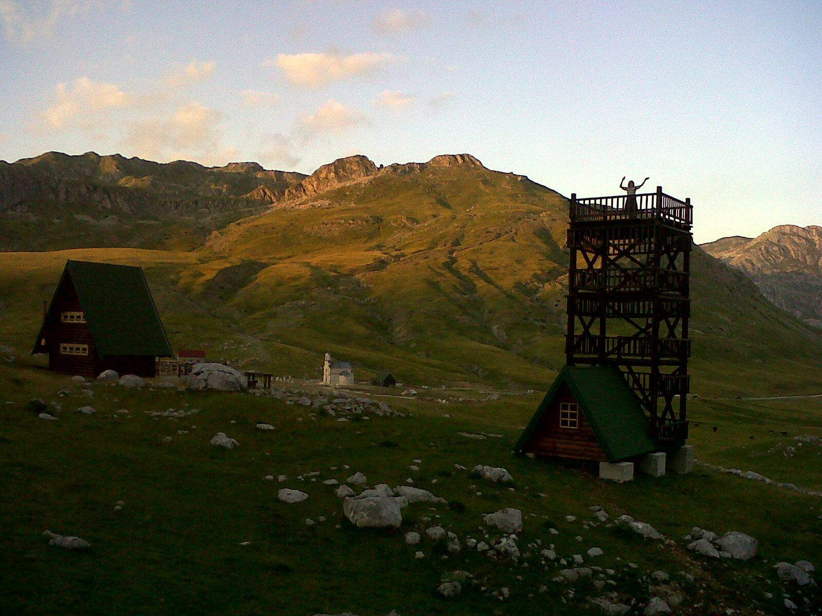

Slide 32
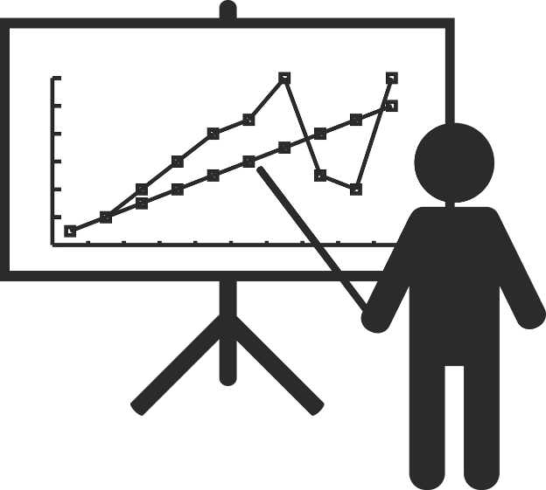
.ppt Presentations:
Conditio Sine Qua Non (4)
n/N
One picture is worth one thousand words!
One animation is worth one thousand pictures!
Semantic breaks (one line - one thought): 80 + 10 + 10
32/56

Slide 33
Semantic Breaks: An Example (Bad)
Research Issues of Importance for Distributed
Shared Memory
Hardware Issues (those to be fully
implemented in hardware)
Software Issues (those to be fully
implemented in software)
Hybrid Issues (those to be partially
implemented in hardware and partially in software)
33/56

Slide 34
Semantic Breaks: An Example (Good)
Research Issues of Importance
for Distributed Shared Memory
Hardware Issues
(those to be fully implemented in hardware)
Software Issues
(those to be fully implemented in software)
Hybrid Issues
(those to be partially implemented in hardware
and partially in software)
34/56

Slide 35
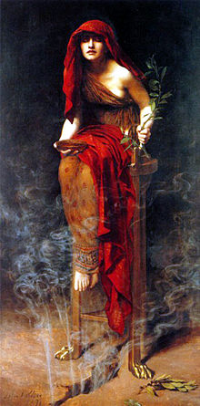
Priestess of Delphi: Pythia
Ibis, redibis nunquam,
in belo peribis
Ibis, redibis,
nunquam in belo peribis
35/56

Slide 36
Romeo and Juliet: Prologue
Two households, both alike in dignity,
In fair Verona, where we lay our scene,
From ancient grudge break to new mutiny,
Where civil blood makes civil hands unclean.
From forth the fatal loins of these two foes
A pair of star-cross'd lovers take their life;
Whose misadventured piteous overthrows
Do with their death bury their parents' strife.
The fearful passage of their death-mark'd love,
And the continuance of their parents' rage,
Which, but their children's end, nought could remove,
Is now the two hours' traffic of our stage;
The which if you with patient ears attend,
What here shall miss, our toil shall strive to mend.
36/56

Slide 37
What is Better?
function DayOfWeek(day, month, year) {
var a = Math.floor((14 - month) / 12);
var y = year - a;
var m = month + 12 * a - 2;
var d = (day + y + Math.floor(y / 4) - Math.floor(y / 100) +
Math.floor(y / 400) + Math.floor((31 * m) / 12)) % 7;
return d;
}
37/56

Slide 38
What is Better?
function DayOfWeek(day, month, year) {
var a = Math.floor((14 - month) / 12);
var y = year - a;
var m = month + 12 * a - 2;
var d = (day + y + Math.floor(y / 4) - Math.floor(y / 100) +
Math.floor(y / 400) + Math.floor((31 * m) / 12)) % 7;
return d;
}
function DayOfWeek(day, month, year) { var a = Math.floor((14 - month) / 12); var y = year - a; var m = month + 12 * a - 2; var d = (day + y + Math.floor(y / 4) - Math.floor(y / 100) + Math.floor(y / 400) + Math.floor((31 * m) / 12)) % 7; return d;}
38/56

Slide 39
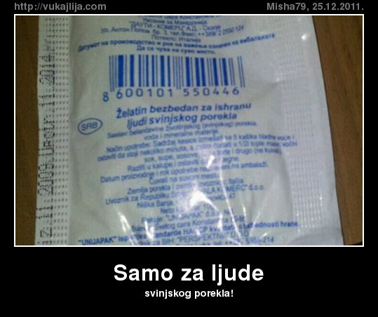
Gelatin safe for people of pork origin ☺
39/56

Slide 40
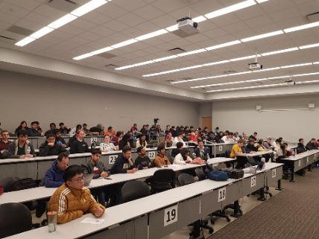
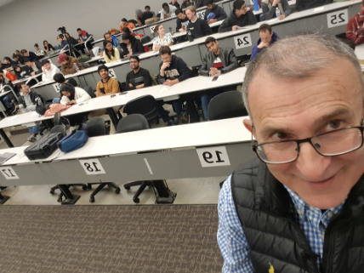
SOME PREVIOUS OFFERINGS OF THESE COURSES
Previous offerings of the related TECH course:
Purdue, Indiana, Harvard, Stanford, MIT, UC Berkeley, Barcelona, Siena, Ljubljana, ETH
40/56
Purdue
Indiana
Dartmouth
Harvard
Barcelona
Salerno
Ljubljana
Podgorica

Slide 41
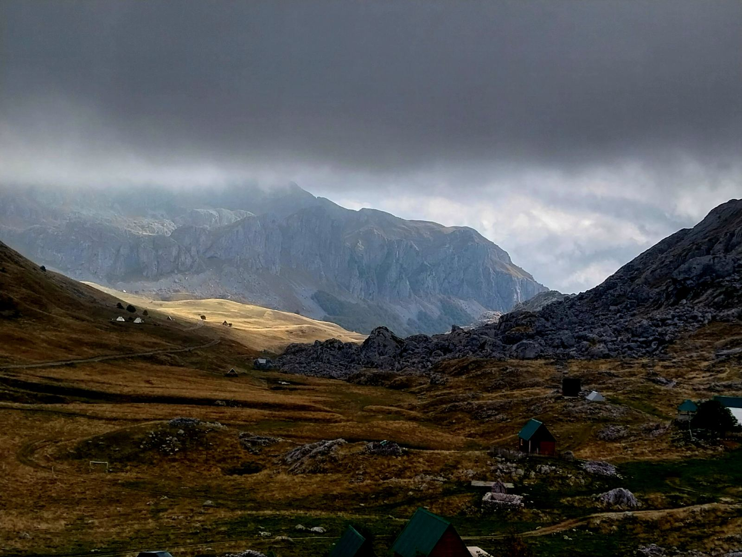

Slide 42
Ten
Idea Generation Methods
42/56

Slide 43

Mendeleyevization:
Inductor versus Catalyst
(M1 vs M2)
Definition:
If one of the classification class includes no examples,
it first has to be checked why is that so.
If it is so because it makes no sense, an appropriate explanation is in place.
If it is so because the technology or the applications are not yet ready
for such an approach, one can act in the same way as the famous chemists Mendeleyev:
Empty positions in any classification are potential avenues leading to new inventions.
We refer to such an approach as: Mendeleyevization.
Examples:
As far as M1/M2, the famous classification of computer systems by Mike Flynn
(SISD, SIMD, MISD, MIMD) initially included no examples of the MISD type.
Later on, a DFT machine (generated using the M1 method)
was categorized as an MISD machine [Milutinovic86A],
as well as one pipelined machine (generated using the M2 method),
namely [Milutinovic87C];
the DFT served as an inductor, and pipeline as a catalyst.
Other popular examples are related to various signal processors and process accelerators.
A: Mendeleyevization (Inductor versus Catalyst) – M1 vs M2
43/56
Notes:
43

Slide 44
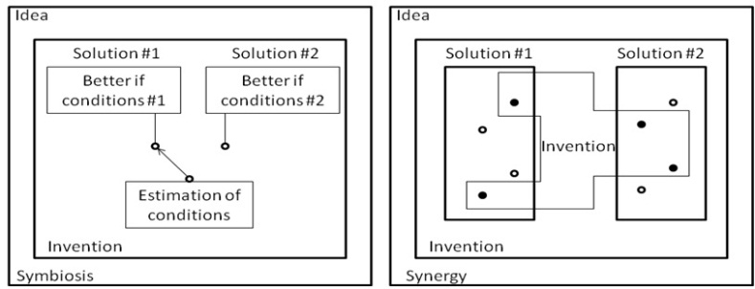
Hybridization:
Symbiosis versus Synergy
(H1 vs H2)
Definition:
Sometimes two classification classes can be combined,
in order to obtain a hybrid solution (hybridization).
Hybrid solutions can be symbiotic (measuring the conditions in the environment
and switching from one approach to the other, so that each approach is active all the time,
while the conditions are such that it provides better performance compared to the other approach)
or synergistic (creating a new approach, which, for each particular solution element
takes the better solution element of two different approaches).
Examples:
As far as H1/H2, the essence of [Milutinovic85] is that two algorithms are combined into one
on the either-one-or-the-other basis (using the H1 method),
and on a combine-inherent-details basis (using the H2 method) in [Milutinovic87B].
Other popular examples include hybrid computers
or computers that use special purpose accelerators,
when appropriate data/process patterns are located.
B: Hybridization (Symbiosis versus Synergy) – H1 vs H2
44/56

Slide 45
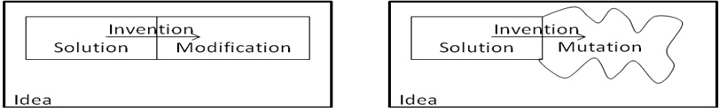
Transdisciplinarization:
Modifications versus Mutations (T1 vs T2)
Definition:
Often times, good new ideas get generated if algorithms, procedures,
ways of thinking, re ported from one field to another field,
along the lines of transdisciplinary research methodologies (transdisciplinarization).
Examples:
As far as T1/T2, [Milutinovic86B] ports algorithms from Silicon to GaAs (using the T1 method),
and introduces appropriate modifications along the process,
while [Milutinovic87A] creates a proposal for a novel computer architecture
(using the T2 method),
along the analogies with a biological honeycomb.
Other popular examples include porting of the FFT
from seismic signal processing to speech signal processing
(modification),
or introduction of mathematical neural networks inspired by biological neural networks (mutation).
C: Transdisciplinarization (Modification versus Mutation) – T1 vs T2
45/56

Slide 46
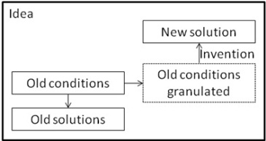
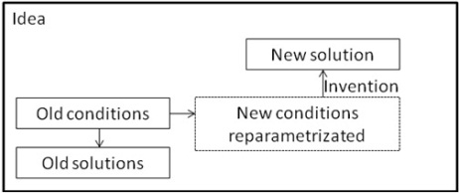
Remodelling:
Granularization versus Reparametrization (R1 vs R2)
Definition:
Sometimes it is simply the best to take a research direction different (even opposite)
compared to what others take (retrajectorization using remodeling).
The different (opposite) research direction makes sense either if a more detailed set of parameters is in place (granularization, due to model changes because of application changes),
or because parameters of the environment have changed permanently
(reparametrization, due to model changes because of technology changes).
The two alternatives are referred to as granularization and reparametrization.
Examples:
As far as R1/R2, [Milutinovic88] offers a new algorithm (using the R1 method)
that makes sense if an environment is represented with a more detailed model,
while [Milutinovic89] offers a new solution in a changed environment (using the R2 method),
when a design has to be ported from Silicon to GaAs
(from the performance/price point of view, the best adder design for Silicon, the carry-lookahead adder,
is among the worst ones for GaAs, and the opposite: the worst adder for Silicon, the ripple-carry adder,
is among the best ones for GaAs; this is because GaAs gate delays depend on fan-out
and ripple-carry adders are characterized with only the minimal fan-out,
while the fan-out of the carry-lookahead adders depends on the word size, and can grow infinitely).
Other popular examples are related to concept modeling in AI based on graphical representation with icons
(in a model with fewer icons, one can make a conclusion which is different, and often times even opposite, compared to a conclusion made from a model with a much larger number of icons);
also, when the environment changes (for example, the ratio of processing speed to communication speed changes), a different type of supercomputing network becomes optimal.
D: Remodeling (Granularization versus Reparametrization) – R1 vs R2
46/56

Slide 47

Unorthodoxization:
ViewFromAbove versus ViewFromInside
(U1 vs U2)
Definition:
This category encompasses the approaches that are difficult to classify:
Sometimes one sees something that others did not see for decades or centuries (ViewFromAbove)
or one gets stroked by an idea of a genius with no ground in existing research (ViewFromInside).
Examples:
As far as U1/U2, [Milutinovic2000] generated an innovation
after trying to make a holistic view (U1),
and [Milutinovic2001] introduces an idea after an effort is made
to understand the intrinsic details of the problem (U2).
Other popular examples include the contributions
of Nobel Laureates Martin Perl and Jerome Friedman.
E: Unorthodoxization (ViewFromAbove versus ViewFromInside) – U1 vs U2
47/56

Slide 48
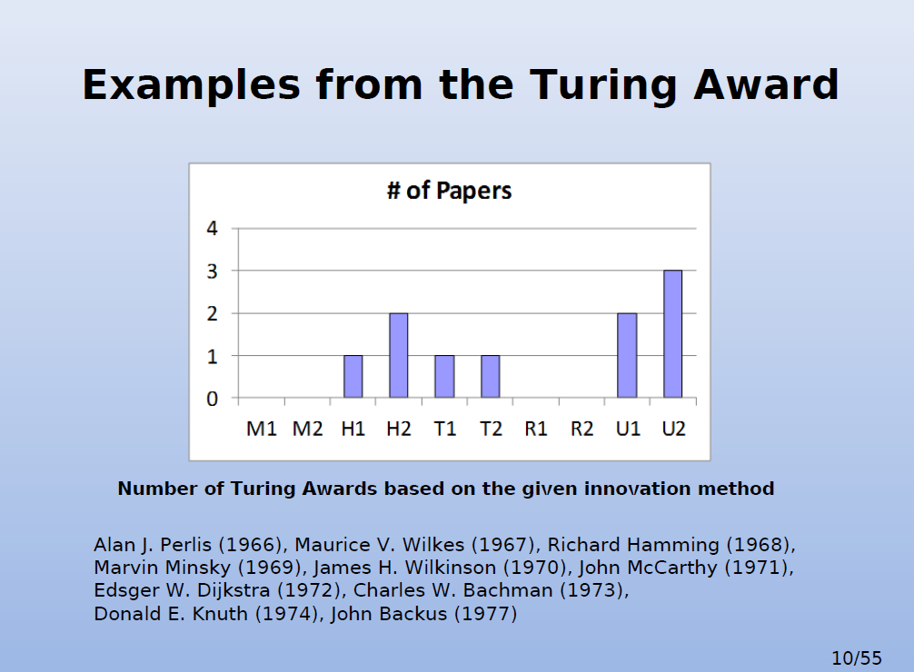
48/56

Slide 49
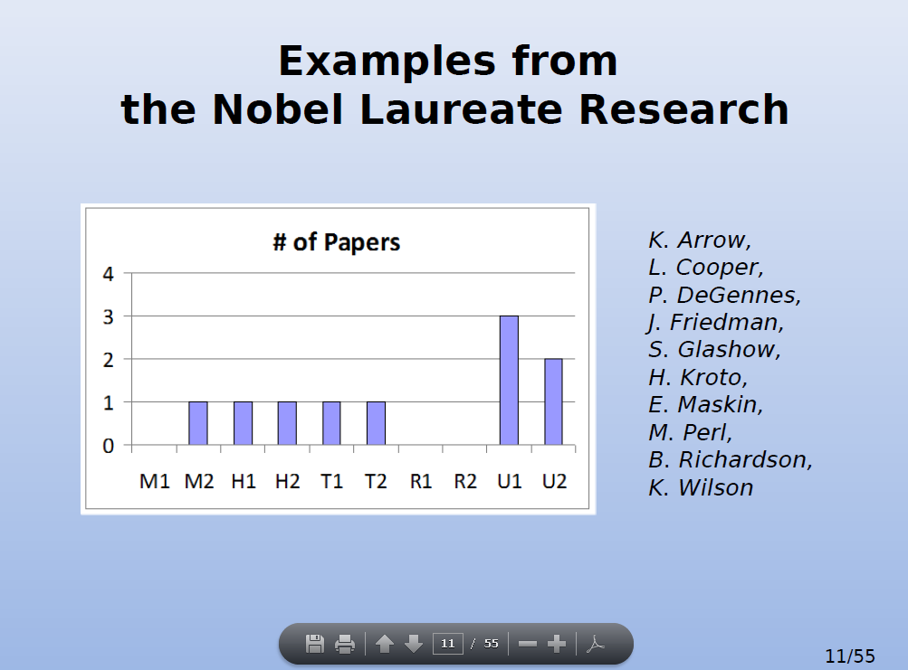
49/56

Slide 50
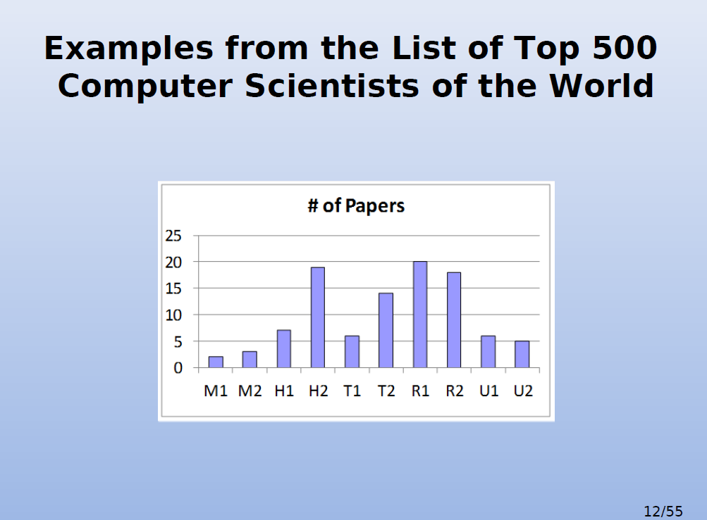
50/56

Slide 51
INSPIRED BY FORMER STUDENTS OF BELGRADE UNIVERSITY:
Vice Presidents or Executive Directors at major USA industries:
JPMorgan (#1 Bank worth $100B) Executive Directors:
Marko Jevremovic, PMF + Jelena Skulic, ETF
BlackRock (#1 Portfolio company worth $40T) VP:
Mladen Laudanovic, PMF + Dusan Misic, SRB
StateStreet (#2 Portfolio company worth $10T) Ontology exPD:
N.K., PMF, ETF, FON
Vanguard Group (#1 in indexed founds):
X.Y.
Qualcomm (#1 in MobilePhones Chips) VP:
Milivoje Aleksic, ETF
Intel (#1 in SuperComputing Chips) VP:
Ranko Scepanovic, PMF
NCR (#1 Technology support for banking worth $2B2) VP:
Dragan Budic, ETF
IBM (#1 in MainFrames):
Marija Zivanovic, ETF
AMD (#1 in HighEnd Gaming):
Andrej Zdravkovic, ETF
HP Labs (SustainableComputing):
Dejan Milojicic, ETF
Endeca (#1 in Acquisition for Data Base eng = $1075 million) CF:
Dejan Mircevski, ETF
SupplyFrame (#1 in Acquisition for Data Supply eng = $800M) CF: Aleksandar Bradic, ETF
Nordeus (#1 in FB Gaming, $370M) VP and CF:
Branko Milutinovic, ETF
ModComp (#1 in Special Medical Support):
Borko Furht, ETF
Records in Patenting:
Kavcic, ETF (#1 in illegal patenting for eng and phy): Marvel $1.2 billion
Bozovic, PMF (#1 in legal patenting for eng and phy): Varian $?
Furht, ETF (#1 in the number of patents activated for eng - over 100): $?
S.M., ETF (#1 for in-company patent awards for eng): $?
Professors at Top 10 Schools in USA for CS and CE:
Ilic, ETF, MIT
Djordjevic, PMF, Harvard
Kovacevic, ETF, CMU
Marinov + Mojsilovic, ETF, UIUC
Vujic + Nikolic, ETF, UC Berkeley
Mencer, Stanford
Ercegovac + Potkonjak + Mirkovic, ETF, UCLA
Mirkovic, ETF, USC
Gligoric, ETF, Texas
Milutinovic, ETF, Purdue
51/56

Slide 52
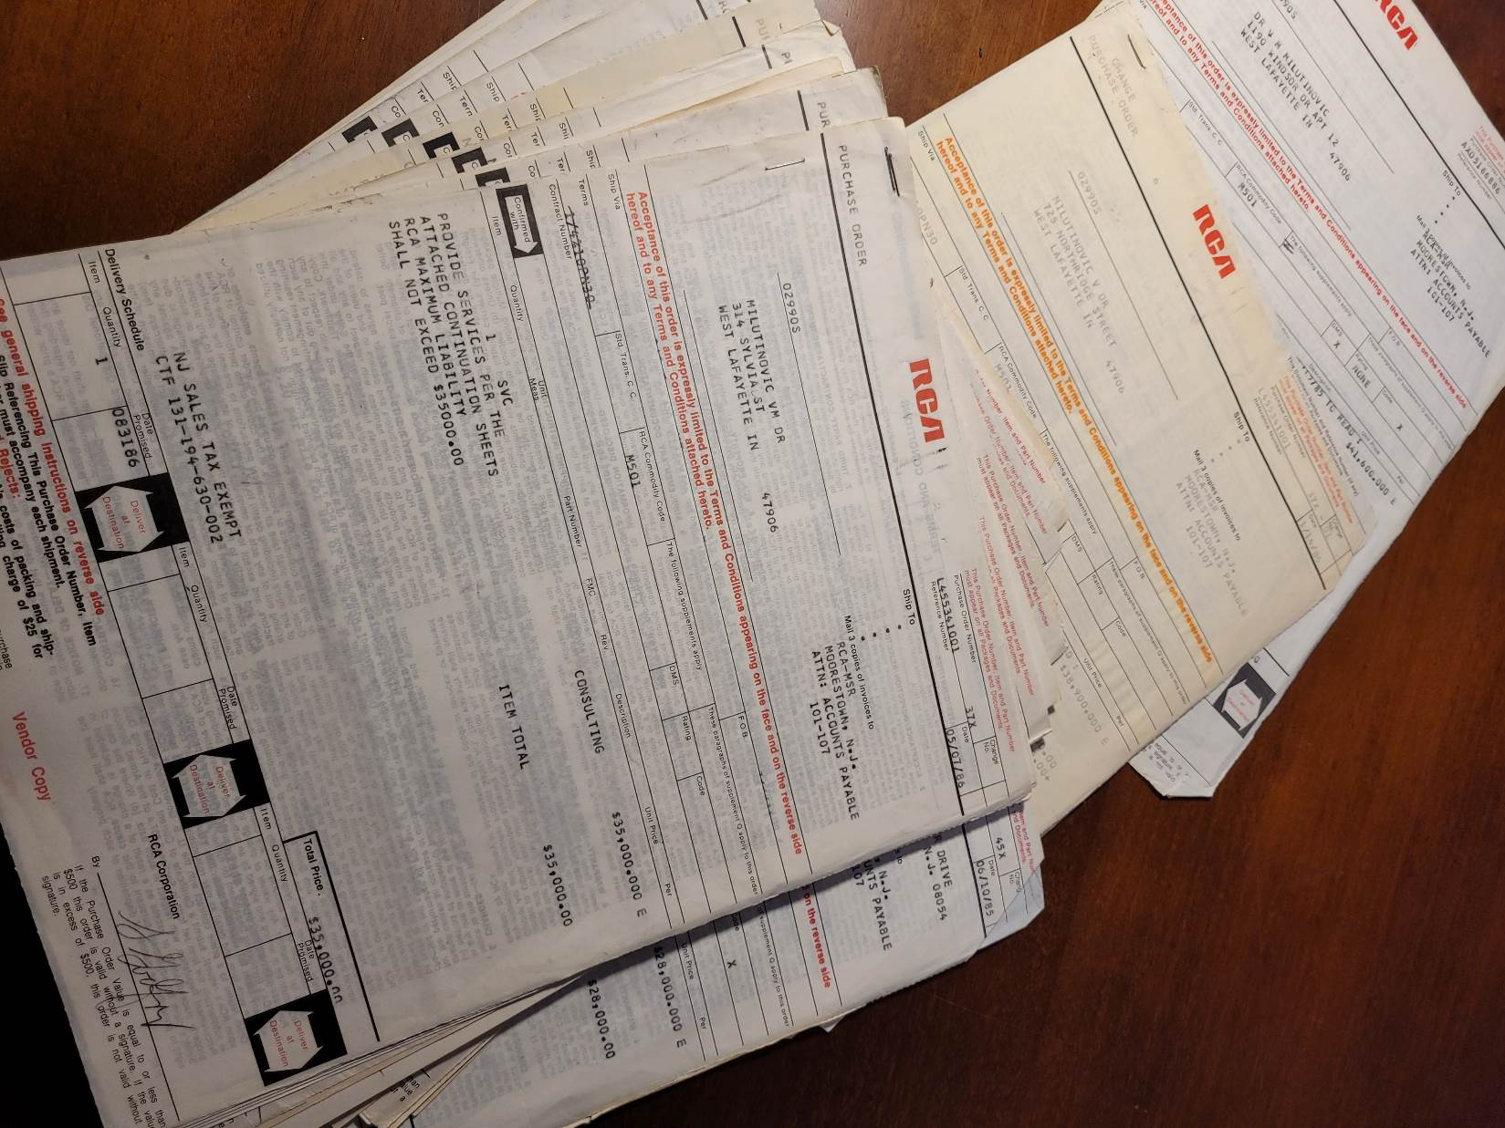
Purchase Orders from A to Z
Learn How to Position Yourselves
AI + QC
52/56

Slide 53
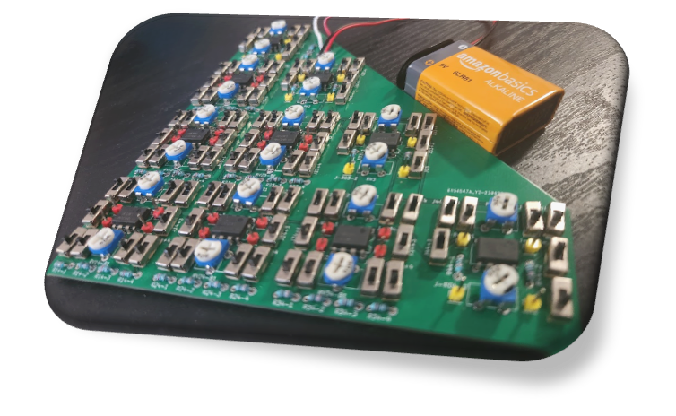
Near Instantaneous O(1) Analog Solver for Linear Symmetric Systems of Equations
… and some extremely talented students of Purdue, e.g. Fura (GaAs) and Abdelaleim (DataFlow):
… or Analog DataFlow
Osama Abdelaleim, Purdue University (osama.mo.hashem@gmail.com)
Arun Prakash, Purdue University
Ayhan Irfanoglu, Purdue University
Veljko Milutinovic, University of Belgrade
This technology is the subject of
  U.S. Provisional Patent Application No. 63/690,322, filed on September 4, 2024.
  U.S. Provisional Patent Application No. 63/839,979, filed on July 8, 2025.
53/56

Slide 54
Acknowledgments
Gerhard Klimeck, VP Purdue,
Enterpreneurship,
Director of the ECE EE694
Arun Prakash, PD Purdue,
Acceleration,
Director of the CIGPs
ECE = Electrical and Computing Engineering
CIGPs = Computational Interdisciplinary Graduate Programs
54/56

Slide 55


Instead of the Conclusion
… all these young people
would probably do a lot better
had they not taken these courses.
Tesla and Pupin didn’t take these courses;
at their young age
they were shepherds …
The story about email and cleaning ;)
55/56

Slide 56
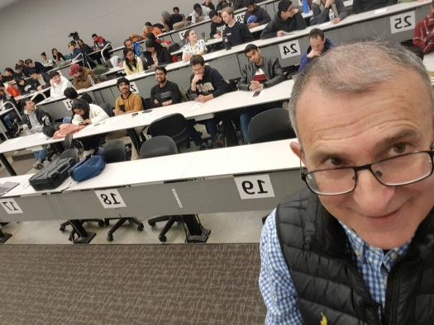
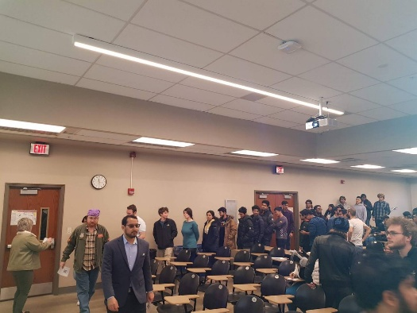
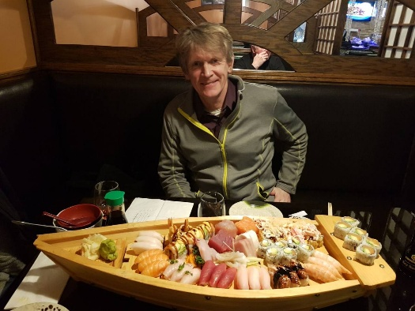
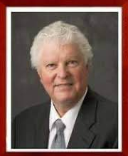
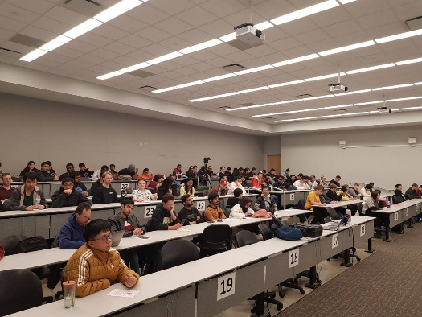
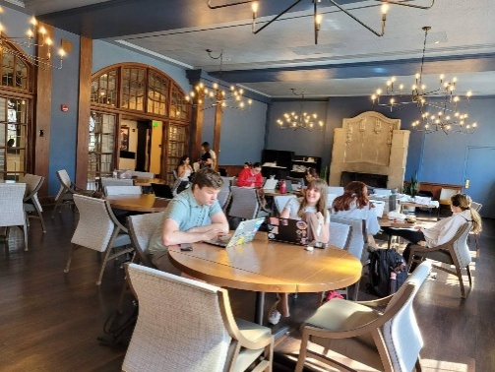
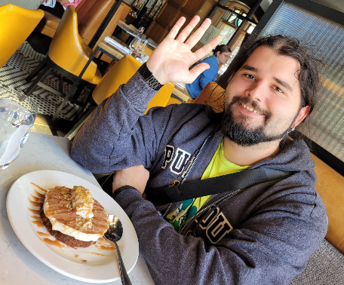
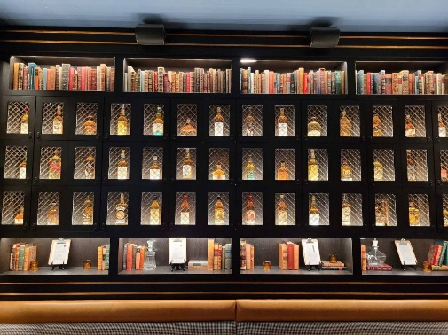
Classrooms
Breaks
Dinners
Wisdoms
56/56

Slide 57


