Slide 1
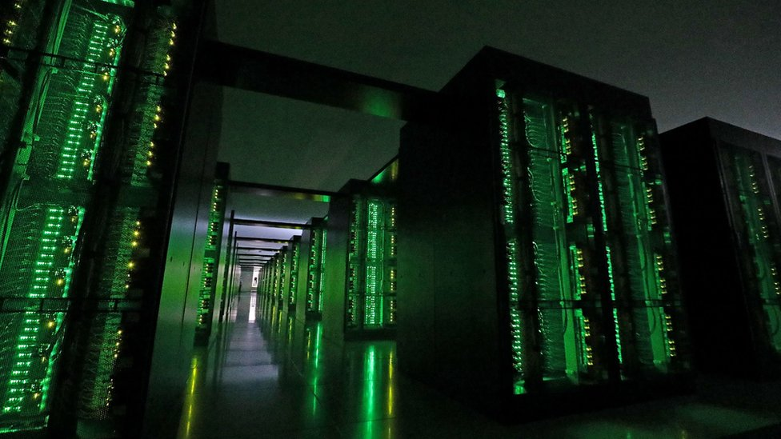
The
Ultimate SuperComputer-on-a-Chip for Acceleration of
Massive Big Data and Highly Iterative Algorithms
Veljko Milutinović
Special Thanks to Oskar Mencer, Honorary Treasurer of Academia Europaea

Slide 2
Classification of Acceleration Approaches:
Criteria: Technology change + Paradigm change (Purdue and IU + ETF and MATF)
T=NOT + P=NOT:
Faster silicon + more cores (Multicore CPUs + Manycore GPUs)
+ more memory (DSM + MPC)
T=YES + P=NOT:
3rd5th(GaAs)/2nd6th(CdTe) + ControlFlow (SpeedUp + RadHardness)
T=NOT + P=YES:
Silicon + DataFlow (MaxDFE + GoogleTPU) or DiffusionFlow (WSN/IoT)
T=YES + P=YES:
PhysMat (Optical + Quantum) + BioChem (Chemical + Molecular)
However, I/O for QCs is semiconductor-based, which undermines the pros of QCs:
Speed + RadHard! Is GaAs the solution? Is GaAs alone the solution?
2

Slide 3
DARPA: GaAs for Star Wars and Quantum Computing (1)
Mapping of High Level Languages directly onto hardware, for minimizing of wiring:
The Vertical Migration Architecture
1985 (after the first ideas and a 1Y/2Y ban):
Milutinovic, V. and Lopez-Benitez, N.,
“A GaAs-based Microprocessor Architecture for Real-Time Applications,”
IEEE Transactions on Computers, 100(6), 714-727, 1987.
1985 (after a rigorous analysis and a 1Y/2Y ban):
Milutinovic, V.,
“A simulation study of the Vertical-Migration Microprocessor Architecture,”
IEEE Transactions on Software Engineering, (12), 1265-1277, 1987.
Why GaAs? Trapped Ion and Topological Qubits QCs are rad-hard – GaAs, also + faster than Si!
However, according to Richard Feynman, wiring is the major “killer” of GaAs advantages! RCA

Slide 4
DARPA: GaAs for Star Wars and Quantum Computing (2)
For eliminating of wiring in interconnection networks and data processing:
The Cellular Honeycomb Architecture
1989 (after the first ideas and a 4Y ban):
Milutinovic, V.,
“Mapping of Neural Networks on the Honeycomb Architecture,”
Proceedings of the IEEE, 77(12), 1875-1878, 1989.
2025 (after a rigorous analysis and a 40Y ban):
Milutinovic, V., Milutinovic, D., Furth, B.,
“On Mapping of Topological Structures and Mathematical Algorithms
onto Specialized Architectures for Graph-Based Computing,”
Springer, JBD, 2025/2026 (TBP).
Note: According to Richard Feynman, GaAs is best utilized if synergized with DataFlow!

Slide 5
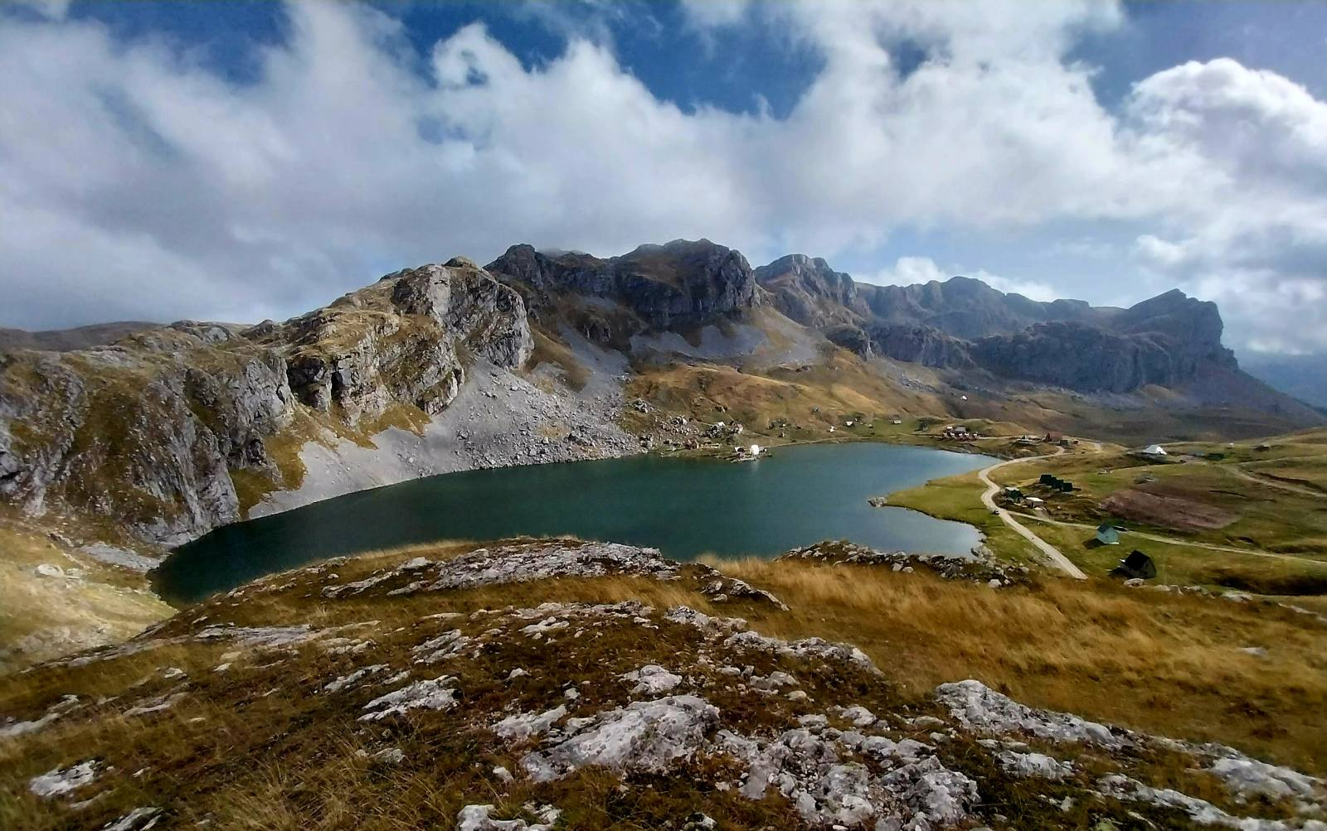

Slide 6
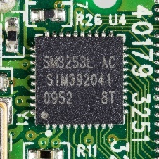
DataFlow: New Paradigm Badly Needed for GaAs, etc…
NOT to Substitute,
BUT to Supplement!
The First FineGrain DataFlow Idea: Proceedings of the IEEE
The First FineGrain DataFlow Implementation: Communications of the ACM
Milutinovic, V. (1989).
Mapping of neural networks on the honeycomb architecture.
Proceedings of the IEEE, 77(12), 1875-1878.
Flynn, M. J., Mencer, O., Milutinovic, V., Rakocevic, G., Stenstrom, P., Trobec, R., & Valero, M. (2013).
Moving from petaflops to petadata.
Communications of the ACM, 56(5), 39-42.
Internal Delays as Short as Absolutely Possible (next: DF as the GaAs enabler, then GaAs)
6

Slide 7
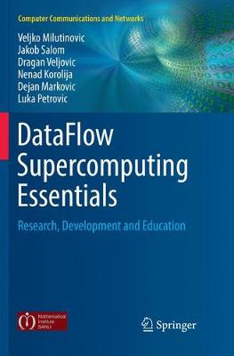
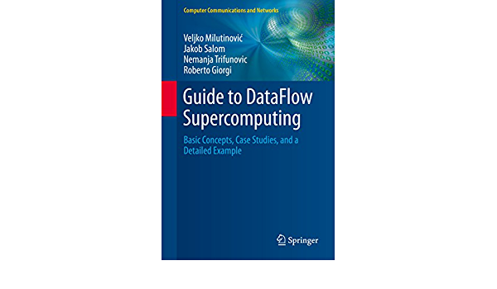
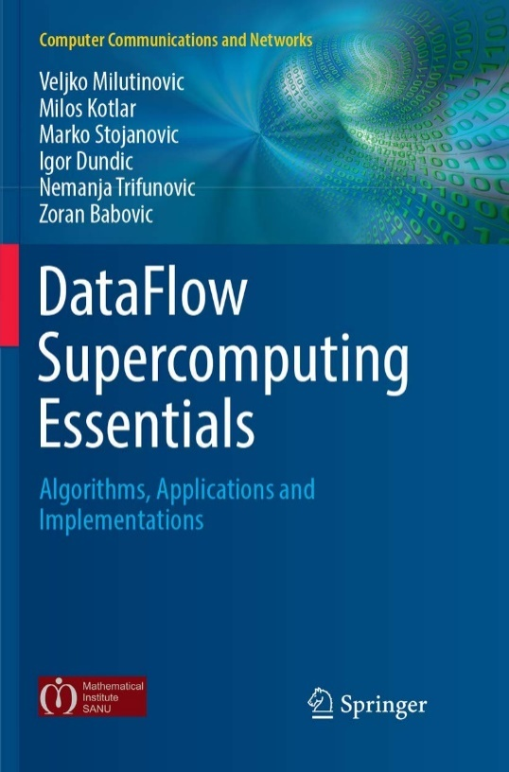
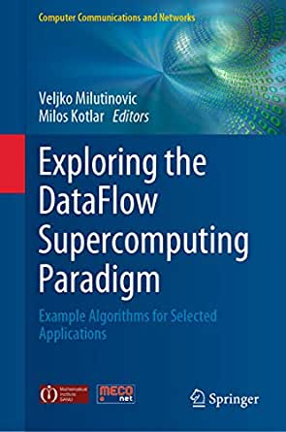

Conclusion: Synergy of ControlFlow and DataFlow
N.B. Successful marriage is THE solution!
7

Slide 8

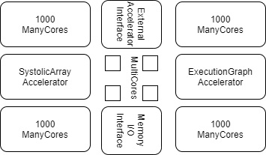
The Optimal Architecture
CF (ControlFlow Programming Model):
N MultiCore CPUs
1000N ManyCore GPUs (10000N, etc…)
DF (DataFlow Programming Model):
An ASIC SystolicArray (Fixed, GoogleTPU)
An FPGA ExecutionGraph (Reconfigurable, GroqMaxelerDFE)
Peripherals to External Accelerators (EnergyFlow Prog Model):
Chemical
Molecular
Opto
Quantum
+ Memory and I/O to WSN and IoT (DiffusionFlow Prog Model)
8

Slide 9
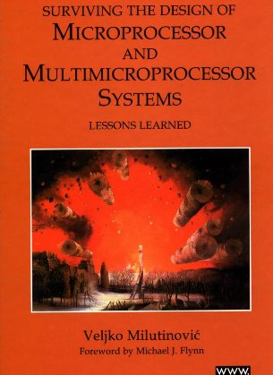
Past Experiences:
MultiCore
Split Cache
  Milutinovic, V. (1996).
  The Split Temporal/Spatial Cache:
  Initial Performance Analysis.
  SCIzzL-5, March 1996, 63-69.
9

Slide 10

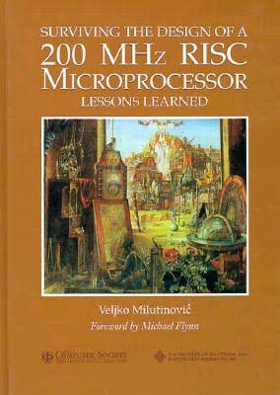
Past Experiences:
ManyCore
GaAs Microprocessor
  Milutinovic, V., Fura, D., & Helbig, W. (1986).
  An Introduction To GaAs
  Microprocessor Architecture for VLSI.
  Computer, (3), 30-42.
10

Slide 11
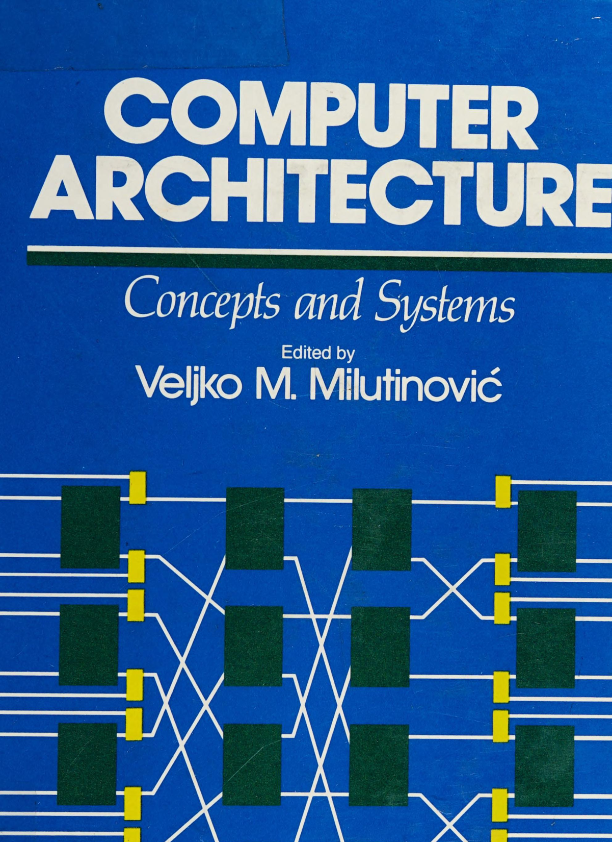
Past Experiences:
SystolicArrays
GaAs Systolics
  Fortes, J. A., Milutinovic, V.,
  (1986, January).
  A High-Level Systolic Architecture
  for GaAs.
  In Proc. 19th Ann. Hawaii Int'l Conf. System Sciences (pp. 253-258).
11

Slide 12
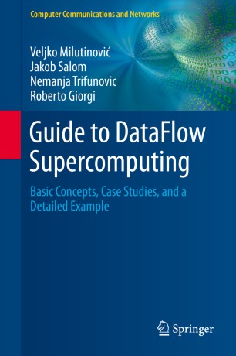
Past Experiences:
ExecutionFlow
DataFlow
  Milutinović, V., Salom, J., Trifunović, N.,
  & Giorgi, R. (2015).
  Guide to DataFlow Supercomputing.
  Cham: Springer Nature.
12

Slide 13
13

Slide 14
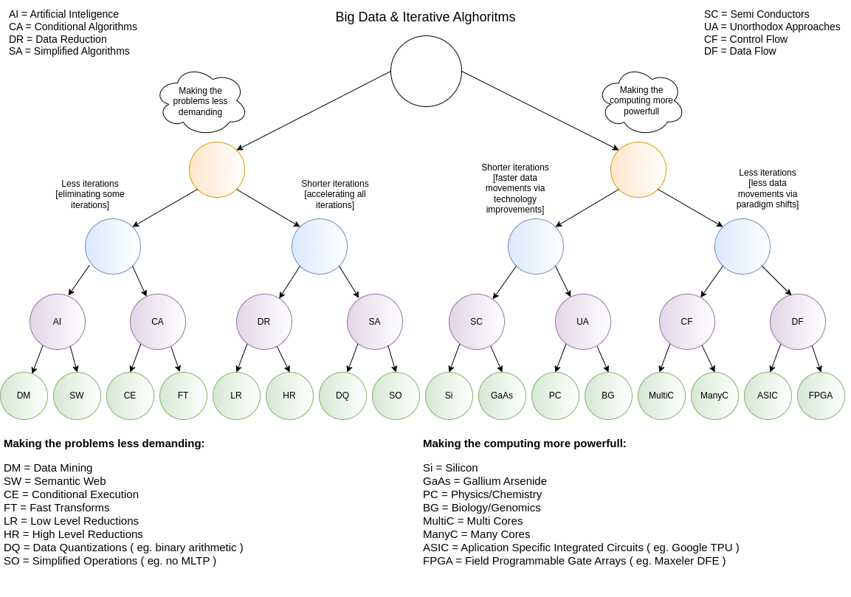
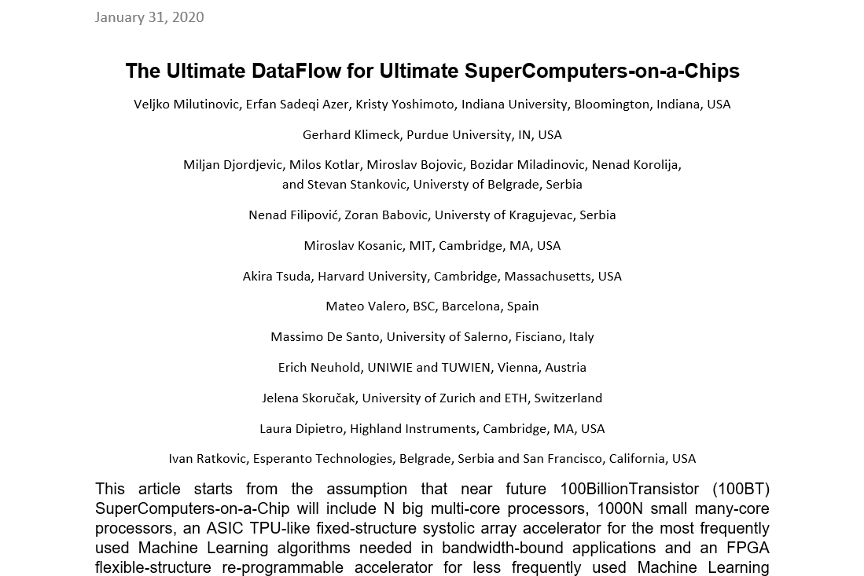
Current Research:
Research in computing-intensive simulations for nature-oriented civil-engineering and related scientific fields, using machine learning and big data: an overview of open problems
Zoran Babović, Branislav Bajat, Vladan Đokić, Filip Đorđević, Dražen Drašković, Nenad Filipović, Borko Furht, Nikola Gačić, Igor Ikodinović, Marija Ilić, Ayhan Irfanoglu, Branislav Jelenković, Aleksandar Kartelj, Gerhard Klimeck, Nenad Korolija, Miloš Kotlar, Miloš Kovačević, Vladan Kuzmanović, Marko Marinković, Slobodan Marković, Avi Mendelson, Veljko Milutinović, Aleksandar Nešković, Nataša Nešković, Nenad Mitić, Boško Nikolić, Konstantin Novoselov, Arun Prakash, Ivan Ratković, Zoran Stojadinović, Andrey Ustyuzhanin, Stan Zak
Journal of Big Data volume 10, Article number: 73 (2023)
14

Slide 15
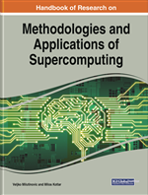
Handbook of Research on Methodologies and Applications of Supercomputing
15

Slide 16
Table of Contents #1
An introduction to Controlflow and Dataflow Supercomputing
Introduction to Control Flow
Optimal Scheduling of Parallel Jobs With Unknown Service Requirements
Intelligent Management of Mobile Systems Through Computational Self-Awareness
Paradigms for Effective Parallelization of Inherently Sequential Graph Algorithms
Data Flow Implementation of Erosion and Dilation
Transforming the Method of Least Squares to the Dataflow Paradigm
Forest Fire Simulation: Efficient Realization Based on Cellular Automata
High Performance Computing for Understanding Natural Language
Deposition of Submicron Particles by Chaotic Mixing in the Pulmonary Acinus
16

Slide 17
Table of Contents #2
Recommender Systems in Digital Libraries Using Artificial Intelligence and Machine Learning
Unified Modeling for Emulating Electric Energy Systems: Toward Digital Twin That Might Work
A Backtracking Algorithmic Toolbox for Solving the Subgraph Isomorphism Problem
AI Storm ... From Logical Inference and Chatbots to Signal Weighting, Entropy Pooling...
Efficient End-to-End Asynchronous Time-Series Modeling
Mind Genomics With Big Data for Digital Marketing on the Internet
Supercomputing in the Study and Stimulation of the Brain
An Experimental Healthcare System: Essence and Challenges
What Supercomputing Will Be Like in the Coming Years
The Ultimate Data Flow for Ultimate Super Computers-on-a-Chip
17

Slide 18
Reviews and Testimonials of 8 Nobel Laureates

Slide 19
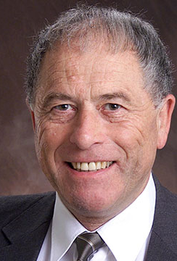
"I want to commend Dr. Veljko Milutinovic and Dr. Milos Kotlar for having completed this volume in the timely field of supercomputing in these difficult times, and I want to share their optimism regarding its use as a textbook around the world."
– Prof. Kurt Wüthrich, Nobel Laureate, Switzerland

Slide 20
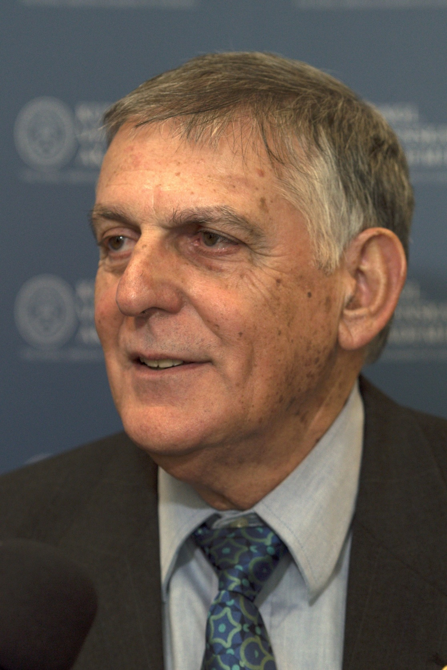
"Our complex and fast-moving world meets big data issues that call for reliable, efficient analysis and prompt response. A most advanced approach to dealing with these issues is presented in this book where algorithms of Control Flow represent the host architecture of supercomputers and Data Flow represents the acceleration architecture. A comprehensive list of applications is illustrated in the book including natural language processing, medical research, customer-oriented studies, and many more.“
– Prof. Dan Shechtman, Nobel Laureate, Israel

Slide 21
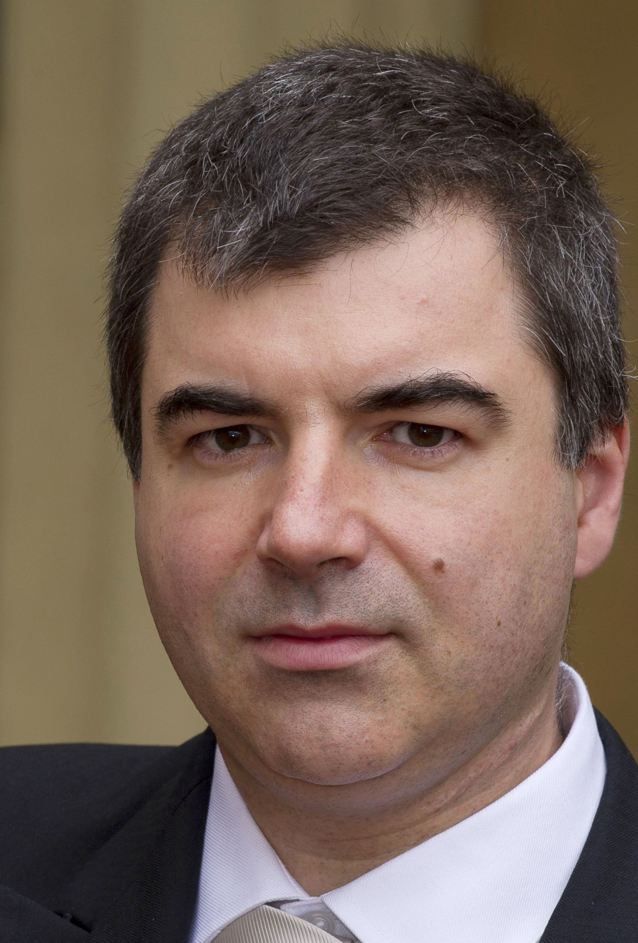
"Supercomputers have become a ubiquitous instrument in many areas of science and technology. Very hard to imagine modern physics, biology or chemistry without the use of this versatile tool. The breakthroughs in the development of supercomputers expand the range of problems we can tackle. Supercomputers, as well as specialised computers will undoubtedly contribute significantly to the overall landscape of discoveries in many different disciplines in the future."
– Prof. Konstantin Novoselov, Nobel Laureate, National University of Singapore, Singapore– Prof. Kurt Wüthrich, Nobel Laureate, Switzerland

Slide 22
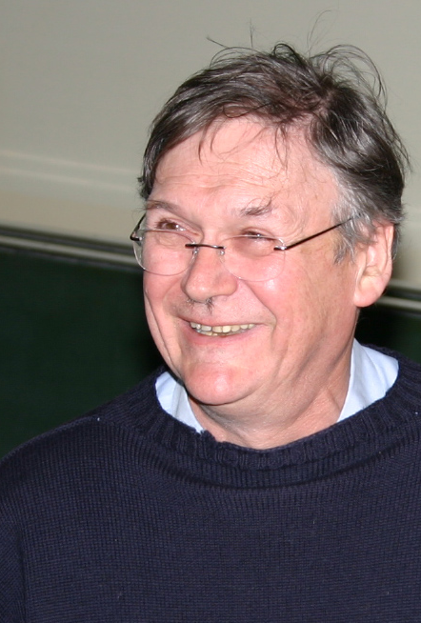
"It’s clear that computers can do anything, as the pioneers already recognised, and it’s probably only a matter of time before they can perform any of the kinds of tasks we humans take for granted quicker than blinking. I guess this book represents a stage on this exciting and very important journey."
– Prof. Tim Hunt, Nobel Laureate, UK

Slide 23
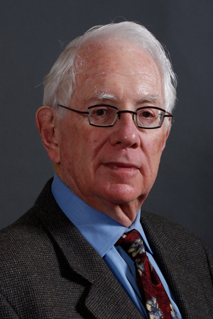
"Computers have become essential tools for the pursuit of both experimental and theoretical physics, as well as synthetic chemistry, paleontology, the medical sciences, economics the social sciences and so much more. Science, being the most international of all endeavors, will be well served by this important book, which honors the golden anniversary of the creation of Montinegro’s Academy of Science."
– Prof. Sheldon Glashow, Nobel Laureate, Boston University and Harvard University, USA

Slide 24
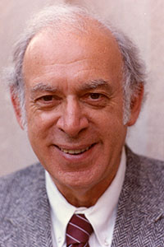
"Humankind’s continuing quests to uncover, understand, and utilize the secrets of nature have been greatly enhanced and will be further extended by the power of supercomputers."
– Prof. Jerome I Friedman, Nobel Laureate, USA

Slide 25
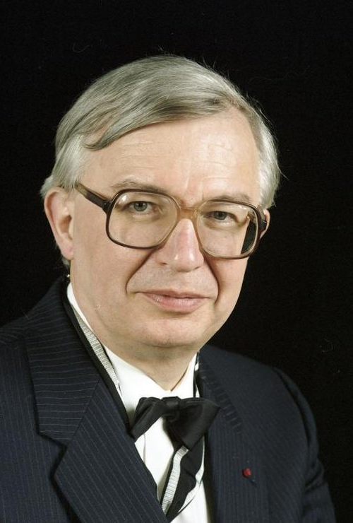
"I wish to congratulate very warmly the Montenegrin Academy of Arts and Sciences on the occasion of its 50th Anniversary and wish the CANU a highly successful future. Science shapes the Future of Mankind."
– Prof. Jean-Marie Lehn, Nobel Laureate, France

Slide 26
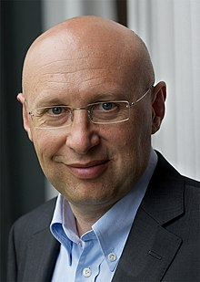
"Aim high, stay grounded! These four crisp words of wisdom accompany the best wishes for the 50th anniversary of the Montenegrin Academy of Sciences and Arts."
– Prof. Stefan Hell, Nobel Laureate, Germany

Slide 27
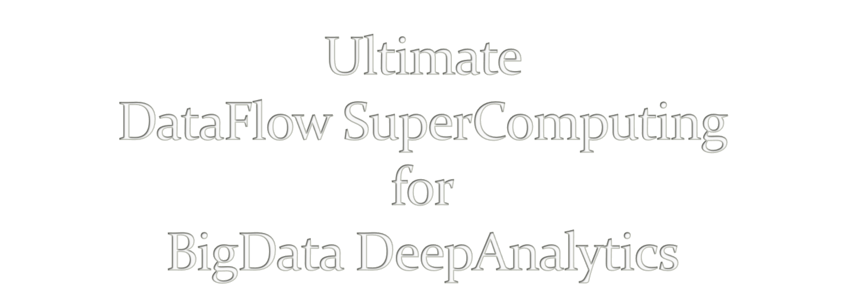
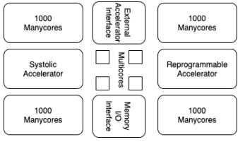
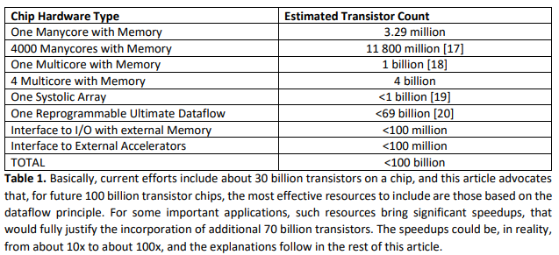
V. Milutinovic, University of Indiana, Bloomington, USA
Acknowledgements: O. Mencer, Imperial College, London, GBR, M.J. Flynn, Stanford University, Palo Alto, USA,
M. Kotlar, School of Electrical Engineering, University of Belgrade, SRB
27

Slide 28

A. Richard Feynman:
Impact of logic/arithmetic and memory/IO
Compiler-generated execution graph
Ilya Prigogine:
Impact of energy, entropy, order, and optimization
Compiler-generated data separation
Daniel Kahneman:
Impact of approximate computing on precision
Compiler-controlled approx computing
Tim Hunt:
Impact of system latency on precision
Compiler-controlled system latency
28

Slide 29

A. Whenever the Technology changes,
the Fundamental Paradigm of Computer Architecture
has to change, too.
aSoG (not: FPGA)
B. If several paradigms are available,
the most suitable paradigm for adoption
is the one most effective for modern Applications.
BrontoData (not: ExaBigData)
Is the von Neumann Paradigm still the most effective one?
A. MultiCores?
B. ManyCores?
29

Slide 30


Applications
Architecture
Size
Power
Speedup
Precision
Technology
30

Slide 31
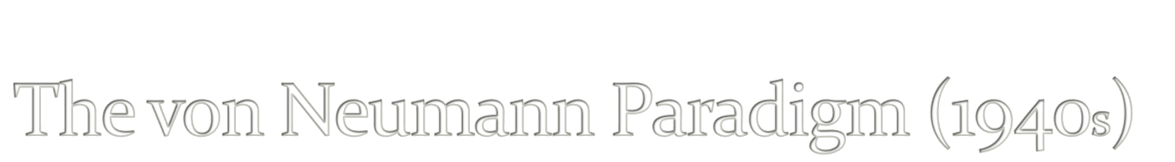
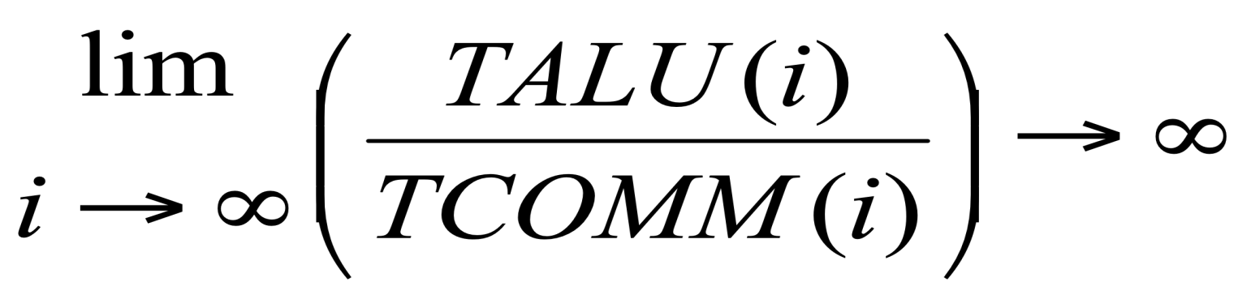
31

Slide 32

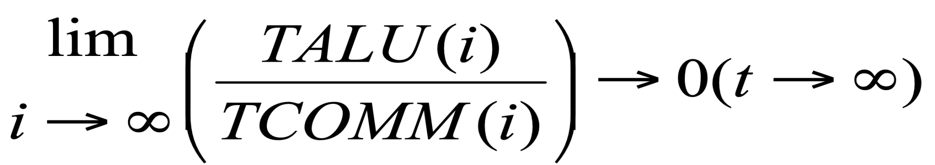

32

Slide 33
The Power Challenge
State of the Art in Technology Today
The Data Movement Challenge
 | 2015 | 2020
Double precision FLOP | 100pj | 10pj
Moving data to off-chip memory | 5000pj | 2000pj
Moving data off-chip will use 200x more energy than computing!
Moving data in 1940s was using 1/60x ...
Conclusion: We are getting close to the Feynman Asymptote!
Important: Power and speed could be traded!
33
Notes:
So what is dataflow buying us? Predictable performance, simpler architecture (no OOO – with its power & area overhead), and less data movement

Slide 34


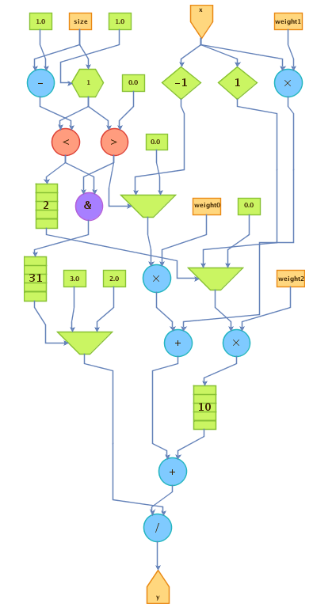
The Maxeler Technology Vision: MultiScale DataFlow
Space
Thinking in space
rather than in time
Difficult change in mindset
to overcome
Transformation of data
through flow over time
Instructions are parallelized
across the available space
Flow / Time
Optimal Solution: Execution Graph
34

Slide 35

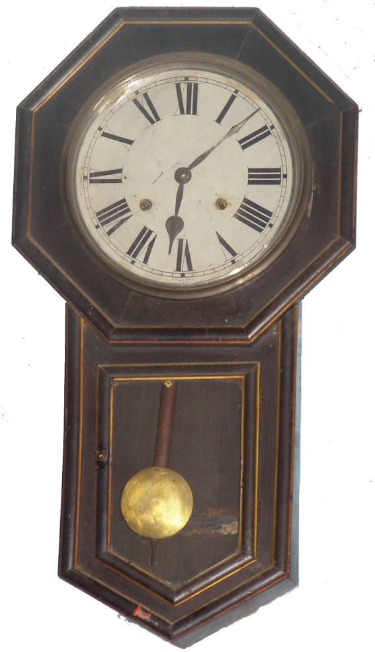
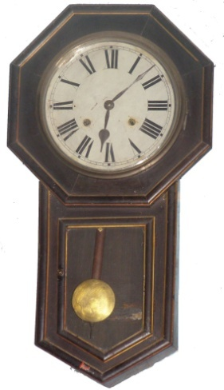
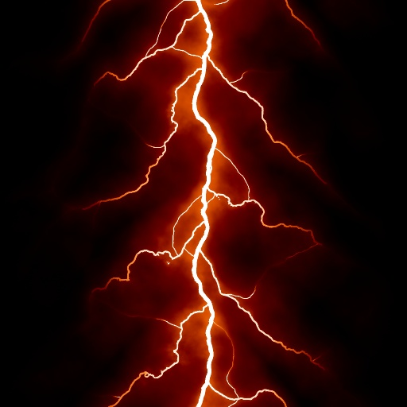
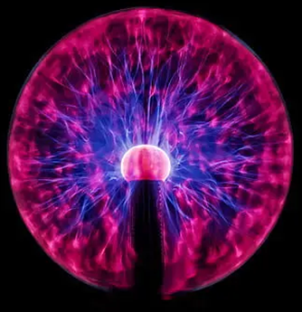
The Von-Neumann paradigm resembles an old wall clock
The Feynman paradigm resembles lightning!
Why?
35

Slide 36
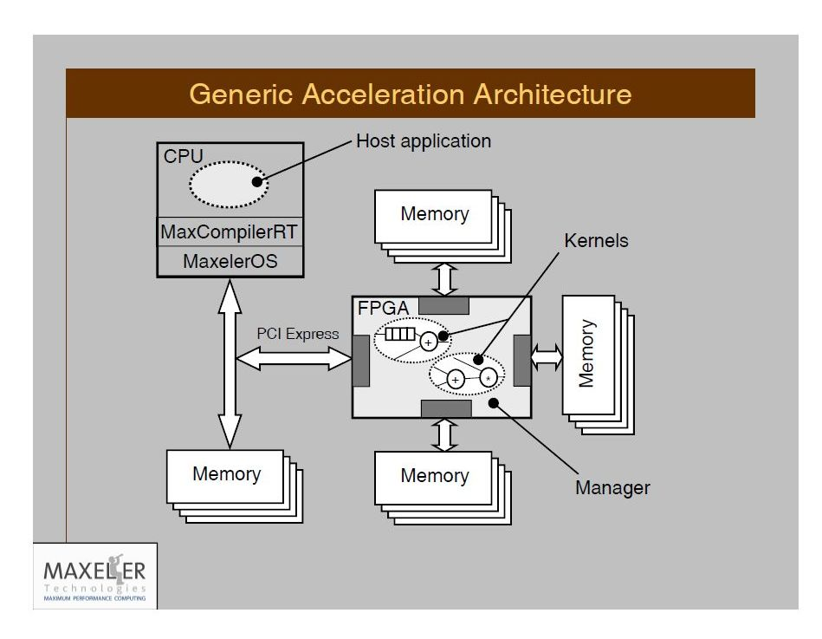
The Maxeler Generic Architecture Application
+ Tests
aSoG
Simulator builder
Hardware builder
2n+3
Important: Supporting any CL and any OS!
36

Slide 37
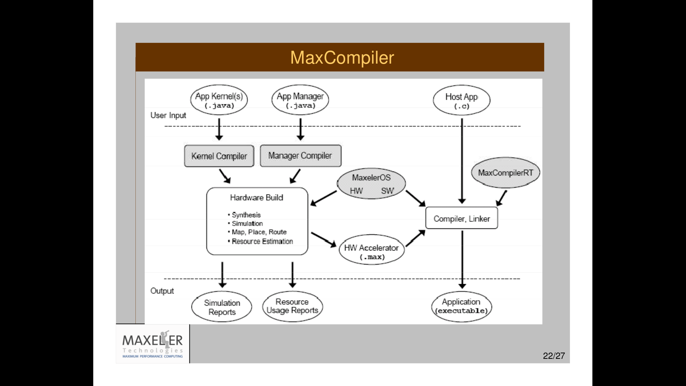

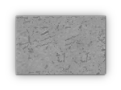
37

Slide 38
Publications of Interest for NanoAcceleration
===========================================================================================================
Flynn, M., Mencer, O., Milutinovic, V., Rakocevic, G., Stenstrom, P., Trobec, R., Valero, M.,
Moving from Petaflops (on Simple Benchmarks) to Petadata per Unit of Time and Power (On Sophisticated Benchmarks),
Communications of the ACM (nano-acceleration), May 2013.
2. Trobec, R., Vasiljevic, R., Tomasevic, M., Milutinovic, V., Beiveide, M., Valero, M.,
Interconnection Networks for SuperComputing,
ACM Computing Surveys (nano-acceleration) , 2017.
------------------------------------------------------------------------------------------------------------------------------------------------------------------------------
3. Milutinovic, V., Tomasevic, M., Markovic, B., Tremblay, M.,
The Split Temporal/Spatial Cache: Initial Performance Analysis,
Proceedings of the SCIzzL-5, Santa Clara, California, USA, March 26, 1996, pp 72-78.
4. Milutinovic, V., Tomasevic, M., Markovic, B., Tremblay, M.,
The Split Temporal/Spatial Cache: Initial Complexity Analysis,
Proceedings of the SCIzzL-5, Santa Clara, California, USA, September, 1996.
------------------------------------------------------------------------------------------------------------------------------------------------------------------------------
5. Milutinovic, V.,
A Comparison of Suboptimal Detection Algorithms Applied to the Additive Mix of Orthogonal Sinusoidal Signals,
IEEE Transactions on Communications, Vol. COM-36, No. 5, May 1988, pp. 538-543.
6. Milutinovic, V.,
Mapping of Neural Networks on the Honeycomb Architectures,
Proceedings of the IEEE, Vol. 77, No 12, December 1989, pp. 1875-1878.
------------------------------------------------------------------------------------------------------------------------------------------------------------------------------
7. Helbig, W., Milutinovic, V.,
The RCA's DCFL E/D MESFET GaAs 32-bit Experimental RISC Machine,
IEEE Transactions on Computers, Vol. 36, No. 2, February 1989, pp. 263-274.
8. Jovanovic, Z., Milutinovic, V.,
FPGA Accelerator for Floating-Point Matrix Multiplication,
IEE Computers & Digital Techniques (nano-acceleration), 2012, 6, (4), pp. 249-256.
The IET 2014 Premium Award for Computing & Digital Techniques. AWARDED AS THE SINGLE TWO-YEAR BEST PAPER
==========================================================================================================
Inspired by:
Feynman
Inspired by:
Prigogine
Inspired by:
Kahneman
Inspired by:
Hunt

Slide 39
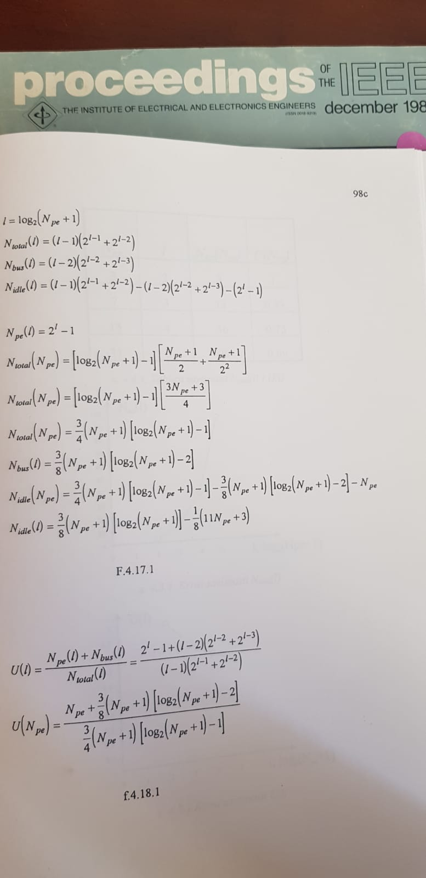
Feynman
39

Slide 40
Prigogine
40

Slide 41
Kahneman
41

Slide 42
Hunt
42

Slide 43


Existing Maxeler-based publications:
Ultimate aSoG-based future:
20 [Size]
20 [Power]
20, 200 [Speedup]
20 [Precision]
20-200 [Size]
20-200 [Power]
20, 200, 2000, 20000 [Speedup]
20+ [Precision]
Applications
Architecture
Technology
43

Slide 44
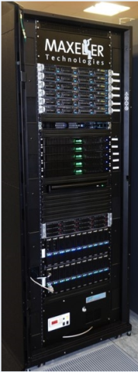



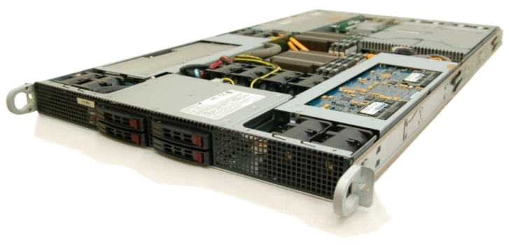
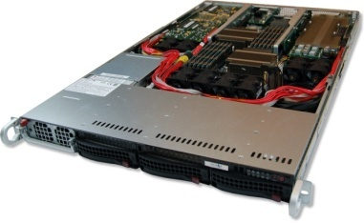
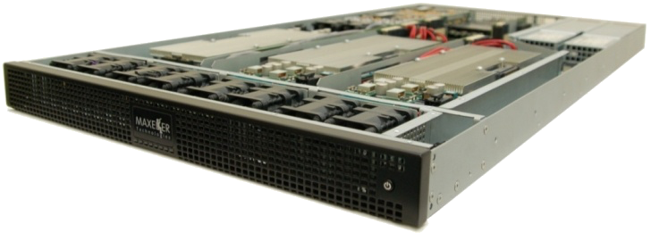
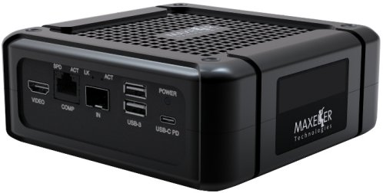
Maxeler Dataflow Appliance
40U: Good for Cloud
Software Based Solution
Dataflow Computing in the Datacentre
The CPU
Conventional CPU cores and
up to 6 DFEs with 288GB of RAM
The Dataflow Appliance
Dense compute with 8 DFEs, 768GB of RAM and dynamic allocation of DFEs to CPU servers with zero-copy RDMA access
The Networking Appliance
Intel Xeon CPUs and 4 DFEs with direct links to up to twelve 40Gbit Ethernet connections
1U: Good for Fog
MicroMAX.5: Good for Dew (Edge Processing of IoT Data)
44

Slide 45
The Major Application Successes
Finances:
  Credit derivatives
  Risk assessment
  Stability of economical systems
  Evaluation of econo-political mechanisms
GeoPhysics:
  Oil&Gas
  Weather forecast
  Astronomy
  Climate changes
Science:
  Physics
  Chemistry
  Biology
  Genomics
Engineering: Synergy of all the Above (ML, etc...)
45

Slide 46
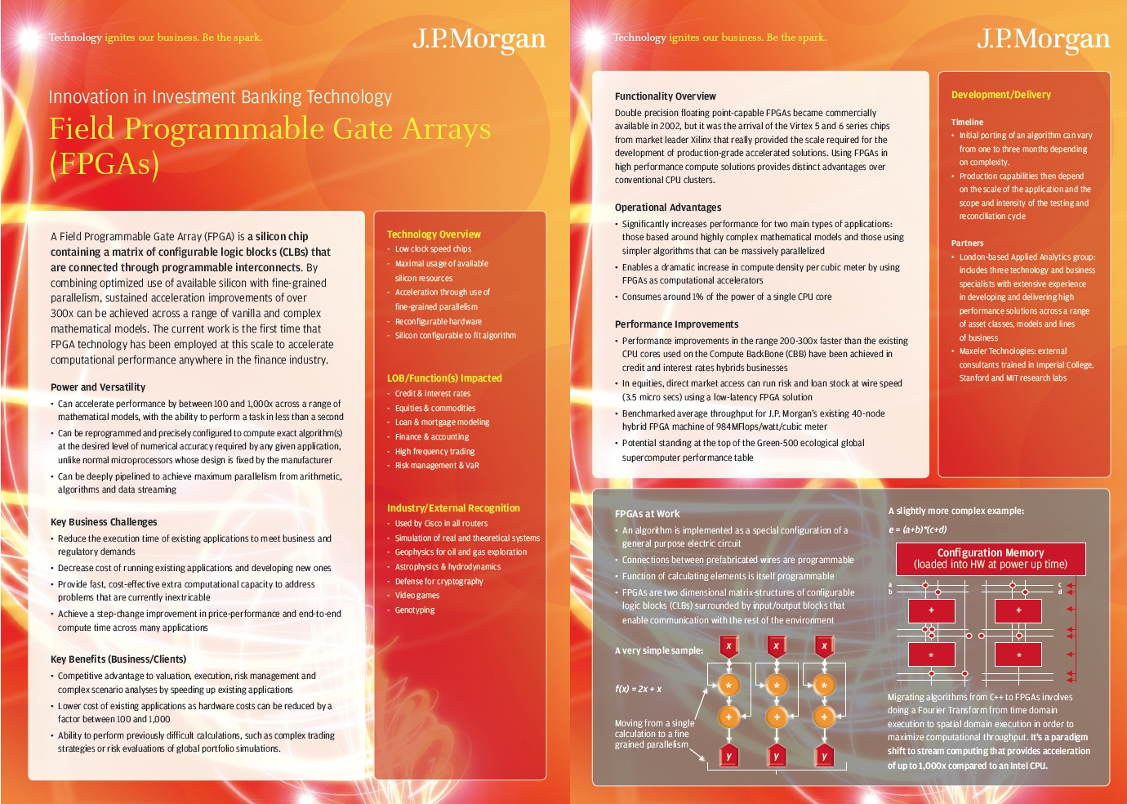
46

Slide 47
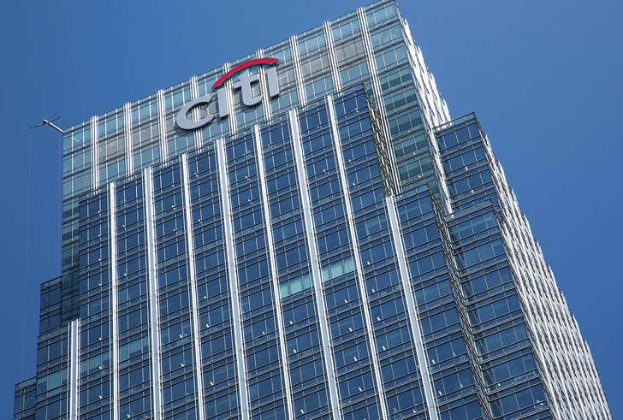
The know-how needed for deep security!
47

Slide 48
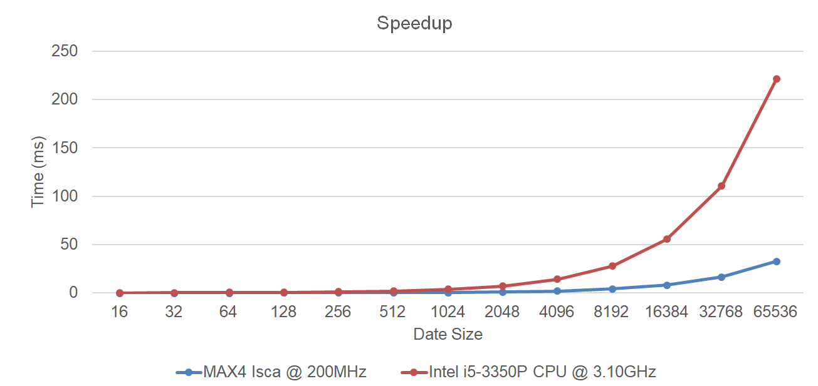
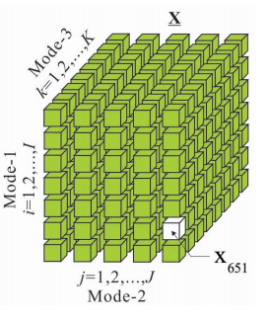
Analysis of the Tensor Calculus Operations on DataFlow
(PhD Thesis by Miloš Kotlar, on DataFlow-based Machine Learning)
  The speedup of 6.75x achieved as early as for KiloData (Perceptron),
  with 10x less on-chip transistors and the power savings of 4.6x
48

Slide 49
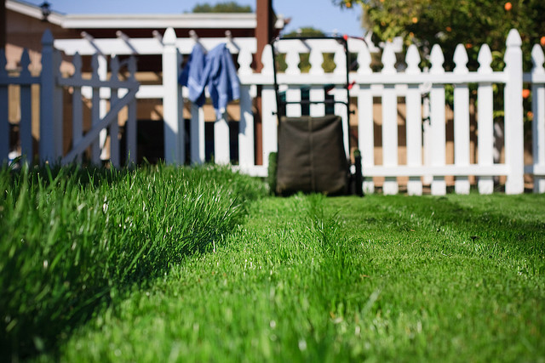
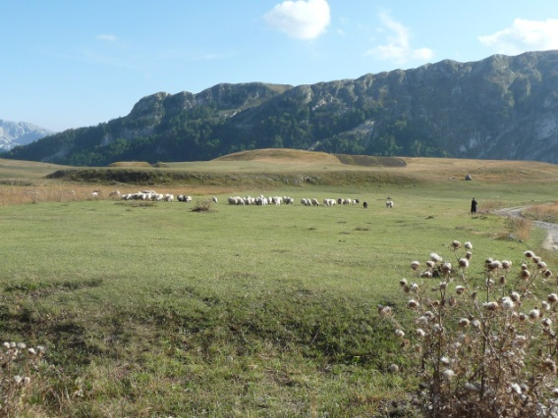
Conditions for the Y-Chart-Based “Kernelization” of Loops @ML
(PhD Thesis by Nenad Korolija, on the Mapping of Algorithms onto DataFlow)
1. | BigData (RAM vs. STREAM) | O(n²)
2. | Code reusability (WORO vs. WORM) | +
3. | Overall application tolerance to latency | +
4. | Over 95% of run time in loops | ++
5. | Reusability of the data in loops | ++
6. | Potential for utilization of pipes | O(n)
Essentials for speedup:
algorithmic modifications,
pipeline utilization,
data choreography,
decision making on precision
49

Slide 50
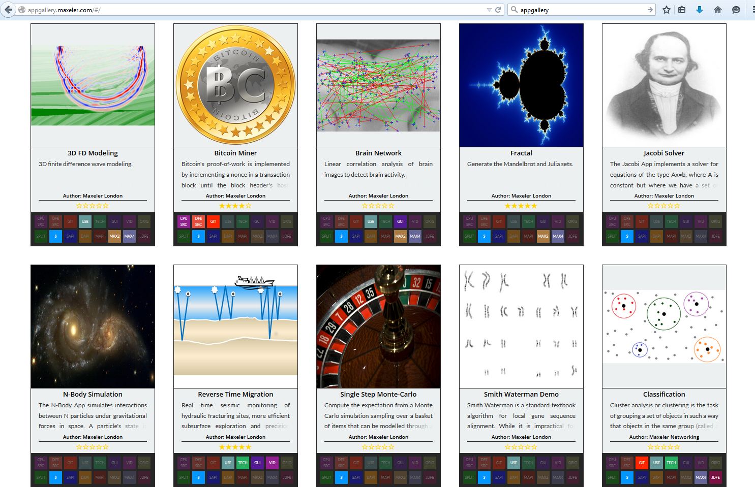
appgallery.maxeler.com
http://www.mi.sanu.ac.rs/~appgallery.maxeler/
50

Slide 51

51

Slide 52

52

Slide 53

webide.maxeler.com
https://maxeler.mi.sanu.ac.rs
53

Slide 54

54

Slide 55
DataFlow Paradigms
SW
Arvind’s PhD at MIT, under Dennis
HW
Oskar’s PhD at Stanford, under Flynn
AW
Osama’s PhD at Purdue, under Irfanoglu and Milutinovic
A new paradigm developed by a civil engineer, 2026
WW
Alas’ PhD at Sorbonne, under Hermite
Another new paradigm developed by a non-CS, 1897
55

Slide 56

Near Instantaneous O(1) AnalogWare Solver for Linear Symmetric Systems of Equations
Osama Abdelaleim, Purdue University (osama.mo.hashem@gmail.com)
Arun Prakash, Purdue University
Ayhan Irfanoglu, Purdue University
Veljko Milutinovic, University of Belgrade
This technology is the subject of
  U.S. Provisional Patent Application No. 63/690,322, filed on September 4, 2024.
  U.S. Provisional Patent Application No. 63/839,979, filed on July 8, 2025.

Slide 57


Q&A
vm@etf.rs
© H. Maurer
57

Slide 58

58

Slide 59

59

Slide 60

Purdue, IU, MIT, Harvard, Boston, NEU, Dartmouth, U of Massachusetts at Amherst, USC, UCLA, Columbia, NYU, Princeton, NJIT, CMU, Temple U,
UIUC, Michigan, Wisconsin, Minnesota, FAU, FIU, Miami, Central Florida,
U of Alabama, U of Kentucky, GeorgiaTech, Ohio State, Imperial, King's,
Manchester, Huddersfield, Cambridge, Oxford, Dublin, Cork, Cardiff,
Edinburgh, EPFL, ETH, TUWIEN, UNIWIE, Graz, Linz, Karlsruhe, Stuttgart, Bonn, Frankfurt, Heidelberg, Aachen, Darmstadt, Dortmund, KTH, Uppsala,
Karlskrona, Karlstad, Napoli, Salerno, Siena, Pisa, Barcelona, Madrid,
Valencia, Oviedo, Ankara, Bogazici, Koc, Istanbul, Technion, Haifa,
BerSheba, Eilat, Podgorica, Koper, Maribor, Ljubljana, Maribor, Nova Gorica, etc, etc. Also at the World Bank in Washington DC, IMF,
the Telenor Bank of Norway, the Raiffeisen Bank of Austria, Brookhaven
National Laboratory, Lawrence Livermore National Laboratory, IBM TJ
Watson, HP Encore Labs, Intel, Qualcomm VP, NCR, RCA, Fairchild,
Honeywell, Yahoo NY, Google CA, Microsoft, Finsoft, ABB Zurich, Oracle
Zurich, and many other industrial labs, as well as at Tsinghua University,
Shandong, NIS of Singapore, NTU of Singapore, Tokyo, Sendai, Seoul,
Pusan, HUJI, TAU, Sydney University of Technology, University of Sydney, Hobart, Auckland, Toronto, Montreal, Durango, MontereyTech, Cuernavaca, UNAM, Belgrade, Kragujevac, Novi Sad , Novi Pazar, ...

Slide 61

61

Slide 62

Olokotun at Stanford
62

Slide 63


Sunnyvale, USA + Bangalore, India + Toronto, Canada + San Diego, USA + Tokyo, Japan
63

Slide 64



Cupertino, California
64

Slide 65

65

Slide 66
Quantum Computing
A quantum computer uses qubits
to run multidimensional quantum algorithms.
Their processing power increases exponentially
as qubits are added.
A classical processor uses bits
to operate various programs.
Their power increases linearly as more bits are added.
66

Slide 67
Potentials:
Quantum computing is 158 million times faster
than the most sophisticated supercomputer
we have in the world today.
It is a device that could do in four minutes
what it would take a traditional supercomputer
10,000 years to accomplish.
67

Slide 68

Reality:
68

Slide 69
The First Eight Companies in Quantum Computing:
Atom Computing
Xanadu
IBM
ColdQuanta
Zapata Computing
Azure Quantum
D-Wave
Strangeworks
69

Slide 70

Beginnings:
70

Slide 71
Maybe the Best Quantum Computing Stocks:
IBM (NYSE: IBM)
Alphabet (Nasdaq: GOOG, Nasdaq: GOOGL)
Intel (Nasdaq: INTC)
Microsoft (Nasdaq: MSFT)
Amazon (Nasdaq: AMZN)
Quantum Computing (OTC: QUBT)
71

Slide 72
State of the Art:
100 miliKelvins (Alum) vs 4 Kelvins (Diamond)
Problems:
  Getting data and programs in
  Getting results and decisions out
  Without loosing the speed
  With the radiation hardness
Examples:
  Quantum Machines at TAU
  Applied Physics at HUJI

Slide 73

TAU

Slide 74


100 miliKelvins

Slide 75

HUJI

Slide 76


4 Kelvins

Slide 77




QC vs DF (from Cloud till QC) / Speed!
77

Slide 78

QC vs DF (from Cloud till QC) / RadHard!
GaAs helps for both, RadHardness and Speed!
There is no help after physical damage!
78

Slide 79
RHard QCs (1)
The least radiation sensitive quantum computers are generally those based on trapped-ion qubits and topological qubits.
Trapped-ion qubits, used by companies like IonQ and Oxford Ionics,
represent qubits as individual ions suspended in electromagnetic fields and manipulated by laser pulses.
These qubits exhibit significantly longer coherence times and lower error rates compared to superconducting qubits,
contributing to a higher resilience against radiation-induced errors. However, they face scalability challenges.
​Topological qubits, still in the experimental stage (notably pursued by Microsoft),
offer the potential for intrinsic error resistance due to their unique quantum state protection mechanisms,
making them promising candidates for radiation hardness in the future.
They aim to use quasiparticles called Majorana fermions
that could be more robust to environmental disturbances including radiation.
In contrast, superconducting qubits, such as those used by IBM and Google,
while commercially mature and scalable, are sensitive to cosmic rays and gamma radiation
causing quasiparticle bursts that increase error rates.
Materials engineering can mitigate some effects,
but radiation remains a critical challenge for superconducting platforms.
Photonics-based quantum computers may also offer advantages
since photons are less susceptible to certain types of radiation and operate at room temperature,
but this technology is still developing.
79

Slide 80
RHard QCs (2)
Basic materials that contribute to making quantum computing radiation hard
focus on minimizing radiation-induced disruption to qubits,
especially in superconducting and semiconductor qubits.
Key materials include:
  Superconducting materials such as niobium (Nb), aluminum (Al), and titanium nitride (TiN)
  are commonly used in qubits.
  Research indicates that using high-purity substrates and optimizing interfaces (e.g., Josephson junctions)
  help reduce defects and quasiparticle generation caused by radiation, thus improving radiation tolerance.
  Semiconductor materials like isotopically purified silicon (Si) and diamond with low nitrogen content
  enhance intrinsic radiation resistance by reducing spin-active nuclei or defect densities.
  Alternative superconducting materials, such as tantalum,
  have demonstrated superior coherence times under irradiation compared to aluminum.
  Shielding materials with high density like tungsten or boron-doped polyethylene can attenuate radiation,
  though they add complexity and mass.
  Minimizing substrate thickness is also beneficial as thicker silicon substrates actually absorb more radiation energy,
  causing greater disruption.
In summary, radiation-hard quantum computing materials typically involve carefully chosen superconductors
and semiconductors characterized by high purity and minimal defects, use of isotopically enriched substrates,
and physical design considerations like substrate thinning and shielding to mitigate radiation effects.
80

Slide 81
From Python to Quantum (1)
Transition Steps:
Install Libraries: Use pip to add Qiskit, Cirq, or PennyLane (e.g., pip install qiskit).
Learn Basics: Understand qubits, superposition, gates; review linear algebra.
Build Circuits: Create quantum circuits in Python (e.g., QuantumCircuit(2); apply H, CX gates).
Simulate/Execute: Run on simulators, then cloud hardware like IBM Quantum.
Optimize & Analyze: Transpile, measure results, iterate for algorithms.
Key Insight: Python SDKs abstract hardware, enabling hybrid classical-quantum workflows.
Basic Goal:
Minimal loss due to paradigm change!
​
81

Slide 82
From Python to Quantum (2)
What is Transpilation?
Rewriting input quantum circuits
to match target hardware topology, native gates, and connectivity
while optimizing for depth/errors.
​
Key Stages of Transpilation:
Init: Unroll custom gates to single/two-qubit basis.
Translation: Decompose to hardware's native gates (e.g., CX, rotations).
Optimization: Reduce gate count/depth via cancellation, synthesis.
Layout/Routing: Map logical qubits to physical; add swaps for connectivity.
Scheduling: Align gates temporally for hardware timing.
Purpose: Enables execution on real QPUs
by minimizing errors from noise/decoherence.
82

Slide 83
DataFlow from Cloud to Quantum
The Process:
Client App: User submits job via API; uploads input data to cloud storage.
Queue/Submit: Classical app authenticates (e.g., managed identity), sends job to quantum workspace/provider.
Transpile/Schedule: Circuit optimized for target QPU (gates, topology).
Execute: Provider runs on quantum hardware/simulator; results stored in cloud storage.
Retrieve: Client polls status, fetches results asynchronously via API.
Key: Hybrid async pattern bridges classical cloud (storage, auth) to remote QPUs.
The Essence:
Input = Information from the cloud.
Core = DataFlow execution graph.
Output = In the ideal case, a vector of 2¹² elements.
83

Slide 84

Libraries:
TensorFlow Quantum (TFQ) for AI
is a quantum machine learning library
for rapid prototyping
of hybrid quantum-classical ML models.
Interfacing for control-flow:
Amdahl’s law is the limitation factor
84

Slide 85
Tensor Flow Quantum:
TensorFlow Quantum focuses on quantum data
and building hybrid quantum-classical models.
It integrates quantum computing algorithms
and logic designed in Cirq,
and provides quantum computing primitives
compatible with existing TensorFlow APIs,
along with high-performance quantum circuit simulators.
85

Slide 86
A Programming Example:
# A hybrid quantum-classical model.
model = tf.keras.Sequential
([
# Quantum circuit data comes in inside of tensors.
tf.keras.Input(shape=(), dtype=tf.dtypes.string),
# Parametrized Quantum Circuit (PQC) provides output
# data from the input circuits run on a quantum computer.
tfq.layers.PQC(my_circuit, [cirq.Z(q1), cirq.X(q0)]),
# Output data from quantum computer passed through model.
tf.keras.layers.Dense(50)
])
State of the art: ?
86

Slide 87

Synergizing all the Above for the Most Sophisticated Applications
State of the art: From Alas at Sorbonne to Dong at Purdue!
87

Slide 88
USA Projects
Nature Based Construction and Computing:
  Purdue
  Indiana University
Complexity Based Media and Computing:
  MIT
  Harvard
88

Slide 89
SOME PREVIOUS OFFERINGS OF THIS COURSE
Purdue, Indiana;
MIT, Harvard;
Imperial, Manchester;
ETH, EPFL;
UNIWIE, TUWIEN;
Siena, Salerno, Barcelona, Madrid;
Tokyo, Sendai - Japan
Technion, Hebrew University of Jerusalem - Israel
Bogazici, Koc - Turkey
Tsinghua, Shandong - China.
Previous offerings of the related MGMT course: Amherst, Dartmouth, Harvard, MIT Media, Pisa, Genova.
89

Slide 90
INSPIRED BY FORMER STUDENTS OF BELGRADE UNIVERSITY:
Vice Presidents or Executive Directors at major USA industries:
JPMorgan (#1 Bank worth $100B) Executive Directors:
Marko Jevremovic, PMF
Jelena Skulic, ETF
BlackRock (#1 Portfolio company worth $40T) VP:
Mladen Laudanovic, PMF
StateStreet (#2 Portfolio company worth $10T) Ontology exPD:
X, PMF, ETF, FON
Vanguard Group (#1 in indexed founds):
Y
Qualcomm (#1 in MobilePhones Chips) VP:
Milivoje Aleksic, ETF
Intel (#1 in SuperComputing Chips) VP:
Ranko Scepanovic, PMF
NCR (#1 Technology support for banking worth $2B2) VP:
Dragan Budic, ETF
IBM (#1 in MainFrames):
Marija Zivanovic, ETF
AMD (#1 in HighEnd Gaming):
Andrej Zdravkovic, ETF
HP Labs (SustainableComputing):
Dejan Milojicic, ETF
Endeca (#1 in Acquisition for Data Base eng = $1075 million) CF:
Dejan Mircevski, ETF
SupplyFrame (#1 in Acquisition for Data Supply eng = $800M) CF: Aleksandar Bradic, ETF
Nordeus (#1 in FB Gaming, $370M) VP and CF:
Branko Milutinovic, ETF
ModComp (#1 in Special Medical Support):
Borko Furht, ETF
Records in Patenting:
Kavcic, ETF (#1 in illegal patenting for eng and phy): Marvel $1.2 billion
Bozovic, PMF (#1 in legal patenting for eng and phy): Varian $?
Furht, ETF (#1 in the number of patents activated for eng - over 100): $?
S.M., ETF (#1 for in-company patent awards for eng): $?
Professors at Top 10 Schools in USA for CS and CE:
Ilic, ETF, MIT
Djordjevic, PMF, Harvard
Kovacevic, ETF, CMU
Marinov + Mojsilovic, ETF, UIUC
Vujic + Nikolic, ETF, UC Berkeley
Mencer, Stanford
Ercegovac + Potkonjak, ETF, UCLA
Mirkovic, ETF, USC
Gligoric, ETF, Texas
Bradic, MAT, Cornell
90

Slide 91

Purchase Orders from A to Z
Learn How to Position Yourselves

Slide 92


Slide 93
Synergizing GaAs and DataFlow
UhrSprung = -40Y (DARPA)
PublicationBans
= +1Y (DefenseConferences: PR)
= +4Y (IEEE Trans/Computers: Archi)
= +10Y (IEEE BestSeller Book: Design)
= +40Y (IEEE Trans/Computers: RadH)
CurrentVision = System Architecture + Rad Flexibility
PublicationAnnouncements
= Babović, Z., Bajat, B., Barac, D., Bengin, V., Đokić, V., Đorđević, F., ... & Zak, S. (2023). Teaching computing for complex problems in civil engineering and geosciences using big data and machine learning: synergizing four different computing paradigms and four different management domains. Journal of Big Data, 10(1), 89.
= Babović, Z., Bajat, B., Đokić, V., Đorđević, F., Drašković, D., Filipović, N., ... & Zak, S. (2023). Research in computing-intensive simulations for nature-oriented civil-engineering and related scientific fields, using machine learning and big data: an overview of open problems. Journal of Big Data, 10(1), 1-21.
= Milutinović, V., Đorđević, F., Kotlar, M., & Salom, J. (2023). An Introduction to the Management of Complex Software Projects. Cambridge Scholars Publishing.
= Milutinović, V. (2026). Synergizing GaAs and DataFlow.
Page Number: 93/325

Slide 94

An Introduction to
VLSI Processor Architecture
for GaAs
(with Current Updates)
Veljko Milutinović
PURDUE UNIVERSITY
This research was initially sponsored by DARPA
and conducted in collaboration of Purdue University
and the RCA Advanced Technology Laboratories,
Moorestown, New Jersey, USA, 1983-1987.
Special Thanks to Wayne Moyers of RCA and Gerhard Klimeck of PURDUE

Slide 95

Advantages
For the same power consumption, at least half order of magnitude faster than Silicon.
Efficient integration of electronics and optics.
Tolerant of temperature variations. Operating range: [−200°C, +200°C].
Radiation hard. Several orders of magnitude more than Silicon: [>100 million RADs].

Slide 96

Disadvantages
High density of wafer dislocations
→ Low yield → small chip size → low transistor count
Noise margin not as good as in Silicon
→ Area has to be traded in for higher reliability
At least two orders of magnitude more expensive than Silicon
→ Preferred for defense and aerospace applications
Having problems with high-speed test equipment
→ You don’t know how good you are

Slide 97


Slide 98



Slide 99

DARPA: A Brief Look Into the GaAs IC Design
Bipolar (TI + CDC)
JFET (McDAC)
GaAs MESFET Logic Families (TriQuint + RCA)
D-MESFET
(* Depletion Mode *)
E-MESFET
(* Enhancement Mode *)

Slide 100
The First 32-bit GaAs MICROPROCESSORS
Goals and project requirements:
  200 MHz clock rate
  32-bit parallel data path
  16 general purpose registers
  Reduced Instruction Set Computer (RISC) architecture
  24-bit word addressing
  Virtual memory addressing
  Up to four coprocessors connected to the CPU
  (Coprocessors can be of any type and all different)
References:
1. Milutinović,V.,(editor),”Special Issue on GaAs
Microprocessor Technology,” IEEE Computer, October 1986.
2. Helbig, W., Milutinović,V., “The RCA DCFL E/D-
MESFET GaAs Experimental RISC Machine,” IEEE
Transactions on Computers, December 1988.

Slide 101
MICROPROCESSORS
Darpa eyes 100-mips GaAs chip for star wars
Palo Alto
For its Star Wars program, the Department of Defense intends to push well beyond the current limits of technol­ogy. And along with lasers and particle beams, one piece of hardware it has in mind is a microprocessor chip having as much computing power as 100 of Digital Equipment Corp.’s VAX-11/780 superminicomputers.
One candidate for the role of basic computing engine for the program, officially called the Strategic Defense Initiative [ElectronicsWeek, May 13, 1985, p. 28], is a gal­lium arsenide version of the Mips reduced-instruction-set computer (RISC) developed at Stanford University. Three teams are now working on the processor. And this month, the Defense Advanced Projects Research Agency closed the request-for-proposal (RFP) process for a 1.25-µm silicon version of the chip.
Last October, Darpa awarded three contracts for a 32-bit GaAs microprocessor and a floating-point coprocessor. One went to McDonnell Douglas Corp., another to a team formed by Texas Instruments Inc. and Control Data Corp., and the third to a team from RCA Corp. and Tektronix Inc. The three are now working on processes to get useful yields. After a year, the program will be reduced to one or two teams. Darpa’s target is to have a 10,000-gate GaAs chip by the beginning of 1988.
If it is as fast as Darpa expects, the chip will be the basic engine for the Advanced Onboard Signal Processor, one of the baseline machines for the SDI. “We went after RISC because we needed something small enough to put on GaAs,” says Sheldon Karp, principal scientist for strategic technology at Darpa. The agency had been working with the Motorola Inc. 68000 microprocessor, but Motorola would­n’t even consider trying to put the complex 68000 onto GaAs, Karp says.
A natural. The Mips chip, which was originally funded by Darpa, was a natural for GaAs. “We have only 10,000 gates to work with,” Karp notes. “And the Mips people had taken every possible step to reduce hardware requirements. There are no hardware interlocks, and only 32 instruc­tions.”
Even 10,000 gates is big for GaAs; the first phase of the work is intended to make sure that the RISC architecture can be squeezed into that size at respectable yields, Karp says.
Mips was designed by a group under John Hennessey at Stanford. Hennessey, who has worked as a consultant with Darpa on the SDI project, recently took the chip into the private sector by forming Mips Computer Systems of Mountain View, Calif. [ElectronicsWeek, April 29, 1985, p. 36]. Computer-aided-design software came from the Mayo Clinic in Rochester, Minn.
The GaAs chip
will be clocked at 200 MHz,
the silicon at 40 MHz
The silicon Mips chip will come from a two-year effort using the 1.25-µm design rules developed for the Very High Speed Integrated Circuit program. (The Darpa chip was not made part of VHSIC in order to open the RFP to contractors outside that program.)
Both the silicon and GaAs microprocessors will be full 32-bit engines sharing 90% of a common instruction core. Pascal and Air Force 1750A compilers will be targeted for the core instruction set, so that all software will be inter­changeable.
The GaAs requirement specifies a clock frequency of 200 MHz and a computation rate of 100 million instructions per second. The silicon chip will be clocked at 40 MHz.
Eventually, the silicon chip must be made radiation-hard; the GaAs chip will be intrinsically rad-hard.
Darpa will not release figures on the size of its RISC ef­fort. The silicon version is being funded through the Air Force’s Air Development Center in Rome, N.Y.
–Clifford Barney

Slide 102

Synergized GaAs DataFlow CPU
What are the 4 internal DataFlow elements?

Slide 103


Slide 104


Slide 105


Slide 106


Slide 107



Slide 108

Director: Professor Gerhard Klimeck, VicePresident of Purdue University

Slide 109


Slide 110

Brookhaven National Labs
Ivan Božović

Slide 111

Ivan Božović, Yale, Adjunct Professor
Ivan Božović is best known for his research in nanoscale physics and condensed matter, including new electronic phenomena and innovative thin film synthesis methods, which also includes work with materials such as GAAS.
His research involves materials with elements from various groups of the periodic table, including detailed control of doping and atomic composition in complex oxides used in superconductor research.
This includes notable work on La2-xSrxCuO4 (LSCO), a high-temperature superconductor incorporating strontium (Group 2) and copper (Group 11), which relates to elements in the second and sixth columns.

Slide 112

Lessons Learned: Methodology
Problem statement
Exiting solutions
Proposed solution
Multidimensional analysis
Final conclusions
Milutinovic, V. (1996). The Best Method for Presentation of Research Results.
IEEE TCCA Newsletter, (9), 1-6.

Slide 113
Lessons Learned: Creativity
Transdiciplinarity
Reparametrization
Unortodoxization
Mendeleyevization
Hybridization
Milutinovic, V. (2015). A Structured Approach to Research for PhD Students in Computer Science
and Engineering: How to Create Ideas, Conduct Research, and Write Papers. Internet Res, 11, 47-54.

Slide 114
Lessons Learned: The HeilMeier Catechism
What are you trying to do?
Articulate your objectives
using absolutely no jargon.
How is it done today,
and what are the limits of current practice?
What is new in your approach
and why do you think it will be successful?
Who cares? If you are successful,
what difference will it make?
What are the risks?
How much will it cost?
How long will it take?
What are the mid-term and final “exams”
to check for success?
www.darpa.mil
Who was George Heilmeier?
Heilmeier, who ran DARPA from 1975-1977, developed this questionnaire
based on his extensive career in technology R&D. His early work at RCA is credited with laying
the foundation for liquid crystal displays.
After his tenure at DARPA,
he served as an executive at Texas Instruments during a time when the company dominated
the home computer market.
Lessons Learned:
Today, the Heilmeier Catechism is used
by some the most innovative research organizations around the world.

Slide 115

2000
Life Fellowship of the IEEE and Academia Europaea

Slide 116


1900
Paris World Expo Gold
Page Number: 116/325

Slide 117
The Mihajlo Petrović Alas integrator refers to his hydrointegrator (sometimes called the hydraulic integrator), which is an early analog computer he invented at the end of the 19th century.
What it is
A mechanical-hydraulic device that solves differential equations using water flow.
Instead of doing calculations numerically (like digital computers), it uses physical analogies:
  Water levels represent variables.
  Fluid flow through channels or tubes represents integration and differential relationships.
  The shape and connectivity of vessels encode the mathematical system.
History
Petrović presented the idea in 1897 (Comptes Rendus de l’Académie des Sciences).
He demonstrated it at the 1900 Paris World Exhibition, where it won a gold medal.
It is considered one of the first analog computing machines,
predating more famous devices like Bush’s differential analyzer.
Applications
Designed to solve ordinary differential equations (ODEs) that appear in physics and engineering.

Slide 118








Purdue
Wisdoms
Classroom
Breaks
Page Number: 118/325
Dinners

Slide 119

HW: Analysis of the Algorithm X in the Context of Selected Emerging Computing Paradigms
Type | Performance | Comment | Measurement
MULTICORE | $$\frac{1}{\left(1−p\right)+\frac{p}{s}}⇒\frac{1}{\left(1−p\right)+\frac{p}{N}}$$ | Amdahl’s law where p is fraction of runtime that is pure compute work for acceleration (0-1), and s is speedup of that compute, in out case number of cores (N) | 150ms (for N 50x50)
MANYCORE | $$\left(1−p\right)+p∗s⇒\left(1 −p\right)+p∗N$$ | Gustafson’s law, similar to Amdahl’s law, but better for big number of cores. | 4ms (for N 50x50)
DSM | $$\frac{1}{\left(1−p\right)+\frac{p}{N}+C(N)}\underset{⇒}{for NUMA}\frac{1}{\left(1−p\right)+\frac{p∗R(N)}{N}+C(N)}$$ | Same Amdahl’s law with communication overheads C(N) (cache coherence, latency, bandwidth). For NUMA memory architecture we have worse case because of remote memory access and NUMA ratio R(N) | 1ms (for N 50x50; GPU better for N > 1700)
MPC | f(p, R, N, C) | Cray | 5ms
GaAs
CdTe
Maxeler DFE | $$\frac{1}{\frac{1}{min⁡(p,N)}+\frac{T_{c}+T_{m}+T_{i}}{Tseq}}$$ | Reference: Computer performance prediction of data flow architecturep is average degree of concurrency (maximum number of independent operations); N number of PE (processing elements); $T_{c}$ (communication overhead); $T_{m}$(scheduling overhead); $T_{i}$ idle overhead | 5ms
Google TPU | $$\frac{1}{(1−p)+\frac{p}{S_{p}∗n}+\frac{N∗p}{N_{ref}}+L_{o}}$$ | p – fraction of work that can be parallelized; $S_{p}$number of parallel stochastic units deployed; n efficiency adjustable factor; N required bit stream; $N_{ref}$reference bit stream length (baseline 256); $L_{a}$latency overhead | 55ms (for N 50x50)
WSN
IoT
Quantum /Optical
Chemical /Biological
Page Number: 119/325

Slide 120
Page Number: 120/325

