Slide 1
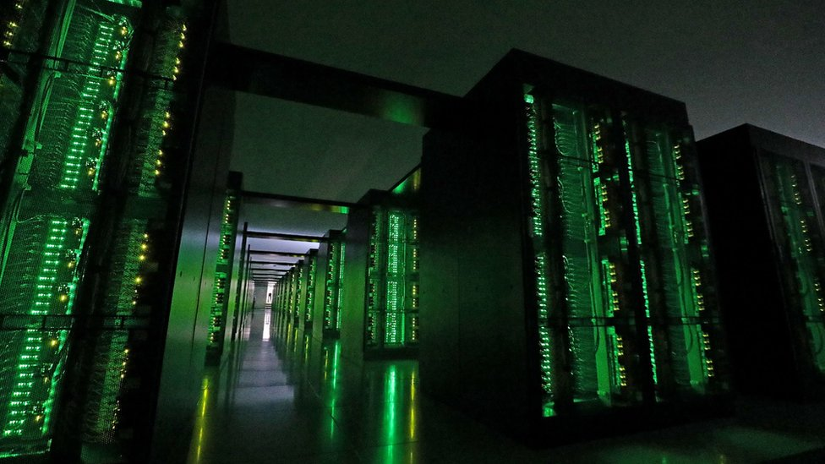
The
Ultimate SuperComputer-on-a-Chip for Acceleration of
Massive Big Data and Highly Iterative Algorithms
Veljko Milutinović
Special Thanks to Oskar Mencer, Honorary Treasurer of Academia Europaea
veljko.milutinovic.1951@gmail.com

Slide 2
Classification of Acceleration Approaches (12):
Criteria: Technology change + Paradigm change
T=NOT + P=NOT (2):
Faster silicon + more cores (Multicore CPUs + Manycore GPUs)
+ or more memory (DSM + MPC)
T=YES + P=NOT (2):
GaAs(ISA)/2nd6th(TuringMachine) + ControlFlow (SpeedUp + RadHardness)
T=NOT + P=YES (4):
Silicon + DataFlow (MaxDFE + GoogleTPU) or DataFly (WSN/IoT)
T=YES + P=YES (4):
PhysMat (Optical + Quantum) + BioChem (Chemical + Molecular)
Creativity: From Turing and Łukasiewicz to LLMs and LNMs, till ELON MUSK and AI
2

Slide 3
THE COURSE OUTLINE:
STAGES OF A COMPLEX RESEARCH/DEVELOPEMENT PROJECT
IN ACADEMIA/INDUSTRY
1. Before the project starts:
a. To ensure funding (e.g., H20); HW = H20.doc
b. To get educated for management (e.g., MBA/PhD); HW = H20.ppt
2. Soon after the project starts:
a. To learn CMMI; HW = CMMI.level2global
b. To learn Another more focused approach (e.g., Microsoft Project); HW = MP.local
3. Before the project is over:
a. To form a company (e.g., using the SBA guidelines); HW = BizPlan.sba
b. To protect the company product (e.g., using the USA PTO guidelines); HW = PatentAplication.pto
4. Immediately after the project is over:
a. To write about existing solutions to the problem (e.g., for a SCI journal); HW = SurveyPaper.doc
b. To write about obtained results (e.g., for a SCI journal); HW = ResearchPaper.doc
5. Soon after the project is over:
a. To form an Internet shop (small, medium, or large scale); HW = STORE.com
b. To apply MindGenomics (for better marketing); HW = MicroScienceCustomerTyping.doc
6. Long after the project is over:
a. To apply business intelligence (Data Mining and Media Mining); HW = NewAlgorithm.ppt
b. To brand yourself (Semantic Web and Internet Gallery and Serbia Forum); HW = NewDigitalization.pdf
READINGS:
7. Efficiency
8. Effectiveness
9. Inventivity
10.Creativity
11.Ethics
12.Esthetics
CASE STUDIES:
MENCER/MAXELER
MEDELSON/MachineLearning
MAURER/MyFORUM
MOSKOWITZ/MindGenomics
MAROM/MyQC
MILUTINOVIC/MyGaAsRISC

Slide 4
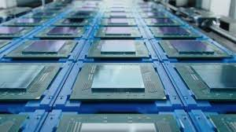
The Flynn's Classification of Computer Systems:
SISD
SIMD
MISD
MIMD
Leonardo Da Vinci, the inventor of the first mechanical calculating machine, was a civil engineer!
4

Slide 5
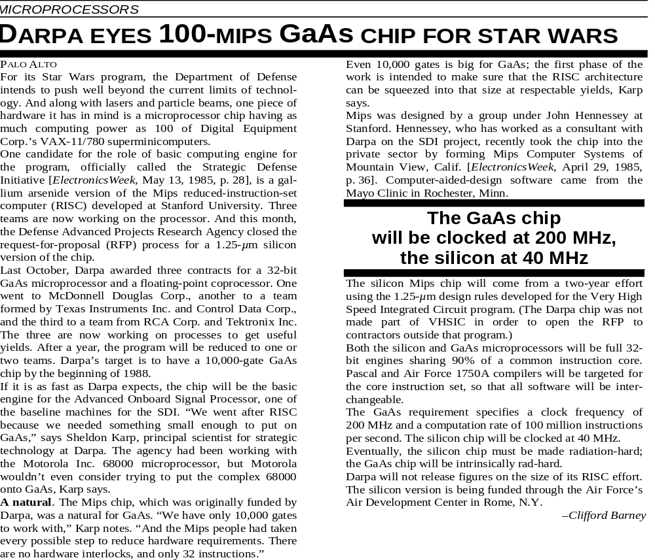
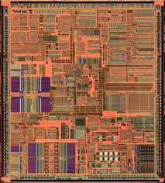
Early 80s: DARPA's First GaAs Microprocessor (SISD)
Lesson Learned:
Mere technological change is NOT a solution,
due to large OFF-CHIP/ON-CHIP delays,
leading fast to asymptotic saturations
of the achievable speedup!
5

Slide 6
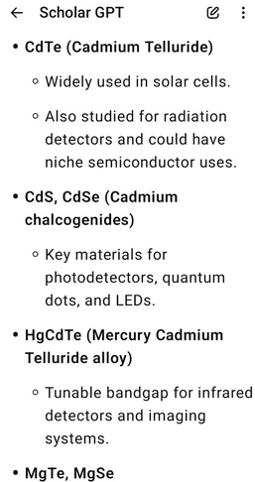
2nd + 6th
6

Slide 7
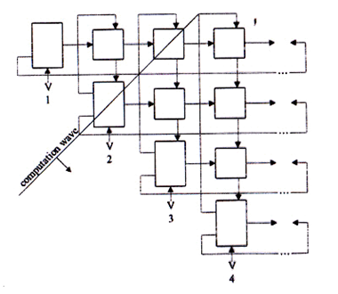
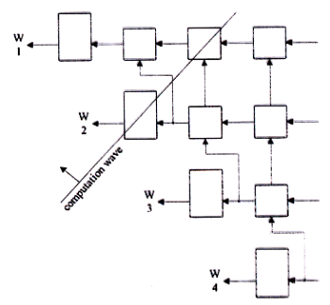
Mid 80s: DARPA's First GaAs Systolic Array 4096 (SIMD) for Gram-Schmidt Orthogonalization
Lesson Learned: Good Mostly for TENSOR CALCULUS!
(now optimal: Google TPU)
TENSOR CALCULUS was invented by a civil engineer
7

Slide 8
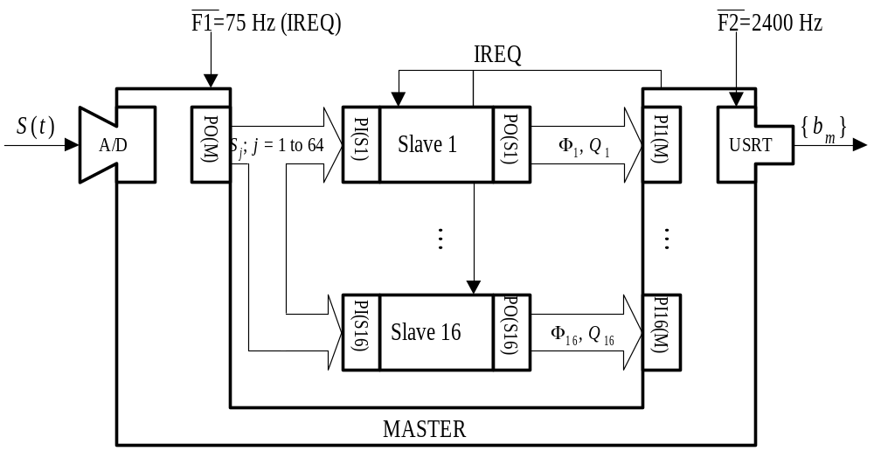
Late 80s: The AeroSpace Fourier Transform Engine (MISD)
Lesson Learned: Good Mostly for TRANSFORMATIONAL ALGORITHMS
(now optimal: Intel MultiCore)
Milutin Milankovic, the inventor of the most accurate Julian calendar, was a civil engineer!
8

Slide 9
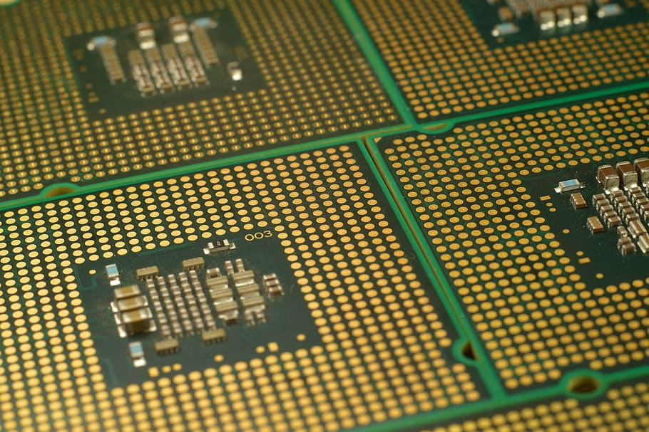
End 80s: The NCR Vertical Migration Engine (MIMD)
Lesson Learned: Good Mostly for IMAGE UNDERSTANDING
(now optimal: nVidia ManyCore)
9

Slide 10
ControlFlow: Inherent Characteristics Represent Limitations
SISD: IEEE T/Computers
SIMD: IEEE T/Communications
MISD: IEEE T/ASSP
MIMD: IEEE T/Software
Helbig, W., & Milutinovic, V. (1989). A dcfl e/d-mesfet gaas experimental risc machine.
IEEE transactions on computers,
38(2), 263-274.
Milutinovic, V. (1988). A comparison of suboptimal detection algorithms
applied to the additive mix of orthogonal sinusoidal signals.
IEEE transactions on communications, 36(5), 538-543.
Milutinovic, V., Fortes, J., & Jamieson, L. (1986). A multimicroprocessor architecture
for real-time computation of a class of DFT algorithms. IEEE transactions on acoustics,
speech, and signal processing, 34(5), 1301-1309.
Milutinovic, V. (1987). A simulation study of the Vertical-Migration microprocessor architecture.
IEEE transactions on software engineering, (12), 1265-1277.
10

Slide 11
DARPA: Creativity Unleashed for GaAs Star Wars (1)
Mapping of High Level Languages directly onto hardware, for minimizing of wiring:
The Vertical Migration Architecture
1985 (after the first ideas and a 1Y ban):
Milutinovic, V. and Lopez-Benitez, N.,
“A GaAs-based Microprocessor Architecture for Real-Time Applications,”
IEEE Transactions on Computers, 100(6), 714-727, 1987.
1985 (after a rigorous analysis and a 1Y ban):
Milutinovic, V.,
“A simulation study of the Vertical-Migration Microprocessor Architecture,”
IEEE Transactions on Software Engineering, (12), 1265-1277, 1987.
Note: After Richard Feynman, and especially stressed in GaAs, as it will be explained later.

Slide 12
DARPA: Creativity Unleashed for GaAs Star Wars (2)
For eliminating of wiring in interconnection networks and data processing:
The Cellular Honeycomb Architecture
1985 (after the first ideas and a 4Y ban):
Milutinovic, V.,
“Mapping of Neural Networks on the Honeycomb Architecture,”
Proceedings of the IEEE, 77(12), 1875-1878, 1989.
2025 (after a rigorous analysis and a 40Y ban):
Milutinovic, V., Milutinovic, D., Furth, B.,
“On Mapping of Topological Structures and Mathematical Algorithms
onto Specialized Architectures for Graph-Based Computing,”
Springer, JBD, 2025/2026 (TBP).
Note: After Richard Feynman, and especially stressed in GaAs, as it will be explained later.

Slide 13
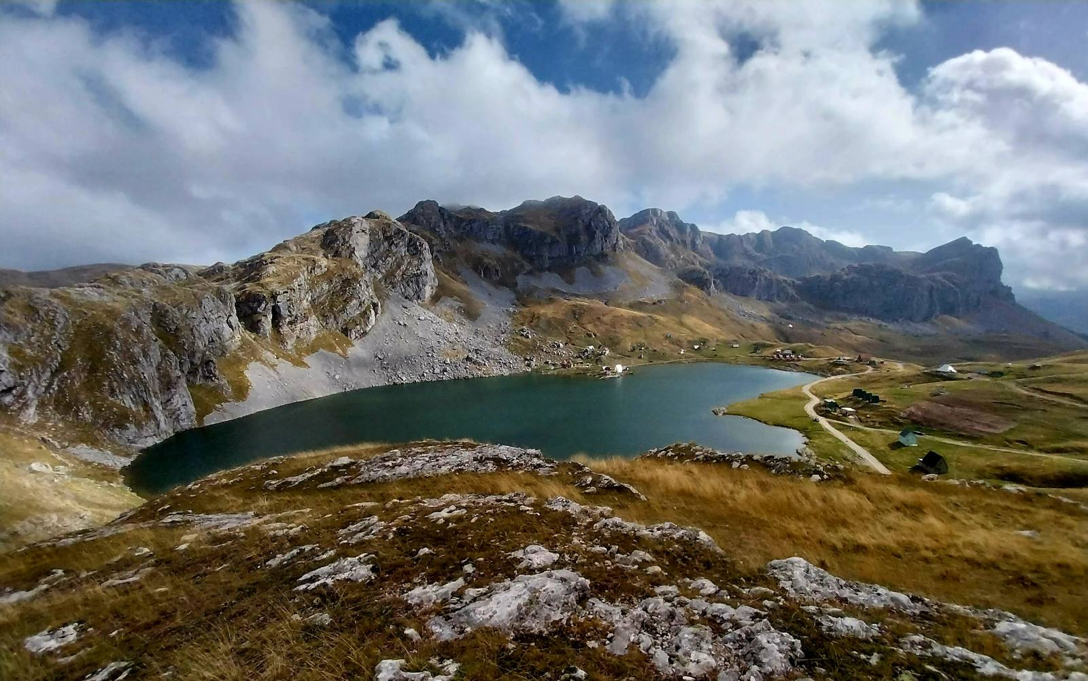

Slide 14
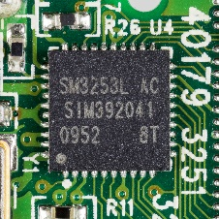
DataFlow: New Paradigms Badly Needed,
NOT to Substitute,
BUT to Supplement!
The First FineGrain DataFlow Idea: Proceedings of the IEEE
The First FineGrain DataFlow Implementation: Communications of the ACM
Milutinovic, V. (1989).
Mapping of neural networks on the honeycomb architecture.
Proceedings of the IEEE, 77(12), 1875-1878.
Flynn, M. J., Mencer, O., Milutinovic, V., Rakocevic, G., Stenstrom, P., Trobec, R., & Valero, M. (2013).
Moving from petaflops to petadata.
Communications of the ACM, 56(5), 39-42.
Condition: Internal Delays as Short as Absolutely Possible (GaAs is essential for DoD)
14

Slide 15
Alternative: WSN+IoT
Condition: External Delays as Long as Realistically Possible
WSN = IoT + Vector(Sensors)
Specific Applications + Initial Solution (GaAs essential for DoD)
Note: A Special Course Available on Request

Slide 16
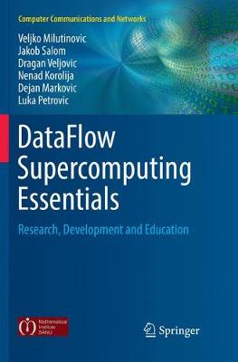
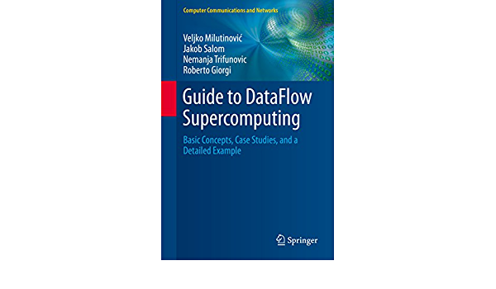
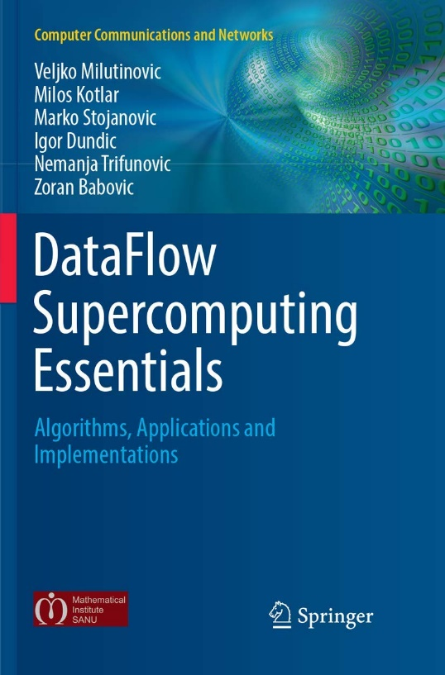
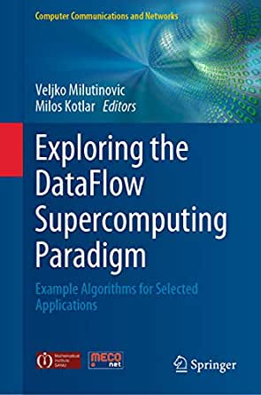

Conclusion: Synergy of ControlFlow and DataFlow
N.B. Successful marriage is THE solution!
16

Slide 17

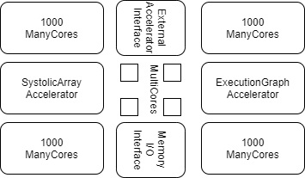
The Optimal Architecture
CF (ControlFlow):
N MultiCore CPUs
1000N ManyCore GPUs (10000N, etc…)
DF (DataFlow):
An ASIC SystolicArray (Fixed)
An FPGA ExecutionGraph (Reconfigurable)
Peripherals to External Accelerators (EnergyFlow):
Chemical
Molecular
Opto
Quantum
+ Memory and I/O + Peripherals to WSN and IoT (DiffusionFlow)
17

Slide 18
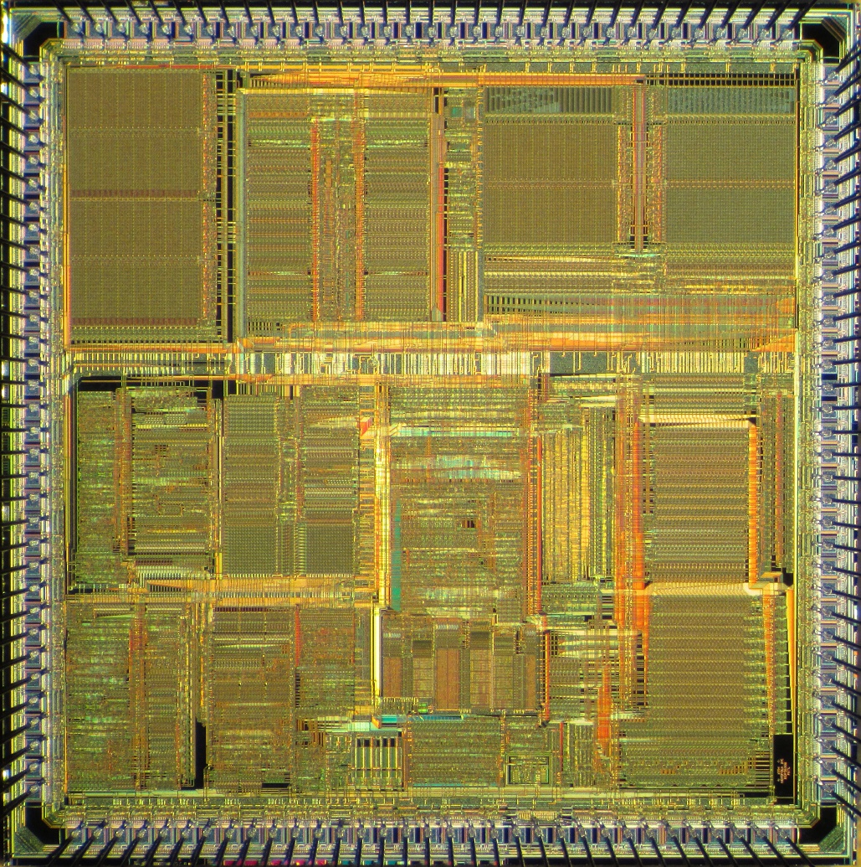
Optimal Distribution of Transistor Budget
Ceiling-Dependent:
  VLSI: 100BTr
  WSI: 1TTr
Application-Dependent:
  SW DataFlow
  ML ControlFlow
Strategy-Dependent:
  CF-Oriented
  DF-Oriented
Memory-Dependent!
18

Slide 19

Pioneering Efforts:
Company | Product name | Country | City | Number of CPU cores | Number of GPU cores | CPU clock rate | Launched
Alibaba | XT910 | China | Hangzhou | 1/2/4 per cluster | N/A | 2.0 – 2.5 GHz | 2020
RISC-V | Micro Magic RISC-V Core [39] | US | San Francisco | 1 | N/A | 4.25 – 5.19 GHz | 2020
SiFive | FU740 RISC-V SoC [25] | US | San Francisco | 4 | 1 | 1.4 – 1.5 GHz | 2020
AMD | AMD Ryzen™ 5 3400G with Radeon™ RX Vega 11 Graphics [24] | US | Santa Clara | 4 | 11 | 3.7 – 4.2 GHz | 2019
Nvidia | Tegra Xavier [28] | US | Santa Clara | 8 | 512 CUDA | N/A | 2019
Esperanto Technologies | N/A | US | Mountain View | 16 ET-Maxion cores | 4096 ET-Minion cores + ET-Graphics [26,27] | 2+GHz | 2018
Intel | Intel Sandy Bridge [23] | US | Santa Clara | 1-4 (4-6 Extreme, 2-8 Xeon) | 6 | 1.60 – 3.60 GHz | 2011
Moscow Center of SPARC Technologies (MCST) | Elbrus-2S+ (1891ВМ7Я) [29] | Russia | Moscow | 2 Elbrus 2000 cores | 4 DSP Elcore-09 cores | 300 – 800 MHz | 2011
State of the Art:
Biren (77BTr@2025) = Chip Integration (China)
Cerebras (1.4TTr@2025) = Wafer Integration (California)
19

Slide 20
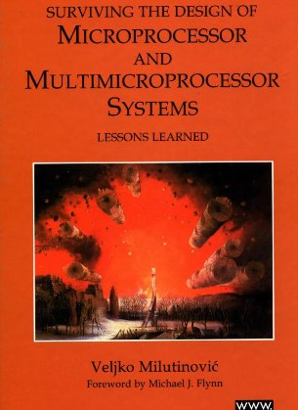
Past Experiences:
MultiCore
Split Cache
  Milutinovic, V. (1996).
  The Split Temporal/Spatial Cache:
  Initial Performance Analysis.
  SCIzzL-5, March 1996, 63-69.
20

Slide 21
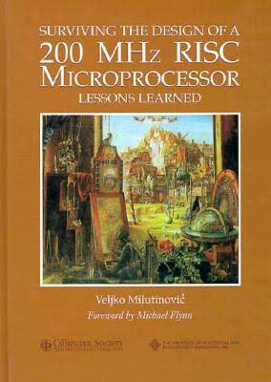
Past Experiences:
ManyCore
GaAs Microprocessor
  Milutinovic, V., Fura, D., & Helbig, W. (1986).
  An Introduction To GaAs
  Microprocessor Architecture for VLSI.
  Computer, (3), 30-42.
21

Slide 22
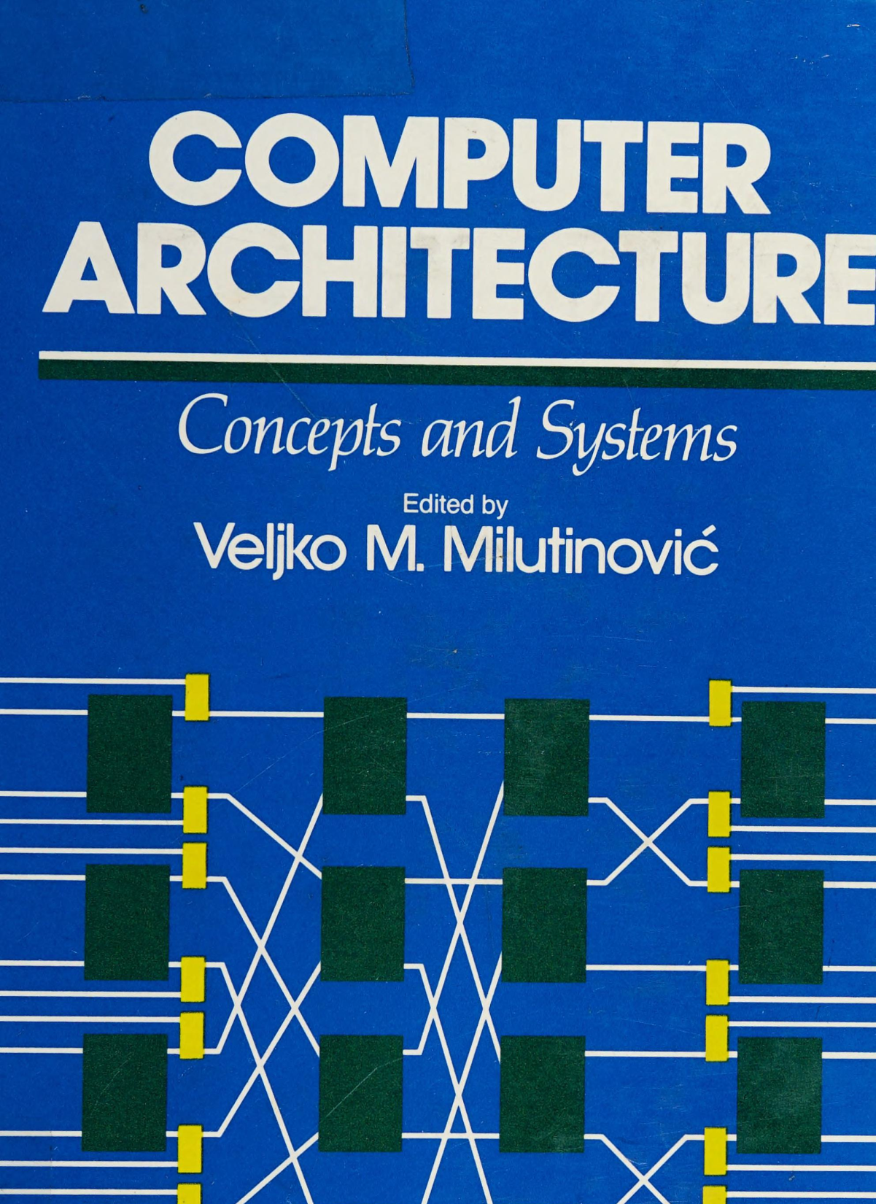
Past Experiences:
SystolicArrays
GaAs Systolics
  Fortes, J. A., Milutinovic, V.,
  (1986, January).
  A High-Level Systolic Architecture
  for GaAs.
  In Proc. 19th Ann. Hawaii Int'l Conf. System Sciences (pp. 253-258).
22

Slide 23
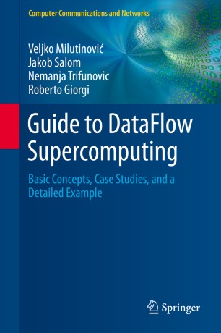
Past Experiences:
ExecutionFlow
DataFlow
  Milutinović, V., Salom, J., Trifunović, N.,
  & Giorgi, R. (2015).
  Guide to DataFlow Supercomputing.
  Cham: Springer Nature.
23

Slide 24
24

Slide 25
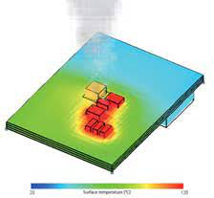
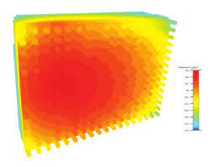
3D Implementations Offer Effective Cooling
In a hybrid processor,
multi-layer semiconductor structure fabrication can spread:
  MultiCore on the entire chip surface,
  ManyCore on the entire chip surface, and
  DataFlow on the entire chip surface.
Thus, for jobs that use predominantly one paradigm,
the frequencies of other chiplets could be lowered by:
  Hardware (automatically) [1], or
  Software (scheduled) [2].
[1] Lakhani, S., Wang, Y., Milenković, A., & Milutinović, V. (1996). 2D matrix multiplication on a 3D systolic array. Microelectronics journal, 27(1), 11-22.
[2] Milenkovic, A., & Milutinovic, V. (1998). A quantitative analysis of wiring lengths in 2D and 3D VLSI. Microelectronics journal, 29(6), 313-321.
25

Slide 26
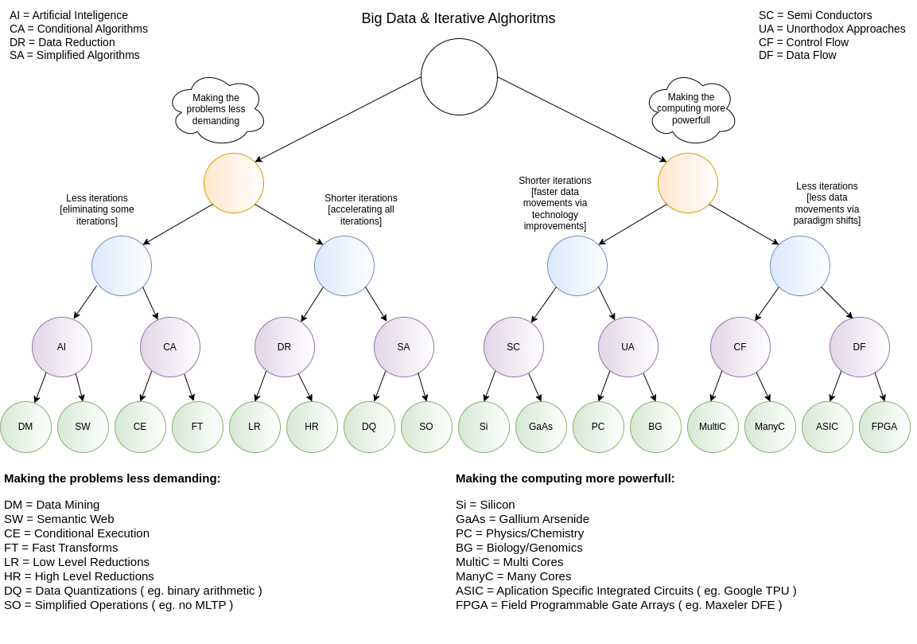
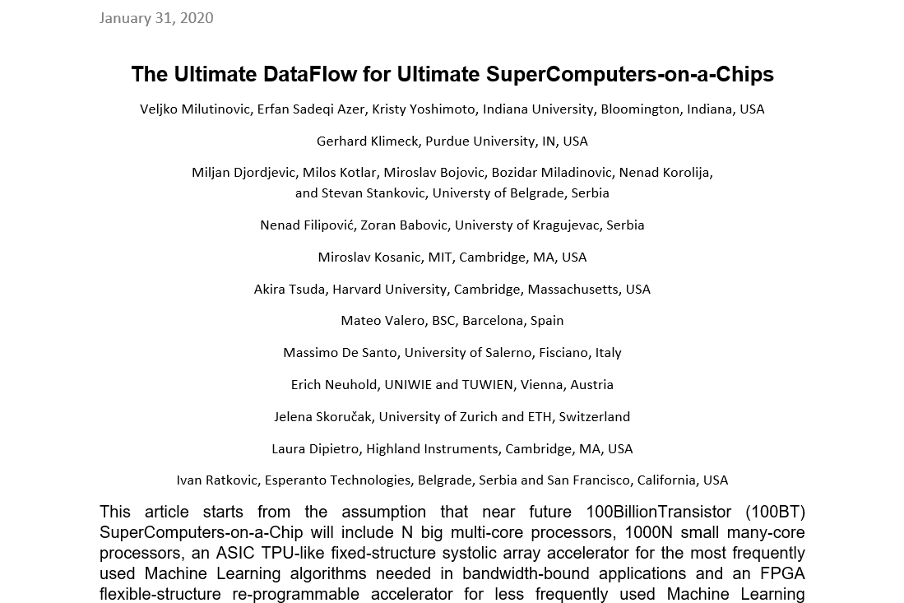
Current Research:
Research in computing-intensive simulations for nature-oriented civil-engineering and related scientific fields, using machine learning and big data: an overview of open problems
Zoran Babović, Branislav Bajat, Vladan Đokić, Filip Đorđević, Dražen Drašković, Nenad Filipović, Borko Furht, Nikola Gačić, Igor Ikodinović, Marija Ilić, Ayhan Irfanoglu, Branislav Jelenković, Aleksandar Kartelj, Gerhard Klimeck, Nenad Korolija, Miloš Kotlar, Miloš Kovačević, Vladan Kuzmanović, Marko Marinković, Slobodan Marković, Avi Mendelson, Veljko Milutinović, Aleksandar Nešković, Nataša Nešković, Nenad Mitić, Boško Nikolić, Konstantin Novoselov, Arun Prakash, Ivan Ratković, Zoran Stojadinović, Andrey Ustyuzhanin, Stan Zak
Journal of Big Data volume 10, Article number: 73 (2023)
26

Slide 27
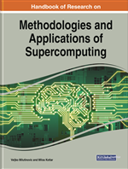
Handbook of Research on Methodologies and Applications of Supercomputing
27

Slide 28
Table of Contents #1
An introduction to Controlflow and Dataflow Supercomputing
Introduction to Control Flow
Optimal Scheduling of Parallel Jobs With Unknown Service Requirements
Intelligent Management of Mobile Systems Through Computational Self-Awareness
Paradigms for Effective Parallelization of Inherently Sequential Graph Algorithms
Data Flow Implementation of Erosion and Dilation
Transforming the Method of Least Squares to the Dataflow Paradigm
Forest Fire Simulation: Efficient Realization Based on Cellular Automata
High Performance Computing for Understanding Natural Language
Deposition of Submicron Particles by Chaotic Mixing in the Pulmonary Acinus
28

Slide 29
Table of Contents #2
Recommender Systems in Digital Libraries Using Artificial Intelligence and Machine Learning
Unified Modeling for Emulating Electric Energy Systems: Toward Digital Twin That Might Work
A Backtracking Algorithmic Toolbox for Solving the Subgraph Isomorphism Problem
AI Storm ... From Logical Inference and Chatbots to Signal Weighting, Entropy Pooling...
Efficient End-to-End Asynchronous Time-Series Modeling
Mind Genomics With Big Data for Digital Marketing on the Internet
Supercomputing in the Study and Stimulation of the Brain
An Experimental Healthcare System: Essence and Challenges
What Supercomputing Will Be Like in the Coming Years
The Ultimate Data Flow for Ultimate Super Computers-on-a-Chip
29

Slide 30
Reviews and Testimonials of 8 Nobel Laureates

Slide 31
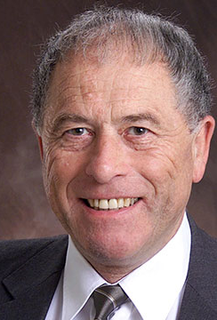
"I want to commend Dr. Veljko Milutinovic and Dr. Milos Kotlar for having completed this volume in the timely field of supercomputing in these difficult times, and I want to share their optimism regarding its use as a textbook around the world."
– Prof. Kurt Wüthrich, Nobel Laureate, Switzerland

Slide 32
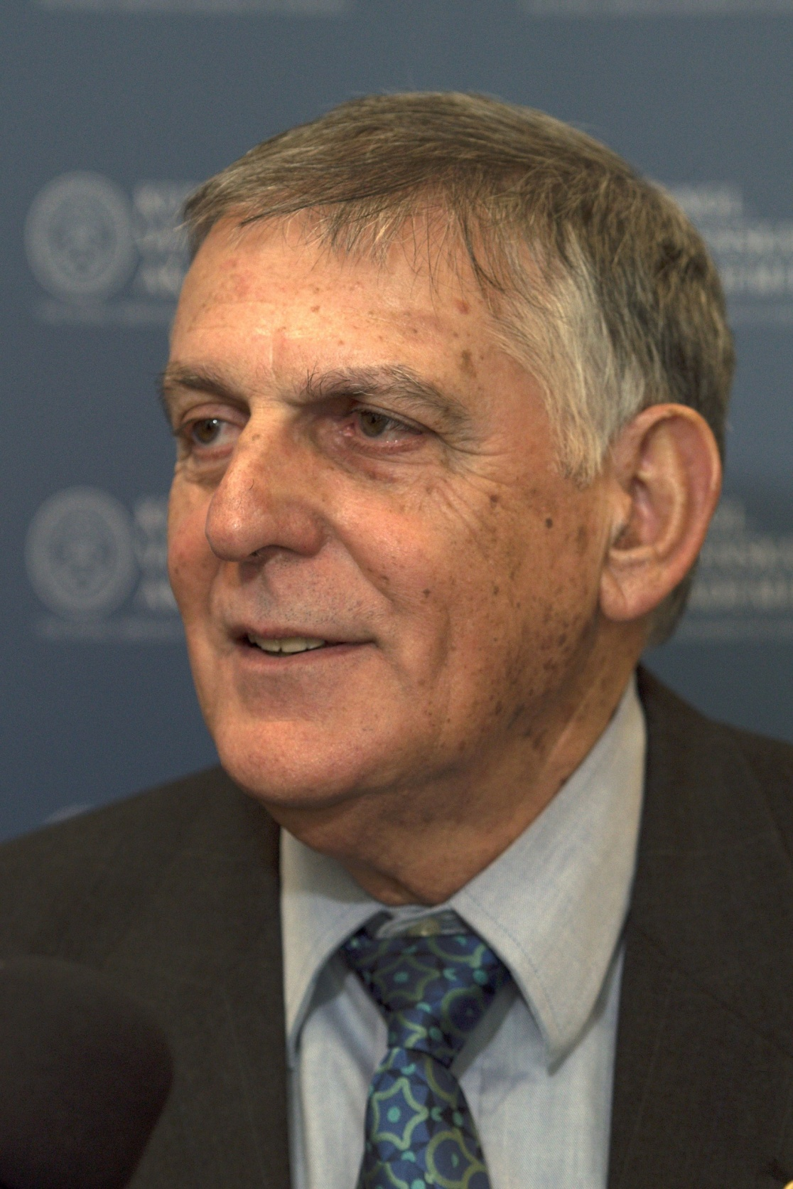
"Our complex and fast-moving world meets big data issues that call for reliable, efficient analysis and prompt response. A most advanced approach to dealing with these issues is presented in this book where algorithms of Control Flow represent the host architecture of supercomputers and Data Flow represents the acceleration architecture. A comprehensive list of applications is illustrated in the book including natural language processing, medical research, customer-oriented studies, and many more.“
– Prof. Dan Shechtman, Nobel Laureate, Israel

Slide 33
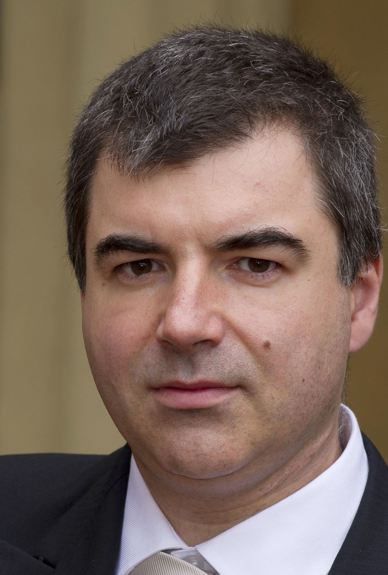
"Supercomputers have become a ubiquitous instrument in many areas of science and technology. Very hard to imagine modern physics, biology or chemistry without the use of this versatile tool. The breakthroughs in the development of supercomputers expand the range of problems we can tackle. Supercomputers, as well as specialised computers will undoubtedly contribute significantly to the overall landscape of discoveries in many different disciplines in the future."
– Prof. Konstantin Novoselov, Nobel Laureate, National University of Singapore, Singapore– Prof. Kurt Wüthrich, Nobel Laureate, Switzerland

Slide 34
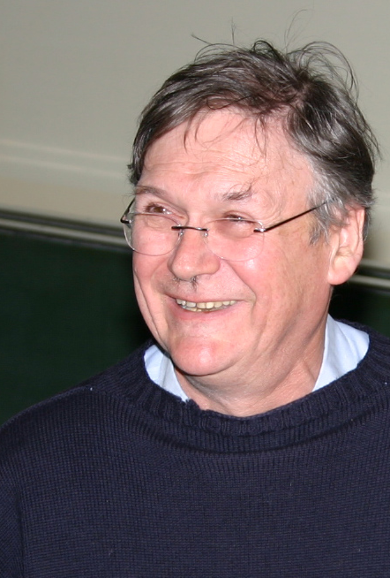
"It’s clear that computers can do anything, as the pioneers already recognised, and it’s probably only a matter of time before they can perform any of the kinds of tasks we humans take for granted quicker than blinking. I guess this book represents a stage on this exciting and very important journey."
– Prof. Tim Hunt, Nobel Laureate, UK

Slide 35
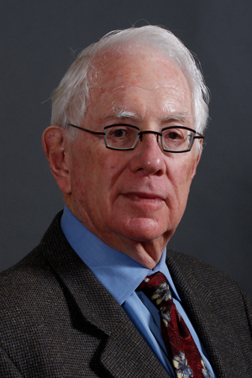
"Computers have become essential tools for the pursuit of both experimental and theoretical physics, as well as synthetic chemistry, paleontology, the medical sciences, economics the social sciences and so much more. Science, being the most international of all endeavors, will be well served by this important book, which honors the golden anniversary of the creation of Montinegro’s Academy of Science."
– Prof. Sheldon Glashow, Nobel Laureate, Boston University and Harvard University, USA

Slide 36
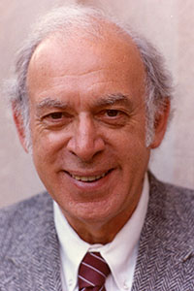
"Humankind’s continuing quests to uncover, understand, and utilize the secrets of nature have been greatly enhanced and will be further extended by the power of supercomputers."
– Prof. Jerome I Friedman, Nobel Laureate, USA

Slide 37
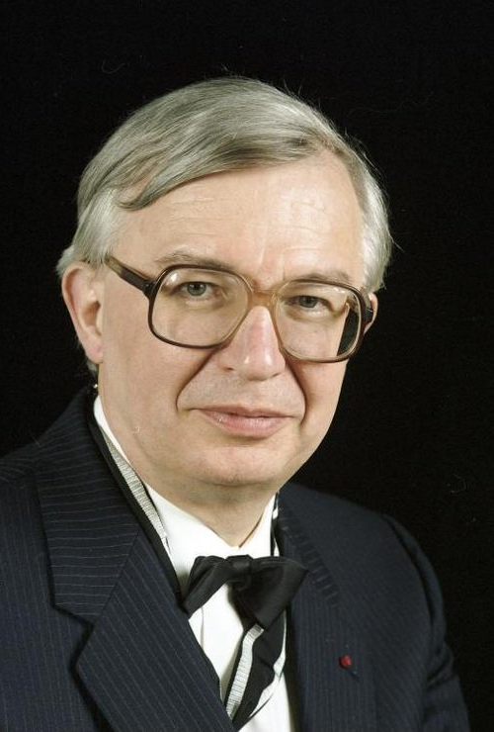
"I wish to congratulate very warmly the Montenegrin Academy of Arts and Sciences on the occasion of its 50th Anniversary and wish the CANU a highly successful future. Science shapes the Future of Mankind."
– Prof. Jean-Marie Lehn, Nobel Laureate, France

Slide 38
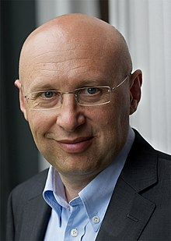
"Aim high, stay grounded! These four crisp words of wisdom accompany the best wishes for the 50th anniversary of the Montenegrin Academy of Sciences and Arts."
– Prof. Stefan Hell, Nobel Laureate, Germany

Slide 39
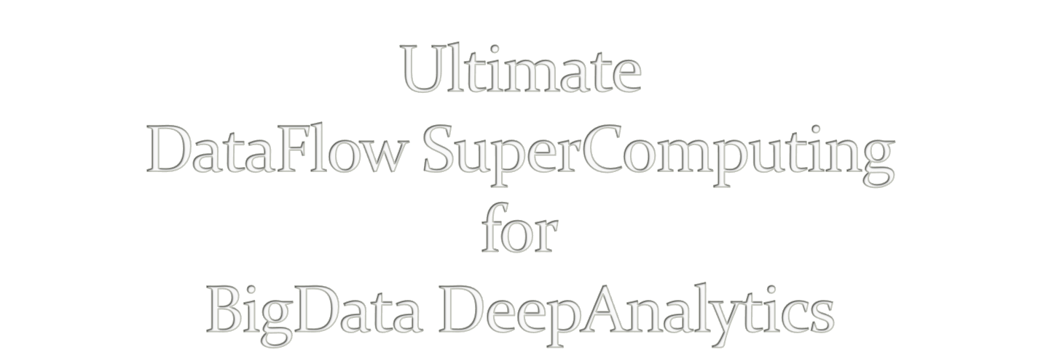
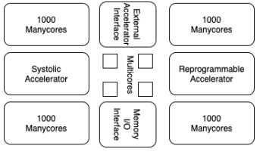
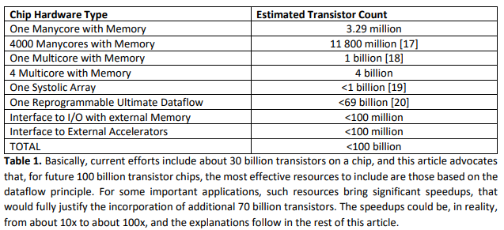
V. Milutinovic, University of Indiana, Bloomington, USA
Acknowledgements: O. Mencer, Imperial College, London, GBR, M.J. Flynn, Stanford University, Palo Alto, USA,
M. Kotlar, School of Electrical Engineering, University of Belgrade, SRB
39

Slide 40

A. Richard Feynman:
Impact of logic/arithmetic and memory/IO
Compiler-generated execution graph
Ilya Prigogine:
Impact of energy, entropy, order, and optimization
Compiler-generated data separation
Daniel Kahneman:
Impact of approximate computing on precision
Compiler-controlled approx computing
Tim Hunt:
Impact of system latency on precision
Compiler-controlled system latency
40

Slide 41

A. Whenever the Technology changes,
the Fundamental Paradigm of Computer Architecture
has to change, too.
aSoG (not: FPGA)
B. If several paradigms are available,
the most suitable paradigm for adoption
is the one most effective for modern Applications.
BrontoData (not: ExaBigData)
Is the von Neumann Paradigm still the most effective one?
A. MultiCores?
B. ManyCores?
41

Slide 42


Applications
Architecture
Size
Power
Speedup
Precision
Technology
42

Slide 43
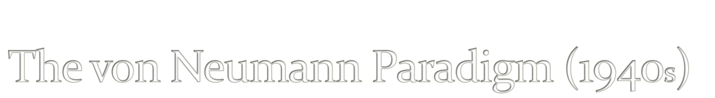
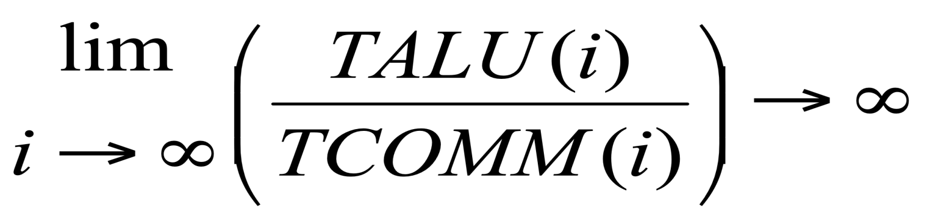
43

Slide 44

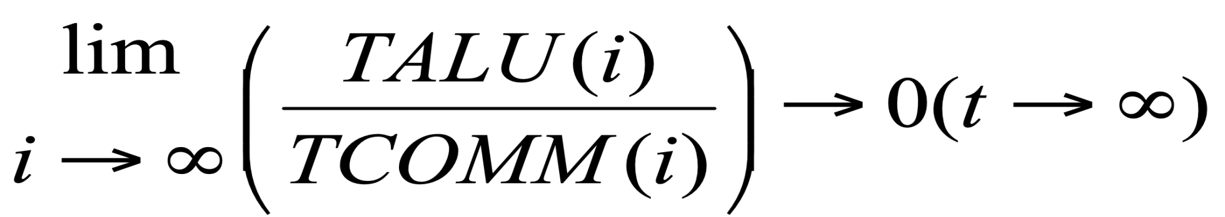
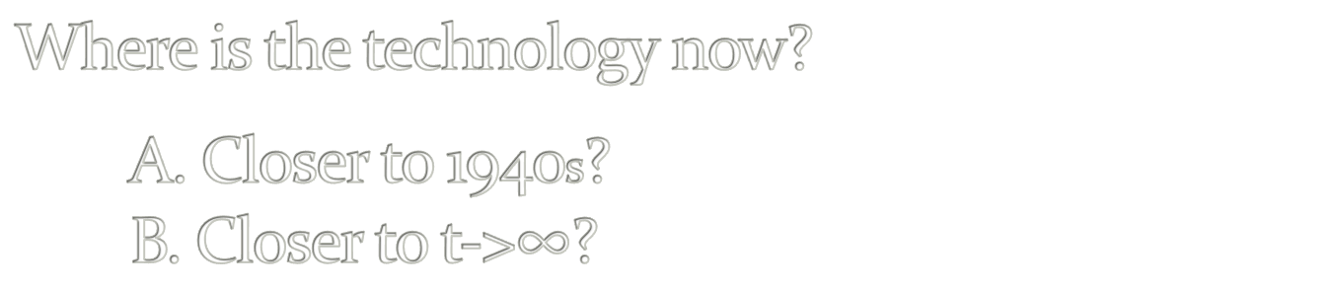
44

Slide 45
The Power Challenge
State of the Art in Technology Today
The Data Movement Challenge
 | 2015 | 2020
Double precision FLOP | 100pj | 10pj
Moving data to off-chip memory | 5000pj | 2000pj
Moving data off-chip will use 200x more energy than computing!
Moving data in 1940s was using 1/60x ...
Conclusion: We are getting close to the Feynman Asymptote!
Important: Power and speed could be traded!
45
Notes:
So what is dataflow buying us? Predictable performance, simpler architecture (no OOO – with its power & area overhead), and less data movement

Slide 46


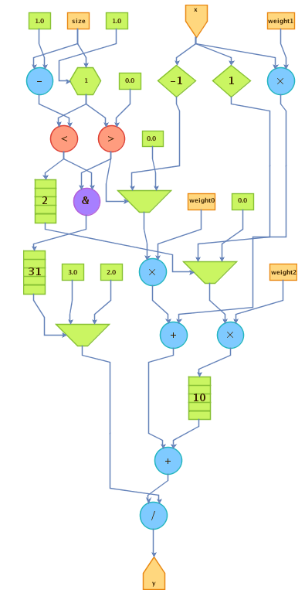
The Maxeler Technology Vision: MultiScale DataFlow
Space
Thinking in space
rather than in time
Difficult change in mindset
to overcome
Transformation of data
through flow over time
Instructions are parallelized
across the available space
Flow / Time
Optimal Solution: Execution Graph
46

Slide 47

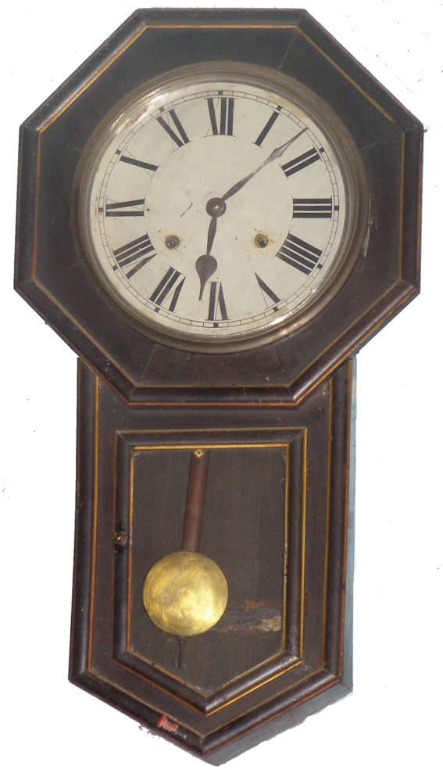
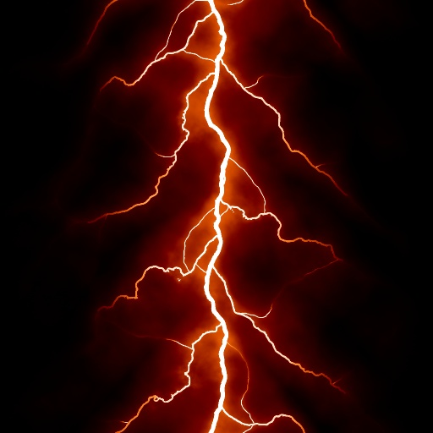
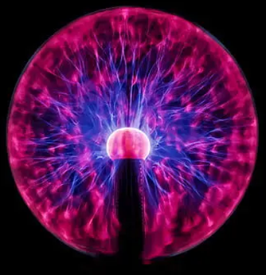
The Von-Neumann paradigm resembles an old wall clock
The Feynman paradigm resembles lightning!
Why?
47

Slide 48

von Neumann:
The Program Moves Data
Feynman:
The Program Configures Hardware
What moves data?
External sources till input.
Voltage difference through aSoG!
Voltage difference moves the important stuff!
48

Slide 49
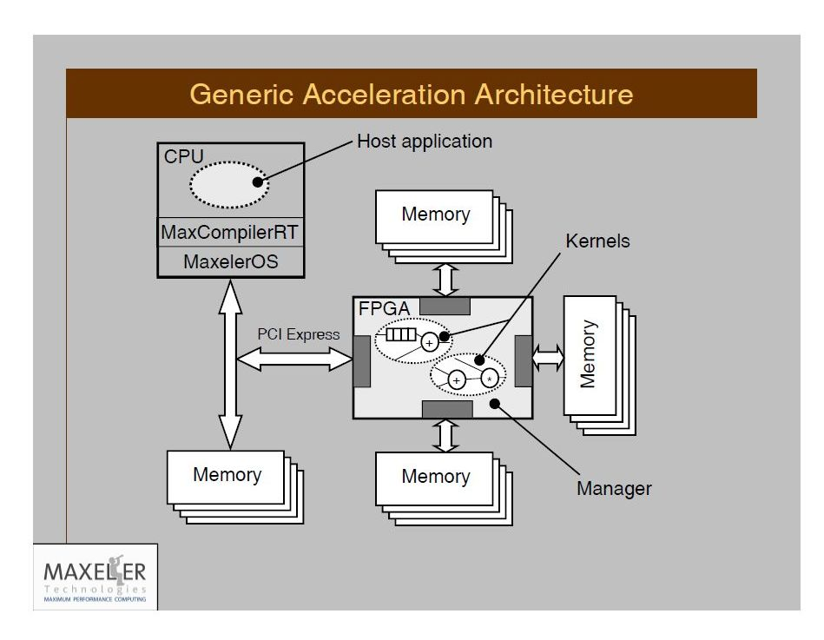
The Maxeler Generic Architecture Application
+ Tests
aSoG
Simulator builder
Hardware builder
2n+3
Important: Supporting any CL and any OS!
49

Slide 50

Nobel Laureate Ilya Prigogine:
Injecting Energy to Decrease Entropy!
Corollary:
Burning energy to split spatial and temporal
decreases the entropy of computing
and enables the DataFlow compiler
to create a maximally effective execution graph.
Final goal:
The execution graph with the minimal length of edges.
50

Slide 51
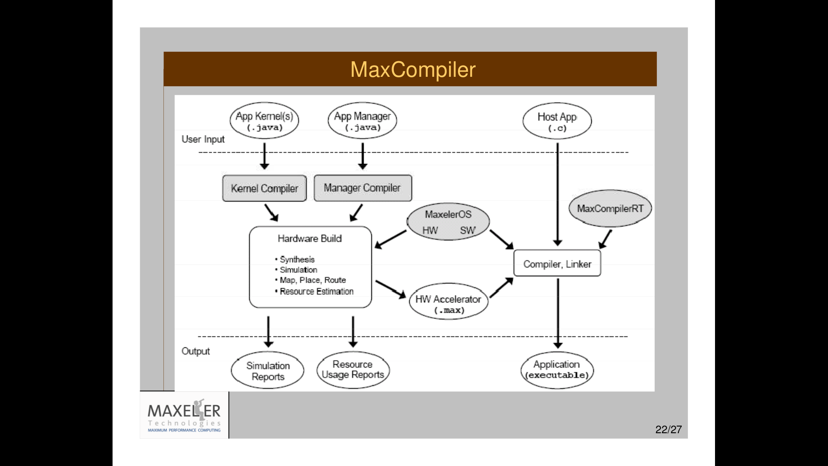

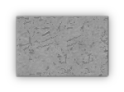
51

Slide 52

Intel acquired Altera
Qualcomm and IBM teaming up with Xilinx
However:
C C C
OpenCL(I) OpenCL(A) MaxCompiler
Intel Altera Altera@MaxZ
1 X>>1 Y>>X
52

Slide 53

Invisible on the DataFlow Concept Level
Invisible to DataFlow Programmers
Visible to the MaxCompiler
The MaxCompiler knows how to utilize them
Best protected by two aSoG (now FPGA) protection levels
and two Vendor (e.g., Maxeler) protection levels!
53

Slide 54
Publications of Interest for NanoAcceleration
===========================================================================================================
Flynn, M., Mencer, O., Milutinovic, V., Rakocevic, G., Stenstrom, P., Trobec, R., Valero, M.,
Moving from Petaflops (on Simple Benchmarks) to Petadata per Unit of Time and Power (On Sophisticated Benchmarks),
Communications of the ACM (nano-acceleration), May 2013.
2. Trobec, R., Vasiljevic, R., Tomasevic, M., Milutinovic, V., Beiveide, M., Valero, M.,
Interconnection Networks for SuperComputing,
ACM Computing Surveys (nano-acceleration) , 2017.
------------------------------------------------------------------------------------------------------------------------------------------------------------------------------
3. Milutinovic, V., Tomasevic, M., Markovic, B., Tremblay, M.,
The Split Temporal/Spatial Cache: Initial Performance Analysis,
Proceedings of the SCIzzL-5, Santa Clara, California, USA, March 26, 1996, pp 72-78.
4. Milutinovic, V., Tomasevic, M., Markovic, B., Tremblay, M.,
The Split Temporal/Spatial Cache: Initial Complexity Analysis,
Proceedings of the SCIzzL-5, Santa Clara, California, USA, September, 1996.
------------------------------------------------------------------------------------------------------------------------------------------------------------------------------
5. Milutinovic, V.,
A Comparison of Suboptimal Detection Algorithms Applied to the Additive Mix of Orthogonal Sinusoidal Signals,
IEEE Transactions on Communications, Vol. COM-36, No. 5, May 1988, pp. 538-543.
6. Milutinovic, V.,
Mapping of Neural Networks on the Honeycomb Architectures,
Proceedings of the IEEE, Vol. 77, No 12, December 1989, pp. 1875-1878.
------------------------------------------------------------------------------------------------------------------------------------------------------------------------------
7. Helbig, W., Milutinovic, V.,
The RCA's DCFL E/D MESFET GaAs 32-bit Experimental RISC Machine,
IEEE Transactions on Computers, Vol. 36, No. 2, February 1989, pp. 263-274.
8. Jovanovic, Z., Milutinovic, V.,
FPGA Accelerator for Floating-Point Matrix Multiplication,
IEE Computers & Digital Techniques (nano-acceleration), 2012, 6, (4), pp. 249-256.
The IET 2014 Premium Award for Computing & Digital Techniques. AWARDED AS THE SINGLE TWO-YEAR BEST PAPER
==========================================================================================================
Inspired by:
Feynman
Inspired by:
Prigogine
Inspired by:
Kahneman
Inspired by:
Hunt

Slide 55
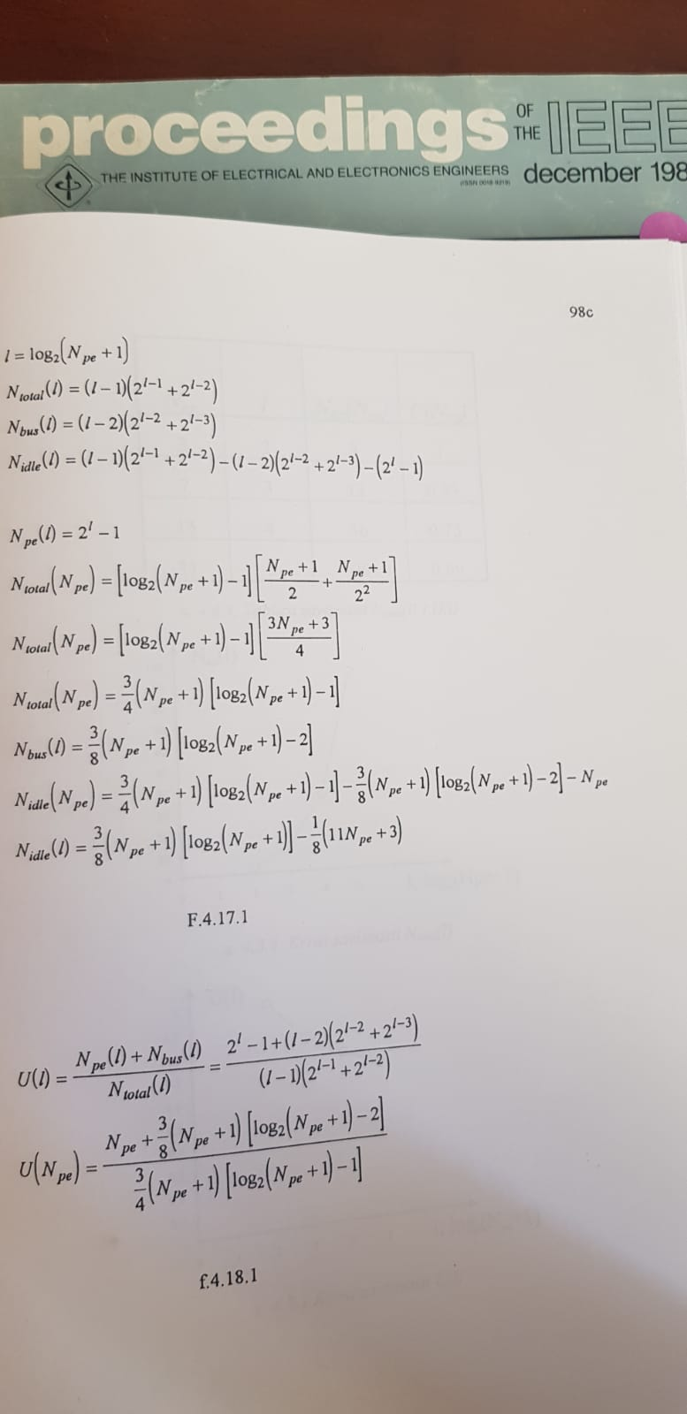
Feynman
55

Slide 56
Prigogine
56

Slide 57
Kahneman
57

Slide 58
Hunt
58

Slide 59
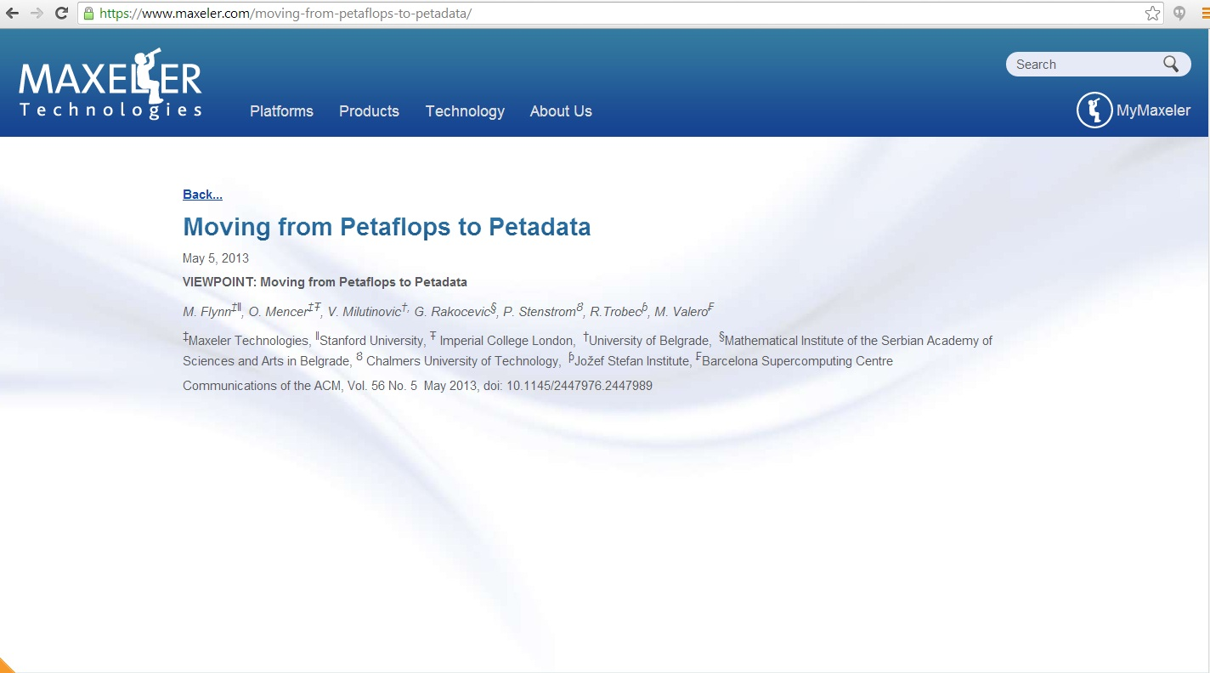
Special Acknowledgements to:
Simon Aglionby, Georgi Gaydadjiev, Itay Greenspon, and Nemanja Trifunovic
IF(2012)=3.80
59

Slide 60

IF (2007) = 15
60

Slide 61


Essence: Feynman Enabled by Prigogine
TALU possible at zero power (Arithmetic+Logic)
TCOMM not possible at zero power (MEM+MPS)
61

Slide 62
Essence: Feynman
TALU possible at zero power (Arithmetic+Logic)
TCOMM not possible at zero power (MEM+MPS)
62

Slide 63
Essence: Feynman
TALU possible at zero power (Arithmetic+Logic)
TCOMM not possible at zero power (MEM+MPS)
63

Slide 64

a DSL acting as a SuperSet of classical Java:
A. A vector of built-in domain-specific classes
B. Two sets of variables: SW + HW
MaxJ is a SubSet of OpenSPL,
created by the Imperial-Stanford-Tokyo-Tsinghua consortium.
Possible Future Mutations of OpenSPL:
MaxPython and/or MaxR
(lower Kolmogorov complexity)
MaxHaskel and/or MaxScala
(easier extension to approximate computing).
MaxJ, the Maxeler Java,
64

Slide 65

Note: Small approximations in one domain
may bring large benefits in another domain
Example: Weather forecast
A 15-bit computational precision (rather than the 64-bit precision)
may decrease the forecast precision for only 2%,
and at the same time,
may increase the grid precision 25 times,
and the forecast precision at grid intersections up to 10⁴.
Easily doable in DataFlow, difficult to do in ControlFlow.
65

Slide 66
Delayed Decision for Better Precision: Hunt
Note: Small latencies in time domain
may bring large benefits in precision domains
Example: Optimal utilization of internal DataFlow pipelines
Compiler optimizations create internal pipelines
that experienced DataFlow programmers know how to utilize
66

Slide 67


Existing Maxeler-based publications:
Ultimate aSoG-based future:
20 [Size]
20 [Power]
20, 200 [Speedup]
20 [Precision]
20-200 [Size]
20-200 [Power]
20, 200, 2000, 20000 [Speedup]
20+ [Precision]
Applications
Architecture
Technology
67

Slide 68








Maxeler Dataflow Appliance
40U: Good for Cloud
Software Based Solution
Dataflow Computing in the Datacentre
The CPU
Conventional CPU cores and
up to 6 DFEs with 288GB of RAM
The Dataflow Appliance
Dense compute with 8 DFEs, 768GB of RAM and dynamic allocation of DFEs to CPU servers with zero-copy RDMA access
The Networking Appliance
Intel Xeon CPUs and 4 DFEs with direct links to up to twelve 40Gbit Ethernet connections
1U: Good for Fog
MicroMAX.5: Good for Dew (Edge Processing of IoT Data)
68

Slide 69

The Essential Figure:
Introduction
t_{CPU} =
N * N_{OPS} * C_{CPU}*T_{clkCPU} /N_{coresCPU}
t_{GPU} =
N * N_{OPS} * C_{GPU}*T_{clkGPU} / N_{coresGPU}
t_{DF} = N_{OPS} * C_{DF} * T_{clkDF} +
(N – N_{DF}) * T_{clkDF} / N_{DF}
Assumptions:
1. Software includes enough parallelism to keep all cores busy
2. The only limiting factor is the number of cores.
69

Slide 70
The Major Application Successes
Finances:
  Credit derivatives
  Risk assessment
  Stability of economical systems
  Evaluation of econo-political mechanisms
GeoPhysics:
  Oil&Gas
  Weather forecast
  Astronomy
  Climate changes
Science:
  Physics
  Chemistry
  Biology
  Genomics
Engineering: Synergy of all the Above (ML, etc...)
70

Slide 71

71

Slide 72

The know-how needed for deep security!
72

Slide 73


73

Slide 74





Juniper for Online Trading
NASDAQ
74

Slide 75

75

Slide 76

Seismic Imaging
Running on MaxNode servers
- 8 parallel compute pipelines per chip
- 10x less power: 150MHz vs 1.5GHz
- 30x faster than microprocessors
An Implementation of the Acoustic Wave Equation on FPGAs
T. Nemeth†, J. Stefani†, W. Liu†, R. Dimond‡, O. Pell‡, R.Ergas§
†Chevron, ‡Maxeler, §Formerly Chevron, SEG 2008
76

Slide 77







Global Weather Simulation: Size is Relevant
Atmospheric equations
Equations: Shallow Water Equations (SWEs)
[L. Gan, H. Fu, W. Luk, C. Yang, W. Xue, X. Huang, Y. Zhang, and G. Yang, Accelerating solvers for global atmospheric equations through mixed-precision data flow engine, FPL2013]
Tsinghua
77

Slide 78


Weather Model – Performance Gain
Platform | Performance () | Speedup
6-core CPU | 4.66K | 1
Tianhe-1A node | 110.38K | 23x
MaxWorkstation | 468.1K | 100x
MaxNode | 1.54M | 330x
14x
78

Slide 79


Weather Model -- Power Efficiency
Platform | Power Efficiency ( ) | Speedup
6-core CPU | 20.71 | 1
Tianhe-1A node | 306.6 | 14.8x
MaxWorkstation | 2.52K | 121.6x
MaxNode | 3K | 144.9x
9 x
79

Slide 80




Weather and Climate Models: Precision
Which one is better?
Finer grid and higher precision are obviously preferred
but the computational requirements will increase ➔ Power usage → $$
What about using reduced precision? (15 bits instead of 64 double precision FP)
The most accurate climate model is developed by a civil engineer
(Milutin Milankovic)
80

Slide 81



Maxeler Running Smith Waterman
81

Slide 82





Niederman-Wuensch
82

Slide 83


Analysis of the Tensor Calculus Operations on DataFlow
(PhD Thesis by Miloš Kotlar, on DataFlow-based Machine Learning)
  The speedup of 6.75x achieved as early as for KiloData (Perceptron),
  with 10x less on-chip transistors and the power savings of 4.6x
83

Slide 84


Conditions for the Y-Chart-Based “Kernelization” of Loops @ML
(PhD Thesis by Nenad Korolija, on the Mapping of Algorithms onto DataFlow)
1. | BigData (RAM vs. STREAM) | O(n²)
2. | Code reusability (WORO vs. WORM) | +
3. | Overall application tolerance to latency | +
4. | Over 95% of run time in loops | ++
5. | Reusability of the data in loops | ++
6. | Potential for utilization of pipes | O(n)
Essentials for speedup:
algorithmic modifications,
pipeline utilization,
data choreography,
decision making on precision
84

Slide 85

Nenad Korolija: Value Profiling for GRF (UBG)
PDE(FE) for risk assessment
PDE(FD) for emergency warnings
BOTH for complex simulations
ML for intelligence upgrade (TENSOR CALCULUS)
Input: Output:
vectors to analyse min-max values
85

Slide 86

Nenad Korolija: Reducing Precision for GRF (UBG)
+, -, *, / operators overloading with custom (reduced precision).
Leonardo Da Vinci was also a civil engineer !
86

Slide 87

appgallery.maxeler.com
http://www.mi.sanu.ac.rs/~appgallery.maxeler/
87

Slide 88

88

Slide 89

89

Slide 90

appgallery.maxeler.com
http://www.mi.sanu.ac.rs/~appgallery.maxeler/
90

Slide 91

webide.maxeler.com
https://maxeler.mi.sanu.ac.rs
91

Slide 92

webide.maxeler.com
https://maxeler.mi.sanu.ac.rs
92

Slide 93

93

Slide 94



94

Slide 95


MultiCore
Which way are the horses going?
DualCore?
95

Slide 96


ManyCore
Is it possible
to use 2000 chicken instead of two horses?
?
==
What is better, real and anecdotic?
96

Slide 97



DataFlow
Data
How about 2 000 000 ants?
97

Slide 98
DataFlow
Big Data Input
98

Slide 99
DataFlow
FPGA
Big Data Input
99

Slide 100

DataFlow
FPGA
Big Data Input
Results
Marmelade
100

Slide 101

An Edited Book Covering the Applications
http://www.amazon.com/Dataflow-Processing-Volume-Advances-Computers/dp/0128021349
http://www.elsevier.com/books/dataflow-processing/milutinovic/978-0-12-802134-7
Indexed by: WoS (SCI)
Contributions welcome for the follow-ups: Vol. 102 + Vol. 104 + Vol.126 + etc…
101

Slide 102

An Original Book Covering the Essence
http://www.amazon.com/Guide-DataFlow-Supercomputing-Concepts-Communications/dp/3319162284
http://www.springer.com/gp/book/9783319162287
The first source to use the term the Feynman Paradigm in contrast with the Von Neumann Paradigm
102

Slide 103

Alibaba recently did the same!
103

Slide 104


Intel says logic is faster than GPUs
Alibaba recently claimed the same!
104

Slide 105
QoL
Maxeler is one of the Top 10 HPC projects
to impact QoL in the World :)
Scientific Computing
[www.scientificcomputing.com/articles/2014/11]
by
Don Johnson
of
Lawrence Livermore National Labs
[editor@ScientificComputing.com]
105

Slide 106


How About QoL?
106

Slide 107
DataFlow Paradigms
SW
Arvind’s PhD at MIT, under Dennis
HW
Oskar’s PhD at Stanford, under Flynn
AW
Osama’s PhD at Purdue, under Irfanoglu
A new paradigm developed by a civil engineer
WW
Alas’ PhD at Sorbonne, under Hermite
107

Slide 108
Essence of the Paradigm for HW:
For Big Data algorithms
and for the same hardware price as before,
achieving:
a) speed-up, 20-200
b) monthly electricity bills, reduced 20 times
c) size, 20 times smaller
d) precision, X times better
The major issues of engineering are: design cost and design complexity.
Remember, economy has its own rules: production count and market demand!
108

Slide 109
Why is DataFlow so Much Faster?
Factor: 20 to 200
MultiCore/ManyCore
DataFlow
Machine Level Code
Gate Transfer Level
109

Slide 110

Why are Electricity Bills so Small?
Factor: 20
MultiCore/ManyCore
DataFlow
110

Slide 111
Why is the Cubic Foot so Small?
Factor: 20
MultiCore/ManyCore
DataFlow
Data Processing
Process Control
Process Control
Data Processing
111

Slide 112

Why is the Precision Better?
Factor: X
112

Slide 113

Near Instantaneous O(1) AnalogWare Solver for Linear Symmetric Systems of Equations
Osama Abdelaleim, Purdue University (osama.mo.hashem@gmail.com)
Arun Prakash, Purdue University
Ayhan Irfanoglu, Purdue University
Veljko Milutinovic, University of Belgrade
This technology is the subject of
  U.S. Provisional Patent Application No. 63/690,322, filed on September 4, 2024.
  U.S. Provisional Patent Application No. 63/839,979, filed on July 8, 2025.

Slide 114



















Theory
$$x_{1}$$
$$x_{2}$$
$$x_{3}$$
$$b_{1}$$
$$b_{2}$$
$$b_{3}$$
$$k_{12}$$
$$k_{23}$$
$$k_{01}$$
$$k_{03}$$
$$k_{13}$$
Mapping to Resistive Network
Stiffness
Displacement
Force
$$\left[\begin{matrix}k_{01}+k_{12}+k_{13} & −k_{12} & −k_{13} \\ −k_{12} & k_{12}+k_{23} & −k_{23} \\ −k_{13} & −k_{23} & k_{03}+k_{23}+k_{13}\end{matrix}\right]\left\{\begin{aligned}x_{1} \\ x_{2} \\ x_{3}\end{aligned}\right\}=$$
$$\left[\begin{matrix} + k_{12}+k_{13} & −k_{12} & −k_{13} \\ −k_{12} & k_{12}+k_{23} & −k_{23} \\ −k_{13} & −k_{23} & + k_{23}+k_{13}\end{matrix}\right]\left\{\begin{aligned}x_{1} \\ x_{2} \\ x_{3}\end{aligned}\right\}=$$
$$\left[\begin{matrix} + k_{12} & −k_{12} & \\ −k_{12} & k_{12}+k_{23} & −k_{23} \\ & −k_{23} & + k_{23} \end{matrix}\right]\left\{\begin{aligned}x_{1} \\ x_{2} \\ x_{3}\end{aligned}\right\}=$$
$$\left[\begin{matrix} & & \\ & & \\ & & \end{matrix}\right]\left\{\begin{aligned}x_{1} \\ x_{2} \\ x_{3}\end{aligned}\right\}=$$
$$\left[\begin{matrix} + k_{12} & −k_{12} & \\ −k_{12} & k_{12} & \\ & & \end{matrix}\right]\left\{\begin{aligned}x_{1} \\ x_{2} \\ x_{3}\end{aligned}\right\}=$$
$$\left\{\begin{aligned}b_{1} \\ b_{2} \\ b_{3}\end{aligned}\right\}$$
Conductance
Voltage
Current

Slide 115

Theory
Negative Conductance/Stiffness
  Two Non-inverting opamp configurations with buffers
Operational Amplifier (opamp)

Slide 116




















Theory
Solution
Proposed Architecture
  Compute in memory (CIM)
  RAM
  Crossbar array
  The linear system of equations is solved with the complexity of
$$+4V$$
$$x_{1}$$
$$x_{2}$$
$$…$$
$$x_{n}$$
$$…$$
$$x_{2n}$$
$$−4V$$
$$x_{1}$$
$$b^{+}$$
$$K$$
$$b^{−}$$
$$x_{2}$$
$$…$$
$$x_{n}$$
$$…$$
$$x_{2n}$$
$$O(1)$$
$$GND$$

Slide 117


Q&A
vm@etf.rs
© H. Maurer
117

Slide 118

118

Slide 119

119

Slide 120

BQCD on a Maxeler Dataflow Computer
120

Slide 121

BQCD on a Dataflow Computer
Porting BQCD from BlueGene to a Maxeler Dataflow Computer
Quantum Chromodynamics (QCD): models interactions of subatomic particles
Lattice QCD (LQCD): its discretisation, suitable for numerical computation
Berlin QCD (BQCD): most popular implementation of the LQCD algorithm
Conjugate Gradient (CG): Majority of the compute time (benchmark: 68%)
  CG iteratively solves linear algebra problem of form Mx = b
  Operator M contains Wilson-dslash and Clover operators
PROJECT TARGET 40x speedup of CG part of BQCD,
followed by speedup of the entire application by 20x
comparing same size boxes Dataflow vs BlueGene/Q
121

Slide 122


Maxeler QCD - Deployment
Maxeler QCD solution is deployed at Jülich Supercomputing Center,
running on a Maxeler Dataflow system (TEV = 682.38).
 | 2 racks of Jülich BlueGene/Q machine | On-premise Maxeler Dataflow system: scale to 1PF equivalent | Factor
Volume | 6.75 m³ | 0.87 m³ | 7.76
Overall Time to Solution | 1576.60 s | 689 s | 2.29
Overall Energy to Solution | 169.6 kWh | 4.42 kWh | 38.4
Volume x TTS | 10,642.05 m³s | 599.43 m³s | 17.8
122

Slide 123

Maxeler QCD on Amazon EC2 F1
123

Slide 124


QCD Demo
124

Slide 125


QCD Demo
125

Slide 126

subEdge: microMAX₅
126

Slide 127
Purdue, IU, MIT, Harvard, Boston, NEU, Dartmouth, U of Massachusetts at Amherst, USC, UCLA, Columbia, NYU, Princeton, NJIT, CMU, Temple U,
UIUC, Michigan, Wisconsin, Minnesota, FAU, FIU, Miami, Central Florida,
U of Alabama, U of Kentucky, GeorgiaTech, Ohio State, Imperial, King's,
Manchester, Huddersfield, Cambridge, Oxford, Dublin, Cork, Cardiff,
Edinburgh, EPFL, ETH, TUWIEN, UNIWIE, Graz, Linz, Karlsruhe, Stuttgart, Bonn, Frankfurt, Heidelberg, Aachen, Darmstadt, Dortmund, KTH, Uppsala,
Karlskrona, Karlstad, Napoli, Salerno, Siena, Pisa, Barcelona, Madrid,
Valencia, Oviedo, Ankara, Bogazici, Koc, Istanbul, Technion, Haifa,
BerSheba, Eilat, Podgorica, Koper, Maribor, Ljubljana, Maribor, Nova Gorica, etc, etc. Also at the World Bank in Washington DC, IMF,
the Telenor Bank of Norway, the Raiffeisen Bank of Austria, Brookhaven
National Laboratory, Lawrence Livermore National Laboratory, IBM TJ
Watson, HP Encore Labs, Intel, Qualcomm VP, NCR, RCA, Fairchild,
Honeywell, Yahoo NY, Google CA, Microsoft, Finsoft, ABB Zurich, Oracle
Zurich, and many other industrial labs, as well as at Tsinghua University,
Shandong, NIS of Singapore, NTU of Singapore, Tokyo, Sendai, Seoul,
Pusan, HUJI, TAU, Sydney University of Technology, University of Sydney, Hobart, Auckland, Toronto, Montreal, Durango, MontereyTech, Cuernavaca, UNAM, Belgrade, Kragujevac, Novi Sad , Novi Pazar, ...

Slide 128

128

Slide 129

129

Slide 130

Olokotun at Stanford
130

Slide 131


Sunnyvale, USA + Bangalore, India + Toronto, Canada + San Diego, USA + Tokyo, Japan
131

Slide 132



Cupertino, California
132

Slide 133

133

Slide 134

Design of an SIMD Multimicroprocessor for RCA
GaAs Systolic Array Based on 4096 Node Processor Elements
Adaptive signal processing is of crucial importance for advanced radar and communications systems. In order to achieve real-time throughput and latencies, one is forced to use advanced semiconductor technologies (e.g., gallium arsenide, or similar) and advanced parallel architectures (e.g., systolic arrays, or similar).
The systolic array described here was designed to support two important applications: (a) adaptive antenna array beam forming, and (b) adaptive Doppler spectral filtering. In both cases,
in theory, the system output is calculated as the product of the signal vector x (complex
N-dimensional vector) and the weight vector w (optimal N-dimensional vector).
Complex vector x is obtained by multiplying N input samples with the corresponding window weighting function consisting of N discrete values. Optimal vector w is obtained as:
134

Slide 135


Symbol R refers to the N-by-N inverse covariance matrix of the signal with the (i,j)-th component defined as:
and symbol refers to N-dimensional vector which defines the antenna direction
(in the case of adaptive antenna beamforming)
or Doppler peak (in the case of adaptive Doppler spectral filtering).
Symbols M and v represent scaled values of R and s, respectively.
In practice, the scaled values M and v may be easier to obtain,
and consequently the remaining explanation is adjusted.
The core of the processing algorithm is the inversion of a N-by-N matrix in real time.
This problem can be solved in a number of alternative ways which are computationally less complex.
The one chosen here includes the operations explained in Figure abcd.
135

Slide 136



Positive semi definite matrix M can be defined as:
M = U D U^{T}
Matrices U and D are defined using the formula:
which is recursively updated using the formula:
a.
Legend:
SAA1 – Cells involved in root covariance update, and the first step of back substitution;
SAA2 - Cells involved in root covariance update, and in both steps of back substitution;
U – Lower triangular matrix with unit diagonal elements
D – Diagonal matrix with positive or zero diagonal elements
b – A scalar initially set to 1
K – Iteration count.
136

Slide 137


137

Slide 138


138

Slide 139


139

Slide 140
Veljko Milutinović
VLSI for SuperComputing:
From Applications and Algorithms to Masks and Chips

Slide 141
World Top Foundries in VLSI for SuperComputing
#1?

Slide 142
World Top Foundries in VLSI for SuperComputing
#1? Qualcomm

Slide 143
World Top Foundries in VLSI for SuperComputing
#1? Qualcomm
#2?

Slide 144
World Top Foundries in VLSI for SuperComputing
#1? Qualcomm
#2? Intel

Slide 145
World Top Foundries in VLSI for SuperComputing
#1? Qualcomm
#2? Intel
#3?

Slide 146
World Top Foundries in VLSI for SuperComputing
#1? Qualcomm
#2? Intel
#3? TSM (Taiwan Semiconductor Manufacturing)

Slide 147
World Top Foundries in VLSI for SuperComputing
#1? Qualcomm
#2? Intel
#3? TSM
The Qualcomm VP/TD started from this course
(first as my PhD student and later as the course TA)

Slide 148
World Top Foundries in VLSI for SuperComputing
#1? Qualcomm
#2? Intel
#3? TSM
The Qualcomm VP/TD started from this course
(first as my PhD student and later as the course TA)
An Intel VP/TD took the IR4RVL in-a-nut-shell
(at my past IEEE/ACM tutorial)

Slide 149
World Top Foundries in VLSI for SuperComputing
#1? Qualcomm
#2? Intel
#3? TSM
The Qualcomm VP/TD started from this course
(first as my PhD student and later as the course TA)
An Intel VP/TD took the IR4RVL in-a-nut-shell
(at my past IEEE/ACM-HICSS conference tutorial)
Maybe,
a Next Gen VP/TD comes from ETF

Slide 150
World Top Foundries in VLSI for SuperComputing
#1? Qualcomm
#2? Intel
#3? TSM
The Qualcomm VP/TD started from this course
(first as my PhD student and later as the course TA)
An Intel VP/TD took the IR4RVL in-a-nut-shell
(at my past IEEE/ACM-HICSS conference tutorial)
Maybe,
a next TSM VP/TD comes from ETF
or MAT

Slide 151
World Top Foundries in VLSI for SuperComputing
#1? Qualcomm
#2? Intel
#3? TSM
The Qualcomm VP/TD started from this course
(first as my PhD student and later as the course TA)
An Intel VP/TD took the IR4RVL in-a-nut-shell
(at my past IEEE/ACM-HICSS conference tutorial)
Maybe,
a next TSM VP/TD comes from ETF
or MAT or FFH

Slide 152
World Top Foundries in VLSI for SuperComputing
#1? Qualcomm
#2? Intel
#3? TSM
#4? ???
The Qualcomm VP/TD started from this course
(first as my PhD student and later as the course TA)
An Intel VP/TD took the IR4RVL in-a-nut-shell
(at my past IEEE/ACM-HICSS conference tutorial)
Maybe,
a next TSM VP/TD comes from ETF
or MAT or FON or Your University
Creativity is the Key!

Slide 153

Who works here?

Slide 154
The Holistic Foundry (R&DFab) in VLSI for SuperComputing
Phase#1: From Applications to Algorithms
Phase#2: From Algorithms to Masks
Phase#3: From Masks to Chips
Phase#4: From Chips to Applications

Slide 155
The Holistic Foundry (R&DFab) in VLSI for SuperComputing
Phase#1: From Applications to Algorithms
Phase#2: From Algorithms to Masks
Phase#3: From Masks to Chips
Verification is crucial
in each one of these phases,
and related teaching is done in coop
with ELSYS or HDLDH!

Slide 156
The Holistic Foundry (R&DFab) in VLSI for SuperComputing
Phase#1: From Applications to Algorithms
Phase#2: From Algorithms to Masks
Phase#3: From Masks to Chips
Phase#4: From Chips to Applications
Verification is crucial
in each one of these phases,
and related teaching is done in coop with ELSYS or HDLDH!
Management issues of importance for an R&D Fab
are covered in the accompanying course: IR4USP
(including 12 related homework assignments)!

Slide 157

Contents:
From Algorithms to Masks
Part#1: VLSI for ControlFlow SuperComputing
Part#2: VLSI for DataFlow SuperComputing
Part#3: VLSI for WirelessFlow SuperComputing
Part#4: VLSI for EnergyFlow SuperComputing (QMOC)

Slide 158
VLSI for ControlFlow SuperComputing
ManyCore Systems:
Enabler Technology: VHDL vs Verilog (0.5 weeks)
Design and Programming of a 200MHz RISC Microprocessor (2.5 weeks) + HW#1
MultiCore Systems:
Enabler Technology: Verification by Elsys (2 weeks) + Lab#1
Design of MicroProcessor and MultiMicroProcessor Systems by Wiley (1 week)

Slide 159


Slide 160


Slide 161
VLSI for DataFlow SuperComputing
FineGrain DataFlow:
Enabler Technology: Altera vs Xilinx (0.5 weeks)
Design and Programming of the 200MHz Maxeler Machine (3.5 weeks) + HW#2
SystolicArray DataFlow:
Enabler Technology: Systolic Array Architectures (0.5 weeks)
Design of DARPA Systolic Architectures (0.5 weeks) + Lab#2

Slide 162

On Flexible DataFlow:
Advances in Computer Architecture (North Holland)
by Veljko M. Milutinovic
with a contribution from John Hennessy

Slide 163

On Fixed DataFlow:
High-Level Language Computer Architecture
(Elsevier Computer Science Press)
by Veljko M. Milutinovic
with a contribution from Michael Flynn

Slide 164
VLSI for WirelessFlow SuperComputing
WSNs: Part#1
Hardware (0.25 weeks)
Software (0.25 weeks)
WSNs: Part#2
Systems (SUN+Slimmer) (0.25 weeks)
Applications (UbiComputing@WSN+DataMining@WSN) (0.25 weeks)
The stress is on integration of WSNs, IoT, Ethernet, and Internet:
Z. Babovic et al., “Web Performance Evaluation of Internet of Things Applications,” IEEE Access 2016.

Slide 165


Slide 166


Slide 167
VLSI for Quantum, Optical, Molecular, and Chemical SuperComputing
Basics:
Hardware (N weeks)
Software (N weeks)
Advances:
Systems (N weeks)
Applications (N weeks)
Optional class projects for extra points!

Slide 168
Quantum Computing
A quantum computer uses qubits
to run multidimensional quantum algorithms.
Their processing power increases exponentially
as qubits are added.
A classical processor uses bits
to operate various programs.
Their power increases linearly as more bits are added.
168

Slide 169
Potentials:
Quantum computing is 158 million times faster
than the most sophisticated supercomputer
we have in the world today.
It is a device that could do in four minutes
what it would take a traditional supercomputer
10,000 years to accomplish.
169

Slide 170

Reality:
170

Slide 171
The First Eight Companies in Quantum Computing:
Atom Computing
Xanadu
IBM
ColdQuanta
Zapata Computing
Azure Quantum
D-Wave
Strangeworks
171

Slide 172

Beginnings:
172

Slide 173
Maybe the Best Quantum Computing Stocks:
IBM (NYSE: IBM)
Alphabet (Nasdaq: GOOG, Nasdaq: GOOGL)
Intel (Nasdaq: INTC)
Microsoft (Nasdaq: MSFT)
Amazon (Nasdaq: AMZN)
Quantum Computing (OTC: QUBT)
173

Slide 174
State of the Art:
100 miliKelvins (Al) vs 4 Kelvins (Diamond)
Problems:
  Getting data and programs in
  Getting results and decisions out
  Without loosing the speed
  With radiation hardness
Examples:
  Quantum Machines at TAU
  Applied Physics at HUJI

Slide 175

TAU

Slide 176


100 miliKelvins

Slide 177

HUJI

Slide 178


4 Kelvins

Slide 179




QC vs DF (from Cloud till QC) / Speed!
179

Slide 180

QC vs DF (from Cloud till QC) / RadHard!
GaAs helps for both, RadHardness and Speed!
There is no help after physical damage!
180

Slide 181
RHard QCs (1)
The least radiation sensitive quantum computers are generally those based on trapped-ion qubits and topological qubits.
Trapped-ion qubits, used by companies like IonQ and Oxford Ionics,
represent qubits as individual ions suspended in electromagnetic fields and manipulated by laser pulses.
These qubits exhibit significantly longer coherence times and lower error rates compared to superconducting qubits,
contributing to a higher resilience against radiation-induced errors. However, they face scalability challenges.
​Topological qubits, still in the experimental stage (notably pursued by Microsoft),
offer the potential for intrinsic error resistance due to their unique quantum state protection mechanisms,
making them promising candidates for radiation hardness in the future.
They aim to use quasiparticles called Majorana fermions
that could be more robust to environmental disturbances including radiation.
In contrast, superconducting qubits, such as those used by IBM and Google,
while commercially mature and scalable, are sensitive to cosmic rays and gamma radiation
causing quasiparticle bursts that increase error rates.
Materials engineering can mitigate some effects,
but radiation remains a critical challenge for superconducting platforms.
Photonics-based quantum computers may also offer advantages
since photons are less susceptible to certain types of radiation and operate at room temperature,
but this technology is still developing.
181

Slide 182
RHard QCs (2)
Basic materials that contribute to making quantum computing radiation hard
focus on minimizing radiation-induced disruption to qubits,
especially in superconducting and semiconductor qubits.
Key materials include:
  Superconducting materials such as niobium (Nb), aluminum (Al), and titanium nitride (TiN)
  are commonly used in qubits.
  Research indicates that using high-purity substrates and optimizing interfaces (e.g., Josephson junctions)
  help reduce defects and quasiparticle generation caused by radiation, thus improving radiation tolerance.
  Semiconductor materials like isotopically purified silicon (Si) and diamond with low nitrogen content
  enhance intrinsic radiation resistance by reducing spin-active nuclei or defect densities.
  Alternative superconducting materials, such as tantalum,
  have demonstrated superior coherence times under irradiation compared to aluminum.
  Shielding materials with high density like tungsten or boron-doped polyethylene can attenuate radiation,
  though they add complexity and mass.
  Minimizing substrate thickness is also beneficial as thicker silicon substrates actually absorb more radiation energy,
  causing greater disruption.
In summary, radiation-hard quantum computing materials typically involve carefully chosen superconductors
and semiconductors characterized by high purity and minimal defects, use of isotopically enriched substrates,
and physical design considerations like substrate thinning and shielding to mitigate radiation effects.
182

Slide 183
From Python to Quantum (1)
Transition Steps:
Install Libraries: Use pip to add Qiskit, Cirq, or PennyLane (e.g., pip install qiskit).
Learn Basics: Understand qubits, superposition, gates; review linear algebra.
Build Circuits: Create quantum circuits in Python (e.g., QuantumCircuit(2); apply H, CX gates).
Simulate/Execute: Run on simulators, then cloud hardware like IBM Quantum.
Optimize & Analyze: Transpile, measure results, iterate for algorithms.
Key Insight: Python SDKs abstract hardware, enabling hybrid classical-quantum workflows.
Basic Goal:
Minimal loss due to paradigm change!
​
183

Slide 184
From Python to Quantum (2)
What is Transpilation?
Rewriting input quantum circuits
to match target hardware topology, native gates, and connectivity
while optimizing for depth/errors.
​
Key Stages of Transpilation:
Init: Unroll custom gates to single/two-qubit basis.
Translation: Decompose to hardware's native gates (e.g., CX, rotations).
Optimization: Reduce gate count/depth via cancellation, synthesis.
Layout/Routing: Map logical qubits to physical; add swaps for connectivity.
Scheduling: Align gates temporally for hardware timing.
Purpose: Enables execution on real QPUs
by minimizing errors from noise/decoherence.
184

Slide 185
DataFlow from Cloud to Quantum
The Process:
Client App: User submits job via API; uploads input data to cloud storage.
Queue/Submit: Classical app authenticates (e.g., managed identity), sends job to quantum workspace/provider.
Transpile/Schedule: Circuit optimized for target QPU (gates, topology).
Execute: Provider runs on quantum hardware/simulator; results stored in cloud storage.
Retrieve: Client polls status, fetches results asynchronously via API.
Key: Hybrid async pattern bridges classical cloud (storage, auth) to remote QPUs.
The Essence:
Input = Information from the cloud.
Core = DataFlow execution graph.
Output = In the ideal case, a vector of 2¹² elements.
185

Slide 186

Libraries:
TensorFlow Quantum (TFQ) for AI
is a quantum machine learning library
for rapid prototyping
of hybrid quantum-classical ML models.
Interfacing for control-flow:
Amdahl’s law is the limitation factor
186

Slide 187
Tensor Flow Quantum:
TensorFlow Quantum focuses on quantum data
and building hybrid quantum-classical models.
It integrates quantum computing algorithms
and logic designed in Cirq,
and provides quantum computing primitives
compatible with existing TensorFlow APIs,
along with high-performance quantum circuit simulators.
187

Slide 188
A Programming Example:
# A hybrid quantum-classical model.
model = tf.keras.Sequential
([
# Quantum circuit data comes in inside of tensors.
tf.keras.Input(shape=(), dtype=tf.dtypes.string),
# Parametrized Quantum Circuit (PQC) provides output
# data from the input circuits run on a quantum computer.
tfq.layers.PQC(my_circuit, [cirq.Z(q1), cirq.X(q0)]),
# Output data from quantum computer passed through model.
tf.keras.layers.Dense(50)
])
State of the art: ?
188

Slide 189
Optical Computing
Optical computing or photonic computing
uses light waves produced by lasers
or incoherent sources for data processing,
data storage or data communication for computing.
For decades, photons have shown promise
to enable a higher bandwidth
than the electrons used in conventional computers.
189

Slide 190
Essence:
“Computation-by-propagation,
where the computation takes place
as the wave propagates through a medium,
can perform computation at the speed of light!”
Speed of light = 300.000km/sec
190

Slide 191
Applications:
Application-specific devices,
such as synthetic-aperture radar (SAR)
and optical correlators,
have been designed
to use the principles of optical computing.
Correlators can be used, for example,
to detect and track objects,
and to classify serial time-domain optical data.
191

Slide 192
Techniques:
Techniques have been developed
that can perform continuous Fourier Transform optically, by utilizing the natural
Fourier transforming property of lenses.
The input is encoded using
a liquid crystal spatial light modulator.
192

Slide 193
Artificial Neural Network with Optical Components:
Early optical neural networks
used a photorefractive Volume Hologram
to interconnect arrays of input neurons
to arrays of output.
With synaptic weights in proportion
to the multiplexed hologram's strength.
193

Slide 194
Optical Neural Networks:
Some artificial neural networks
that have been implemented
as optical neural networks
include the Hopfield neural network.
Also the Kohonen map
with liquid crystal spatial light modulators.
194

Slide 195
Do Photonic Chips Exist?
Now scientists have developed
a deep neural network on a photonic microchip
that can classify images in less than a nanosecond,
roughly the same amount of time
as a single tick of the kind of clocks
found in state-of-the-art electronics.
A lot more effective
compared to microprocessor based design!
195

Slide 196

Molecular Computing
Molecular computing is a branch of computing
that uses DNA, biochemistry,
and molecular biology hardware,
instead of traditional
silicon-based computer technologies,
to achieve dense computing!
Applications for dense computing are many!
196

Slide 197
Who invented DNA computing?
Leonard Adleman,
professor of computer science and molecular biology
at the University of Southern California, USA,
who pioneered the field
when he built the first DNA based computer.
L. M. Adleman, Science 266, 1021–102; 1994.
197

Slide 198
Essence:
With DNA,
the way the molecules can be triggered
to bind with each other
can be used to create a circuit
of logic gates in test tubes.
Compatible with nature based computing!
198

Slide 199
Techniques:
Many gates can be combined in a circuit:
Each output DNA will bind to the next logic gate
until some predictable terminal output strand
is liberated,
to produce an intermediate or final result.
199

Slide 200
N.B.:
In DNA computing, information is represented
using the four-character genetic alphabet:
A [adenine], G [guanine], C [cytosine], and T [thymine].
The core advantage of molecular computing is its potential
to pack vastly more circuitry onto a microchip
than silicon will ever be capable of—and to do it cheaply.
200

Slide 201
Miniaturization:
Molecules are only a few nanometers in size.
Making it possible to manufacture chips
that contain billions, even trillions,
of switches and components.
201

Slide 202
Can DNA be programmed?
Researchers at The University of Texas at Austin have programmed DNA molecules
to follow specific instructions
to create sophisticated molecular machines
that could be capable of communication,
signal processing, problem-solving, decision-making,
and control of motion in living cells.
Libraries under construction at MIT.
202

Slide 203
How does DNA computing work?
In one method, called DNA strand displacement,
the input of DNA that binds to a DNA logic gate
displaces a strand of DNA that serves as the output.
Many gates can be combined in a circuit:
Each output DNA will bind to the next logic gate
until some predictable terminal output strand
is liberated.
203

Slide 204

An Experiment:
204

Slide 205
Flexibility:
With the flexible molecular algorithms on the rise,
one might be able to assemble a complex entity
on the nanoscale
with the reprogrammable tile set.
Flexibility is the issue
for a great number of applications!
Amato and Rauchwerger, UIUC, USA
205

Slide 206

Do DNA computers exist?
The DNA Computing Technology is in the research phase.
DNA computers can't be found
at your local electronics store yet.
The technology is still in development;
it didn't even exist as a concept a decade ago.
206

Slide 207



Connecting Living Neurons Through Synapses
Systolic array connected through resistors
(varied electrical conductivity represents the strength of the connection
between the neurons/resistors - adaptable based learning)
To match the world of computing to the needs of AI, we must build computers with a structure inspired by the brain. These computers should have no separation between storage and computation, but instead use units capable of calculating and saving the values simultaneously. Electrical circuits inspired by the brain are called neuromorphic circuits
Electronic circuits that mimic the behavior of neurons in the human body.
Neuromorphic circuits can be combined to create neuromorphic computers.
In neuromorphic circuits, the same electronic components are used to both perform a calculation and to store the result locally. The structure of such a computer is completely different from a von Neumann machine, and it looks like a neural network in the brain.
Researchers from John Hopkins University and Cortical Labs suggest that it’s time to create a new type of computer that uses biological components. They believe that biological computers could outperform electronic computers in certain applications and use significantly less electricity.
State of the art: Synapses know how to find their ways!
Courtesy of Prof. Josep Torrellas, Prof. Shahar Kvatinsky, and
Researchers from John Hopkins University and Cortical Labs
207

Slide 208
ChatGPT (1): Core Idea
Neuromorphic computing is a field of computer engineering and neuroscience
that designs hardware and software systems
inspired by the structure and function of the human brain.
The idea is to move beyond the traditional von Neumann architecture
(where memory and processing are separated)
and create computing systems that integrate processing and memory,
much like biological neural networks.
Mimics the brain’s neurons and synapses in silicon.
Uses parallel, distributed processing instead of sequential execution.
Emphasizes energy efficiency, adaptability, and real-time learning.
208

Slide 209
ChatGPT (2): Hardware
Built using spiking neural networks (SNNs),
where neurons exchange information via discrete spikes, like in the brain.
Chips often integrate memory and computation locally
to reduce the “memory bottleneck.”
Notable neuromorphic chips:
  IBM TrueNorth (IBM)
  Intel Loihi / Loihi 2 (Intel)
  BrainScaleS (Heidelberg University)
  SpiNNaker (University of Manchester)
209

Slide 210
ChatGPT (3): Advantages
Low power consumption – brain-inspired designs
can perform complex computations
using orders of magnitude less energy than GPUs/CPUs.
Event-driven processing – they activate only when needed,
saving power.
On-chip learning – some systems can adapt
and learn in real time without cloud training.
Scalability – suited for massively parallel tasks.
210

Slide 211
ChatGPT (4): Applications
Robotics – real-time adaptive control, low-power sensing.
Edge AI – smart devices that can learn on-device
without cloud reliance.
Brain-machine interfaces – decoding neural signals.
Pattern recognition – speech, vision, and gesture recognition.
Scientific modeling – simulating neural processes to study the brain.
211

Slide 212
ChatGPT (5): Challenges
Programming difficulty – traditional software tools
don’t map easily onto spiking hardware.
Algorithms – while deep learning is mature,
spiking neural networks are less developed.
Hardware limitations – neuromorphic chips are still experimental
and not widely available.
Adoption barrier – industry is heavily invested in GPUs/TPUs for AI.
👉 In short, neuromorphic computing is an attempt to bridge neuroscience and computer engineering,
aiming for machines that are more brain-like: adaptive, efficient, and intelligent.
Would you like me to dive deeper into how spiking neural networks (SNNs) work,
or give a comparison with traditional deep learning?
212

Slide 213
Chemical Computing
Computing with real molecules
like programming electronic devices,
but using principles taken from chemistry
and appropriate chemical processes.
Effective for simulations in chemistry
and physical chemistry!
213

Slide 214

An Example:
214

Slide 215
A chemical computer, also called a reaction-diffusion computer:
Belousov–Zhabotinsky (BZ) computer, or gooware computer,
is an unconventional computer
based on a semi-solid chemical "soup"
where data are represented
by varying concentrations of chemicals.
The computations are performed
by naturally occurring chemical reactions.
215

Slide 216
Origins:
Originally chemical reactions were seen
as a simple move towards a stable equilibrium
which was not very promising for computation.
This was changed by a discovery made
by Boris Belousov, a Soviet scientist, in the 1950s.
216

Slide 217
Belousov:
Belousov created a chemical reaction
between different salts and acids
that swing back and forth
between being yellow and clear.
This is because the concentration
of the different components
changes up and down in a cyclic way.
217

Slide 218
Adamatzky:
Andrew Adamatzky
at the University of the West of England
has demonstrated simple logic gates
using reaction–diffusion processes.
An important step towards programmability.
218

Slide 219

An Implementation:
State of the art: ?
219

Slide 220

Synergizing all the Above for the Most Sophisticated Applications
State of the art: From Alas at Sorbonne to Dong at Purdue!
220

Slide 221
European Projects
ESF:
RoMoL: Riding on Moore's Law (0 weeks)
HiPeac: Parallel Programming Models (0 weeks)
FP7/H20:
FP7: ProSense (0 weeks)
FP7: BalCon (0 weeks)
221

Slide 222
USA Projects
Nature Based Construction and Computing:
  Purdue (X weeks)
  Indiana University (X weeks)
Nature Based Media and Computing:
  MIT (X weeks)
  Harvard (X weeks)
222

Slide 223
Example Algorithms for Practical Implementations
Engineering:
Computer Engineering (M weeks)
Financial Engineering (M weeks)
Science:
Physical Chemistry (M weeks)
Computer Science (M weeks)
223

Slide 224
SOME PREVIOUS OFFERINGS OF THIS TECH COURSE
Purdue, Indiana;
MIT, Harvard;
Imperial, Kings;
ETH, EPFL;
UNIWIE, TUWIEN;
Siena, Salerno, Barcelona, Madrid;
Ljubljana, Koper, Zagreb, Rijeka, Podgorica, Sarajevo;
Technion, Jerusalem;
Bogazici, Koc;
Tsinghua, Shandong.
Previous offerings of the related MGMT course: Amherst, Dartmouth, Harvard, MIT Media, Pisa, Genova.
224

Slide 225

BOTTOM LINE:
BRINGING ADVANCED INDUSTRIAL EXPERIENCE INTO THE CLASSROOM
225

Slide 226

BOTTOM LINE:
BRINGING ADVANCED INDUSTRIAL EXPERIENCE INTO THE CLASSROOM
226

Slide 227
BOTTOM LINE:
BRINGING ADVANCED INDUSTRIAL EXPERIENCE INTO THE CLASSROOM
227

Slide 228

BOTTOM LINE:
BRINGING ADVANCED INDUSTRIAL EXPERIENCE INTO THE CLASSROOM (2)
228

Slide 229

BOTTOM LINE:
BRINGING ADVANCED INDUSTRIAL EXPERIENCE INTO THE CLASSROOM (2)
229

Slide 230

BOTTOM LINE:
BRINGING ADVANCED INDUSTRIAL EXPERIENCE INTO THE CLASSROOM (2)
230

Slide 231

BOTTOM LINE:
BRINGING ADVANCED INDUSTRIAL EXPERIENCE INTO THE CLASSROOM (3)
231

Slide 232

BOTTOM LINE:
BRINGING ADVANCED INDUSTRIAL EXPERIENCE INTO THE CLASSROOM (3)
232

Slide 233
BOTTOM LINE:
BRINGING ADVANCED INDUSTRIAL EXPERIENCE INTO THE CLASSROOM (3)
Wireless Sensor Networks: ApplicationDesign and DataMining
233

Slide 234
SUGGESTED READINGS:
Z. Babovic, V. Milutinovic, “Novel System Architectures for Semantic-Based Integration
of Sensor Networks,” Elsevier, Advances in Computers, 2013.
Z. Babovic, “DataFlow systems: From their origins to future applications in data analytics,
deep learning, and the Internet of Things,”
In V. Milutinovic et al. “DataFlow Supercomputing Essentials,” Springer, 2017.
IPSI TIR (Transactions on Internet Research), 2024.
IPSI TAR (Transactions on Advanced Research), 2024.
Special Issues of Elsevier – Advances in Computers 2024.
Special Issues of Springer – Journal of Big Data, 2024, 2025.

Slide 235

Google: prof vm
Powered by: Amazon AWS and Microsoft AZURE
235

Slide 236
IMPACTED BY:
The GaAs RISC Microprocessor and the GaAs Systolic Array
The Honeycomb Data Flow and the Maxeler Data Flow
The Mind Genomics Technology
The Heritage Forum Technology
236

Slide 237
INSPIRED BY FORMER STUDENTS OF BELGRADE UNIVERSITY:
Vice Presidents or Executive Directors at major USA industries:
JPMorgan (#1 Bank worth $100B) Executive Directors:
Marko Jevremovic, PMF + Jelena Skulic, ETF
BlackRock (#1 Portfolio company worth $40T) VP:
Mladen Laudanovic, PMF + Dusan Misic, SRB
StateStreet (#2 Portfolio company worth $10T) Ontology exPD:
N.K., PMF, ETF, FON
Vanguard Group (#1 in indexed founds):
X
Qualcomm (#1 in MobilePhones Chips) VP:
Milivoje Aleksic, ETF
Intel (#1 in SuperComputing Chips) VP:
Ranko Scepanovic, PMF
NCR (#1 Technology support for banking worth $2B2) VP:
Dragan Budic, ETF
IBM (#1 in MainFrames):
Marija Zivanovic, ETF
AMD (#1 in HighEnd Gaming):
Andrej Zdravkovic, ETF
HP Labs (SustainableComputing):
Dejan Milojicic, ETF
Endeca (#1 in Acquisition for Data Base eng = $1075 million) CF:
Dejan Mircevski, ETF
SupplyFrame (#1 in Acquisition for Data Supply eng = $800M) CF: Aleksandar Bradic, ETF
Nordeus (#1 in FB Gaming, $370M) VP and CF:
Branko Milutinovic, ETF
ModComp (#1 in Special Medical Support):
Borko Furht, ETF
Records in Patenting:
Kavcic, ETF (#1 in illegal patenting for eng and phy): Marvel $1.2 billion
Bozovic, PMF (#1 in legal patenting for eng and phy): Varian $?
Furht, ETF (#1 in the number of patents activated for eng - over 100): $?
S.M., ETF (#1 for in-company patent awards for eng): $?
Professors at Top 10 Schools in USA for CS and CE:
Ilic, ETF, MIT
Djordjevic, PMF, Harvard
Kovacevic, ETF, CMU
Marinov + Mojsilovic, ETF, UIUC
Vujic + Nikolic, ETF, UC Berkeley
Mencer, Stanford
Ercegovac + Potkonjak + Mirkovic, ETF, UCLA
Mirkovic, ETF, USC
Gligoric, ETF, Texas
Milutinovic, ETF, Purdue
237

Slide 238

Purchase Orders from A to Z
Learn How to Position Yourselves

Slide 239


Slide 240
Synergizing GaAs and DataFlow
UhrSprung = -40Y (DARPA)
PublicationBans
= +1Y (DefenseConferences: PR)
= +4Y (IEEE Trans/Computers: Archi)
= +10Y (IEEE BestSeller Book: Design)
= +40Y (IEEE Trans/Computers: RadH)
CurrentVision = System Architecture + Rad Flexibility
PublicationAnnouncements
= Babović, Z., Bajat, B., Barac, D., Bengin, V., Đokić, V., Đorđević, F., ... & Zak, S. (2023). Teaching computing for complex problems in civil engineering and geosciences using big data and machine learning: synergizing four different computing paradigms and four different management domains. Journal of Big Data, 10(1), 89.
= Babović, Z., Bajat, B., Đokić, V., Đorđević, F., Drašković, D., Filipović, N., ... & Zak, S. (2023). Research in computing-intensive simulations for nature-oriented civil-engineering and related scientific fields, using machine learning and big data: an overview of open problems. Journal of Big Data, 10(1), 1-21.
= Milutinović, V., Đorđević, F., Kotlar, M., & Salom, J. (2023). An Introduction to the Management of Complex Software Projects. Cambridge Scholars Publishing.
= Milutinović, V. (2026). Synergizing GaAs and DataFlow.
Page Number: 240/325

Slide 241

An Introduction to
VLSI Processor Architecture
for GaAs
(with Current Updates)
Veljko Milutinović
PURDUE UNIVERSITY
This research was initially sponsored by DARPA
and conducted in collaboration of Purdue University
and the RCA Advanced Technology Laboratories,
Moorestown, New Jersey, USA, 1983-1987.
Special Thanks to Wayne Moyers of RCA and Gerhard Klimeck of PURDUE

Slide 242

Advantages
For the same power consumption, at least half order of magnitude faster than Silicon.
Efficient integration of electronics and optics.
Tolerant of temperature variations. Operating range: [−200°C, +200°C].
Radiation hard. Several orders of magnitude more than Silicon: [>100 million RADs].

Slide 243

Disadvantages
High density of wafer dislocations
→ Low yield → small chip size → low transistor count
Noise margin not as good as in Silicon
→ Area has to be traded in for higher reliability
At least two orders of magnitude more expensive than Silicon
→ Preferred for defense and aerospace applications
Having problems with high-speed test equipment
→ You don’t know how good you are

Slide 244


Slide 245
Applications for GaAs Microprocessors
  General purpose processing in defense and aerospace,
  and execution of compiled HLL code.
  General purpose processing and substitution
  of current CISC microprocessors.*
  Dedicated special-purpose applications
  in digital control and signal processing.*
  Multiprocessing of the SIMD/MIMD type,
  for numeric and symbolic applications.

Slide 246
Basic Differences of Relevance for Microprocessor Architecture
Small area and low transistor count
(* in general, implications of this fact are dependent
on the speed of the technology *)
High ratio of off-chip and on-chip delays
(* consequently, off-chip memory access
is much longer then on-chip memory access *)
Limited fan-in and fan-out (?)
(* temporary differences *)
High demand on efficient fault-tolerance (?)
(* to improve the yield for bigger chips *)

Slide 247


Slide 248


Slide 249



Slide 250

DARPA: A Brief Look Into the GaAs IC Design
Bipolar (TI + CDC)
JFET (McDAC)
GaAs MESFET Logic Families (TriQuint + RCA)
D-MESFET
(* Depletion Mode *)
E-MESFET
(* Enhancement Mode *)

Slide 251
Speed Dissipation Complexity
(ns) (W) (K transistors)
Arithmetic
32‑bit adder 2,9 total 1,2 2,5
(BFL D‑MESFET)
1616‑bit multiplier 10,5 total 1,0 10,0
(DCFL E/D MESFET)
Control
1K gate array 0,4/gate 1,0 6,0
(STL HBT)
2K gate array 0,08/gate 0,4 8,2
(DCFL E/D MESFET)
Memory
4Kbit SRAM 2,0 total 1,6 26,9
(DCFL E/D MODFET)
16K SRAM 4,1 total 2,5 102,3
(DCFL E/D MESFET)
Figure 7.1. Typical (conservative) data for speed, dissipation, and complexity of digital GaAs chips.

Slide 252
 | GaAs (1 m E/D-MESFET) | Silicon (2 m NMOS) | Silicon (2 m CMOS) | Silicon (1.25 m NMOS) | Silicon (2 m ECL)
Complexity
On-chip transistor count | 40K | 200K | 200K | 400K | 40K (T or R)
Speed
Gate delay (minimal fan-out) | 50-150 ps | 1-3 ns | 800-1000 ps | 500-700 ps | 150-200 ps
On-chip memory access (3232 bit capacity) | 0.5-2.0 ns | 20-40 ns | 10-20 ns | 5-10 ns | 2-3 ns
Off-chip, on package memory access (25632 bits) | 4-8 ns | 40-80 ns | 30-40 ns | 20-30 ns | 6-10 ns
Off-package memory access (1k32 bits) | 10-50 ns | 100-200 ns | 60-100 ns | 40-80 ns | 20-80 ns
Figure 7.2. Comparison (conservative) of GaAs and silicon, in terms of complexity and speed of the chips
(assuming equal dissipation).
Symbols T and R refer to the transistors and the resistors, respectively.
Data on silicon ECL technology complexity includes the transistor count increased for the resistor count.

Slide 253
 | GaAs E/D‑DCFL | Silicon SOS‑CMOS
Minimal geometry | 1 m | 1.25 m
Levels of metal | 2 | 2
Gate delay | 250 ps | 1.25 ns
Maximum fan-in | 5 NOR, 2 AND | 4 NOR, 4 NAND
Maximum fan-out | 4 | 20
Noise immunity level | 220 mV | 1.5 V
Average gate transistor count | 4.5 | 7
On-chip transistor count | 25 000 | 100 000-150 000
Figure 7.3. Comparison of GaAs and silicon, in the case of actual 32-bit microprocessor implementations (courtesy of RCA). The impossibility of implementing “phantom” logic (wired-OR) is a consequence of the low noise immunity of GaAs circuits (200 mV).

Slide 254

Figure 7.4. Processor organization based on the BS (bit-slice) components. The meaning of symbols is as follows: IN—input, BUFF—buffer, MUX—multiplexer, DEC—decoder, L—latch, OUT—output. The remaining symbols are standard.

Slide 255

Figure 7.5. Processor organization based on the FS (function slice) components: IM—instruction memory, I_D_U—instruction decode unit, DM_I/O_U—data memory input/output unit, DM—data memory.

Slide 256
Implication of the High Off/On Ratio
On the Choice of Processor Design Philosophy
Only a single-chip reduced architecture makes sense!
In Silicon environment, we can argue “RISC” or “CISC”.
In GaAs environment, there is only one choice: “RISC”.
However, the RISC concept has to be significantly modified
for efficient GaAs utilization.

Slide 257
The Information Bandwidth Problem of GaAs
Assume a 10:1 advantage in on-chip switching speed,
but only a 3:1 advantage in off-chip/off-package memory access.
Will the microprocessor be 10 times faster?
Or only 3 times faster?
Why the Information Bandwidth Problem?
The Reduced Philosophy:
• Large register file
• Μοst or all on-chip memory is used for the register file
• On chip instruction cache is out of question
• Sophisticated compilation
Instruction fetch must be from an off-chip environment

Slide 258


Slide 259


Slide 260


Slide 261


Slide 262


Slide 263


Slide 264


Slide 265


Slide 266


Slide 267
Which Design Issues Are Affected?
On-chip issues:
Register file
ALU
Pipeline organization
Instruction set
Off-chip issues:
Cache
Virtual memory management
Coprocessing
Multiprocessing
System software issues:
Compilation
Compilation
Compilation
Code optimization
Code optimization
Code optimization

Slide 268


Adder Design
igure 7.6. Comparison of GaAs and silicon. Symbols CL and RC refer to the basic adder types (carry look ahead and ripple carry). Symbol B refers to the word size.
a) Complexity comparison. Symbol C[tc] refers to complexity, expressed in transistor count.
b) Speed comparison. Symbol D[ns] refers to propagation delay through the adder, expressed in nanoseconds. In the case of silicon technology, the CL adder is faster when the word size exceeds four bits (or a somewhat lower number, depending on the diagram in question). In the case of GaAs technology, the RC adder is faster for the word sizes up to n bits (actual value of n depends on the actual GaAs technology used).

Slide 269

Figure 7.7. Comparison of GaAs and silicon technologies: an example of the bit-serial adder. All symbols have their standard meanings.

Slide 270


Register File Design
a)
b)
Figure 7.8. Comparison of GaAs and silicon technologies: design of the register cell: (a) an example of the register cell frequently used in the silicon technology; (b) an example of the register cell frequently used in the GaAs microprocessors. Symbol BL refers to the unique bit line in the four-transistor cell. Symbols A BUS and B BUS refer to the double bit lines in the seven-transistor cell. Symbol F refers to the refresh input. All other symbols have their standard meanings.

Slide 271

Pipeline Design
Figure 7.9. Comparison of GaAs and silicon technologies: pipeline design—a possible design error: (a) two-stage pipeline typical of some silicon microprocessors; (b) the same two-stage pipeline when the off-chip delays are three times longer than on-chip delays (the off-chip delays are the same as in the silicon version). Symbols IF and DP refer to the instruction fetch and the ALU cycle (datapath). Symbol T refers to time.

Slide 272




a1)
a2)
a3)
b)
b) IP
Figure 7.10. Comparison of GaAs and silicon technologies: pipeline design—possible solutions; (a1) timing diagrams of a pipeline based on the IM (interleaved memory) or the MP (memory pipelining); (a2) a system based on the IM approach; (a3) a system based on the MP approach; (b) timing diagram of the pipeline based on the IP (instruction packing) approach. Symbols P, M, and MM refer to the processor, the memory, and the memory module. The other symbols were defined earlier

Slide 273
The First 32-bit GaAs MICROPROCESSORS
Goals and project requirements:
  200 MHz clock rate
  32-bit parallel data path
  16 general purpose registers
  Reduced Instruction Set Computer (RISC) architecture
  24-bit word addressing
  Virtual memory addressing
  Up to four coprocessors connected to the CPU
  (Coprocessors can be of any type and all different)
References:
1. Milutinović,V.,(editor),”Special Issue on GaAs
Microprocessor Technology,” IEEE Computer, October 1986.
2. Helbig, W., Milutinović,V., “The RCA DCFL E/D-
MESFET GaAs Experimental RISC Machine,” IEEE
Transactions on Computers, December 1988.

Slide 274
MICROPROCESSORS
Darpa eyes 100-mips GaAs chip for star wars
Palo Alto
For its Star Wars program, the Department of Defense intends to push well beyond the current limits of technol­ogy. And along with lasers and particle beams, one piece of hardware it has in mind is a microprocessor chip having as much computing power as 100 of Digital Equipment Corp.’s VAX-11/780 superminicomputers.
One candidate for the role of basic computing engine for the program, officially called the Strategic Defense Initiative [ElectronicsWeek, May 13, 1985, p. 28], is a gal­lium arsenide version of the Mips reduced-instruction-set computer (RISC) developed at Stanford University. Three teams are now working on the processor. And this month, the Defense Advanced Projects Research Agency closed the request-for-proposal (RFP) process for a 1.25-µm silicon version of the chip.
Last October, Darpa awarded three contracts for a 32-bit GaAs microprocessor and a floating-point coprocessor. One went to McDonnell Douglas Corp., another to a team formed by Texas Instruments Inc. and Control Data Corp., and the third to a team from RCA Corp. and Tektronix Inc. The three are now working on processes to get useful yields. After a year, the program will be reduced to one or two teams. Darpa’s target is to have a 10,000-gate GaAs chip by the beginning of 1988.
If it is as fast as Darpa expects, the chip will be the basic engine for the Advanced Onboard Signal Processor, one of the baseline machines for the SDI. “We went after RISC because we needed something small enough to put on GaAs,” says Sheldon Karp, principal scientist for strategic technology at Darpa. The agency had been working with the Motorola Inc. 68000 microprocessor, but Motorola would­n’t even consider trying to put the complex 68000 onto GaAs, Karp says.
A natural. The Mips chip, which was originally funded by Darpa, was a natural for GaAs. “We have only 10,000 gates to work with,” Karp notes. “And the Mips people had taken every possible step to reduce hardware requirements. There are no hardware interlocks, and only 32 instruc­tions.”
Even 10,000 gates is big for GaAs; the first phase of the work is intended to make sure that the RISC architecture can be squeezed into that size at respectable yields, Karp says.
Mips was designed by a group under John Hennessey at Stanford. Hennessey, who has worked as a consultant with Darpa on the SDI project, recently took the chip into the private sector by forming Mips Computer Systems of Mountain View, Calif. [ElectronicsWeek, April 29, 1985, p. 36]. Computer-aided-design software came from the Mayo Clinic in Rochester, Minn.
The GaAs chip
will be clocked at 200 MHz,
the silicon at 40 MHz
The silicon Mips chip will come from a two-year effort using the 1.25-µm design rules developed for the Very High Speed Integrated Circuit program. (The Darpa chip was not made part of VHSIC in order to open the RFP to contractors outside that program.)
Both the silicon and GaAs microprocessors will be full 32-bit engines sharing 90% of a common instruction core. Pascal and Air Force 1750A compilers will be targeted for the core instruction set, so that all software will be inter­changeable.
The GaAs requirement specifies a clock frequency of 200 MHz and a computation rate of 100 million instructions per second. The silicon chip will be clocked at 40 MHz.
Eventually, the silicon chip must be made radiation-hard; the GaAs chip will be intrinsically rad-hard.
Darpa will not release figures on the size of its RISC ef­fort. The silicon version is being funded through the Air Force’s Air Development Center in Rome, N.Y.
–Clifford Barney

Slide 275

System Software
1. Core-MIPS translators MC680x0+1750A
2. Compilers C + Pascal + Ada
Technology Limitations
1. Constraints on logic functions
a. No NAND gates.
b. NOR gates can have up to 5 inputs, plus a 2-input AND on each of the 5 inputs.
2. Power Levels: High, Reference, and Low:
a. Circuits are always drawing current,
and the number of such circuits on a die is severely limited, due to power consumption.
b. If smaller-size device are used, the circuit`s internal impedance becomes higher,
it needs less power to operate, the number of circuits on a die increases,
but the fun–out gets severely limited.
Three different circuits` types exit in the standard cell library.
These represent the trade-offs between power, area, and fanout.

Slide 276

3. The outputs of two circuits can not be tied together:
A. One can not utilize phantom logic on the chip, to implement functions like WIRED-OR
(all outputs active).Circuits have a low “operating noise margin”.
B. One can not use three-state logic on the chip, to implement functions
like MULTIPLE-SOURCE-BUS (only the output active). Circuits have no “off-state”.
C. Actually, if one insist on having a MULTIPLE-SOURCE-BUS on the chip,
one can have it at the cost of only one active load and the need to pre-charge
(both mean “constraints” and “slowdown” on the architecture level).
D. Fortunately, logic function AND-OR is exactly what is needed
to create a multiplexer - a perfect replacement for a bus.

Slide 277


Slide 278
E. Consequently, in hand-crafted areas (register file and barrel shifter),
busses were used (no need for multiple active loads, and time was not critical).
In standard-cell areas (all the rest) multiplexers were used.
F. Using multiplexers frequently resulted in extra functionality on the architecture level,
simply because it was cheaper to keep them, than to exclude them.

Slide 279


a)
b)
Figure 7.11. The technological problems that arise from the usage of GaAs technology: (a) an example of the fan-out tree, which provides a fan-out of four, using logic elements with the fan-out of two; (b) an example of the logic element that performs a two-to-one one-bit multiplexing. Symbols a and b refer to data inputs. Symbol c refers to the control input. Symbol o refers to data output.

Slide 280




Figure 7.12. Some possible techniques for realization of PCBs (printed circuit boards):
(a) The MS technique (microstrip); (b) The SL technique (stripline).
Symbols and refer to the signal delay and the characteristic impedance, respectively.
The meaning of other symbols is defined in former figures, or they have standard meanings

Slide 281
The CPU Architecture
1. Deep Memory Pipelining:
Optimal memory pipelining depends on the ratio of off-chip and on-chip delays, plus many other factors. Therefore, precise input from DP and CD people was crucial. Unfortunately, these data were not quite known at the design time, and some solutions (e.g. PC-stack) had to work for various levels of the pipeline depth.
2. Latency Stages:
One group of latency stages (WAIT) was associated to instruction fetch; the other group was associated to operand load.
3. Four Basic Opcode Classes:
      ALU
      LOAD/STORE
      BRANCH
      COPROCESSOR
4. Register zero is hardwired to zero.

Slide 282



Slide 283

The ALU Class

Slide 284

Synergized GaAs DataFlow CPU
What are the 4 internal DataFlow elements?

Slide 285


Slide 286


Slide 287


Slide 288


Slide 289
Design of an SIMD Multimicroprocessor for RCA
GaAs Systolic Array Based on 4096 Node Processor Elements
Adaptive signal processing is of crucial importance
for advanced radar and communications systems.
In order to achieve real-time throughput and latencies,
one is forced to use advanced semiconductor technologies (e.g., gallium arsenide, or similar)
and advanced parallel architectures (e.g., systolic arrays, or similar).
The systolic array described here was designed to support two important applications:
(a) adaptive antenna array beam forming, and
(b) adaptive Doppler spectral filtering.
In both cases, in theory, the system output is calculated as the product of the signal vector x
(complex N-dimensional vector) and the weight vector w (optimal N-dimensional vector).
Complex vector x is obtained by multiplying N input samples with the corresponding window weighting function consisting of N discrete values. Optimal vector w is obtained as:

Slide 290
Symbol R refers to the N-by-N inverse covariance matrix of the signal with the (i,j)-th component defined as:
and symbol refers to N-dimensional vector which defines
the antenna direction (in the case of adaptive antenna beamforming)
or Doppler peak (in the case of adaptive Doppler spectral filtering).
Symbols M and v represent scaled values of R and s, respectively.
In practice, the scaled values M and v may be easier to obtain,
and consequently the remaining explanation is adjusted.
The core of the processing algorithm is the inversion of a N-by-N matrix in real time.
This problem can be solved in a number of alternative ways which are computationally less complex.
The one chosen here includes the operations explained in Figure abcd.

Slide 291
Positive semi definite matrix M can be defined as:
M = U D U^{T}
Matrices U and D are defined using the formula:
which is recursively updated using the formula:
a.
Legend:
SAA1 – Cells involved in root covariance update, and the first step of back substitution;
SAA2 - Cells involved in root covariance update, and in both steps of back substitution;
U – Lower triangular matrix with unit diagonal elements
D – Diagonal matrix with positive or zero diagonal elements
b – A scalar initially set to 1
K – Iteration count.

Slide 292


Slide 293



Slide 294



Slide 295
CATALYTIC MIGRATION
from the
RISC ENVIRONMENT
POINT-OF-VIEW
Veljko Milutinović
UNIVERSITY of BELGRADE
This research was initially sponsored by NCR; currently sponsored via IPSI

Slide 296

DEFINITION: DIRECT MIGRATION
Migration of an entire hardware resource into the system software.
EXAMPLES:
Pipeline interlock.
Branch delay control.
ESSENCE:
Examples that result in code speed-up are very difficult to invent.

Slide 297


DELAYED CONTROL TRANSFER
Delayed Branch Scheme

Slide 298

DEFINITION: Catalytic Migration
Migration base on the utilization of a catalyst.
MIGRANT vs CATALIST
Figure 7.13. The catalytic migration concept. Symbols M, C, and P refer to the migrant, the catalyst, and the processor, respectively. The acceleration, achieved by the extraction of a migrant of a relatively large VLSI area, is achieved after adding a catalyst of a significantly smaller VLSI area.
ESSENCE:
Examples that result in code speed-up are much easier to invent.

Slide 299

METHODOLOGY:
Area estimation: Migrant
Area estimation: Catalyst
Real estate to invest: Difference
Investment strategy: R↑
Compile time algorithms
Analytical analysis
Simulation analysis
Implementational analysis
NOTE: Before the reinvestment, the migration may result in slow-down.

Slide 300


(N-2)*W vs DMA
a)
b)
Figure 7.16. An example of the DW (double windows) type of catalytic migration, (a) before the migration; (b) after the migration. Symbol M refers to the main store. The symbol L-bit DMA refers to the direct memory access which transfers L bits in one clock cycle. Symbol NW refers to the register file with N partially overlapping windows (as in the UCB-RISC processor), while the symbol DW refers to the register file of the same type, only this time with two partially overlapping windows. The addition of the L-bit DMA mechanism, in parallel to the execution using one window, enables the simultaneous transfer between the main store and the window which is currently not in use. This enables one to keep the contents of the nonexistent N – 2 windows in the main store, which not only keeps the resulting code from slowing down, but actually speeds it up, because the transistors released through the omission of N – 2 windows can be reinvested more appropriately.
Migrant: (N−2)*W
Catalyst: L-bit DMA

Slide 301



i: load r1, MA{MEM – 6}
i + 1: load r2, MA{MEM – 3}
a)
b)
Figure 7.14. An example of catalytic migration: Type HW (hand walking): (a) before the migration; (b) after the migration. Symbols P and GRF refer to the processor and the general-purpose register file, respectively. Symbols RA and MA refer to the register address and the memory address in the load instruction. Symbol MEM – n refers to the main store which is n clocks away from the processor. Addition of another bus for the register address eliminates a relatively large number of nop instructions (which have to separate the interfering load instructions).

Slide 302

Figure 7.15. An example of catalytic migration: type II (ignore instruction): (a) before the migration; (b) after the migration. Symbol t refers to time, and symbol UI refers to the useful instruction. This figure shows the case in which the code optimizer has successfully eliminated only two nop instructions, and has inserted the ignore instruction, immediately after the last useful instruction. The addition of the ignore instruction and the accompanying decoder logic eliminates a relatively large number of nop instructions, and speeds up the code, through a better utilization of the instruction cache.

Slide 303


CODE INTERLEAVING
a)
b)
Figure 7.17. An example of the CI (code interleaving) catalytic migration: (a) before the migration; (b) after the migration. Symbols A and B refer to the parts of the code in two different routines that share no data dependencies. Symbols GRF and SGRF refer to the general purpose register file (GRF), and the subset of the GRF (SGRF). The sequential code of routine A is used to fill in the slots in routine B, and vice versa. This is enabled by adding new registers (SGRF) and some additional control logic which is quite. The speed-up is achieved through the elimination of nop instructions, and the increased efficiency of the instruction cache (a consequence of the reduced code size).

Slide 304

APPLICATIONS:
1. Technologies with small on-chip transistor count.
The larger the ratio of off-chip to on-chip delays,
the better it works.
2. Technologies with dissipation-related limitations.
The larger the dissipation costs, the better it works.

Slide 305
CLASSIFICATION:
CM
ICM ACM
C-+ C++ -+ ++
EXAMPLES:
(N−2)*W vs DMA
RDEST BUS vs CFF
IGNORE
CODE INTERLEAVING

Slide 306

for i := 1 to N do:
1. MAE
2. CAE
3. DFR
4. RSD
5. CTA
6. AAP
7. AAC
8. SAP
9. SAC
10. SLL
Figure 7.18. A methodological review of catalytic migration (intended for a detailed study of a new catalytic migration example). Symbols S and R refer to the speed-up and the initial register count. Symbol N refers to the number of generated ideas. The meaning of other symbols is as follows: MAE—migrant area estimate, CAE—catalyst area estimate, DFR—difference for reinvestment, RSD—reinvestment strategy developed, CTA—compile-time algorithm, AAC—analytical analysis of the complexity, AAP—analytical analysis of the performance, SAC—simulation analysis of the complexity, SAP—simulation analysis of the performance, SLL—summary of lessons learned.
end do

Slide 307

RISCs FOR NN: Core + Accelerators
Figure 8.1. RISC architecture with on-chip accelerators. Accelerators are labeled ACC#1, ACC#2, …, and they are placed in parallel with the ALU. The rest of the diagram is the common RISC core. All symbols have standard meanings.

Slide 308

Figure 8.2. Basic problems encountered during the realization of a neural computer: (a) an electronic neuron; (b) an interconnection network for a neural network. Symbol D stands for the dendrites (inputs), symbol S stands for the synapses (resistors), symbol N stands for the neuron body (amplifier), and symbol A stands for the axon (output). The symbols , , , and stand for the input connections, and the symbols , , , and stand for the output connections.

Slide 309

Figure 8.3. A system architecture with N-RISC processors as nodes. Symbol PE (processing element) represents one N-RISC, and refers to “hardware neuron.” Symbol PU (processing unit) represents the software routine for one neuron, and refers to “software neuron.” Symbol H refers to the host processor, symbol L refers to the 16-bit link, and symbol R refers to the routing algorithm based on the MP (message passing) method.

Slide 310

Figure 8.4. The architecture of an N-RISC processor. This figure shows two neighboring N-RISC processors, on the same ring. Symbols A, D, and M refer to the addresses, data, and memory, respectively. Symbols PLA (comm) and PLA (proc) refer to the PLA logic for the communication and processor subsystems, respectively. Symbol NLR refers to the register which defines the address of the neuron (name/layer register). Symbol refers to the only register in the N‑RISC processor. Other symbols are standard.

Slide 311

Figure 8.5. Example of an accelerator for neural RISC: (a) a three-layer neural network; (b) its implementation based on the reference [Distante91]. The squares in Figure 8.5.a stand for input data sources, and the circles stand for the network nodes. Symbols W in Figure 8.5.b stand for weights, and symbols F stand for the firing triggers. Symbols PE refer to the processing elements. Symbols W have two indices associated with them, to define the connections of the element (for example, and so on). The exact values of the indices are left to the reader to determine, as an exercise. Likewise, the PE symbols have one index associated with them, to determine the node they belong to. The exact values of these indices were also left out, so the reader should determine them, too.

Slide 312

Figure 8.6. VLSI layout for the complete architecture of Figure 8.5. Symbol T refers to the delay unit, while symbols IN and OUT refer to the inputs and the outputs, respectively

Slide 313

Figure 8.7. Timing for the complete architecture of Figure 8.5. Symbol t refers to time, symbol F refers to the moments of triggering, and symbol P refers to the ordinal number of the processing element.

Slide 314

Feynman
Page Number: 314/325

Slide 315

Prigogine
Page Number: 315/325

Slide 316

Kahneman
Page Number: 316/325

Slide 317

Hunt
Page Number: 317/325

Slide 318
Spanning Four Decades of Research
An Introduction to GaAs Microprocessor Architecture for VLSI
V Milutinovic, D Fura, W Helbig - IEEE Computer, 1986
A DCFL e/d-MESFET GaAs Experimental RISC Machine
W Helbig, V Milutinovic - IEEE Transactions on Computers, 1989
Research in Computing-Intensive Simulations for Nature-Oriented Civil-Engineering
and Related Scientific Fields, Using Machine Learning and Big Data
…, S Marković, A Mendelson, V Milutinović… - Springer, Journal of Big Data, 2023
Teaching Computing for Complex Problems in Civil Engineering and Geosciences
Using Big Data and Machine Learning: Synergizing Four Different Computing Paradigms …
…, F Mesinger, G Milovanović, V Milutinović… - Springer, Journal of Big Data, 2023
NOTE: Leading JIF of all four journals at the time of appearance of the above articles!

Slide 320

Director: Professor Gerhard Klimeck, VicePresident of Purdue University

Slide 321


Slide 322

Brookhaven National Labs
Ivan Božović

Slide 323

Ivan Božović, Yale, Adjunct Professor
Ivan Božović is best known for his research in nanoscale physics and condensed matter, including new electronic phenomena and innovative thin film synthesis methods, which also includes work with materials such as GAAS.
His research involves materials with elements from various groups of the periodic table, including detailed control of doping and atomic composition in complex oxides used in superconductor research.
This includes notable work on La2-xSrxCuO4 (LSCO), a high-temperature superconductor incorporating strontium (Group 2) and copper (Group 11), which relates to elements in the second and sixth columns.

Slide 324

Lessons Learned: Methodology
Problem statement
Exiting solutions
Proposed solution
Multidimensional analysis
Final conclusions
Milutinovic, V. (1996). The Best Method for Presentation of Research Results.
IEEE TCCA Newsletter, (9), 1-6.

Slide 325
Lessons Learned: Creativity
Transdiciplinarity
Reparametrization
Unortodoxization
Mendeleyevization
Hybridization
Milutinovic, V. (2015). A Structured Approach to Research for PhD Students in Computer Science
and Engineering: How to Create Ideas, Conduct Research, and Write Papers. Internet Res, 11, 47-54.

Slide 326
The HeilMeier Catechism
What are you trying to do?
Articulate your objectives
using absolutely no jargon.
How is it done today,
and what are the limits of current practice?
What is new in your approach
and why do you think it will be successful?
Who cares? If you are successful,
what difference will it make?
What are the risks?
How much will it cost?
How long will it take?
What are the mid-term and final “exams”
to check for success?
www.darpa.mil
Who was George Heilmeier?
Heilmeier, who ran DARPA from 1975-1977, developed this questionnaire based on his extensive career in technology R&D. His early work at RCA is credited with laying the foundation for liquid crystal displays. After his tenure at DARPA, he served as an executive at Texas Instruments during a time when the company dominated the home computer market.
Today, the Heilmeier Catechism is used by some the most innovative research organizations around the world.

Slide 327

2000
Life Fellowship of the IEEE and Academia Europaea

Slide 328


1900
Paris World Expo Gold
Page Number: 328/325

Slide 329
The Mihajlo Petrović Alas integrator refers to his hydrointegrator (sometimes called the hydraulic integrator), which is an early analog computer he invented at the end of the 19th century.
What it is
A mechanical-hydraulic device that solves differential equations using water flow.
Instead of doing calculations numerically (like digital computers), it uses physical analogies:
  Water levels represent variables.
  Fluid flow through channels or tubes represents integration and differential relationships.
  The shape and connectivity of vessels encode the mathematical system.
History
Petrović presented the idea in 1897 (Comptes Rendus de l’Académie des Sciences).
He demonstrated it at the 1900 Paris World Exhibition, where it won a gold medal.
It is considered one of the first analog computing machines,
predating more famous devices like Bush’s differential analyzer.
Applications
Designed to solve ordinary differential equations (ODEs) that appear in physics and engineering.

Slide 330








Purdue
Wisdoms
Classroom
Breaks
Page Number: 330/325
Dinners

Slide 331

HW: Analysis of the Algorithm X in the Context of Selected Emerging Computing Paradigms
Type | Performance | Comment | Measurement
MULTICORE | $$\frac{1}{\left(1−p\right)+\frac{p}{s}}⇒\frac{1}{\left(1−p\right)+\frac{p}{N}}$$ | Amdahl’s law where p is fraction of runtime that is pure compute work for acceleration (0-1), and s is speedup of that compute, in out case number of cores (N) | 150ms (for N 50x50)
MANYCORE | $$\left(1−p\right)+p∗s⇒\left(1 −p\right)+p∗N$$ | Gustafson’s law, similar to Amdahl’s law, but better for big number of cores. | 4ms (for N 50x50)
DSM | $$\frac{1}{\left(1−p\right)+\frac{p}{N}+C(N)}\underset{⇒}{for NUMA}\frac{1}{\left(1−p\right)+\frac{p∗R(N)}{N}+C(N)}$$ | Same Amdahl’s law with communication overheads C(N) (cache coherence, latency, bandwidth). For NUMA memory architecture we have worse case because of remote memory access and NUMA ratio R(N) | 1ms (for N 50x50; GPU better for N > 1700)
MPC | f(p, R, N, C) | Cray | 5ms
GaAs
CdTe
Maxeler DFE | $$\frac{1}{\frac{1}{min⁡(p,N)}+\frac{T_{c}+T_{m}+T_{i}}{Tseq}}$$ | Reference: Computer performance prediction of data flow architecture p is average degree of concurrency (maximum number of independent operations); N number of PE (processing elements); $T_{c}$ (communication overhead); $T_{m}$(scheduling overhead); $T_{i}$ idle overhead | 5ms
Google TPU | $$\frac{1}{(1−p)+\frac{p}{S_{p}∗n}+\frac{N∗p}{N_{ref}}+L_{o}}$$ | p – fraction of work that can be parallelized; $S_{p}$number of parallel stochastic units deployed; n efficiency adjustable factor; N required bit stream; $N_{ref}$reference bit stream length (baseline 256); $L_{a}$latency overhead | 55ms (for N 50x50)
WSN
IoT
Quantum /Optical
Chemical /Biological
Page Number: 331/325

Slide 332


Performance Prediction for Data Flow (Reference: [ECE694])
$T\left(N\right)=\frac{T_{seq}}{E(N)}$ $T_{seq}$- sequential execution time; E(N) – effective speedup; N – number of processing elements (PE)
$E\left(N\right)=\min\left(p,N\right)∗U(N)$ p – average degree of concurrency (maximum number of independent operations);
U(N) – hardware utilization factor (fraction of time that PEs are busy)
$U(N)≈\left\{\begin{aligned}\frac{p}{N}, N>p \\ &1, N≤p\end{aligned}⇒E(n)≈\left\{\begin{aligned}N, N≤p \\ &p, N>p\end{aligned}\right.\right.$ now we substitute E(N) into first equation
$T\left(N\right)=\frac{T_{seq}}{E(N)}=\left\{\begin{aligned}\frac{T_{seq}}{N}, N≤p \\ &\frac{Tseq}{p}, N>p\end{aligned}\right.$ now we add overheads $T_{c},T_{m},T_{i}$ (communication, multiprogramming delay, idle delay)
$T\left(N\right)=\frac{T_{seq}}{min⁡(p,N)}+T_{c}+T_{m}+T_{i}$ now if we want speed-up we need sequential time over accelerated time
$S\left(N\right)=\frac{T_{seq}}{T(N)}=\frac{T_{seq}}{\frac{T_{seq}}{min⁡(p,N)}+T_{c}+T_{m}+T_{i}}$ now after factorization so this looks more like Amdahl’s law we got
Important - We can express p using concurrency vector $C=(c_{1},c_{2},c_{3}…c_{k})$ where each $c_{i}$ is the number of operation executed in parallel at time i. We can form that vector from execution graph in a way that every coordinate $c_{i}$ of that vector is sum of all nodes in execution graph at same level i in a graph. Now we can express p like:
$$p=\frac{1}{k}\sum_{i=1}^{k}{c_{i}}$$
$$S\left(N\right)=\frac{1}{\frac{1}{min⁡(p,N)}+\frac{T_{c}+T_{m}+T_{i}}{T_{seq}}}$$
Page Number: 332/325

Slide 333
Page Number: 333/325

Slide 334

Special acknowledgements
veljko.milutinovic.1951@gmail.com
Ivan Boskovic
Stefan Bukorovic
Mladen Colakovic
Vuk Djordjevic
David Milinkovic
Nikola Nikolic
Lazar Radosavljevic
Nikola Ristic
Pavle Sarenac
Uros Savurdic
THE ETF ACCELERATION COURSE 2026

