Slide 1
DataFlow Computing for Exascale HPC
Veljko Milutinović and Saša Stojanović
University of Belgrade
Oliver Pell and Oskar Mencer
Maxeler Technologies

Slide 2
Essence of the Approach!
Compiling below the machine code level brings speedups;
also a smaller power, size, and cost.
The price to pay:
The machine is more difficult to program.
Consequently:
Ideal for WORM applications :)
Examples:
GeoPhysics, banking, life sciencies, datamining...

Slide 3
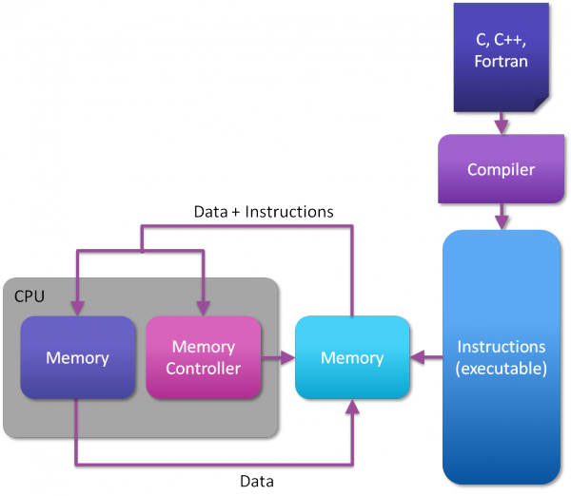
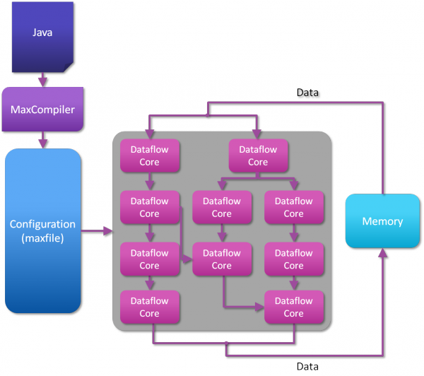
ControlFlow vs. DataFlow

Slide 4
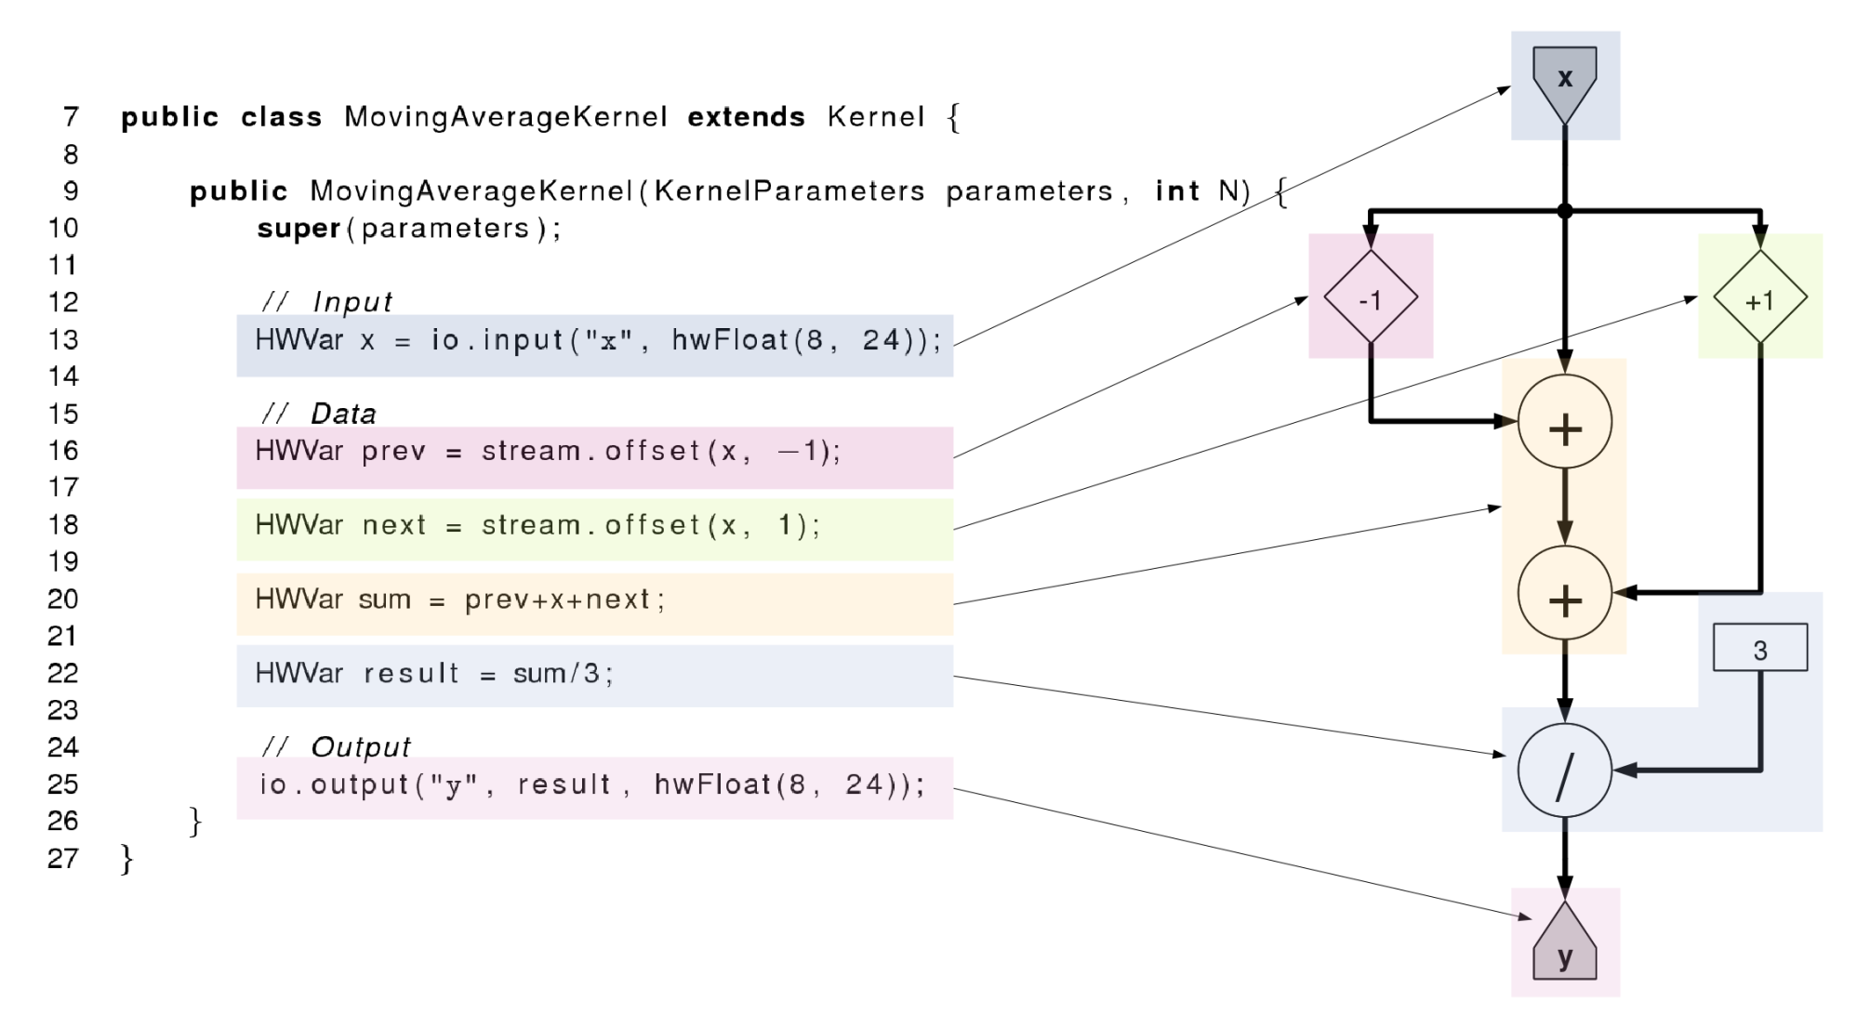
DataFlow Programming

Slide 5
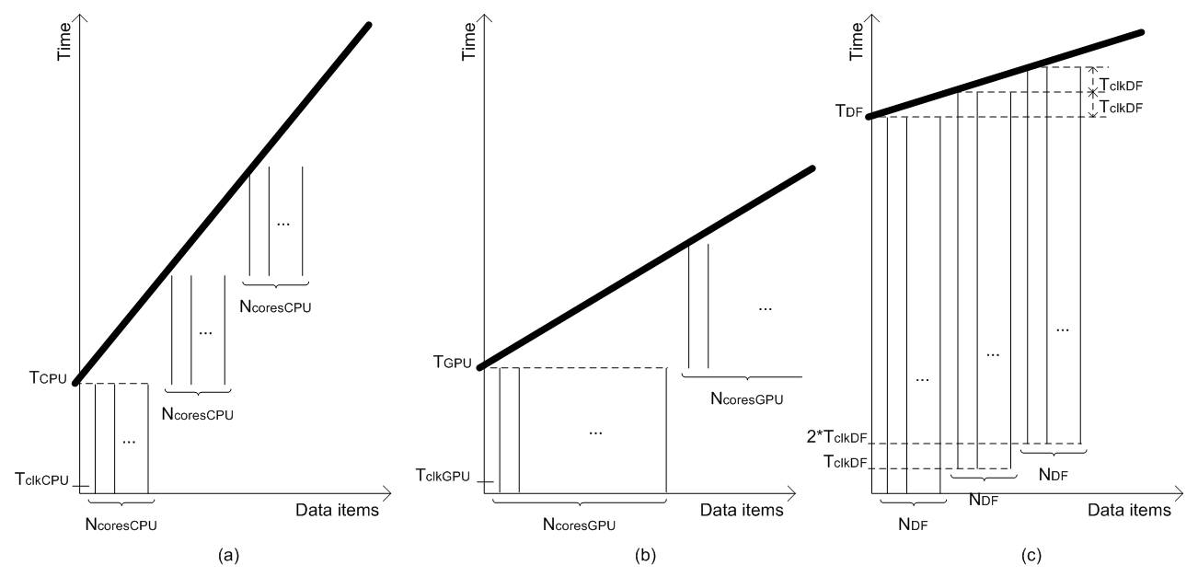
The essential figure
tCPU =
N * NOPS * CCPU*TclkCPU /NcoresCPU
tGPU =
N * NOPS * CGPU*TclkGPU / NcoresGPU
tDF = NOPS * CDF * TclkDF +
(N – 1) * TclkDF / NDF
Assumptions:
1. Software includes enough parallelism to keep all cores busy
2. The only limiting factor is the number of cores.

Slide 6
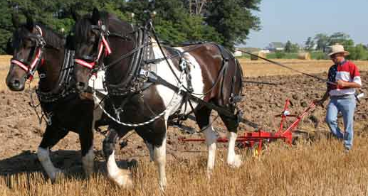
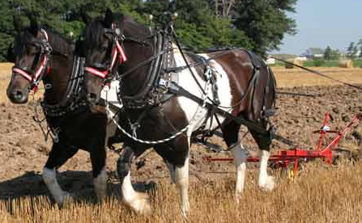
MultiCore
Where are the horses going?
DualCore?

Slide 7
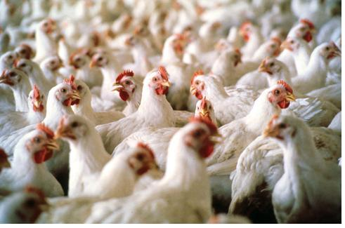
ManyCore
Is it possible
to use 2000 chicken instead of two horses?
?
==

Slide 8
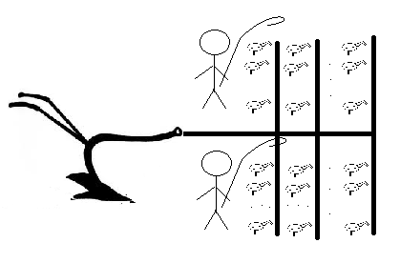
ManyCore
2 x 1000 chickens

Slide 9

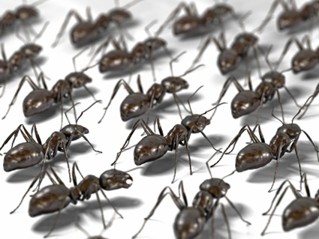

DataFlow
Data
How about 2 000 000 ants?

Slide 10
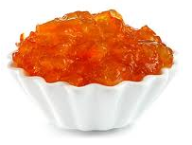
DataFlow
Big Data Input
Results
Marmalade

Slide 11
Why is DataFlow so Much Faster?
Factor: 20 to 200
MultiCore/ManyCore
Dataflow
Machine Level Code
Gate Transfer Level

Slide 12
Why are Electricity Bills so Small?
Factor: 20
MultiCore/ManyCore
Dataflow

Slide 13
Why is the Cubic Foot so Small?
Factor: 20
MultiCore/ManyCore
Dataflow
Data Processing
Data Processing
Process Control
Process Control

Slide 14
Required Programming Effort?
MultiCore:
  Explain what to do, to the driver
  Caches, instruction buffers, and predictors needed
ManyCore:
  Explain what to do, to many sub-drivers
  Reduced caches and instruction buffers needed
DataFlow:
  Make a field of processing gates
  No caches, instruction buffers, or predictors needed

Slide 15
Required Debug Effort?
MultiCore:
  Business as usual
ManyCore:
  More difficult
DataFlow:
  Much more difficult
  Debugging both, application and configuration code

Slide 16
Required Compilation Effort?
MultiCore/ManyCore:
  Several minutes
DataFlow:
  Several hours

Slide 17
Now the Fun Part

Slide 18
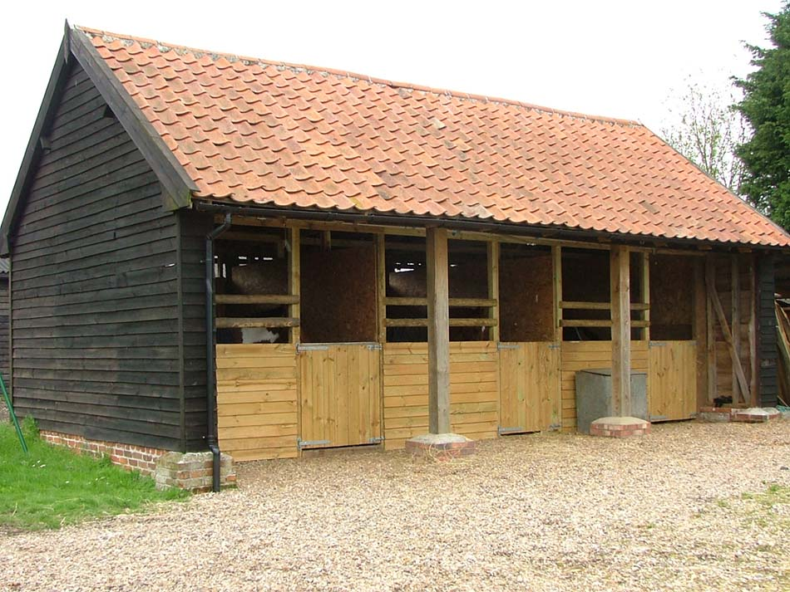
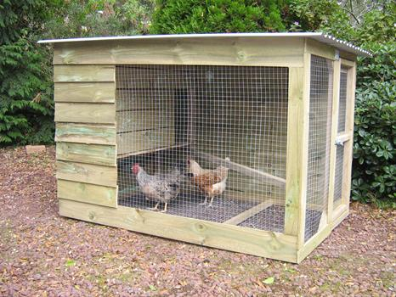
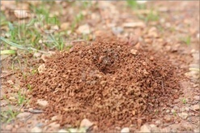
Required Space?
MultiCore:
  Horse stable
ManyCore:
  Chicken house
DataFlow:
  Ant hole

Slide 19
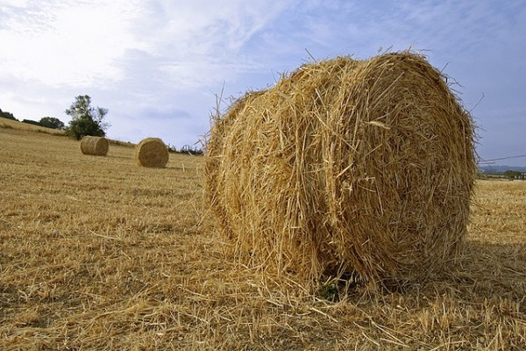
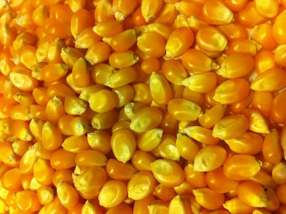
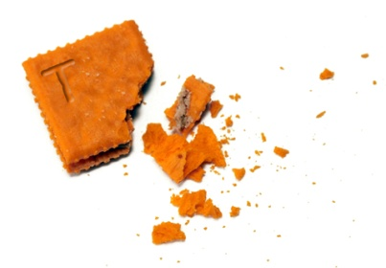
Required Energy?
MultiCore:
  Haystack
ManyCore:
  Cornbits
DataFlow:
  Crumbs

Slide 20

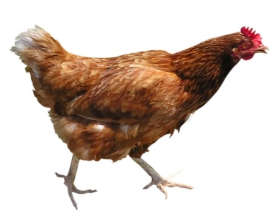
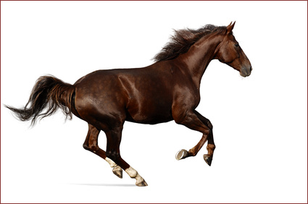
Why Faster?
Small Data

Slide 21
Why Faster?
Medium Data

Slide 22
Why Faster?
Big Data

Slide 23
DataFlow for Exascale Challenges
Power consumption
  Massive static parallelism at low clock frequencies
Concurrency and communication
  Concurrency between millions of tiny cores difficult,
  “jitter” between cores will harm performance
  at synchronization points.
  “Fat” dataflow chips minimize number of engines needed and statically scheduled dataflow cores minimize jitter.
Reliability and fault tolerance
  10-100x fewer nodes, failures much less often
Memory bandwidth and FLOP/byte ratio
  Optimize data movement first, and computation second.

Slide 24
Combining ControlFlow with DataFlow
DataFlow engines handle the bulk part
of computation (as a “coprocessor”)
Traditional ControlFlow CPUs run OS,
main application code etc
Lots of different ways these can be combined

Slide 25
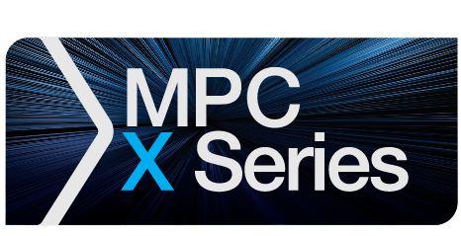


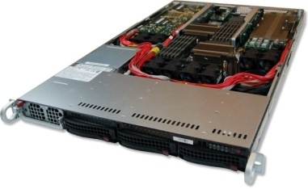
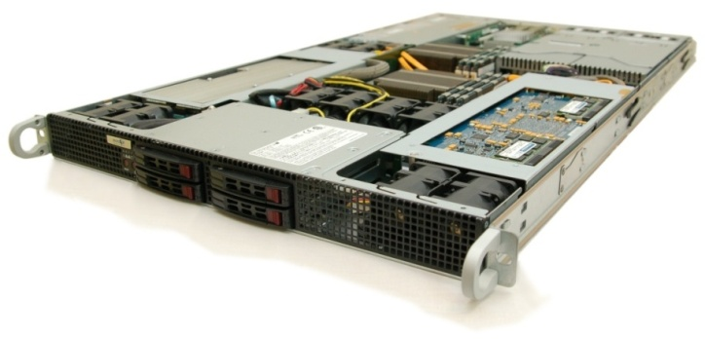
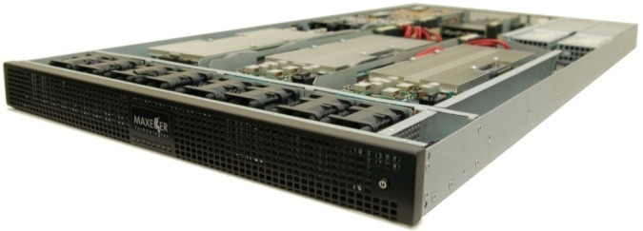
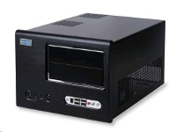
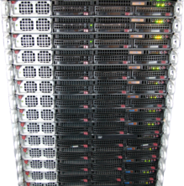
Maxeler Hardware
CPUs plus DFEs
Intel Xeon CPU cores and up to 4 DFEs with 192GB of RAM
DFEs shared over Infiniband
Up to 8 DFEs with 384GB of RAM and dynamic allocation of DFEs to CPU servers
Low latency connectivity
Intel Xeon CPUs and 1-2 DFEs with up to six 10Gbit Ethernet connections
MaxWorkstation
Desktop development system
MaxCloud
On-demand scalable accelerated
compute resource, hosted in London

Slide 26
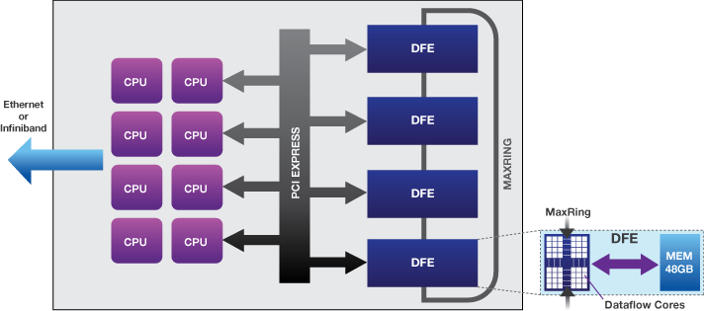
MPC-C
Tightly coupled DFEs and CPUs
Simple data center architecture with identical nodes

Slide 27

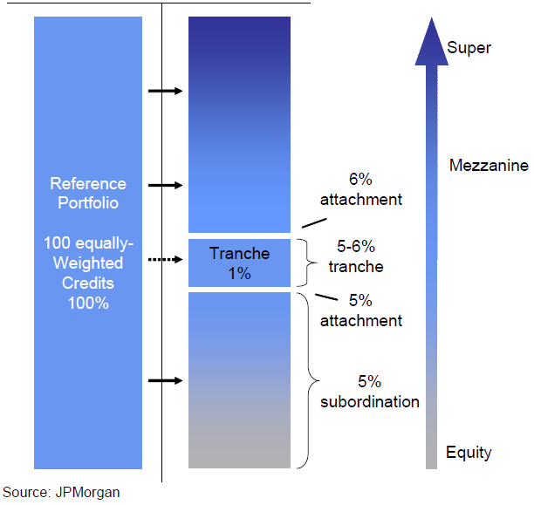
Credit Derivatives Valuation & Risk
O. Mencer and S. Weston, 2010
Compute value of complex financial derivatives (CDOs)
Typically run overnight, but beneficial to compute in real-time
Many independent jobs
Speedup: 220-270x
Power consumption per node drops from 250W to 235W/node

Slide 28

CRS Trace Stacking
P. Marchetti et al, 2010
Seismic processing application
Velocity independent / data driven method
to obtain a stack of traces, based on 8 parameters
  Search for every sample of each output trace
2 parameters ( emergence angle & azimuth )
3 Normal Wave front parameters ( K_{N,11}; K_{N,12} ; K_{N22} )
3 NIP Wave front parameters ( K_{Nip,11}; K_{Nip,12} ; K_{Nip22} )

Slide 29
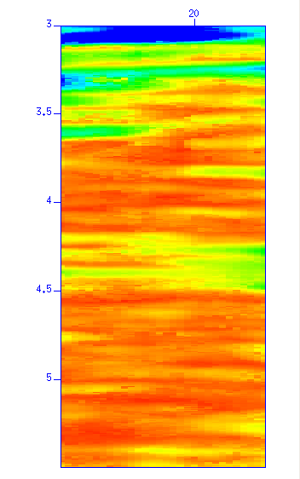
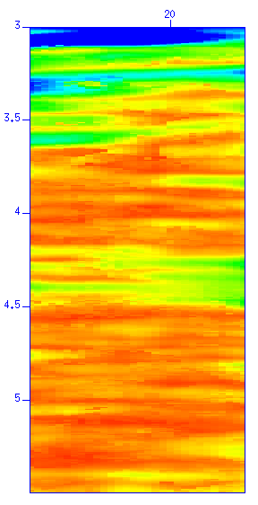
CRS Results
Performance of MAX2 DFEs vs. 1 CPU core
  Land case (8 params), speedup of 230x
  Marine case (6 params), speedup of 190x
CPU Coherency
MAX2 Coherency

Slide 30
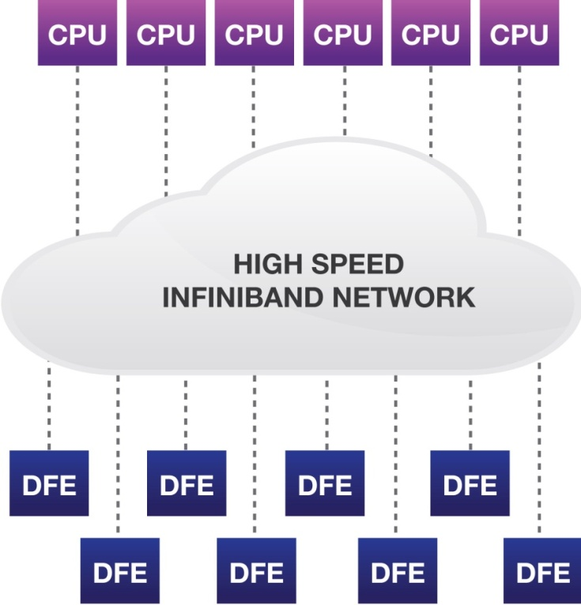
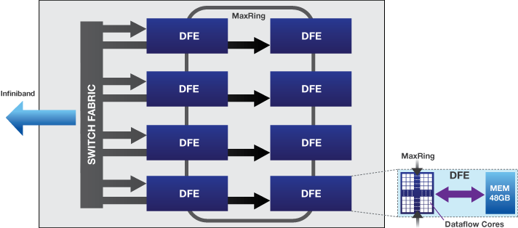
MPC-X
DFEs are shared resources on the cluster,
accessible via Infiniband connections
Loose coupling optimizes efficiency
Communication managed in hardware for performance

Slide 31
Major Classes of Applications
Coarse grained, stateful
  CPU requires DFE for minutes or hours
Fine grained, stateless transactional
  CPU requires DFE for ms to s
  Many short computations
Fine grained, transactional with shared database
  CPU utilizes DFE for ms to s
  Many short computations, accessing common database data

Slide 32
Coarse Grained: FD Wave Modeling
Long runtime, but:
Memory requirements change dramatically based on modelled frequency
Number of DFEs allocated to a CPU process can be easily varied to increase available memory
Streaming compression
Boundary data exchanged over chassis MaxRing

Slide 33
Fine Grained, Stateless: BSOP
Portfolio with thousands of Vanilla European Options
Analyse > 1,000,000 scenarios
Many CPU processes run on many DFEs
  Each transaction executes on any DFE in the assigned group atomically
~50x MPC-X vs. multi-core x86 node
CPU
DFE
CPU
DFE
CPU
Loop over instruments
DFE
CPU
Loop over instruments
DFE
CPU
Loop over instruments
Market and instruments
data
DFE
Tail analysis on CPU
Loop over instruments
Tail analysis on CPU
Loop over instruments
Tail analysis on CPU
Random number generator and sampling of underliers
Tail analysis on CPU
Random number generator and sampling of underliers
Tail analysis on CPU
Random number generator and sampling of underliers
Random number generator and sampling of underliers
Random number generator and sampling of underliers
Price instruments using Black Scholes
Price instruments using Black Scholes
Price instruments using Black Scholes
Price instruments using Black Scholes
Price instruments using Black Scholes
Instrument values
Notes:
Elastic makes things worse

Slide 34
Fine Grained, Shared Data: Searching
DFE DRAM contains the database to be searched
CPUs issue transactions find(x, db)
Complex search function
  Text search against documents
  Shortest distance to coordinate (multi-dimensional)
  Smith Waterman sequence alignment for genomes
Any CPU runs on any DFE
that has been loaded with the database
  MaxelerOS may add or remove DFEs
  from the processing group to balance system demands
  New DFEs must be loaded with the search DB before use

Slide 35
Conclusion
Dataflow computing focuses on data movement
and
utilizes massive parallelism at low clock frequencies
Improved performance, power efficiency,
system size, and data movement
can help address exascale challenges
Mix of DataFlow with ControlFlow and interconnect can be balanced at a system level
What’s next?

Slide 36
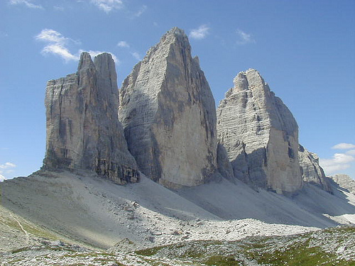
The TriPeak
BSC + Maxeler

Slide 37
The TriPeak
MontBlanc = A ManyCore (NVidia) + a MultiCore (ARM)
Maxeler = A FineGrain DataFlow (FPGA)
How about a happy marriage
of MontBlanc and Maxeler?
In each happy marriage,
it is known who does what :)

Slide 38
Core of the Symbiotic Success:
An intelligent scheduler,
partially implemented for compile time,
and partially for run time.
At compile time:
Checking what part of code fits where
(MontBllanc or Maxeler).
At run time:
Rechecking the compile time decision,
based on the current data values

Slide 39
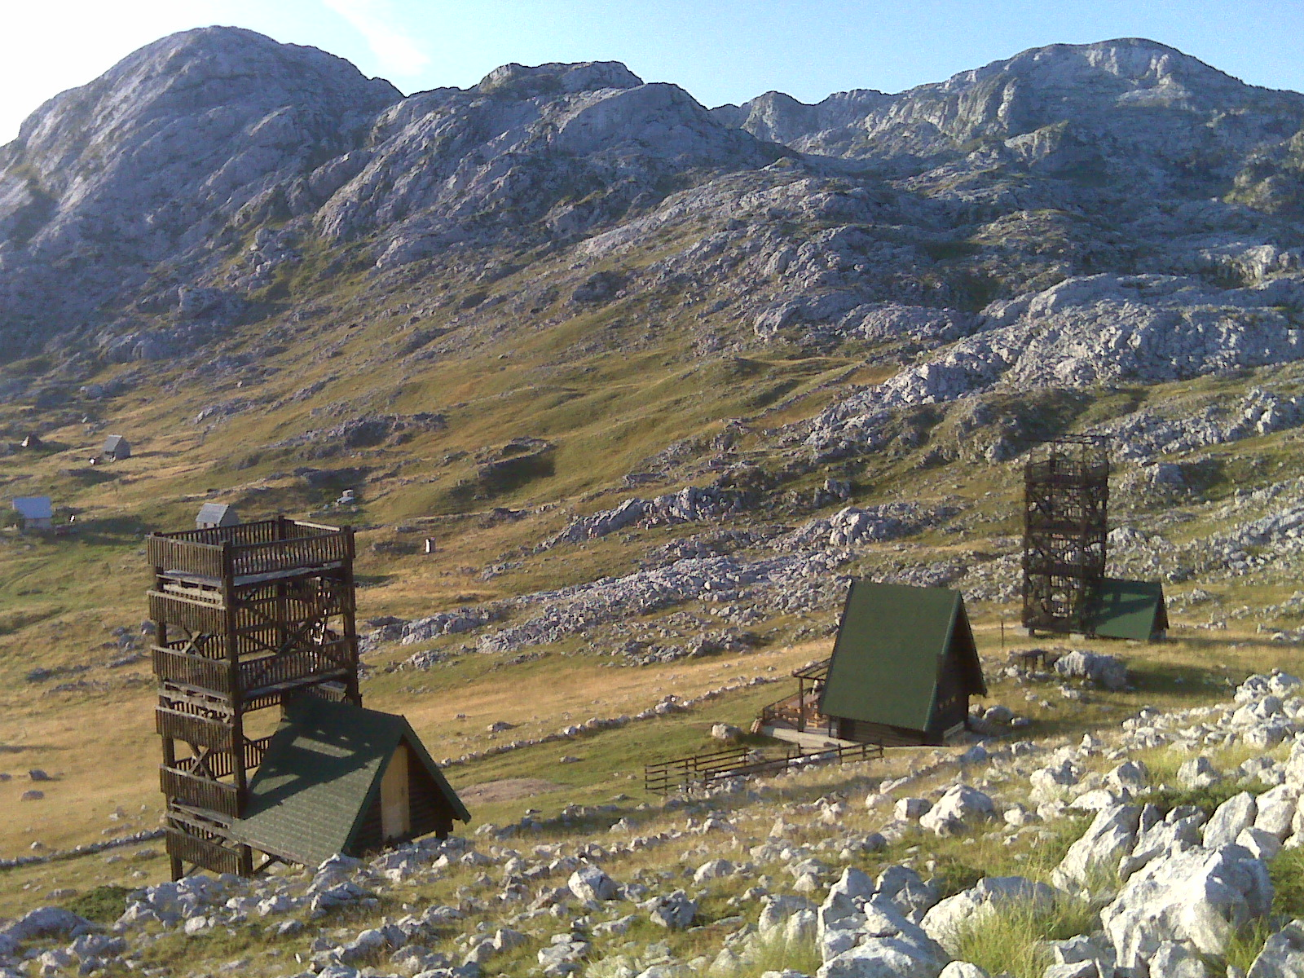
39

Slide 40
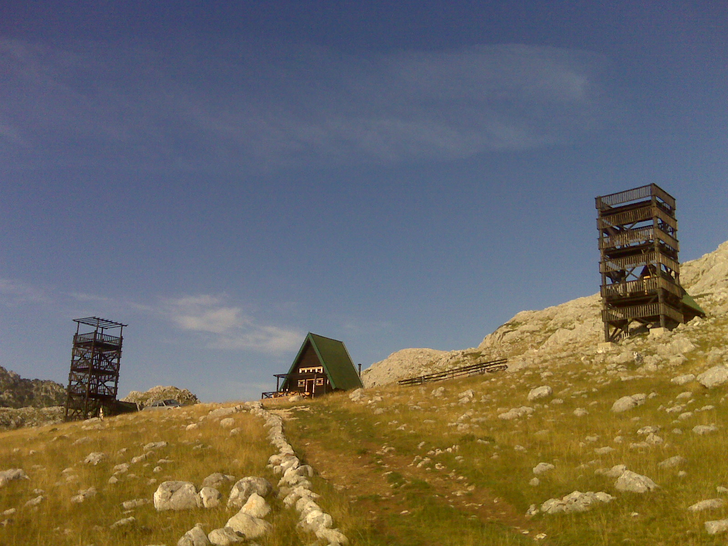
40
© H. Maurer

Slide 41
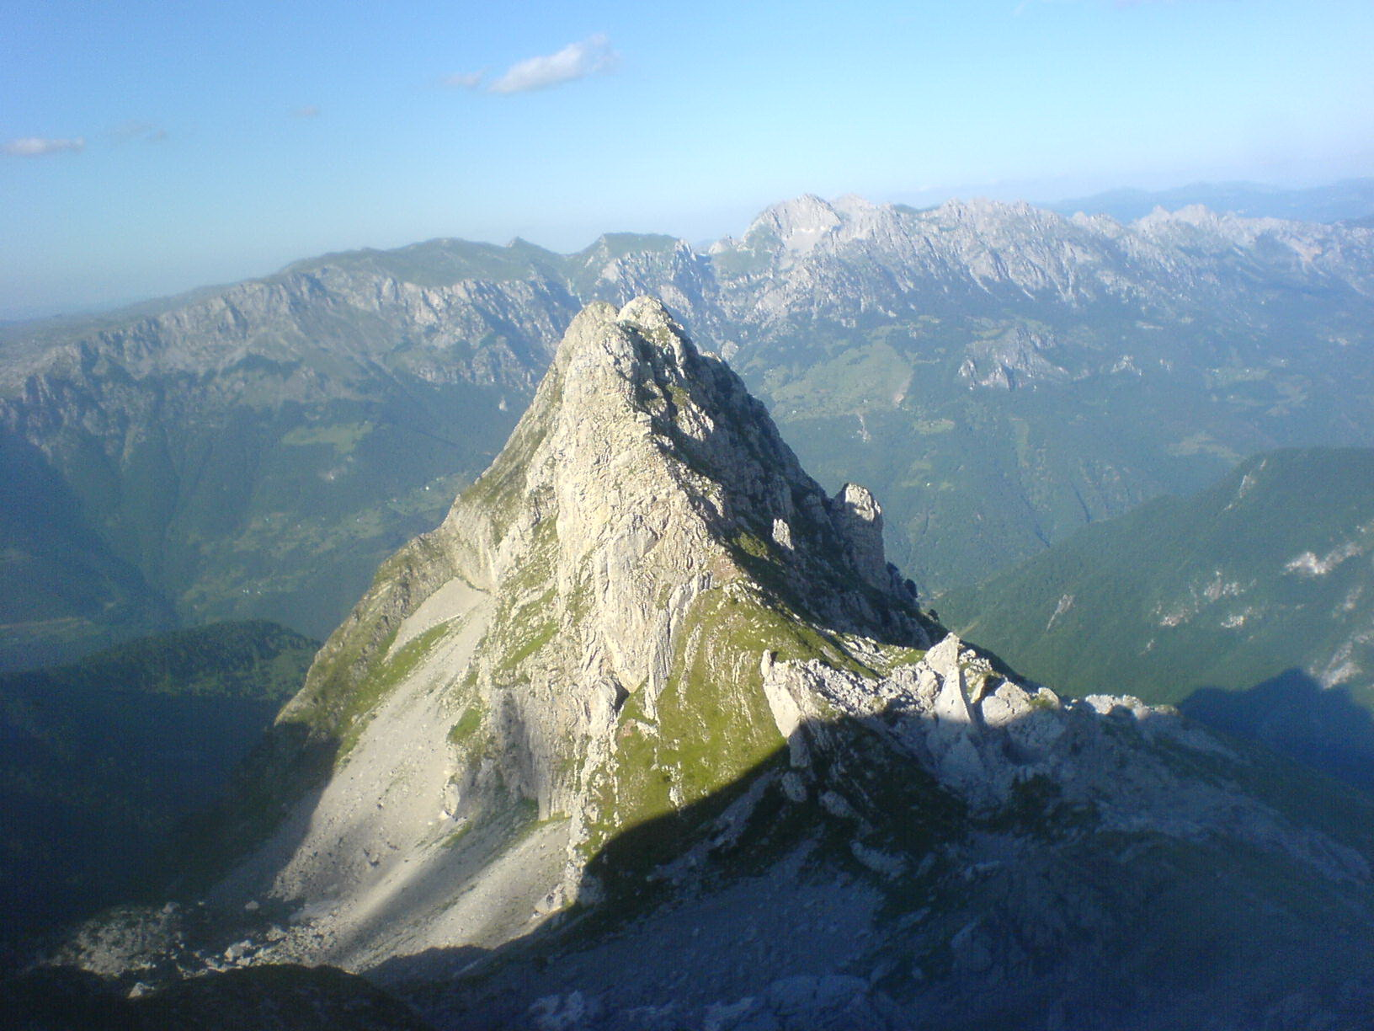
41
© H. Maurer

Slide 42
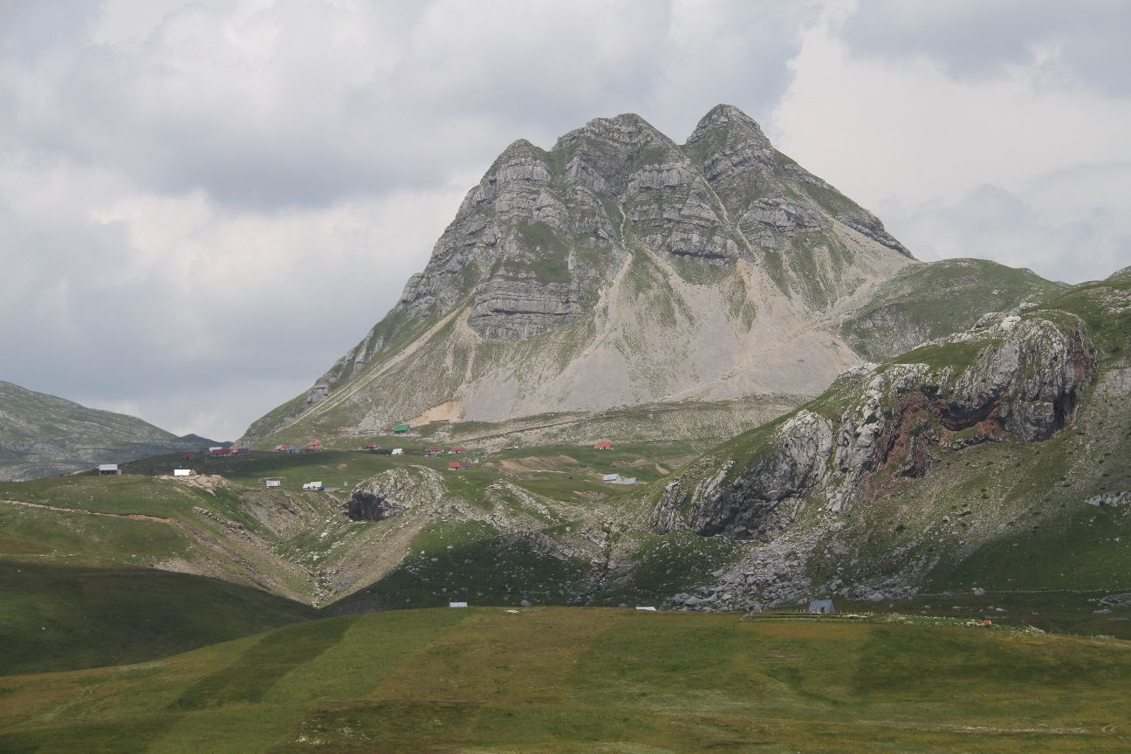
Q&A
vm@etf.rs
oliver@maxeler.com
42
© H. Maurer

