Slide 1
ACM/CSUR #4
ACCELERATION
TEAM
vm
UrosS UrosM LAZAR
KOROLIJA
· Google
· Boeing
· Max
· Groq
· Siena
· Stuttgart
· London
· Barcelona

Slide 2
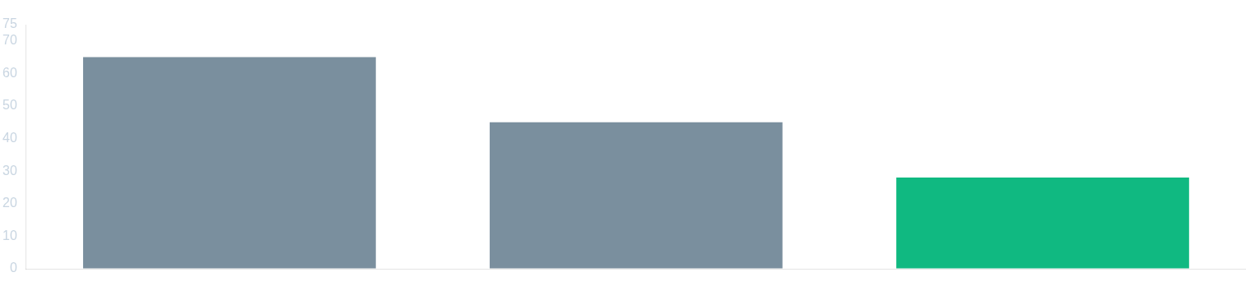
WORLD'S BEST JOURNALS
Nature JIF = 65 Science JIF = 45 ACM/CSUR JIF = 28
Life Long Adjunct Professor,
Technical University of Graz, Austria
Life Long Visiting Professor, University of Kragujevac, Serbia Adjunct Professor, Indiana University, Bloomington, USA
Former Faculty Member and Current Guest Lecturer,
Purdue University, USA (1983)
Guest Professor, UNIVIE and TUWIEN, Vienna, Austria (2018)
Former Guest Lecturer, Harvard University, USA (2015–2020) Former Guest Lecturer, MIT, USA (2015–2020)
Life Fellow of the IEEE, Washington D.C., USA
Member of The Academy of Europe, London, United Kingdom
Founding Member, Serbian National Academy of Engineering · Foreign Member, Montenegrin National Academy of Sciences
Veljko
Milutinović
ACM/CSUR#4 · ACCELERATION
2

Slide 3
Classification of Acceleration Approaches
Technology change × Paradigm change · Purdue and IU + ETF and MATF
T = NOT
T = YES
T=NOT · P=NOT
Faster silicon +
more cores (Multicore CPUs + Manycore GPUs) +
more memory (DSM + MPC)
T=YES · P=NOT
3rd5th(GaAs) / 2nd6th(CdTe) +
ControlFlow (SpeedUp + RadHardness)
P = NOT
T=NOT · P=YES
Silicon +
DataFlow (MaxDFE + GoogleTPU) or
DiffusionFlow (WSN/IoT)
T=YES · P=YES
PhysMat (Optical + Quantum) +
BioChem (Chemical + Molecular)
P = YES
However, I/O for QCs is semiconductor-based, which undermines the pros of QCs: Speed + RadHard! Is GaAs the solution? Is GaAs alone the solution?

Slide 4
The Optimal Architecture
Programming Models & Their Hardware
CF
ControlFlow Programming Model
N MultiCore CPUs
1000N ManyCore GPUs (10000N, etc...)
DF
DataFlow Programming Model
An ASIC SystolicArray (Fixed, GoogleTPU)
An FPGA ExecutionGraph (Reconfigurable, Groq)
Peripherals to External Accelerators
EnergyFlow Model
+ Memory and I/O to WSN and IoT
DiffusionFlow Model
Chemical
Molecular
Opto
Quantum

Slide 5
1.
INTRO [vm]
Problem + Importance + Growing + Viewpoint
2.
CLASSIFICATION
[vm]
Criteria + TaxonomyVM
3–14.
For(3–14) Do
OUTER LOOP + INNER LOOP
15.
APPS
REVISITED
[4 × Juniors]
16.
CONCLUSIONS
[vm]
STRUCTURE
Article
Outline
OUTER LOOP (1)
F1 = Infrastructure
F2 = I/O Data Structure
F3 = Algorithm
F4 = List Major Apps
INNER LOOP (N ≥10)
P1 = 7Ws
P2 = Local Essence
P3 = Major Highlights Opening Up New Horizons P4 = Newly Open Apps
ACM/CSUR#4 · ACCELERATION
5

Slide 6
Distribution Table
Sections 1 – 6 · Authors & Technologies
# | Section | Technology | Responsible | Notes
1 | CPU | DSM + MPC | LAZAR
2 GPU | DSM + MPC | UROS MARKOVIC | JelicaOstatakIzCPU + New
3 GaAs | X + vm | KORO | (3+5) JPL
4 CdTe | Y + vm | UrosS | (2+6) TUR
5 DF Systolic / Google |  | UrosS
6 DF Max / Groq |  | UrosM

Slide 7
Distribution Table
Sections 7 – 12 · Authors & Technologies
#
Section
Technology
Responsible
Notes
7
IoT
Lazar
8
WSN
KORO
9
OPTO
Uros Savurdic
10
QC
Uros Markovic
11
Chemo
KORO
12
Bio
LAZAR

Slide 8
APPS REVISITED
SECTION 15
[ 4 × Juniors ]
KORO
UrosS
UrosM
LAZAR
ACM/CSUR#4 · ACCELERATION
8

Slide 9
Conclusions [vm]
01
Recap
02
NewlyOpenProbs
03
ToWhomOfImportance
04
FinalWisdom 4444
REFERENCES
100+
TOPIC
MIND GENOMICS
ACM/CSUR#4 · ACCELERATION
9

Slide 10
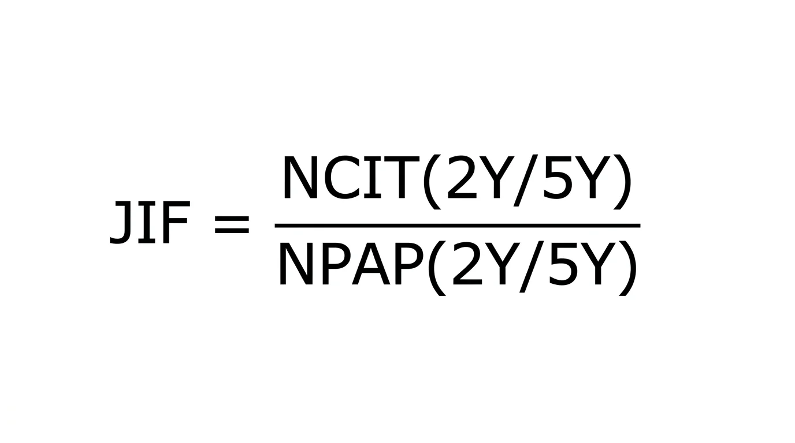
Research Opportunities in Top Journals
BEST JIF JOURNAL — DATA SCIENCE
Journal of Big Data
Springer · JBD
BEST JIF JOURNAL — ARTIFICIAL INTELLIGENCE
Machine Intelligence
Springer · MIJ
ACM/CSUR#4 · ACCELERATION
10

Slide 11
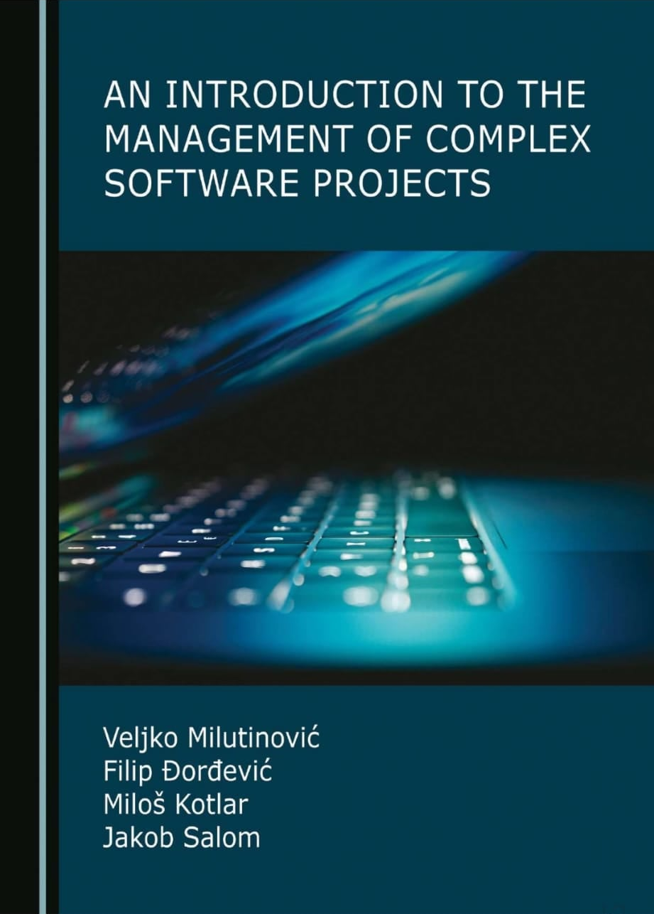
An Introduction to the Management of Complex Software Projects
RECOMMENDED READING
AUTHORS
Veljko Milutinović Filip Đorđević Miloš Kotlar Jakob Salom
Thank you — Questions?
ACM/CSUR#4 · ACCELERATION
11

