Slide 1
DataFlow Computing for Exascale eGov:
Revisiting the Algorithms
V. Milutinović, G. Rakocevic, S. Stojanović, and Z. Sustran
University of Belgrade
Oskar Mencer
Imperial College, London
Oliver Pell
Maxeler Technologies
Goran Dimic
Institute Michael Pupin

Slide 2
Goals of the Paradigm:
Modify the Big Data eGov algorithms
to achieve,
for the same hardware price,
a) speed-up of 20-200
b) monthly electricity bills reduced 20 times
c) size 20 times smaller

Slide 3
European Dimension of the Paradigm:
Absolutely all results achieved with:
a) all hardware produced in Europe, UK
b) all software generated by programmers
of EU and WB
c) primary project beneficiaries in EU;
secondary project beneficiaries world wide
(this is a potential export product for EU)

Slide 4
ControlFlow vs. DataFlow:
ControlFlow:
  Top500 ranks using Linpack (Japanese K,…)
DataFlow:
  Coarse Grain (HEP) vs. Fine Grain (Maxeler)

Slide 5
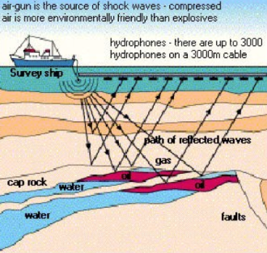

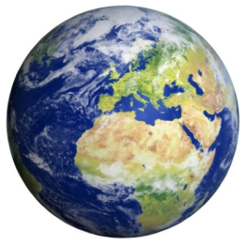
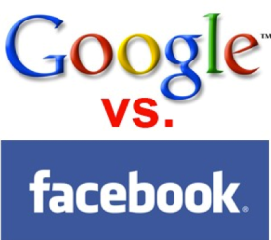
Essence of the DataFlow Approach!
Compiling below the machine code level brings speedups;
also a smaller power, size, and cost.
The price to pay:
The machine is more difficult to program.
Consequently:
Ideal for WORM applications :)
Examples using Maxeler:
GeoPhysics (20-40), Banking (200-1000, with JP Morgan 20%),
M&C (New York City), Datamining (Google), …, eGov

Slide 6
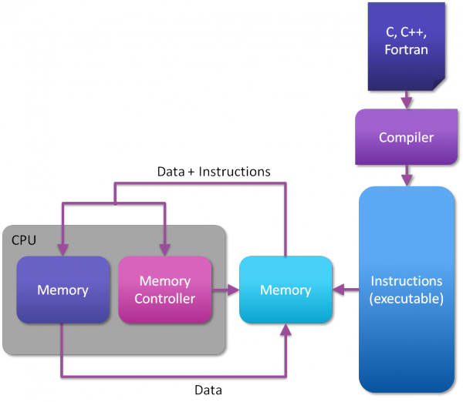
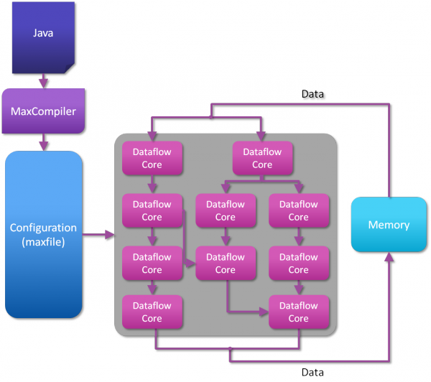
ControlFlow vs. DataFlow

Slide 7
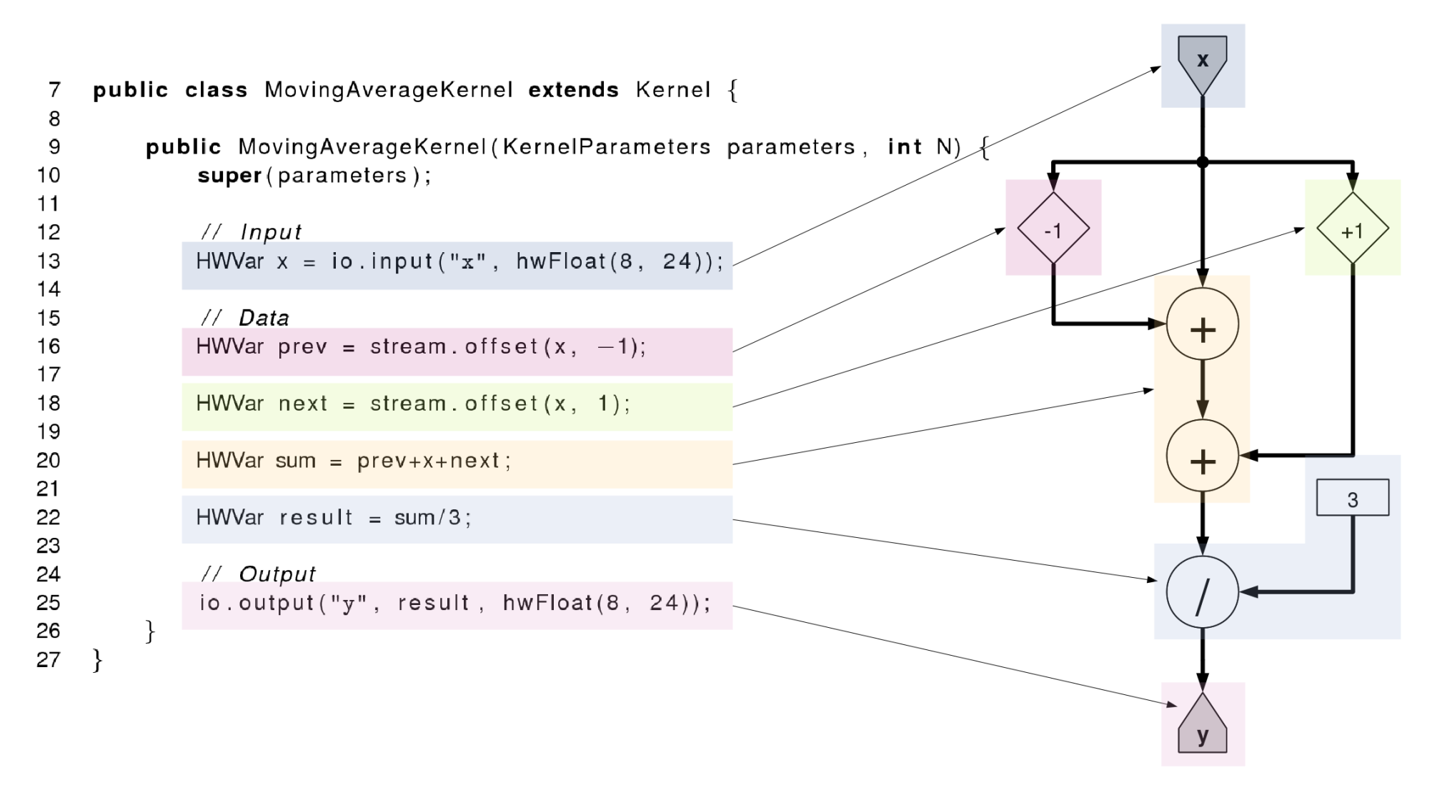
DataFlow Programming (1C +5Java)

Slide 8
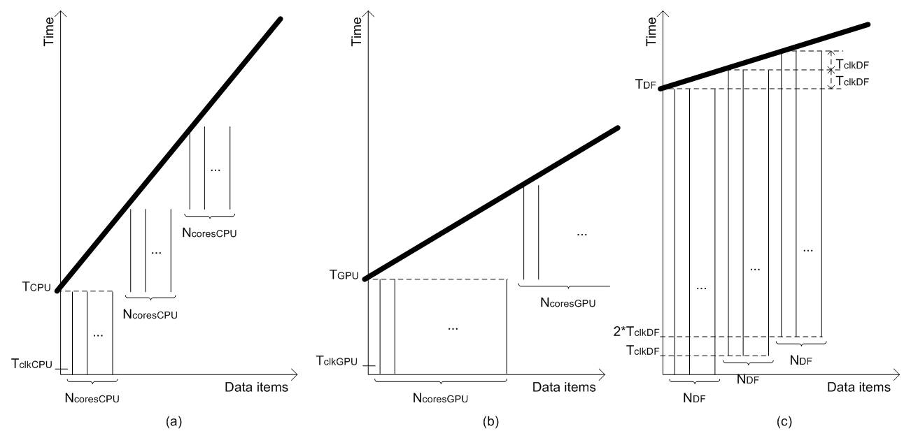
Essence: Communication of the ACM
tCPU =
N * NOPS * CCPU*TclkCPU /NcoresCPU
tGPU =
N * NOPS * CGPU*TclkGPU / NcoresGPU
tDF = NOPS * CDF * TclkDF +
(N – 1) * TclkDF / NDF
Assumptions:
1. Software includes enough parallelism to keep all cores busy
2. The only limiting factor is the number of cores.

Slide 9
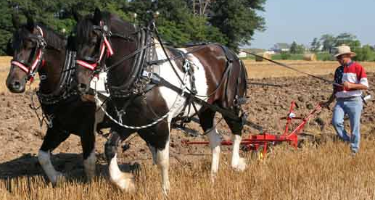
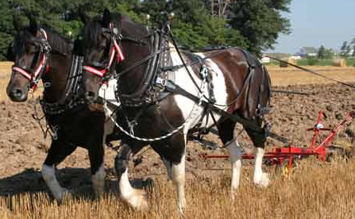
MultiCore
Which way are the horses going?
DualCore?

Slide 10
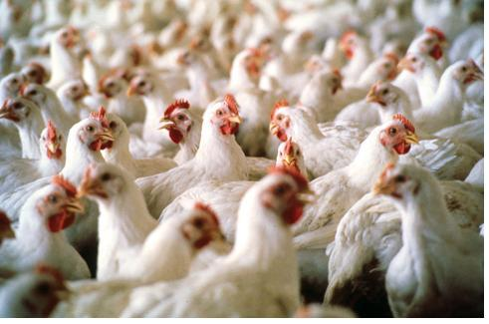
ManyCore
Is it possible
to use 2000 chicken instead of two horses?
?
==
What is better, real and anecdotic?

Slide 11
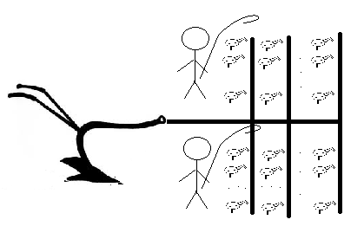
ManyCore
2 x 1000 chickens (CUDA and rCUDA)

Slide 12

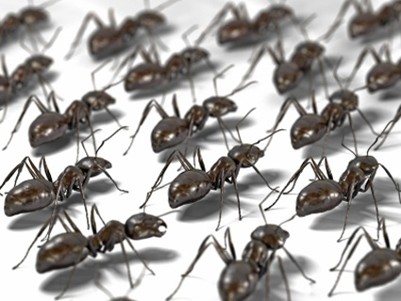

DataFlow
Data
How about 2 000 000 ants?

Slide 13
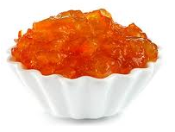
DataFlow
Big Data Input
Results
Marmalade

Slide 14
Why is DataFlow so Much Faster?
Factor: 20 to 200
MultiCore/ManyCore
Dataflow
Machine Level Code
Gate Transfer Level

Slide 15
Why are Electricity Bills so Small?
Factor: 20
MultiCore/ManyCore
Dataflow
P = kfU²

Slide 16
Why is the Cubic Foot so Small?
Factor: 20
MultiCore/ManyCore
DataFlow
Data Processing
Data Processing
Process Control
Process Control

Slide 17
Required Programming Effort?
MultiCore:
  Explain what to do, to the driver
  Caches, instruction buffers, and predictors needed
ManyCore:
  Explain what to do, to many sub-drivers
  Reduced caches and instruction buffers needed
DataFlow:
  Make a field of processing gates: 1C+5Java
  No caches, etc. (300 students/year: BGD, BCN, LjU,…)

Slide 18
Required Debug Effort?
MultiCore:
  Business as usual
ManyCore:
  More difficult
DataFlow:
  Much more difficult
  Debugging both, application and configuration code

Slide 19
Required Compilation Effort?
MultiCore/ManyCore:
  Several minutes
DataFlow:
  Several hours for the real hardware
  Fortunately, only several minutes for the simulator
  The simulator supports
  both the large JPMorgan machine
  as well as the smallest “University Support” machine
Good news:
  Tabula@2GHz

Slide 20
Now the Fun Part

Slide 21
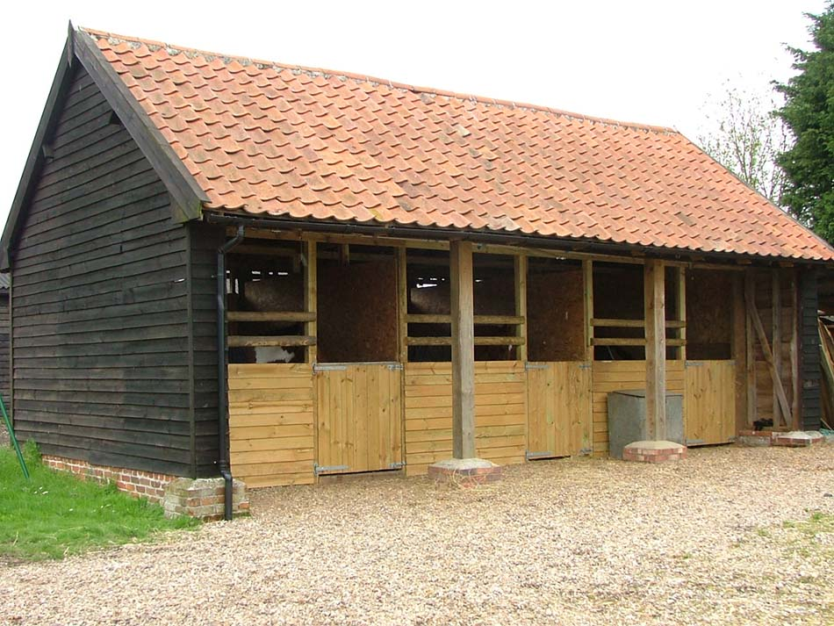
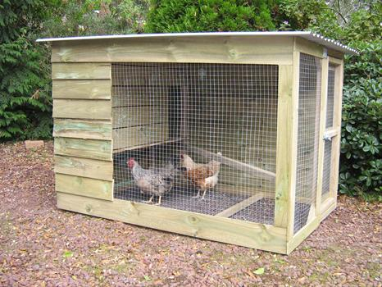
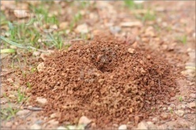
Required Space?
MultiCore:
  Horse stable
ManyCore:
  Chicken house
DataFlow:
  Ant hole

Slide 22
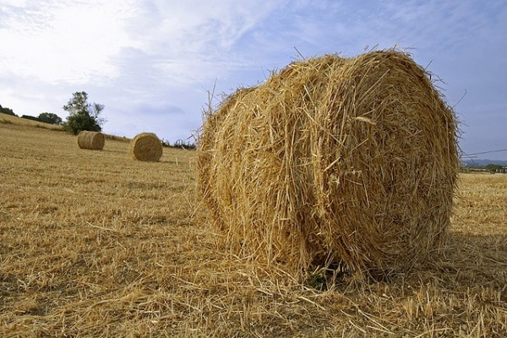
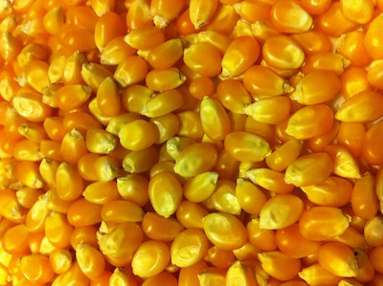
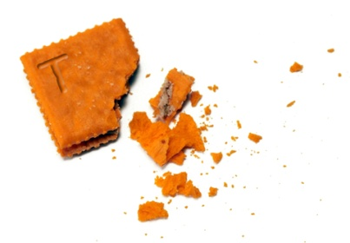
Required Energy?
MultiCore:
  Haystack
ManyCore:
  Cornbits
DataFlow:
  Crumbs

Slide 23

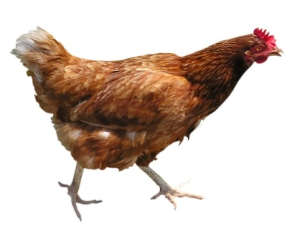
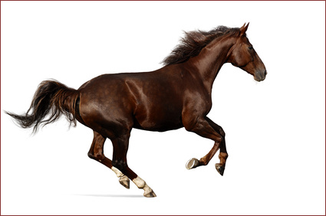
Why Faster?
Small Data: Toy Benchmarks (e.g., Linpack)

Slide 24
Why Faster?
Medium Data (benchmarks
favorising Nvidia,
compared to Intel,…)

Slide 25
Why Faster?
Big Data

Slide 26
DataFlow for Exascale eGov
Revisting all major Big Data DM algorithms
  Massive static parallelism at low clock frequencies
Concurrency and communication
  Concurrency between millions of tiny cores difficult,
  “jitter” between cores will harm performance
  at synchronization points.
Reliability and fault tolerance
  10-100x fewer nodes, failures much less often
Memory bandwidth and FLOP/byte ratio
  Optimize data choreography, data movement,
  and the algorithmic computation.

Slide 27
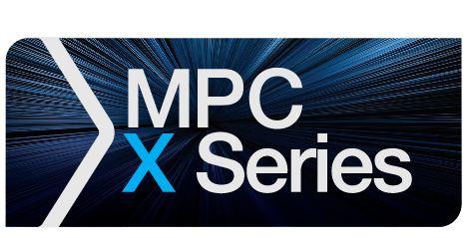


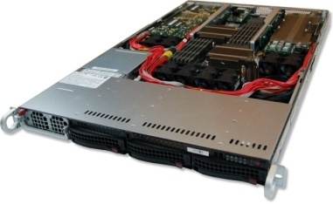
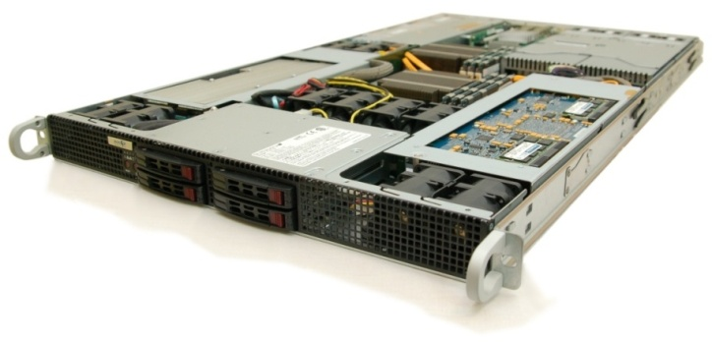
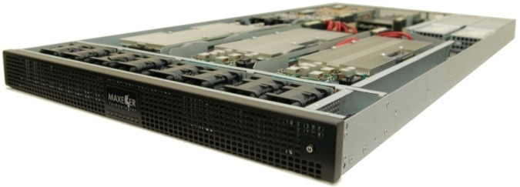
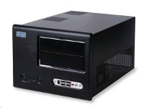
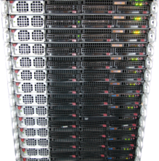
Maxeler Hardware
CPUs plus DFEs
Intel Xeon CPU cores and up to 4 DFEs with 192GB of RAM
DFEs shared over Infiniband
Up to 8 DFEs with 384GB of RAM and dynamic allocation of DFEs to CPU servers
Low latency connectivity
Intel Xeon CPUs and 1-2 DFEs with up to six 10Gbit Ethernet connections
MaxWorkstation
Desktop development system
MaxCloud
On-demand scalable accelerated
compute resource, hosted in London

Slide 28
Major Classes of DM Algorithms, from the Computational Perspective
Coarse grained, stateful
  CPU requires DFE for minutes or hours
Fine grained, stateless transactional
  CPU requires DFE for ms to s
  Many short computations
Fine grained, transactional with shared database
  CPU utilizes DFE for ms to s
  Many short computations, accessing common database data

Slide 29
Coarse Grained: FD Wave Modeling
Long runtime, but:
Memory requirements change dramatically based on modelled frequency
Number of DFEs allocated to a CPU process can be easily varied to increase available memory
Streaming compression
Boundary data exchanged over chassis MaxRing

Slide 30
Fine Grained, Stateless: BSOP Control
Analyse > 1,000,000 scenarios
Many CPU processes run on many DFEs
  Each transaction executes on any DFE in the assigned group atomically
~50x MPC-X vs. multi-core x86 node
CPU
DFE
CPU
DFE
CPU
Loop over instruments
DFE
CPU
Loop over instruments
DFE
CPU
Loop over instruments
Market and instruments
data
DFE
Tail analysis on CPU
Loop over instruments
Tail analysis on CPU
Loop over instruments
Tail analysis on CPU
Random number generator and sampling of underliers
Tail analysis on CPU
Random number generator and sampling of underliers
Tail analysis on CPU
Random number generator and sampling of underliers
Random number generator and sampling of underliers
Random number generator and sampling of underliers
Price instruments using Black Scholes
Price instruments using Black Scholes
Price instruments using Black Scholes
Price instruments using Black Scholes
Price instruments using Black Scholes
Instrument values
Notes:
Elastic makes things worse

Slide 31
Fine Grained, Shared Data: Monitoring
DFE DRAM contains the database to be searched
CPUs issue transactions find(x, db)
Complex search function
  Text search against documents
  Shortest distance to coordinate (multi-dimensional)
  Smith Waterman sequence alignment for genomes
Any CPU runs on any DFE
that has been loaded with the database
  MaxelerOS may add or remove DFEs
  from the processing group to balance system demands
  New DFEs must be loaded with the search DB before use

Slide 32

Trace Stacking: Speed-up 217
P. Marchetti et al, 2010
DM for Monitoring and Control in Seismic processing
Velocity independent / data driven method
to obtain a stack of traces, based on 8 parameters
  Search for every sample of each output trace
2 parameters ( emergence angle & azimuth )
3 Normal Wave front parameters ( K_{N,11}; K_{N,12} ; K_{N22} )
3 NIP Wave front parameters ( K_{Nip,11}; K_{Nip,12} ; K_{Nip22} )

Slide 33
Conclusion: Nota Bene
This is about algorithmic changes,
to maximize
the algorithm to architecture match!
The winning paradigm
of Big Data eGov?

Slide 34
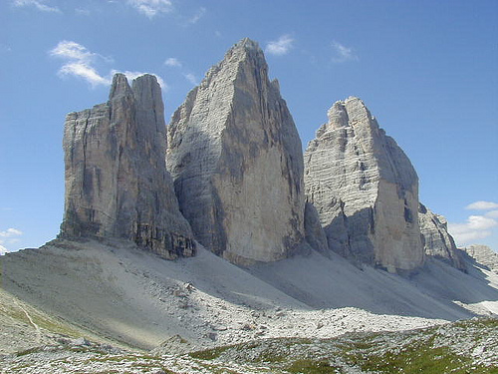
The TriPeak
BSC
+ Imperial College
+ Maxeler
+ Belgrade

Slide 35
The TriPeak
MontBlanc = A ManyCore (NVidia) + a MultiCore (ARM)
Maxeler = A FineGrain DataFlow (FPGA)
How about a happy marriage
of MontBlanc and Maxeler?
In each happy marriage,
it is known who does what :)
The Big Data eGov algorithms:
What part goes to MontBlanc and what to Maxeler?

Slide 36
Core of the Symbiotic Success:
An intelligent DM algorithmic scheduler,
partially implemented for compile time,
and partially for run time.
At compile time:
Checking what part of code fits where
(MontBllanc or Maxeler).
At run time:
Rechecking the compile time decision,
based on the current data values.

Slide 37
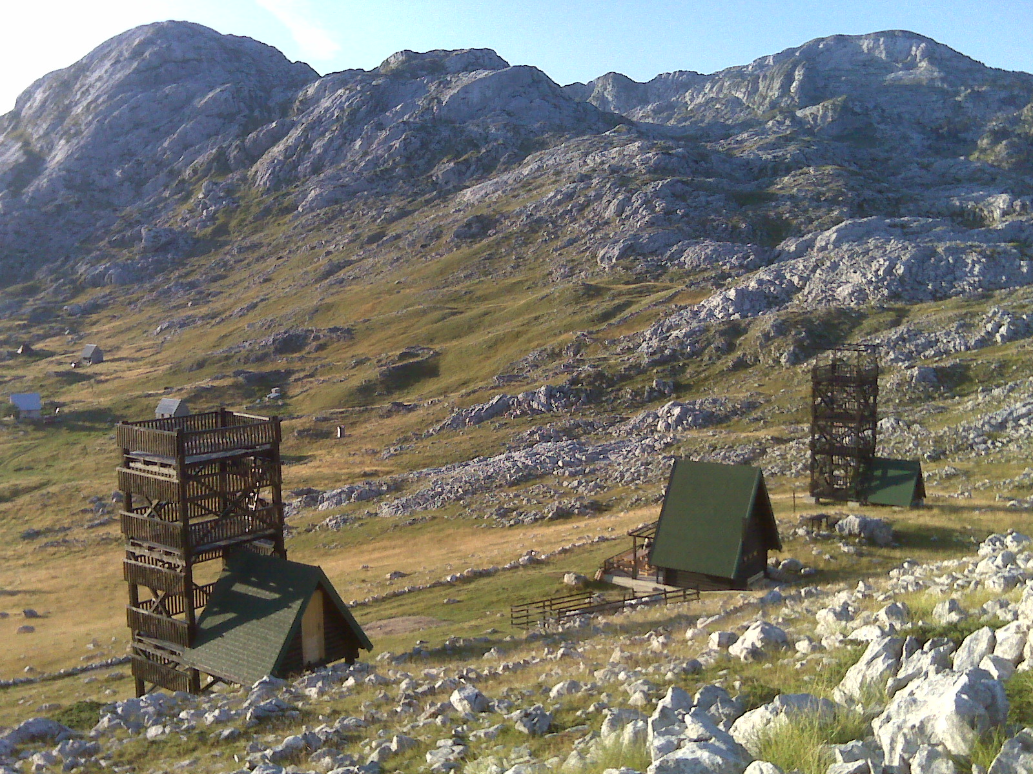
37

Slide 38
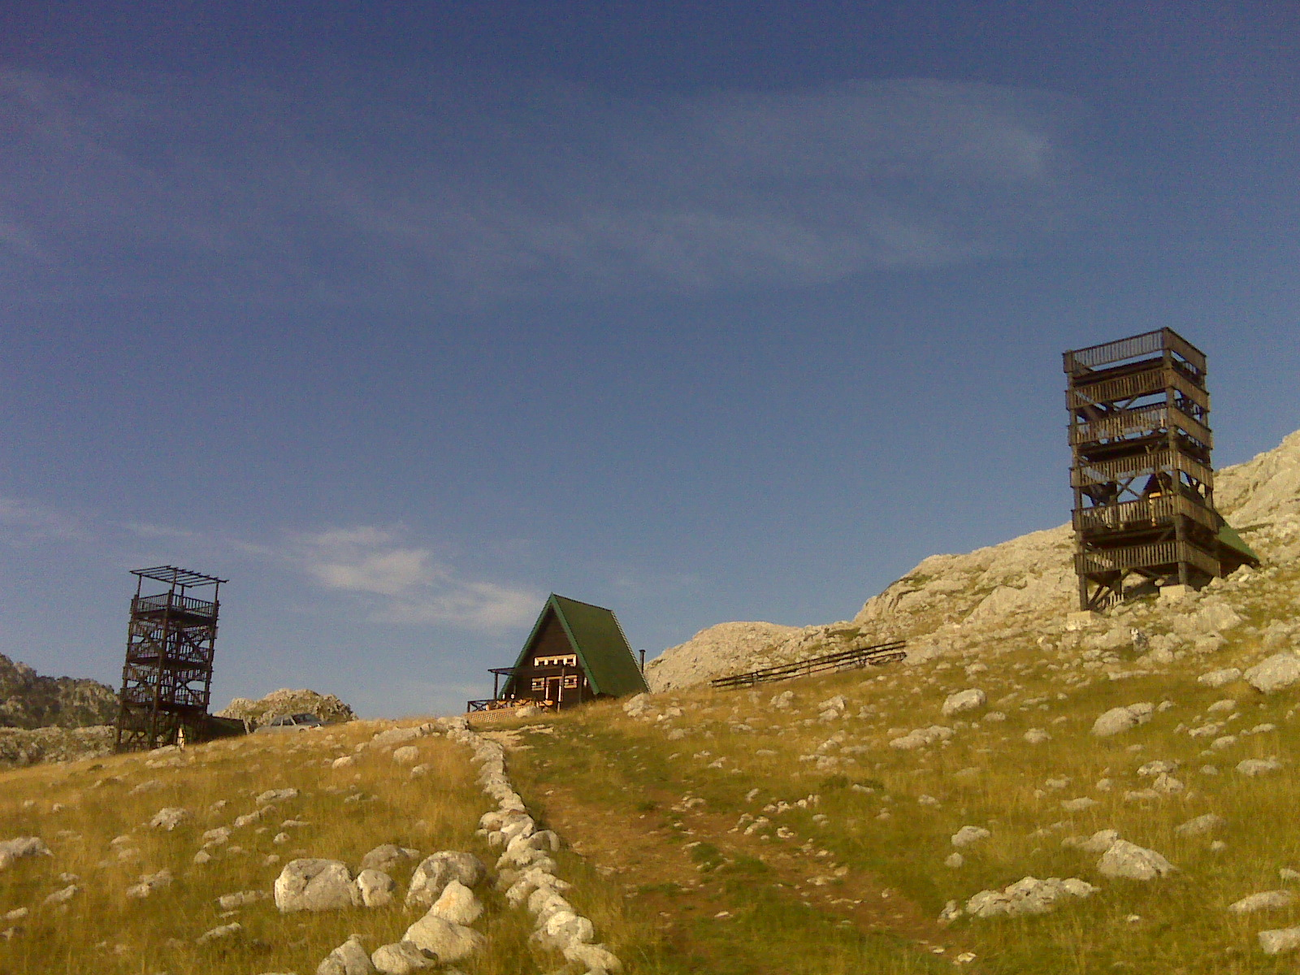
38
© H. Maurer

Slide 39
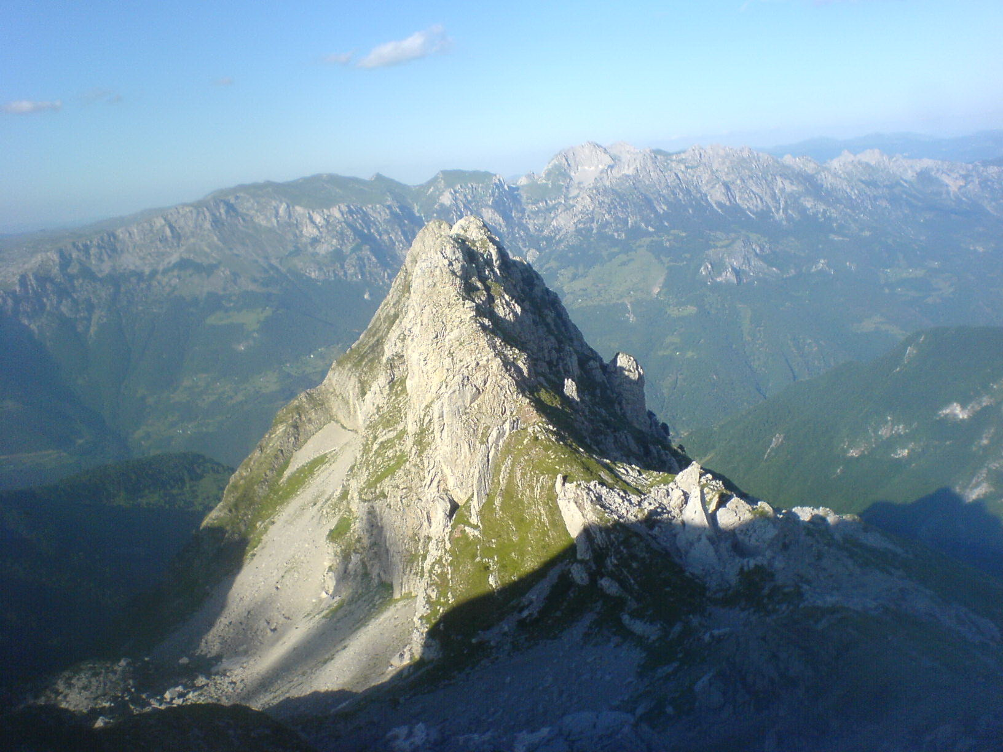
39
© H. Maurer

Slide 40
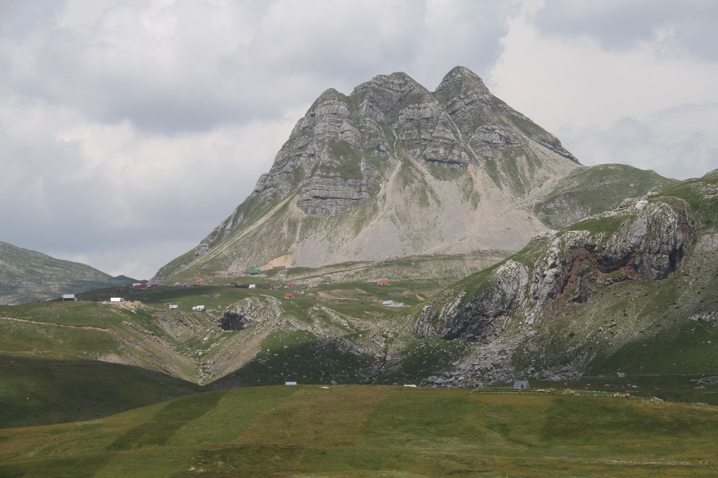
Q&A
vm@etf.rs
oliver@maxeler.com
40
© H. Maurer

