Slide 1
1 Down Place
Hammersmith
London UK
530 Lytton Ave.
Palo Alto
CA USA

Slide 2
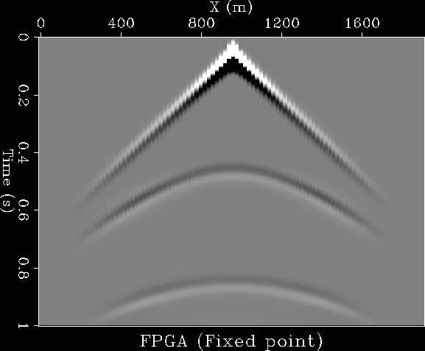
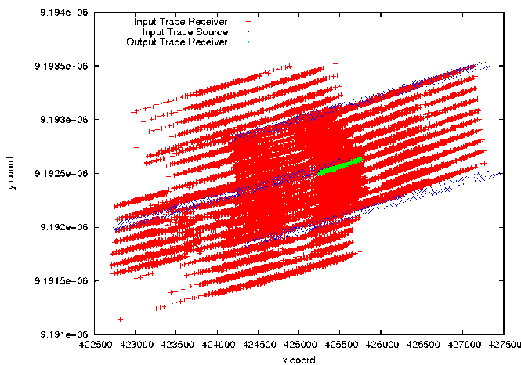
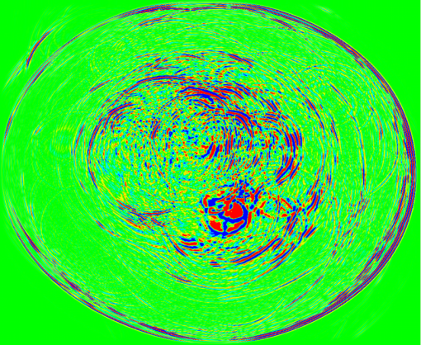
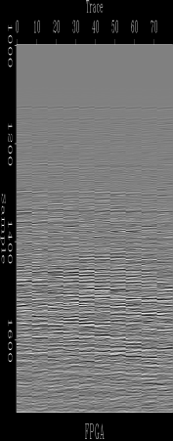
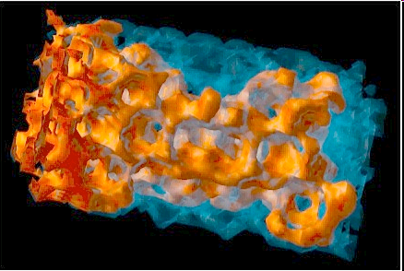
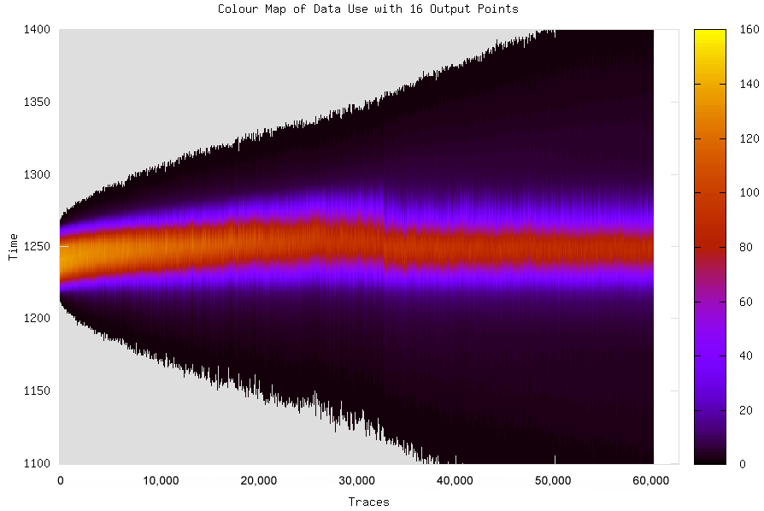
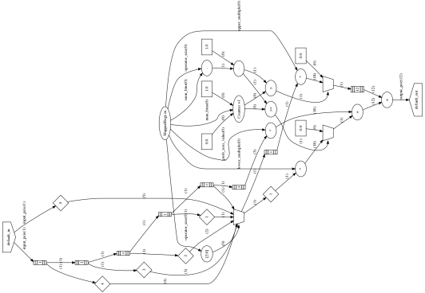
Deployed Maximum Performance Computing customers comparing 1 box from Maxeler (in a deployed system) with 1 box from Intel
Customer 1
App1 19x and App2 25x
Customer 2
1.2GB/s per card
Customer 3
App1 22x, App2 22x
Customer 4
App 32x and App2 29x
Customer 5
30x
Customer 6
App1 26x and App2 30x

Slide 3
What Maxeler do
Maxeler delivers bespoke dataflow HPC solutions
=> An HPC Computing Appliance for “structured Big Data”
Building the HPC compute fabric based on the application in a
multi-disciplinary, data-centric approach
Hardware
Building 1U boxes, Workstations and the cards inside.
Building custom large memory systems to deal with Big Data
Integrating rack system with networking and storage.
Software
Integrated environment brings bespoke dataflow computing
to high end HPC users
Dataflow programming in Java and Eclipse IDE
Consulting
HPC System Performance Architecture
Algorithms and Numerical Optimization
Integration into business and technical processes

Slide 4
Dataflow Computing

Slide 5
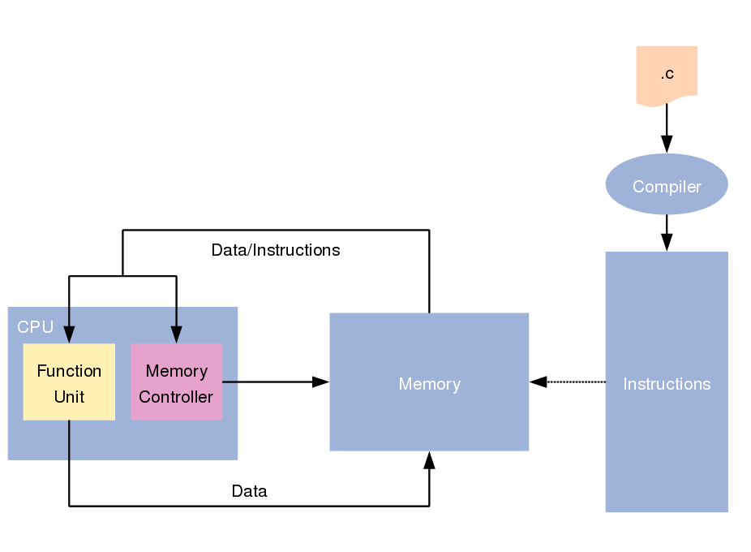
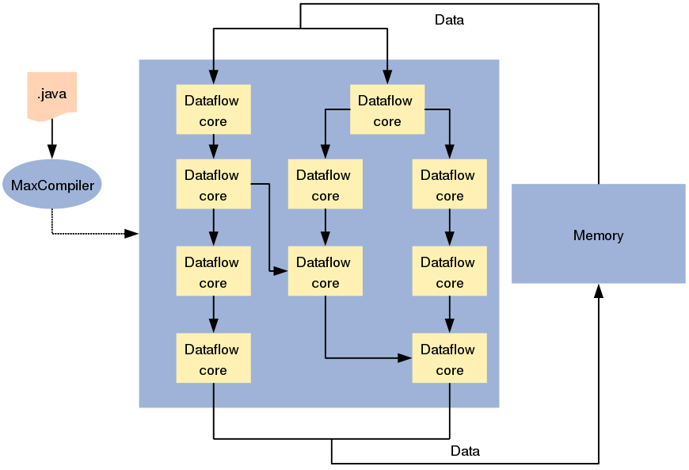
What is Dataflow Computing?
Computing with control flow processors
Computing with dataflow engines (DFEs)
vs.

Slide 6
Technology
MAXELER DATAFLOW COMPUTING
One result
per clock cycle
Dynamic (switching) Power Consumption:
Minimal frequency f achieves maximal performance, thus for a
given power budget, we get Maximum Performance Computing (MPC)!

Slide 7

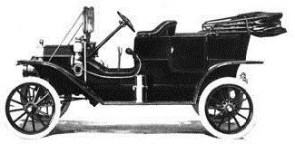

Explaining Control Flow versus Data Flow
Analogy 1: The Ford Production Line
Experts are expensive and slow (control flow)
Many specialized workers are more efficient (data flow)

Slide 8



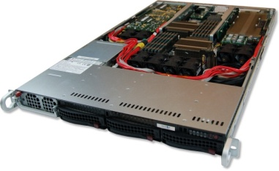
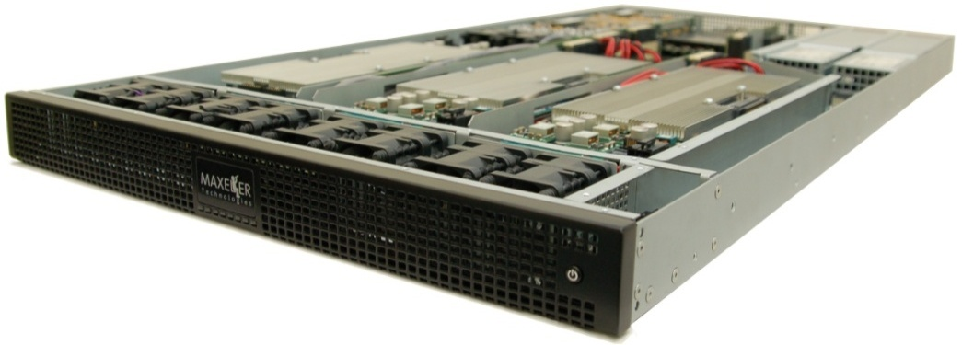
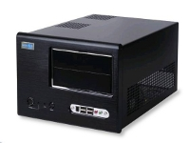
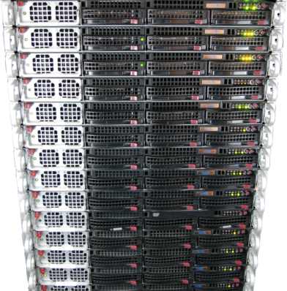
Maxeler Hardware Solutions
CPUs plus DFEs
Intel Xeon CPU cores and up to 6 DFEs with 288GB of RAM
DFEs shared over Infiniband
Up to 8 DFEs with 384GB of RAM and dynamic allocation of DFEs to CPU servers
Low latency connectivity
Intel Xeon CPUs and 1-2 DFEs with up to six 10Gbit Ethernet connections
MaxWorkstation
Desktop development system
MaxCloud
On-demand scalable accelerated
compute resource, hosted in London

Slide 9
Maxeler Application Components
CPU
Host application
SLiC
MaxelerOS
Kernels
DataFlow
PCI Express
+
Memory
+
*
Memory
Manager

Slide 10
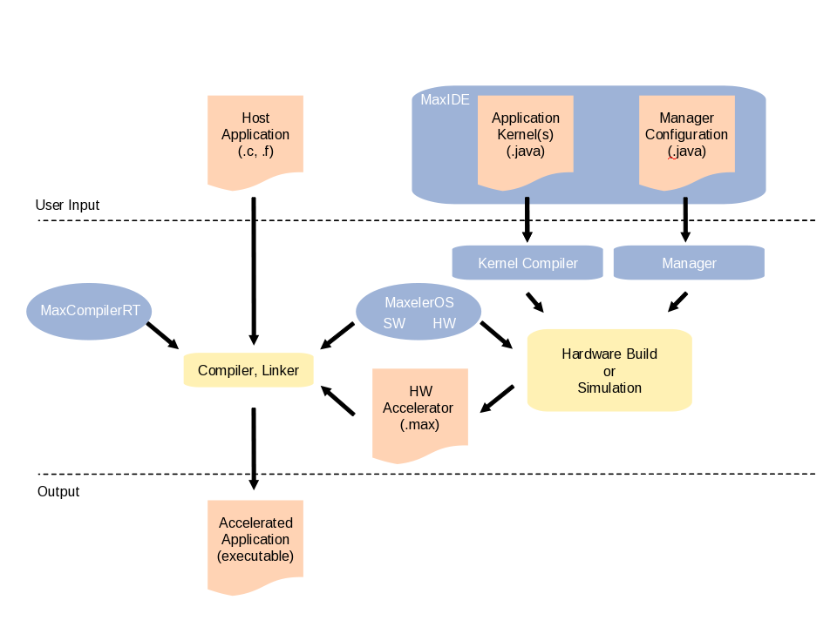
Programming with MaxCompiler
C / C++ / Fortran
Java
SLiC

Slide 11
Cluster-level management
Deploying Maximum Performance Computing requires considering cluster resource allocation and scheduling
Maxeler create custom job-management systems to manage clusters
MaxQ Cluster Management System
  Job Distribution
  Designed to manage thousands of CPU cores and terabytes of memory
  Dynamically reallocates resources during execution
  Logging of running processes
  Remotely Attach to running processes

Slide 12
Example Accelerated Applications

Slide 13

Seismic Imaging
Running on MaxNode servers
- 8 parallel compute pipelines per chip
- 150MHz => low power consumption!
- 30x faster than microprocessors
An Implementation of the Acoustic Wave Equation on FPGAs
T. Nemeth†, J. Stefani†, W. Liu†, R. Dimond‡, O. Pell‡, R.Ergas§
†Chevron, ‡Maxeler, §Formerly Chevron, SEG 2008

Slide 14
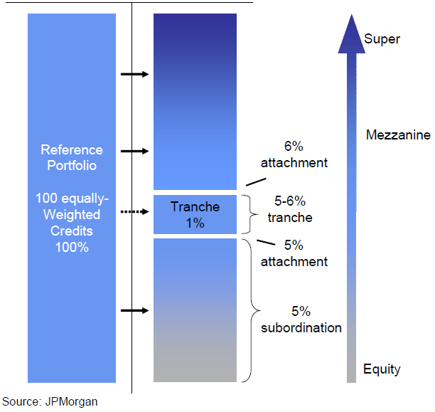
JP Morgan Credit Derivatives Pricing
O. Mencer and S. Weston, 2010
Compute value of complex financial derivatives (CDOs)
Typically run overnight, but beneficial to compute in real-time
Many independent jobs
Speedup: 220-270x
Power consumption per node drops from 250W to 235W/node

Slide 15

3000³ Modeling
Compared to 32 3GHz x86 cores parallelized using MPI
*presented at SEG 2010.
8 Full Intel Racks ~100kWatts => Single 3U Maxeler System <1kWatt

Slide 16
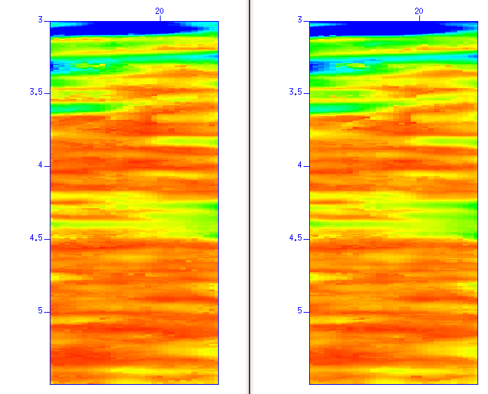
CRS Results
Performance of one MAX2 card vs. 1 CPU core
  Land case (8 params), speedup of 230x
  Marine case (6 params), speedup of 190x
CPU Coherency
MAX2 Coherency

Slide 17
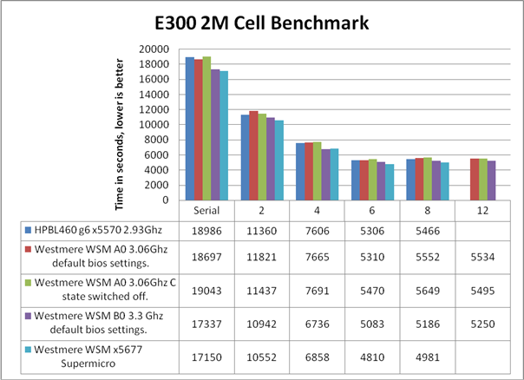

Sparse Matrix Solving with Maxeler
O. Lindtjorn et al, HotChips 2010
Given matrix A, vector b, find vector x in Ax = b.
DOES NOT SCALE BEYOND 6 x86 CPU CORES
MAXELER SOLUTION: 20-40x in 1U
Domain Specific Address and Data Encoding (*Patent Pending)

