Slide 1
Acceleration of the SAT Problem
Zivojin Sustran, ETF, University of Belgrade
Veljko Milutinovic, ETF, University of Belgrade
Zoran Ognjanovic,
Mathematical Institute of the Serbian Academy of Sciences and Arts

Slide 2
MyWork in a NutShell
Introduction: Synergy of Logics and CS
Problem: Moving SAT to Maxeler
Existing Solutions: Many and none
Essence: Map+Optimize (PACT)
Details: MyPhD
Analysis: Math+Simulation
Conclusion: Expected 10000 (SPC)
Full work on the web: URL=http://home.etf.rs/~vm/os/vlsi/predavanja/maxeler.html

Slide 3
The SATisfiability Problem
Essence of SAT
The problem of determining if there exists an interpretation,
which satisfies the formula.
Formula for SAT
F = (x₁₁·x₁₂·x₁₃) +(x₂₁·x₂₂·x₂₃)+(x₃₁·x₃₂·x₃₃)+…
Applications of SAT
VLSI Design

Slide 4
Implementation of SAT
Bad: Limited scalability.
Good: No data interdependencies
among loop iterations.
Excellent: The best potentials
for acceleration on DataFlow machines.

Slide 5
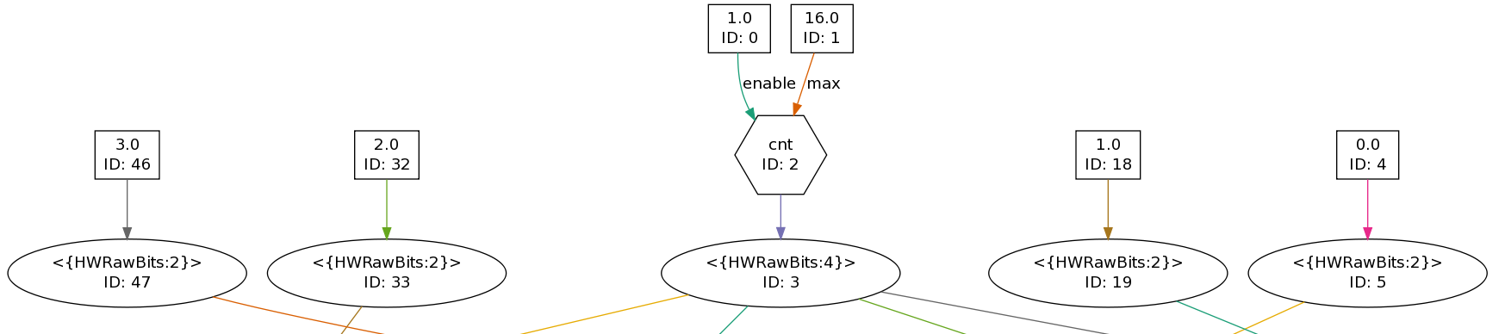
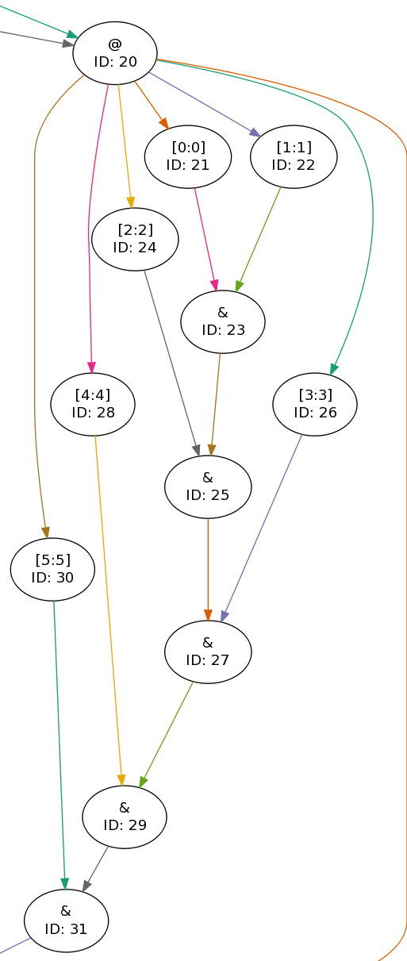
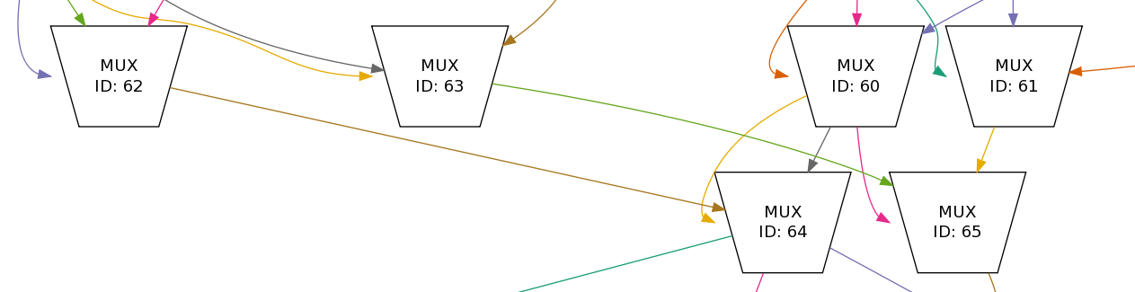
Kernel(S)
Generation of variables permutations
Function calculation
Results checking

Slide 6
Performance
Run time on MAX 2 and MAX 3
= Z2 and Z3
Run time on i7
= Z7
Speedup on MAX 2 and MAX 3
= X2 and X3
Power reduction:
Sasa Stojanovic is our expert!☺

Slide 7

Q+A: zika@etf.bg.ac.rs

