Slide 1
Sorting Networks
for
Maxeler DataFlow SuperComputer
Authors: Vukašin Ranković and Anton Kos
Advisor: Veljko Milutinovic

Slide 2
Goal of the research
To show that, for a given application, the ranking of most effective algorithms changes, as the technology changes
To find the best sorting algorithm for data flow computing, using the Maxeler architecture as the case study
To show that the Maxeler architecture can achieve speedups
superior to multi core and many core architectures (the CPU solution)
2/8

Slide 3
Problems
Random access to memory
Recursion
Hard to modify
Comparing consecutive elements
3/8

Slide 4
Tuning the algorithms to the DataFlow paradigm
Combining the algorithms
e.g., Quick + Bucket sort combined
Breaking the array into “smaller” parts,
sorting each “small” part with a selected algorithm,
merging the intermediate results (sorted “small” parts)
Overlapping algorithmic sections, via parallel execution
Re-choreography of data
Re-ordering of operations
Tuning the precision level to real precision needs
Adding new layers of hardware acceleration, e.g. sorting networks
4/8

Slide 5
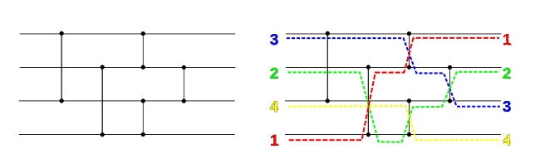
Sorting networks: The essence
Abstract mathematical model
of a network of wires and comparator modules,
which is used to sort a sequence of numbers.
5/8

Slide 6
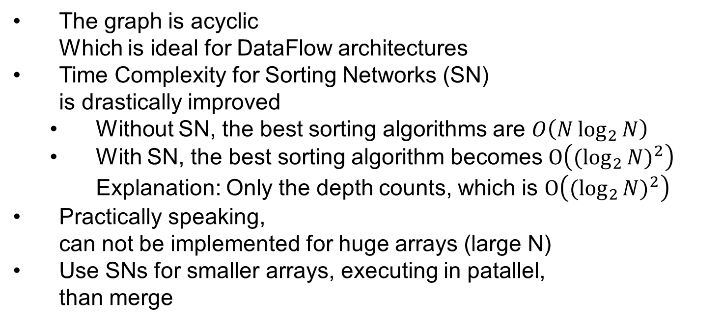
Sorting networks: Specifications
The graph is acyclic Which is ideal for DataFlow architectures
Time Complexity for Sorting Networks (SN) is drastically improved
Without SN, the best sorting algorithms are $O\left(N\log_{2}{N}\right)$
With SN, the best sorting algorithm becomes $O\left({(\log_{2}{N)}}^{2}\right)$ Explanation: Only the depth counts, which is $O\left({(\log_{2}{N)}}^{2}\right)$
Practically speaking, can not be implemented for huge arrays (large N)
Use SNs for smaller arrays, executing in patallel, than merge
6/8

Slide 7
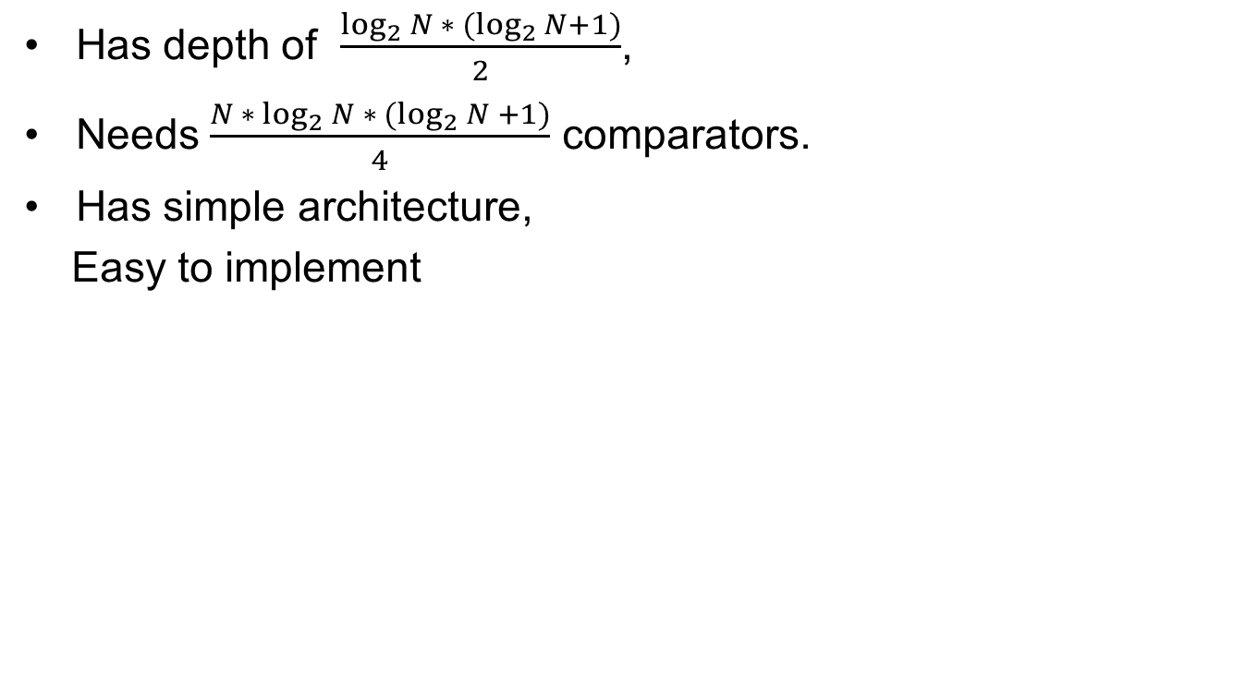
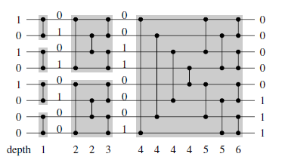
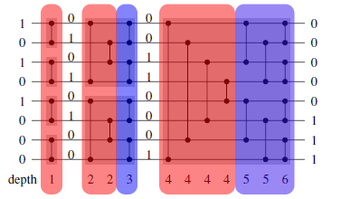
Bitonic Merge Network
7/8

Slide 8
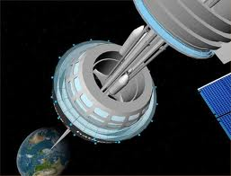
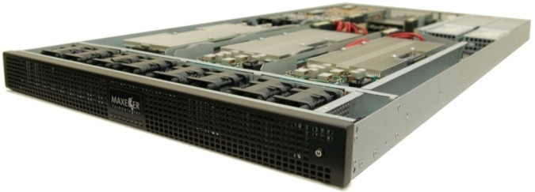
Results
Speed up: x Power reduction: y
Invented 200 years ago Invented 50 years ago
Enabling technology: Enabling technology:
C60 Maxeler
8/8

