Slide 1

Implementation of the RSA Algorithm on a Dataflow Architecture
Nikola Bežanić
nbezanic@gmail.com
Advisors: Veljko Milutinović, Jelena Popović-Božović, and Ivan Popović

Slide 2

Introduction
Case study area: Public key cryptography acceleration
Problem: RSA implementation on Maxeler
Existing problem solutions: None
Summary: Under review (IPSI)
Approach:
  Accelerate multiplications
  Analyze usability
Conclusions:
  Multiplication speedup: 70% (28% total)
  Usability: Picture encryption

Slide 3
RSA
Montgomery method: n -> r
r=2^{sw} -> power of 2
Montgomery product (MonPro): modulo r arithmetic
------------------------------------
m_{s-1}
. . .
m₁
m₀
bits
function ModExp(M, e, n) {n is odd} Step 1. Compute n’. Step 2. M_{m} := M ∙ r mod n Step 3. x_{m} := 1 ∙ r mod n Step 4. for i = k – 1 down to 0 do Step 5. x_{m} := MonPro(x_{m}, x_{m}) Step 6. if e_{i} = 1 then x_{m} := MonPro(M_{m}, x_{m}) Step 7. x := MonPro(x_{m}, 1) Step 8. return x
e_{k-1}
. . .
e₁
e₀
1 bit

Slide 4
Montgomery product
function MonPro(a, b) Step 1. t := a ∙ b Step 2. m := t ∙ n’ mod r Step 3. u := (t + m ∙ n) / r Step 4. if u ≥ n then return u – n else return u
a and b are big numbers
Breaking them to digits:
  b_{s-1}…b₁b₀
  a_{s-1}…a₁a₀
Processing on a word basis
for i = 0 to s-1 C := 0 for j = 0 to s-1 (C, S) := t[i + j] + a[j]∙b[i] + C t[i + j] := S t[i + S] := C

Slide 5
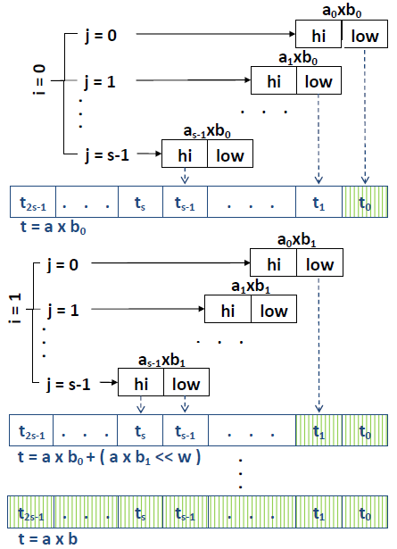
Montgomery product: Step 1
for i = 0 to s-1 C := 0 for j = 0 to s-1 (C, S) := t[i + j] + a[j]∙b[i] + C t[i + j] := S t[i + S] := C
a[j]
b[i]
X
CPU
Product:
hi
low
32 bits

Slide 6
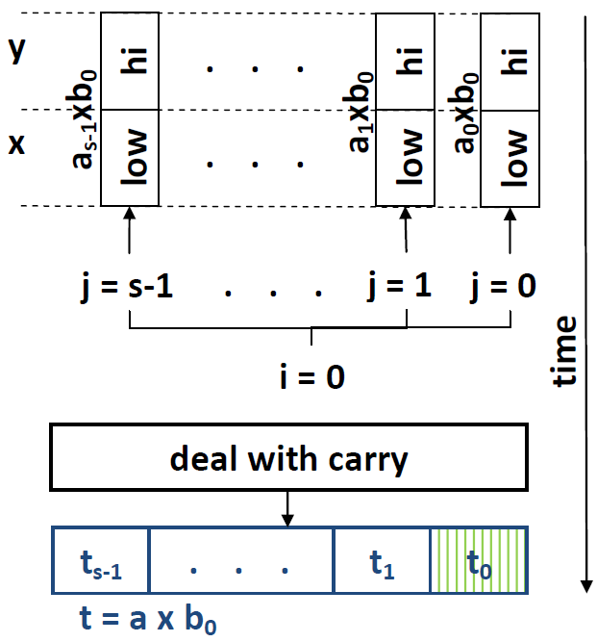
Dataflow multiplier
a[j]
b[i]
X
CPU
Product:
hi
low
32 bits
Stream a
Constant b₀
Dataflow engine (DFE)
X
Stream y
Stream x

Slide 7
Dataflow multiplier: Pipeline problem
Next iteration (next constant b₁) => new DFE run
New DFE run => new pipeline fill-up overhead
1024-bits key requires only 32 digits (32 bits each)
Not enough to fill-up the pipeline
Result: CPU time < DFE time !
Solution:
  Work on blocks of data
  Do not use constants, rather use a stream
  Stream has redundant values: acts as a const.
b₀
b₁
a₀
a₁
a₂
a₃
a₀
a₁
a₂
a₃
X
Stream y
Stream x

Slide 8
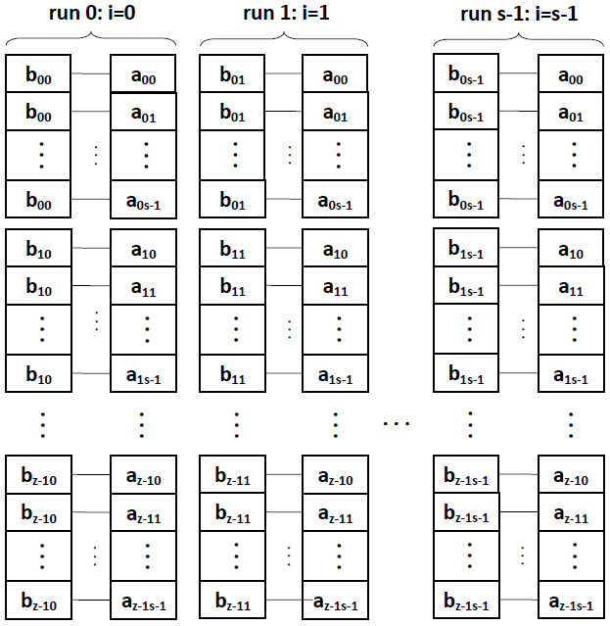
Dataflow multiplier: Blocks of data
b₀ x a < = >
Block 0
Block 1
Big streams for each run
Block z-1

Slide 9
Results
Using blocks pipeline is full
Using one multiplier speed up is 10% for RSA
Speedup is 70% for multiplication using 4 multiplers
It leads to 28% for complete RSA (Amdahl’s law)
Future work
  Deal with carry at DFE or
  Overlap carry propagation at CPU and multiplication at DFE

Slide 10
The End
function ModExp(M, e, n) { n is odd } Step 1. Compute n’. Step 2. M_{m} := M ∙ r mod n Step 3. x_{m} := 1 ∙ r mod n Step 4. for i = k – 1 down to 0 do Step 5. x_{m} := MonPro(x_{m}, x_{m}) Step 6. if e_{i} = 1 then x_{m} := MonPro(M_{m}, x_{m}) Step 7. x := MonPro(x_{m}, 1) Step 8. return x

