Slide 1
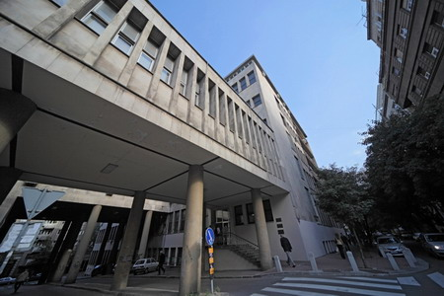
Maxeler@FFH: Selected FFH Applications

Slide 2


Maxeler @ FFH
Šćepan miljanić,
epan@ffh.bg.ac.rs
Milena petković,
milena@ffh.bg.ac.rs
Aleksandar Jović, aleksandar.jovic@ffh.bg.ac.rs

Slide 3
A Short Survey of FFH Algorithms Suitable for DataFlow Technology
Quantum Chemistry
Chemical Kinetics
Analysis of Fluids
Statistical Thermodynamics
Spectroscopy

Slide 4
Condition for an Algorithm to be Suitable for DataFlow
The FFH Viewpoint:
BigData
Over 95 % of run time in loops
Reusability of the data
n/a
n/a
n/a

Slide 5
Quantum Chemistry
Time-independent Schrödinger equation:
Goal: optimization of the structure!
Method of steepest descent – the next point x_{n+1} is chosen in the direction of the negative gradient at x_{n}:
Conjugate gradient methods – gradients at the last two points are taken into account:
Newton-Raphson method – in addition to the gradient, the Hessian is computed at each point:

Slide 6
Chemical Kinetics
System of partial differential equations: used for finding
numerical solutions to sets of coupled chemical reactions.
Euler method
Runge-Kutta algorithm
Taylor theorem

Slide 7
Analysis of Fluids
Monte-Carlo methods
Korteweg–de Vries equation (KdV equation)
Vlasov equation for classical fluids

Slide 8
Statistical Thermodynamics
System of a large number of statistical methods
Euler-Lagrange equations
Boltzmann H-function
Schmidt recurrence relation

Slide 9
Spectroscopy
Fourier transform
Taylor Series Expansion
Green's function

Slide 10
Synergy Possibilities: FFH and ETF
HW @ ETF
HW @ FFH
Periodical Joint Meetings
ETF speed up of concrete FFH calculations

Slide 11
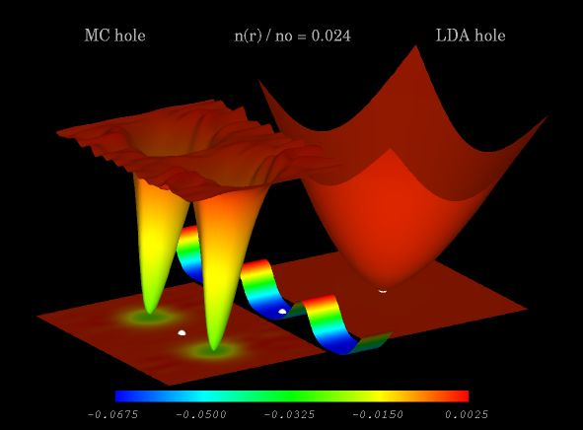
Why all of this?

Slide 12
Šćepan miljanić,
epan@ffh.bg.ac.rs
Milena petković,
milena@ffh.bg.ac.rs
Aleksandar Jović, aleksandar.jovic@ffh.bg.ac.rs

