Slide 1

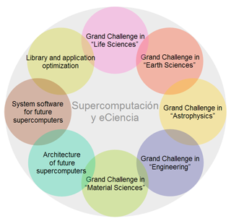
Solutions for Scientific Computing
SyeC
Barcelona
Supercomputing
Center
May 2013
NASA JPL
April 2013

Slide 2

Richard Feynman on Computation
In theory, a computer system
can be constructed which uses no energy.
Energy is only needed when information is lost.
Reordering of information does not require energy
from a pure physics perspective.
Of course, moving information takes Energy…

Slide 3
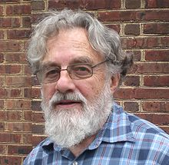

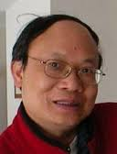
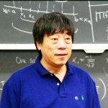
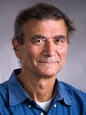

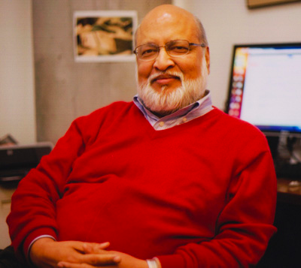
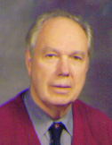
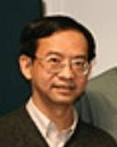
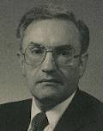

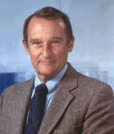
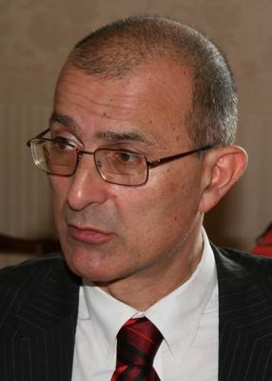
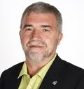
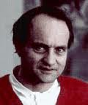
The Next Generation
Systolic Arrays
Reversible Computing
Jack Dennis
Static Dataflow
Martin Morf
S.Y. Kung
H.T. Kung
Reconfigurable
Computing
Tommaso Tofoli
Tofoli Gate
Ed Fredkin
Fredkin Gate
Arvind
Dynamic
Dataflow
Mike Flynn
SIMD, SISD
MIMD, MISD
Norman Margolus
MIT
CAM-8
Wayne
Luk
Dan Slotnick
ILLIAC IV
SOLOMON
Seymour
Cray
Mateo
Valero
Jean Vuillemin
Programmable Active
Memories
V. Milutinovic GaAs Processors
Vector
Supercomputing

Slide 4
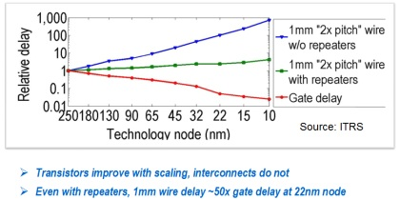
As a PhD student at Stanford in 1995 I was told:
Wires will dominate VLSI
Clock frequency will stop increasing
Power dissipation per unit space will set the limit
Memory speed grows slower than CPU speed
I concluded than in the long term,
computing will have to change focus from arithmetic to
The choreography of data movement.

Slide 5
Multiscale dataflow computing
Dataflow computing requires a change on all levels of abstraction ☹
Multiple scales of computing | Important features for optimization
complete system level | balance compute, storage and IO
parallel node level | maximize utilization of compute and interconnect
microarchitecture level | minimize data movement
arithmetic level | tradeoff range, precision and accuracy = discretize in time, space and value
bit level | encode and add redundancy
transistor level | => create the illusion of ‘0’ and ‘1’

Slide 6
Maxeler Technologies
Roots at Stanford University, Bell Labs, and Imperial College London
Founded in 2003, incorporated in Delaware and England
2006: signs long term R&D contract with Chevron in San Ramon CA
2011: sold 20% stake to JP Morgan’s strategic investments group
2010: ENI (Italy) buys largest Maxeler Supercomputer for Imaging
2013: 100 MAX-UP members worldwide across science and engineering.

Slide 7
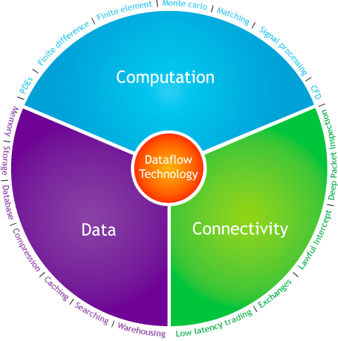

Slide 8
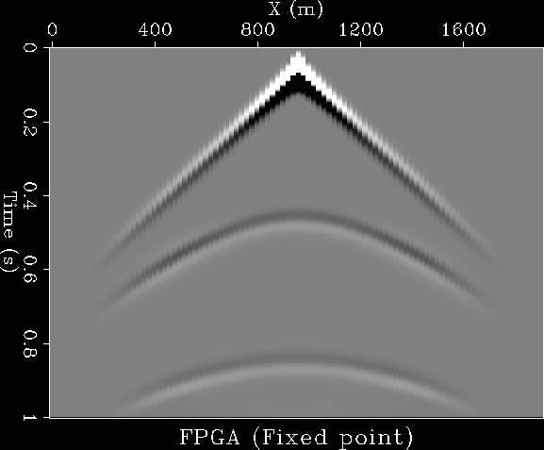
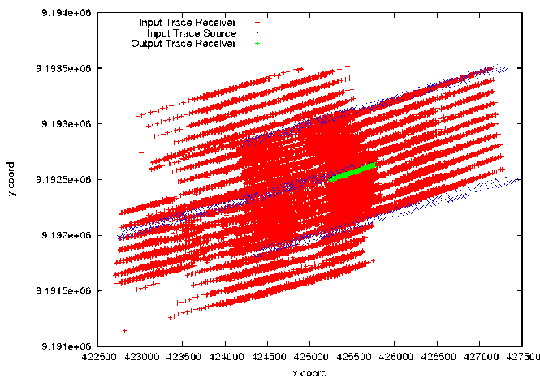
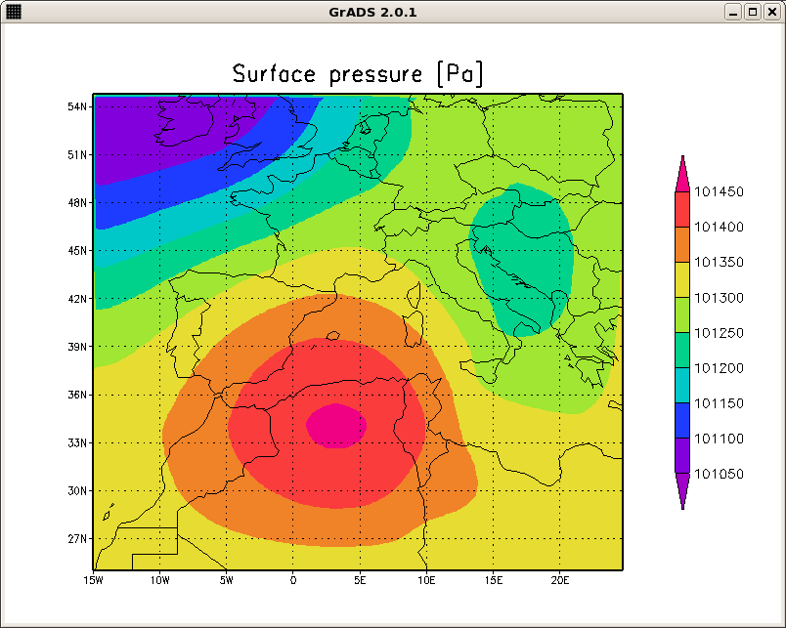
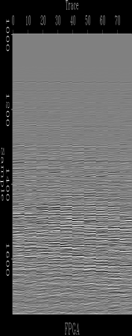
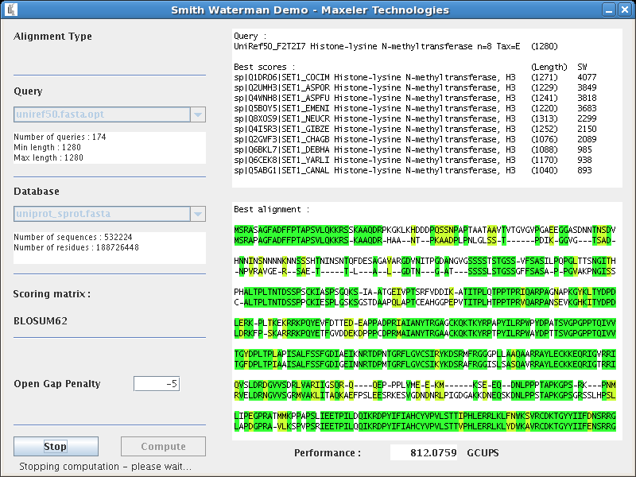
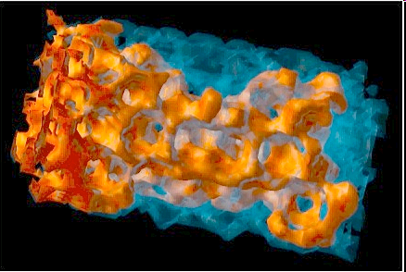
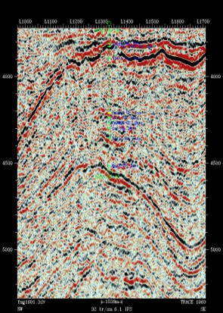
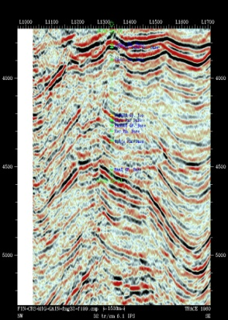
Comparing an x86 based 1U machine with a Multiscale Dataflow based 1U machine with 8 DFEs
Modelling 25x
Finite Difference 60x
Data Correlation 22x
Smith-Waterman 16-32x
Fluid Flow 30x
Imaging 29x

Slide 9
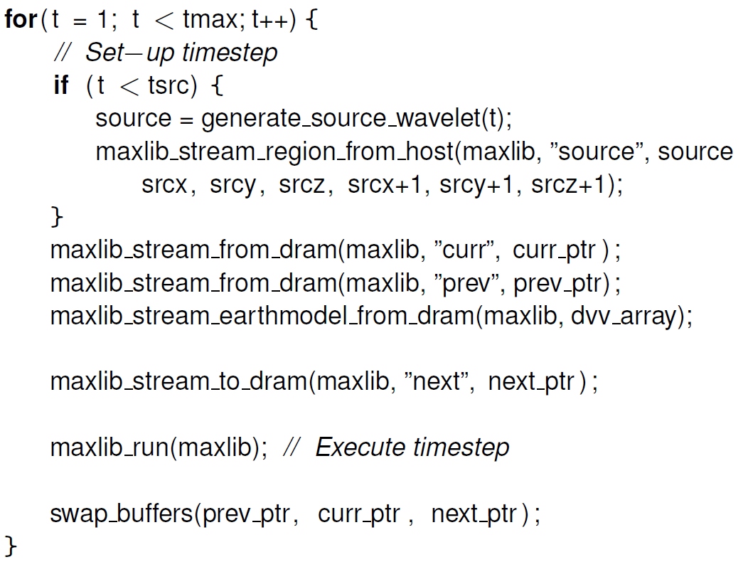
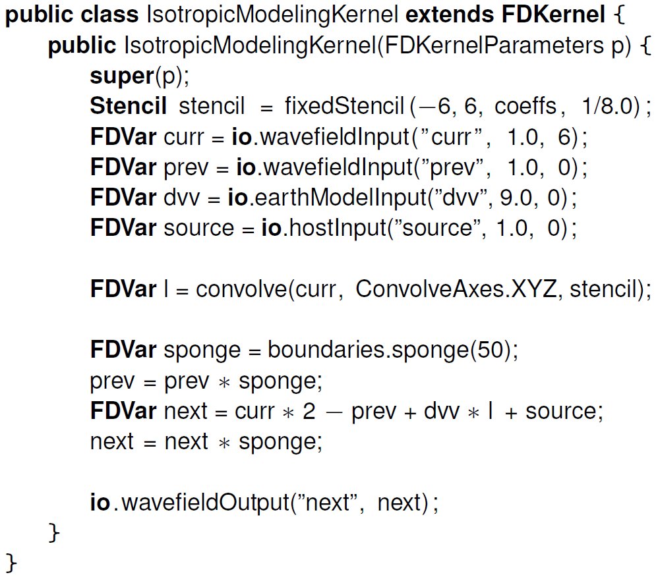
Finite Difference, Self-parallelizing code
Host Code (.c)
FDKernel (.java)

Slide 10

Does Speed Matter?
Running on MPC-C servers - 8 parallel compute pipelines per chip - 150MHz => low power consumption! - 30x advantage over same size CPU-only implementation
Beyond Traditional Microprocessors for Geoscience High-Performance Computing Applications
O. Lindtjorn, R. G. Clapp, O. Pell, O. Mencer, M. J. Flynn and H. Fu,. Stanford, Schlumberger, Maxeler, Tsinghua University, IEEE Micro, vol. 31, no. 2, March/April 2011.
10 / 28

Slide 11
3D Finite Difference 2 MaxNodes equiv. to 1,900 Intel CPU cores
Compared to 32 3GHz x86 cores parallelized using MPI
FD modeling beyond 70Hz with FPGA acceleration, D. Oriato, O. Pell, C. Andreoletti and N. Bienati. Maxeler Technologies, Eni E&P Division, SEG 2010 HPC Workshop, Denver, Oct 2010.
Notes:
Elastic makes things worse

Slide 12
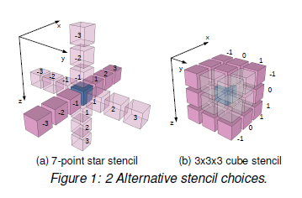
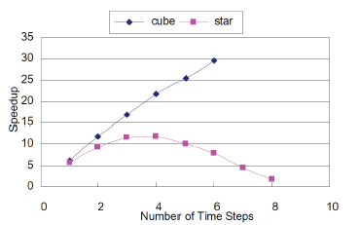
The Difference between computing in time vs computing in space
More Computation in Less Time?
Local temporal parallelism
cascade in space
twice as many timesteps
19 MADDs
27 MADDs
Local Buffer = 6 slices
Local Buffer = 3 slices
Collaboration with Bob Clapp, Stanford Geophysics

Slide 13
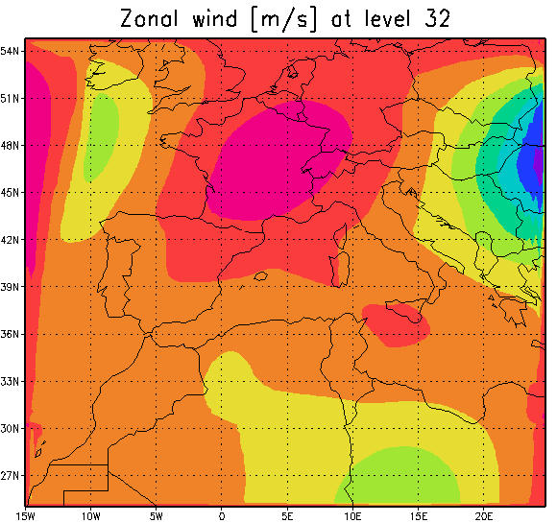
Meteorological Modelling
Computationally intensive process
Accurate local weather forecasts require dense grids
Dataflow computing can provide order of magnitude performance boosts
Example: 1 dataflow node equivalent to 381 cores
Joint work between Maxeler and CRS4 Lab, Italy
Presented at SAAHPC 2012: Acceleration of a Meteorological Limited Area Model with Dataflow Engines

Slide 14


2 hours to 2 minutes
1U CPU Node
Wall Clock Time: 2 hours
1U Dataflow Node
less than 2 minutes
Problem size: (Longitude) 13,600 Km x (Latitude) 3330 Km
Simulation of baroclinic instability after 500 time steps.

Slide 15
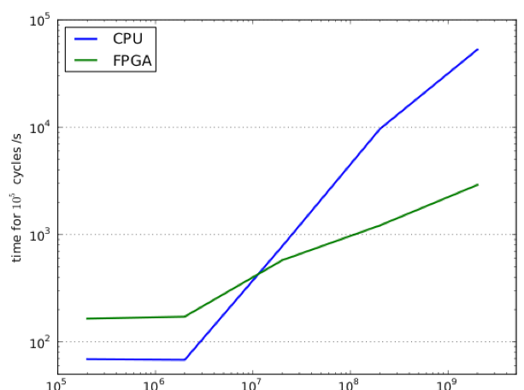


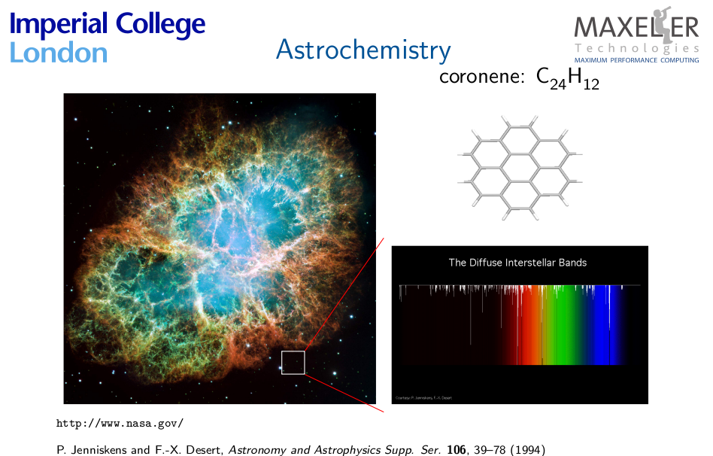
CPU
DFE
MAX-UP: Astro Chemistry

Slide 16
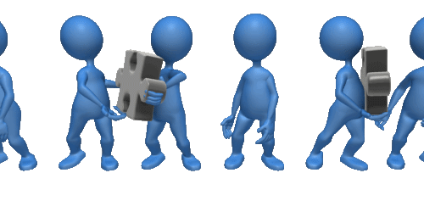
What is the most efficient way to move lot’s of stuff?
Courtesy of Bob Clapp, Stanford Geophysics

Slide 17

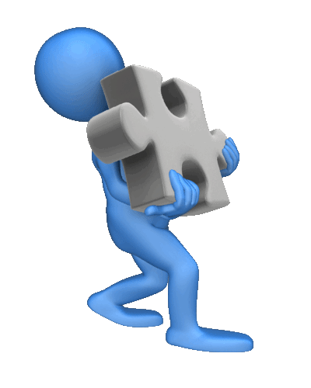
Control Flow versus Data Flow
CPUs
DFEs
Which one would you rather do?
Which one would you rather do now?

Slide 18

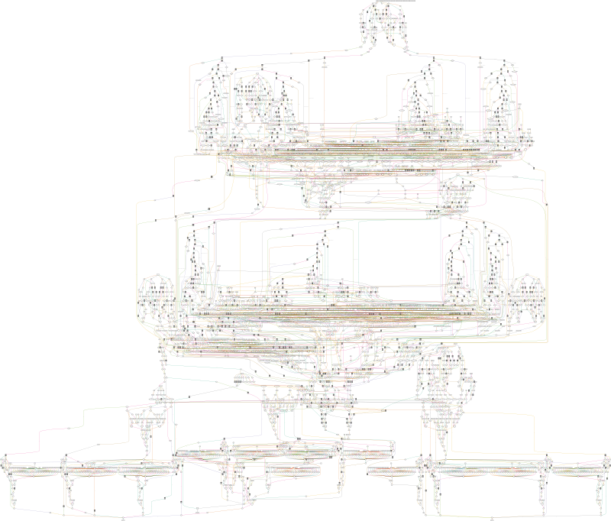
Maxeler Multiscale Dataflow Computing
T_{compute}=GB/[GB/s] for up to 10K operations
computing on the stream within a window of 7 MB
Dataflow Engine [DFE]
4866 Arithmetic Operations
GB
GB
10K
Arithmetic Units
GB/s
GB/s
GB/s
GB/s
GB
GB
10TB/s
Local SRAM
7 MB
PCI Express or Infiniband

Slide 19



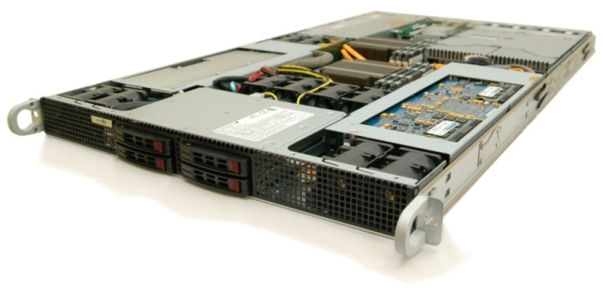
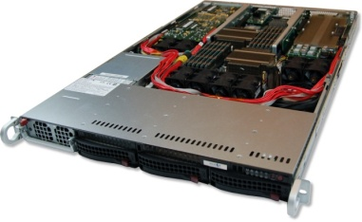
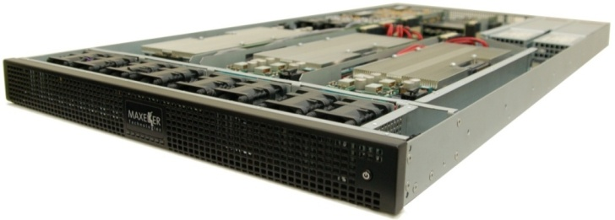
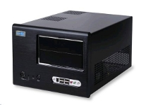
Maxeler Dataflow Engines (DFEs)
High Density DFEs Intel Xeon CPU cores and up to 6 DFEs with 288GB of RAM
The Dataflow Appliance
Dense compute with 8 DFEs, 384GB of RAM and dynamic allocation of DFEs to CPU servers with zero-copy RDMA access
The Low Latency Appliance
Intel Xeon CPUs and 1-2 DFEs with direct links to up to six 10Gbit Ethernet connections
MaxRack
10, 20 or 40 node rack systems integrating
compute, networking & storage
Dataflow Engines
48GB DDR3, high-speed connectivity and dense configurable logic
MaxWorkstation
Desktop
dataflow
development system
MaxCloud
Hosted, on-demand, scalable accelerated
compute

Slide 20
2D convolution with MaxCompiler
CPU
Memory
CPU
Code
c3
Chip
SLiC
MaxelerOS
Manager
c0
c1
c2
PCI
Express
c3
Main
Memory
c0
c1
c2
c4
x
y
c4
CPU Code (.c)
Manager (.java)
MyKernel (.java)
Manager m = new Manager(“Calc”);
Kernel k =
new MyKernel();
m.setKernel(k);
m.setIO(
link(“x", PCIE),
m.addMode(modeDefault());
m.build();
int *x, *y;
link(“y", PCIE));
DFEvar x = io.input("x", hwInt(32));
DFEvar result = c0*FIFO(x,1) +
c1*x + c2*FIFO(x,-1) +
c3*FIFO(x,L) +
c4*FIFO(x,-L);
io.output("y", result, hwInt(32));
#include “MaxSLiCInterface.h”
#include “Calc.max”
Calc(x, y, DATA_SIZE)
for (int i =L; i < DATA_SIZE-L; i++)
y[i]= c0*x[i-1] + c1*x[i] +
c2 * x[i+1] +
c3 * x[i-L] + c4 * x[i+L]

Slide 21
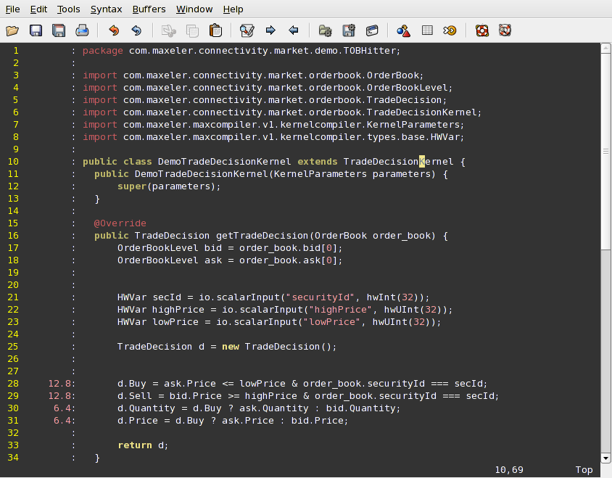
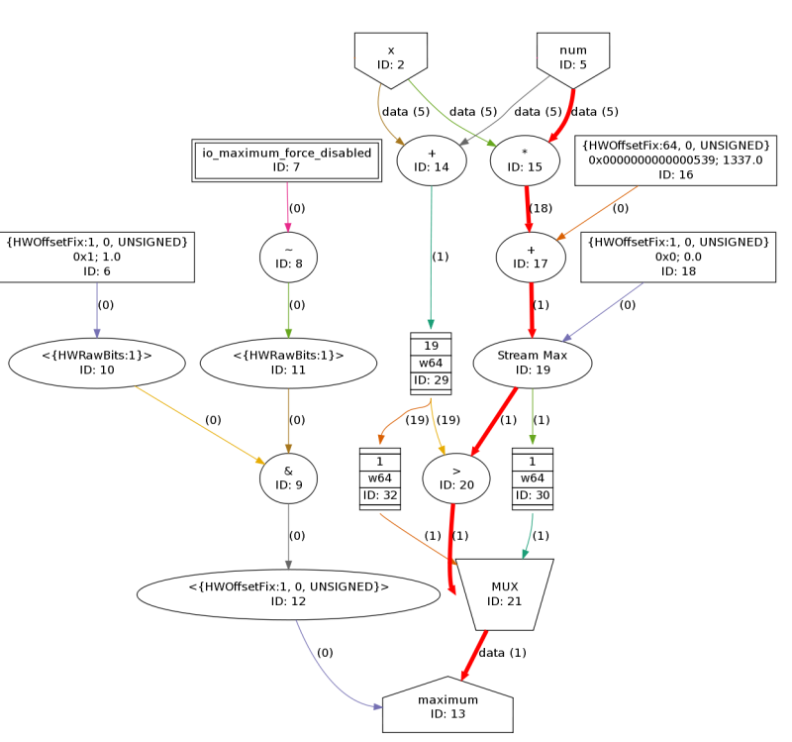
Optimization Feedback inside MaxIDE
MaxCompiler gives detailed latency and area annotation back to the programmer inside MaxIDE
Evaluate precise effect of code
on latency and chip area
+
=
12.8ns
6.4ns
19.2ns (total compute latency)

Slide 22
The CPU-DFE Interface (SLiC)
Base
single maxfile, single interface, and single user/process
Multi-interface
multiple use cases in one MaxFile
Multi-MaxFile
multiple MaxFiles in one application
Arrays
for using MaxRing
Groups
share engines across multiple processes
Non-blocking
asynchronous action runs
Base
Multi-interface
Multi-MaxFile
Arrays
Groups
Non-blocking
Base
Multi-interface
Multi-MaxFile
Arrays
Groups
Non-blocking
Base
Multi-interface
Multi-MaxFile
Arrays
Groups
Non-blocking
Interfaces
Basic static
Advanced static
Dynamic

Slide 23
MaxSkins
Custom Engine Interfaces
(.c)
MaxCompiler
.max file
Testing /
Application integration
Dataflow Design
(.maxj)
MaxCompiler
App Packager
.max file developer
.max file user
App Installer
SLiC level programming
MATLAB
C/C++
R
Excel
Python
.mex
.m

Slide 24

Maxeler Risk Analytics Software
Maxeler’s finance appliance accepts client input data and generates required risk management data at any and all requested levels of aggregation.
Scenario analysis: permutative, combinatorial, ad- hoc or Monte Carlo.
The finance appliance is fully scalable to client requirements.
Maxeler’s finance library provides accelerated analytics for valuation and risk management across all major asset classes
Client
input data
Client input data
2013

Slide 25
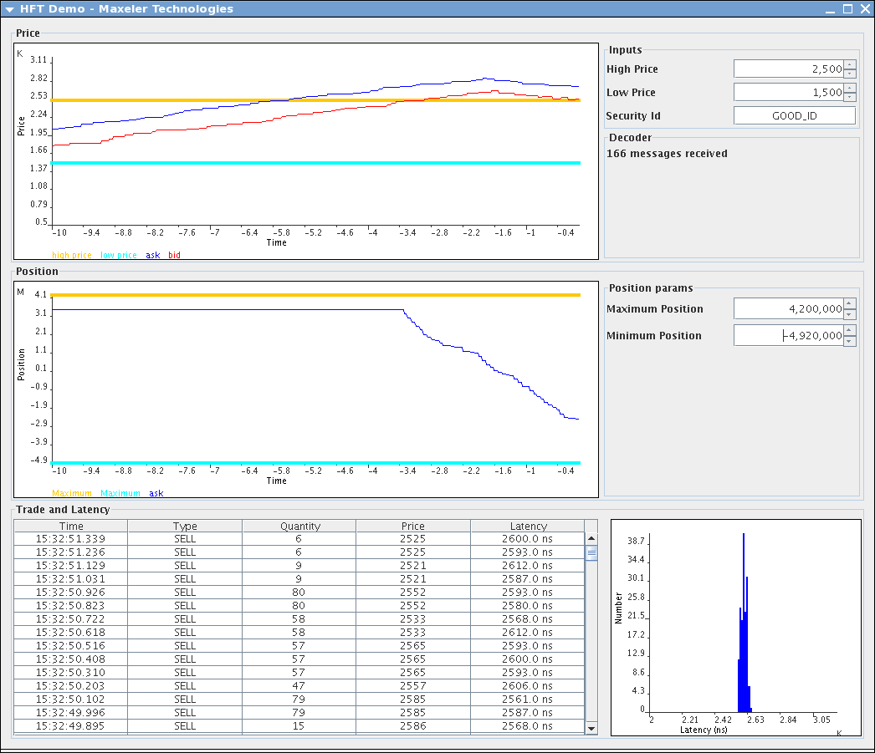
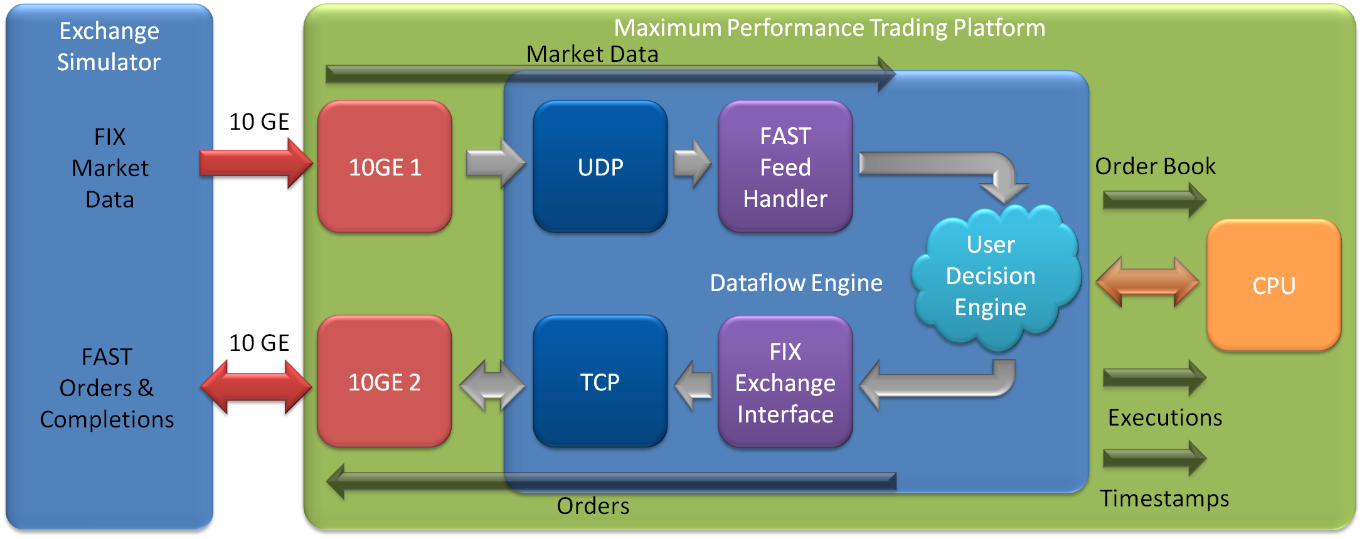

High Frequency Trading with Maxeler DFEs
Maxeler Trading User Interface
Realtime market view
Position Management
Built-in Latency monitoring
Executed trades
Architecture

Slide 26
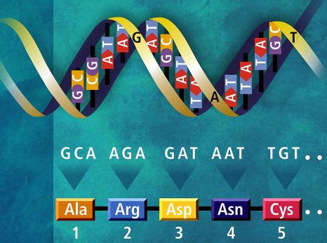

Maxeler running Smith Waterman

Slide 27
Comparison CPU, GPU, DFE in a 1U box
CPU Node Intel Xeon X5570 (2.93GHz, 8 cores) | 1,872[MCUPS]
GPU Node 2x NVIDIA GeForce 8800 GTX (575MHz, 128core) | 3,700[MCUPS]
GPU node 2x NVIDIA Tesla C2050 (1.15GHz, 448core) | 25,900[MCUPS] (=2x 1850*448/128*1150/575)
DFE Node: MPC-C 4x MAX3-vectis (2011) | 240,000[MCUPS] (=4x2x30,000)
DFE Node: MPC-X 8x MAX4-maia (2013) | 960,000[MCUPS]
CUPS = Cell Updates Per Sec
Notes:
関連研究としまして
２００８ に GPU を用いた SWA の高速化 の報告があり
それによると GPUは １８５０ MCUPS でした
少し古いので最新の 数値計算専用の GPU を使った場合 の簡単な スケーリング をおこないました
それでも １２９５０で FPGAのほうが２．５倍近い スピードが出ています

Slide 28
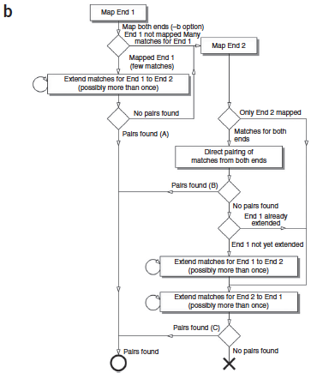
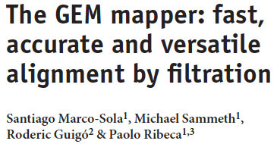
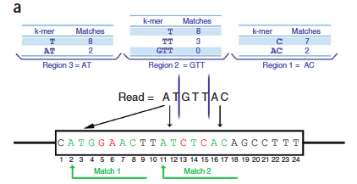
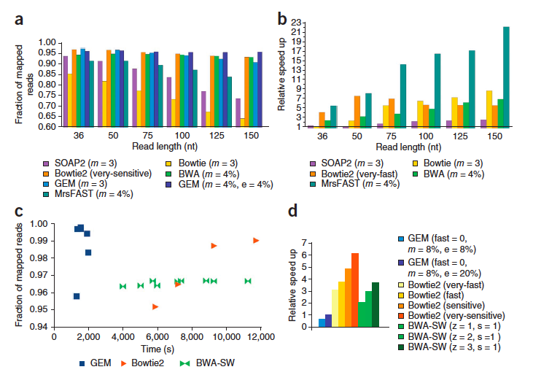
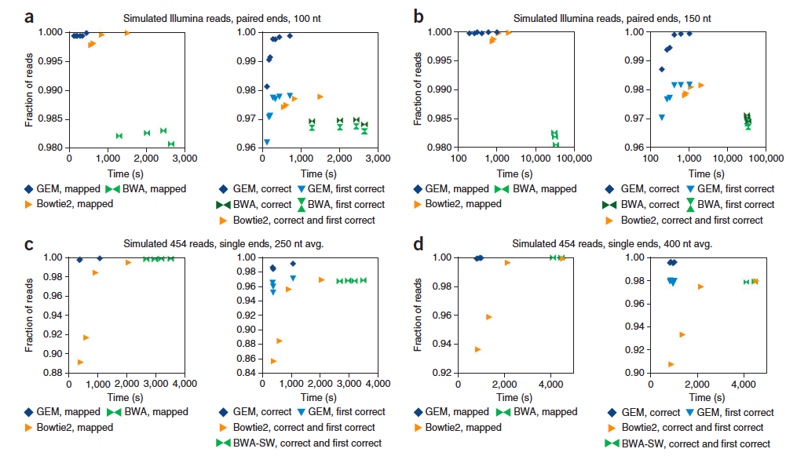

Slide 29
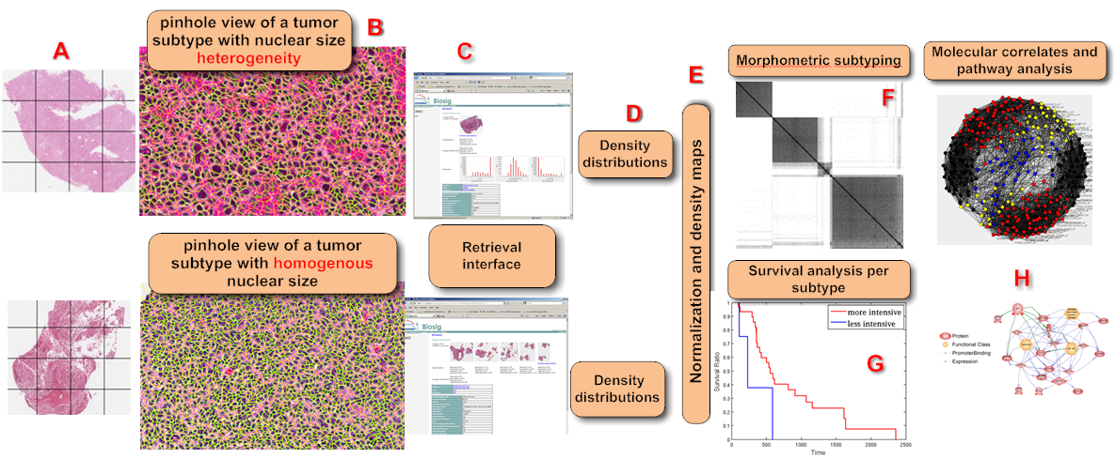
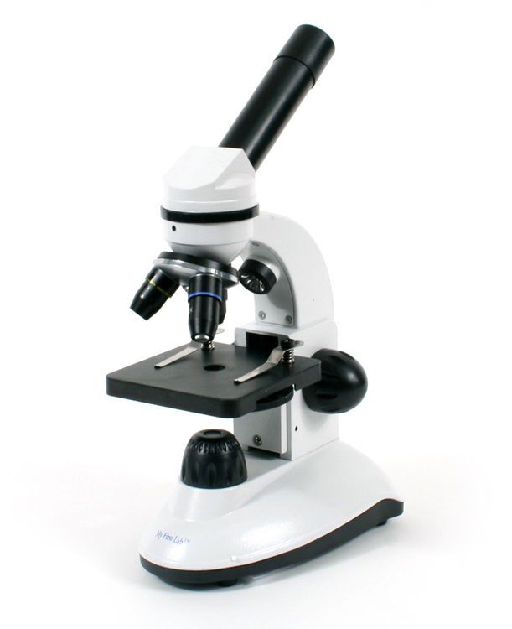
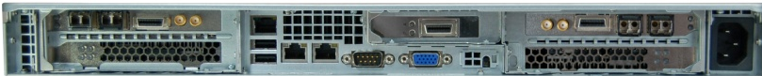
Molecular Correlates of Tumor Signatures from a Large Cohort
From whole slide sections, of a cohort, to pathway analysis (Prof Bahram Parvin, Berkeley)
High Content Analysis (HCA) on MPC-X

Slide 30


Brain network analysis Dynamic community analysis on corpus callosum to identify functional regions. By accelerating the linear correlation calculation, Maxeler dataflow engines can build brain networks on-the-fly while the lab experiment is running.

Slide 31
Quotes:
“With the new Maxeler technology, J.P. Morgan’s trading businesses can now compute orders of magnitude more quickly, making it possible to improve our understanding and control of the profile of our complex trading risk.” Peter Cherasia, Head of Markets Strategies, J.P. Morgan
"Maxeler's superfast Dataflow Computers are the next wave of supercomputing for scientific applications and we at Tsinghua and PanDing are ready to take the lead of deploying this exciting new technology across research facilities in China."
Prof Haohuan Fu, Tsinghua University, Beijing, and PanDing,
http://www.panding.com.cn/
“WesternGeco wishes to leverage the increased performance available through the Maxeler platform.” Planned commercial availability with Omega 2013.
Schlumberger, announcement, SEG Conference 2013.
"Ashworth notes that he's ‘very keen on exploring’ technology from Maxeler, …"
Michael Ashworth, UK Science and Technology Facilities Council (STFC)

