Slide 1
Lattice Boltzmann for Blood Flow: A Software Engineering Approach for a DataFlow SuperComputer
Nenad Korolija, nenadko@etf.rs
Tijana Djukic, tijana@kg.ac.rs Nenad Filipovic, nfilipov@hsph.harvard.edu
Veljko Milutinovic, vm@etf.rs

Slide 2


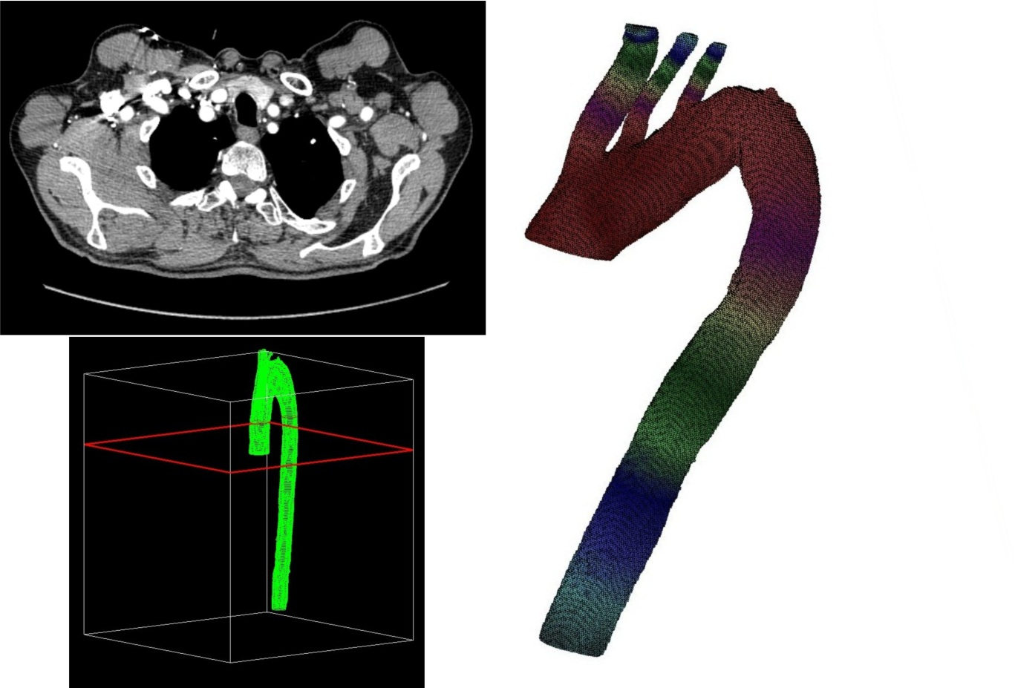


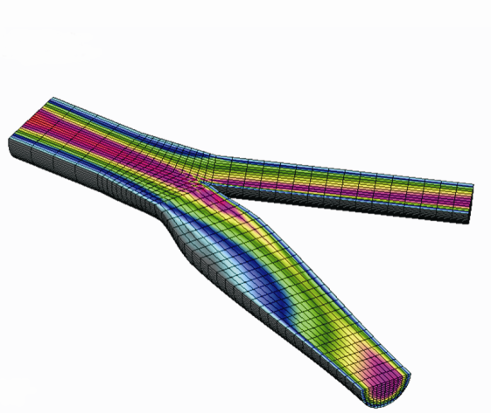
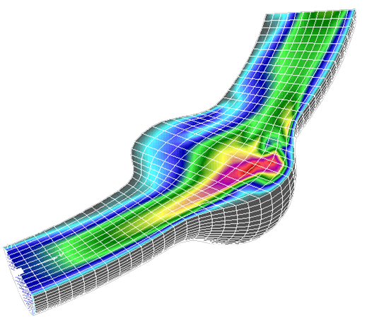

Cooperation between BioIRC, UniKG and School of Electrical Engineering, UniBG
Notes:
Moja ideja za ovaj slajd:
NK : ovde ti mozes da kazes nesto o vasoj instituciji, mi se bavimo …
TDj : Mi u BioIRC-u se bavimo biomedicinskim inzenjeringom, primarno modeliranjem pojava u kardiovaskularnom sistemu. Modeli koje koristimo su kreirani na osnovu MRI/CT slika dobijenih iz klinike, za konkretne pacijente. Za tako kreirane modele mi sprovodimo numericke simulacije da bi se dobila raspodela brzine, pritiska itd. Ono sto je povezalo nase dve institucije je upravo (click) Maxeler ! Naime, nase simulacije mogu da budu jako zahtevne kada je u pitanju kompjutersko vreme i znaju da traju i po nekoliko dana. Zbog toga smo dosli na ideju da zajedno sa kolegama sa ETF-a pokusamo da jedan deo nase aplikacije pokrenemo na Maxeler-u i da na taj nacin drasticno ubrzamo nase proracune.
Note: moze ovde sa leve strane da se postave grbovi i drugih institucija prof. Veljka, ali ja nisam bila sigurna sta treba staviti, pa sam to ostavila tebi …

Slide 3

Lattice Boltzmann for Blood Flow: A Software Engineering Approach
Expensive
Quiet
Fast
Electrical
20m cord
Environment-friendly
Big-pack
Wide-track
Easy handling
Reparation manual
Reparation kit
5Y warranty
Service in your town
New-technology high-quality non-rusting heavy-duty precise-cutting recyclable blades streaming grass only to bag ...

Slide 4
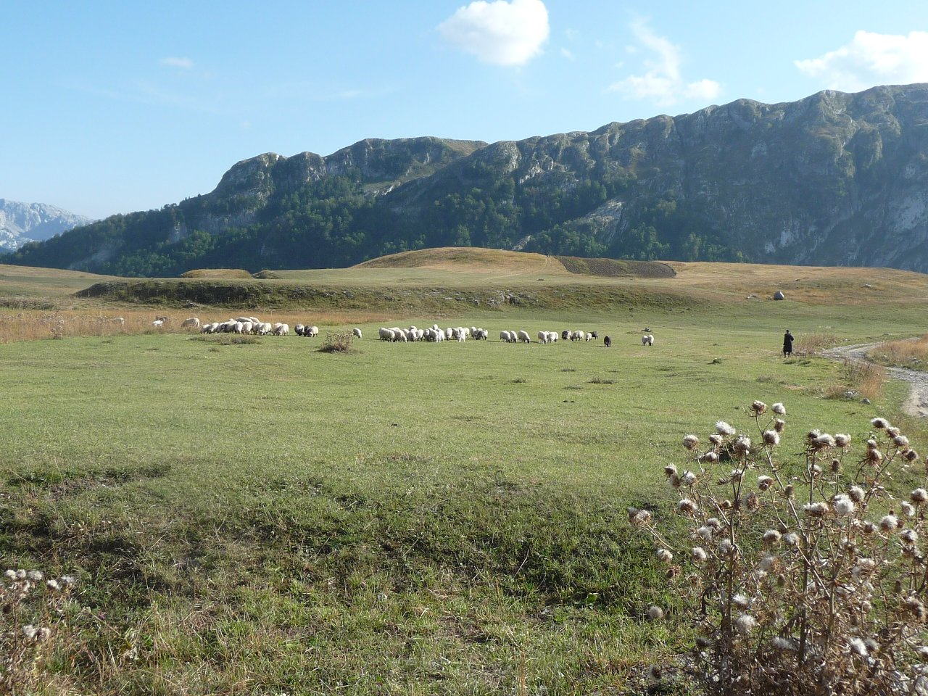
Lattice Boltzmann for Blood Flow: A Software Engineering Approach
Expensive
Quiet
Electrical
20m cord
Environment-friendly
Big-pack
Wide-track
Easy handling
Reparation manual
Reparation kit
5Y warranty
Service in your town
New-technology high-quality non-rusting heavy-duty precise-cutting recyclable blades streaming grass only to bag ...

Slide 5

Lattice Boltzmann for Blood Flow: A Software Engineering Approach

Slide 6
Structure of the Existing C-Code for a MultiCore Computer
LS1 LS2 LS3 LS4 LS5
Statically: P / T = 100 / 400 = 25% => Only 100 lines to “kernelize”
Dynamically: P / T = 99% => Potential speed-up factor is at most 100
LS – Looping structure
LS1 and LS5 – Nested loops
LS2, LS3, and LS4 – Simple loops
P – lines to parallelize
T – total number of lines

Slide 7
What Looping Structures to “Kernelize”
All, because we like all data to reside on MAX3 prior to the execution start
MAX
MAX
MAX
MAX
MAX
MAX
CPU
CPU
CPU
CPU
CPU
CPU

Slide 8
What Looping Structures Bring what Benefits?
FOR i = 1 2 3 4 5 … k … n DO FOR i = 1 2 3 4 5 … n DO
T₀ T₁ T₂ T₃ T₄ T₀ T_{k} T_{2k} T_{3k}
_{OP1 OP1}
_{OP2 OP2}
_{OP3 OP3}
_{OP4 OP4}
_{OP5 OP5}
_{OP6 OP6}
. .
. .
. .
_{OPk OPk}
T_{k} T_{k+1} T_{k+2} T_{k} T_{2k}
1 result/clock_{MAX} T_{3k} T_{4k} 1 result/k*clock_{CPU}
LS1 moderate
LS2, LS3, LS4 negligible, but must “kernelize”
LS5 major
FPGA doing k operations
CPU doing only one

Slide 9
Why “Kernelizing” the Looping Structures? Conditions for “Kernelizing” Revisited
 | Why? | LS1 | LS2/3/4 | LS5
1. | BigData | O(n²) | O(n2) | O(n²)
2. | WORM | + | + | +
3. | Tolerance to latency | + | + | +
4. | Over 95% of run time in loops | ++ | ++ | ++
5. | Reusability of the data | ++ | ++ | ++
6. | Skills | + | + | ++

Slide 10
Programming: Iteration #1 What to do with LS1..5?
Direct MultiCore Data Choreography
1, 2, 3, 4, ...
Direct MultiCore Algorithm Execution
∑∑ + ∑ + ∑ + ∑ + ∑∑
Direct MultiCore Computational Precision: Double Precision Floating Point (64 bits)

Slide 11
Programming: Iteration #1 Potentials of Direct “Kernelization”
1%
99%
Amdahl Low: limes(FPGA Potential → ∞) = 100
Reality Estimate: limes(work → 30.6.2013.) = N
1%
0%
1%
x%

Slide 12
Pipelining the Inner Loops
inputs
0
Kernel(s) Stream
Middle
Functions Kernels
Manager
Kernel
j
Kernel(s) Collide
320
0
i
112
output

Slide 13
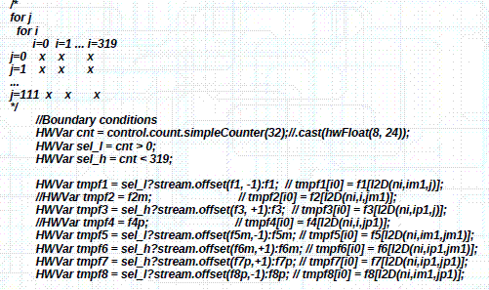
The Kernel for LS1: Direct Migration

Slide 14
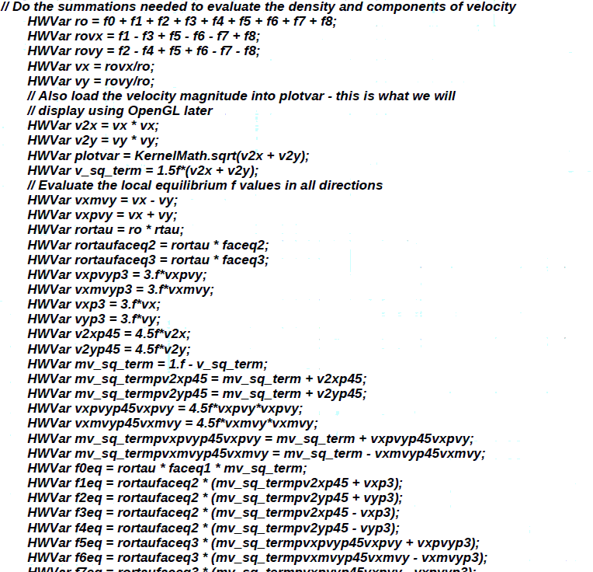
The Kernel for LS5: Direct Migration

Slide 15
Programming: Iteration #2 Ideas for Additional Speedup (a)
Better Data Choreography
5x x 5x
Estimate:
1.2 X Speed-up (as seen from the drawing above)

Slide 16
Programming: Iteration #3 Ideas for Additional Speedup (b)
Algorithmic Changes: ∑∑ + ∑ + ∑ + ∑ + ∑∑ → ∑∑ + ∑ + ∑∑
Explanation: As seen from the previous drawing, LS2 and LS3 can be integrated with LS1
Estimate: 1.6

Slide 17
Programming: Iteration #4 Ideas for Additional Speedup (c)
Precision Changes: LUT (Double-precision floating point, 64) = 500 LUT (Maxeler-precision floating point, 24) = 24
Explanation: With less precision, hardware complexity can be reduced by a factor of about 20. Increasing number of iterations 4 times brings approximately similar precision, much faster.
Estimate: Factor = (500/24)/4 ≈ 5
This is the only action, before which an topic expert has to be consulted!

Slide 18
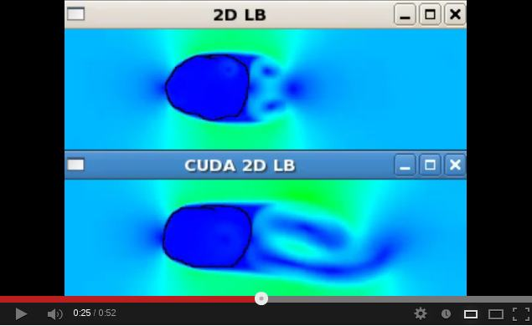
Lattice Boltzman
http://www.youtube.com/watch?v=vXpCC3q0tXQ

Slide 19
Results: SPTC ≈ 1000x “Maxeler’s technology enables organizations to speed up processing times by 20-50x, with over 90% reduction in energy usage and over 95% reduction in data centre space”.
Speedup factor: 1.2 x 1.6 x 5 x N ≈ 10N - Precisely 30.6.2013.
Power reduction factor(i7/MAX3) = 17.6 / (MAX2 / MAX3) ≈ 10 - Precisely: the WallCord method
Transistor count reduction factor = i7 / MAX3 - Precisely: about 20
Cost reduction factor: x - Precisely: depends on production volumes

Slide 20
Q&A: nenadko@etf.rs
10km/h !
30km/h !!!
Hawaii
Tahiti

