Slide 1
Veljko Milutinovic

Slide 2
The ICE of USA
Formed around NYU: Queens College
Goals: Teaching + Consulting + Research
Teaching: Army of promoters + Educating future experts
Consulting: e.g., Pfizer animal health care Private prenatal hospital rooms Student mind sets elaborated (self-esteem, control, concentration)

Slide 3
Vision for Europe: National ICE Growing MultiNational
Step#1: Getting incorporated Step#2: The 50/50 memorandum/contract with the ICE of USA Step#3: The B2C infrastructure (.ppt explanation + customer contract)
The pitch of the explanation: a. If MG is used as a one-step process: Better 5% to 25% or more b. If MG is used as a two-step process: UNIQUE c. Axioms of MG: Think? Like? How much ready to pay/donate?

Slide 4
Step#4: The First Project
From min 1Y to max 3Y Price Structure = Expences + Fee(ICE) Expenses: Polling + Travel (if any) + Specifics (if any) Fee(ICE): MicroScience (one time) + IndividualTyping (one month) = $2K IndividualTyping (monthly) = $200 Sefte = 50% off

Slide 5
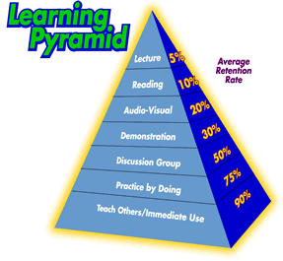
The MindGenomics Process
Step#5: LESSONS LEARNED ANALYZED!
Step#6: Careful selection of the next 9 projects!

Slide 6
The MindGenomics Process
Step#7: Another 9 projects @ 50% discount in cooperation with ICE(USA) Step#8: Lecturing in front of few big prospects. Definition of a Big Prospect: Chain of Identical Units or Single Multi Variety Production Examples: Dealerships (e.g., VW) or Monopolists (e.g., DELTA) Step#9: Automating the process: Setting the production rules Setting the quality control rules Teaching the HRs Setting the quality control of quality controllers

Slide 7
Step#10: Lecturing in front of many small firms!
Local USA Chamber of Commerce Local National Chamber of Commerce Local Commercial Chambers of Managers Pitch: This is a game of large numbers! Worst seller with MG vs Best seller w/o MG = 23% better The gain is statistical (invisible becomes visible)

Slide 8
The MindGenomics Process
Step#11: Learning How to Close the Sale in Big Noise! Suggestions: Not to hire a marketing agency a. One of co-owners (for big prospects) b. N assistants under one of co-owners
(for many small) Step#12: Classification of Master Targets Master targets are classified as: a. Those having a problem e.g., NY Times selling subscription to college students b. Those anticipating the problem e.g., Politicians before entering a campaign

Slide 9
The MindGenomics Process
Step#13: Education at a vector of universities! a. Course structure (e.g., Freshmen's MATH 110 @ NYU): 1/3 Statistics (including linear regression) 1/3 The MG process 1/3 An MG class project
b. Invited lectures (e.g., Master and PhD Students) Step#14: All child diseases cured!

Slide 10
Step#15: H2020 Proposal Preparation
Essence: Introduction to a vector of National ICE companies Mechanism: 40 different partners from 40 different EU countries Entrance Tickets: a. Have an educational course (on-site or via-skype) b. Have a paper published at a peer-review conference: Proof of understanding and building credentials c. Have a research idea compatible with the call d. Have a national ICE formed, as an affiliate of ICE.SRB: NGBT (no give before take) 50% stays locally 50% goes to ICE.SRB (for using the brand and technology) Half goes to ICE.USA Half stays at ICE.SRB Half stays with the majority owner Half goes to share-holders Axiomatic issue: Unlimited IntraBorder Growth

Slide 11
The MindGenomics Process
Step#16: Proposal Building on the top of Public Domain Improvements in 8 domain avenues! Step#17: Patenting Dr. Moskowitz holds (alone) 4 major MG patents
Step#18: Conferencing e.g., VIPSI Brainstorming: What next? Step#19: Journalization Step#20: Exchange or JPMorgan

Slide 12
Definitions of Basic Terms
IdeaMap
MindGenomics
AddressableMinds
RDE

Slide 13
IdeaMap = A Program
Function: Running a study
Input:
Demographic (facts for the polling agency)
Silos (concepts of interest for marketing)
Elements (concept related marketing slogans)

Slide 14
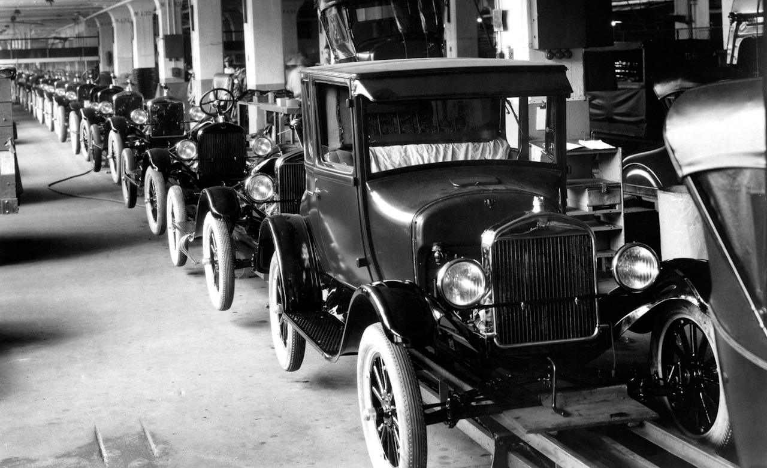
Intermediate Products
1. VIGNETTES
2. POLLING AGENCY INTERFACE

Slide 15
1. VIGNETTES
Vignettes (screens with a scenario and questions): 40 or 48
Scenario (one silo and 3 to 4 elements from other silos)
Questions (2 or 3): Think? Like? HowMuch?
Scale: Each question on the scale ZERO to 9, or 1 to 9.
Important: Questions are NEVER demographic! Questions are: PSYCHOGRAPHIC (What do you like in this 50Y old picture?) BEHAVIOURISIC (Do you like the meeting to be casual?) MERCANTILISTIC (How much are you willing to pay or donate?) Patent: If 2 questions, then: B+M (more common) Patent: Combinations form consistency sets catch liars (acceptable justification for polling re-requests) IdeaMap: Others who praised/liked/bought the same book as you, also purchased ... (patent) IdeaMap: Number of vignettes is study dependent (patent)

Slide 16
2. POLLING AGENCY INTERFACE
Several million people on file:
Field House and Amazon Turk
Each person willing to read and click 96 times
(typical 2 questions, in each one of 48 vignettes)
Requests and re-requests
(demographic data must be precisely defined in re-requests)

Slide 17
Output
Elements ranked by utility values
(each element gets a utility value assigned)
Clusters of mind sets
(to select three clusters manually) INSERT 3 FIGURES FROM MOSKOWITZ

Slide 18
MidGenomics = A Process
The scientific process of discovery: a. How people think b. How people feel c. What are they ready to pay d. [and in future, how they change]
For the following: a. Product b. Service c. Idea d. [HR]
Typing is a part of MG!

Slide 19
AddressableMinds = A Set of People
Set of people who belong to one of the categories discovered by MG! Only such people can be typed!

Slide 20
RDE = Rules Developed Experimentation
Alias: Development of MicroScience Goal: Finding minds of given characteristics Example: Peter Coleman (conflict resolution in Israel) Scenaria:
1. $ to ALL 2. Finding what they like, and make it! 3. The best: Finding mindsets who like to cooperate online, and offering them a business opportunity :)

Slide 21
A RESTAURANT EXAMPLE
Step#1: Talk and Google, to understand the essence!
Step#2: Make 6 Silos (e.g., music, food, wines, ambience, ...)
Step#3: Make 6 elements per Silo (slogans) This results in 36 marketing slogans, some good some bad: IdeaMap will rank them and will give each one a weight Those above a threshold: Good Those below the threshold: Bad
Examples: a. Food, wine, and opera - the best choice for the first date b. Select tunes to fit your wine bouquet c. ... These should be generated by a PsychoAnalyst! Long story!

Slide 22
Step#4: Submit all 36 to IdeaMap, after the MJ is ready for you. This means: An account was formed to which you log in. Upon creation of the account: Type 36 elements and press SUBMIT Step#5: Get 48 vignettes, each one 2 questions; each question 1 to 9. Step#6: Find the polling agency and give them demographic requests for 300 Step#7: Polling in which the polling agency (PA) does not see vignettes! PA sends only the URL to polling individuals (PI) PI = pollees or pollers PIs log in remotely and click 96 times.

Slide 23
Step#8: Consistency check by IdeaMap If an inconsistency is caught, MJ re-requests N repeats, and specifies their demographics. If the PA assumes abuse (getting more than 300 w/o pay), MJ shows the inconsistencies! Step#9: Getting reports, manual clustering, and selecting top 3 slogans for each cluster. INSERT SLIDES 16-20 THAT EXPLAIN THE PROCESS Step#10: Shipping top 3 slogans for each cluster to media! Billboards, TV, Radio, Web, ... Maximal number of slogans for a campaign: 5

Slide 24
TYPING
Axiom#1: The compile time axiom! Type them before they get to the restaurant, e.g., when making the reservation, via web (interactive login) or phone (direct call or call center).
Axiom#2: After they come, they do not like to "push buttons", so if you have a "fresh-from-the-oven" offer, or the guest just dropped-in un-announced, the value exchange must be considerable (TABLET with 3 questions to select a free appetizer).
Final GOAL: Increased the spending and many happy returns :)

Slide 25
ANALYSIS OF THE OPTIMAL NUMBER OF TYPING QUESTIONS!
INSERT 3 VM PAPERS IN IEE and 1 IN IEEE!

Slide 26
ESSENCE
Experimental design: Sets the vignettes
Linear regression deconstructs combinations, and detects lies as a byproduct
Clustering and discriminant function analysis: Create Qs for Typing
Empathy mining: Media based preprocessor - ongoing research!

Slide 27
MyPapers!
Milutinovic, V., A Comparison of Suboptimal Detection Algorithms Applied to the Additive Mix of Orthogonal Sinusoidal Signals, IEEE Transactions on Communicatiions, Vol. COM-36, No. 5, May 1988, pp. 538-543.
Milutinovic, V., Knezevic, P., Radunovic, B., Casselman, S., Schewel, J., Obelix Searches Internet Using Customer Data, IEEE COMPUTER, July 2000 (impact factor 2.205/2010).
Milutinovic, V., Cvetkovic, D., Mirkovic, J., Genetic Search Based on Multiple Mutation Approaches, IEEE COMPUTER, November 2000 (impact factor 2.205/2010).
Milutinovic, V., Ngom, A., Stojmenovic, I., STRIP --- A Strip Based Neural Network Growth Algorithm for Learning Multiple-Valued Functions, IEEE TRANSACTIONS ON NEURAL NETWORKS, March 2001, Vol.12, No.2, pp. 212-227 (impact factor 2.889/2010).

Slide 28
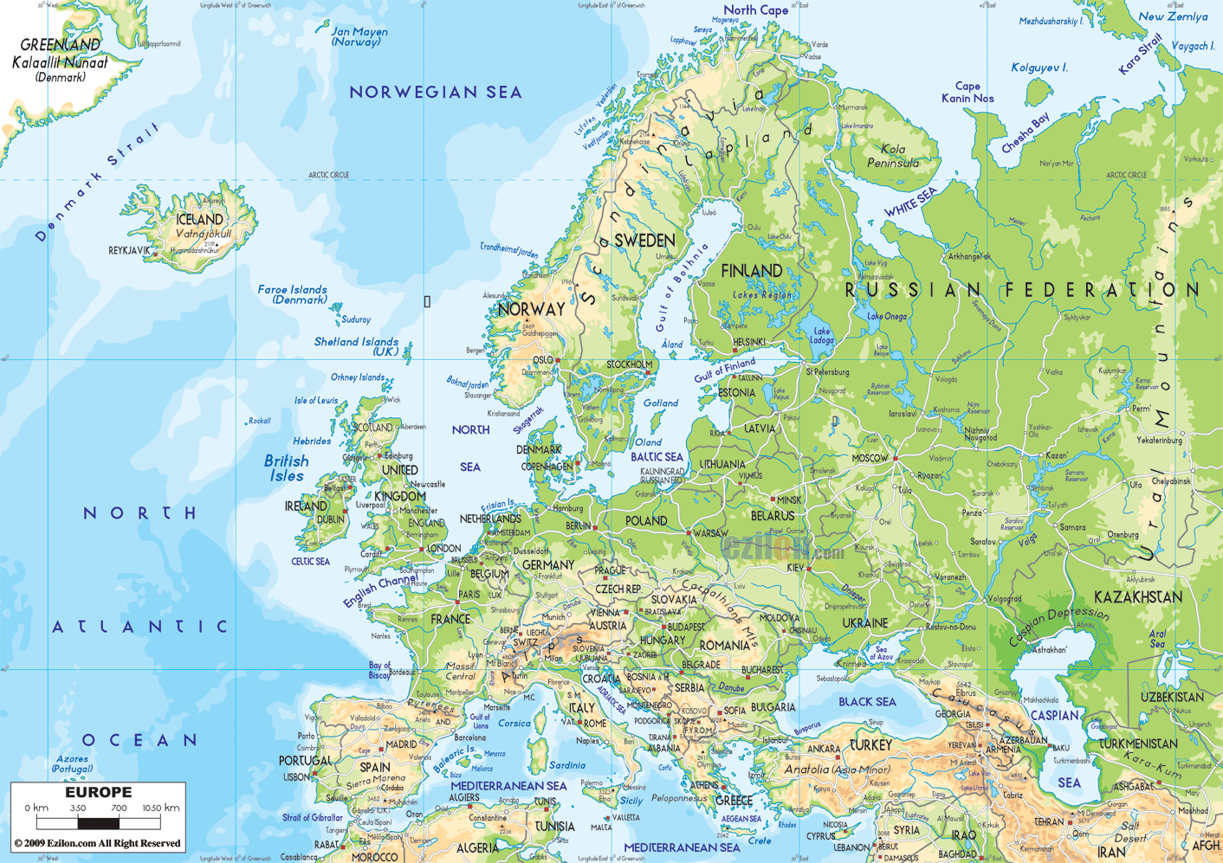
MyFP7s
BalCon
ProSense
ArtTreat
HiPeac

Slide 29
NB: 1. Using induction (datamining) create rules 2. Using deduction (from global to specific) create questions from which one can deduce 3. Example: Cooperation over children! ENABLERS: 1. Technology enables each individual to be addresses in a different way 2. Condition: Modern behavior 3. Example: Drop in who does not push buttons ;) STRATEGIC LAYERS: 1. SRB -> Europe 2. JPM == World 3. MAT == Universe

