Slide 1
DataFlow SuperComputing for ExaScale DM/FF:
Revisiting the Algorithms
V. Milutinović, G. Rakocevic, S. Stojanović, and Z. Sustran
University of Belgrade
Oskar Mencer
Imperial College, London
Oliver Pell
Maxeler Technologies, London and Palo Alto
Michael Flynn
Stanford University, Palo Alto

Slide 2
Essence of the Paradigm:
For Big Data DM/FM algorithms
and for the same hardware price as before,
achieving:
a) speed-up, 20-200
b) monthly electricity bills, reduced 20 times
c) size, 20 times smaller
2/55

Slide 3
European Dimension of the Paradigm:
Absolutely all results achieved with:
a) all hardware produced in Europe,
specifically UK
b) all software generated by programmers
of EU and WB
3/55

Slide 4
ControlFlow vs. DataFlow:
ControlFlow:
  Top500 ranks using Linpack (Japanese K,…)
DataFlow:
  Coarse Grain (HEP) vs. Fine Grain (Maxeler)
4/55

Slide 5
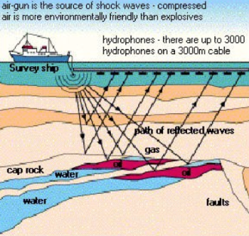

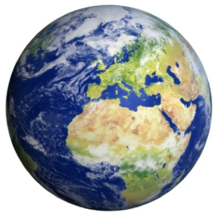
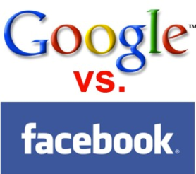
Essence of the DataFlow Approach!
Compiling below the machine code level brings speedups;
also a smaller power, size, and cost.
The price to pay:
The machine is more difficult to program.
Consequently:
Ideal for WORM applications :)
Examples using Maxeler:
GeoPhysics (20-40), Banking (200-1000, with JP Morgan 20%),
M&C (New York City), Datamining (Google), …
5/55

Slide 6
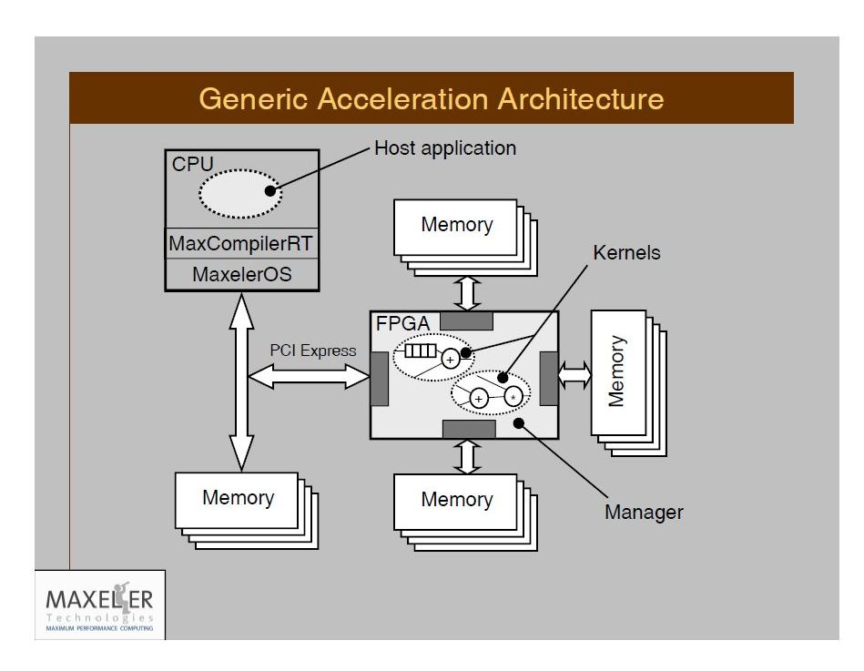

Slide 7
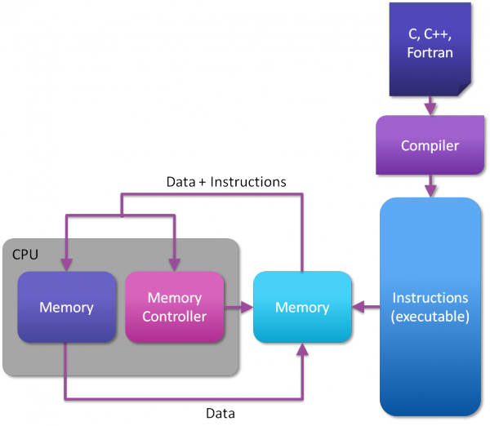
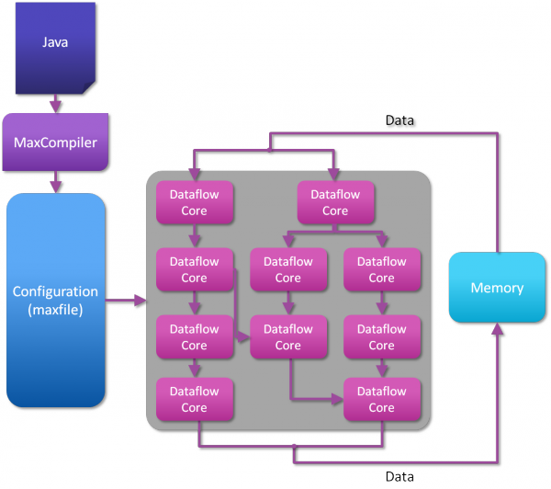
ControlFlow vs. DataFlow

Slide 8
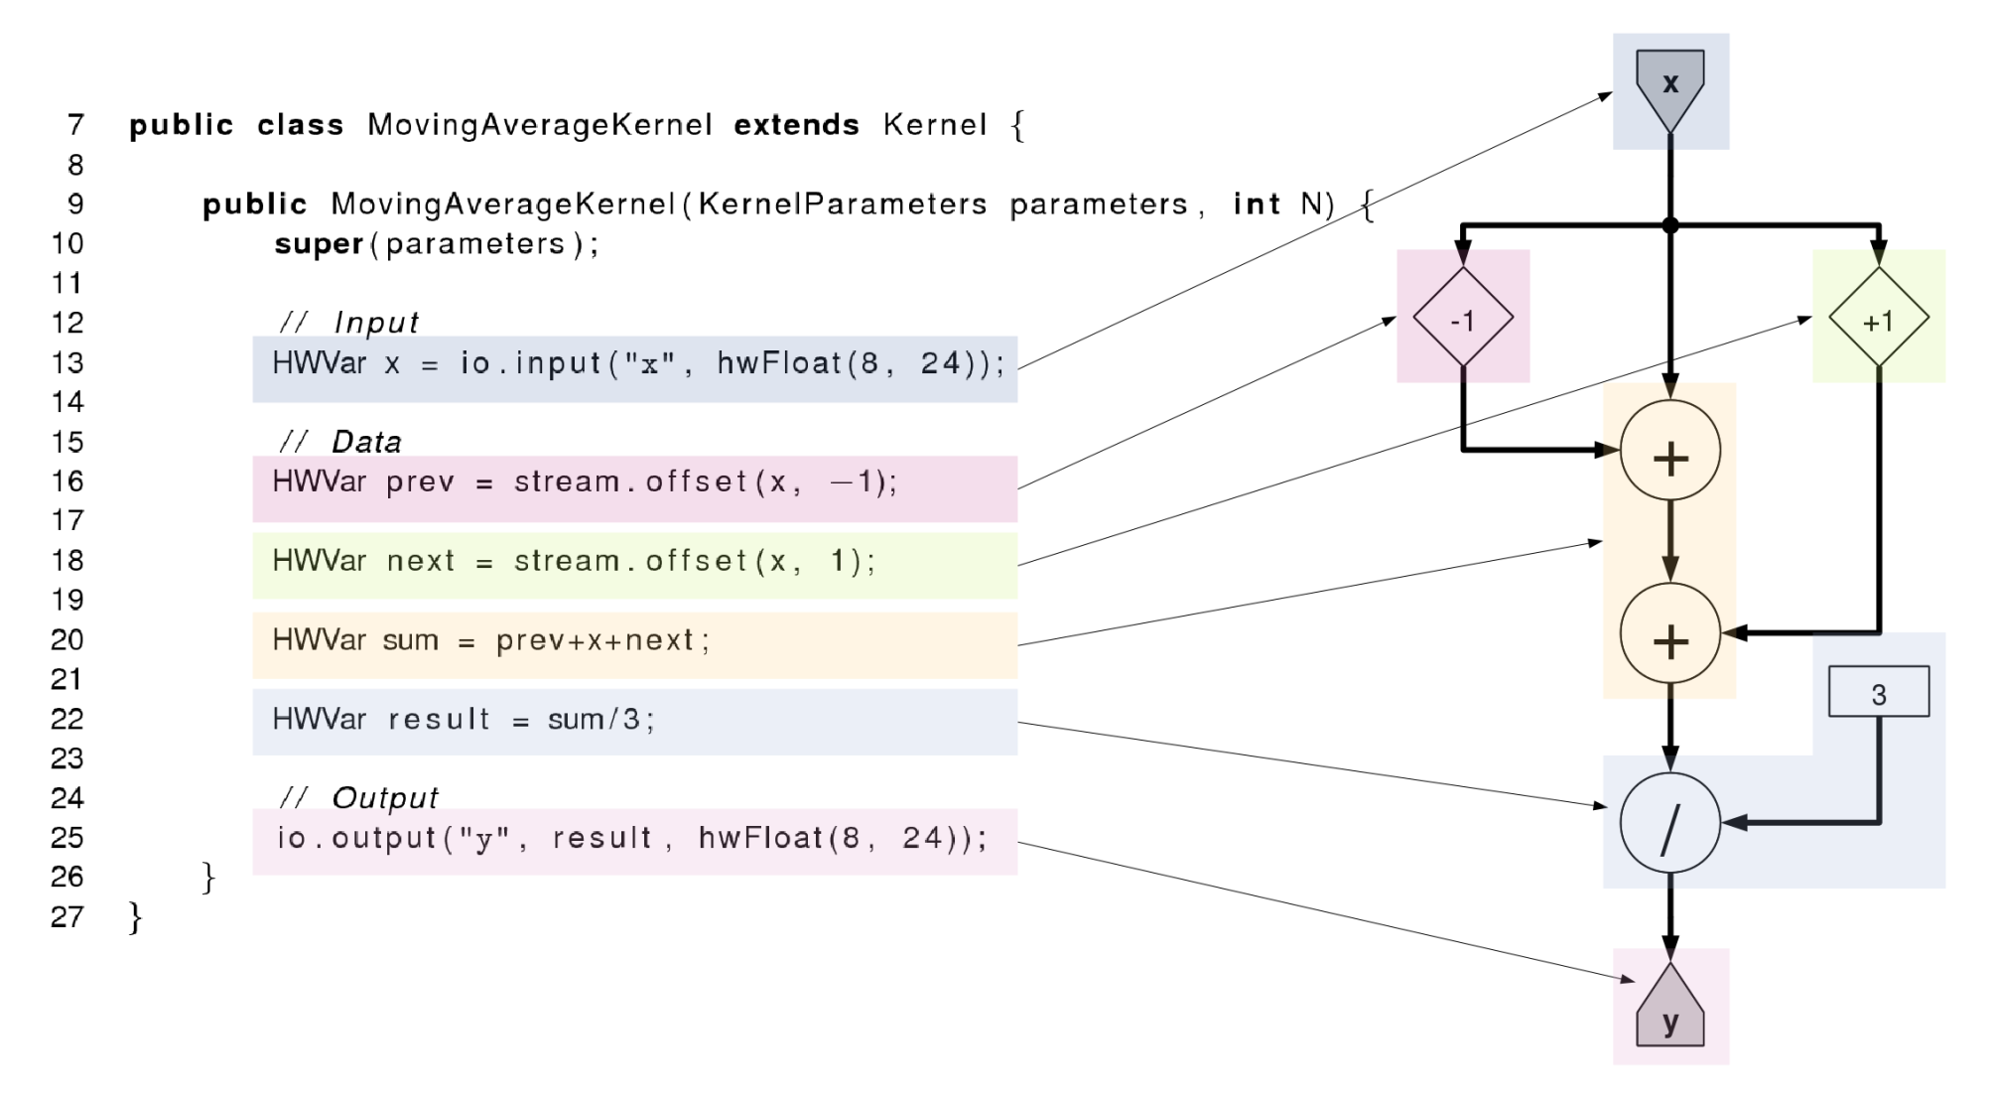
DataFlow Programming (1C +5Java)

Slide 9
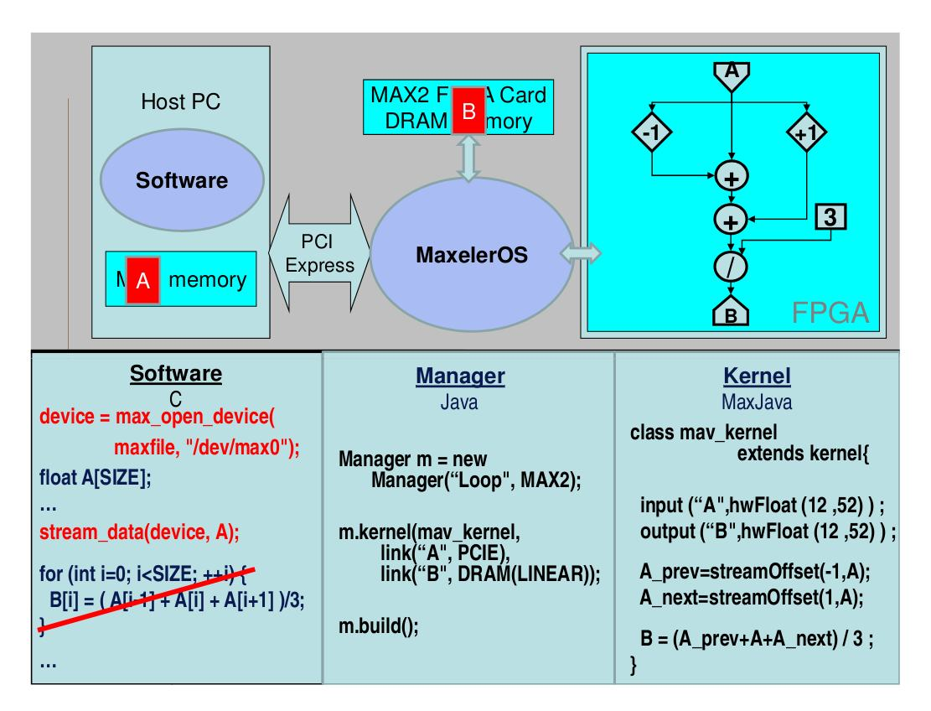

Slide 10
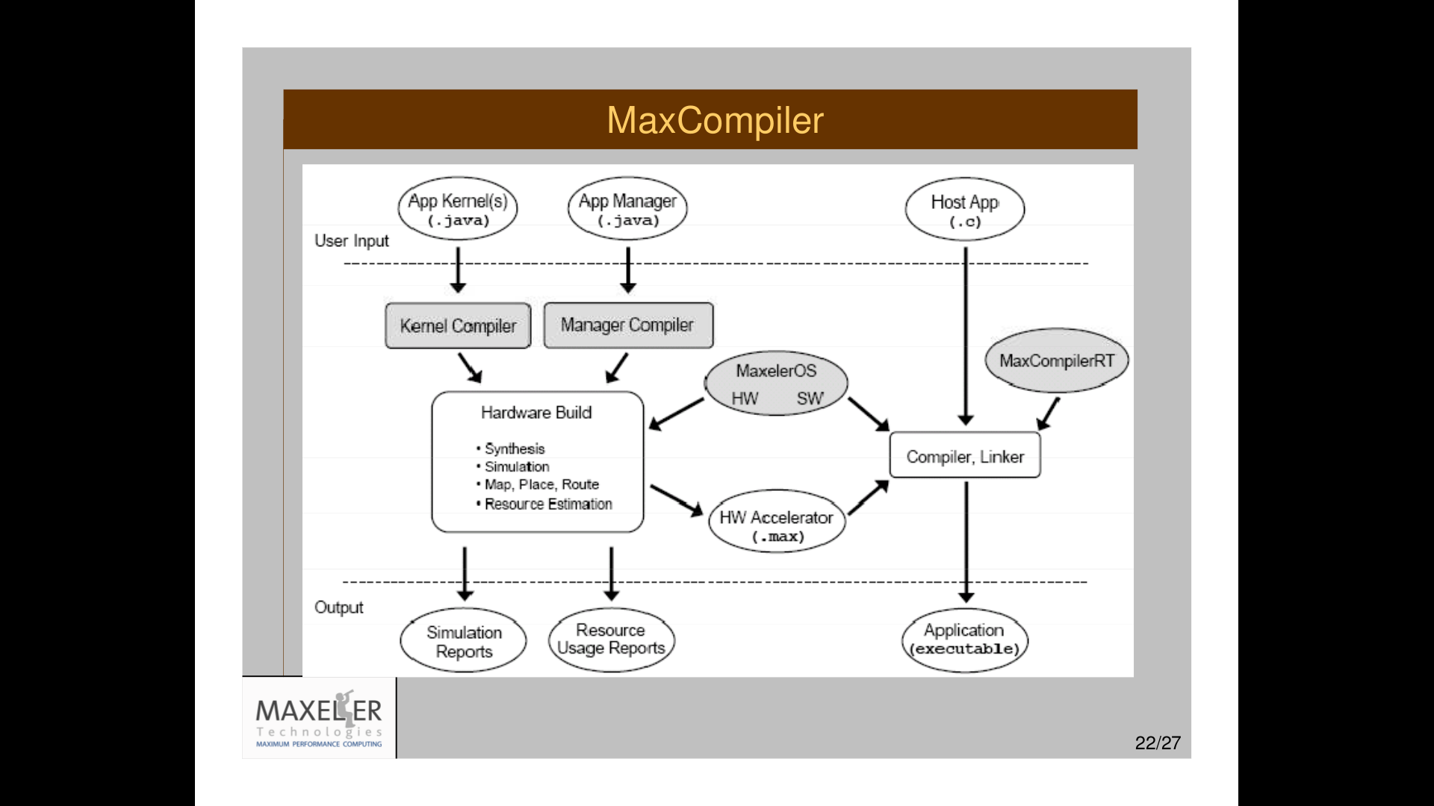

Slide 11
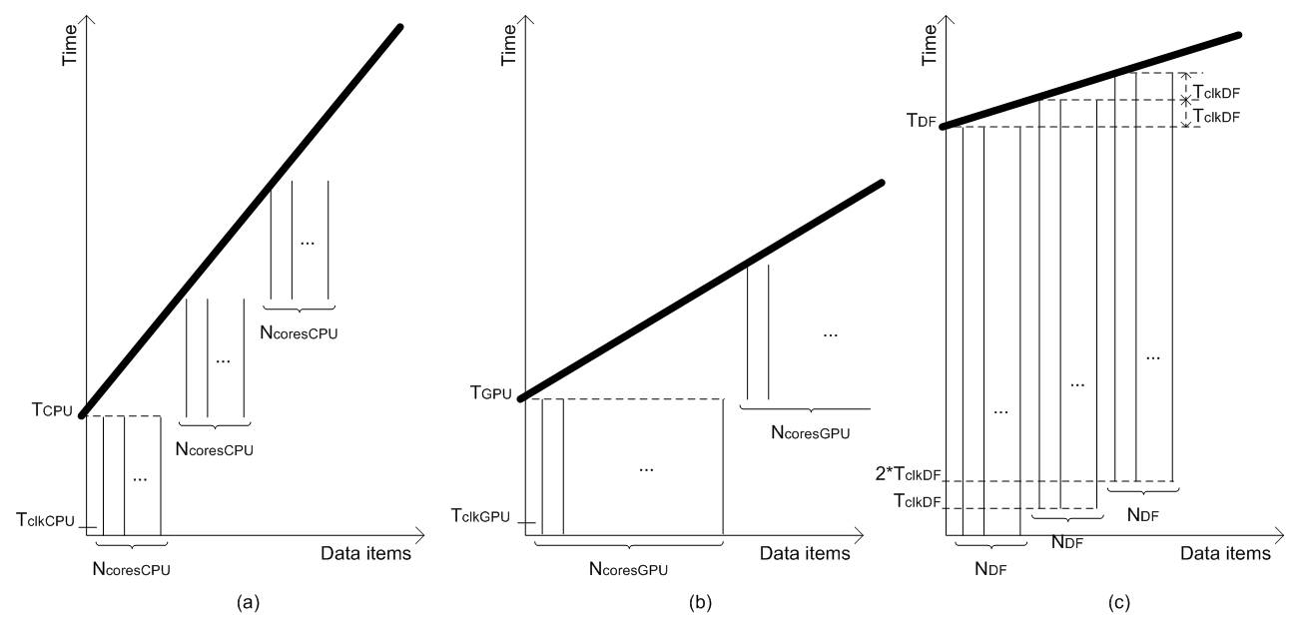
Essence: Our Paper in IEEE Computer
tCPU =
N * NOPS * CCPU*TclkCPU /NcoresCPU
tGPU =
N * NOPS * CGPU*TclkGPU / NcoresGPU
tDF = NOPS * CDF * TclkDF +
(N – 1) * TclkDF / NDF
Assumptions:
1. Software includes enough parallelism to keep all cores busy
2. The only limiting factor is the number of cores.

Slide 12
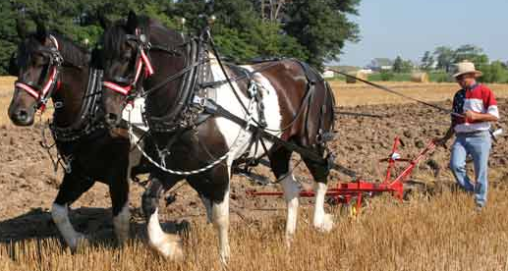
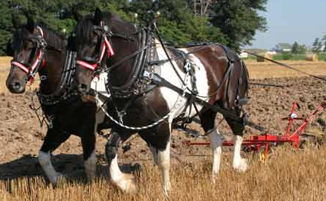
MultiCore
Which way are the horses going?
DualCore?

Slide 13
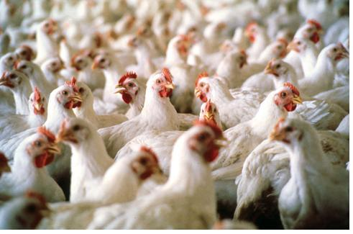
ManyCore
Is it possible
to use 2000 chicken instead of two horses?
?
==
What is better, real and anecdotic?

Slide 14
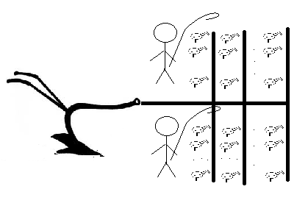
ManyCore
2 x 1000 chickens (CUDA and rCUDA)

Slide 15
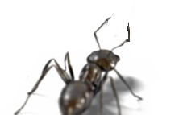
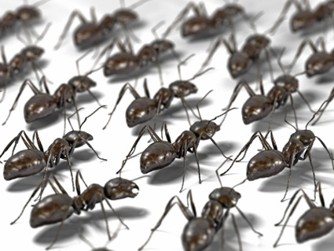

DataFlow
Data
How about 2 000 000 ants?

Slide 16
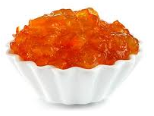
DataFlow
Big Data Input
Results
Marmalade

Slide 17
Why is DataFlow so Much Faster?
Factor: 20 to 200
MultiCore/ManyCore
Dataflow
Machine Level Code
Gate Transfer Level

Slide 18
Why are Electricity Bills so Small?
Factor: 20
MultiCore/ManyCore
Dataflow
P = kfU²

Slide 19
Why is the Cubic Foot so Small?
Factor: 20
MultiCore/ManyCore
DataFlow
Data Processing
Data Processing
Process Control
Process Control

Slide 20
Required Programming Effort?
MultiCore:
  Explain what to do, to the driver
  Caches, instruction buffers, and predictors needed
ManyCore:
  Explain what to do, to many sub-drivers
  Reduced caches and instruction buffers needed
DataFlow:
  Make a field of processing gates: 1C+nJava+4Java
  No caches, etc. (300 students/year: BGD, BCN, LjU, ICL,…)

Slide 21
Required Debug Effort?
MultiCore:
  Business as usual
ManyCore:
  More difficult
DataFlow:
  Much more difficult
  Debugging both, application and configuration code

Slide 22
Required Compilation Effort?
MultiCore/ManyCore:
  Several minutes
DataFlow:
  Several hours for the real hardware
  Fortunately, only several minutes for the simulator
  The simulator supports
  both the large JPMorgan machine
  as well as the smallest “University Support” machine
Good news:
  Tabula@2GHz

Slide 23
Now the Fun Part

Slide 24
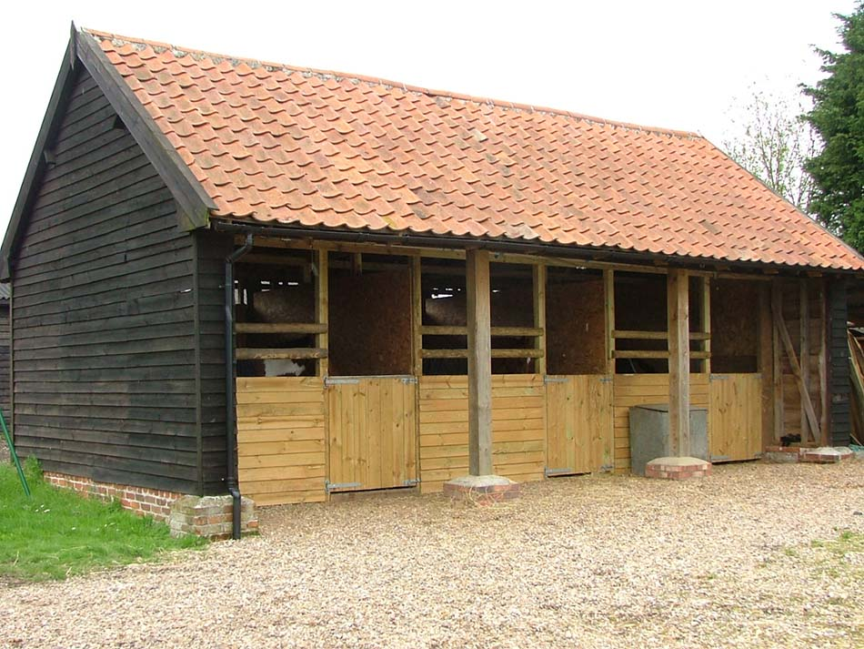
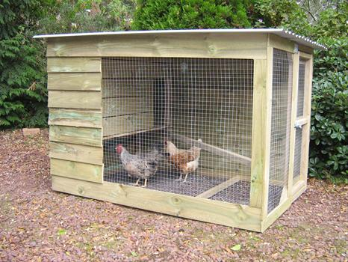
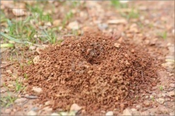
Required Space?
MultiCore:
  Horse stable
ManyCore:
  Chicken house
DataFlow:
  Ant hole

Slide 25
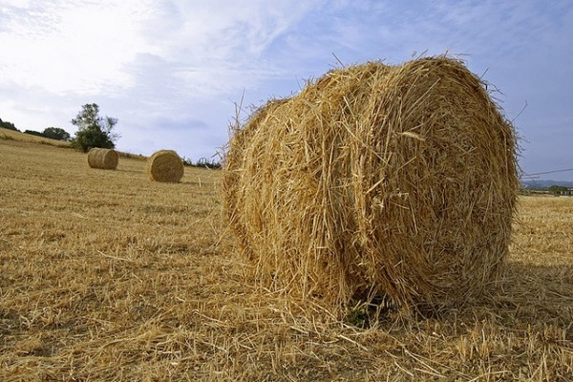
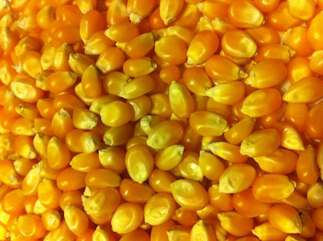
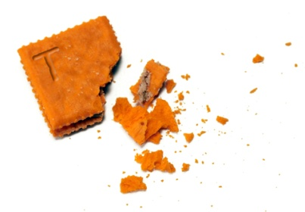
Required Energy?
MultiCore:
  Haystack
ManyCore:
  Cornbits
DataFlow:
  Crumbs

Slide 26

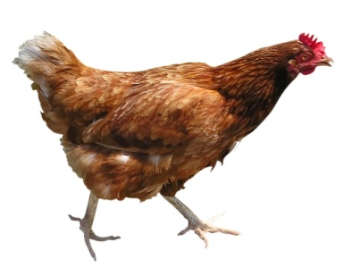
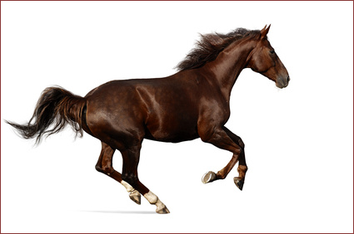
Why Faster?
Small Data: Toy Benchmarks (e.g., Linpack)

Slide 27
Why Faster?
Medium Data (benchmarks
favorising Nvidia,
compared to Intel,…)

Slide 28
Why Faster?
Big Data

Slide 29
DataFlow for ExaScale DM
Revisiting the Top 500 SuperComputer Benchmarks
  Our paper in Communications of the ACM
Revisiting all major Big Data DM algorithms
  Massive static parallelism at low clock frequencies
Concurrency and communication
  Concurrency between millions of tiny cores difficult,
  “jitter” between cores will harm performance
  at synchronization points
Reliability and fault tolerance
  10-100x fewer nodes, failures much less often
Memory bandwidth and FLOP/byte ratio
  Optimize data choreography, data movement,
  and the algorithmic computation

Slide 30



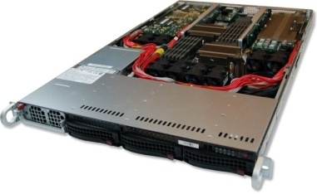
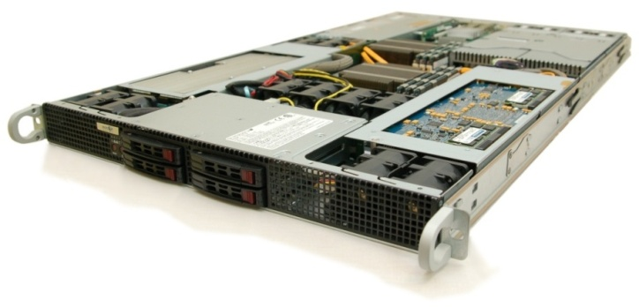
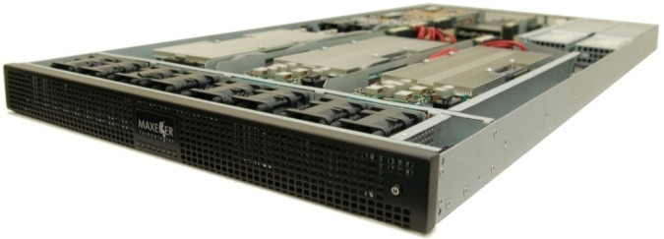
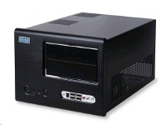
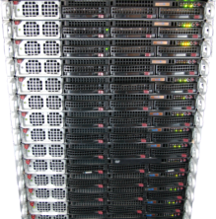
Maxeler Hardware
CPUs plus DFEs
Intel Xeon CPU cores and up to 4 DFEs with 192GB of RAM
DFEs shared over Infiniband
Up to 8 DFEs with 384GB of RAM and dynamic allocation of DFEs to CPU servers
Low latency connectivity
Intel Xeon CPUs and 1-2 DFEs with up to six 10Gbit Ethernet connections
MaxWorkstation
Desktop development system
MaxCloud
On-demand scalable accelerated
compute resource, hosted in London

Slide 31
Major Classes of Algorithms, from the Computational Perspective
Coarse grained, stateful: Business
  CPU requires DFE for minutes or hours
Fine grained, transactional with shared database: DM
  CPU utilizes DFE for ms to s
  Many short computations, accessing common database data
Fine grained, stateless transactional: Science (FF)
  CPU requires DFE for ms to s
  Many short computations

Slide 32
Coarse Grained: Modeling
Long runtime, but:
Memory requirements change dramatically based on modelled frequency
Number of DFEs allocated to a CPU process can be easily varied to increase available memory
Streaming compression
Boundary data exchanged over chassis MaxRing

Slide 33
Fine Grained, Shared Data: Monitoring
DFE DRAM contains the database to be searched
CPUs issue transactions find(x, db)
Complex search function
  Text search against documents
  Shortest distance to coordinate (multi-dimensional)
  Smith Waterman sequence alignment for genomes
Any CPU runs on any DFE
that has been loaded with the database
  MaxelerOS may add or remove DFEs
  from the processing group to balance system demands
  New DFEs must be loaded with the search DB before use

Slide 34
Fine Grained, Stateless: The BSOP Control
Analyse > 1,000,000 scenarios
Many CPU processes run on many DFEs
  Each transaction executes on any DFE in the assigned group atomically
~50x MPC-X vs. multi-core x86 node
CPU
DFE
CPU
DFE
CPU
Loop over instruments
DFE
CPU
Loop over instruments
DFE
CPU
Loop over instruments
Market and instruments
data
DFE
Tail analysis on CPU
Loop over instruments
Tail analysis on CPU
Loop over instruments
Tail analysis on CPU
Random number generator and sampling of underliers
Tail analysis on CPU
Random number generator and sampling of underliers
Tail analysis on CPU
Random number generator and sampling of underliers
Random number generator and sampling of underliers
Random number generator and sampling of underliers
Price instruments using Black Scholes
Price instruments using Black Scholes
Price instruments using Black Scholes
Price instruments using Black Scholes
Price instruments using Black Scholes
Instrument values
Notes:
Elastic makes things worse

Slide 35
Selected FF Examples

Slide 36
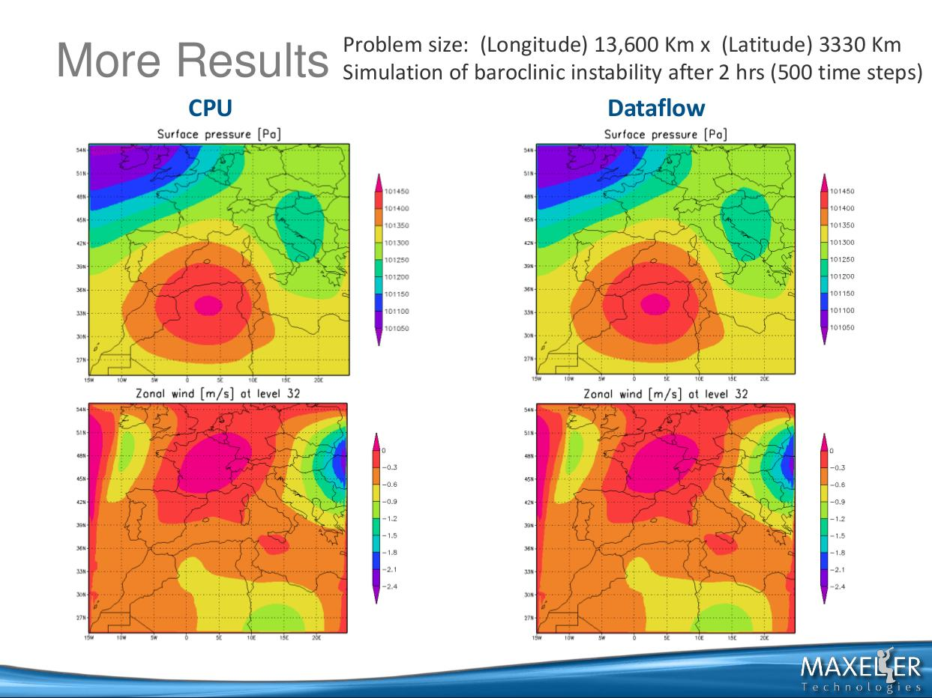
36/55

Slide 37
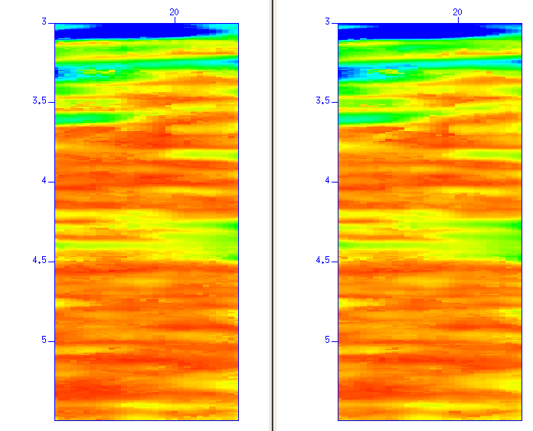
The CRS Results
Performance of one MAX2 card vs. 1 CPU core
  Land case (8 params), speedup of 230x
  Marine case (6 params), speedup of 190x
CPU Coherency
MAX2 Coherency

Slide 38

Seismic Imaging
Running on MaxNode servers
- 8 parallel compute pipelines per chip
- 150MHz => low power consumption!
- 30x faster than microprocessors
An Implementation of the Acoustic Wave Equation on FPGAs
T. Nemeth†, J. Stefani†, W. Liu†, R. Dimond‡, O. Pell‡, R.Ergas§
†Chevron, ‡Maxeler, §Formerly Chevron, SEG 2008

Slide 39
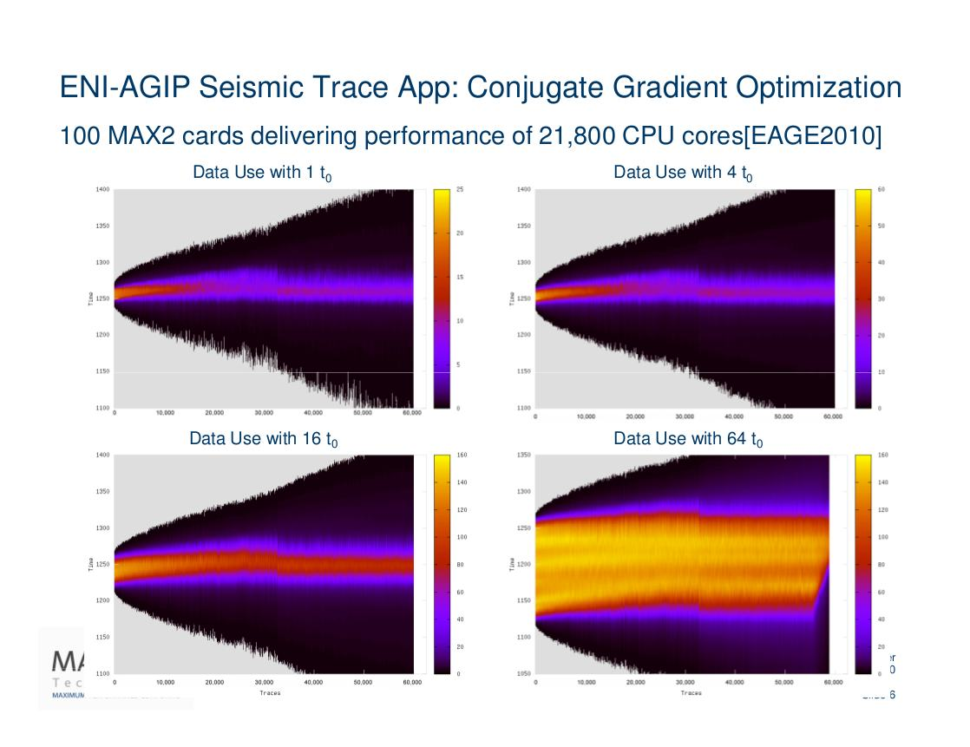

Slide 40
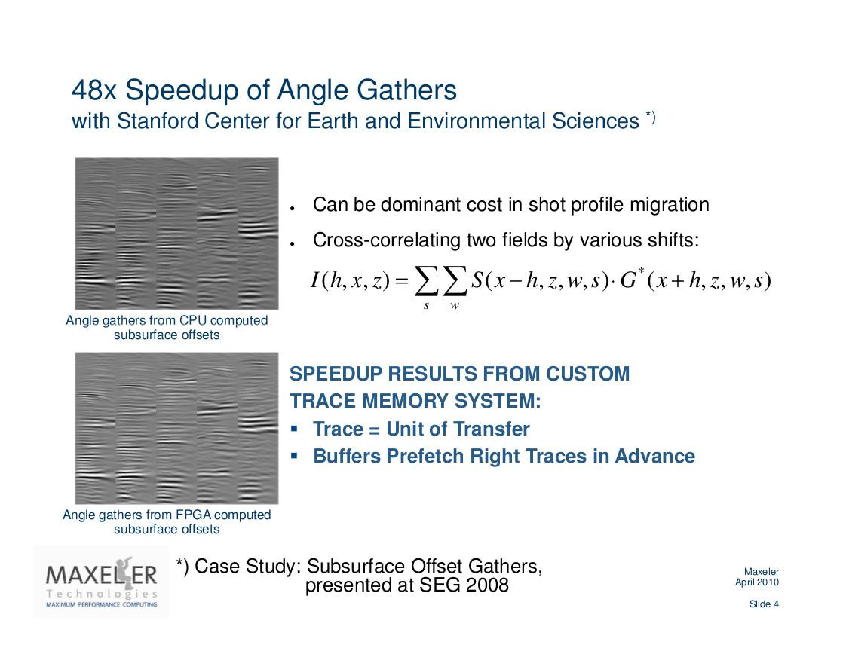

Slide 41

Trace Stacking: Speed-up 217
P. Marchetti et al, 2010
DM for Monitoring and Control in Seismic processing
Velocity independent / data driven method
to obtain a stack of traces, based on 8 parameters
  Search for every sample of each output trace
2 parameters ( emergence angle & azimuth )
3 Normal Wave front parameters ( K_{N,11}; K_{N,12} ; K_{N22} )
3 NIP Wave front parameters ( K_{Nip,11}; K_{Nip,12} ; K_{Nip22} )

Slide 42
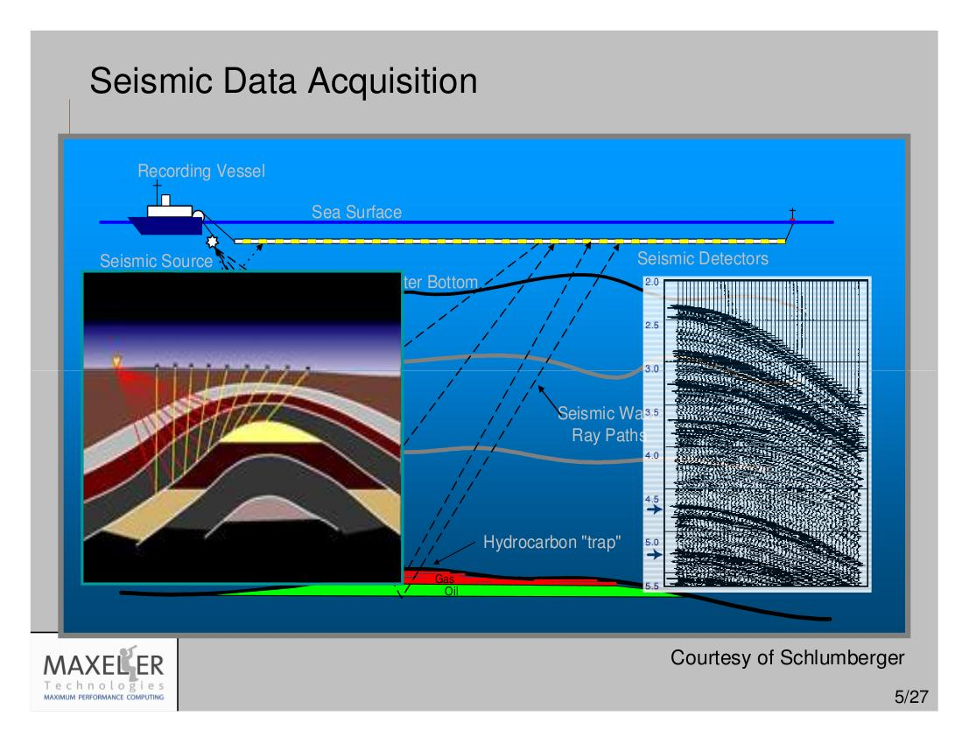

Slide 43
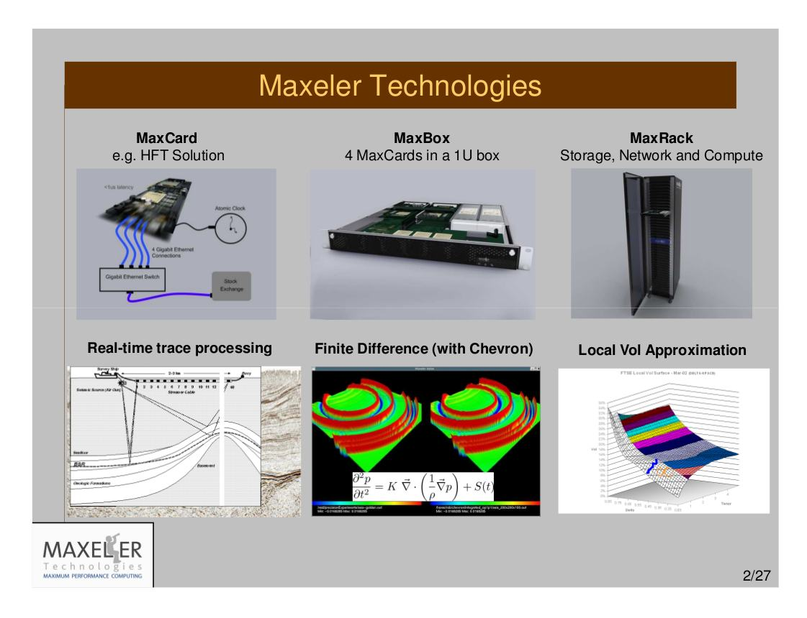

Slide 44
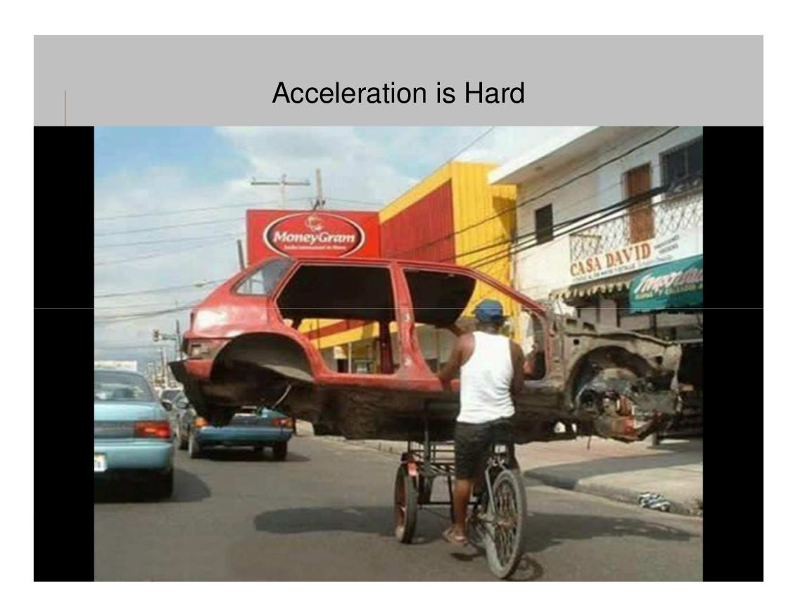

Slide 45
Conclusion: Nota Bene
This is about algorithmic changes,
to maximize
the algorithm to architecture match:
Data choreography
and
process modifications
The winning paradigm
of Big Data DM/FF?

Slide 46
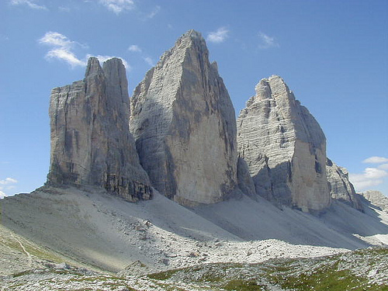
The TriPeak
BSC
+ Imperial College
+ Maxeler
+ Belgrade
46/55

Slide 47
The TriPeak
MontBlanc = A ManyCore (NVidia) + a MultiCore (ARM)
Maxeler = A FineGrain DataFlow (FPGA)
How about a happy marriage?
MontBlanc (ompSS) and Maxeler (an accelerator)
In each happy marriage,
it is known who does what :)
The Big Data DM algorithms:
What part goes to MontBlanc and what to Maxeler?
47/55

Slide 48
Core of the Symbiotic Success
An intelligent DM algorithmic scheduler,
partially implemented for compile time,
and partially for run time.
At compile time:
Checking what part of code fits where
(MontBllanc or Maxeler): LoC 1M vs 2K vs 20K
At run time:
Rechecking the compile time decision,
based on the current data values.
48/55

Slide 49
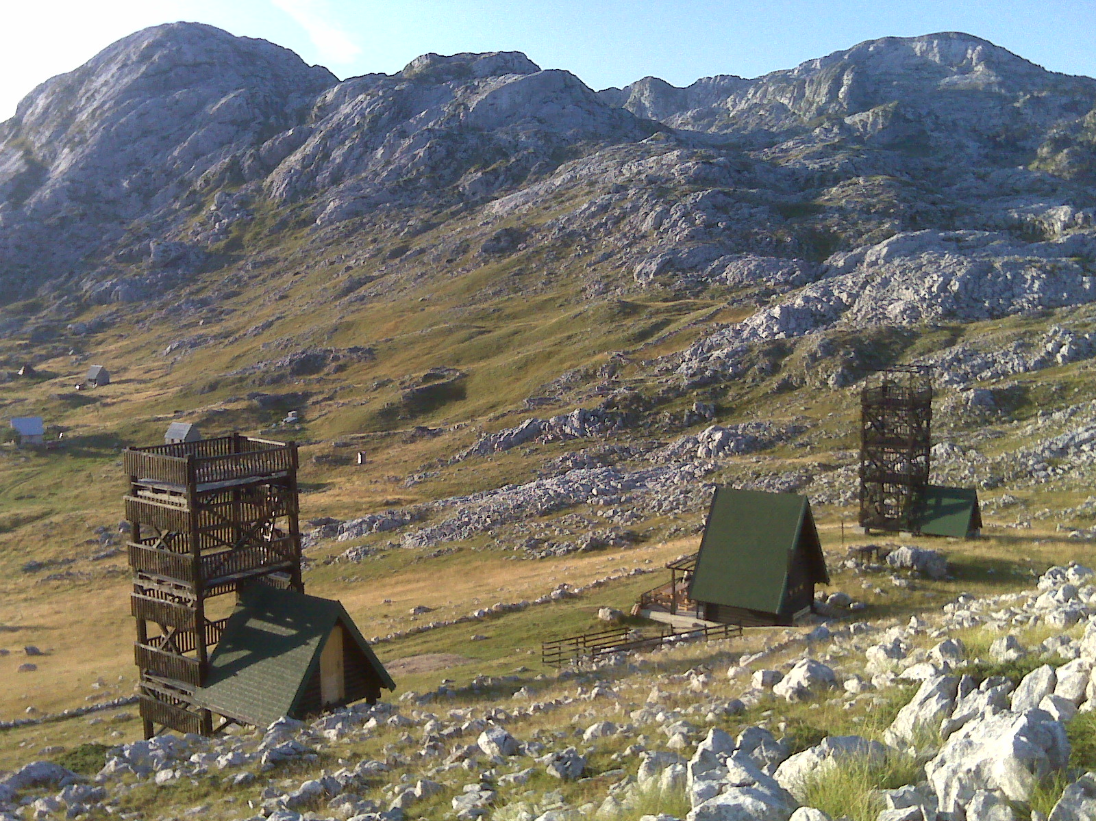
49

Slide 50
Maxeler: Teaching (Google: prof vm)
TEACHING, VLSI, PowerPoints, Maxeler:
Maxeler Veljko Explanations, August 2012
Maxeler Veljko Anegdotic,
Maxeler Oskar Talk, August 2012
Maxeler Forbes Article
Flyer by JP Morgan
Flyer by Maxeler HPC
Tutorial Slides by Sasha and Veljko: Practice (Current Update)
Paper, unconditionally accepted for Advances in Computers by Elsevier
Paper, unconditionally accepted for Communications of the ACM
Tutorial Slides by Oskar: Theory (7 parts)
Slides by Jacob, New York
Slides by Jacob, Alabama
Slides by Sasha: Practice (Current Update)
Maxeler in Meteorology
Maxeler in Mathematics
Examples generated in Belgrade
THE COURSE ALSO INCLUDES DARPA METHODOLOGY FOR MICROPROCESSOR DESIGN,
with an example
50/55

Slide 51
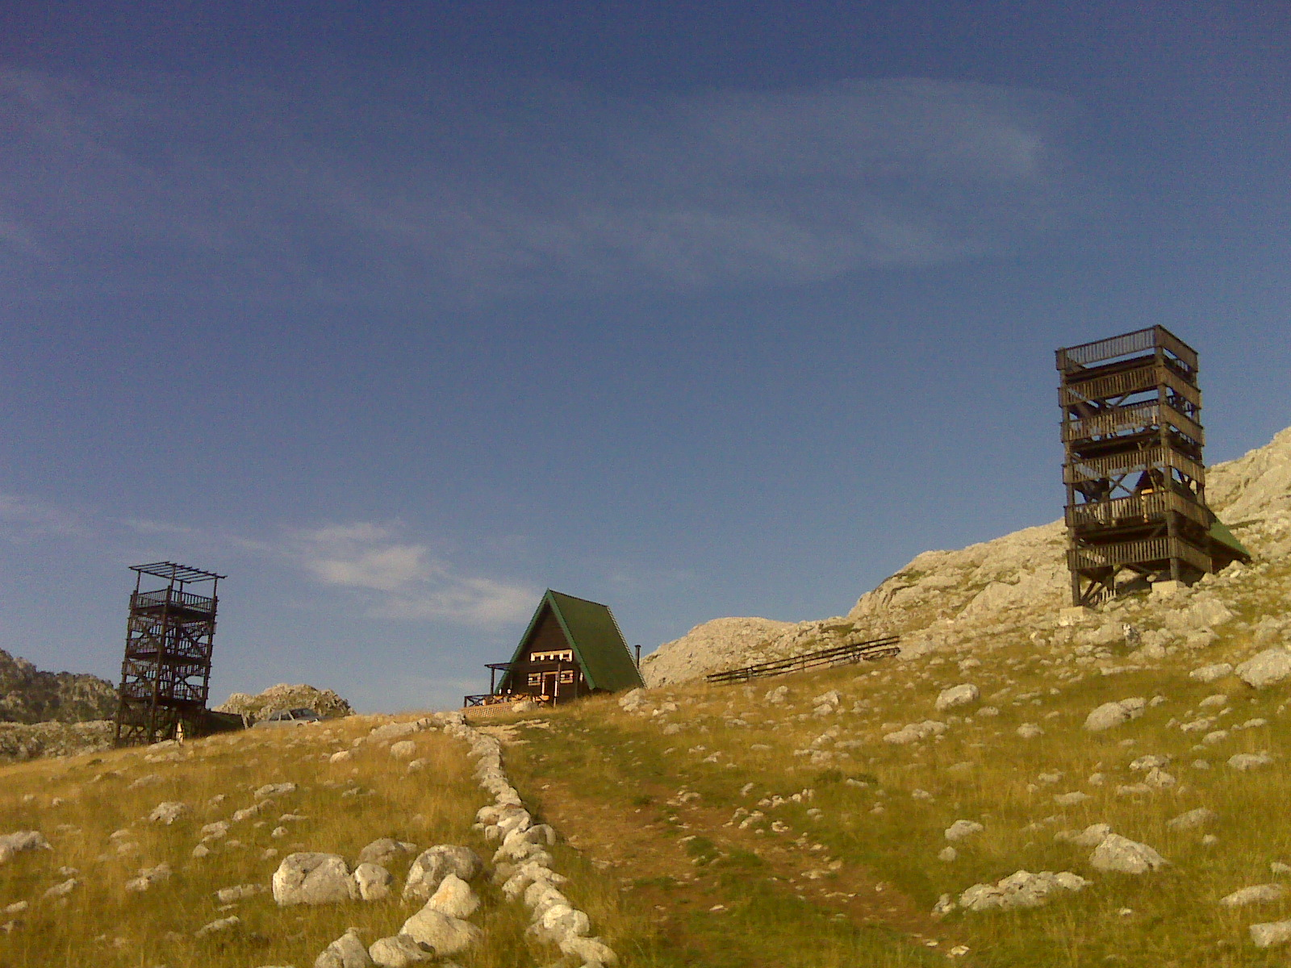
51
© H. Maurer

Slide 52
Maxeler: Research (Google: good method)
Structure of a Typical Research Paper: Scenario #1
Curve A: MultiCore of approximately the same PurchasePrice
Curve B: Maxeler after a direct algorithm migration
Curve C: Maxeler after algorithmic modifications
Curve D: Maxeler after data choreography
Structure of a Typical Research Paper: Scenario #2
CurveSet A: Comparison of Algorithms on a MultiCore
CurveSet B: Comparison of Algorithms on a ManyCore
CurveSet C: Comparison on Maxeler, after a direct algorithm migration
CurveSet D: Comparison on Maxeler, after algorithmic modifications
CurveSet E: Comparison on Maxeler, after data choreography
52/55

Slide 53
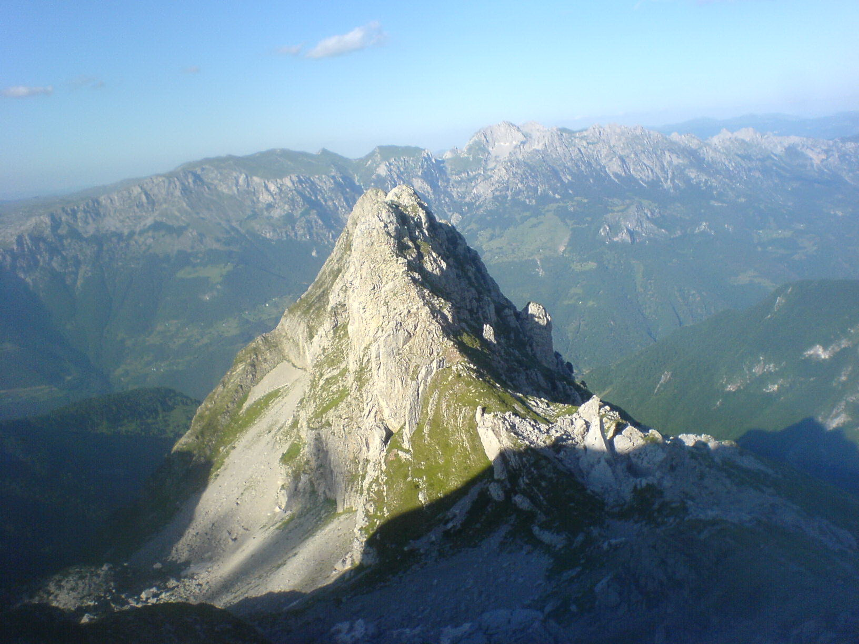
53
© H. Maurer

Slide 54
Maxeler: Topics (Google: HiPeac Berlin)
SRB (TR):
KG: Blood Flow
NS: Combinatorial Math
BG1: MiSANU Math
BG2: Meteos Meteorology
BG3: Physics
BG4: Physics
(reusability with MPI/OpenMP vs effort to accelerate)
FP7 (Call 11):
ICL, UK,
BSC, Spain,
QPLAN, Greece,
ETF, Serbia,
University of Siena, Italy,
IJS, Slovenia, …
54/55

Slide 55
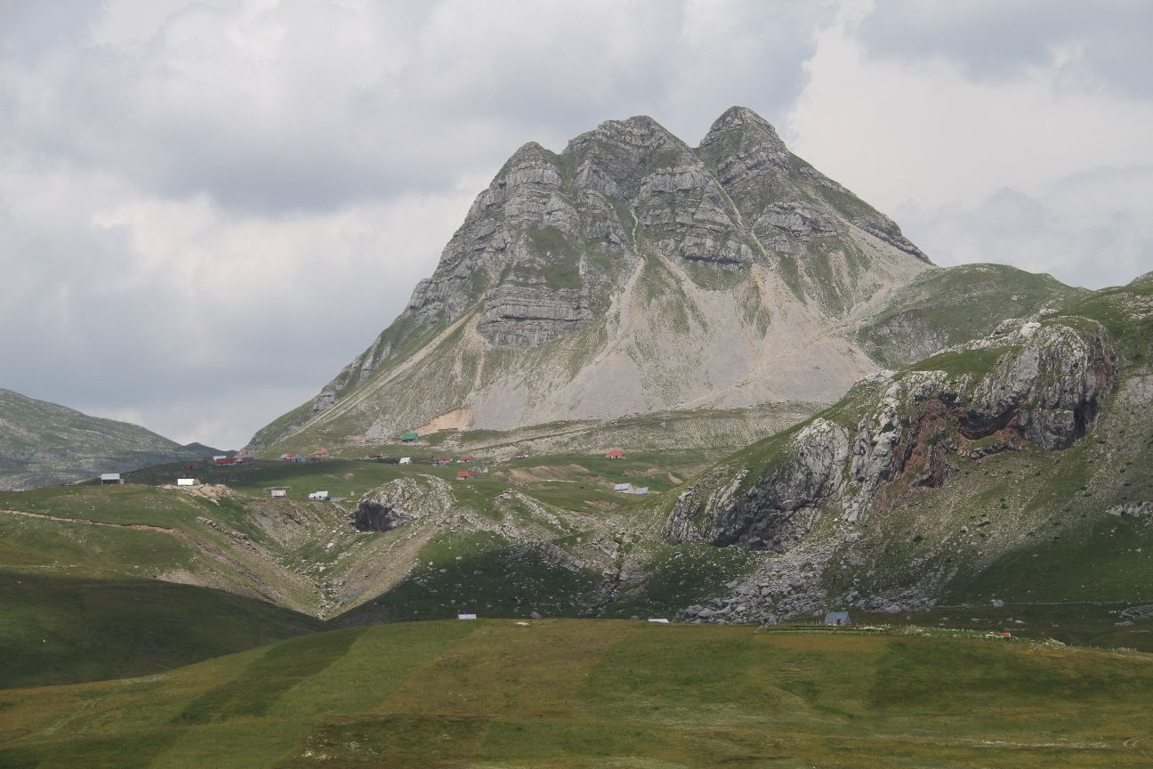
Q&A
vm@etf.rs
55
© H. Maurer

