Slide 1
Selected MaxCompiler Examples
Zivojin Sustran
zika@etf.rs
Sasa Stojanovic
stojsasa@etf.rs

Slide 2
How-to? What-to?
Introduction
One has to know how to program Maxeler machines, in order to get the best possible speedup out of them!
For some applications (G), there is a large difference between what an experienced programmer achieves, and what an un-experienced one can achieve!
For some other applications (B), no matter how experienced the programmer is, the speedup will not be revolutionary (may be even <1).

Slide 3
Lemas
Introduction
Lemas:
1. The how-to and how-not-to is important to know!
2. The what-to and what-not-to is important to know!
N.B.
The how-to is taught through most of the examples to follow (all except the introductory ones).
The what-to/what-not-to is taught using a figure.

Slide 4
The Essential Figure:
Introduction
t_{CPU} =
N * N_{OPS} * C_{CPU}*T_{clkCPU} /N_{coresCPU}
t_{GPU} =
N * N_{OPS} * C_{GPU}*T_{clkGPU} / N_{coresGPU}
t_{DF} = N_{OPS} * C_{DF} * T_{clkDF} + (N – 1) * T_{clkDF} / N_{DF}
Assumptions:
1. Software includes enough parallelism to keep all cores busy
2. The only limiting factor is the number of cores.

Slide 5
Bottomline:
Introduction
When is Maxeler better?
If the number of operations in a single loop iteration is above some critical value
Then More data items means more advantage for Maxeler.
In other words:
More data does not mean better performance if the #operations/iteration is below a critical value.
Conclusion:
If we see an application with a small #operations/iteration, it is possibly (not always) a “what-not-to” application, and we better execute it on the host; otherwise, we will (or may) have a slowdown.
ADDITIVE SPEEDUP ENABLER
ADDITIVE SPEEDUP MAKER

Slide 6
To have it more concrete:
Introduction
Maxeler: One new result in each cycle e.g. Clock = 100MHz Period = 10ns One result every 10ns [No matter how many operations in each loop iteration] Consequently: More operations does not mean proportionally more time; however, more operations means higher latency till the first result.
CPU: One new result after each iteration e.g. Clock=10GHz (!?) Period = 100ps One result every 100ps times #ops [If #ops > 100 => Maxeler is better, although it uses a slower clock]
Also: The CPU example will feature an additional slowdown, due to memory hierarchy access and pipeline related hazards => critical #ops (bringing the same performance) is significantly below 100!!!

Slide 7
Don’t missunderstand!
Introduction
Maxeler has no cache, but does have a memory hierarchy.
However, memory hierarchy access with Maxeler is carefully planed by the programmer at the program write time
As opposed to memory hierarchy access with a multicore CPU/GPU which calculates the access address at the program run time.

Slide 8
Teaching by Questioning
Introduction
Now we are ready for examples which show how-to ☺
My questions, from time to time, will ask you about time consequences of how-not-to alternatives ☹

Slide 9
N.B.
Introduction
We have chosen many simple examples [small steps] which together build a realistic application [mountain top]
vs
father
three sons with 1-stick bunches
a 3-stick bunch

Slide 10
N.B.
Introduction
Java to configure Maxeler! C to program the host!
One or more kernels! Only one manager!
In theory, Simulator builder not needed if a card is used. In practice, you need it until the testing is over, since the compilation process is slow, for hardware, and fast, for software (simulator).

Slide 11
Content 1/2
E#1: Hello world
E#2: Vector addition
E#3: Type mixing
E#4: Addition of a constant and a vector
E#5: Input/output control
E#6: Conditional execution
E#7: Moving average 1D
E#8: Moving average 2D
E#9: Array summation
E#10: Optimization of E#9

Slide 12
Example No.1: Hello World!
Example No. 1
Write a program that sends the “Hello World!” string to the MAX2 card, for the MAX2 card kernel to return it back to the host.
To be learned through this example:
How to make the configuration of the accelerator (MAX2 card) using Java:
How to make a simple kernel (ops description) using Java (the only language),
How to write the standard manager (config description based on kernel(s)) using Java,
How to test the kernel using a test (code+data) written in Java,
How to compile the Java code for MAX2,
How to write a simple C code that runs on the host and triggers the kernel,
How to write the C code that streams data to the kernel,
How to write the C code that accepts data from the kernel,
How to simulate and execute an application program in C that runs on the host and periodically calls the accelerator.

Slide 13
Standard Files in a MAX Project
Example No. 1
One or more kernel files, to define operations of the application:
<app_name>Kernel[<additional_name>].maxj
One (or more) Java file, for simulation of the kernel(s):
<app_name>SimRunner.maxj
One manager file for transforming the kernel(s) into the configuration of the MAX card (instantiation and connection of kernels):
<app_name>Manager.maxj
One Java file, for compilation configuration
<app_name>EngineParameter.maxj
Simulator builder:
Simulation Run Rules
Hardware builder:
DFE Run Rules
Application code that uses the MAX card accelerator:
<app_name>CpuCode.c

Slide 14
example1Kernel.maxj
Example No. 1
package example1;
import com.maxeler.maxcompiler.v2.kernelcompiler.Kernel;
import com.maxeler.maxcompiler.v2.kernelcompiler.KernelParameters;
import com.maxeler.maxcompiler.v2.kernelcompiler.types.base.DFEType;
import com.maxeler.maxcompiler.v2.kernelcompiler.types.base.DFEVar;
public class example1Kernel extends Kernel {
private static final DFEType type = dfeInt(8);
public example1Kernel(KernelParameters parameters) {
super(parameters);
DFEVar x = io.input("x", type);
DFEVar result = x;
io.output("z", result, type);
}
}
It is possible to substitute the last three lines with:
io.output("z", result, type);

Slide 15
example1SimRunner.maxj
Example No. 1
package example1UnitTest;
import com.maxeler.maxcompiler.v2.managers.standard.SimulationManager;
import example1.example1Kernel;
public class example1SimRunner {
public static void main(String[] args) {
SimulationManager m = new SimulationManager("example1Sim");
example1Kernel k = new example1Kernel(m.makeKernelParameters());
m.setKernel(k);
m.setInputData("x", 1, 2, 3, 4, 5, 6, 7, 8);
m.setKernelCycles(8);
m.runTest();
m.dumpOutput();
double expectedOutput[] = { 1, 2, 3, 4, 5, 6, 7, 8 };
m.checkOutputData("z", expectedOutput);
m.logMsg("Test passed OK!");
}
}

Slide 16
example1CpuCode.c
Example No. 1
#include <math.h>
#include <stdio.h>
#include <stdlib.h>
#include <inttypes.h>
#include "Maxfiles.h"
#include "MaxSLiCInterface.h"
#define SIZE 16
int main(void)
{
char x[SIZE] = "Hello World";
char z[SIZE];
int8_t test;
printf("Running on DFE.\n");
example1(SIZE, x, z);
printf("Result: %s\n",z);
printf("Done.\n");
return 0;
}

Slide 17
example1Manager.maxj 1/4
Example No. 1
package example1;
import static com.maxeler.maxcompiler.v2.managers.standard.Manager.link;
import com.maxeler.maxcompiler.v2.build.EngineParameters;
import com.maxeler.maxcompiler.v2.kernelcompiler.Kernel;
import com.maxeler.maxcompiler.v2.managers.BuildConfig;
import com.maxeler.maxcompiler.v2.managers.engine_interfaces.CPUTypes;
import com.maxeler.maxcompiler.v2.managers.engine_interfaces.EngineInterface;
import com.maxeler.maxcompiler.v2.managers.engine_interfaces.InterfaceParam;
import com.maxeler.maxcompiler.v2.managers.standard.IOLink.IODestination;
import com.maxeler.maxcompiler.v2.managers.standard.Manager;
public class example1Manager {
private static final String s_kernelName = "example1Kernel";

Slide 18
example1Manager.maxj 2/4
Example No. 1
public static void main(String[] args) {
EngineParameters params = new EngineParameters(args);
Manager manager = new Manager(params);
Kernel kernel = new example1Kernel(manager.makeKernelParameters(s_kernelName));
manager.setKernel(kernel);
manager.setIO(link("x",IODestination.CPU), link("z", IODestination.CPU));
manager.createSLiCinterface(interfaceDefault());
configBuild(manager, params);
manager.build();
}

Slide 19
example1Manager.maxj 3/4
Example No. 1
private static EngineInterface interfaceDefault() {
EngineInterface engine_interface = new EngineInterface();
CPUTypes type = CPUTypes.INT8;
int size = type.sizeInBytes();
InterfaceParam N = engine_interface. addParam("N", CPUTypes.INT);
engine_interface.setTicks(s_kernelName, N);
engine_interface.setStream("x", type, N * size);
engine_interface.setStream("z", type, N * size);
return engine_interface;
}

Slide 20
example1Manager.maxj 4/4
Example No. 1
private static void configBuild(Manager manager, EngineParameters params) {
manager.setEnableStreamStatusBlocks(false);
BuildConfig buildConfig = manager.getBuildConfig();
buildConfig.setMPPRCostTableSearchRange( params.getMPPRStartCT(), params.getMPPREndCT());
buildConfig.setMPPRParallelism( params.getMPPRThreads());
buildConfig.setMPPRRetryNearMissesThreshold( params.getMPPRRetryThreshold());
}
}

Slide 21
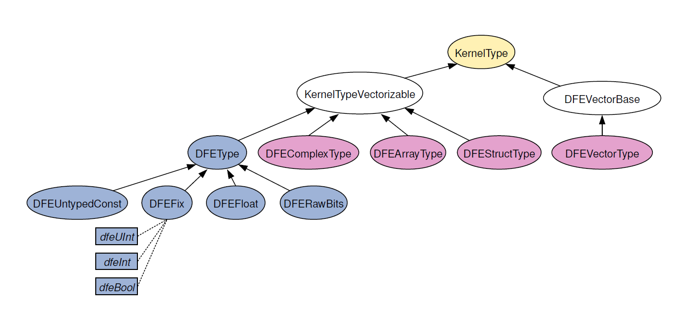
Hardware Types
Types

Slide 22
Hardware Primitive Types
Types
Floating point numbers - DFEFloat:
dfeFloat(exponent_bits, mantissa_bits);
float ~ dfeFloat(8,24)
double ~ dfeFloat(11,53)
Fixed point numbers - DFEFix:
dfeFix(integer_bits, fractional_bits, sign_mode)
SignMode.UNSIGNED
SignMode.TWOSCOMPLEMENT
Integers - DFEFix:
dfeInt(bits) ~ dfeFix(bits, 0, SignMode.TWOSCOMPLEMENT)
Unsigned integers - DFEFix:
dfeUint(bits) ~ dfeFix(bits, 0, SignMode.UNSIGNED)
Boolean – DFEFix:
dfeBool() ~ dfeFix(1, 0, SignMode.UNSIGNED)
1 ~ true
2 ~ false
Raw bits – DFERawBits:
dfeRawBits(width)

Slide 23
Example No. 2: Vector Addition
Example No. 2
Write a program that adds two arrays of floating point numbers.
Program reads the size of arrays, makes two arrays with an arbitrary content (test inputs), and adds them using a MAX card.

Slide 24
example2Kernel.maxj
Example No. 2
package example2;
import com.maxeler.maxcompiler.v2.kernelcompiler.Kernel;
import com.maxeler.maxcompiler.v2.kernelcompiler.KernelParameters;
import com.maxeler.maxcompiler.v2.kernelcompiler.types.base.DFEType;
import com.maxeler.maxcompiler.v2.kernelcompiler.types.base.DFEVar;
public class example2Kernel extends Kernel {
private static final DFEType type = dfeFloat(8, 24);
public example2Kernel(KernelParameters parameters) {
super(parameters);
DFEVar x = io.input("x", type);
DFEVar y = io.input("y", type);
DFEVar result = x + y;
io.output("z", result, type);
}
}

Slide 25
example2SimRunner.maxj
Example No. 2
package example2UnitTest;
import com.maxeler.maxcompiler.v2.managers.standard.SimulationManager;
import example2.example2Kernel;
public class example2SimRunner {
public static void main(String[] args) {
SimulationManager m = new SimulationManager("example2Sim");
example2Kernel k = new example2Kernel( m.makeKernelParameters() );
m.setKernel(k);
m.setInputData("x", 1, 2, 3, 4, 5, 6, 7, 8);
m.setInputData("y", 2, 3, 4, 5, 6, 7, 8, 9);
m.setKernelCycles(8);
m.runTest();
m.dumpOutput();
double expectedOutput[] = { 3, 5, 7, 9, 11, 13, 15, 17 };
m.checkOutputData("z", expectedOutput);
m.logMsg("Test passed OK!");
}
}

Slide 26
example2CpuCode.c 1/2
Example No. 2
#include <math.h>
#include <stdio.h>
#include <stdlib.h>
#include <inttypes.h>
#include "Maxfiles.h"
#include "MaxSLiCInterface.h"
int main(void) {
float *data_in1, *data_in2, *data_out;
uint64_t N, i;
printf("Enter size of array: ");
scanf("%"PRIu64, &N);
data_in1 = malloc(N * sizeof(float));
data_in2 = malloc(N * sizeof(float));
data_out = malloc(N * sizeof(float));
for (i = 0; i < N; ++i) {
data_in1[i] = (random() % 100) / 100.0 * 100;
data_in2[i] = (random() % 100) / 100.0 * 100;
}

Slide 27
example2CpuCode.c 2/2
Example No. 2
printf("Running on DFE.\n");
example2(N, data_in1, data_in2, data_out);
printf("Checking data read from DFE.\n");
for (i = 0; i < N; i++)
if (data_out[i] != data_in1[i] + data_in2[i]) {
printf("Error on element %"PRIu64". Expected %f, but found %f.", i,
(float) data_in1[i] + data_in2[i], data_out[i]);
break;
}
printf("Done.\n");
free(data_in1);free(data_in2);free(data_out);
return 0;
}

Slide 28
example2Manager.c (part)
Example No. 2
...
private static EngineInterface interfaceDefault() {
EngineInterface engine_interface = new EngineInterface();
CPUTypes type = CPUTypes.FLOAT;
int size = type.sizeInBytes();
InterfaceParam N = engine_interface.addParam("N", CPUTypes.UINT64);
engine_interface.setTicks(s_kernelName, N);
engine_interface.setStream("x", type, N * size);
engine_interface.setStream("y", type, N * size);
engine_interface.setStream("z", type, N * size);
return engine_interface;
}
...

Slide 29
Example No. 3: Type Mixing
Example No. 3
Do the same as in the example no 2, with the following modification:
one input array contains floating point numbers, and the other one contains integers.

Slide 30
Type Conversion
Example No. 3
Casting here means moving data from one form to another, without changing their essence.
Type is:
specified for inputs and outputs,
propagated from inputs, down the dataflow graph to outputs,
used to check that output stream has correct type.
If conversion is needed, explicit conversion (cast) is required
How to do it?
use the method cast in class DFEVar,
Additional hardware required (especially for conversion to or from floating point numbers),
introduces additional latency.
Cast between a floating point number and an integer number is done by rounding to the nearest integer!

Slide 31
example3Kernel.maxj
Example No. 3
package example3;
import com.maxeler.maxcompiler.v2.kernelcompiler.Kernel;
import com.maxeler.maxcompiler.v2.kernelcompiler.KernelParameters;
import com.maxeler.maxcompiler.v2.kernelcompiler.types.base.DFEType;
import com.maxeler.maxcompiler.v2.kernelcompiler.types.base.DFEVar;
public class example3Kernel extends Kernel {
private static final DFEType type1 = dfeFloat(8, 24), type2 = dfeInt(32);
public example3Kernel(KernelParameters parameters) {
super(parameters);
DFEVar x = io.input("x", type1);
DFEVar y = io.input("y", type2);
DFEVar result = x + y.cast(type1);
io.output("z", result, type1);
}
}

Slide 32
example3SimRunner.maxj
Example No. 3
package example3UnitTest;
import com.maxeler.maxcompiler.v2.managers.standard.SimulationManager;
import example2.example2Kernel;
public class example2SimRunner {
public static void main(String[] args) {
SimulationManager m = new SimulationManager("example3Sim");
example3Kernel k = new example3Kernel( m.makeKernelParameters() );
m.setKernel(k);
m.setInputData("x", 1, 2, 3, 4, 5, 6, 7, 8);
m.setInputData("y", 2, 3, 4, 5, 6, 7, 8, 9);
m.setKernelCycles(8);
m.runTest();
m.dumpOutput();
double expectedOutput[] = { 3, 5, 7, 9, 11, 13, 15, 17 };
m.checkOutputData("z", expectedOutput);
m.logMsg("Test passed OK!");
}
}

Slide 33
example3CpuCode.c 1/2
Example No. 3
#include <math.h>
#include <stdio.h>
#include <stdlib.h>
#include <inttypes.h>
#include "MaxSLiCInterface.h"
#include "Maxfiles.h"
int main(void) {
float *data_in1, *data_out;
int *data_in2;
uint64_t N, i;
printf("Enter size of array: "); scanf("%"PRIu64, &N);
data_in1 = malloc(N * sizeof(float));
data_in2 = malloc(N * sizeof(int));
data_out = malloc(N * sizeof(float));
for (i = 0; i < N; ++i) {
data_in1[i] = (random() % 100) / 100.0 * 100;
data_in2[i] = random() % 100;
}

Slide 34
example3CpuCode.c 2/2
Example No. 3
printf("Running on DFE.\n");
example3(N, data_in1, data_in2, data_out);
printf("Checking data read from DFE.\n");
for (i = 0; i < N; i++)
if (data_out[i] != data_in1[i] + data_in2[i]) {
printf("Error on element %"PRIu64". Expected %f, but found %f.", i,
(float) data_in1[i] + data_in2[i], data_out[i]);
break;
}
printf("Done.\n");
free(data_in1);free(data_in2);free(data_out);
return 0;
}

Slide 35
example3Manager.maxj (part)
Example No. 3
private static EngineInterface interfaceDefault() {
EngineInterface engine_interface = new EngineInterface();
CPUTypes type1 = CPUTypes.FLOAT, type2 = CPUTypes.INT32;
int size1 = type1.sizeInBytes(), size2 = type2.sizeInBytes();
InterfaceParam N = engine_interface. addParam("N", CPUTypes.UINT64);
engine_interface.setTicks(s_kernelName, N);
engine_interface.setStream("x", type1, N * size1);
engine_interface.setStream("y", type2, N * size2);
engine_interface.setStream("z", type1, N * size1);
return engine_interface;
}

Slide 36
Generating Graph
Generating Graph
Command:
maxRenderGraphs <build_dir>
<build_dir> - directory where the design is compiled
In the virtual machine, directory “Desktop/MaxCompiler-Builds” contains the build directories.
Example for application “example2”:
maxRenderGraphs example_MAX2336B_DFE_SIM/
Renders graphs for the resulting max file

Slide 37
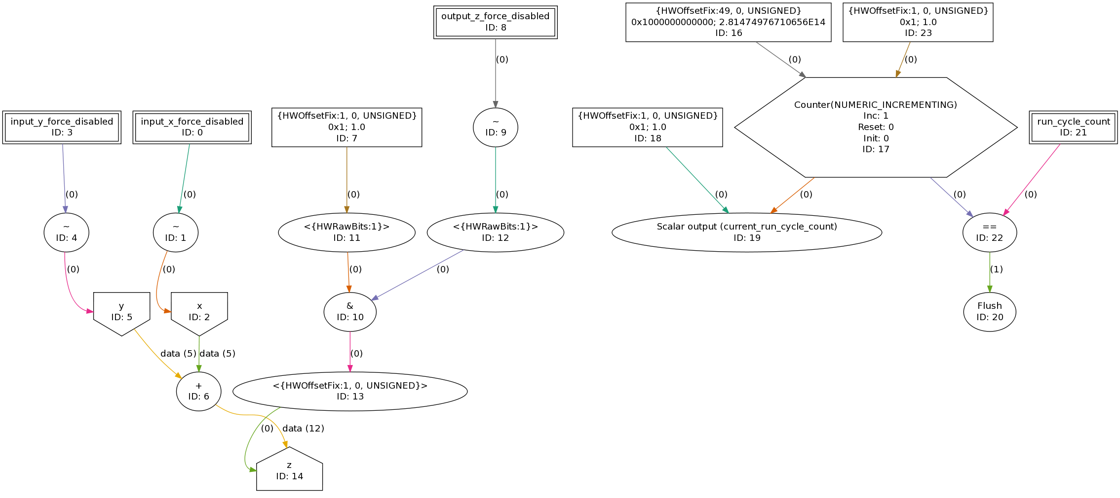
Final Kernel Graph for Example No 2
Generating Graph

Slide 38
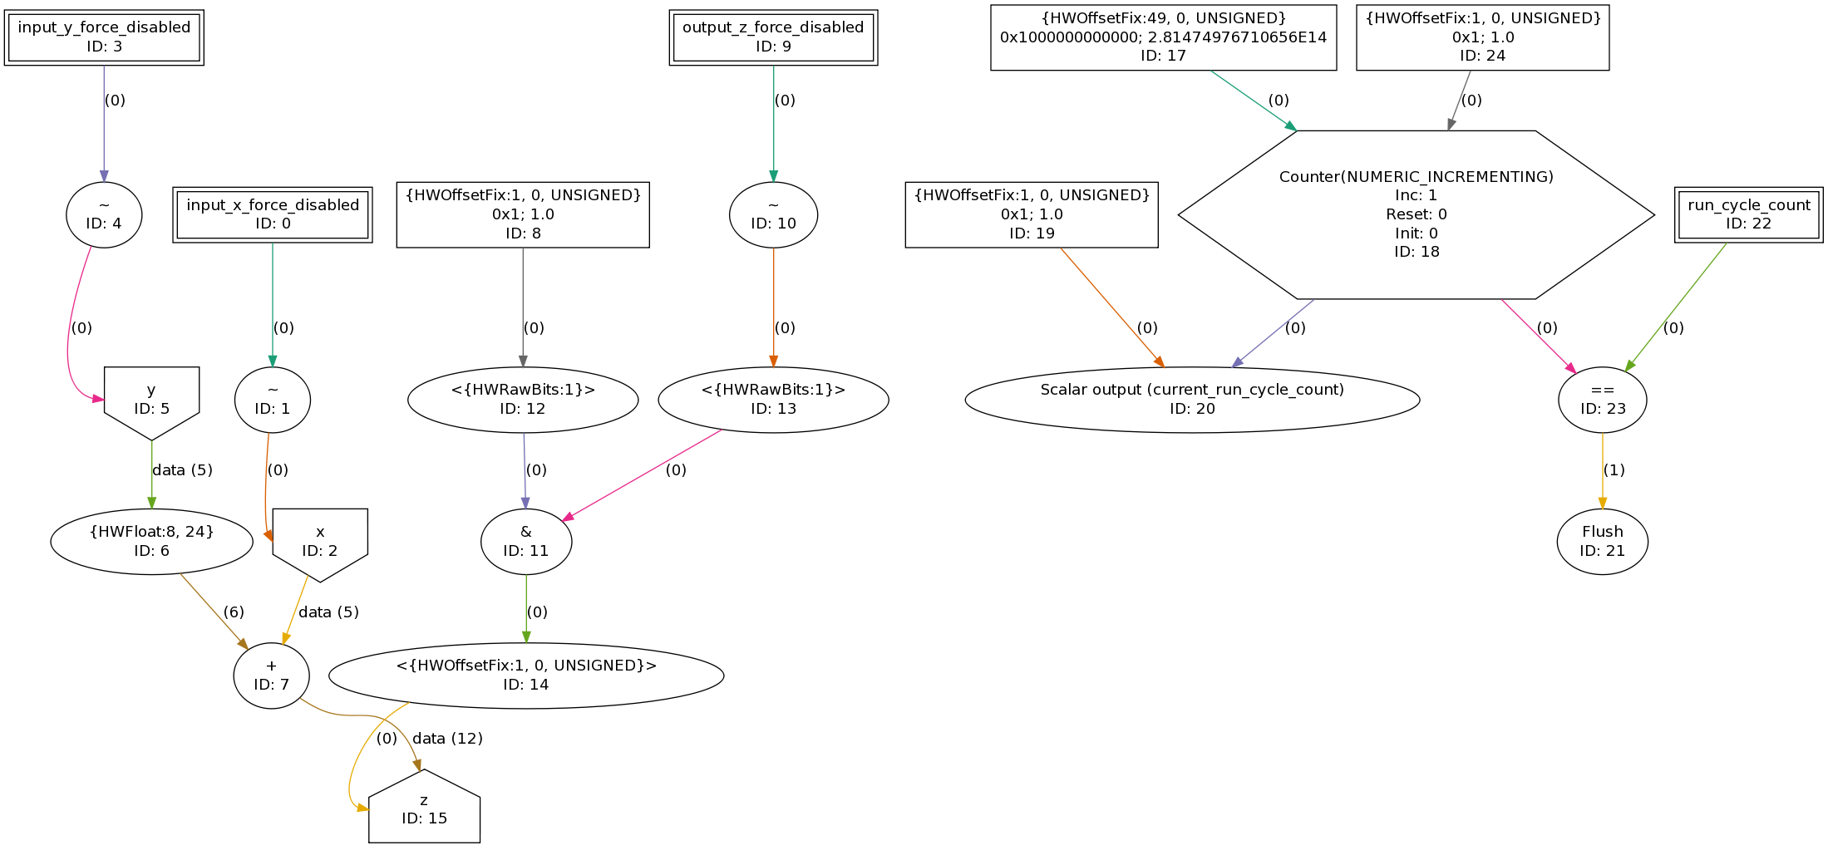
Final Kernel Graph for Example No 3
Generating Graph

Slide 39
Example No. 4: Addition of a Constant and a Vector
Example No. 4
Write a program that adds a constant to an array that contains floating point numbers.
Program:
reads the size of the array and the constant that will add to elements of the array,
makes one array in an arbitrary way, and
adds the constant to the array using the MAX card.

Slide 40
Example4Kernel.maxj
Example No. 4
package example4;
import com.maxeler.maxcompiler.v2.kernelcompiler.Kernel;
import com.maxeler.maxcompiler.v2.kernelcompiler.KernelParameters;
import com.maxeler.maxcompiler.v2.kernelcompiler.types.base.DFEType;
import com.maxeler.maxcompiler.v2.kernelcompiler.types.base.DFEVar;
public class example4Kernel extends Kernel {
private static final DFEType type = dfeFloat(8,24);
public example4Kernel(KernelParameters parameters) {
super(parameters);
DFEVar x = io.input("x", type);
DFEVar y = io.scalarInput("y", type);
DFEVar sum = x + y;
io.output("z", sum, type);
}
}

Slide 41
Other Modifications in Example 4
Example No. 4
example4SimRunner.maxj:
Before the kernel run, invoke:
setScalarInput(“y”,2);
example4Manager.maxj:
Create the scalar parameter InterfaceParam y = engine_interface.addParam("y", type);
Connect the parameter to scalar variable in kernel engine_interface.setScalar(s_kernelName, "y", y);

Slide 42
Example No. 5: Input/Output Control
Example No. 5
Do the same as in example no 4, with the following modification: use controlled inputs and counters.

Slide 43
example5Kernel.maxj
Example No. 5
package example5;
import com.maxeler.maxcompiler.v2.kernelcompiler.Kernel;
import com.maxeler.maxcompiler.v2.kernelcompiler.KernelParameters;
import com.maxeler.maxcompiler.v2.kernelcompiler.types.base.DFEType;
import com.maxeler.maxcompiler.v2.kernelcompiler.types.base.DFEVar;
public class example5Kernel extends Kernel {
private static final DFEType type = dfeFloat(8,24);
public example5Kernel(KernelParameters parameters) {
super(parameters);
DFEVar cnt = control.count.simpleCounter(32);
DFEVar x = io.input("x", type);
DFEVar y = io.input("y", type, cnt.eq(0));
DFEVar sum = x + y;
io.output("z", sum, type);
}
}

Slide 44
example5SimRunner.maxj
Example No. 5
package example5UnitTest;
import com.maxeler.maxcompiler.v2.managers.standard.SimulationManager;
import example5.example5Kernel;
public class example5SimRunner {
public static void main(String[] args) {
SimulationManager m = new SimulationManager("example5Sim");
example5Kernel k = new example5Kernel(m.makeKernelParameters());
m.setKernel(k);
m.setInputData("x",1,2,3,4,5,6,7,8);
m.setInputData("y",2);
m.setKernelCycles(8);
m.runTest();
m.dumpOutput();
double expectedOutput[] = {3,4,5,6,7,8,9,10};
m.checkOutputData("z", expectedOutput);
m.logMsg("Test passed OK!");
}
}

Slide 45
Example No. 6: Conditional Execution
Example No. 6
Translate the following part of code for the Maxeler MAX2 card:
for(int i=0; i<N; i++)
if(a[i] != b[i]){
c[i] = b[i]-a[i];
d[i] = a[i]*b[i]/c[i];
}else {
c[i] = a[i];
d[i] = a[i]+b[i];
}

Slide 46
example6Kernel.maxj
Example No. 6
package example6;
import com.maxeler.maxcompiler.v2.kernelcompiler.Kernel;
import com.maxeler.maxcompiler.v2.kernelcompiler.KernelParameters;
import com.maxeler.maxcompiler.v2.kernelcompiler.types.base.DFEType;
import com.maxeler.maxcompiler.v2.kernelcompiler.types.base.DFEVar;
public class example6Kernel extends Kernel {
private static final DFEType type = dfeFloat(8, 24);
public example6Kernel(KernelParameters parameters) {
super(parameters);
DFEVar a = io.input("a", type);
DFEVar b = io.input("b", type);
DFEVar c, d;
c = ~a.eq(b) ? b - a : a;
d = a.eq(b) ? a + b : a * b / c;
io.output("c", c, type);
io.output("d", d, type);
}
}

Slide 47
Example No. 7: Moving Average 1D
Example No. 7
Write a program that calculates moving average over an array, calculating the average value for each one of the three successive elements of the input array.
(a[0]+a[1])/2 , for i = 0;
avg[i] = (a[i-1]+a[i]+a[i+1])/3 , for 0 < i < n-1;
(a[n-2]+a[n-3])/2, for i = n-1.

Slide 48
example7Kernel.maxj
Example No. 7
package example7;
import com.maxeler.maxcompiler.v2.kernelcompiler.Kernel;
import com.maxeler.maxcompiler.v2.kernelcompiler.KernelParameters;
import com.maxeler.maxcompiler.v2.kernelcompiler.types.base.DFEType;
import com.maxeler.maxcompiler.v2.kernelcompiler.types.base.DFEVar;
public class example7Kernel extends Kernel {
private static final DFEType type = dfeFloat(8, 24);
public example7Kernel(KernelParameters parameters) {
super(parameters);
DFEVar x = io.input("x", type);
DFEVar N = io.scalarInput("N", dfeUInt(64));
DFEVar cnt = control.count.simpleCounter(64);
DFEVar prev, next, divider, result;
prev = cnt.eq(0) ? 0 : stream.offset(x, -1);
next = cnt.eq(N - 1) ? 0 : stream.offset(x, +1);
divider = (cnt.eq(0) | cnt.eq(N - 1)) ? constant.var(type,2): 3;
result = (prev + next + x)/divider;
io.output("z", result, type);
}
}
x.simWatch("x");
prev.simWatch("xprev");
next.simWatch("xnext");
cnt.simWatch("i");

Slide 49
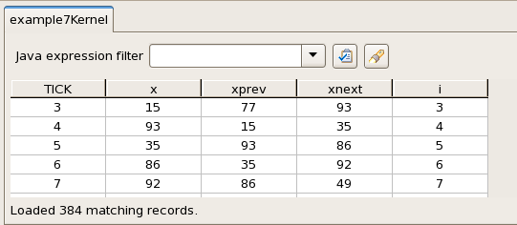
Simulation watches
Example No. 7

Slide 50
Debugging
Example No. 7
Simulation watches
Tell us the value of any specified DFEVar for every Kernel tick
Simulation printf
Allow us to print and format the print values explicitly from streams within the Kernel on every tick
debug.simPrintf(String message,Object … arg);
debug.simPrintf(DFEVar condition, String message,Object … arg);
DFE printf
Same as the simulation printf
Available for DFE runs

Slide 51
Example No. 8: Moving Average 2D
Example No. 8
Write a program that calculates moving average along a 2D matrix of the size MxN.
Transfer the matrix to the MAX2 card through one stream, row by row.

Slide 52
example8Kernel.maxj 1/3
Example No. 8
package example8;
import com.maxeler.maxcompiler.v2.kernelcompiler.Kernel;
import com.maxeler.maxcompiler.v2.kernelcompiler.KernelParameters;
import com.maxeler.maxcompiler.v2.kernelcompiler.stdlib.core.CounterChain;
import com.maxeler.maxcompiler.v2.kernelcompiler.stdlib.core.Stream.OffsetExpr;
import com.maxeler.maxcompiler.v2.kernelcompiler.types.base.DFEType;
import com.maxeler.maxcompiler.v2.kernelcompiler.types.base.DFEVar;
public class example8Kernel extends Kernel {
private static final DFEType type = dfeFloat(8, 24), type_cnt = dfeInt(33);
public example8Kernel(KernelParameters parameters) {
super(parameters);
DFEVar matrix = io.input("matrix", type);
DFEVar M = io.scalarInput("M", dfeUInt(32)), N = io.scalarInput("N",
dfeUInt(32));
OffsetExpr Nof = stream.makeOffsetParam("Nof", 3, 128);
CounterChain cc = control.count.makeCounterChain();
DFEVar j = cc.addCounter(M, 1);
DFEVar i = cc.addCounter(N, 1);

Slide 53
example8Kernel.maxj 2/3
Example No. 8
DFEVar window[] = new DFEVar[9];
int k = 0;
for (int x = -1; x <= 1; x++)
for (int y = -1; y <= 1; y++)
window[k++] = ((i.cast(type_cnt) + x >= 0)
& (i.cast(type_cnt) + x < N.cast(type_cnt))
& (j.cast(type_cnt) + y >= 0) & (j.cast(type_cnt) + y < M.cast(type_cnt))) ? stream.offset(matrix, x + y * Nof) : 0;
DFEVar sum = constant.var(type, 0);
for (DFEVar dfeVar : window) {
sum = sum + dfeVar;
}

Slide 54
example8Kernel.maxj 3/3
Example No. 8
DFEVar divider = i.eq(0) | i.eq(N - 1) | j.eq(0) | j.eq(M - 1) ? ((i.eq(0) | i.eq(N - 1)) & (j.eq(0) | j.eq(M - 1)) ? constant.var(type, 4) : 6) : 9;
DFEVar result = sum/divider;
io.output("z", result, type);
}
}

Slide 55
example8SimRunner.maxj
Example No. 8
package example8UnitTest;
import com.maxeler.maxcompiler.v2.managers.standard.SimulationManager;
import example8.example8Kernel;
public class example8SimRunner {
public static void main(String[] args) {
SimulationManager m = new SimulationManager("example8Sim");
example8Kernel k = new example8Kernel( m.makeKernelParameters() );
m.setKernel(k);
m.setInputData("matrix", 1, 2, 3, 4, 5, 6, 7, 8, 9, 10,11,12, 13,14,15,16);
m.setScalarInput("M", 4);
m.setScalarInput("N", 4);
m.setStreamOffsetParam("Nof",4);
m.setKernelCycles(16);
m.runTest();
m.dumpOutput();
double expectedOutput[] = { 3.5, 4, 5, 5.5, 5.5, 6, 7, 7.5, 9.5, 10, 11, 11.5, 11.5, 12, 13, 13.5 };
m.checkOutputData("z", expectedOutput);
m.logMsg("Test passed OK!");
}
}

Slide 56
example8Manager.maxj
Example No. 8
private static EngineInterface interfaceDefault() {
EngineInterface engine_interface = new EngineInterface();
CPUTypes type = CPUTypes.FLOAT;
int size = type.sizeInBytes();
InterfaceParam M = engine_interface.addParam("M", CPUTypes.UINT64),
N = engine_interface.addParam("N", CPUTypes.UINT64);
InterfaceParam SIZE = engine_interface.addParam("SIZE", CPUTypes.UINT64);
InterfaceParam Nof = engine_interface.addParam("Nof",CPUTypes.UINT64);
engine_interface.setTicks(s_kernelName, SIZE);
engine_interface.setScalar(s_kernelName, "M", M);
engine_interface.setScalar(s_kernelName, "N", N);
engine_interface.setOffset(s_kernelName, "Nof",Nof);
engine_interface.setStream("matrix", type, SIZE * size);
engine_interface.setStream("z", type, SIZE * size);
return engine_interface;
}

Slide 57
example8CpuCode.c
Example No. 8
The function prototype is: example8(M, N, Offset,SIZE, data_in, data_out);

Slide 58
Example No. 9: Array summation
Example No. 9
Write a program that calculates the sum of n floating point numbers.

Slide 59
example9Kernel.java, try #1
Example No. 9
package example9;
import com.maxeler.maxcompiler.v2.kernelcompiler.Kernel;
import com.maxeler.maxcompiler.v2.kernelcompiler.KernelParameters;
import com.maxeler.maxcompiler.v2.kernelcompiler.stdlib.core.Stream.OffsetExpr;
import com.maxeler.maxcompiler.v2.kernelcompiler.types.base.DFEType;
import com.maxeler.maxcompiler.v2.kernelcompiler.types.base.DFEVar;
public class example9Kernel extends Kernel {
private static final DFEType type = dfeFloat(8, 24);
public example9Kernel(KernelParameters parameters) {
super(parameters);
DFEVar sum, cnt, result, loopVal, cnt_output;
cnt = control.count.simpleCounter(64);
sum = type.newInstance(this);
DFEVar x = io.input("x", type);
result = x + (cnt < 1?0:sum);
sum <== stream.offset(result, -1);
io.output("z", result, type);
}
}
Problem?

Slide 60
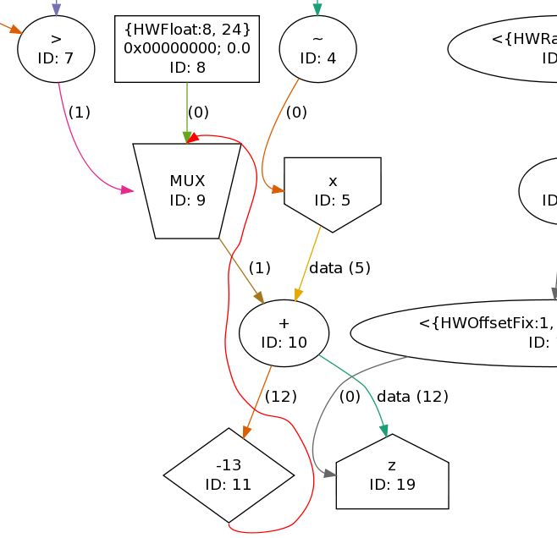
Graph of Dataflow for Summation
Example No. 9

Slide 61
example9Kernel.maxj 1/2 #2
Example No. 9
package example9;
import com.maxeler.maxcompiler.v2.kernelcompiler.Kernel;
import com.maxeler.maxcompiler.v2.kernelcompiler.KernelParameters;
import com.maxeler.maxcompiler.v2.kernelcompiler.stdlib.core.Stream.OffsetExpr;
import com.maxeler.maxcompiler.v2.kernelcompiler.types.base.DFEType;
import com.maxeler.maxcompiler.v2.kernelcompiler.types.base.DFEVar;
public class example9Kernel extends Kernel {
private static final DFEType type = dfeFloat(8, 24);
public example9Kernel(KernelParameters parameters) {
super(parameters);
DFEVar sum, cnt, result, loopVal, cnt_output;
OffsetExpr loop = stream.makeOffsetAutoLoop("loop");
loopVal = loop.getDFEVar(this,dfeUInt(64));
cnt = control.count.simpleCounter(64);
cnt_output = control.count.simpleCounter(8,loopVal.cast(dfeUInt(8)));

Slide 62
example9Kernel.maxj 2/2 #2
Example No. 9
sum = type.newInstance(this);
DFEVar x = io.input("x", type,cnt_output.eq(0));
result = x + (cnt < loopVal?0:sum);
sum <== stream.offset(result, -loop);
io.output("z", result, type, cnt_output.eq(0));
}
}
Solution:
New offset
=
Depth of pipeline loop

Slide 63
example9SimRunner.maxj #2
Example No. 9
package example9UnitTest;
import com.maxeler.maxcompiler.v2.managers.standard.SimulationManager;
import example9.example9Kernel;
public class example9SimRunner {
public static void main(String[] args) {
SimulationManager m = new SimulationManager("example9Sim");
example9Kernel k = new example9Kernel(m.makeKernelParameters());
m.setKernel(k);
int loopSize = m.getOffsetAutoLoopSize("loop");
m.setInputData("x", 1, 2, 3);
m.setKernelCycles(3 * loopSize);
m.runTest();
m.dumpOutput();
double expectedOutput[] = { 1, 3, 6 };
m.checkOutputData("z", expectedOutput);
m.logMsg("Test passed OK!");
}
}

Slide 64
example9Manager.maxj #2
Example No. 9
private static EngineInterface interfaceDefault() {
EngineInterface engine_interface = new EngineInterface();
CPUTypes type = CPUTypes.FLOAT;
int size = type.sizeInBytes();
InterfaceParam N = engine_interface.addParam("N", CPUTypes.INT);
InterfaceParam loopOffset = engine_interface.getAutoLoopOffset(s_kernelName,"loop");
engine_interface.ignoreAutoLoopOffset(s_kernelName, "loop");
engine_interface.setTicks(s_kernelName, N*loopOffset);
engine_interface.setStream("x", type, N * size);
engine_interface.setStream("z", type, N * size);
return engine_interface;
}

Slide 65
Example No. 10: Optimized Array Summation
Example No. 10
Write an optimized program that calculates the sum of numbers in an input array
First, calculate several parallel/partial sums; then, add them at the end

Slide 66
example10Kernel1.maxj
Example No. 10
package example10;
import com.maxeler.maxcompiler.v2.kernelcompiler.Kernel;
import com.maxeler.maxcompiler.v2.kernelcompiler.KernelParameters;
import com.maxeler.maxcompiler.v2.kernelcompiler.stdlib.core.Stream.OffsetExpr;
import com.maxeler.maxcompiler.v2.kernelcompiler.types.base.DFEType;
import com.maxeler.maxcompiler.v2.kernelcompiler.types.base.DFEVar;
public class example10Kernel1 extends Kernel {
private static final DFEType type = dfeFloat(8,24),
uint64 = dfeUInt(64);
public example10Kernel1(KernelParameters parameters) {
super(parameters);
DFEVar N = io.scalarInput("size", uint64);
DFEVar cnt, result, sum;
OffsetExpr loop = stream.makeOffsetAutoLoop("loop");
DFEVar loopOffset = loop.getDFEVar(this,uint64);
cnt = control.count.simpleCounter(64);
sum = type.newInstance(this);
DFEVar x = io.input("x", type);
result = x + (cnt < loopOffset?0:sum);
sum <== stream.offset(result, -loop);
io.output("z", result, type, cnt >= N - loopOffset);
}
}

Slide 67
example10Kernel2.maxj
Example No. 10
package example10;
import com.maxeler.maxcompiler.v2.kernelcompiler.Kernel;
import com.maxeler.maxcompiler.v2.kernelcompiler.KernelParameters;
import com.maxeler.maxcompiler.v2.kernelcompiler.stdlib.core.Stream.OffsetExpr;
import com.maxeler.maxcompiler.v2.kernelcompiler.types.base.DFEType;
import com.maxeler.maxcompiler.v2.kernelcompiler.types.base.DFEVar;
public class example10Kernel2 extends Kernel {
private static final DFEType type = dfeFloat(8,24);
public example10Kernel2(KernelParameters parameters) {
super(parameters);
DFEVar sum, cnt, result, loopVal, cnt_output;
OffsetExpr loop = stream.makeOffsetAutoLoop("loop");
loopVal = loop.getDFEVar(this,dfeUInt(64));
cnt = control.count.simpleCounter(64);
cnt_output = control.count.simpleCounter(8,loopVal.cast(dfeUInt(8)));
sum = type.newInstance(this);
DFEVar x = io.input("x", type,cnt_output.eq(0));
result = x + (cnt < loopVal?0:sum);
sum <== stream.offset(result, -loop);
io.output("z", result, type, cnt >= loopVal*loopVal-4);
}
}

Slide 68
example10SimRunner.maxj
Example No. 10
package example10UnitTest;
import com.maxeler.maxcompiler.v2.managers.standard.SimulationManager;
import example10.example10Kernel1;
public class example10SimRunner {
public static void main(String[] args) {
SimulationManager m = new SimulationManager("example10Sim");
example10Kernel1 k = new example10Kernel1(m.makeKernelParameters());
m.setKernel(k);
int loopSize = m.getOffsetAutoLoopSize("loop");
m.setInputData("x", 1, 2, 3, 4, 5, 6, 7, 8, 9, 10, 11, 12, 13, 14, 15, 16, 17, 18, 19, 20, 21, 22, 23, 24, 25, 26);
m.setScalarInput("size", 26);
m.setKernelCycles(26);
m.runTest();
m.dumpOutput();
double expectedOutput[] = new double[loopSize];
for (int i = 0;i < loopSize;i++)
expectedOutput[i] = i*2 + 2 + loopSize;
m.checkOutputData("z", expectedOutput);
m.logMsg("Test passed OK!");
}
}

Slide 69
example10Manager.maxj 1/2
Example No. 10
public class example10Manager extends CustomManager {
private static final String s_kernelName1 = "example10Kernel1",s_kernelName2 = "example10Kernel2";
public example10Manager(EngineParameters engineParameters) {
super(engineParameters);
KernelBlock block1 = addKernel(new example10Kernel1(makeKernelParameters(s_kernelName1)));
KernelBlock block2 = addKernel(new example10Kernel2(makeKernelParameters(s_kernelName2)));
for (String inputName: block1.getAllInputs())
block1.getInput(inputName).connect(addStreamFromCPU(inputName));
block2.getInput("x") <== block1.getOutput("z");
for (String outputName: block2.getAllOutputs())
addStreamToCPU(outputName).connect(block2.getOutput(outputName));
createSLiCinterface(interfaceDefault());
configBuild(this,engineParameters);
}

Slide 70
example10Manager.maxj 2/2
Example No. 10
private static EngineInterface interfaceDefault() {
EngineInterface engine_interface = new EngineInterface();
CPUTypes type = CPUTypes.FLOAT;
int size = type.sizeInBytes();
InterfaceParam N = engine_interface.addParam("N", CPUTypes.UINT32);
InterfaceParam a = engine_interface.addParam("size", CPUTypes.UINT32);
InterfaceParam loopOffset = engine_interface.getAutoLoopOffset(s_kernelName2, "loop");
engine_interface.ignoreAutoLoopOffset(s_kernelName2, "loop");
engine_interface.setTicks(s_kernelName1, N);
engine_interface.setScalar(s_kernelName1, "size", a);
engine_interface.setStream("x", type, N * size);
engine_interface.setTicks(s_kernelName2, loopOffset*loopOffset);
engine_interface.setStream("z", type, 4*size);
return engine_interface;
}

Slide 71
Example No. 11: Image filter
Example No. 11
Write an optimized program that applies filter to an image
Every pixel in a row is multiplied by coefficient
i – position of the pixel in a row
x – row width

Slide 72
example11Kernel.maxj
Example No. 11
public class example11Kernel extends Kernel {
private static final DFEType type = dfeUInt(32), coefficient_type = dfeFloat(8,24);
protected example11Kernel(KernelParameters parameters, int image_width) {
super(parameters);
DFEVar inImage = io.input("imageInput", type);
CounterChain cnt_chain = control.count.makeCounterChain();
DFEVar pixel = cnt_chain.addCounter(image_width, 1);
DFEVar component = cnt_chain.addCounter(3, 1);
Memory<DFEVar> mappedRom = mem.alloc(coefficient_type, image_width);
mappedRom.mapToCPU("mappedRom");
DFEVar result = inImage.cast(coefficient_type) * mappedRom.read(pixel);
result = result.cast(type);
io.output("imageOutput", result, type);
}
}

Slide 73
Example No. 11
Example No. 11
Manager implicitly creates SliC parameter for initializing ROM memory
Static initialization of ROM
Requires recompilation
double contents[] = …;
…
Memory<DFEVar> ROM = mem.alloc(dfeFloat(8,24), dataSize);
ROM .setContents(contents);

Slide 74
Example No. 12: Image filter
Example No. 12
Same as example 11
Use RAM memory and input stream to initialize memory

Slide 75
example12Kernel.maxj
Example No. 12
public class example12Kernel extends Kernel {
private static final DFEType type = dfeUInt(32), coefficient_type = dfeFloat(8,24);
protected example12Kernel(KernelParameters parameters, int image_width) {
super(parameters);
DFEVar input_coefficients_cnt = control.count.simpleCounter(64);
DFEVar work = ~(input_coefficients_cnt < image_width);
DFEVar inImage = io.input("imageInput", type,work);
DFEVar inCoefficients = io.input("inputCoefficients", coefficient_type,~work);
CounterChain cnt_chain = control.count.makeCounterChain(work);
DFEVar pixel = cnt_chain.addCounter(image_width, 1);
DFEVar component = cnt_chain.addCounter(3, 1);
Memory<DFEVar> ram = mem.alloc(coefficient_type, image_width);
ram.write(input_coefficients_cnt.cast(dfeUInt(8)), inCoefficients, ~work);
DFEVar result = inImage.cast(coefficient_type) * ram.read(pixel);
result = result.cast(type);
io.output("imageOutput", result, type,work);
}
}

