Slide 1
Multiscale Dataflow Computing
Competitive Advantage Where It Matters

Slide 2
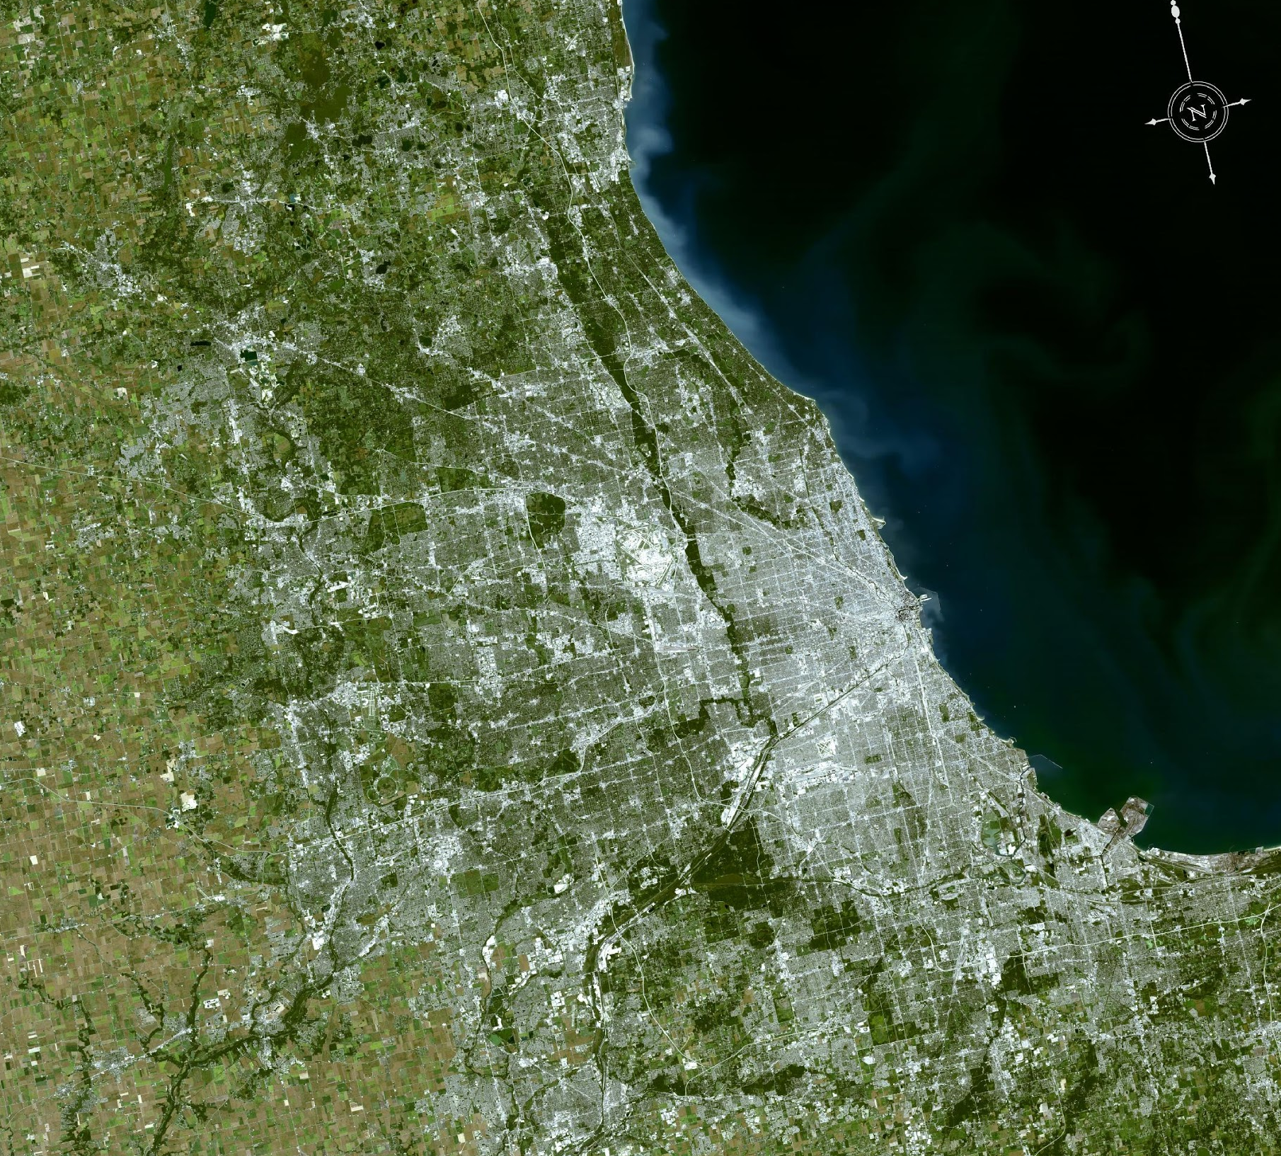
What Makes Computers Inefficient?
A metaphor: Silicon vs GaAs (DARPA for Star Wars)
DATA
ALU
DATA
L1
L2
DATA
DATA
Notes:
Imagine the city of Chicago passes a law requiring all office work to be done in a single building, say the Willis tower.
The same number of office workers, i.e. dentists, lawyers, magazine editors, stock brokers, all still live in the city and surrounds. What does the city look like?
You might let all the dentists work every Monday for 1 hour, and then the lawyers for an hour and so on. And the highways would constantly be clogged with one group driving to work and another back home. Human ingenuity would come in, and you’d zone off temporary corporate housing near the tower to “cache” workers who would be needed the next day, and so on.
Still, you would have a very unproductive city with most of the infrastructure dedicated to transportation instead of actual productivity. If you showed this design to an alien they might describe it as a complex machine for moving people who are not working. At some point, when we’ve pushed the infrastructure of the city to its limits, we just can’t move people around any faster, there’s only one way to get more done.

Slide 3
What Makes Computers Inefficient?
A metaphor: @vonNeumann(ALU/COMM->~) @Feynman(ALU/COMM->0) @2020(ALU/COMM->1/200)
Notes:
We duplicate that design 2, 4, 8, 16 times etc. Or potentially thousands of times.
This is basically what we as a species do with the multiple square miles of silicon we turn into transistors on a die each year; this isn’t just an odd way to do computing, this is what almost all computing is. Every microprocessor, CPU, GPU, TPU – all variations on the same pattern: put a tiny bit of compute in a sea of machinery for moving data, and replicate n times.

Slide 4
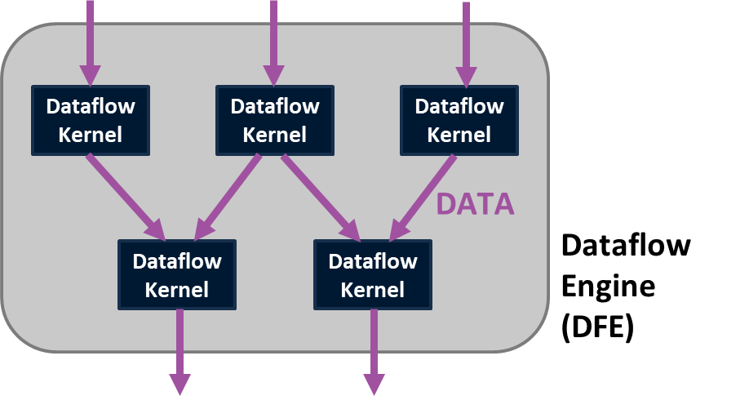
The Dataflow Model
Build the computer around the problem
Data moves continuously
Compute in space – arrange operations in 2D
Optimal solution for a specific problem
No wasted silicon – maximum performance density
No wasted clock cycles – predictable speed
Notes:
If the inefficiency of the control flow model comes from all the machinery to move data, we need a better model for computing – one that assumes data will always be moving. In the dataflow model, we treat data as a continuous stream between computational units arranged in two-dimensional space.
Where control flow provides general hardware for any problem, we optimize a dataflow solution’s hardware for a specific problem, with each operation required in the underlying algorithm represented by a physical space on the chip. The goal is to use as much of the silicon on the chip as possible to do useful computing, what we call maximum performance density.
A dataflow engine, or DFE, is a chain of computational units that operates like a data factory, with each stream of data moving from kernel to kernel like parts along an assembly line. No clock cycles are wasted fetching and storing data through various caches, so the performance of this factory is predictable and can be engineered.

Slide 5
The Story of Maxeler Dataflow Computing
Research to real world
Researched at Stanford pre 2000
Mencer, O. (2000) Rational Arithmetic in Computer Systems, (Ph. D. Thesis). Stanford University, California, USA.
Refined at Bell Labs from 2000 - 2003
Computing Sciences Center, Unit 1127
Birthplace of the transistor, Unix, C, C++ ...
Realized via Maxeler, founded in 2003
Oil and Gas with Chevron, ENI, Schlumberger
Finance with J.P. Morgan, CME, Citi
Defense and Cyber Security
Strategic Technology Partnerships
Juniper, Hitachi, AWS
Notes:
Maxeler was founded to make dataflow computing a reality.
It began as a research project by our founder, Oskar Mencer, at Stanford University pre-2000, and was refined in the private sector at Bell labs.
After incorporating in 2003, Maxeler grew by finding use cases in the oil and gas field with companies like Chevron, and finance with tier 1 institutions such as JP Morgan, CME and Citi. We’ve recently expanded into defense and cybersecurity, and entered a number of strategic technical partnerships I’ll talk about later.

Slide 6
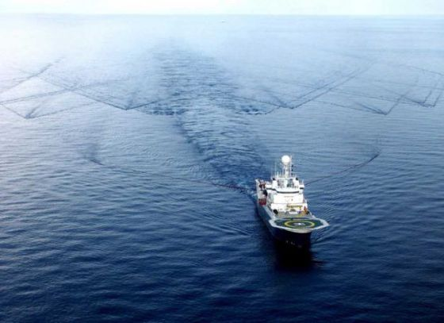
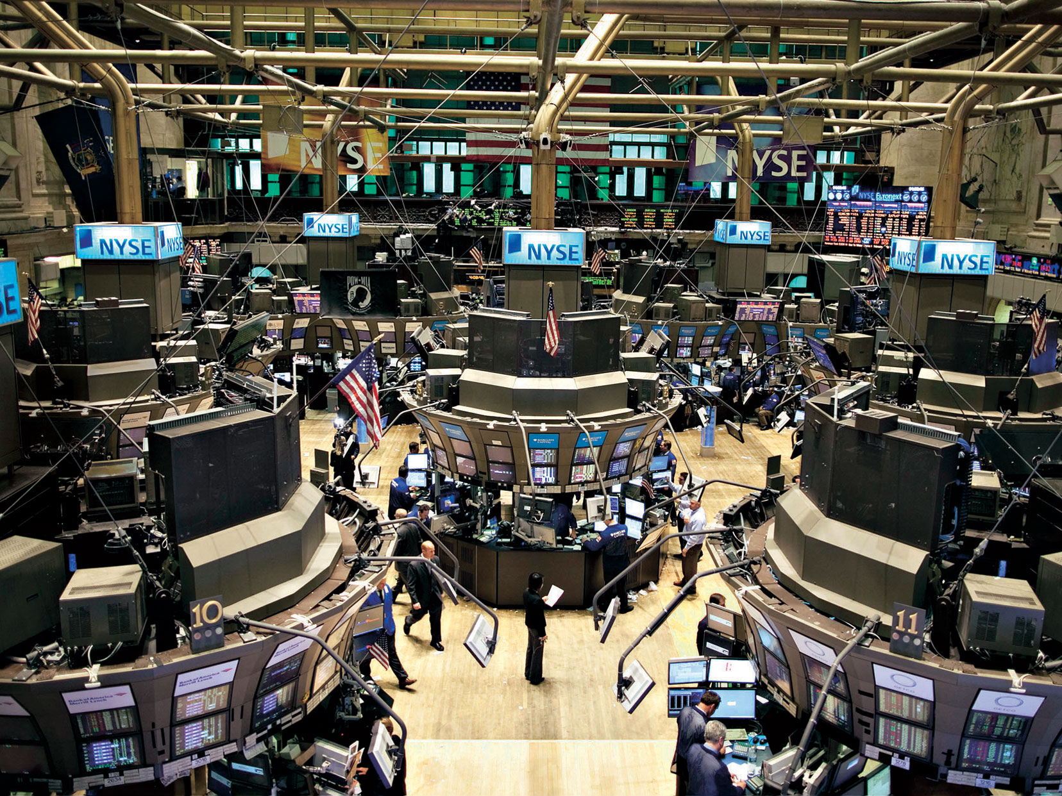
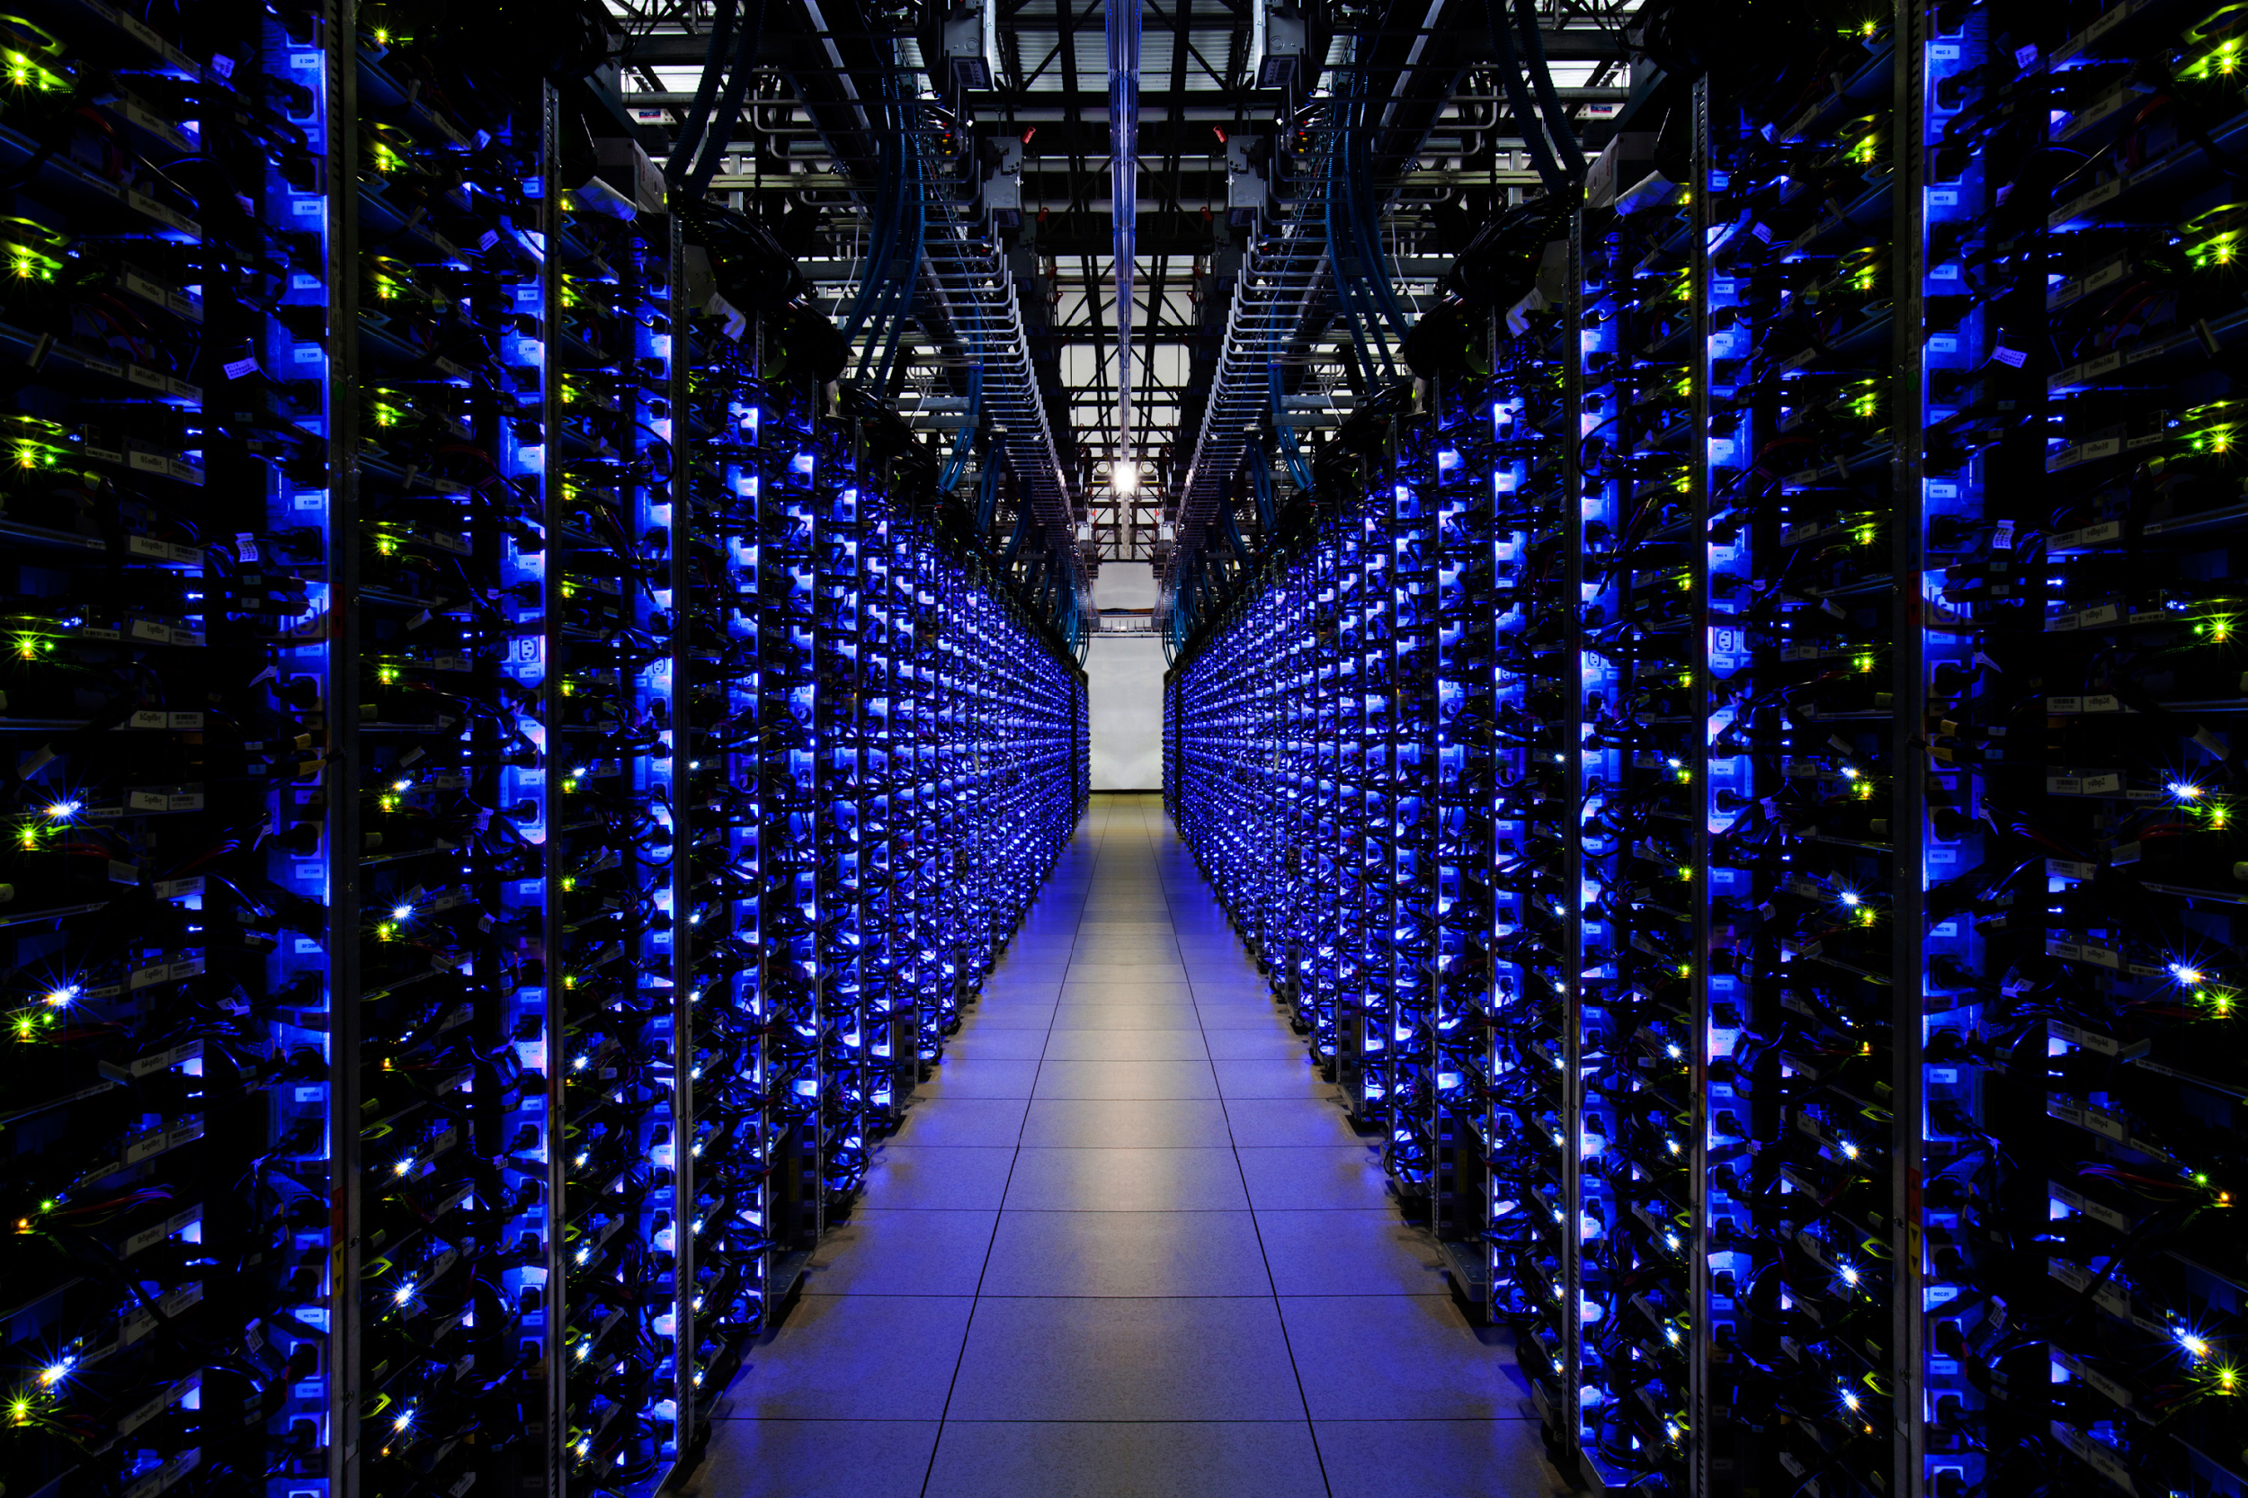
Maxeler Success Stories
Dataflow computing provides competitive advantage in multiple industries
Chevron
Seismic shoot data must be processed for imaging
Maxeler developed dataflow computing to address performance density.
JP Morgan
Complex credit derivatives
Unable to run risk calcs in 2008 crisis
Maxeler DFEs reduced run time for risk calcs from 8 hours to 2 minutes.
Juniper
Added dataflow acceleration to top-of-rack QFX5100 switch
Maxeler delivers in-line processing of network data.

Slide 7
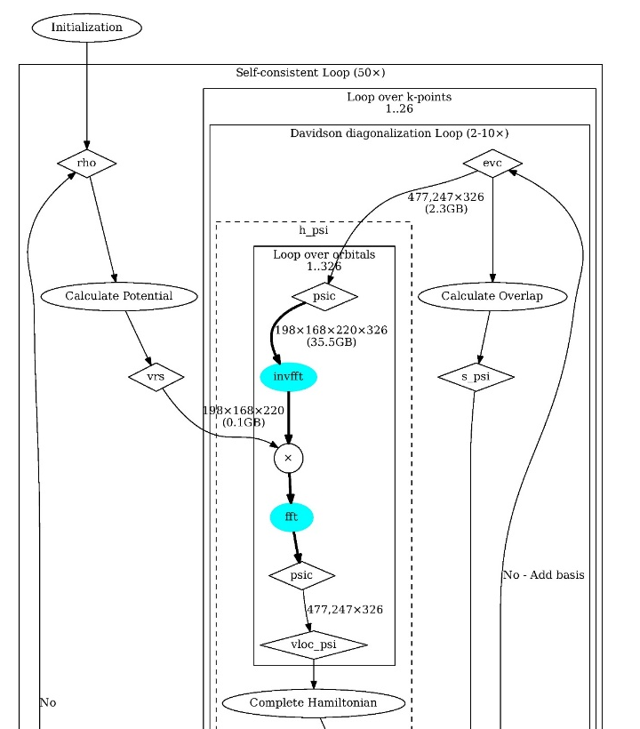
Building a Dataflow Computer
First, convert the problem to MaxJ
Algorithm analysis
Convert loops to dataflow
MaxJ
Java-based language
Dataflow graph
Assembled by MaxCompiler
HARDWARE
BUILD
MaxJ Simulator
Debugging and JUnit tests
Notes:
We know why we want to build a dataflow computer, to design an optimal use of silicon for our problem. How do we do it?
In Maxeler’s dataflow programming model, we begin by analyzing the code we’re looking to accelerate, with a focus on compute-intensive loops. I’ll talk about this in more detail with a case study later.
We then write some code describing our dataflow calculation in MaxJ, which is an extended version of the Java language developed by Maxeler.
The MaxJ code doesn’t get “executed” in the way FORTRAN or C++ code would be – each statement defines an operation connecting some streams of data, so running them using our MaxCompiler library actually draws a dataflow graph.
At this point, we haven’t built a dataflow computer, we’ve only described what we want one to do. We use a high-speed MaxJ simulator to test this design before we ever build it – because we simulate only the graph and not the hardware implementing it, this simulator is an order of magnitude better than comparable tools. This framework allows us to leverage standard tools like JUnit and develop MaxJ as a software project, with the usual iterative loop of design, test, debug. Once we’ve described our dataflow computer in MaxJ, and tested the dataflow graph to our satisfaction, we move on to a hardware implementation of the graph.

Slide 8
MaxJ
Dataflow computing in a language you know
Notes:
Before moving on, we’ll take a quick dive into the MaxJ language itself. As I mentioned before, it’s based on (and syntactically equivalent to) Java.
Here we’re showing our MaxIDE development environment, which is based on Eclipse. In the left pane we have MaxJ source code, and the right pane is displaying the dataflow graph it generates when executed with MaxCompiler.
At the beginning of the MaxJ code, we create an input x, represented by the orange pentagon at the top of the graph. This doesn’t represent a single value, but a stream of data. In this case, we’ve defined that data to be single precision floating-point values, but you can easily imagine how we might select other types.
We want to compute the moving average of this stream x and output the result as another stream y. You can see in the last line where that output gets created. For example, if we drop the values 1,4,10 in the graph at the top, we want to see the value 5 come out the bottom.
The lines that define the moving average calculation itself are pretty easy to understand – we use the usual addition and division symbols in code. These operations are represented by blue circles in our graph.
The “stream.offset” lines require a little more explanation – since x is a stream of data we can look forwards and backwards in it to obtain three consecutive elements for the average. Those offsets are represented by green diamonds in the graph.

Slide 9
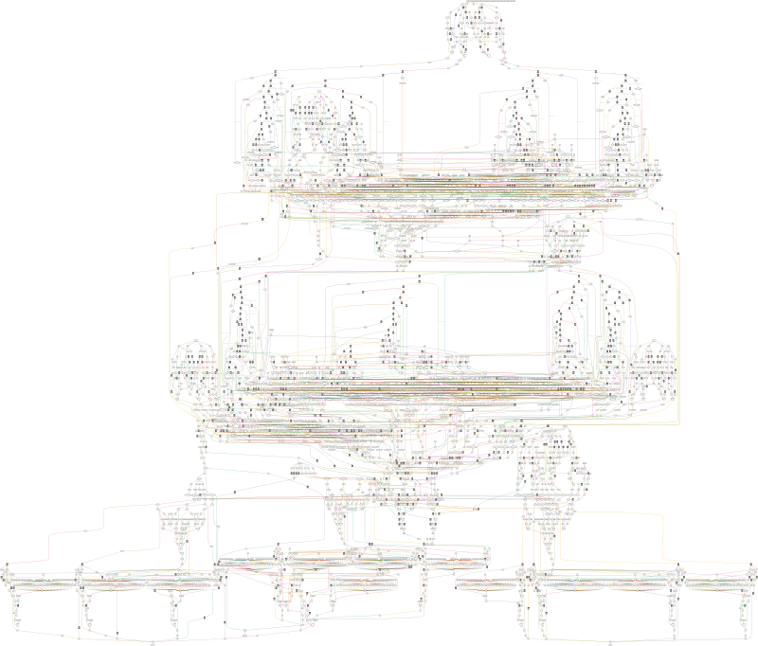
MaxJ
Complex graphs from simple code
3D finite difference time step
Notes:
The simplicity of MaxJ makes it possible to write a few dozen lines of code and define a complex compute problem as a dataflow graph.
For example, this graph of a finite difference time step has on the order of a thousand nodes.

Slide 10
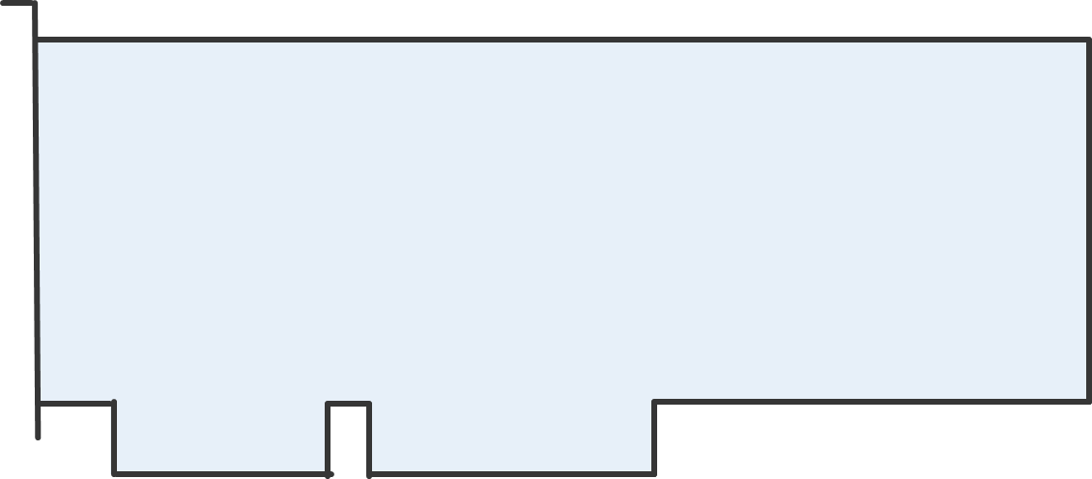
Building a Dataflow Computer
Then build a physical machine

Slide 11
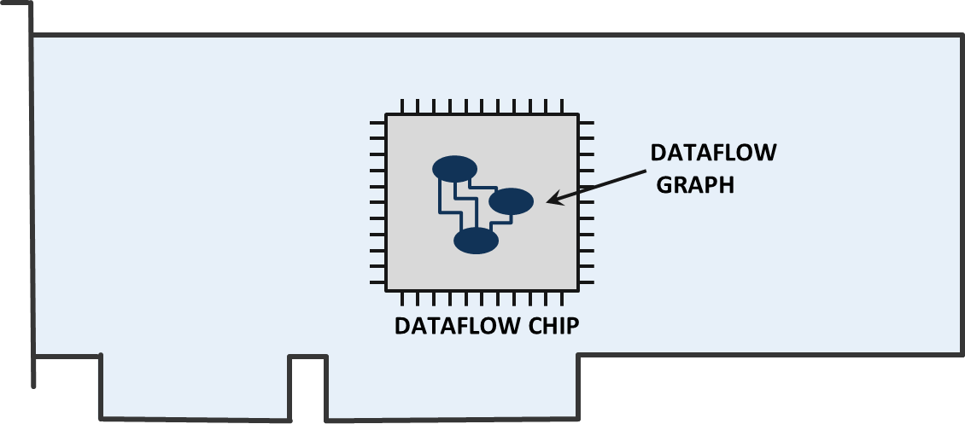
The Dataflow Engine
The dataflow graph as hardware

Slide 12
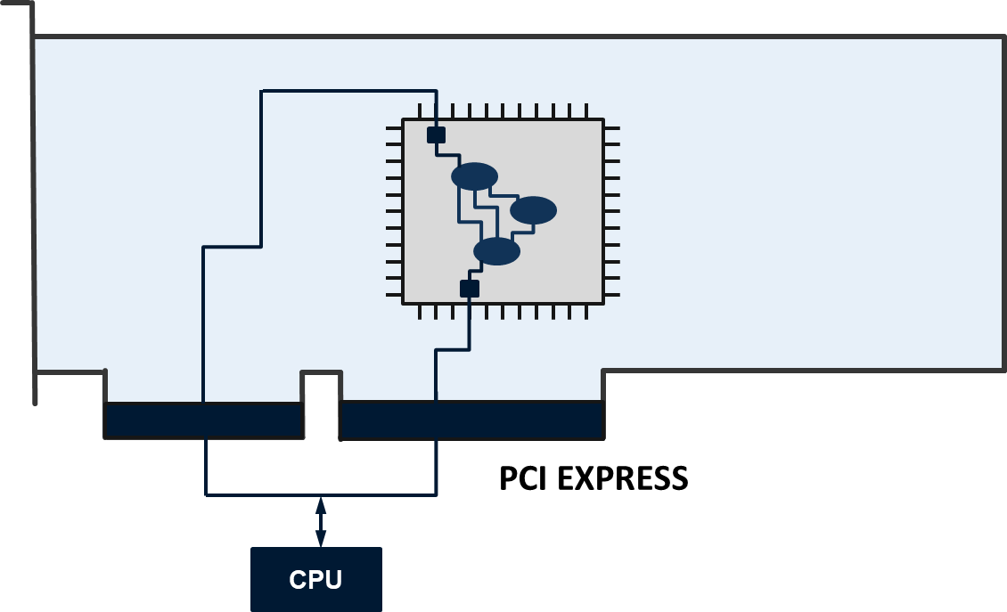
The Dataflow Engine
Communicate with a CPU through PCIe and the MaxelerOS API

Slide 13
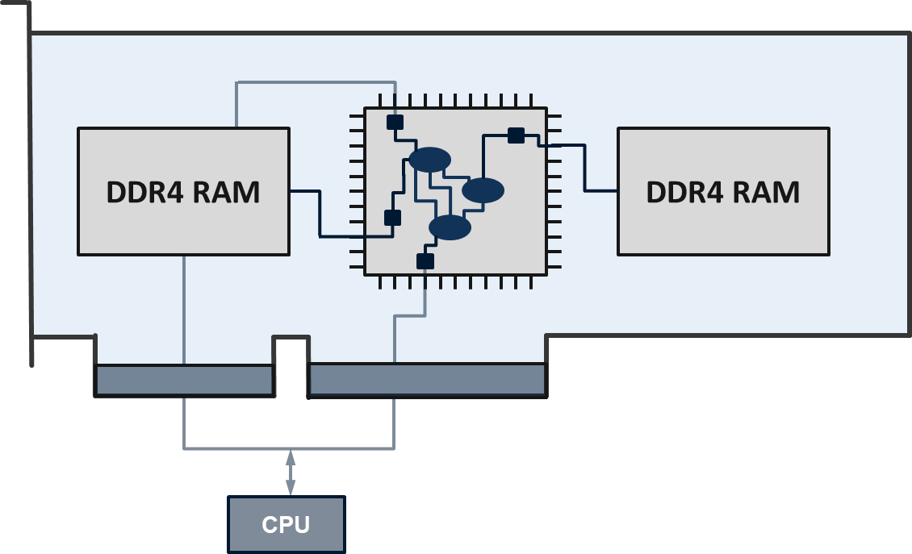
The Dataflow Engine
High-bandwidth connections to large on-card memory

Slide 14
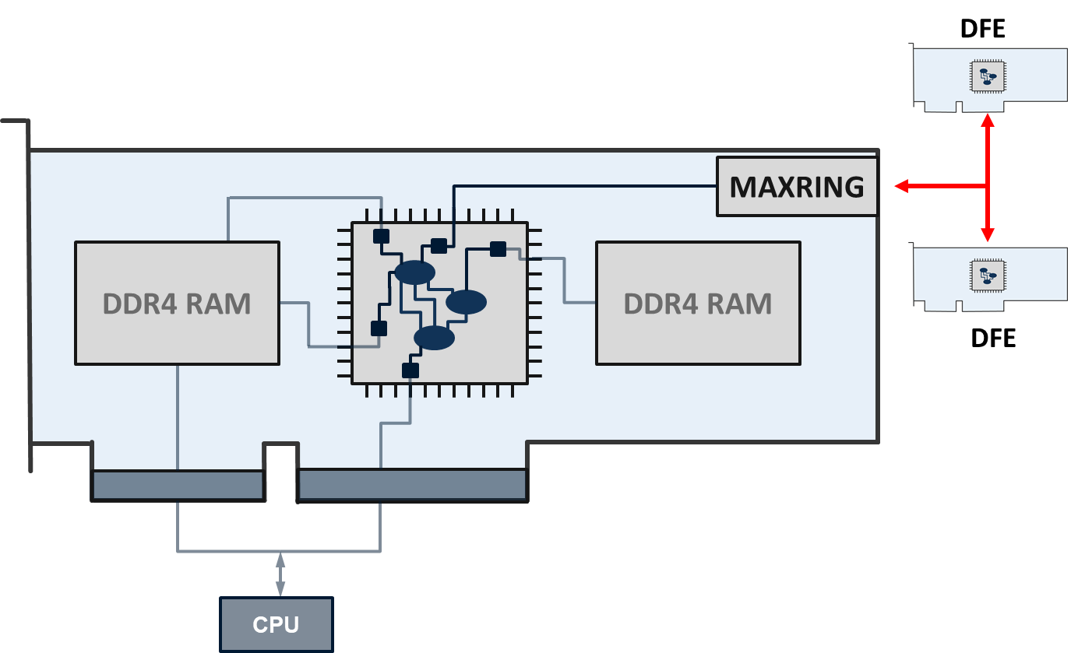
The Dataflow Engine
Two high-speed duplex interconnects to other DFEs through MaxRing

Slide 15
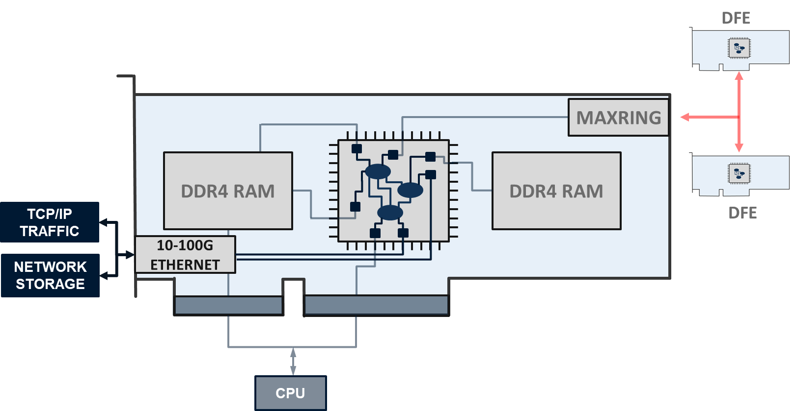
The Dataflow Engine
Optional networking hardware using MaxCompilerNet for frame decoding

Slide 16
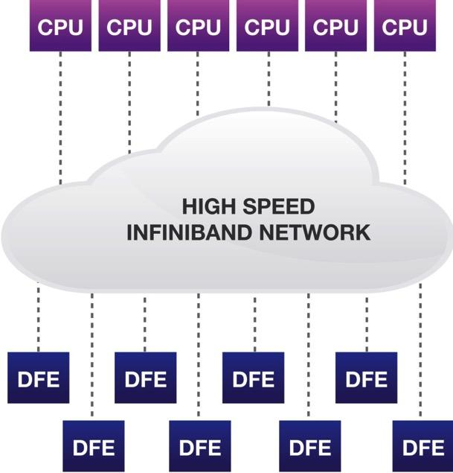
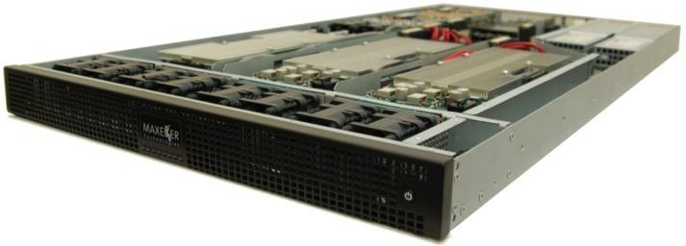
The Maxeler DFE
Dataflow appliance
MPC-X1000
8 Dataflow Engines in 1U
Up to 768 GB of DFE RAM
Dynamic allocation of DFEs to conventional CPU servers through Infiniband
Equivalent performance to 20-50 x86 servers

Slide 17
Strategic Partnerships
Cloud computing, networking and storage for enterprise solutions
Cloud Partnership with Amazon Web Services
F1 instance on Amazon EC2, Nov 2016
Latest-generation infrastructure, on-premise and in the cloud
Dual-source procurement, rapid scaling, hardware upgrades
Networking Partnership with Juniper
Compute-integrated TOR networking switch
Develop custom logic to process at line rate
Storage Partnership with Hitachi
Line rate dataflow systems integrated with highly configurable HCP Anywhere storage systems
Dataflow ingest can address regulatory challenges

Slide 18
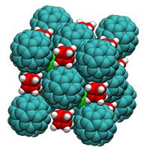
Dataflow Case Study
Quantum ESPRESSO
FORTRAN software package for
Ab initio quantum chemistry
Materials modeling
Focus on PWSCF program
Plane-wave basis set
Self-consistent field calculation
Iterative solve for multiple-electron wavefunctions
Reference system – Ta₂O₅
32,768 cores of BlueGene/Q
53m wall time
384 kW (25% cooling)

Slide 19
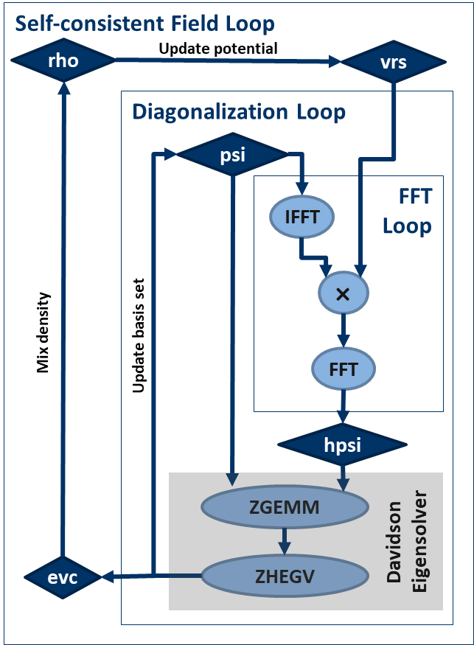
Loopflow Graph
Focus profiling on loop structure, not function calls
Function calls are control flow concept
30% of time is “calls to 3D FFT” – not useful
Map out major loops instead
Determine size of dataflows
FFT loop over wavefunctions
Low dataflow in/out compared to inside
One input (vrs) updated infrequently
Diagonalization loop
Wraps I/O from FFT loop
Large matrices are many GB
Reduced matrices are a few MB

Slide 20
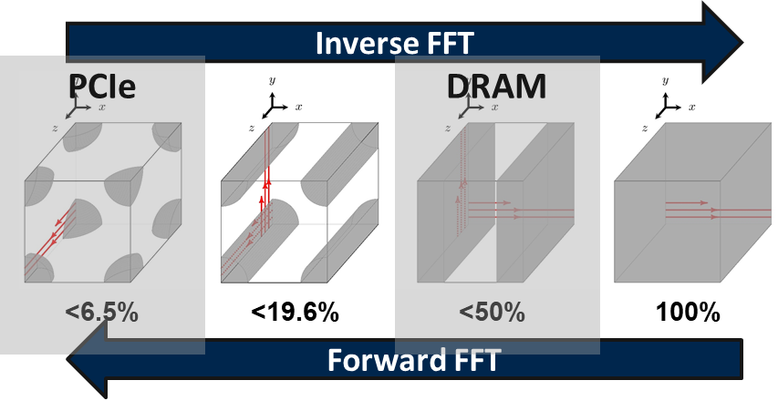
Optimize Memory
Identify data sizes to layout dataflow architecture
FFT grid = 256³ complex elements, 8 bytes each
One plane is 0.5 MB – fits in fast, on-chip FMem (up to 40 MB)
The whole cube is 128 MB – fits in large, on-board LMem (many GB)
Input/output wavefunctions are small compared to entire FFT domain
Only need to transfer 6% of the cube via PCIe
Use FMem for 2D transposes, no bandwidth constraint
Order of magnitude higher demand on DRAM bandwidth for 3D transpose

Slide 21
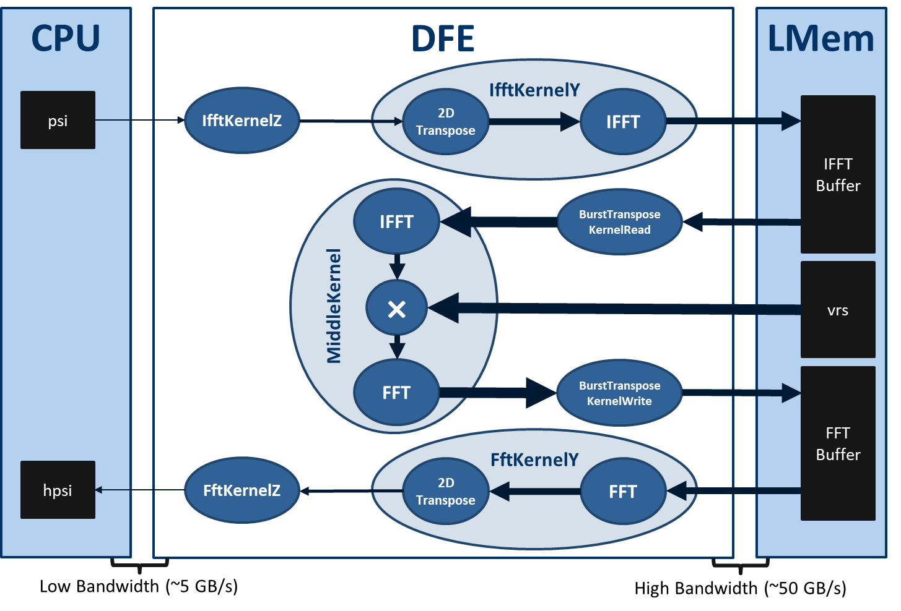
Dataflow Architecture
Match dataflows to available capacities and bandwidths

Slide 22
Performance Modeling
Predictable throughput determined by architecture
Simple spreadsheet model
Inputs are data sizes, bandwidths, frequencies
No guess work (no cache, no OS, etc)
3D FFT performance
Compute-bound with 1 pipe – 72 cubes/s
DRAM-bound with 3 pipes – 160 cubes/s
Reference: 42 cubes/s with 2,048 cores!
Energy efficiency up to 7344 MOPS/W
Top of Green500 only broke this in 2016

Slide 23
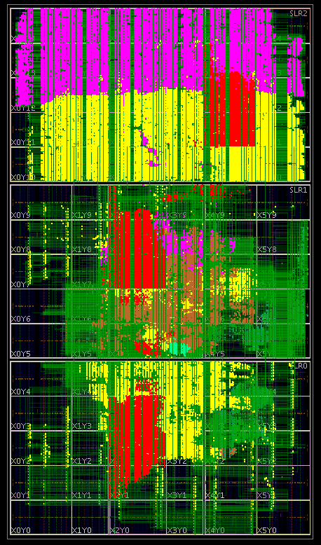
Maximum Performance Density
Utilize as much area as possible for compute
Control flow has fixed scale
Specific integer/float types, ops, etc
Fixed number of cores
Dataflow is multiscale
Choose data types to fit compute need
Operation-level parallelism
Wasted silicon is expensive – goal is 100%
Performance density enables:
Energy-efficient computing with low frequency
Pushing compute to the edge of IoT
 | Double | Single | Fixed
Complex bits | 128 | 64 | 54
Utilization
Logic | 63.5% | 23.9% | 7.7%
DSPs | 44.8% | 21.2% | 6.8%
Max Pipes | 1 | 3 | 12
Usage at Max | 64% | 72% | 92%

Slide 24
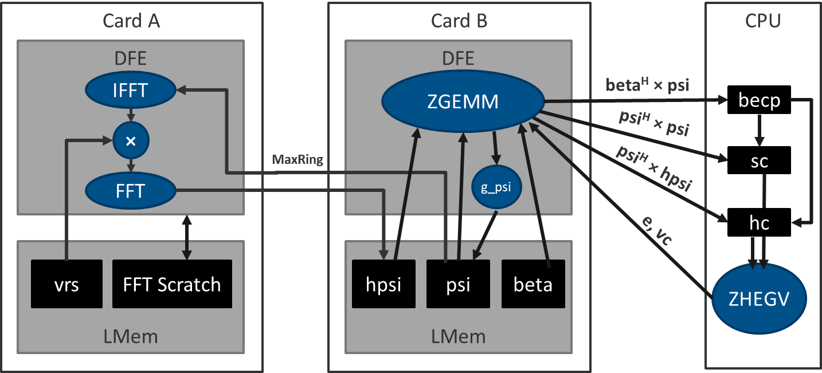
System Architecture
Scaling to a full solution
Add second DFE, move out one loop
High-capacity DRAM for large matrices
MaxRing for high-bandwidth duplex transfer between DFEs
Only transfer reduced matrices (MBs) over PCIe
Target: Replace 32,768 BlueGene cores with 48 DFEs + 16 CPUs
1x wall time
< 10kW total (40x)

Slide 25
AppGallery
Largest collection of dataflow applications
http://appgallery.maxeler.com/#/

Slide 26
MaxGenFD
Purpose-built finite difference suite for dataflow computing
Developed to serve energy industry
Finite-difference in 3D
Seismic study modeling
Layer over MaxJ/MaxCompiler
Science user codes FD equations in Java
Domain decomposition
Sharing of halo through MaxRing
Minimal dataflow knowledge required

Slide 27
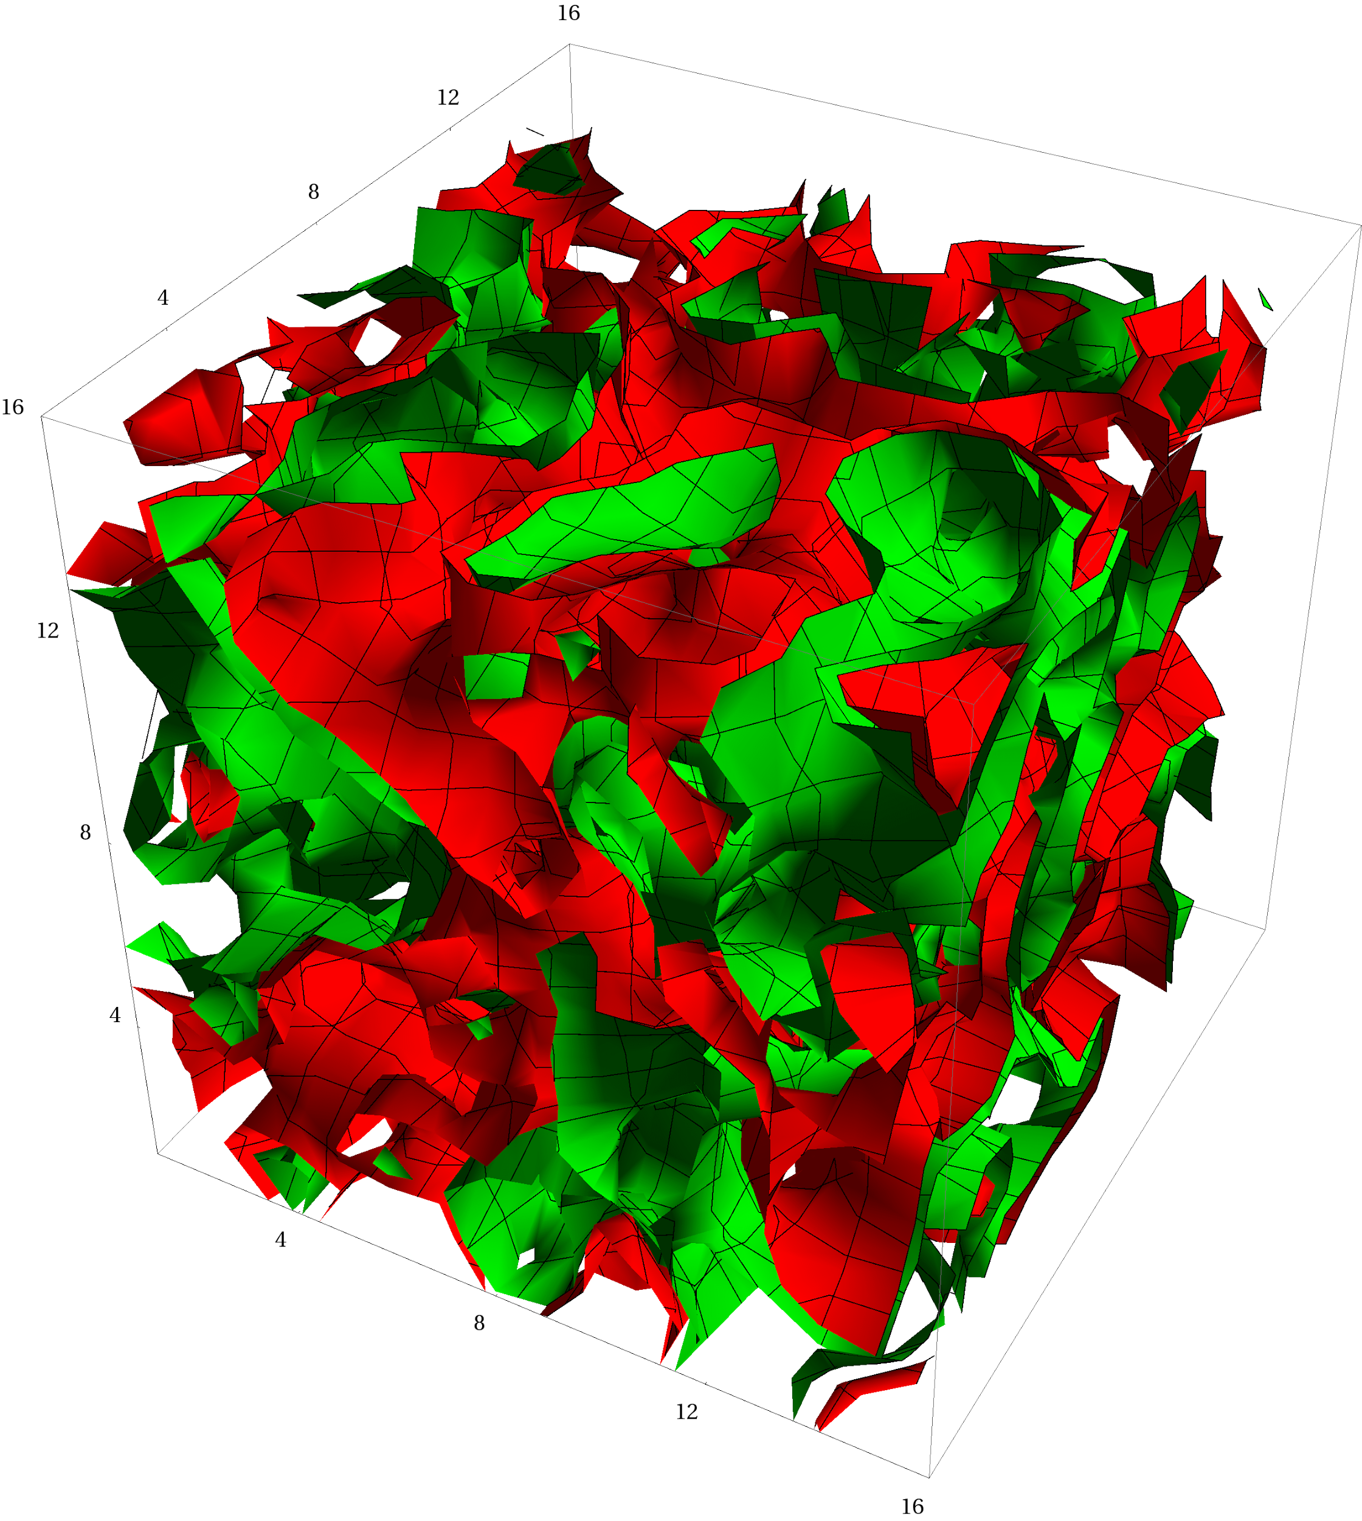
PRACE PCP
Designing the next generation of energy-efficient high performance computers
Began phase III in 2016: small-scale development
Porting four applications
Quantum ESPRESSO
Berlin QCD
NEMO
SPECFEM3D
Expect on the order of 50x improvements in energy-to-solution

Slide 28
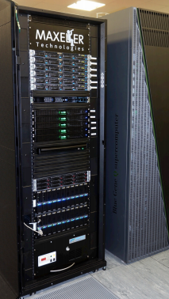
UK Science and Technology Facilities Council
World’s most energy efficient supercomputer, 2014
Deployed 2014, STFC Hartree center
8.97 GFLOPs/Watt
Beating top of Green500 at the time
Erasmus Brain Project
Simulate brain activity in silico
http://www.erasmusbrainproject.com/

Slide 29
Global Weather Simulation
An order of magnitude improvement over a leading supercomputer
L. Gan, H. Fu, W. Luk, C. Yang, W. Xue, X. Huang, Y. Zhang, and G. Yang, Accelerating solvers for global atmospheric equations through mixed-precision data flow engine, FPL2013
Joint research with Imperial College and Tsinghua University
Simulating the atmosphere using the shallow water equation
Platform | Speedup | Efficiency
6 Core CPU | 1x | 1x
Tianhe-1A Node | 23x | 15x
Maxeler MPC-X | 330x | 145x

Slide 30
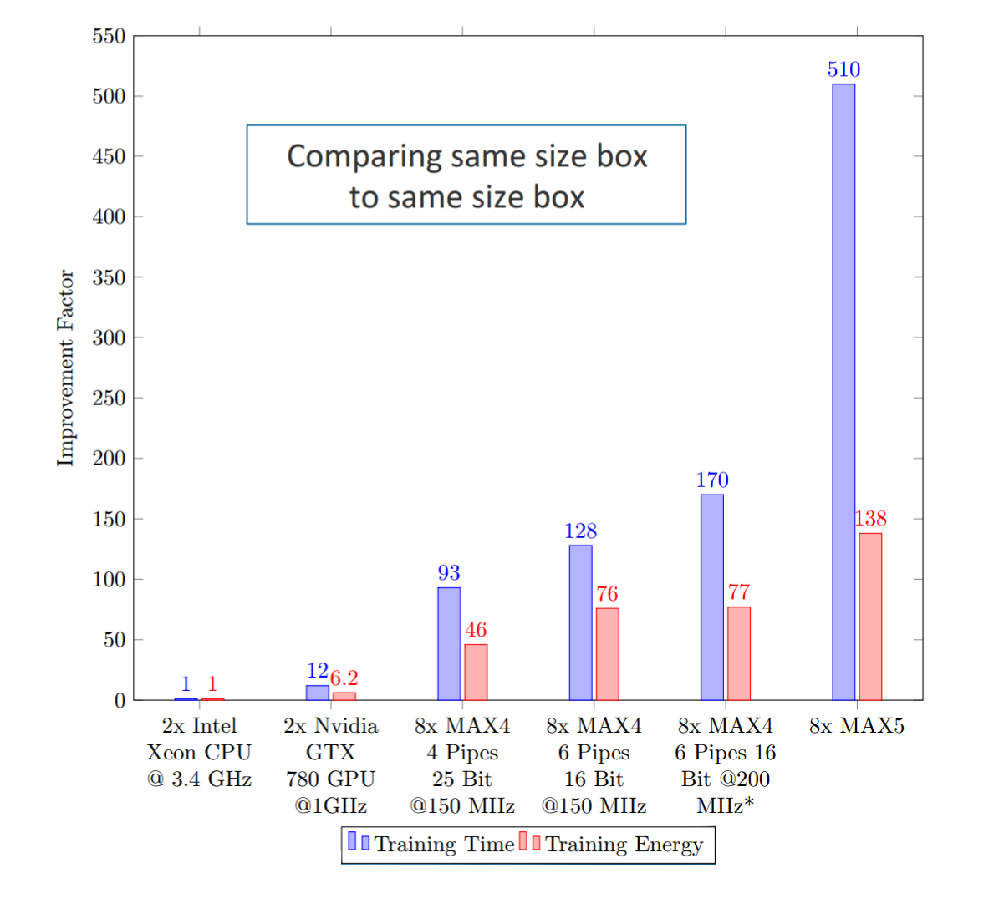
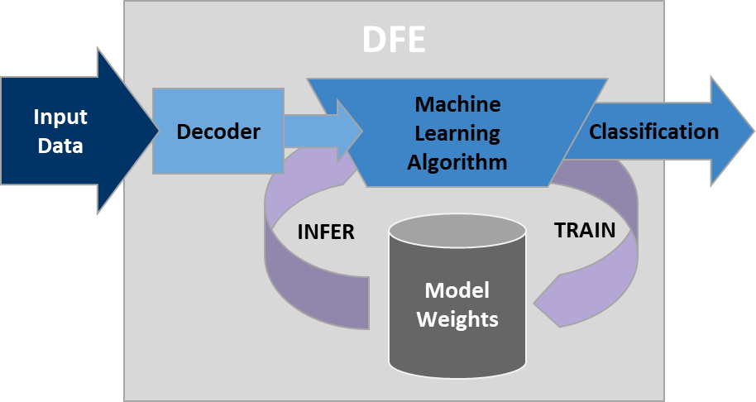
MaxML for Machine Learning
Order of magnitude improvements in training and inference
Machine learning on DFEs uses large-capacity memory and in-line training updates
Support for convolutional and fully connected layers
Choose the exact precision you need for maximum performance
Oskar Mencer @ The AI Conference and Expo, Boston, December 11-13, 2017.

