Slide 1
Maxeler Dataflow Programming for Amazon EC2 F1 Instances
Tobias Becker
Maxeler Technologies
Tutorial
FPL 2017

Slide 2
Overview
General introduction to Maxeler Dataflow Computing and MaxCompiler
Practical application porting and Loopflow graph analysis
Programming Amazon EC2 F1 instances with MaxCompiler and running applications on AWS

Slide 3
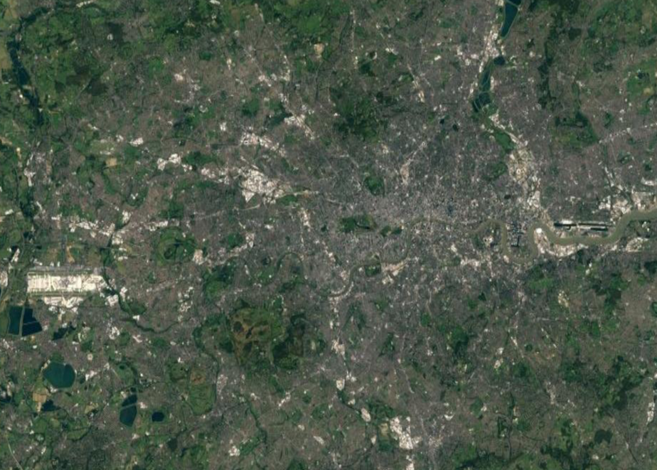
What Makes Computers Inefficient?
A Metaphor
Data
Work happens here!
Data
L1
L2
Data
Data

Slide 4
What Makes Computers Inefficient?
How about this?
Data
Data
Work happens here!
Work happens here!
Data
Data
L2
L1
L2
L1
Data
Data
Data
Data
Data
Data
Work happens here!
Work happens here!
Data
Data
L2
L1
L2
L1
Data
Data
Data
Data

Slide 5
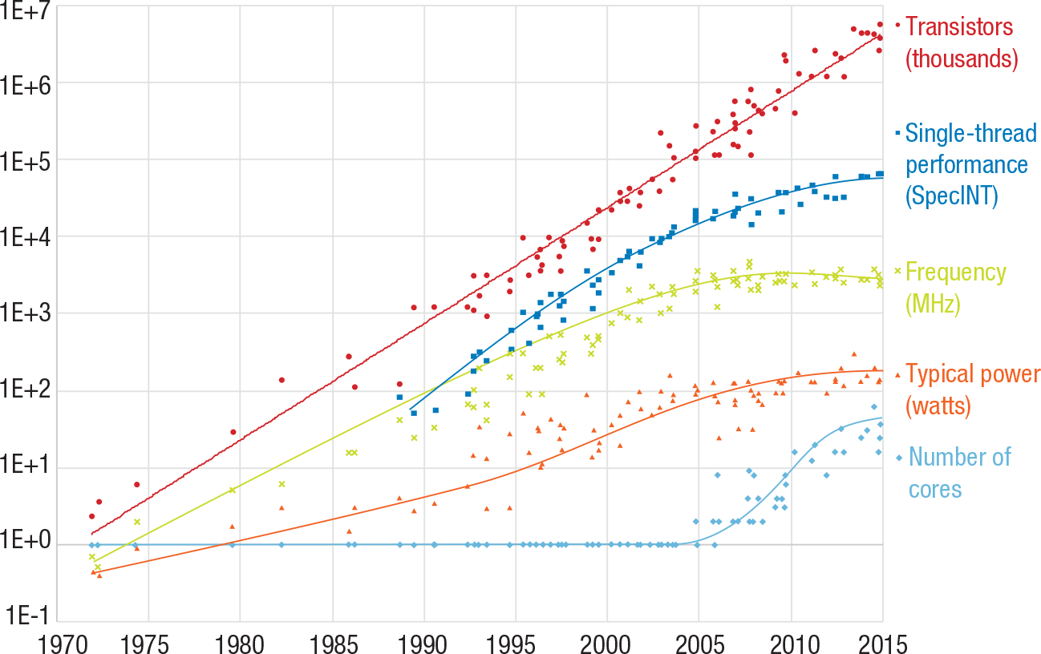
The End of Performance
Frequency levels off, cores fill in the gap
http://doi.ieeecomputersociety.org/10.1109/MC.2015.368
Notes:
But performance isn’t “free” anymore.
For the first 35 years in this chart, control flow performance scaled exponentially with growing frequency and a larger number of smaller transistors. If you had code that was portable enough, you could buy a new processor every year or two, recompile it and watch your runtime drop some measurable factor – the compiler did most of the work when instruction sets got better for example.
Since 2005, that pattern has broken down. Individual cores aren’t getting more powerful, and frequency has basically leveled off. Moore’s law still holds, we’re still adding transistors to a chip at a growing pace, but now we do it by duplicating the core n times. Theoretically, performance goes up, but now the programmer has to expose it directly by finding things for multiple threads to do asynchronously, it doesn’t just come from recompiling.

Slide 6
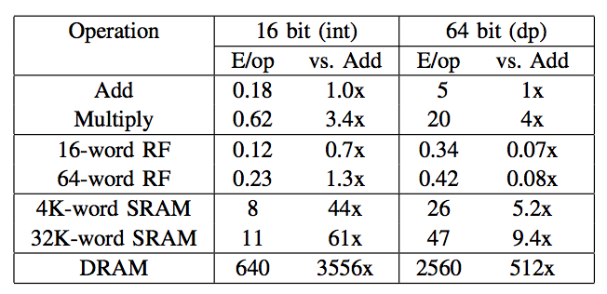
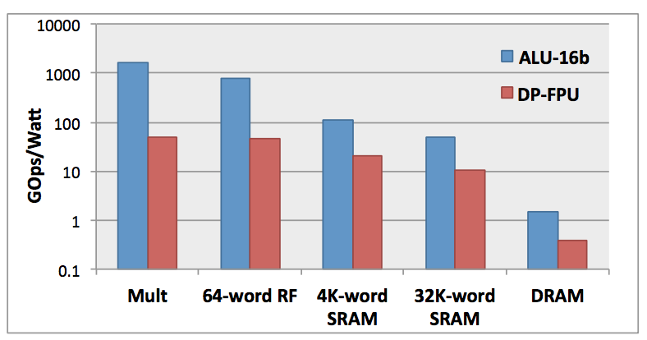
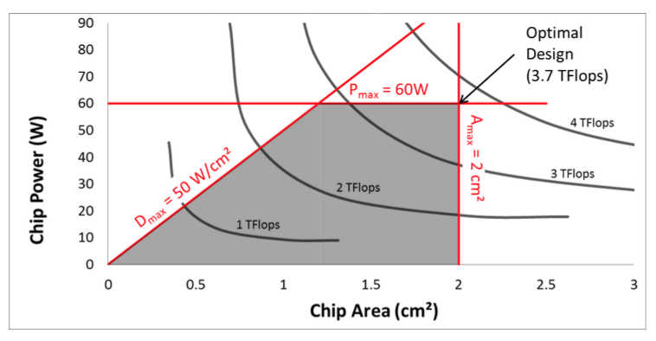
The real challenge: data movements
“As a result the most important optimization must be done at the algorithm level, to reduce off- chip memory accesses, to create Dark Memory. The algorithms must first be (re)written for both locality and parallelism before you tailor the hardware to accelerate them.”
In agreement with Intel:
“My hypothesis is that we can solve [the software crisis in parallel computing], but only if we work from the algorithm down to the hardware — not the traditional hardware first mentality.” Tim Mattson, principal engineer at Intel.
[Pedram, Richardson, Galal, Kvatinsky, and Horowitz, Dark Memory and Accelerator-Rich System Optimization in the Dark Silicon Era,
April 2016, IEEE Design & Test]

Slide 7
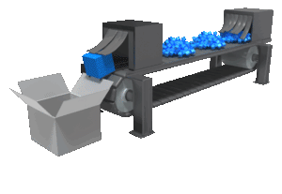
Data-Flow Computing
“Systolic Arrays” without nearest neighbour interconnect restrictions
Static ultra-deep (>1,000 stages) computing pipelines
One result
per clock cycle
Notes:
the benefit of this is high parallelism and things arrive exactly at the right time (minimizing movements)
this is how we address many “parallel” problems, e.g in car manufacturing

Slide 8
About Maxeler Technologies
Roots at Stanford University, Bell Labs,
and Imperial College London
Founded in 2003,
incorporated in Delaware and England
2006: starting Finite Difference project
with Chevron in San Ramon CA
2011: 20% stake to JP Morgan’s
strategic investments group (AFTA award for risk analytics)
2010: ENI (Italy) buys largest Maxeler Supercomputer
for Seismic Imaging
2014 Series B: CME Group, Juniper, Galaxis Capital
2016: Hitachi Data Systems, Amazon Web Services
Notes:
outline of company history

Slide 9
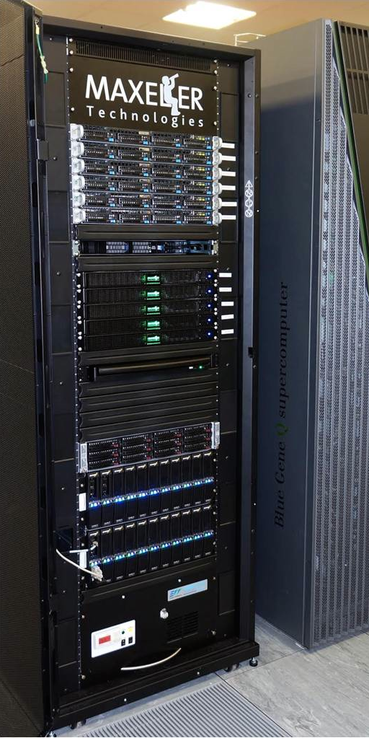
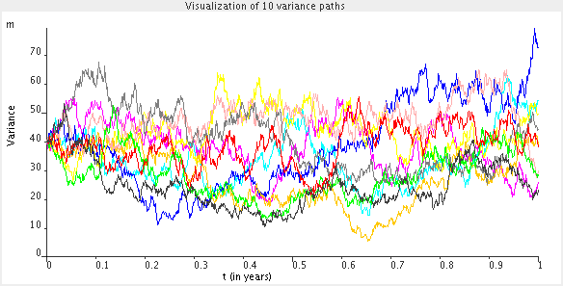
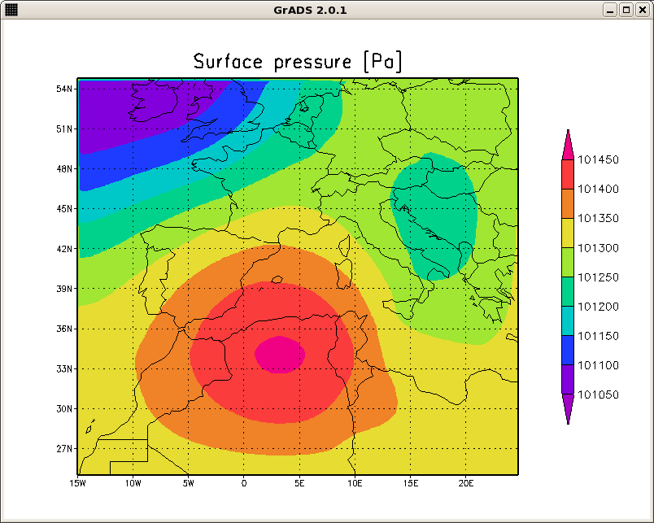
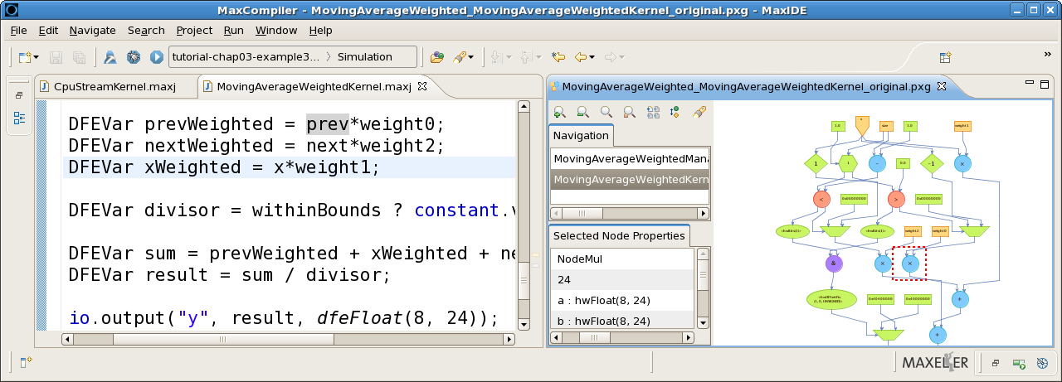
Maxeler’s offering
Dataflow computing systems Software & Applications

Slide 10
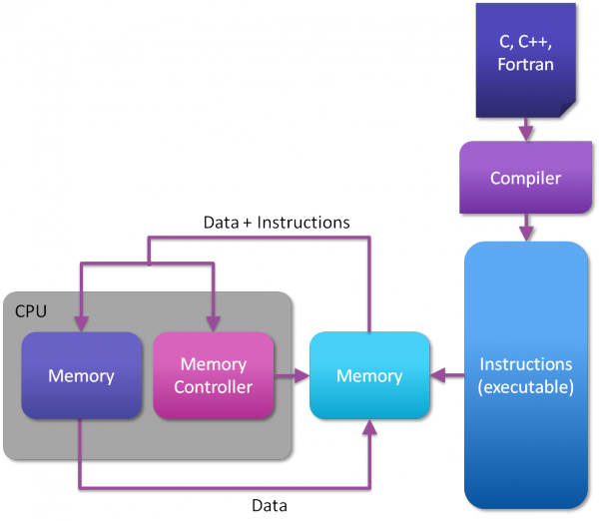
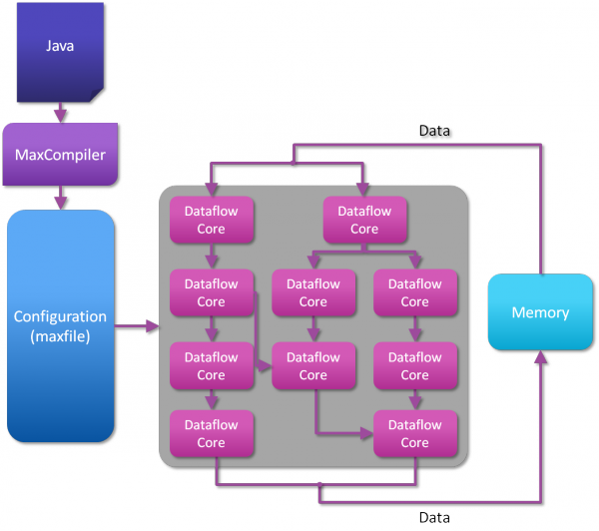
How to build a Dataflow Computer
control flow
data flow
Simple and general purpose
Forces sequential model
Wastes silicon area on ALU “life support”
Inefficient and unpredictable
Data moves continuously
No wasted silicon: maximum compute density
No wasted clock cycles: predictable speed
Optimal solution for a specific problem

Slide 11
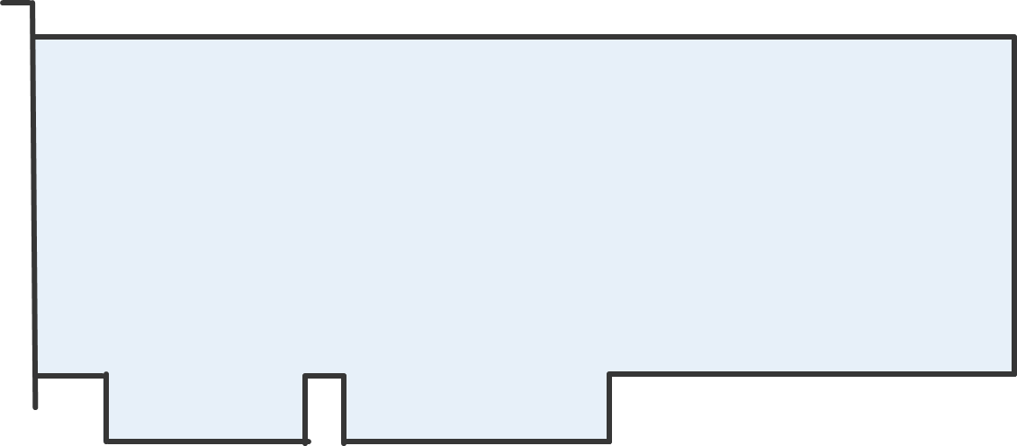
Building a Dataflow Computer
… from a Dataflow card

Slide 12
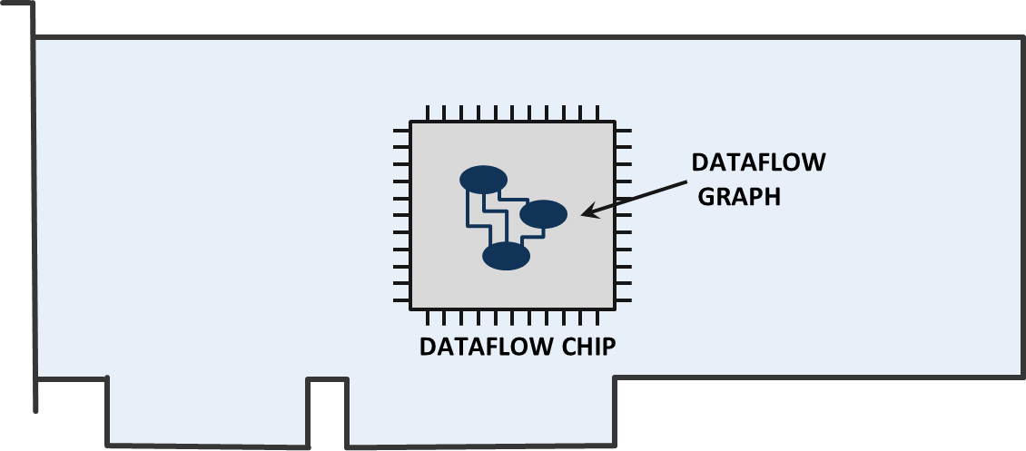
The Dataflow Engine
Compute kernels carry out dataflow computations

Slide 13
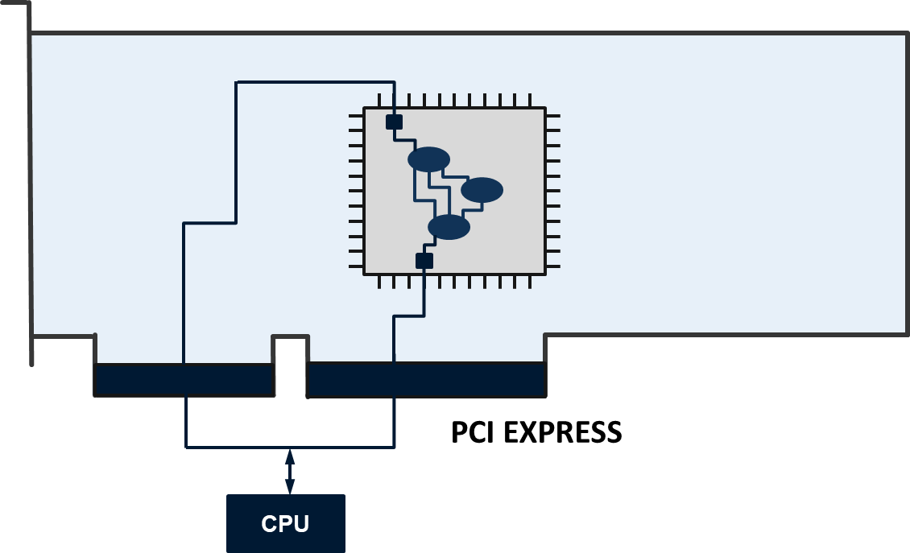
The Dataflow Engine
Streaming interface from CPU via PCIe

Slide 14
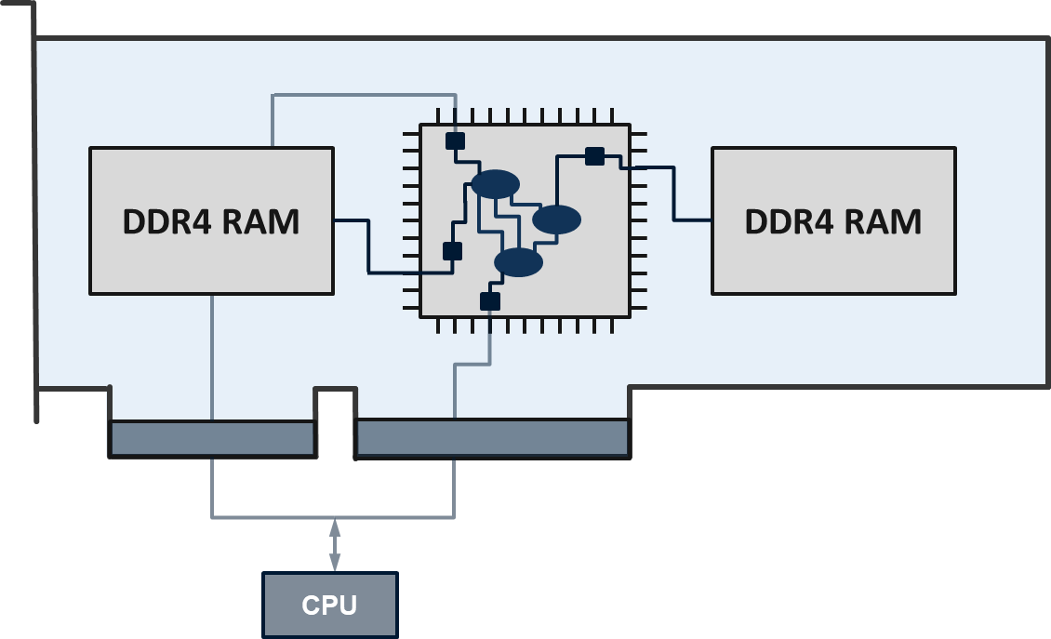
The Dataflow Engine
High-bandwidth access to local memory for large data sets

Slide 15
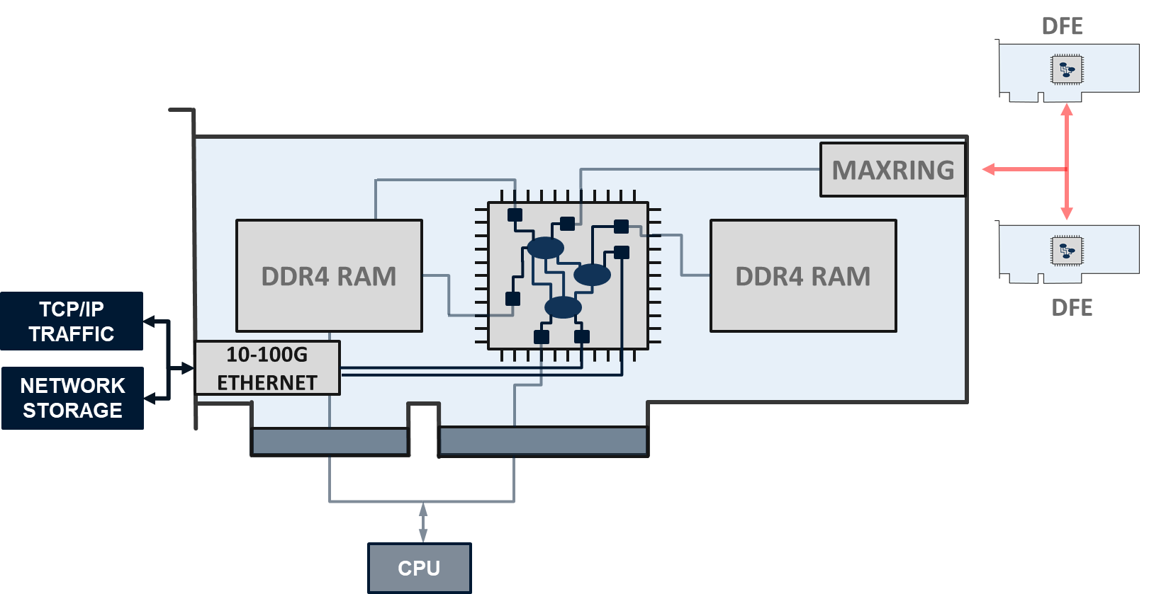
The Dataflow Engine
Optional networking and local MaxRing connections

Slide 16
MaxJ example: X² + 30
C Code:
for(int i=0; i<NumIterations; i++){
result[i] = x[i] * x[i] + 30;
}
x
x
DFEVar x = io.input("x", dfeInt(11));
DFEVar result = x * x + 30;
io.output("y", result, dfeInt(23));
30
+
y

Slide 17
Streaming Data through the Kernel
5 4 3 2 1 0
x
0
x
0
30
+
30
y
30

Slide 18
Streaming Data through the Kernel
5 4 3 2 1 0
x
1
x
1
30
+
31
y
30 31

Slide 19
Streaming Data through the Kernel
5 4 3 2 1 0
x
2
x
4
30
+
34
y
30 31 34

Slide 20
Streaming Data through the Kernel
5 4 3 2 1 0
x
3
x
9
30
+
39
y
30 31 34 39

Slide 21
Streaming Data through the Kernel
5 4 3 2 1 0
x
4
x
16
30
+
46
y
30 31 34 39 46

Slide 22
Streaming Data through the Kernel
5 4 3 2 1 0
x
5
x
25
30
+
55
y
30 31 34 39 46 55

Slide 23
MaxJ: Java meta-programming
You can use the full power of Java to write a program that generates the dataflow graph
Java statically evaluated
  variables can be used as constants in hardware
  int y; DFEVar x; x = x + y;
Java conditionals and loops choose how to generate hardware → not make run-time decisions
Need type to handle run-time data: DFEVar
  DFEVar variables can not be read in Java!
  Cannot do: int y; DFEVar x; y = x;

Slide 24
Java Variables
What’s the value of h if we stream in 1?
DFEVar x = io.input(“x”, type);
int s = 2;
s = s + 5;
x = x + 10;
x = x + s;
1
+
10
+
7
18
What’s the value of s if we stream in 1?
DFEVar x = io.input(“x”, type);
int s = 2;
s = s + 5;
x = x + 10;
s = x + s;
Compile error.
You can’t assign a hardware value to a Java int

Slide 25
Control Statements
x
class SimpleKernel extends Kernel {
SimpleKernel() {
DFEVar x = io.input(“x”, dfeFix(24));
DFEVar result = (x>10) ? x+1 : x-1;
io.output(“y”, result, dfeFix(25));
}
}
10
1
1
>
+
-
y

Slide 26
Example: Loops
What dataflow graph is generated?
DFEVar x = io.input(“x”, type);
DFEVar y = x;
for (int i = 1; i <= 3; i++) {
y = y + i;
}
io.output(“y”, y, type);
x
1
+
2
+
3
+
Can make the loop any size – until you run out of space on the chip!
Larger loops can be partially unrolled in space and reused multiple times in time
y

Slide 27
Scalar Inputs
Consider:
In fn2, we can change the value of C without recompiling, but it is constant for the whole loop
MaxCompiler equivalent:
void fn1(int N, int *q, int *p) {
for (int i = 0; i < N; i++)
q[i] = p[i] + 4;
}
void fn2(int N, int *q, int *p, int C) {
for (int i = 0; i < N; i++)
q[i] = p[i] + C;
}
VS.
d
DFEVar p = io.input(“p”, dfeInt(32));
DFEVar C = io.scalarInput(“C”, dfeInt(32));
DFEVar q = p + C;
io.output(“q”, q, dfeInt(32));
Written by host
C
+
A scalar input can be changed once per stream, loaded into the chip before computation starts.
q

Slide 28
On-chip memories / tables
A MAX5 DFE has a 40 MB of very fast SRAM on the chip
Can be used to explicitly store data on chip:
  Lookup tables
  Temporary Buffers
Mapped ROMs/RAMs can also be accessed by host
for (i = 0; i < N; i++) {
q[i] = table[ p[i] ];
}
d
Mapped ROM table
Written by host
DFEVar p = io.input(“p”, dfeInt(10));
DFEVar q = mem.romMapped(“table”, p,
dfeInt(32), 1024);
io.output(“q”, q, dfeInt(32));
q

Slide 29
Getting data in and out of the chip
In general we have streams, ROMs (tables) and scalars
Use the most appropriate mechanism for the type of data and required host access speed.
Stream inputs/outputs can operate for a subset of cycles using a control signal to turn them on/off
Type | Size (items) | Host write speed | Chip area cost
Scalar input/output | 1 | Slow | Low
Mapped memory (ROM / RAM) | Up to a few thousand | Slow | Moderate
Stream input/output | Thousands to billions | Fast | Highest

Slide 30
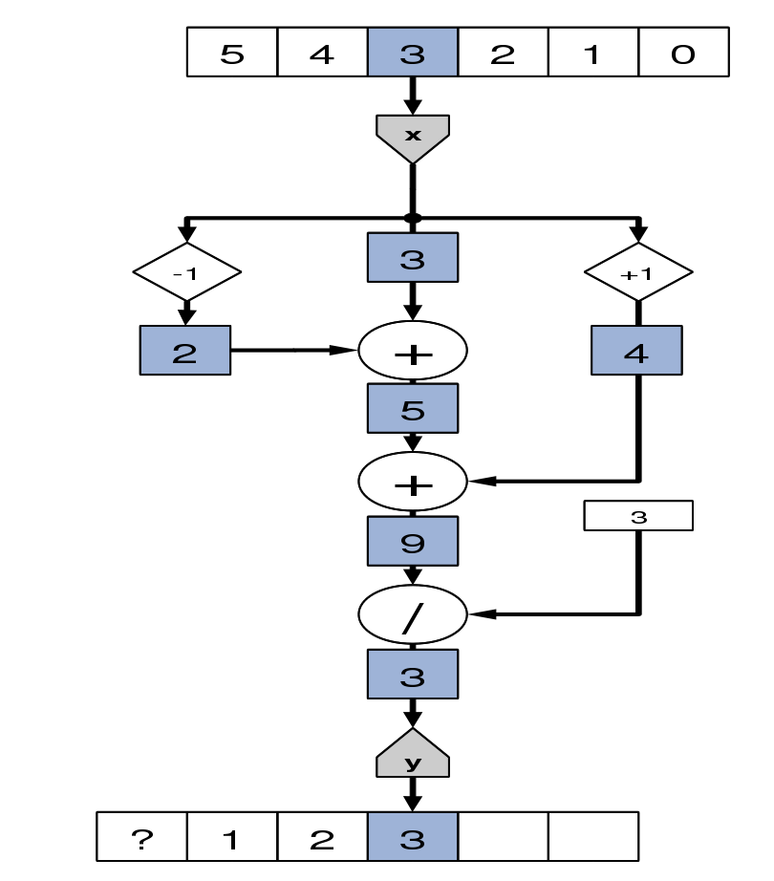
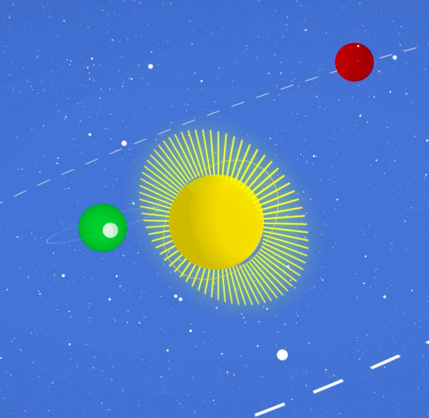
Stream Offsets Example: Moving Average
class MovingAvgKernel extends Kernel {
MovingAvgKernel() {
DFEVar x = io.input(“x”, dfeFloat(7,17));
DFEVar prev = stream.offset(x, -1);
DFEVar next = stream.offset(x, 1);
DFEVar sum = prev + x + next;
DFEVar result = sum / 3;
io.output(“y”, result, dfeFloat(7,17));
}
}
Notes:
extension of the Java language

Slide 31
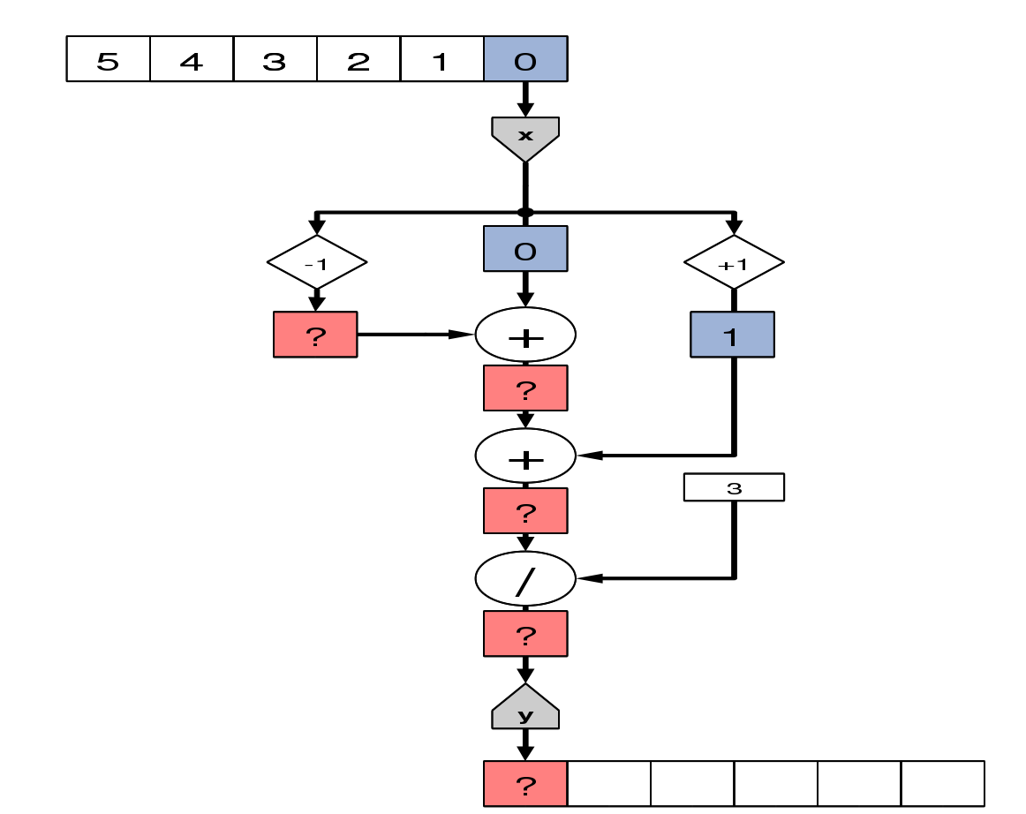
Kernel Execution

Slide 32
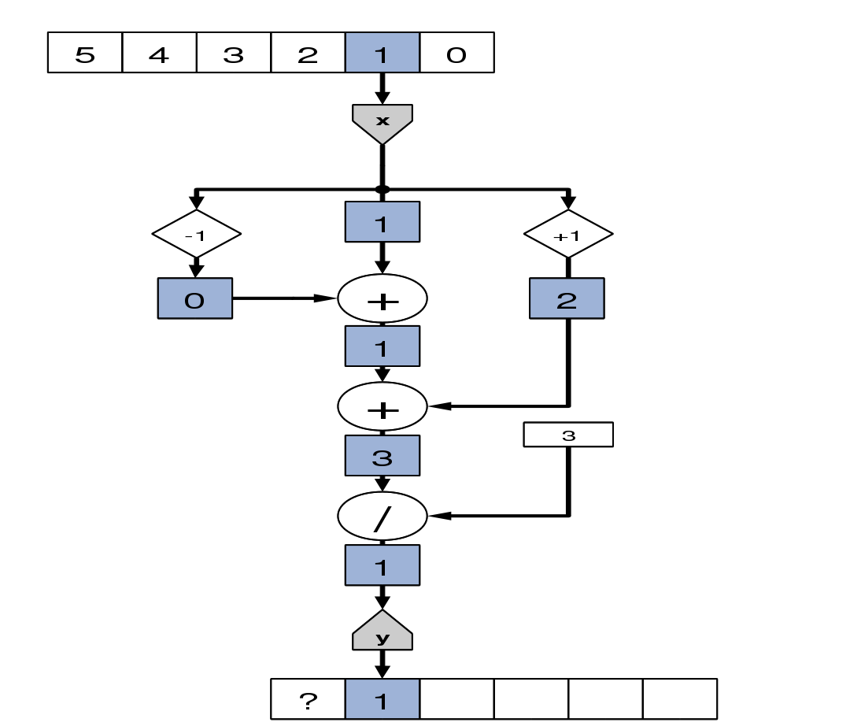
Kernel Execution

Slide 33
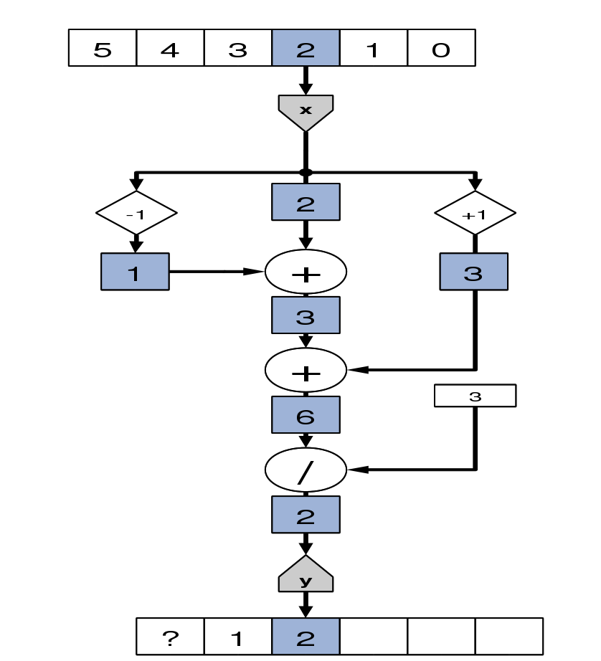
Kernel Execution

Slide 34
Kernel Execution

Slide 35
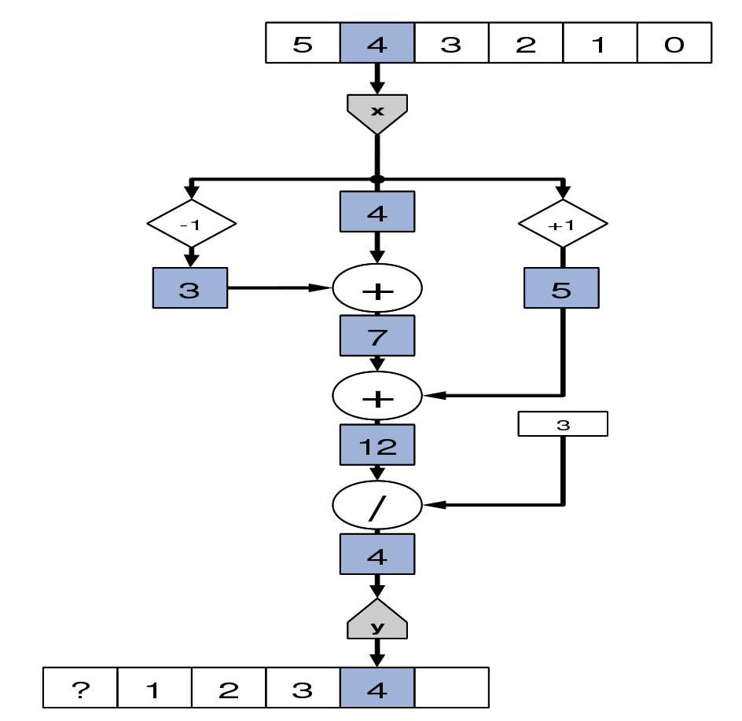
Kernel Execution

Slide 36
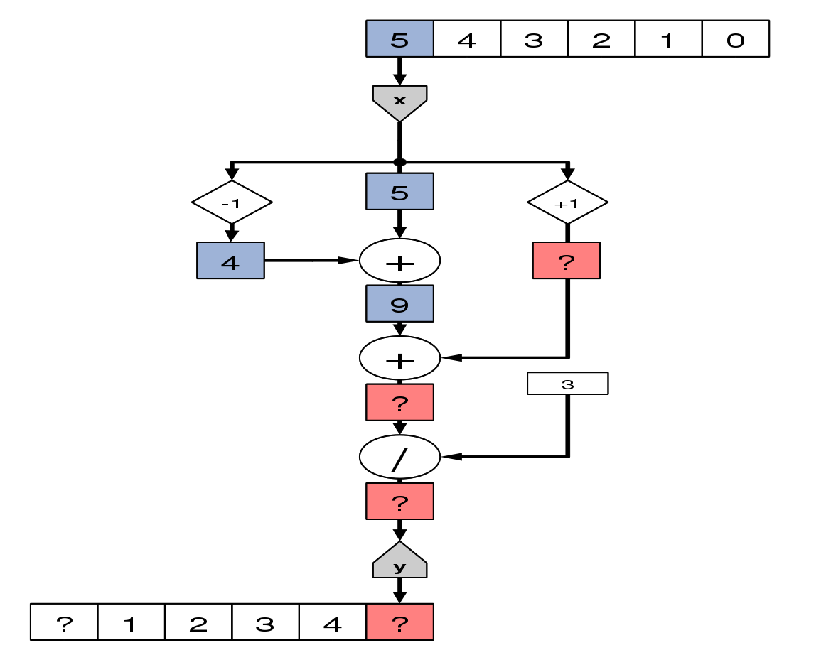
Kernel Execution

Slide 37
Kernel Handling Boundary Cases

Slide 38
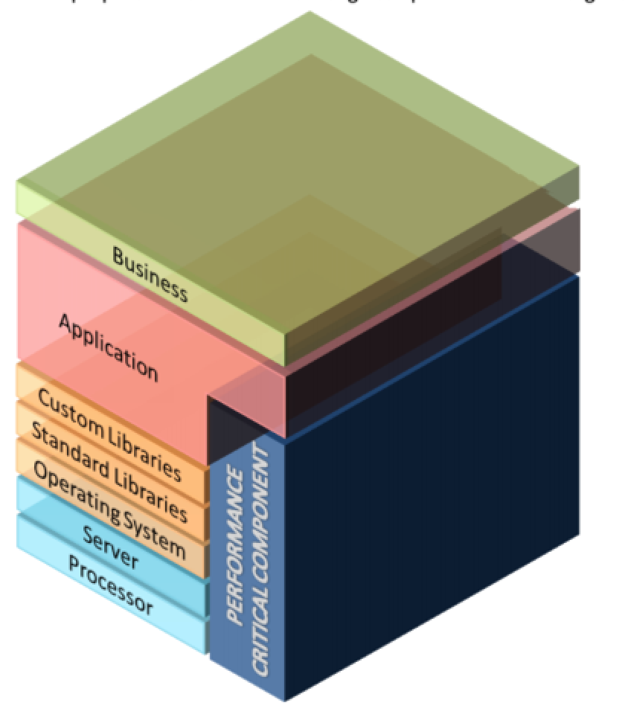
Thinking Vertically about Computing Problems
Co-optimise the HW and the SW stack for the performance critical areas of the application
Problem
Algorithm
?
Program in HL Language
Machine Architecture
Implementation
Circuits
Devices
Solutions
Solutions
Solutions
Solutions
Notes:
typically we develop applications on a existing stack of hardware, software and libraries,
here I come back to the Intel quote, if we just program an existing chip with an existing stack I get inefficient results
instead we cut across layers of abstraction and co develop architecture and algorithm
for instance I might change my algorithm for a star-based stencil to a cube because I’m IO limited but I can afford the extra compute

Slide 39
Dedicated optimisations
Multiple scales of computing | Important features for optimization
complete system level | balance compute, storage and IO
parallel node level | maximize utilization of compute and interconnect
microarchitecture level | minimize data movement
arithmetic level | tradeoff range, precision and accuracy = discretize in time, space and value
bit level | encode and add redundancy
transistor level | => create the illusion of ‘0’ and ‘1’
And more, e.g., trade Communication (Time) for Computation (Space)

Slide 40
Trading memory for compute resources
Computing f(x) in the range [a,b] with |E| ≤ 2⁻ⁿ
Table Table+Arithmetic Arithmetic
and +,-,×,÷
+,-,×,÷
uniform vs non-uniform
number of table entries
how many coefficients
polynomial or rational approx
continued fractions
multi-partite tables
Underlying hardware/technology changes the optimum

Slide 41
Number Representation
CPUs:
- Integer: unsigned, signed
- Floating Point: IEEE single-precision, double-precision
DFEs:
  Fixed point
  Logarithmic number representation
  Redundant number systems: use more bits, compute faster
    Signed-digit representation
    Residue number system (modulo arithmetic)
  Decimal: decimal floating point, binary coded decimal

Slide 42
Benefits of Fixed Point
Consider fixed point
compared to single precision floating point
If range is tightly confined,
we could use 24-bit fixed point
If data has a wider range, may need 32-bit fixed point
Arithmetic is not 100% of the chip. In practice, often see ~5x performance boost from fixed point.
 | dfeFloat(8,24) | dfeFixOffset(24,..) | dfeFixOffset(32,..)
Add | 500 logic cells | 24 logic cells | 32 logic cells
Multiply | 2 MULTs | 2 MULTs | 4 MULTs

Slide 43
Fixed-point bit-width exploration
Different parts are explored separately, i.e., when we investigate one part, we keep the bit-widths in other parts a constant high value
Similarly, we observe a significant drop of the error when the SQRT bit-width increases from 8 to 10
Similar precision thresholds observed in both synthetic and field results. This behavior enables an automatic tool to determine the minimum precision that still keeps the result good enough
[H.Fu, W. Osborne, R. G. Clapp, O. Pell, Accelerating Seismic Computations [], 70th EAGE Conference, Italy, 2008]

Slide 44
Development Process
CPU
Memory
x
CPU
Code
DFE
x
SLiC
MaxelerOS
Manager
30
PCI
Express
+
Main
Memory
x
y
y
Host Code (.c)
MyManager (.maxj)
MyKernel (.maxj)
Manager m = new Manager();
Kernel k =
new MyKernel();
m.setKernel(k);
m.setIO(
link(“x", CPU),
m.build();
DFEVar x = io.input("x", dfeInt(32));
DFEVar result = x * x + 30;
io.output("y", result, dfeInt(32));
int*x, *y;
link(“y", CPU));
for (int i =0; i < DATA_SIZE; i++)
y[i]= x[i] * x[i] + 30;
MyKernel(DATA_SIZE,
x, DATA_SIZE*4,
y, DATA_SIZE*4);

Slide 45
MaxCompiler Details
Host Application *.c, *.f90 ...
MyManager.maxj
MyKernel.maxj
MaxIDE
User Input
maxelerOS
Library
MaxCompiler
Compiler
SLiC
library
Linker
.max File
(Simulation or DFE)
Output
Executable

Slide 46

DFE Programming in MaxIDE
MaxCompiler – Java-driven dataflow compiler
SLiC Interface – CPU integration
MaxelerOS – optimized DFE <-> CPU link
Seamless simulation environment

Slide 47
How it maps to hardware
Mon 16:27: MaxCompiler version: 2012.2
Mon 16:27: Build “MyKernel" start time: Mon Apr 08 16:27:24 BST 2013
Mon 16:27: Main build process running as user training1 on host Maxworkstation7478
Mon 16:27: Build location: /home/training1/maxcompiler-builds/MyKernel
Mon 16:27: Instantiating manager
Mon 16:27: Instantiating kernel “MyKernel"
Mon 16:27: Compiling manager (CPU I/O Only)
Mon 16:27: Compiling kernel "MyKernel"
Mon 16:27: Generating input files (VHDL, netlists, CoreGen)
Mon 16:27: Running back-end build (12 phases)
Mon 16:27: (1/12) - Prepare MaxFile Data (GenerateMaxFileDataFile)
Mon 16:27: (2/12) - Synthesize DFE Modules (XST)
Mon 16:30: (3/12) - Link DFE Modules (NGCBuild)
Mon 16:30: (4/12) - Prepare for Resource Analysis (EDIF2MxruBuildPass)
Mon 16:30: (5/12) - Generate Preliminary Annotated Source Code
Mon 16:30: (6/12) - Report Resource Usage (ResourceCounter)
Mon 16:30: About to start chip vendor Map/Place/Route toolflow. This will take some time.
Mon 16:30: (7/12) - Prepare for Placement (NGDBuild)
Mon 16:30: (8/12) - Place and Route DFE (MPPR)
Mon 16:30: Executing MPPR with 1 cost tables and 1 threads.
Mon 16:30: MPPR: Starting 1 cost table
Mon 16:43: MPPR: Cost table 1 met timing with score 0 (best score 0)
Mon 16:43: (9/12) - Prepare for Resource Analysis (XDLBuild)
Mon 16:44: (10/12) - Generate Resource Report (ResourceUsageBuildPass)
Mon 16:44: (11/12) - Generate Annotated Source Code (ResourceAnnotationBuildPass)
Mon 16:44: (12/12) - Generate MaxFile (GenerateMaxFile)
Mon 16:45:
Mon 16:45: FINAL RESOURCE USAGE
Mon 16:45: LUTs: 9503 / 149760 (6.35%)
Mon 16:45: FFs: 12749 / 149760 (8.51%)
Mon 16:45: BRAMs: 34 / 516 (6.59%)
Mon 16:45: DSPs: 0 / 1056 (0.00%)
Mon 16:45:
Mon 16:45: MaxFile: /home/training1/maxcompiler-builds/MyKernel/results/MyKernel.max
(MD5Sum: e564cd922aeeda04acfa2f4ecce8236d)
Mon 16:45: Build completed: Mon Apr 08 16:45:58 BST 2013 (took 18 mins, 33 secs)
FPGA vendor specific
back-end tool flow
Abstracted by MaxCompiler

Slide 48
Resource Usage Reporting
Allows you to see what lines of code are using what resources and focus optimization
  Separate reports for each kernel and for the manager
LUTs FFs BRAMs DSPs : MyKernel.java
727 871 1.0 2 : resources used by this file
0.24% 0.15% 0.09% 0.10% : % of available
71.41% 61.82% 100.00% 100.00% : % of total used
94.29% 97.21% 100.00% 100.00% : % of user resources
:
: public class MyKernel extends Kernel {
: public MyKernel (KernelParameters parameters) {
: super(parameters);
1 31 0.0 0 : DFEVar p = io.input("p", dfeFloat(8,24));
2 9 0.0 0 : DFEVar q = io.input("q", dfeUInt(8));
: DFEVar offset = io.scalarInput("offset", dfeUInt(8));
8 8 0.0 0 : DFEVar addr = offset + q;
18 40 1.0 0 : DFEVar v = mem.romMapped("table", addr,
: dfeFloat(8,24), 256);
139 145 0.0 2 : p = p * p;
401 541 0.0 0 : p = p + v;
: io.output("r", p, dfeFloat(8,24));
: }
: }

Slide 49
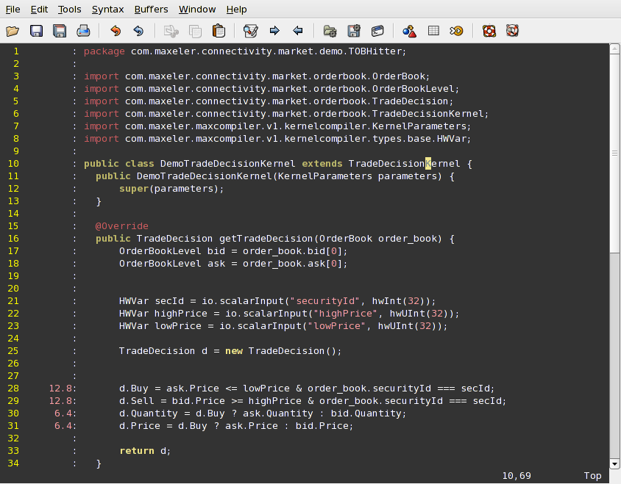
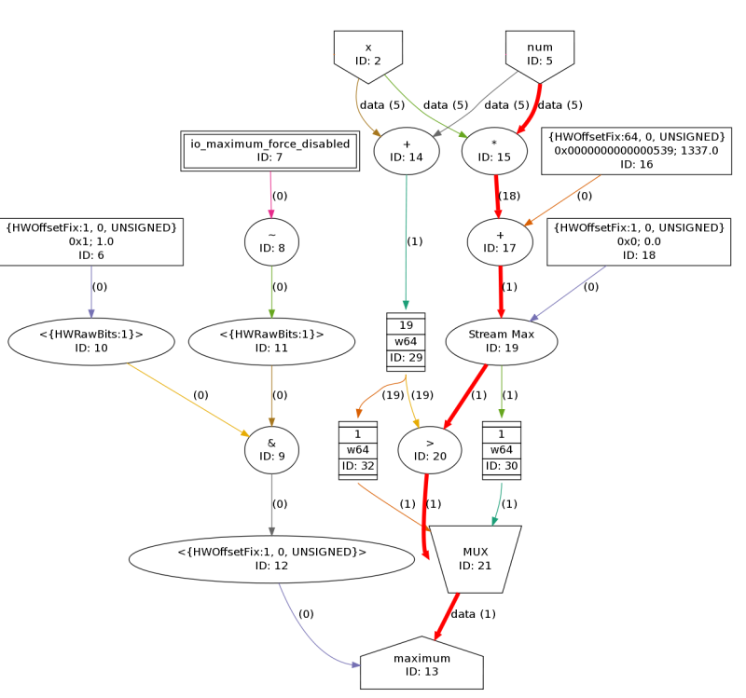
Optimization Feedback inside MaxIDE
MaxCompiler gives detailed latency and area annotation back to the programmer inside MaxIDE
Evaluate precise effect of code
on latency and chip area
+
=
12.8ns
6.4ns
19.2ns (total compute latency)

Slide 50
MaxJ to VHDL number of lines
 | MaxJ | VHDL | (note)
Gzip | 2,104 | 1,469,012 | -
FFT | 221 / 1,413 | 116,227 | without / with maxpower
BQCD (Dslash) | 3,889 | 556,404 | including ±1% MaxJ comments (50 lines)
Trace search | 2,343 | 463,998 | -
DNMO | 6,692 | 549,761 | -
RDO | 13,210 | 1,222,536 | -
ME | 3,246 | 1,269,657 | -
MC | 2,869 | 1,808,593 | -
PP | 7,917 | 1,276,930 | -
RTM | 399 | 842,435 | -
Matrix multiply | 398 | 388,206 | -
NEMO (zdf_loop8) | 361 | 94,856 | -
Notes:
also more production than OpenCL

Slide 51
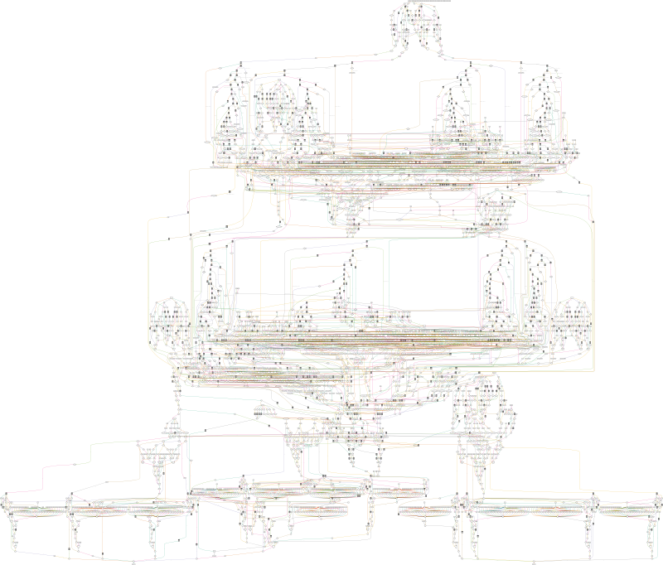
Enabling large scale dataflow designs
Real data flow graph as
generated by MaxCompiler
4866 nodes;
10,000s of stages/cycles

Slide 52
SLiC Interface: CPU <-> DFE API
Simple Live CPU Interface:
  Combination of fixed software function calls and
  MaxCompiler-generated code for interacting with DFEs
SLiC has a layered interface:
  Basic Static – Single function-call to execute and complete a compute action on any appropriate DFE available
  Advanced Static – Can be more specific about which DFE to use and enables use of multiple DFEs at once
  Dynamic – Remove dependency on generated code from MaxCompiler in .max-file for maximum flexibility
By default all functions in all layers can be used from C

Slide 53
Example SLiC Application
#include “Convolve.h"
#include "MaxSLiCInterface.h"
int main(void)
{
const int size = 384;
int sizeBytes = size * sizeof(float);
float *x, *y, *z1, *z2;
int coeff1 = 3, coeff2 = 5;
printf("Generating data...\n");
// Initialize x, y data
printf("Convolving on DFE...\n");
Convolve(size, coeff1, x, y, z1);
Convolve(size, coeff2, x, z1, z2);
printf("Done.\n");
return 0;
}
Choose a DFE configuration which gets linked into your CPU application
Call the DFE via standard function calls
Data will be transferred to/from the DFE automatically to carry out the computation

Slide 54
Simple Manager + CPU code
CPU code (.c)
Manager (.maxj)
#include “Convolve.h"
#include "MaxSLiCInterface.h"
int main(void)
{
const int size = 384;
int sizeBytes = size * sizeof(float);
float *x, *y, *z1, *z2;
int coeff1 = 3, coeff2 = 5;
printf("Generating data...\n");
// Allocate x,y,z of sizeBytes
// Initialize x, y data
printf("Convolving on DFE...\n");
Convolve(size, coeff1, x, y, z1);
Convolve(size, coeff2, x, z1, z2);
printf("Done.\n");
return 0;
}
public class ConvolveManager {
public static void main(String[] args) {
// Create kernel and manager
EngineParameters p = new EngineParameters(args);
Manager m = new Manager(p);
Kernel k = new ConvolveKernel(
m.makeKernelParameters());
// Set-up kernel I/O to/from CPU
m.setKernel(k);
m.setIO(
link("x", IODestination.CPU),
link("y", IODestination.CPU),
link("z", IODestination.CPU));
// Auto-generate simple SLiC interface
m.createSLiCinterface();
m.build();
}
}
SLiC function generated in MaxFile
void Convolve(int32_t param_N, double inscalar_ConvolveKernel_a,
const float* instream_x, const float* instream_y,
float* outstream_z);

Slide 55
Advanced Static SLiC Level
CPU code (.c)
Manager (.maxj)
#include “Convolve.h"
#include "MaxSLiCInterface.h"
int main(void)
{
...
printf("Convolving on DFE...\n");
// Create actions
Convolve_actions_t act1 = {size,coeff1,x,y,z1};
Convolve_actions_t act2 = {size,coeff2,x,z1,z2};
// Load DFE
max_file_t* maxfile = Convolve_init();
max_engine_t *eng = max_load(maxfile, "*");
// Run actions
Convolve_run(eng, &act1);
Convolve_run(eng, &act2);
// Unload DFE
max_unload(eng);
max_file_free(maxfile);
printf("Done.\n");
return 0;
}
public class ConvolveManager {
public static void main(String[] args) {
// Create kernel and manager
EngineParameters p = new EngineParameters(args);
Manager m = new Manager(p);
Kernel k = new ConvolveKernel(
m.makeKernelParameters());
// Set-up kernel I/O to/from CPU
m.setKernel(k);
m.setIO(
link("x", IODestination.CPU),
link("y", IODestination.CPU),
link("z", IODestination.CPU));
// Auto-generate simple SLiC interface
m.createSLiCinterface();
m.build();
}
}
SLiC actions structs and run function generated in MaxFile
typedef struct {
int32_t param_N; double inscalar_ConvolveKernel_a;
const float* instream_x; const float* instream_y;
float* outstream_z;
} Convolve_actions_t;
void Convolve_run(max_engine_t *engine,
Convolve_actions_t *interface_actions);

Slide 56
Different Stages of using an Engine
CPU code (.c)
Any use of a DFE has the same basic stages
  Initialize MaxFile data structure
  Load MaxFile onto a DFE
  Run one or more actions
  Unload DFE
  Free MaxFile
Actions are structs that can be created separately from being run
#include “Convolve.h"
#include "MaxSLiCInterface.h"
int main(void)
{
...
printf("Convolving on DFE...\n");
// Create actions
Convolve_actions_t act1 = {size,coeff1,x,y,z1};
Convolve_actions_t act2 = {size,coeff2,x,z1,z2};
// Load DFE
max_file_t* maxfile = Convolve_init();
max_engine_t *eng = max_load(maxfile, "*");
// Run actions
Convolve_run(eng, &act1);
Convolve_run(eng, &act2);
// Unload DFE
max_unload(eng);
max_file_free(maxfile);
printf("Done.\n");
return 0;
}

Slide 57
Advanced Dynamic Level
CPU code (.c)
Same semantics as Advanced Static, but
Actions are now dynamically created objects
  Init action object
  Set values in action
  Run action
  (and reuse if desired)
  Free action object
#include “Convolve.h"
#include "MaxSLiCInterface.h"
int main(void)
{
...
printf("Convolving on DFE...\n");
// Set-up action
max_file_t* maxfile = Convolve_init();
max_actions_t* act1 = max_actions_init(maxfile, "default");
max_set_param_uint64t(act1, "N", size);
max_set_double(act1, "ConvolveKernel", "a", coeff1);
max_queue_input(act1, "x", x, sizeBytes);
max_queue_input(act1, "y", y, sizeBytes);
max_queue_output(act1, "z", z1, sizeBytes);
// Load DFE
max_engine_t *eng = max_load(maxfile, "*");
// Run action
max_run(eng, act1);
// Unload DFE
max_unload(eng);
// Free action
max_actions_free(act1);
printf("Done.\n");
return 0;
}

Slide 58
Comparing SLiC Levels
 | Basic Static | Advanced Static | Advanced Dynamic
Operating model | Simple function call | Construct actions object and run on engine
Engine loads | On first use, can’t control which DFE | Explicitly on max_load
Engine unloads | On process exit | Explicitly on max_unload
Actions are | Not needed | Struct | Object
Complexity | Simplest, easiest | Moderate | Complex
Flexibility | Low | Medium | High
Dependency on specific MaxFile | High | High | Low
Main uses | Simple applications or self-contained functionality | Applications needing explicit control over which DFEs are used or what actions are run | Maximum control over actions, debugging and for meta-programming with maxfiles

Slide 59
Non-blocking
Non-blocking run functions return immediately, allowing CPU execution to continue
Functions return a run handle
  At some point later must wait or nowait this handle
Advanced Static CPU code (.c)
Advanced Dynamic CPU code (.c)
int main(void)
{
...
Convolve_actions_t a1, a2, a3;
// Load DFE and prepare actions to run
max_wait_t* w1 = Convolve_run_nonblock(eng, &a1);
max_wait_t* w2 = Convolve_run_nonblock(eng, &a2);
max_wait_t* w3 = Convolve_run_nonblock(eng, &a3);
// Run other computation on CPU in parallel
...
// Synchronize when last action has completed
max_nowait(w1);
max_nowait(w2);
max_wait(w3);
...
}
int main(void)
{
...
max_actions_t* a1, a2, a3;
// Load DFE and prepare actions to run
max_wait_t* w1 = max_run(eng, a1);
max_wait_t* w2 = max_run(eng, a2);
max_wait_t* w3 = max_run(eng, a3);
// Run other computation on CPU in parallel
...
// Synchronize when last action has completed
max_nowait(w1);
max_nowait(w2);
max_wait(w3);
...
}

Slide 60
Arrays of DFEs
Fixed size set of engines loaded with the same MaxFile
MaxRing connections between engines in the array
The whole array can be run with a single command
Advanced static & dynamic interfaces only
  Load with max_load_array
  Run with <MaxFile>_run_array (static) or max_run_array (dynamic)

Slide 61
Groups
Groups are pools of engines with the same MaxFile that can be shared
  Multiple processes on multiple nodes can share multiple DFEs
Can have a fixed size, or can change size dynamically depending on demand at run-time
A single process can lock an engine from a group
  Provides exclusive use for the duration of the lock
Useful for optimizing execution of short actions where DFEs all have the same state e.g. searching

Slide 62
SLiC Skins
Enable SLiC calls across many languages:
  Currently: C, Python, MATLAB, R
  Upcoming: Java, Excel
Any .max-file usable from any supported language
.max file
SLiC-Compile
tool
MATLAB:
.mex + .m
C/C++:
.o
Python:
.py + .so
R:
.tar.gz

Slide 63
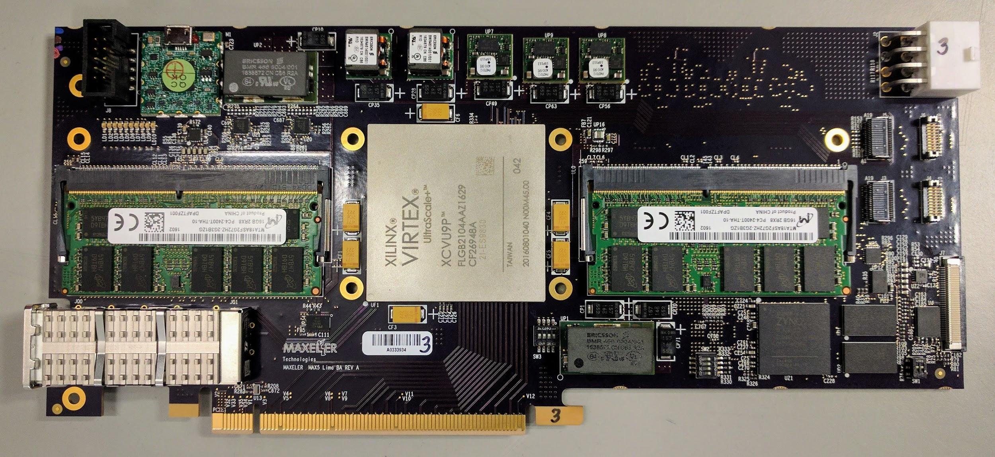
The DFE hardware

Slide 64
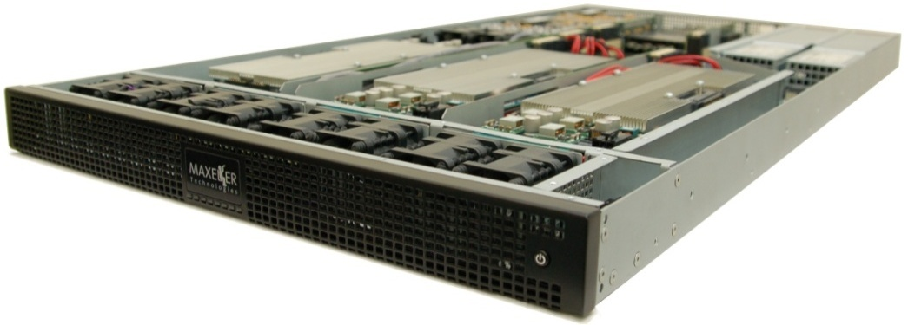
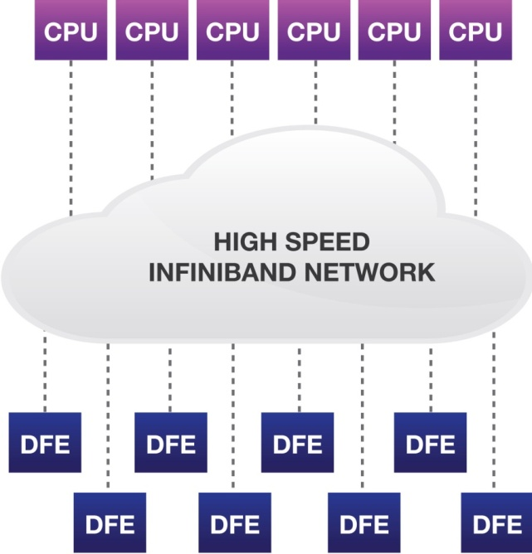
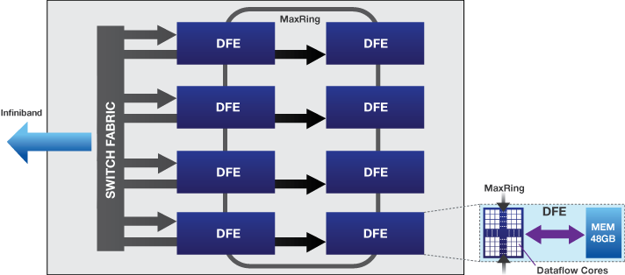
MPC-X2000
8 MAX4 DFEs (up to 768GB RAM)
High-speed MaxRing
Zero-copy RDMA between
CPUs and DFEs over Infiniband
Dynamic CPU/DFE balancing
Notes:
very dense unit
connect to standard servers via Infiniband
flexible scaling, vary number of CPU servers and MPC-Xs

Slide 65
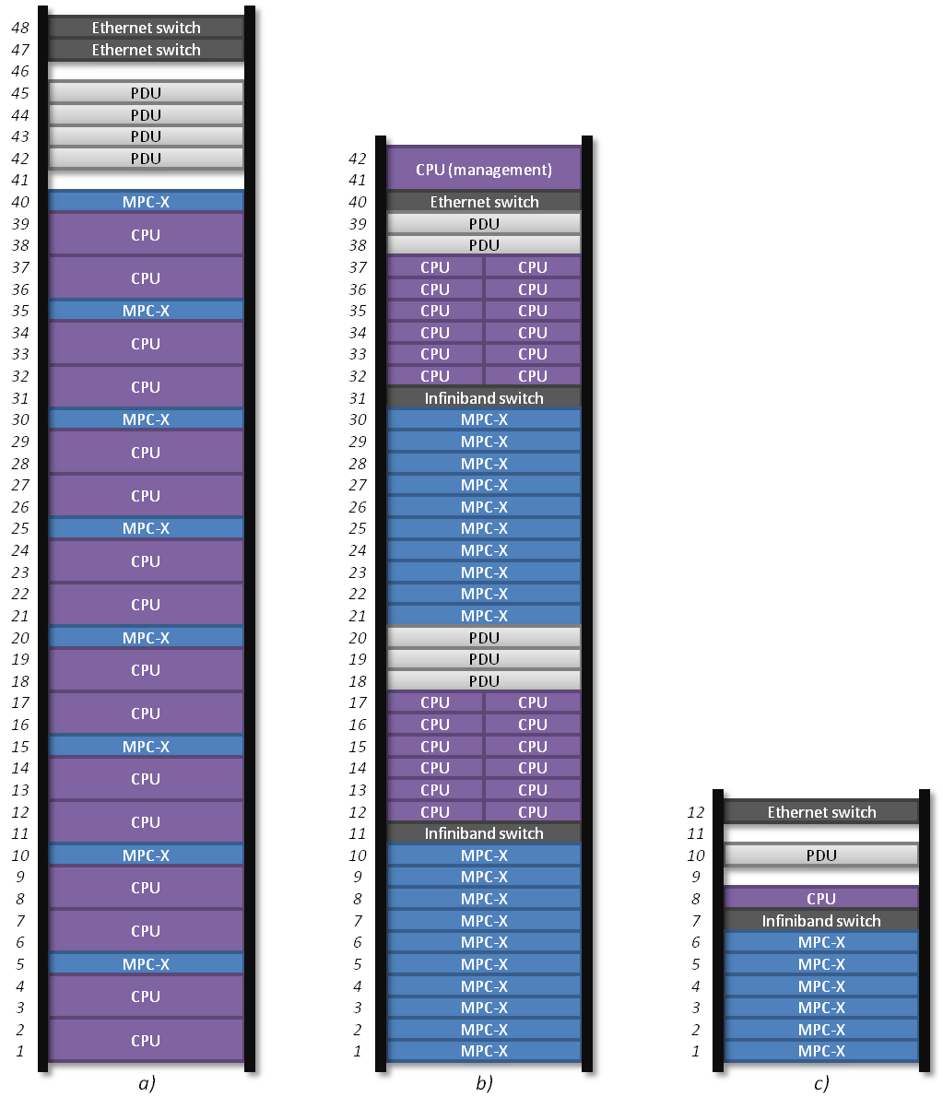
Rack-level optimisation
Optimized to balance resources for particular application challenges
Flexible at design-time and at run-time
48U seismic imaging cluster
42U in-memory analytics cluster
Notes:
rack can be optimised to application requirements

Slide 66
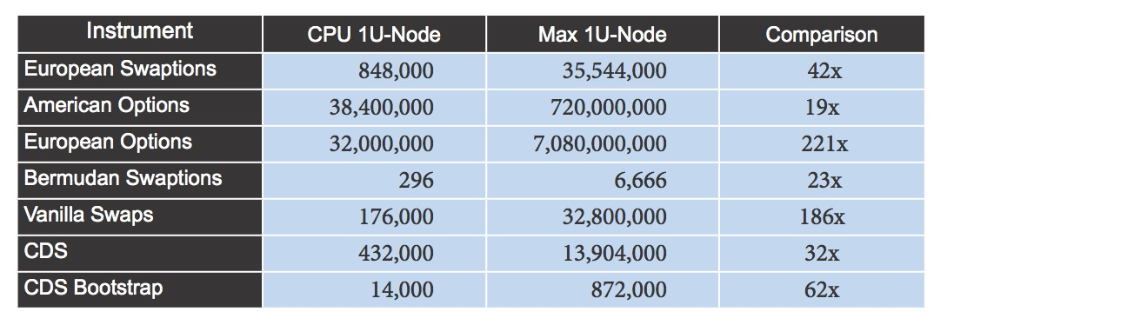
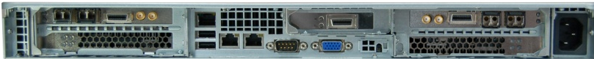
Finance: Risk Analytics Platform
Combine Trading and Risk in a unified platform
see www.hotchips.org, 2013 at Stanford, deployment at CME Group
http://www.cmegroup.com/trading/interest-rates/dsf-analytics.html
Moving risk computations from local overnight to corporation global
in real-time, moving traders from looking back to looking forward.
Prop
customer
data
Trade
data
Price calculations per second
Market data
Real-time risk reports
Wall Street Journal, Maxeler Makes Waves With Dataflow Design,
American Finance Technology Award, New York, Dec 2011
Notes:
here is an example from finance
basically and application or domain specific appliance

Slide 67
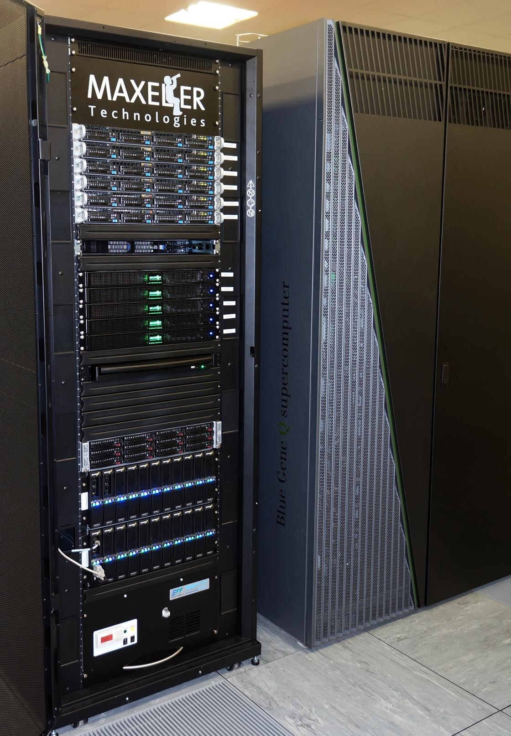
Dataflow HPC at UK National Lab (STFC)
Maxeler at STFC, Daresbury Lab:
  5x MPC-X, 40x DFEs
  5x CPU nodes, 1x management node
  Connected via Infiniband
  Storage: 2 Panasas Shelves
  Air cooled, liquid cooled rear door
Multi-user HPC
  Node configuration, provisioning
  Job distribution and management
  MaxelerOS orchestrator: DFEs management
Reservation
Orchestrated
Cluster of
DFEs
MAIA
MAIA
GROUP
MAIA
MAIA
MAIA
MAIA
MAIA
CORIA
MAIA
ARRAY
MAIA
MAIA
CORIA
CORIA
MAIA
MAIA
MAIA
CORIA
Retire
MAIA
CORIA
MAIA
MAIA
Notes:
here is an example of an general HPC system at a UK research foundation
the hardware consists of…
completely different use case than previous example

Slide 68
End of part 1…

