Slide 1
Open Spatial Programming (OpenSPL) and Multiscale Dataflow Computing
Itay Greenspon
2014 HiT Embedded Systems, Holon, Israel

Slide 2

Outline
What is OpenSPL
OpenSPL models
Spatial arithmetic
Code examples
Implementations

Slide 3

OpenSPL Introduction Video

Slide 4
Temporal Computing (1D)
A program is a sequence of instructions
Performance is dominated by:
  Memory latency
  ALU availability
CPU
Memory
Actual computation time
Get Inst.
1
Read data
1
C
O
M
P
Write Result
1
Get Inst.
2
Read data
2
C
O
M
P
Write Result
2
Get Inst.
3
Read data
3
C
O
M
P
Write Result
3
Time

Slide 5
Spatial Computing (2D)
Synchronous data movement
Control
ALU
Control
data
in
data
out
ALU
Buffer
ALU
ALU
ALU
Read data [1..N]
Computation
Write results [1..N]
Time
Throughput dominated
Notes:
Each node pulls data in, pushes intermediate results out

Slide 6
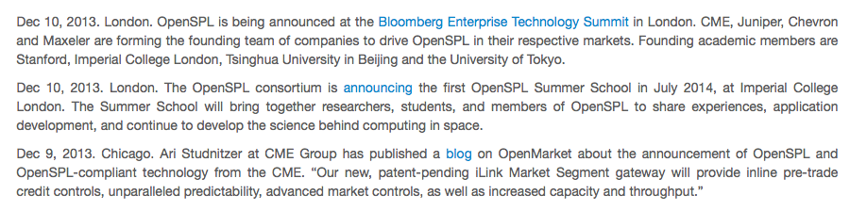

OpenSPL
Founding Corporations:
Founding Academic Partners:
http://www.OpenSPL.org
launched on Dec 9, 2013

Slide 7
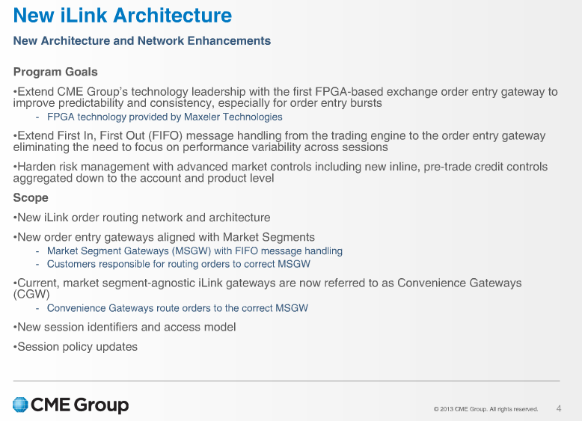
OpenSPL in Practice
New CME Electronic Trading Gateway will be going live in March 2014!
Webinar Page: http://www.cmegroup.com/education/new-ilink-architecture-webinar.html
CME Group Inc. (Chicago Mercantile Exchange) is one of the largest options and futures exchanges. It owns and operates large derivatives and futures exchanges in Chicago, and New York City, as well as online trading platforms. It also owns the Dow Jones stock and financial indexes, and CME Clearing Services, which provides settlement and clearing of exchange trades. …. [from Wikipedia]
Notes:
Race to Zero

Slide 8
OpenSPL - Why Now?
Semiconductor technology is ready
  Within ten years (2003 to 2013) the number of transistors on a chip went up from 400M (Itanium 2) to 5Bln (Xeon Phi)
Memory performance isn’t keeping up
  Memory density has followed the trend set by Moore’s law
  But Memory latency has increased from 10s to 100s of CPU clock cycles
  As a result, On-die cache % of total die area has increased from 15% (1um) to 40% (32nm)
  The memory latency gap could eliminate most of the benefits of CPU improvements
Exascale challenges (10^18 FLOPS)
  clock frequencies stagnated in the few GHz range
  energy usage and Power wastage of modern HPC systems are becoming a huge economic burden that can not be ignored any longer
  requirements for annual performance improvements grow steadily
  programmers continue to rely on sequential execution (1D approach)
For affordable exascale systems ➔ Novel approach is needed

Slide 9
OpenSPL Basics
Control and Data-flows are decoupled
  both are fully programmable
  can run in parallel for maximum performance
Operations exist in space and by default run in parallel
  their number is limited only by the available space
All operations can be customized at various levels
  e.g., from algorithm down to the number representation
Data sets (actions) streams through the operations
The data transport and processing can be matched

Slide 10
OpenSPL Models
Memory:
  Fast Memory (FMEM): many, small in size, low latency
  Large Memory (LMEM): few, large in size, high latency
  Scalars: many, tiny, lowest latency, fixed during exec.
Execution:
  datasets + scalar settings sent as atomic “actions”
  all data flows through the system synchronously in “ticks”
Programming:
  API allows construction of a graph computation
  meta-programming allows complex construction

Slide 11
OpenSPL Machine
A spatial computing machine system consists of:
  appropriate hardware technology, a.k.a. the Spatial Computing Substrate (SCS) (flexible arithmetic/computation units and interconnect)
  an SCS specific compilation tool-chain
  CPU-based runtime for control of SCS
Computation divided into discrete kernels interconnected by data flow streams to form bigger entities
In a spatial system one or more SCS engines exist, each executing a single action at any moment in time

Slide 12
OpenSPL Example: X² + 30
x
x
SCSVar x = io.input("x", scsInt(32));
SCSVar result = x * x + 30;
io.output("y", result, scsInt(32));
30
+
y

Slide 13
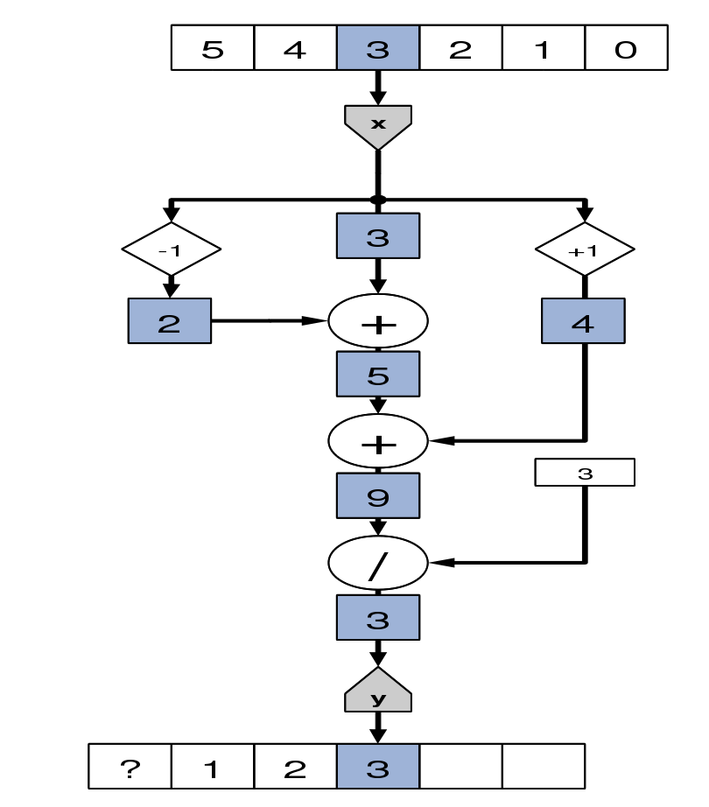
OpenSPL Example: Moving Average
Y = (X_{n-1} + X + X_{n+1}) / 3
SCSVar x = io.input(“x”, scsFloat(7,17));
SCSVar prev = stream.offset(x, -1);
SCSVar next = stream.offset(x, 1);
SCSVar sum = prev + x + next;
SCSVar result = sum / 3;
io.output(“y”, result, scsFloat(7,17));

Slide 14
OpenSPL Example: Choices
x
10
1
1
SCSVar x = io.input(“x”, scsUInt(24));
SCSVar result = (x>10) ? x+1 : x-1;
io.output(“y”, result, scsUInt(24));
>
+
-
y

Slide 15
Spatial Arithmetic
Operations instantiated as separate arithmetic units
Units along data paths use custom arithmetic and number representation
The above may reduce individual unit sizes
  can maximize the number that fit on a given SCS
Data rates of memory and I/O communication may also be maximized due to scaled down data sizes
Exponent (8)
Mantissa (23)
S
S
S
S
S
S
S
s
Exponent (3)
S
S
S
s
Potentially optimal encoding
Mantissa (10)

Slide 16
Spatial Arithmetic at All Levels
Arithmetic optimizations at the bit level
  e.g., minimizing the number of ’1’s in binary numbers, leading to linear savings of both space and power (the zeros are omitted in the implementation)
Higher level arithmetic optimizations
  e.g., in matrix algebra, the location of all non-zero elements in sparse matrix computations is important
Spatial encoding of data structures can reduce transfers between memory and computational units (boost performance and improve efficiency)
  In temporal computing encoding and decoding would take time and eventually can cancel out all of the advantages
  In spatial computing, encoding and decoding just consume a bit more of additional space

Slide 17
Benchmarking Spatial Computers
Spatial computing systems generate one result during every tick
SC system efficiency is strongly determined by how efficiently data can be fed from external sources
Fair comparison metrics are needed, among others:
  computations per cubic foot of datacenter space
  computations per Watt
  operational costs per computation

Slide 18
SCS Implementation
Multiscale Dataflow Engine (DFE) by Maxeler is the first SCS implementation, used by:
  Chevron
  ENI
  JP Morgan
  CME Group
Open research areas
  map on to CPUs (e.g. using OpenMP/MPI)
  GPUs
  other accelerator technology

