Slide 1
Newton-Raphson Method Using Derivative
Darko Stošić 23/2011

Slide 2

Content
DEFINITION
DEMONSTRATION
EXAMPLE
MAXELER
IMPLEMENTATION
RESULTS
REFERENCES
2/13

Slide 3

Newton-Raphson Method DEFINITION
In numerical analysis, Newton–Raphson method (Newton’s method), named after Isaac Newton and Joseph Raphson, is a method for finding successively better approximations to the roots (or zeroes) of a real-valued function.
$x: ƒ (x) = 0$
The Newton–Raphson method in one variable is implemented as follows:
Given a function $ƒ$ defined over the reals $x$, and its derivative $ƒ′$, we begin with a first guess $x0$ for a root of the function $ƒ$. Provided the function satisfies all the assumptions made in the derivation of the formula, a better approximation $x_{1}$ is
$x_{1}=x_{0} – \frac{ƒ (x_{0})}{ƒ′ (x_{0}) }$
Geometrically, $(x1, 0)$is the intersection with the x-axis of the tangent to the graph of $ƒ$ at $(x0, ƒ (x0)).$
The process is repeated as
$x_{n+1}= x_{n} – \frac{ƒ (x_{n})}{ƒ′ (x_{n}) }$
until a sufficiently accurate value is reached.
3/13

Slide 4
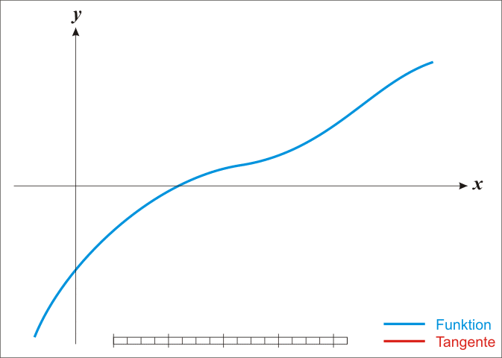

Newton-Raphson Method Demonstration
The function $ƒ$ is shown in blue and the tangent line is in red. We see that $x_{n+1}$ is a better approximation than $x_{n}$ for the root x of the function $ƒ$.
4/13

Slide 5
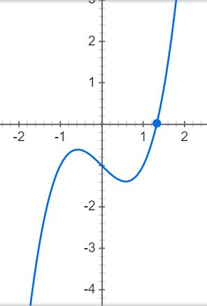

Example
Use Newton’s method to find the only real root of the equation $x^{3}−x−1=0$correct to 13 decimal places.
We have $ƒ(x) =x^{3}−x−1$. Since $ƒ(1)=−1$ and $ƒ(2)=5$, the function changes sign in the interval $(1, 2)$ which means that in the same interval it has a root$.$Let us make an initial guess $x_{0}=1.5$.
Newton’s formula is:
$x_{n+1} = x_{n} – \frac{ƒ \left(x_{n}\right)}{ƒ′ (x_{n})} = x_{n} – \frac{{x_{n}}^{3}−x_{n}−1}{3{x_{n}}^{2}−1} = \frac{{2x_{n}}^{3}+1}{3{x_{n}}^{2}−1}$
so, with our value of $x_{0}=1.5$, our approximation for $x_{1}$ is given by
$x_{1}=\frac{{2(1.5)}^{3}+1}{3{(1.5)}^{2}−1} ≈1.3478260…$
5/13

Slide 6
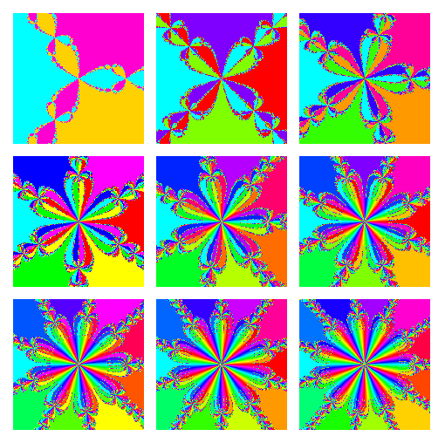

Example and Solution
Using a scientific calculator, it is possible to finish the sum.
Take the value of $x_{1}$ and repeat the above calculations using this as the initial guess. The resulting answer will be $x_{2}$.
Again repeat the procedure until the 13th decimal place remains unchanged.
Another solution would be creating the program that will calculate this for us.
Here will be presented solution in Maxeler Tehnologies.
Program will be divided into two parts: sequential and parallel, and the results will be compared in the end.
6/13

Slide 7


Maxeler
DataFlow paradigm
The writing in the memory is postponed until the data processing is finished
Decreases cost of reading and writing temporary results
Tokens on the entry points of vertices in a graph are a condition for operation completion
Loop oriented, big data
As less data dependences as possible
Previous example will be implemented in MaxIDE.
7/13

Slide 8
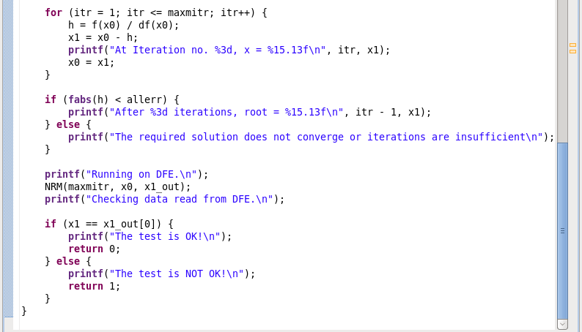
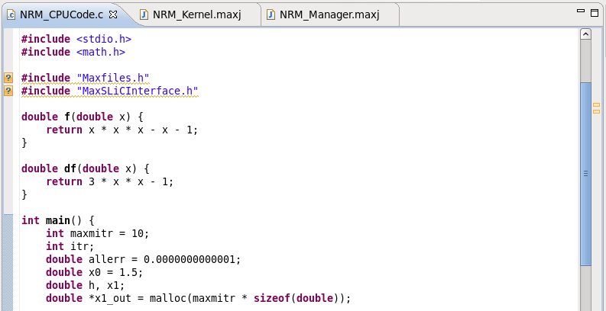
NRM_cpuCode
8/13

Slide 9
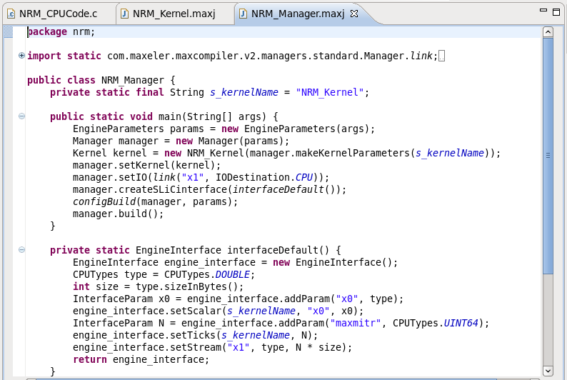
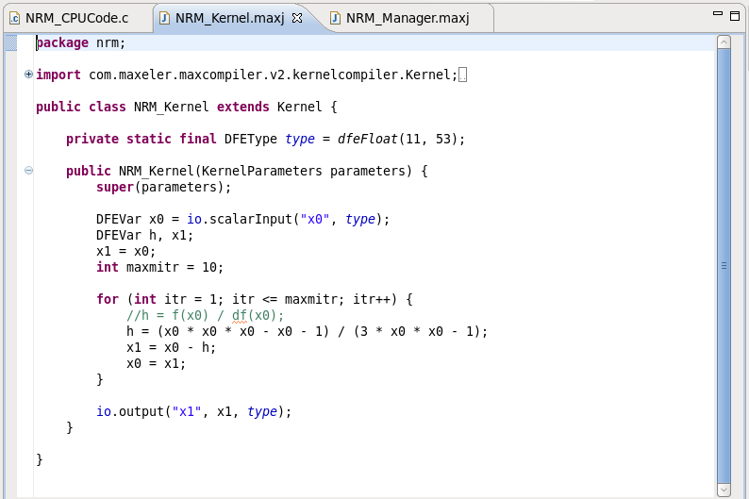
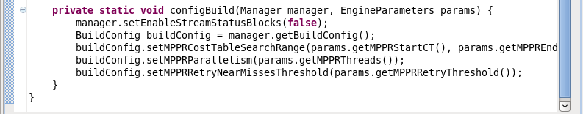
NRM_Kernel and NRM_Manager
9/13

Slide 10
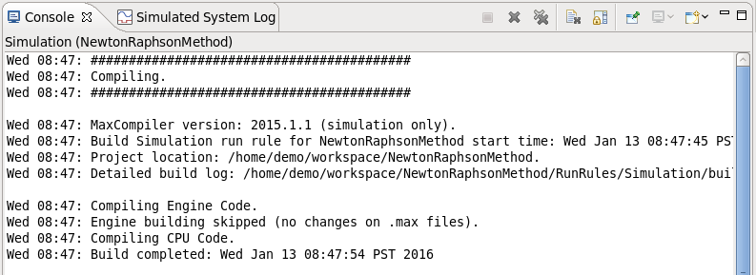
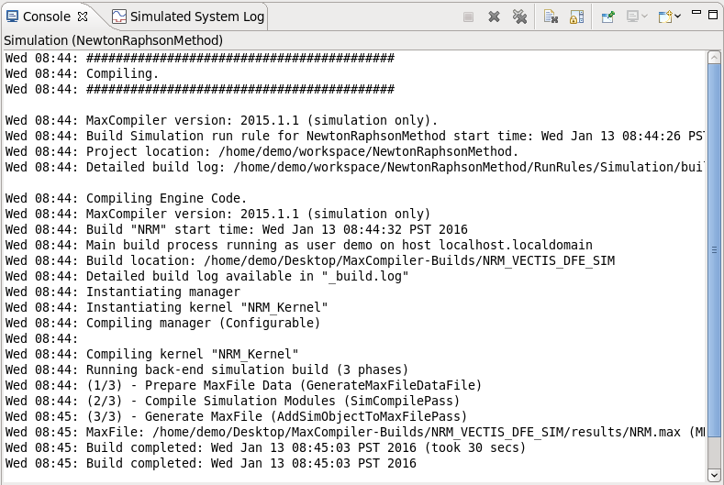
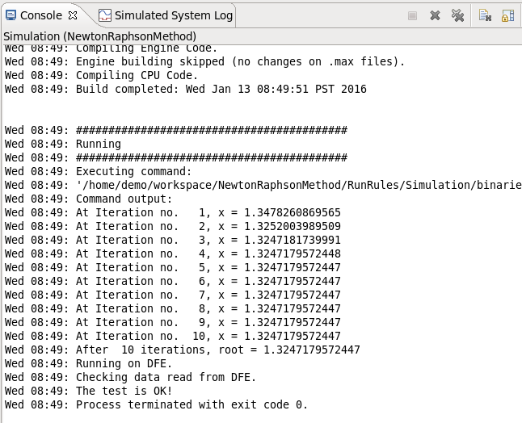
Build and Run
10/13

Slide 11
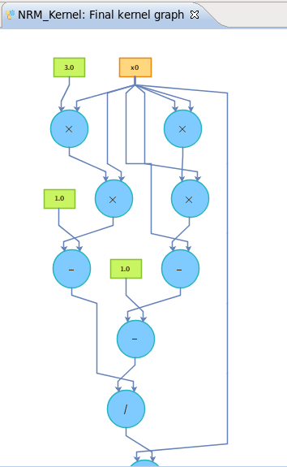
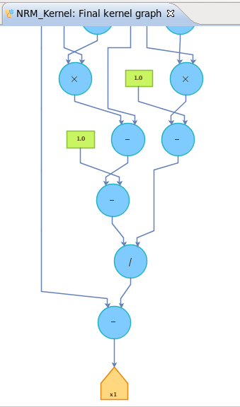
Graph
11/13

Slide 12
References
Milutinovic, V., Salom, J., Trifunovic, N., Giorgi, R., “Guide to DataFlow SuperComputing”, Springer, 2015.
Milutinovic, V., editor, “Advances in Computers: DataFlow”, Elsevier, 2015.
Milutinovic, V., editor, “High-Level Language Computer Architecture,“ (Chapter 9, DataFlow Machines, Gaudiot, J.-L.,), Computer Science Press, 1989.
Press, W., Teukolsky, S., Vetterling, W., Flanner, B., “Numerical Recipes in C – The Art of Scientifing Computing”, Cambridge University Press, 1992.
-, “Newton’s Method”, https://en.wikipedia.org/wiki/Newton's_method, 2016.
12/13

Slide 13

Questions?
Thank you for your attention!
13/13

