Slide 1
NBody simulation with collision detection and response
Stefan Pantelić 511/12

Slide 2
Simulation of the particles interaction
This is simulation of particles interaction in closed system under gravitational field
Model of collision detection and response is simplified
Particle is defined by its
position in 3D space (x,y,z)
velocity (x,y,z)
mass

Slide 3
Proposed solution
Speed and position are calculated numerically
Collision detection is implemented as comparison of position of two particles
Collision response is implemented as simple merge of two particle

Slide 4
Software implementation - control flow
Array of particles is initialised with random generated numbers
Through two nested loops particle velocity is being calculated
After that new position is being calculated for each particle
This is repeated in given number of time steps

Slide 5
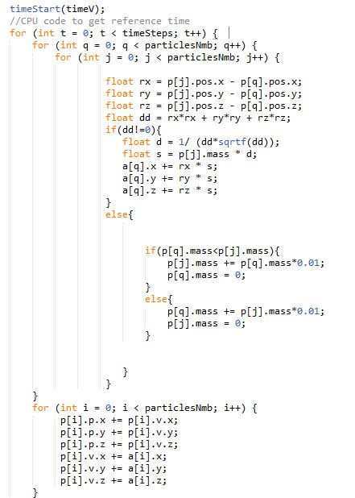
Softverska realizacija - control flow

Slide 6
Software implementation - data flow
In total 8 input streams - x,y,z and mass and 4 output - x,z,y velocity and mass
First 4 streams are written in BRAM on dataflow card while other 4 are withheld using controlled input
After that for every tuple from other 4 streams velocity and mass are being calculated considering every tuple stored in BRAM
Finally velocity and mass are being streamed through output streams

Slide 7
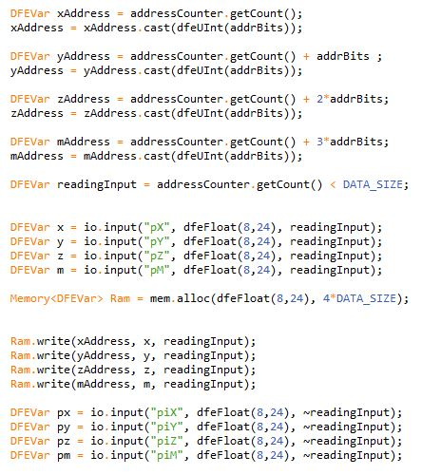
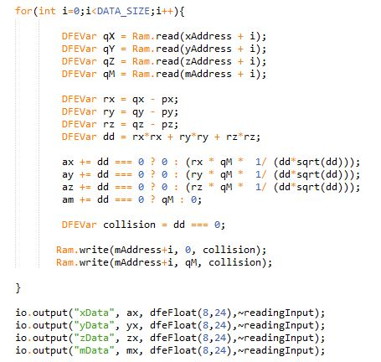
Software implementation - data flow

Slide 8
Proposed upgrades
Implementing more complex detection collision and response
Adding particle radius
Using better code optimisation
Reducing communication overhead by importing entire loop that counts time steps in DFE code

Slide 9
Reference
Wikipedia https://en.wikipedia.org/wiki/N-body_problem
Milutinovic, V., Salom, J., Trifunovic, N., Giorgi, R., "The Guide To DataFlow SuperComputing," Springer, 2015.
Jovanovic, Z., Milutinovic, v., "FPGA Accelerator for Floating-Point Matrix Multiplication," The IET Computers and Digital Techniques, Vol 6, Issue 4, 2012, pp. 249-256 (THE IET PREMIUM AWARD IN COMPUTERS AND DIGITAL TECHNIQUES FOR 2014).

