Slide 1

Mirror, Mirror on the Wall…New Digital Media for ALL
Products & Services for Generations X & Y
Howard R. Moskowitz, Nadya Livshits, Linda Ettinger Lieberman, Moskowitz Jacobs, Inc.
Batool Batalvi, S B & B Marketing Research
Stephen D. Rappaport, Advertising Research Foundation
© Powered by www.RedOffice.com

Slide 2

It’s the 21st century and our world’s changing rapidly.
It’s hard to forecast the future. But, we can get ideas…
and help New Digital Media services companies see the future that they want…like picking the constellations out of the galaxy.
How can we do that?
Find out with…. Empathy & Experiment ™

Slide 3
Topics of Discussion
Psychology of Empathy ..and Science of Experiment
Is it about the product – or is it about the subject?
Data...Mind Genomics® of the New Digital Media
  Why a study?
  How?
  So?
Segmentation Wizard™ – here’s the customer…
make an offer?

Slide 4
Empathy & Experiment ™
Where do we begin? We start by seeing and organizing stuff. That’s the way our brains work.
5 KEYS EMPATHY- ethnography/qualitative/
psychodynamics decode ‘what works’
It’s about the subject
EXPERIMENT- gather ideas, run structured tests,
discover messages about products/services,
create a typing tool
Mix and match ideas, what floats to the top

Slide 5
But first…
Do we even know our customers?

Slide 6
Identifying Our Target Market
We want to make Generations X and Y happy…
How do we identify them?
Are there different consumer mind-sets?
What New Digital Media services do they want or need?
How much they are willing to pay for them?
Well, let’s find out!

Slide 7

Generations X and Y…
Who exactly are OUR Customers?
Gender: 49% Female/51% Male
Age: 48% 18-29 years
Nationality: American
Family Status: 60% Single
Annual Income: 28% < $30K
59% >$30Kbut < $100K
12% > $100K
Education: 43% college
13% grad/professional
Ethnicity: Caucasian/Black/
Asian/Latino
Neighborhood: City/Suburban

Slide 8
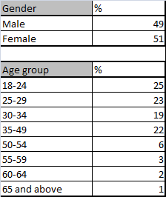
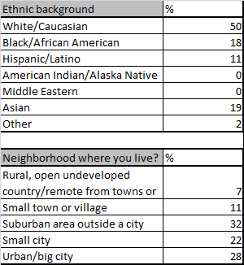
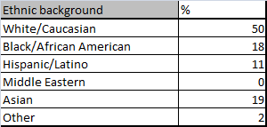
These people participated
in our web study

Slide 9
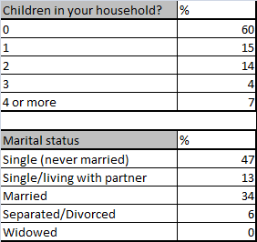
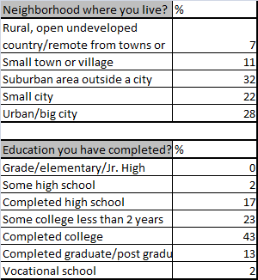
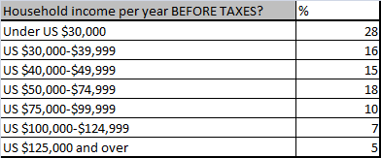
Respondent profile

Slide 10
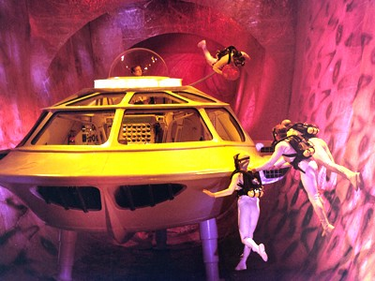
Here they are…
Now, how do we make them happy? We travel into the future by traveling into their minds…identifying mind types in the continents of the new world.
© Jacob Hall, Moviefone, “Fantastic Voyage”

Slide 11

Charting and surveying these new lands… to create services/products for new customers
IDENTIFY ING OUR TARGET MARKET
DEVELOPING SURVEY STIMULI AND QUESTIONS
INTERNET invitation
Mind Genomics ® IdeaMap.net
Users of
New Digital
Media Devices
and Services
SUY
SURVEY
ANALYZING SURVEY RESULTS→ Mind Genomics® IdeaMap ®.net
MARKET SEGMENTATION
MARKETING PHRASES
SEGMENTATION WIZARD
Notes:
11

Slide 12
What Have We Discovered?
Regardless of the features/services companies provide:
  Consumers have shifted from traditional communication tools.
  Consumer device decisions became actual/virtual reflections.
  Consumer engagement changes daily.
  Consumers’ physical face-to-face communications has decreased, marginalizing non-users, and social skills have been lost.

Slide 13
What Does This Tell Us?
Regardless of the services companies provide:
Consumers are increasing the amount of time they spend
re-making their images on social media
Consumers are forging new relationships, re-establishing
old ones and discovering people with common interests.

Slide 14
We Put Together a Simple Survey
Set up a conjoint online study
  Concept stimuli with 7 categories of features/services
Survey invitations
  Panel of 300 respondents,18 years of age and older
Web-based internet research survey
  Run October 15, 2012
Consumers asked two rating questions
  Interest in features/services subscription
  Amount willing to pay for subscription

Slide 15
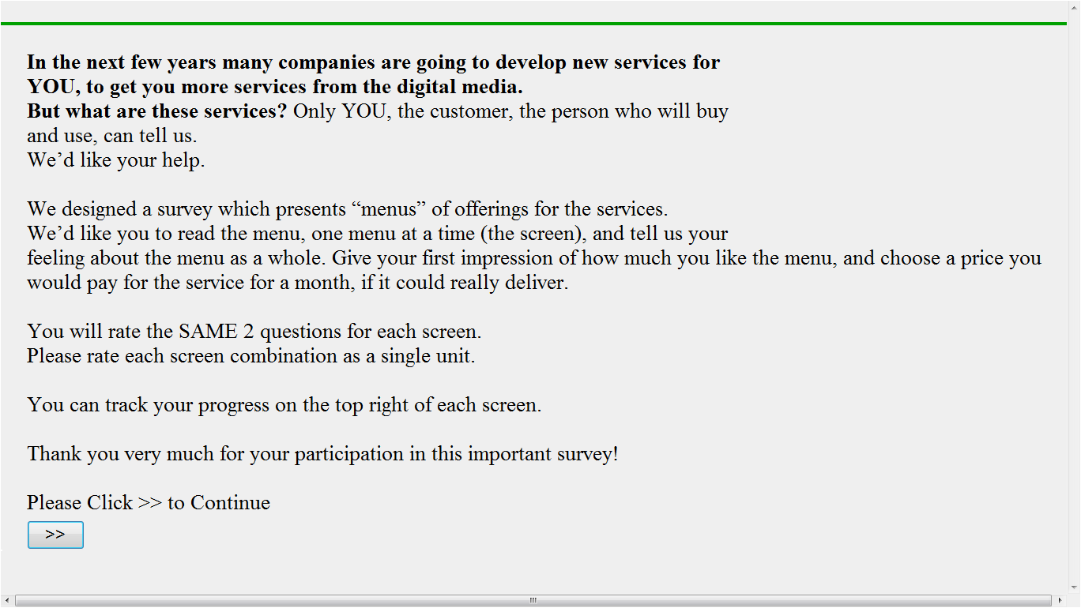
ORIENTATION SCREEN:
the first screen respondents saw
15

Slide 16
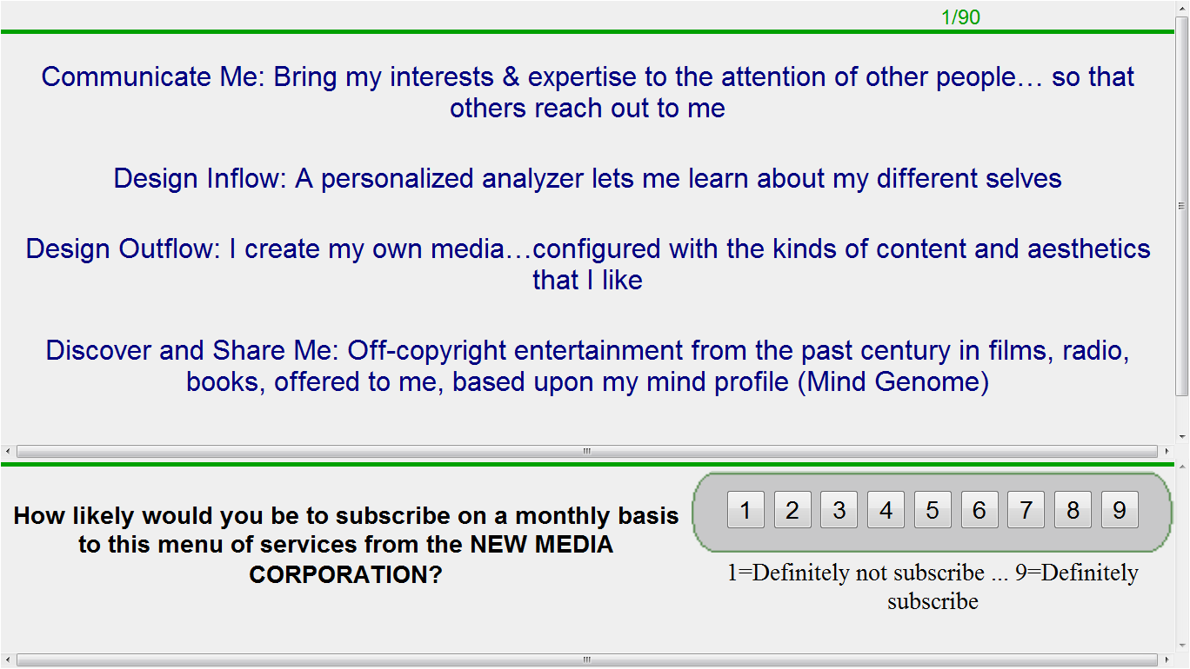
Each respondent rated 48 concept screens (unique combinations of elements),
first on overall interest…..
16

Slide 17
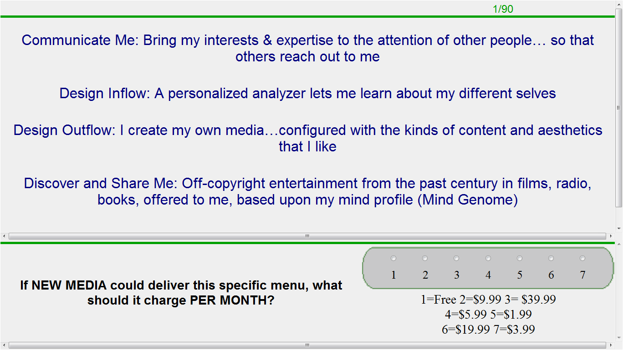
…then asked to put their own price on
a monthly subscription for the service
17
Notes:
17

Slide 18
To find out what was appealing and how they felt when reading the concepts.
We Analyzed the Survey Elements

Slide 19
We found four constellations
(mind-sets) from the future…
We have to learn “What to say”…. “What not to say”
Will some messages make a respondent
subscribe to New Digital Media services?
Let’s see what we tested and what we found

Slide 20
Segment 1: Focus on Self-Experience
Segment 2: Knowledge: Learn New & Share Mine
Segment 3: Externalize & Involve Me
Segment 4: Socialize Me
Constellations of Different
Consumer Mind-Sets:
What They Want and Don’t Want

Slide 21
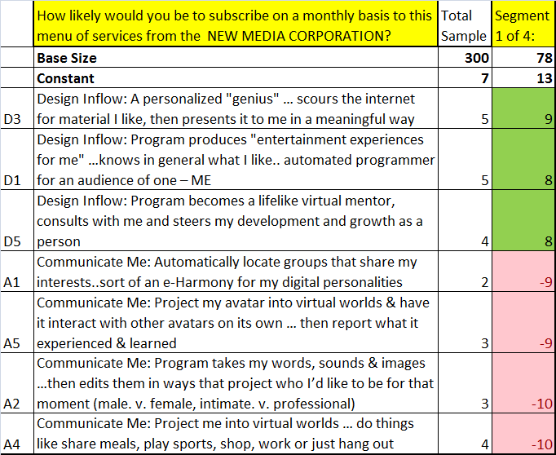
Segment 1: Focus on self-experience

Slide 22
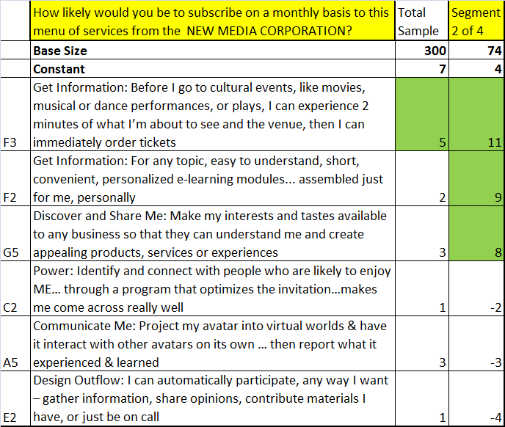
Segment 2: The Knowledge-
Learn New & Share Mine Viewpoint

Slide 23
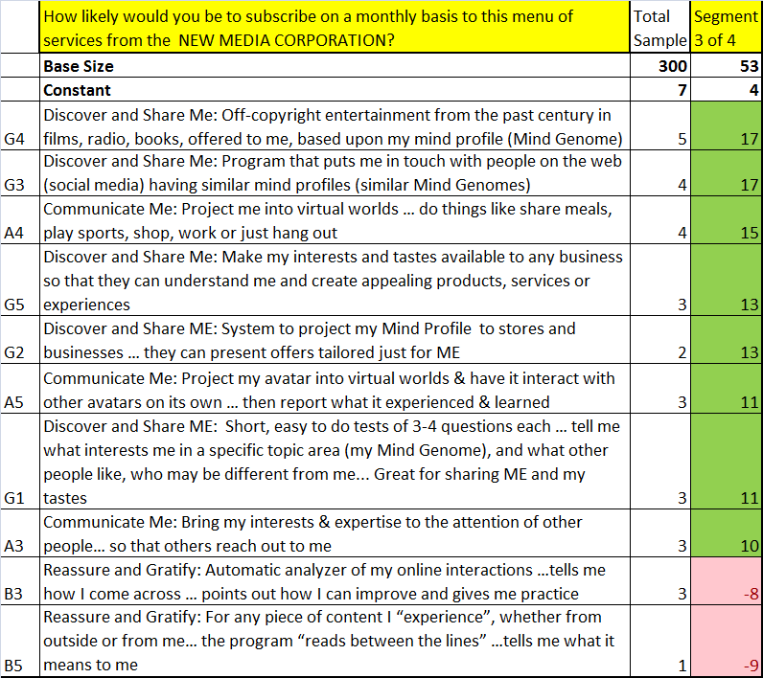
Segment 3: The Externalize &
Involve Me Viewpoint

Slide 24
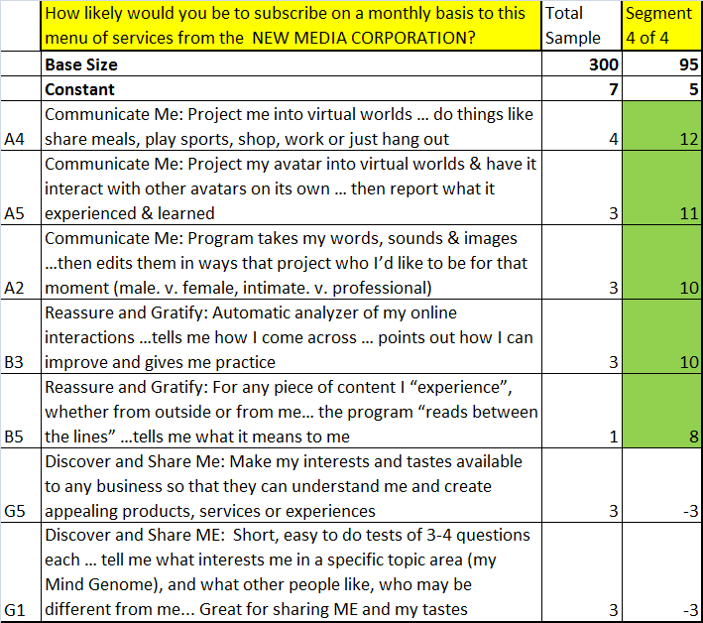
Segment 4: The Socialize Me Viewpoint

Slide 25
And last, but not least…
We analyzed the data to find out how much
each segment was willing to pay to receive
the RIGHT (OPTIMAL) MESSAGES
25

Slide 26
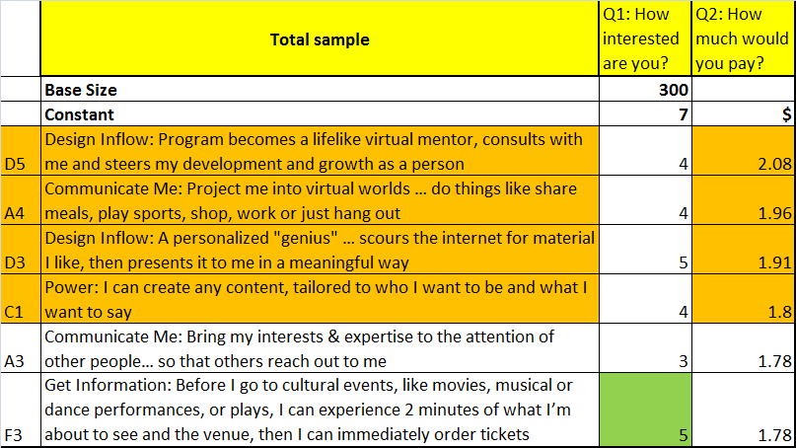
Let’s look at the highest $ prices
in the Total Sample

Slide 27
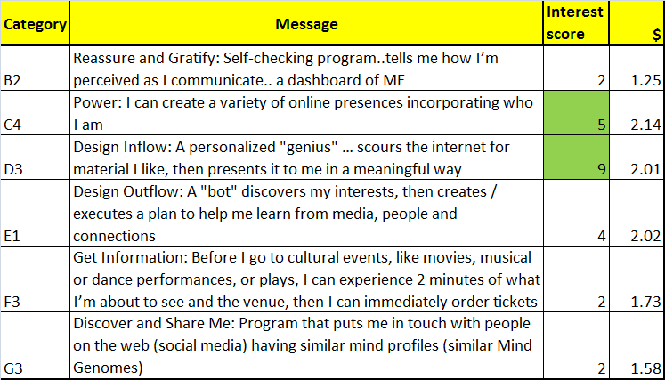
Optimal concept for SEGMENT 1
We took the highest scoring elements from each
category and totaled their dollar values:
$1.25+$2.14+$2.01+$2.02+$1.73+$1.58= $10.73 (for monthly subscription)

Slide 28
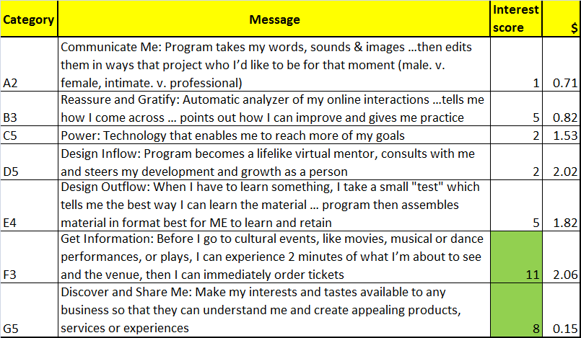
Optimal concept for SEGMENT 2
$0.71+$0.82+$1.53+$2.02+$1.82+$2.06+$0.15=
$9.11 (for monthly subscription)

Slide 29
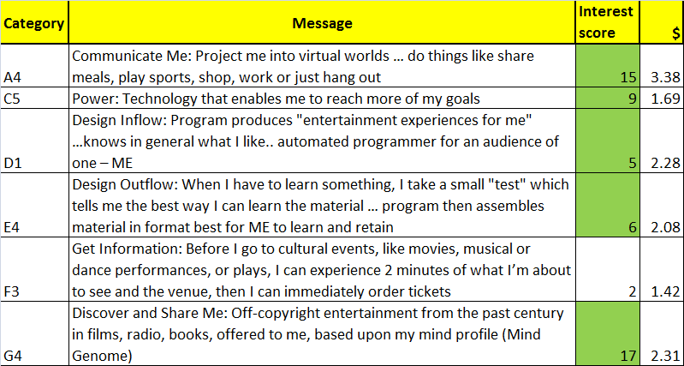
Optimal concept for SEGMENT 3
$3.38+$1.69+$2.28+$2.08+$1.42+$2.31=
$13.16 (for monthly subscription)

Slide 30
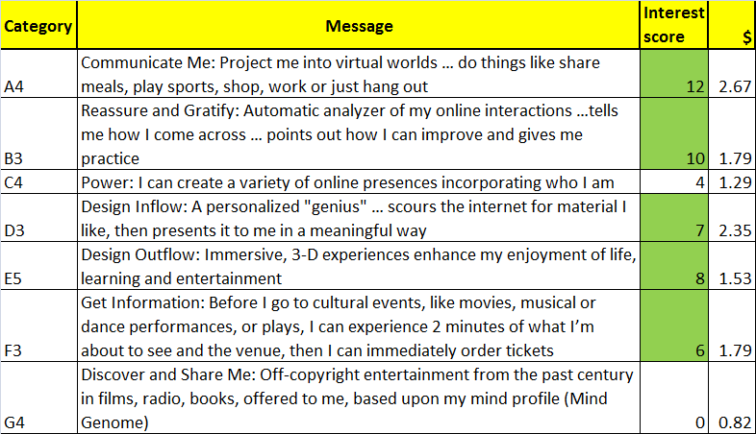
Optimal concept for SEGMENT 4
$3.38+$1.69+$2.28+$2.08+$1.42+$2.31=
$12.24 (for monthly subscription)

Slide 31

We use the Segmentation Wizard™… and navigate to the future and beyond to understand today’s mind
http://www.mjiweb.com/mjitt/Media/Media.htm

Slide 32
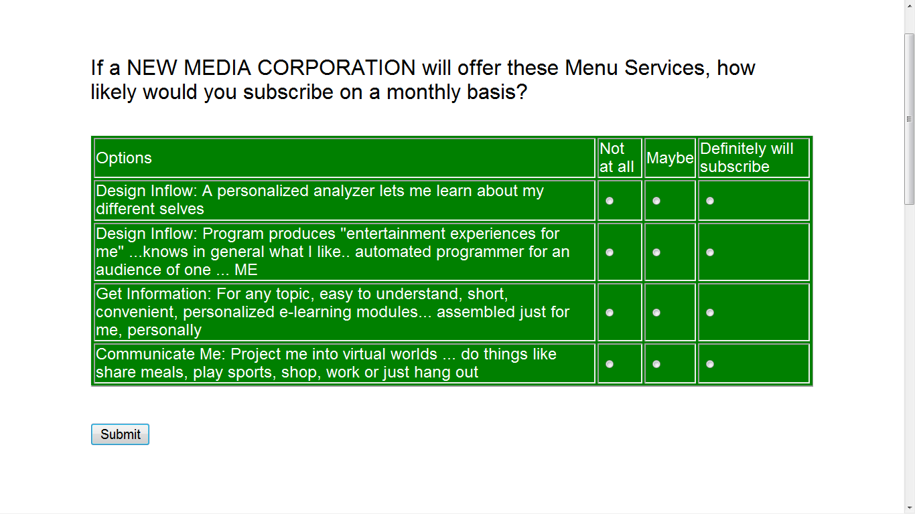
The Segmentation Wizard™
asks a few simple questions

Slide 33
On the spot… we know what to say
or avoid saying for Segment 1:
Focus on Self-Experience
Things to say
Design Inflow: A personalized “genius”…scours the internet for material I like, then
presents it to me in a meaningful way
Design Inflow: Program produces “entertainment experiences for me”…knows in
general what I like…automated programmer for an audience of one…ME
Design Inflow: Program becomes a lifelike mentor, consults with me and steers my
development and growth as a person
Design Inflow: A personalized analyzer lets me learn about my different selves

Slide 34
On the spot… we know what to say
or avoid saying for
Segment 1: Focus on Self-Experience
Things to Avoid
Communicate Me: Automatically locate groups that share my interests…sort of an
e-Harmony® for my digital personalities
Communicate Me: Project my avatar into virtual worlds and have it interact with
other avatars on its own…then report what it experienced and learned
Communicate Me: Program takes my words, sounds and images…then edits them
in ways that project who I’d be like for that moment (male vs. female, intimate vs.
professional)
Communicate Me: Project me into virtual worlds…do things like share meals, play
sports, shop, work or just hang out

Slide 35
On the spot… we know what to say
or avoid saying for Segment 2:
Knowledge: Learn New & Share Mine
Things to Say
Get Information: Before I go to cultural events, like movies, musical or dance
performances or plays, I can experience 2 minutes of what I’m about to see
and then venue, then I can immediately order tickets
Get Information: For any topic, easy to understand, short, convenient, personalized
e-learning modules…assembled just for me, personally
Discover and Share Me: Make my interests and tastes available to any business so
that they can understand me and create appealing products, services or experiences
Get Information: Program monitors the interests of friends and people I follow, then
reports back to me

Slide 36
On the spot… we know what to say
or avoid saying for Segment 2:
Knowledge: Learn New & Share Mine
Things to Avoid
Communicate Me: Automatically locate groups that share my interests…sort of
an e-Harmony® for my digital personalities
Power Me: Identify and connect with people who are likely to enjoy ME…through
a program that optimizes the invitation…makes me come across really well
Communicate Me: Project my avatar into virtual worlds and have it interact with
other avatars on its own…then report what it experienced and learned
Design Outflow: I can automatically participate, any way I want…gather
information, share opinions, contribute materials I have, or just be on call

Slide 37
On the spot… we know what to say
or avoid saying for Segment 3:
Externalize and Involve Me
Things to Say
Discover and Share Me: Off- copyright entertainment from the past century in
films, radio, books, offered to me based upon my mind profile (Mind Genome)
Discover and Share Me: Program that puts me in touch with people on the web
(social media) having similar mind profiles (similar Mind Genomes)
Communicate Me: Project me into virtual worlds…do things like share meals,
play sports, shop, work or just hang out
Discover and Share Me: Make my interests and tastes available to any business
so they can understand me and create appealing products, services or
experiences

Slide 38
On the spot… we know what to say
or avoid saying for Segment 3:
Externalize and Involve Me
Things to Avoid
Design Inflow: A personalized analyzer lets me learn about my different selves
Reassure and Gratify: Self-checking program…tells me how I’m perceived as
I communicate…a dashboard of me
Reassure and Gratify: Automatic analyzer of my online interactions…tells me
how I come across…points out how I can improve and gives me practice
Reassure and Gratify: For any piece of content I ‘experience’, whether from
outside or from me…the program ‘reads between the lines’…tells me what it
means to me

Slide 39
On the spot… we know what to say
or avoid saying Segment 4: Socialize Me
Things to say
Communicate Me: Project me into virtual worlds…do things like share meals,
play sports, shop, work or just hang out
Communicate Me: Project my avatar into virtual worlds and have it interact with
other avatars on its own…then report what it experienced and learned
Communicate Me: Program takes my words, sounds and images…then edits
them in ways that project who I’d like to be for that moment (male vs. female,
intimate vs. professional)
Reassure and Gratify: Automatic analyzer of my online interactions…tells me
how I come across…points out how I can improve and gives me practice

Slide 40
On the spot… we know what to say
or avoid saying
Segment 4: Socialize Me
Things to Avoid
Discover and Share ME: System to project my Mind Profile to stores and
businesses…they can present offers tailored just for ME
Discover and Share ME: Make my interests and tastes available to any business so
that they can understand me and create appealing products, services or experiences
Get Information: Program creates a personal briefing on any topic that interests
me…may not be the prettiest, but it hits all the keys
Discover and Share ME: Short, easy to do tests of 3-4 questions each…tell me what interests me in a specific topic area (my Mind Genome), and what other people like, who may be different from me…Great for sharing ME and my tastes

Slide 41
Now, we know how to:
Design services that are appealing to people according
to their mind-set segments
Price the services at levels people value and are willing to pay
Create a family of deeply resonating messages that drive
interest across the different mind-set segments
Target messages to individuals and deliver them
at the right time and place
Repeat the research so that services and customers
stay in tune with each other over time

Slide 42
For further information on
Empathy & Experiment™
Contact Moskowitz Jacobs Inc.
call 914-421-7400 e-mail mjihrm@sprynet.com
Visit our website www.mji-designlab.com

Slide 43
Thank you !

