Slide 1
The psychological economics of sensory experience: Hotels “Geography of Senses”
Johanna Fyrbjörk
Howard Moskowitz
Rieko Shofu
Marco Bevolo
David Moskowitz
Alex Gofman

Slide 2
What this presentation will provide YOU
Experimental design of ideas
Applications to experience
Economics of ideas
What experiences are worth paying for
Practical applications
Segmentation to improve individual experience
Typing to recognize people

Slide 3
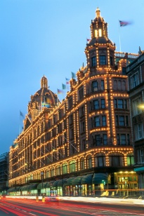
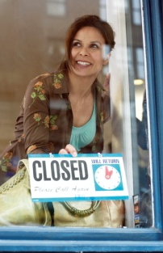
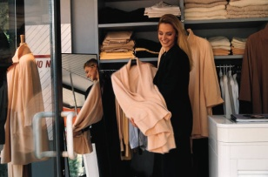
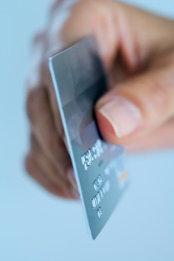
Today’s Advertising Practice Messages…not-targeted, not-relevant
Retailers / Manufacturers ->
...Traditional advertising
Messaging targeted to large audiences
Simple classification descriptors and what they purchase
It’s how media is bought
Your Customers
Advertising strategy assumes/hopes for group homogeneity…Men want “Y”, Women want “X”
Result
Lots of messages
No regard to ‘true/effective’ messages & motivators ‘that really work’ for each customer
Demographics - Behaviour

Slide 4
Mindsets Create Business Opportunities
People differ from each other
Conventional methods divide them by easy-to-buy information (geo-demos)
Other methods divide them by high-level psychographics (general world views)
Still others divide people by what they buy, etc.
We are going to segment the respondents based on how they react to these new ideas
This is called mind-set segmentation
It is granular, specific to the particular product and opportunity
And it is up-to-date

Slide 5
The Addressable Mind™ Solution Targeted by mind-set, very relevant messaging
Retailers - Manufacturers ->
IdeaMap.Net Foundation
Database/test for each retailer/manufacturer
Discover Segments
Create Typing Tool
Identify Message Drivers
Classify/Segment
Classify new population into segments
THEY LOOK THE SAME BUT THEIR MINDS ARE DIFFERENT
Target
Now, Target best messages to each segment and do it by each manufacturer and retailer
IdeaMap.net
Discover Mind
Segments:
Green Conscious
Only The Best
Identify Mechanism
For Segmentation
Identify Importance
Of Each Message by
Total, Segments etc.
GREEN
BEST
GREEN
BEST
GREEN
BEST

Slide 6
Which “sensory components” should a business offer?
Knowledge about the “sensory components” is valuable … it identifies what
the customer value and will pay for
different minds exist among customers,
you should do to please them..get them and keep them
These three pieces of information enables the us to identify what to feature in business, and how to personalize/optimize individual communications to current and prospective customers/guests.

Slide 7
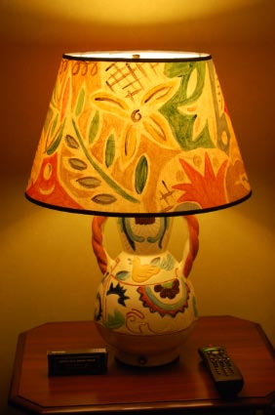
What are the guests experiencing...
“It was a unique experience, as each hotel is designed using a specific magazine for cues to furnishings, senses, wall colors, etc. Ours was based on the New Yorker magazine.
The walls were painted citrusy yellow and chartreuse colors. Black and dark brown furniture. You’d expect John Steinbeck to come around the corner.
I can still smell the citrus thyme scent of the building, my toiletries, etc. The impression they set will remain with us for a long, long time.”
“The hotel exudes comfort, sophistication and style which made me as a guest feel very luxurious and relaxed.
The attention to details regarding materials, lighting, artwork, service etc. has made the hotel my top choice of hotels globally.“

Slide 8
Which “sensory components” should a hotel offer to maximize the price a guest is prepared to pay for an evening?
The pilot study with 315 respondents show that customers around the world differ in what they want.
BY CITY: There may be large city-to-city differences. Knowledge of these differences can suggest strategies appropriate for a city.
BY MINDSET: There are mind-set segments for the different sensory aspects, so that someone may be a
fragrance seeker
touch/ kinesthetic seeker, and so forth.
Knowledge of the segments can enable creation of generalized strategies for communication to the segments.
TYPING A GUEST PROSPECT OR A NEW GUEST: The person-to-person differences can be harnessed by a short intervention, the guest mind-set typing, to identify the mind-set segment to which a new guest or prospect belongs.
Notes:
Knowing and understanding these differences at a specific level, and identifying what a new guest or prospect wants confer a competitive advantage.

Slide 9
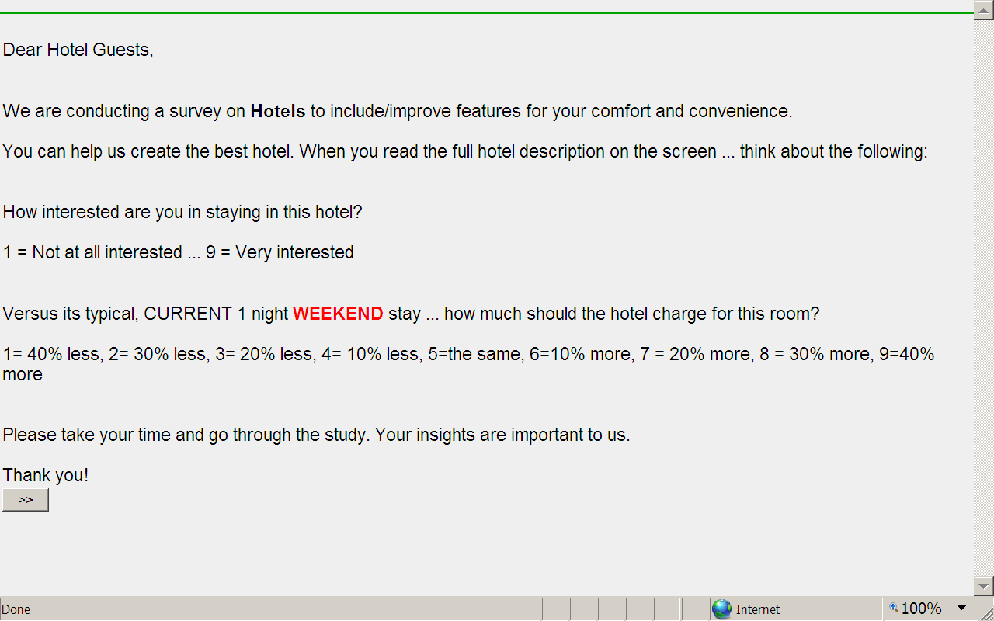
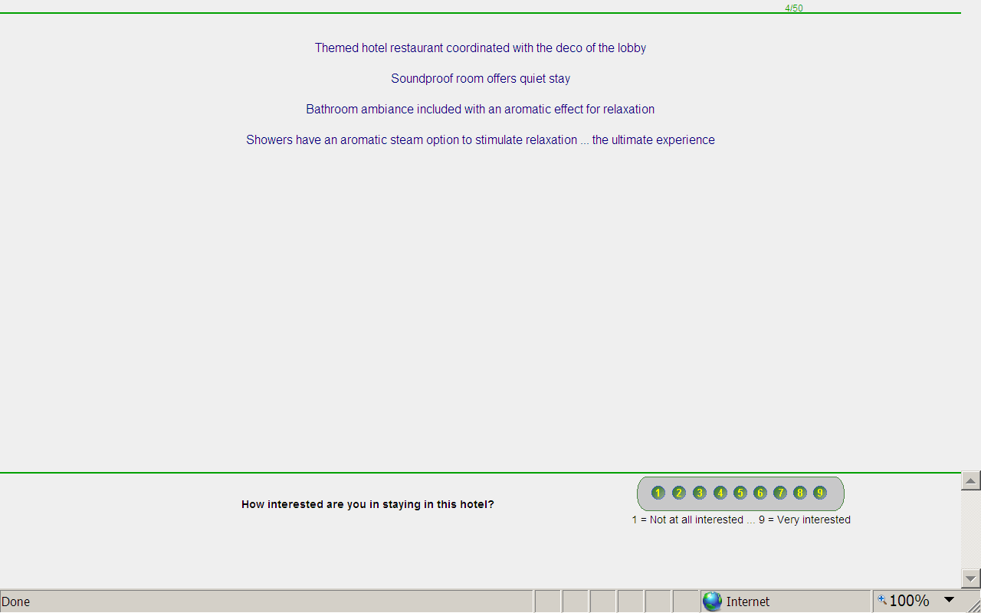
Online survey

Slide 10
16 Phrases - Combined Into Small Concepts Four Silos - Four Phrases Each
Silo 1 Feeling/Touch
Rich, lush and soft ... uniquely crafted bed and pillows in your room for a comfortable sleep
Natural selected linen and towel with pleasant texture and colors
Rooms equipped with a massage chair
Showers have an aromatic steam option to stimulate relaxation ... the ultimate experience
Silo 2 Seeing/Sight
Know what to expect inside just by looking at the exterior of the hotel
The lobby elevator color schemes are carefully selected for peace and comfort
Hotel rooms color schemes carefully selected for peace and comfort
Themed hotel restaurant coordinated with the deco of the lobby
Silo 3 Smelling/Smell - Fragrance
At lobby, guests welcomed by a pleasant fragrance
All rooms equipped with an air purifier that has an aromatic function
Bathroom ambiance included with an aromatic effect for relaxation
Hotel features a "Fragrance Bar" ... test many fragrances ... choose best fragrance for your room
Silo 4 Hearing/Sound
Unique background music in the lobby developed ... for warm welcoming
Unique background music in each room ... for a comfortable sleep and fresh awakening
Sound on demand system in every room ... choose from a variety of music
Soundproof room offers quiet stay

Slide 11
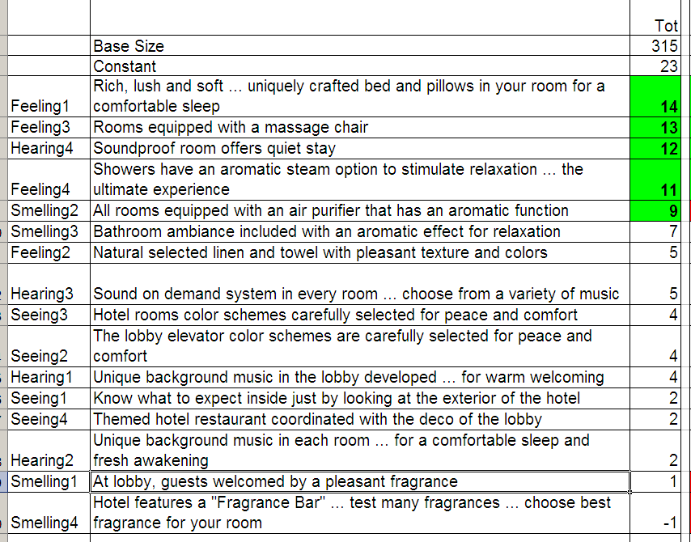
What Features Make the Guests More Interested
The data set tells us what people find interesting in the sensory experience of the hotel…
Avoid the reds…any element which has a ‘red score’ for a segment is to be avoided because at least one group really dislikes the element…
Go for greens..

Slide 12
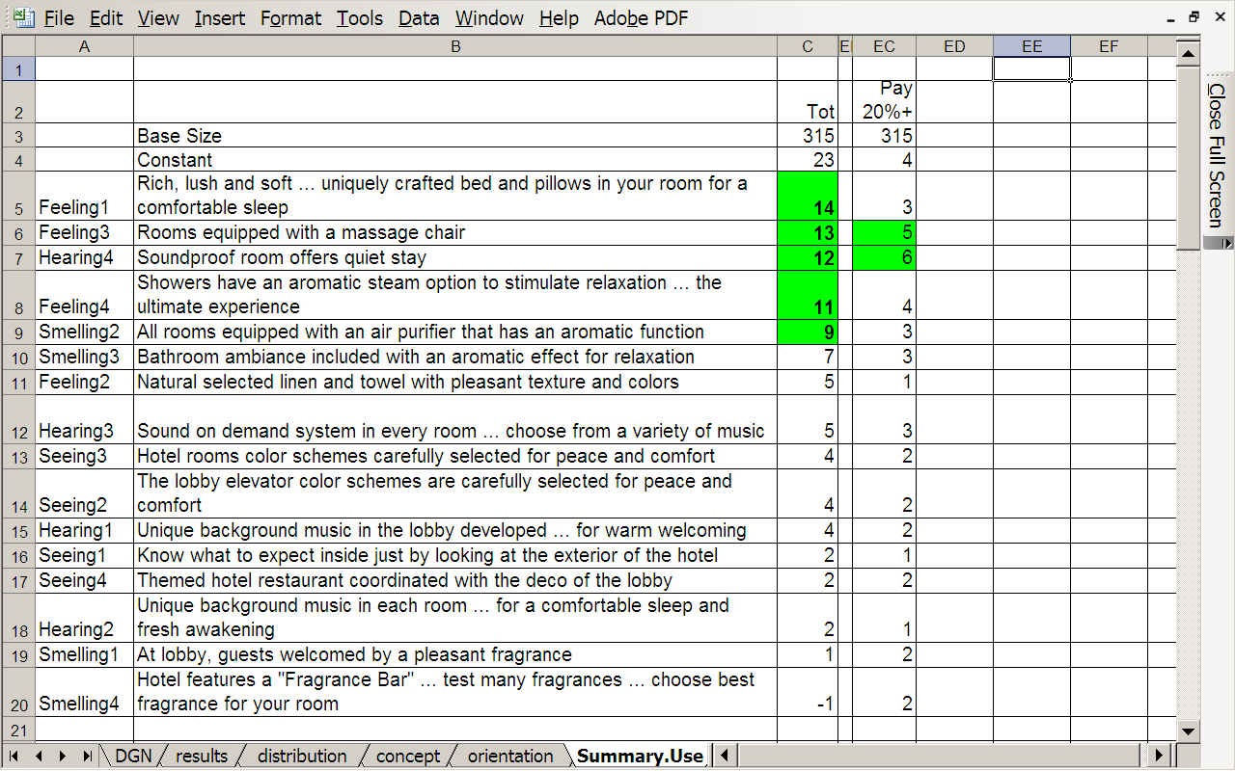
Will the guests pay more?
But…. will guests pay ‘more’ for these features…
Table shows % saying they would pay 20% or more for their hotel room to get these features
Here is the opportunity
Look for the greens on the right side

Slide 13
Finding Mindsets to customize Messages
When creating mind-sets the data shows how to tailor the message
When knowing or more easily being able to discover prospect’s mind set, one can offer the right “sensory components“ to the right person.
Again…avoid the reds…

Slide 14
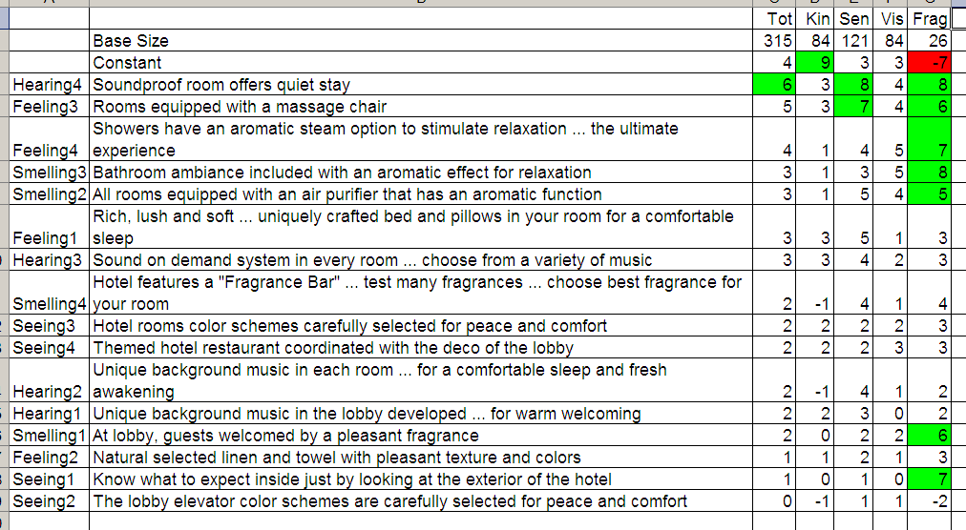
Finding Mindsets to customize Messages
Now … really please some of the guests
Give them the ‘right sensory components’
And.. Of Course …tell them in the marketing materials

Slide 15
Scratch Test for Mind-Typing
Knowing how a guest or guest prospect rates interest in three sensory experiences gives better odds of knowing the mindset segment to which the guest will belong. That knowledge tells what you should communicate and offer.
We use a discriminant function program to selects the limited number of elements needed to ‘classify’ guests and prospect guests.
Natural selected linen and towel with pleasant texture and colors
Hotel rooms color schemes carefully selected for peace and comfort
Unique background music in the lobby developed ... for warm welcoming
Hotel features a "Fragrance Bar" ... test many fragrances ... choose best fragrance for your room

Slide 16
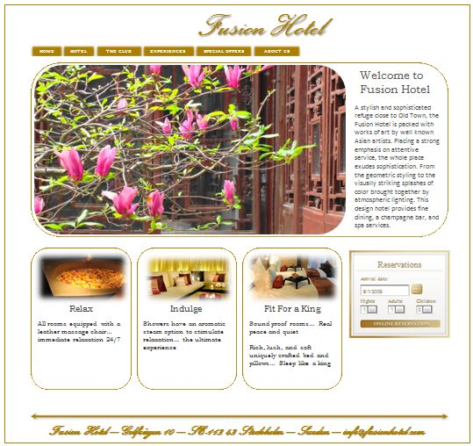
Examples of personalized landing page for site visitors
Sensory Seekers
Fragrance and Touch
Design and Relaxation

Slide 17
Groups highlighted in orange are the target for a strategy

Slide 18
Conclusions
Addressable Minds enable mind segmentation using conjoint analysis
Segmentation based on the reaction/interest in sensory experiences
Three segments were found interspersed in the population:
Sensory Seekers
Fragrance and Touch
Design and Relaxation
Knowledge can be used to create a “scratch test”
Quick and reliable way to segment customers and prospects
65% accuracy in classifying a prospect
Very few are prepared to pay for the sensory experiences they want. It should instead be viewed as a competitive advantage.

