Slide 1
Mapping a New Political Landscape: Mind Genomics and Addressable Minds Crack the 2012 Utah State Convention

Slide 2
Agenda
Background
Addressable Minds . . . What it is
Data . . . Results from the Utah State Convention
Exploring the Actionable Data – what to see, how to identify Mind-Sets

Slide 3
Background
Republican gubernatorial candidate Ken Sumsion had a lot on his plate: the Republican State Convention was just 10 days away, he was running against a popular incumbent, his campaign staff was green, and nearly 90% of the recently assembled Republican State Convention delegates—those who held Ken’s political future in their hands—were new to the job.
The majority of delegates were blank slates. It was unknown how they would vote on even the most basic of campaign issues. It was probable that even the delegates themselves – new to politics – were unsure how they would vote.
Ken came to INOVUM for help. He needed actionable insight into the minds of the 4,000 delegates. He needed to know how they would vote on key topics. And in just five days, Addressable Minds delivered the help he desperately needed.

Slide 4
Our Vision
Our primary goal was to deliver to Ken and his campaign leadership an intuitive process that illuminates the diverse campaign issues that resonate with the delegates.
This delivered process would not only identify issues of key importance to the delegates, but it would also provide detailed speaking points for the candidate and his staff to use to optimize delegate conversion.
Our secondary goal was to provide this campaign-changing process in five days.

Slide 5
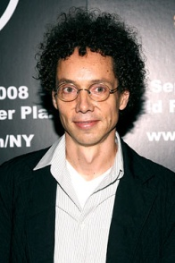
Technology: Addressable Minds
Addressable Minds is a scientific, actionable form of “predictive audience intelligence” . . . it accurately defines audience attitudes and preferences . . . both stated and unstated.
It has been described by Malcolm Gladwell and others as discovering the “DNA of the audiences' Mind.”
Award-winning science created by Dr. Howard Moskowitz, author of “Selling Blue Elephants” (Wharton Press) and the Wharton Business School . . . achieved critical acclaim and financial success across:
Product design and development,
Consumer messaging,
More effective consumer engagement, physically and digitally.
Author Malcolm Gladwell
Watch Gladwell explore the innovative thinking that led to the development of Addressable Minds: http://www.ted.com/talks/malcolm_gladwell_on_spaghetti_sauce.html

Slide 6
What the Science of Addressable Minds Delivers . . .
Fast, Granular Mind-Set Mapping of Political Campaign Issues Across Any Audience or Constituency And the Scripting Required to Convert.

Slide 7
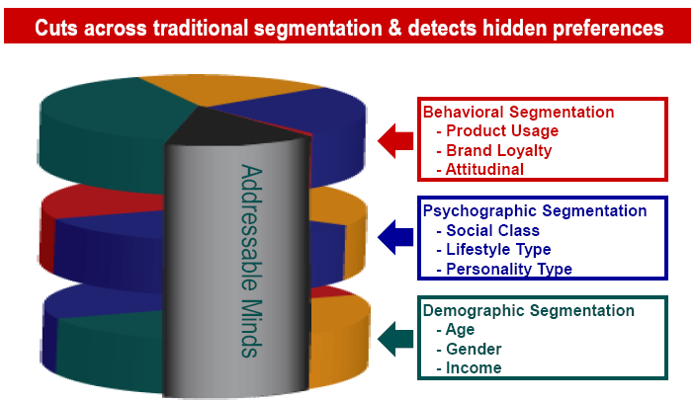
From 20,000 Feet: Addressable Minds

Slide 8
A Visual: Addressable Minds
Identify Relevant Campaign Issues & Relevant Audience(s)
Develop Strategic Survey Questions
Voters Delegates Press, any constituency
IdeaMapTM
(Online Engine)
Analyzed Results = Addressable Minds

Slide 9
This strategic work contains analysis of summary and detail data gathered in a survey of Utah Delegates over the age of 18. The survey was run from April 6th 2012 to April 9th 2012.
190 delegates responded to the instrument which was emailed directly from the Utah State Republican Party.
Objective was to pinpoint which campaign issues when associated with a gubernatorial candidate would resonate with delegates, and which issues were show stoppers.
Addressable Minds revealed actionable mind-sets within the population of delegates; and, more importantly, provided scripting that increased the likelihood that a delegate would support a candidate.

Slide 10
Dear Utah Delegate,
Within this communication is a unique opportunity to participate in a novel
research technology being used for the first time in any gubernatorial race.
The technology, a highly unique form of conjoint analysis survey developed
by the Wharton School of Business and marketing entrepreneur Howard
Moskowitz, is designed to illuminate the inner workings of large groups of
people. A scientific paper is planned to document the value of this novel
technology within the Utah Convention.
In addition, in consideration for your participation, all submissions will
be entered in a drawing for a $25 gasoline card.
This survey should take between 10 and 15 minutes to complete.
Link to survey
Thank you for your interest and participation.

Slide 11
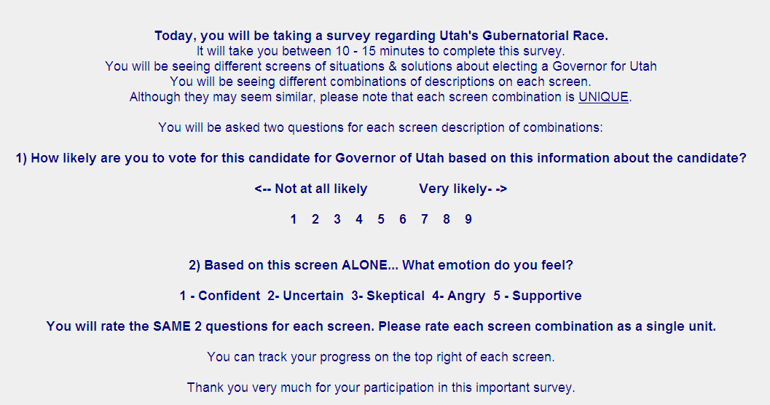

Slide 12
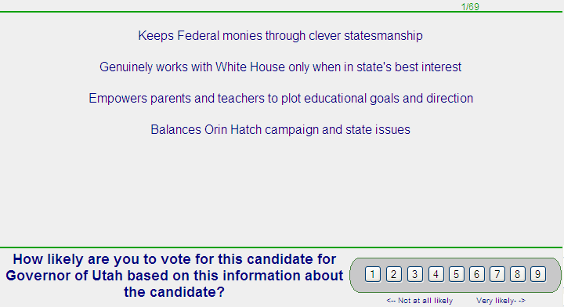
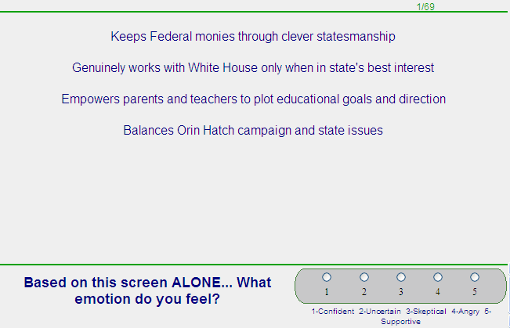

Slide 13
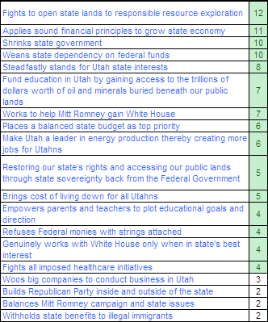
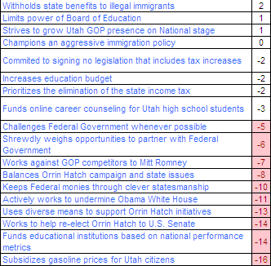
Total Panel: interested in:
Acquiring control of state resources.
Fiscal responsibility
Shrink state government
Help Romney gain White House
Total Panel: NOT interested in:
Subsidizing gasoline
Funding education based on nat’l performance metrics
Work to re-elect Orin Hatch to US Senate

Slide 14
Note: Prior to the convention, the re-election of Orrin Hatch was considered a lock. Only Addressable Minds
correctly predicted that the delegates would have a problem with the senator.
This proved to be the case when delegates voted to force Hatch to run in a primary. The first time this had occurred in decades.

Slide 15
Addressable Minds Identifies 3 Actionable Mindsets Within the 4,000 Delegate Population
(Remember ~90% were first-time delegates of whom nothing was known)
Utah First 65%
Back to Basics 20%
GOP National 15%
Campaign Issues that resonate with one mind-set can repel the others . . .

Slide 16
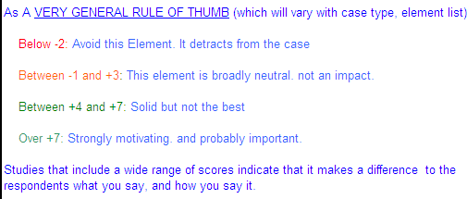
The next three pages will highlight each of the three mind-sets. Note how different issues appeal and repel each segment.
Addressable Minds delivers actionable data.

Slide 17
Utah GOP Gubernatorial Primary |  | 3 Segments
1 )How likely are you to vote for this candidate for Governor of Utah based on this information about the candidate? <-- Not at all likely to buy Very likely to buy- -> 1 2 3 4 5 6 7 8 9 Sorted by Total Sample : Highlighted >+3 & <-3 | Total Sample | Segment 1 of 3 Utah First 65% | Segment 2 of 3 Back to Basics 20% | Segment 3 of 3 GOP National 15%
Base | 190 | 124 | 37 | 28
Propensity to ... | 41 | 50 | 23 | 27
Fights to open state lands to responsible resource exploration | 12 | 12 | 17 | 7
Withholds state benefits to illegal immigrants | 2 | 11 | -19 | -13
Weans state dependency on federal funds | 10 | 10 | 5 | 15
Shrinks state government | 10 | 9 | 16 | 5
Applies sound financial principles to grow state economy | 11 | 7 | 21 | 12
Steadfastly stands for Utah state interests | 8 | 6 | 12 | 8
Empowers parents and teachers to plot educational goals and direction | 4 | 6 | -3 | 4
Make Utah a leader in energy production thereby creating more jobs for Utahns | 6 | 5 | 17 | -8
Limits power of Board of Education | 1 | 5 | -17 | 8
Places a balanced state budget as top priority | 6 | 4 | 13 | 4
Fund education in Utah by gaining access to the trillions of dollars worth of oil and minerals buried beneath our public lands | 7 | 3 | 3 | 28
Champions an aggressive immigration policy | 0 | 3 | -6 | -8
Prioritizes the elimination of the state income tax | -2 | 3 | -10 | -16
Restoring our state’s rights and accessing our public lands through state sovereignty back from the Federal Government | 5 | 3 | 11 | 5
Works to help Mitt Romney gain White House | 7 | 2 | 17 | 16
Brings cost of living down for all Utahns | 5 | 2 | 17 | 1
Refuses Federal monies with strings attached | 4 | 1 | 8 | 9
Fights all imposed healthcare initiatives | 4 | 1 | 9 | 10
Balances Mitt Romney campaign and state issues | 2 | 0 | 11 | -1
Genuinely works with White House only when in state's best interest | 4 | -1 | 11 | 14
Woos big companies to conduct business in Utah | 3 | -1 | 17 | 2
Commited to signing no legislation that includes tax increases | -2 | -1 | -1 | -4
Builds Republican Party inside and outside of the state | 2 | -3 | 6 | 19
Funds online career counseling for Utah high school students | -3 | -4 | -3 | -2
Strives to grow Utah GOP presence on National stage | 1 | -5 | 11 | 16
Challenges Federal Government whenever possible | -5 | -5 | -8 | 1
Works against GOP competitors to Mitt Romney | -7 | -8 | -1 | -12
Keeps Federal monies through clever statesmanship | -10 | -11 | -9 | -6
Increases education budget | -2 | -12 | 18 | 14
Shrewdly weighs opportunities to partner with Federal Government | -6 | -12 | 1 | 13
Actively works to undermine Obama White House | -11 | -14 | -14 | 7
Subsidizes gasoline prices for Utah citizens | -16 | -14 | -11 | -30
Funds educational institutions based on national performance metrics | -14 | -15 | -19 | -6
Balances Orrin Hatch campaign and state issues | -8 | -16 | 13 | 2
Uses diverse means to support Orrin Hatch initiatives | -13 | -23 | 9 | 1
Works to help re-elect Orrin Hatch to U.S. Senate | -14 | -24 | 4 | 8

Slide 18
1 )How likely are you to vote for this candidate for Governor of Utah based on this information about the candidate? <-- Not at all likely to buy Very likely to buy- -> 1 2 3 4 5 6 7 8 9 Sorted by Total Sample : Highlighted >+3 & <-3 | Total Sample | Segment 1 of 3 Utah First 65% | Segment 2 of 3 Back to Basics 20% | Segment 3 of 3 GOP National 15%
Base | 190 | 124 | 37 | 28
Propensity to ... | 41 | 50 | 23 | 27
Applies sound financial principles to grow state economy | 11 | 7 | 21 | 12
Increases education budget | -2 | -12 | 18 | 14
Woos big companies to conduct business in Utah | 3 | -1 | 17 | 2
Make Utah a leader in energy production thereby creating more jobs for Utahns | 6 | 5 | 17 | -8
Works to help Mitt Romney gain White House | 7 | 2 | 17 | 16
Brings cost of living down for all Utahns | 5 | 2 | 17 | 1
Fights to open state lands to responsible resource exploration | 12 | 12 | 17 | 7
Shrinks state government | 10 | 9 | 16 | 5
Balances Orrin Hatch campaign and state issues | -8 | -16 | 13 | 2
Places a balanced state budget as top priority | 6 | 4 | 13 | 4
Steadfastly stands for Utah state interests | 8 | 6 | 12 | 8
Genuinely works with White House only when in state's best interest | 4 | -1 | 11 | 14
Strives to grow Utah GOP presence on National stage | 1 | -5 | 11 | 16
Restoring our state’s rights and accessing our public lands through state sovereignty back from the Federal Government | 5 | 3 | 11 | 5
Balances Mitt Romney campaign and state issues | 2 | 0 | 11 | -1
Fights all imposed healthcare initiatives | 4 | 1 | 9 | 10
Uses diverse means to support Orrin Hatch initiatives | -13 | -23 | 9 | 1
Refuses Federal monies with strings attached | 4 | 1 | 8 | 9
Builds Republican Party inside and outside of the state | 2 | -3 | 6 | 19
Weans state dependency on federal funds | 10 | 10 | 5 | 15
Works to help re-elect Orrin Hatch to U.S. Senate | -14 | -24 | 4 | 8
Fund education in Utah by gaining access to the trillions of dollars worth of oil and minerals buried beneath our public lands | 7 | 3 | 3 | 28
Shrewdly weighs opportunities to partner with Federal Government | -6 | -12 | 1 | 13
Commited to signing no legislation that includes tax increases | -2 | -1 | -1 | -4
Works against GOP competitors to Mitt Romney | -7 | -8 | -1 | -12
Empowers parents and teachers to plot educational goals and direction | 4 | 6 | -3 | 4
Funds online career counseling for Utah high school students | -3 | -4 | -3 | -2
Champions an aggressive immigration policy | 0 | 3 | -6 | -8
Challenges Federal Government whenever possible | -5 | -5 | -8 | 1
Keeps Federal monies through clever statesmanship | -10 | -11 | -9 | -6
Prioritizes the elimination of the state income tax | -2 | 3 | -10 | -16
Subsidizes gasoline prices for Utah citizens | -16 | -14 | -11 | -30
Actively works to undermine Obama White House | -11 | -14 | -14 | 7
Limits power of Board of Education | 1 | 5 | -17 | 8
Funds educational institutions based on national performance metrics | -14 | -15 | -19 | -6
Withholds state benefits to illegal immigrants | 2 | 11 | -19 | -13

Slide 19
1 )How likely are you to vote for this candidate for Governor of Utah based on this information about the candidate? <-- Not at all likely to buy Very likely to buy- -> 1 2 3 4 5 6 7 8 9 Sorted by Total Sample : Highlighted >+3 & <-3 | Total Sample | Segment 1 of 3 Utah First 65% | Segment 2 of 3 Back to Basics 20% | Segment 3 of 3 GOP National 15%
Base | 190 | 124 | 37 | 28
Propensity to ... | 41 | 50 | 23 | 27
Fund education in Utah by gaining access to the trillions of dollars worth of oil and minerals buried beneath our public lands | 7 | 3 | 3 | 28
Builds Republican Party inside and outside of the state | 2 | -3 | 6 | 19
Strives to grow Utah GOP presence on National stage | 1 | -5 | 11 | 16
Works to help Mitt Romney gain White House | 7 | 2 | 17 | 16
Weans state dependency on federal funds | 10 | 10 | 5 | 15
Genuinely works with White House only when in state's best interest | 4 | -1 | 11 | 14
Increases education budget | -2 | -12 | 18 | 14
Shrewdly weighs opportunities to partner with Federal Government | -6 | -12 | 1 | 13
Applies sound financial principles to grow state economy | 11 | 7 | 21 | 12
Fights all imposed healthcare initiatives | 4 | 1 | 9 | 10
Refuses Federal monies with strings attached | 4 | 1 | 8 | 9
Limits power of Board of Education | 1 | 5 | -17 | 8
Steadfastly stands for Utah state interests | 8 | 6 | 12 | 8
Works to help re-elect Orrin Hatch to U.S. Senate | -14 | -24 | 4 | 8
Fights to open state lands to responsible resource exploration | 12 | 12 | 17 | 7
Actively works to undermine Obama White House | -11 | -14 | -14 | 7
Restoring our state’s rights and accessing our public lands through state sovereignty back from the Federal Government | 5 | 3 | 11 | 5
Shrinks state government | 10 | 9 | 16 | 5
Empowers parents and teachers to plot educational goals and direction | 4 | 6 | -3 | 4
Places a balanced state budget as top priority | 6 | 4 | 13 | 4
Woos big companies to conduct business in Utah | 3 | -1 | 17 | 2
Balances Orrin Hatch campaign and state issues | -8 | -16 | 13 | 2
Challenges Federal Government whenever possible | -5 | -5 | -8 | 1
Uses diverse means to support Orrin Hatch initiatives | -13 | -23 | 9 | 1
Brings cost of living down for all Utahns | 5 | 2 | 17 | 1
Balances Mitt Romney campaign and state issues | 2 | 0 | 11 | -1
Funds online career counseling for Utah high school students | -3 | -4 | -3 | -2
Commited to signing no legislation that includes tax increases | -2 | -1 | -1 | -4
Funds educational institutions based on national performance metrics | -14 | -15 | -19 | -6
Keeps Federal monies through clever statesmanship | -10 | -11 | -9 | -6
Champions an aggressive immigration policy | 0 | 3 | -6 | -8
Make Utah a leader in energy production thereby creating more jobs for Utahns | 6 | 5 | 17 | -8
Works against GOP competitors to Mitt Romney | -7 | -8 | -1 | -12
Withholds state benefits to illegal immigrants | 2 | 11 | -19 | -13
Prioritizes the elimination of the state income tax | -2 | 3 | -10 | -16
Subsidizes gasoline prices for Utah citizens | -16 | -14 | -11 | -30

Slide 20
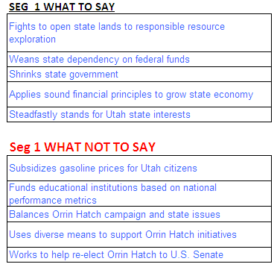
Issue Scripting for Candidate and Staff
Utah First 65%

Slide 21
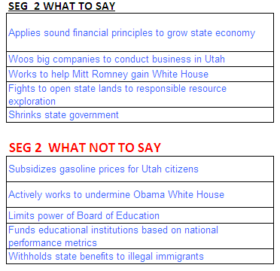
Issue Scripting for Candidate and Staff
Back to Basics 20%

Slide 22
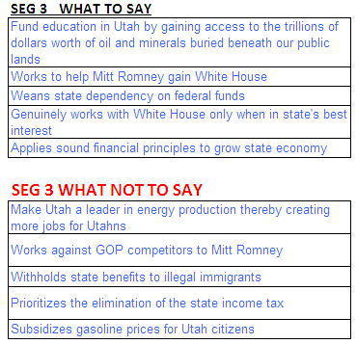
Issue Scripting for Candidate and Staff
GOP National 15%

Slide 23
Innovative
Technology
The Addressable Minds Typing Tool
Identifying mind-sets in a group is one thing – but
what if you want to know what mind-set a specific
person belongs to?
?

Slide 24
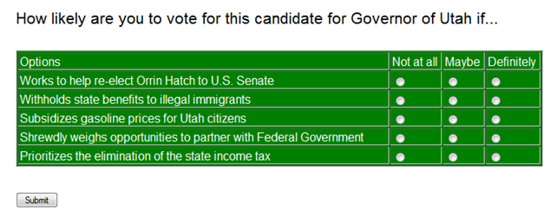
Innovative
Technology
The Addressable Minds Typing Tool
Ask 3 to 5 questions to learn what mind-set any individual belongs to – and know with
confidence what you should say, and what you should NOT say.
Questions can be posed on a website, mailers,
Surveys, phone polls, etc.

Slide 25
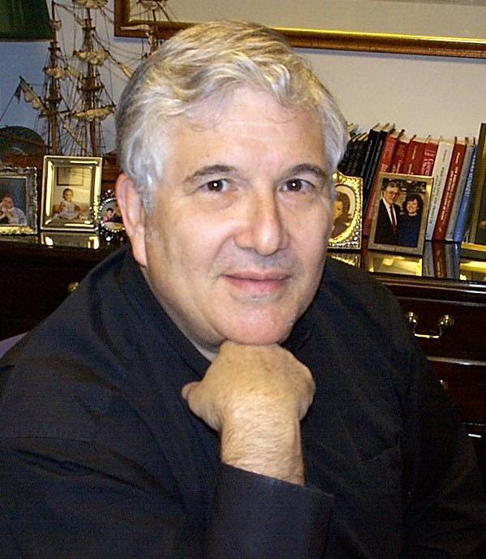
Dr. Howard Moskowitz.
Addressable Minds Inventor, honored by the scientific community
Is the President of Moskowitz Jacobs Inc. and holds a Ph.D. in Experimental Psychology from Harvard University.
•Won two of the most prestigious awards in marketresearch
•2005 Charles Coolidge Parlin Marketing Research AwardThe “Nobel
Prize” of Market Research, received only by the pioneers of market research. Recipients include Arthur Nielsen, George Gallup, Michael Porter, David Ogilvy and Philip Kotler.
•2010 Walston Chubb Award for Innovation across all sciences, Sigma Xi, The Scientific Research Society, international Awarded for Mind Genomics: The science underlying the technology discussed in this presentation

