Slide 1
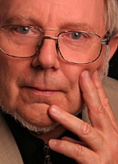


Why Wikipedia is Not Enough?
Hermann Maurer
Professor at Graz University of Technology
Chair of the Informatics Section of Academia Europaea
Veljko Milutinovic
Professor at University of Belgrade
Member of the Informatics Section of Academia Europaea
Presentation for the Ministry of Science of Montenegro
Podgorica, April 6, 2012
Notes:
1

Slide 2
Wikipedia:
A valuable resource to get up-to-date information
Available in many languages:
English: ~ 3,000.000 entries
German: ~1,500.000 entries
Serbian: ~150.000 entries
However,
most entries in the Serbian Wikipedia
do not (!) concentrate on Serbia
and are quite incomplete.
2

Slide 3
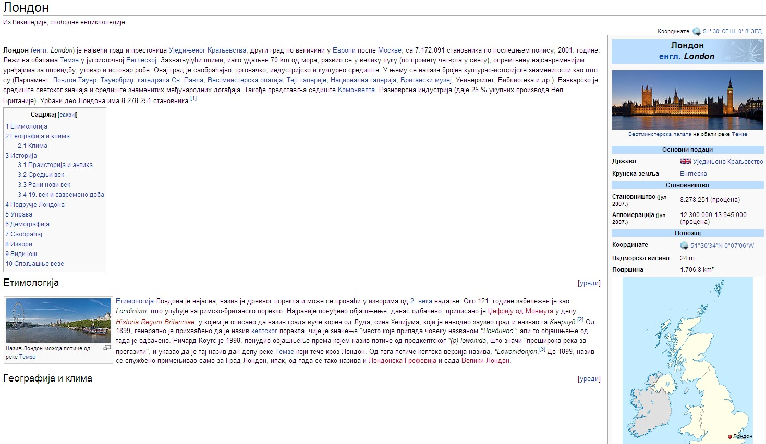
The majority of topics on the Serbian Wikipedia does not deal with Serbia (like the above) and is incomplete (links missing) as the red entries show.
3

Slide 4
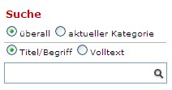
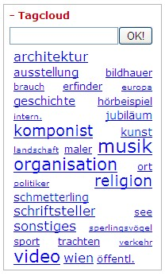
Forum: Important points of regional servers
(1) Information: Not a single linearly ordered lexicographical collection,
but structured into various collections.
Searching can be restricted to one of the categories
(essential for full-text search).
General Encyclopedia
Cities and villages
Geographical features
Flowers of Montenegro
Animals of Montenegro
Famous Persons
Important Historic Facts
.
.
.
Various options
for searching
4

Slide 5
Forum: Important points of regional servers
(2) Information should be integrated
(= pulled together from various sources semi-automatically)
Examples:
Picture databases (how to merge two data-bases of pictures)
CVs (how to merge two different CVs of same person)
Linking of data (accross time and region)
In general, a very important but very complex task
(many Ph.D. theses just in this area!)
5

Slide 6
Forum: Important points of regional servers
(3) Information must be searchable by metadata.
Next page shows:
We are searching for someone
whose name we don‘t know,
but we know he was born in Vienna (Wien),
was working in physics (Physik) and died in Italy (Italien).
The one person fitting the description, Ludwig Boltzmann, is indeed found.
6

Slide 7
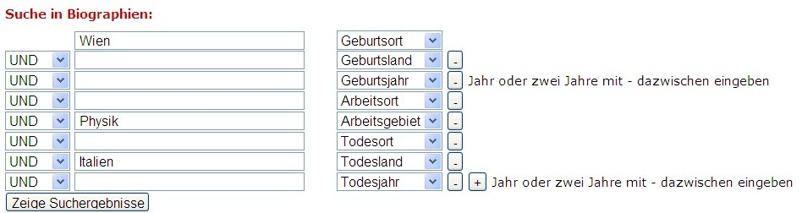

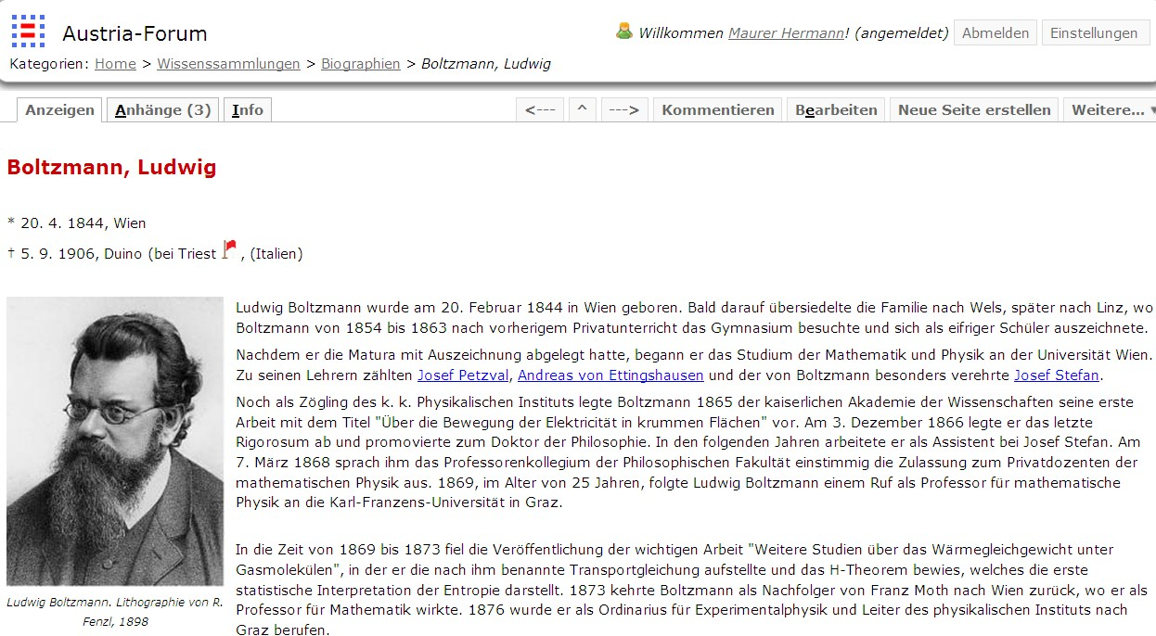
7

Slide 8
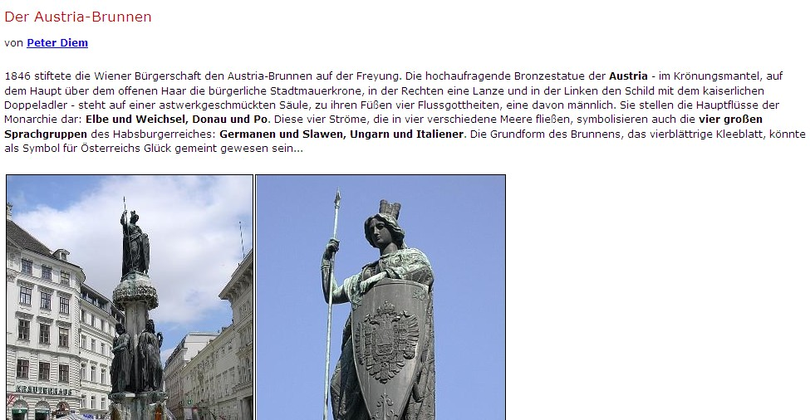
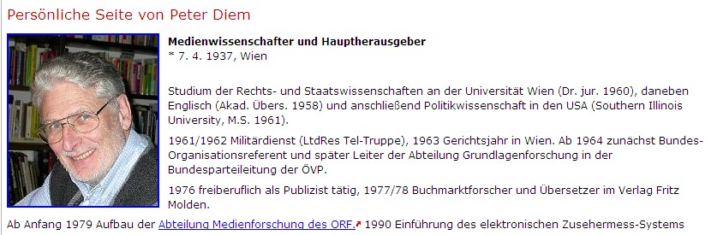
(4) There is often no absolute truth.
Hence, many topics deserve presentations from various points of view.
(5) The source of the text must be always known:
Either the name of the author including CV,
or the book/archive it comes from! Example:
Reading about „Austria Brunnen“ one gets the author at one click.
8

Slide 9
(6) Updating is dangerous:
It destroys previous information and hence history.
When, e.g. an old building is „updated“ (renovated)
one cannot experience what it was like earlier.
The same is true of information:
We believe in preservation of information,
allowing „time-travel“ by reading about e.g. Podgorica
at various points in time.
The next page contains VREMEPLOV
of the main theater in Vienna
9

Slide 10
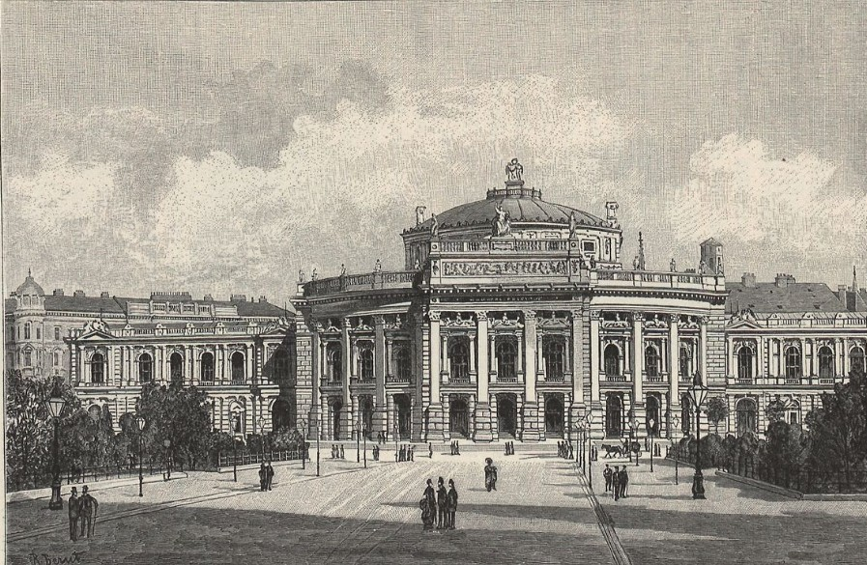
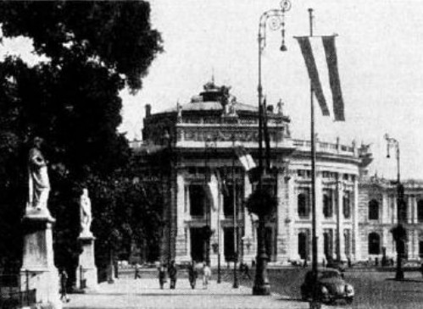
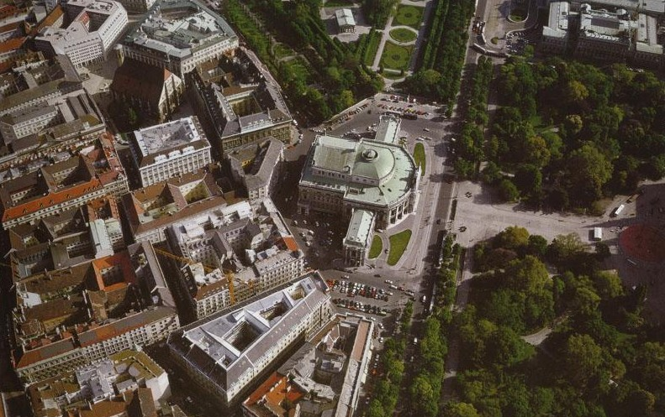
BurgTheaterWien
1900
1965
2000
10

Slide 11
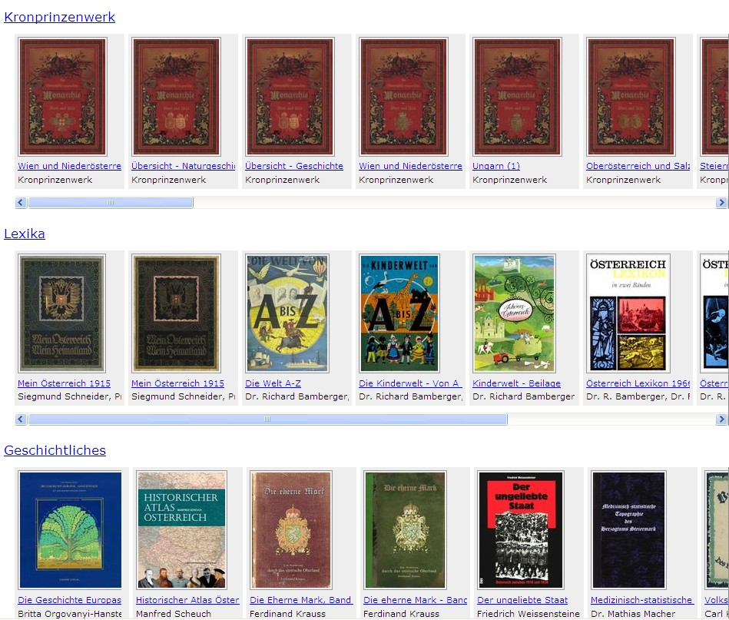
(7) Books are not just a source of information!
Web Books behave like printed books
but also offer some new functions: links, bookmarks, …
11

Slide 12
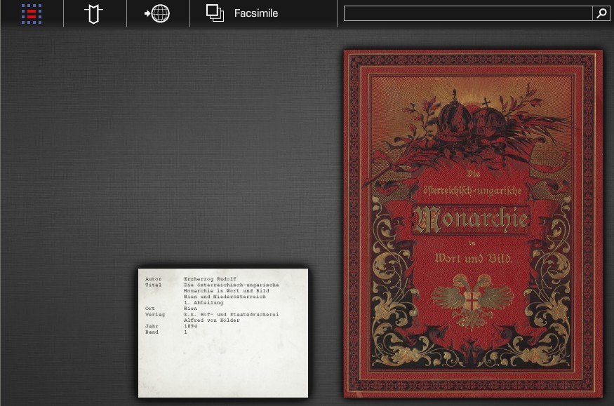
Clicking at book opens it.
Then one can turn pages or jump to an arbitrary page.
12

Slide 13
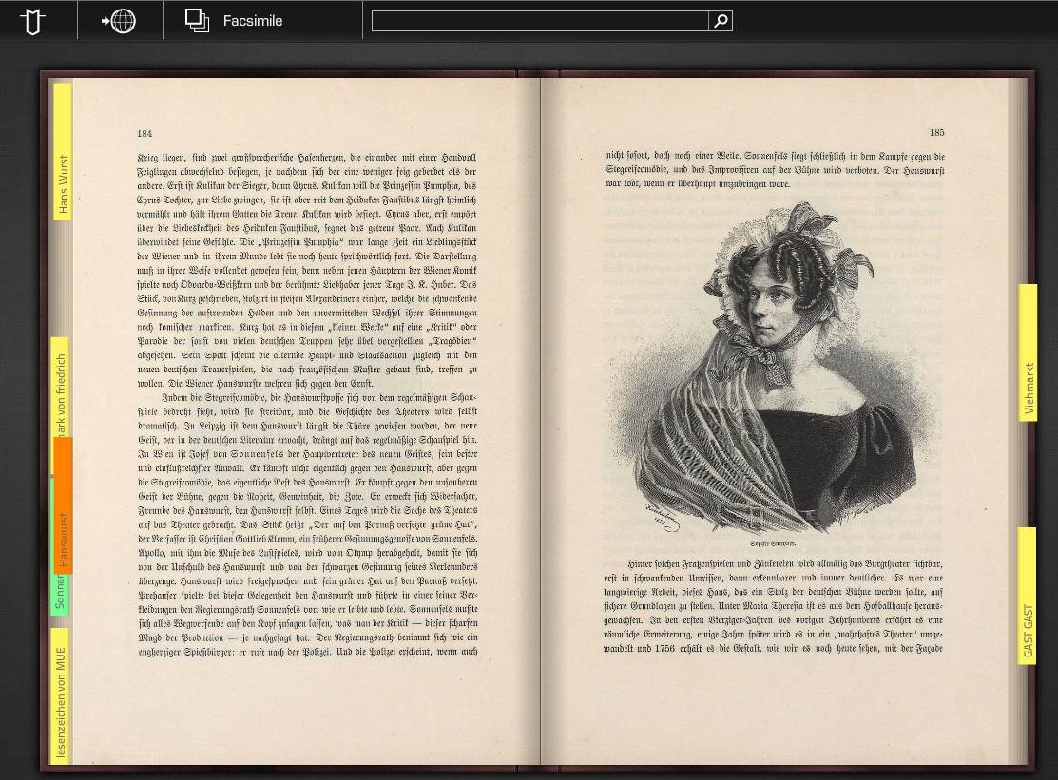
This screen-shot shows some bookmarks. This icon allows a switch, to an ordinary font. Clicking at one page, only that one is shown,
and one can then zoom in (see next page)
13

Slide 14
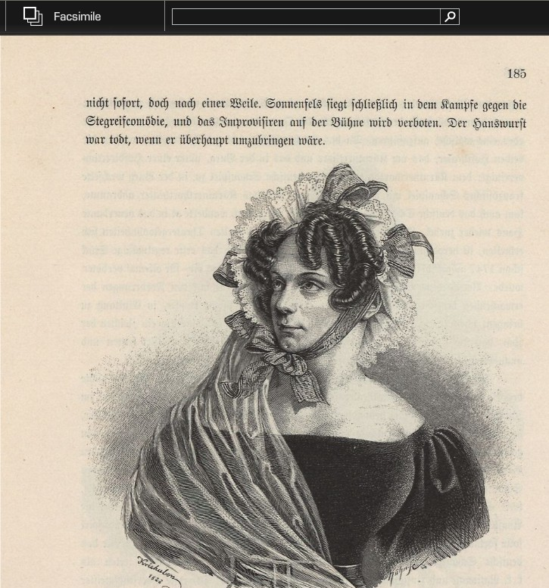
When choosing a
single page it can
be zoomed and moved
around arbitrarily
The enlarged picture. Note the field that allows full-text search!
14

Slide 15
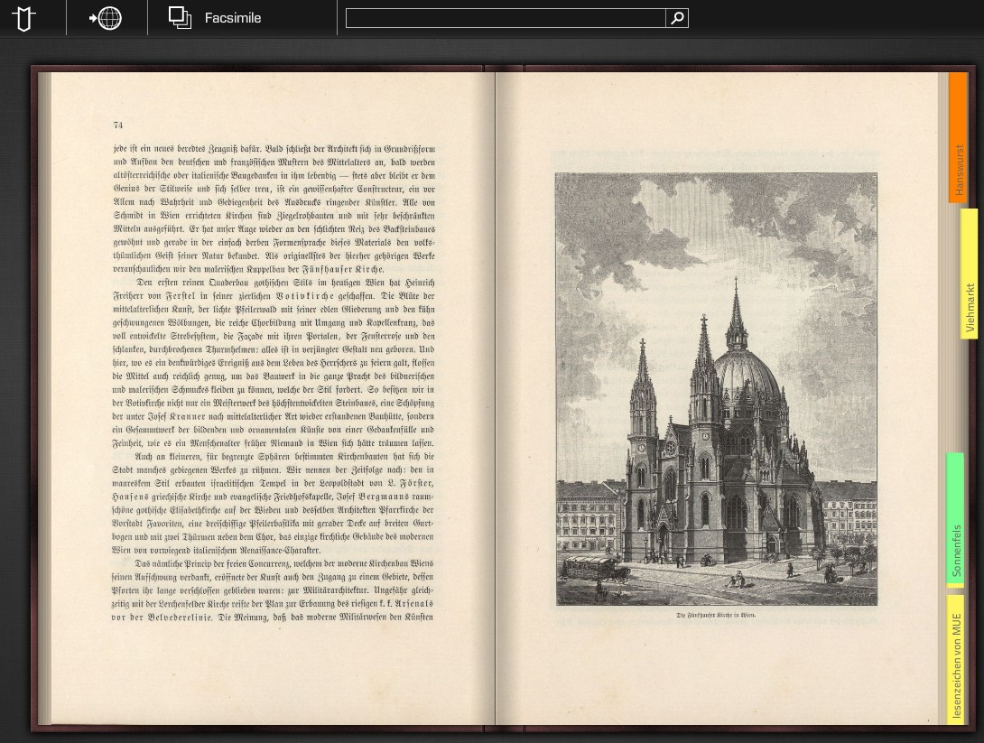
Bookmark and Link creation
15

Slide 16
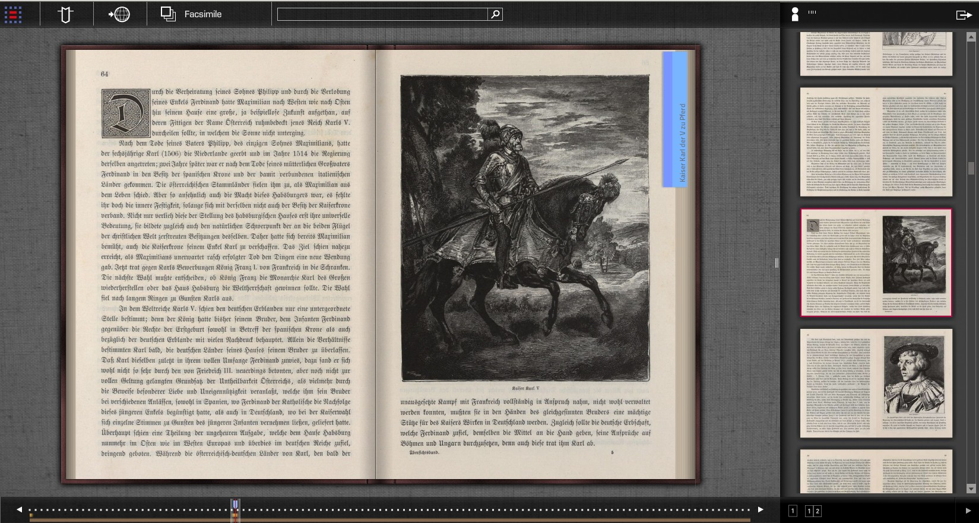
Full view of Web Book with other features:
Click here to see page number and preview
Preview of all pages (single page or double page as shown)
16

Slide 17
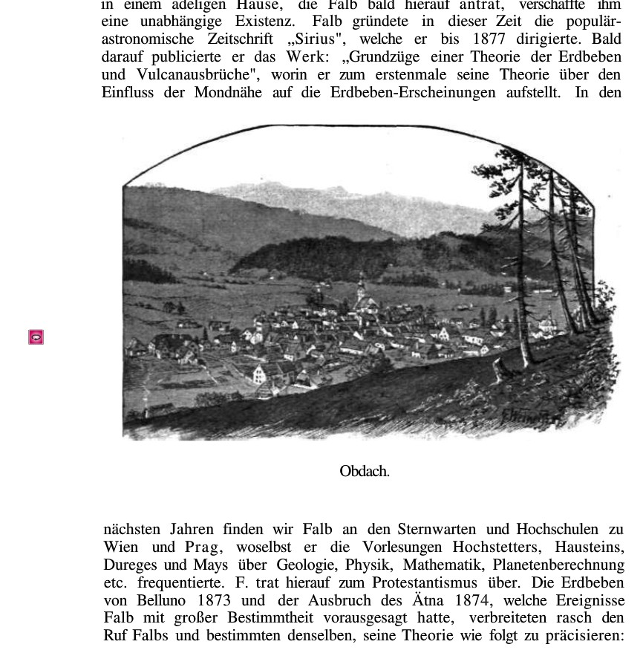
Page from old
book on a
village Obdach.
Clicking here
gives panoramic
view in our days
(next page)
17

Slide 18
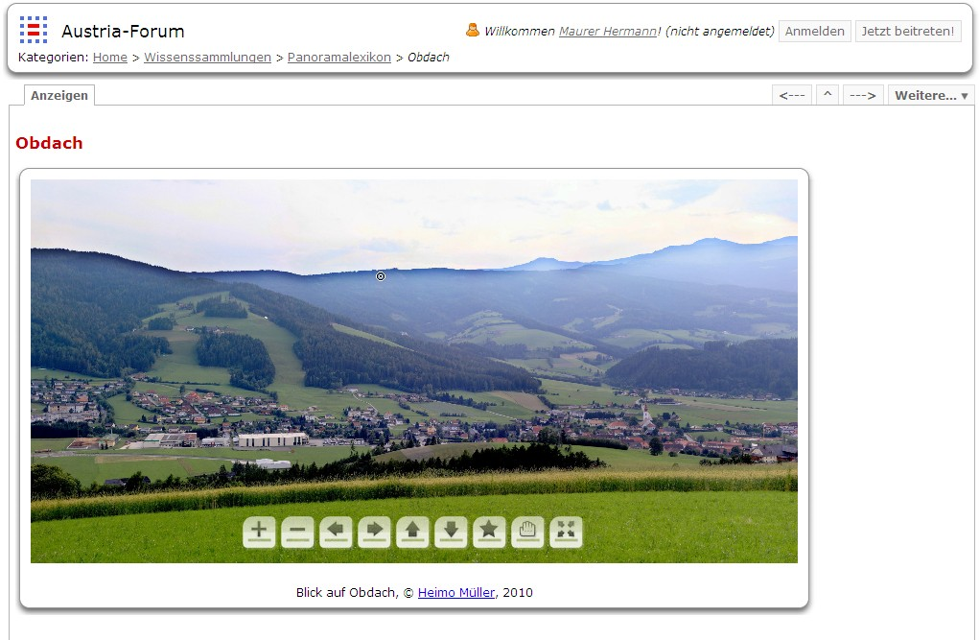
Panoramic picture, zoomable and moveable
18

Slide 19
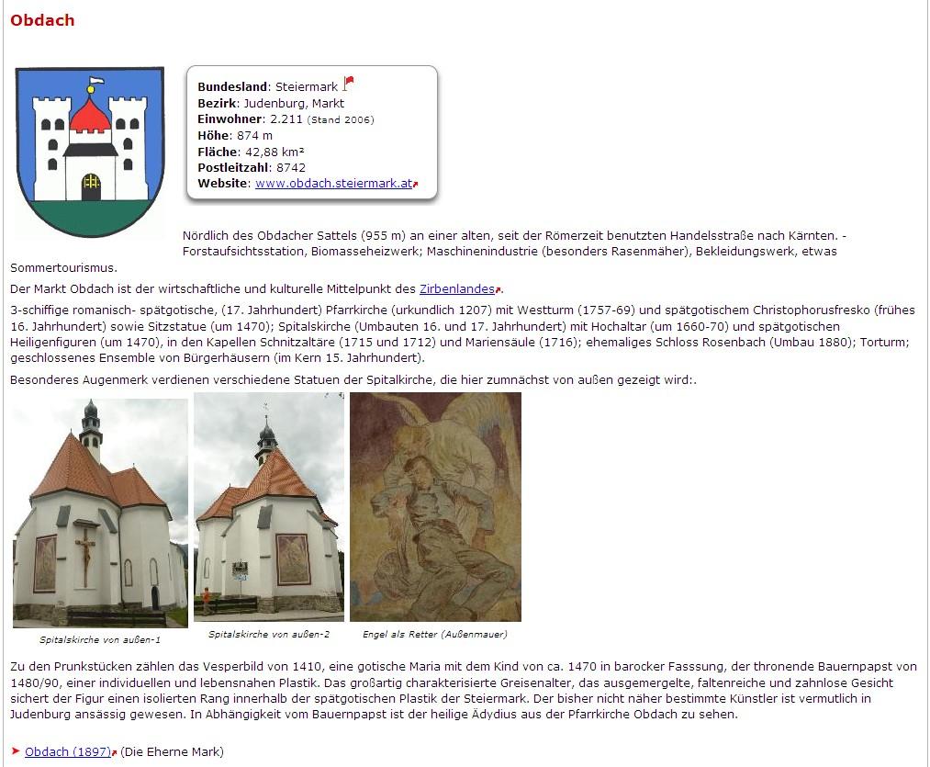
…or general information on the village today
19

Slide 20
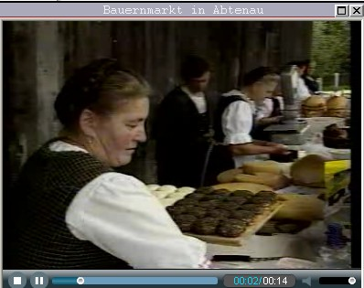
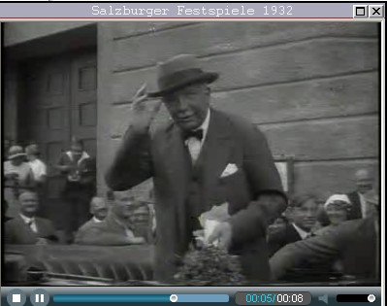
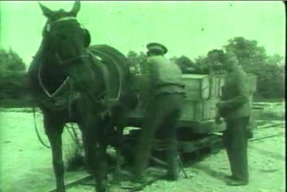
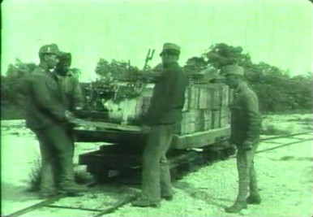
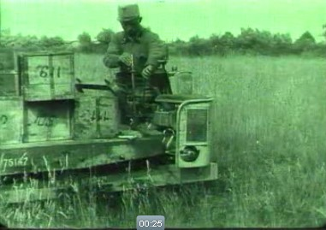
Of course regional forums must also contain: Videoclips
Farmer‘s
Market
Famous
person in
1932
Changing from horse-railway to motorized railway cars (1914)
20
(Examples taken from the regional server called www.austria-forum.org)

Slide 21
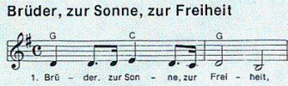
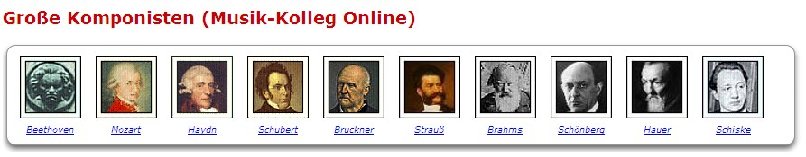
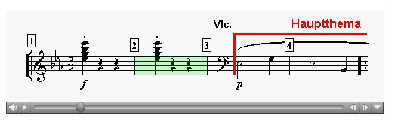
Of course regional forums must also contain:
Samples of music
21

Slide 22

Of course regional forums must also contain:
Zooming of pictures
22

Slide 23

23

Slide 24







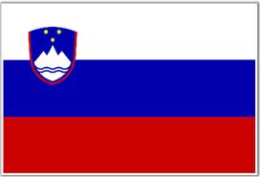


Fori in works (FP7):
Europaea, fully operational!
(2) Germany
(3) Holland
(4) England
(5) Portugal
(6) Italy
(7) Spain
(8) Slovenia
(9) Serbia
(10) Montenegro, maybe?
24

Slide 25


Slide 26
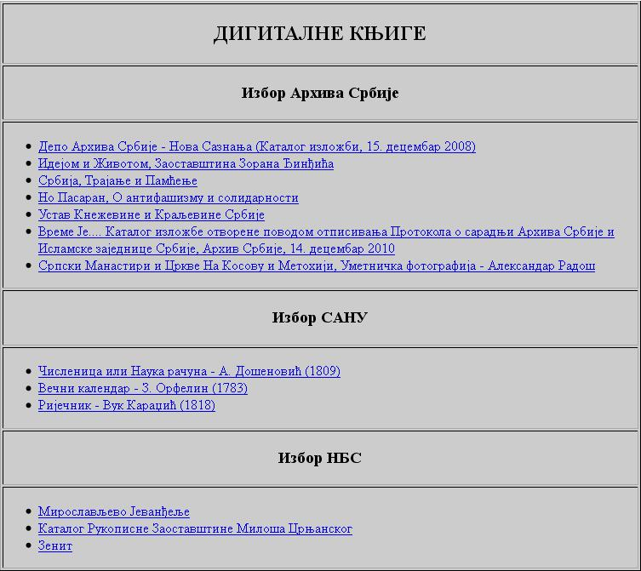

Slide 27
Axioms of Serbia Forum:
Primary
Secondary
27

Slide 28
Secondary Axioms of Serbia Forum:
Temporary differences compared to Wikipedia!
May dissappear over time!
(1) Semantic search
(2) Author visibility
(3) Evolution tracking
(4) Original commodities
28

Slide 29
Primary Axioms of Serbia Forum:
Essential differences compared to Wikipedia!
Will stay forever!
(1) National herritage owned by national institutions
must be exposed by servers under control of these institutions
(2) National herritage falls into a number of different legal
regulatories, not only CC
(3) Stress on quality,
not quantity
(4) Semantic culture oriented translation
into a relatively high number of foreign languages
29

Slide 30
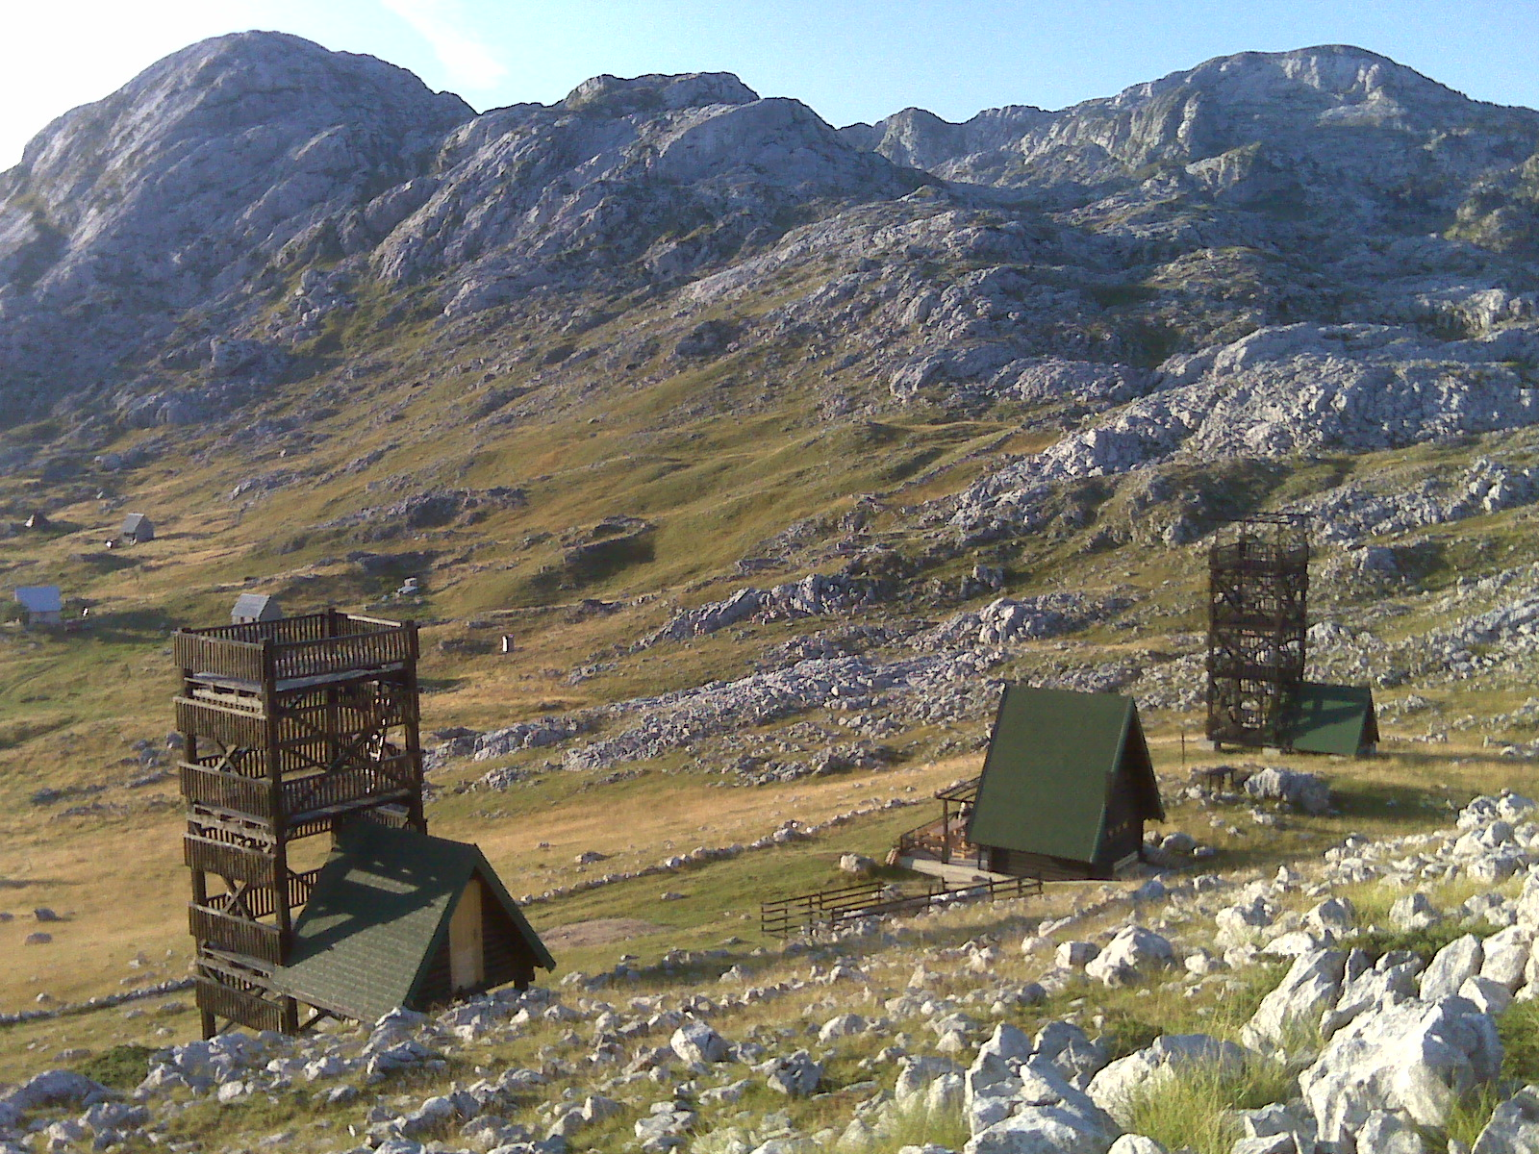
30

Slide 31
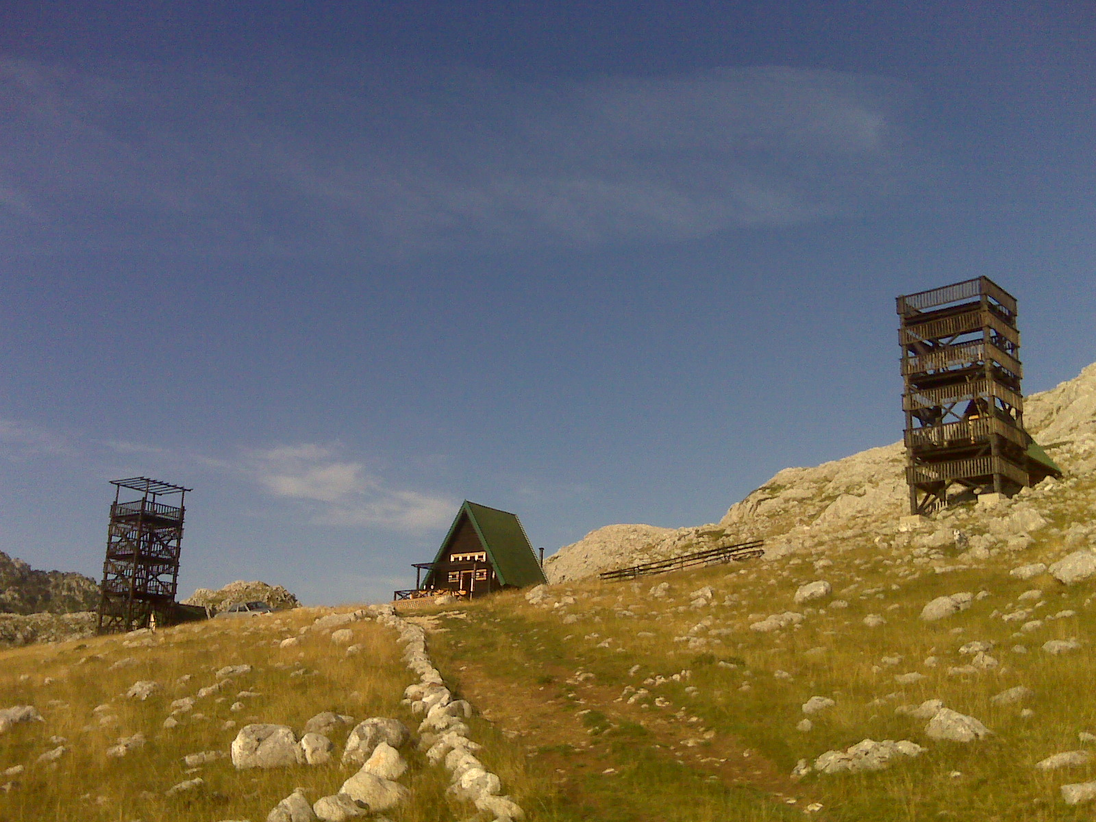

Slide 32
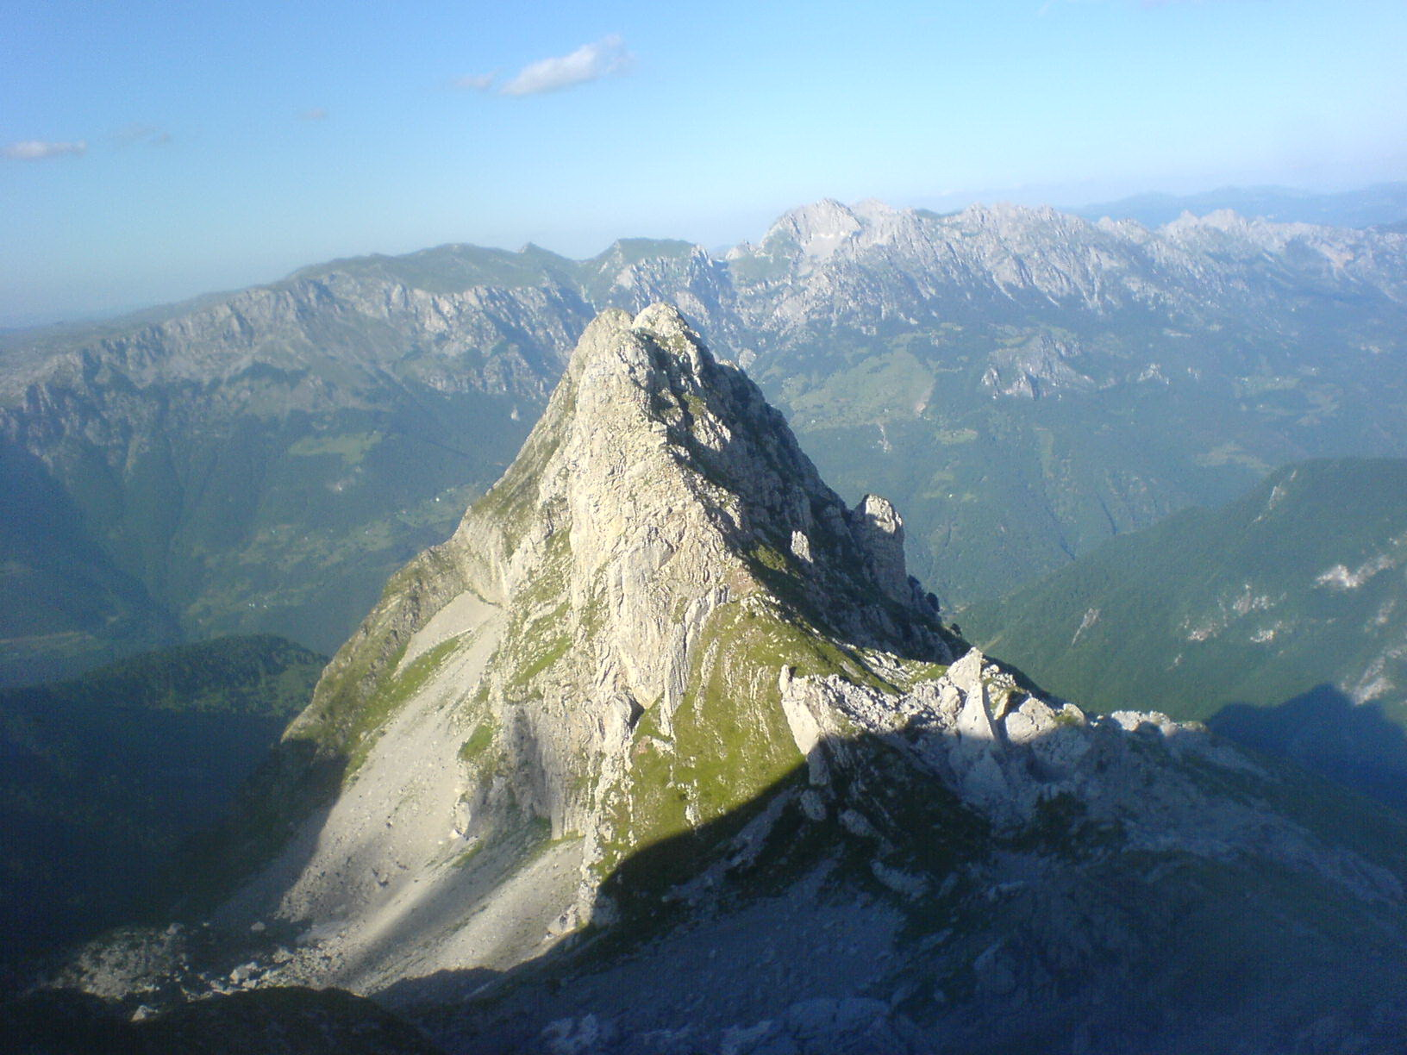

Slide 33
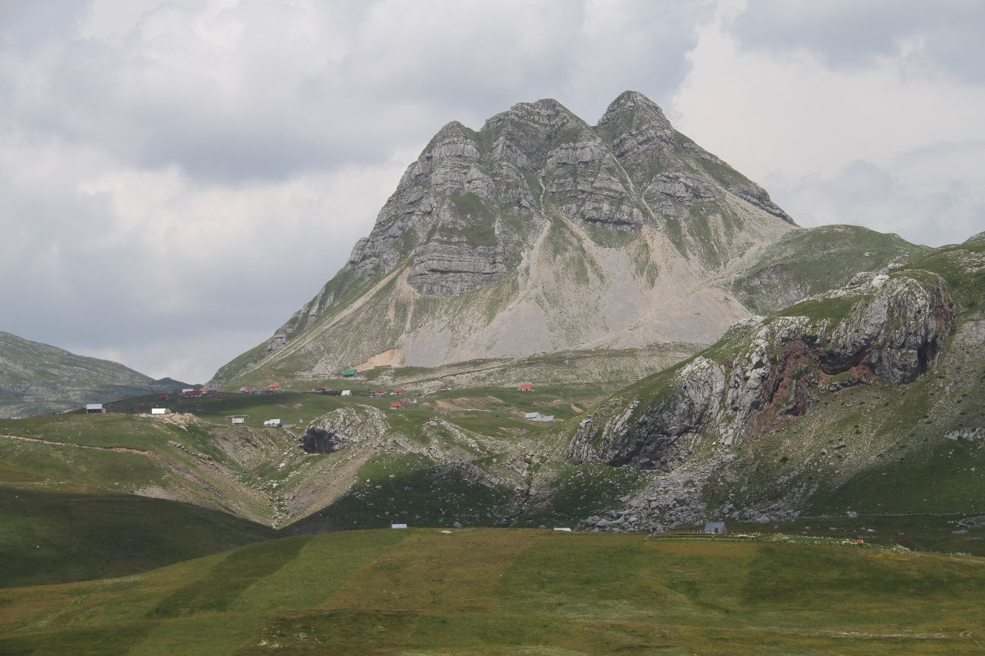
Q&A
vm@etf.rs

