Slide 1
Web-Protégé
Jelena Vukovic, 53/07
jeca.zr@gmail.com

Slide 2
Introduction
Ontologies are getting larger
No single person can develop them efficiently
How to allow easy collaboration between people?
Web is a natural solution!
Widely available platform!

Slide 3
Requirements for web-based collaborative ontology environment
Simple way of making ontologies available on the web
Comments and discussions are part of development process
Same sort of editing help when making a change to ontology in a browser as available in desktop client editors
Customizable appearance of the web interface

Slide 4
System description
Protégé
Collaborative protégé
Widely used
open-source
ontology and knowledge
base editor
Protégé extension
Enables users to hold
discussions, chat, annotate ontology components and changes as integral part of the ontology development process

Slide 5
Web-Protégé
Open-source, lightweight ontology editor for the Web
Uses Protégé as its base
Better supports collaborative development process
in web environment
Easily customizable platform for different users
Possible to connect with a Collaborative Protégé
desktop client

Slide 6
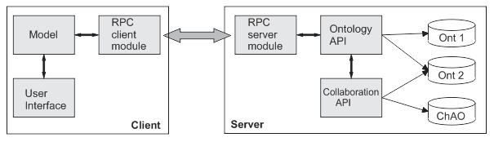
Architecture
Client
Server
Model
User interface
RPC client module
(Remote Procedure Calls)
Ontology API
Collaboration API
RPC server module
Changes and Annotations ontology

Slide 7
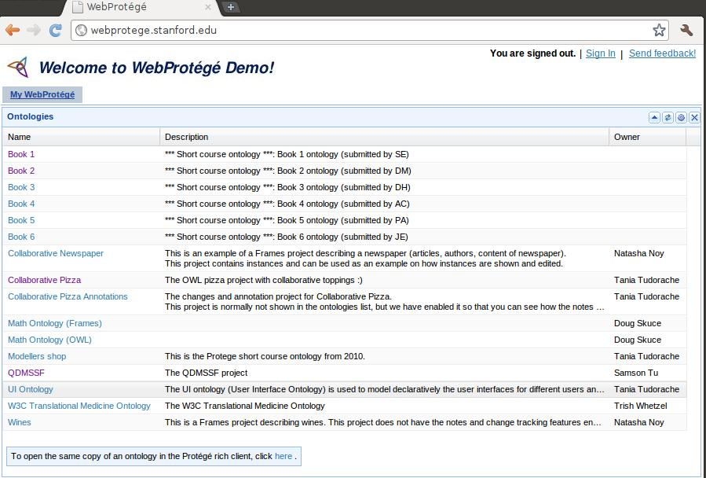
User interface

Slide 8
User Interface
Shows all available ontologies
Possibility to connect through desktop client
Both desktop and web client are linked to the
same Collaborative protégé server
All of the edits are reflected in between them

Slide 9
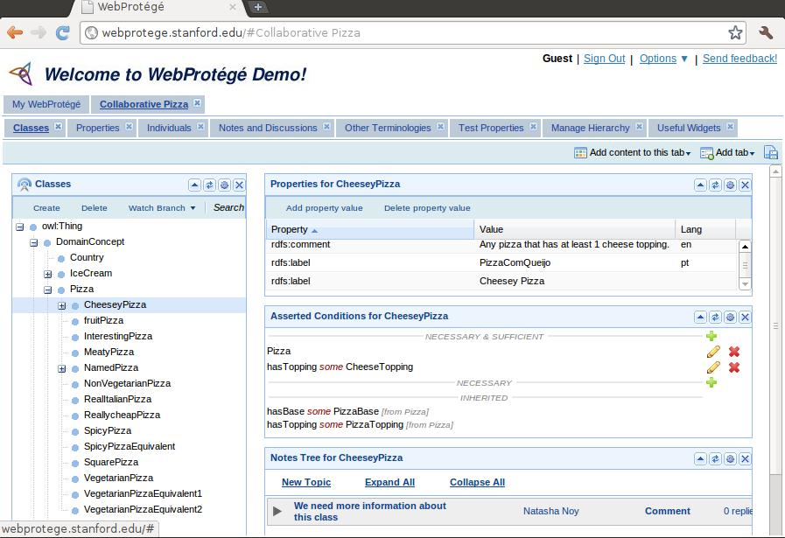
Classes interface

Slide 10
Classes interface
Shows class hierarchy
Possible to see class
    Properties
    Axioms
    Notes
    Etc.

Slide 11
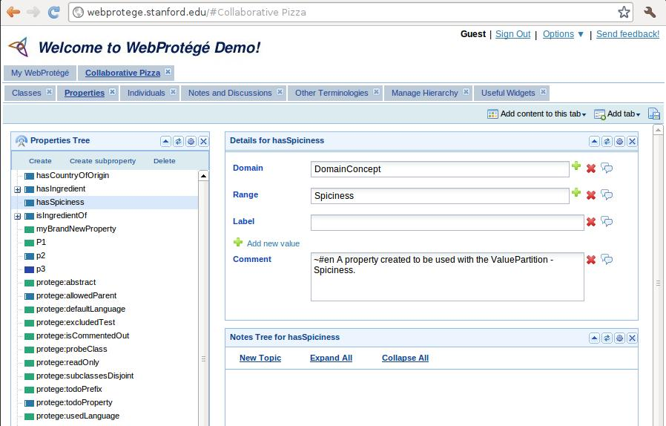
Properties

Slide 12
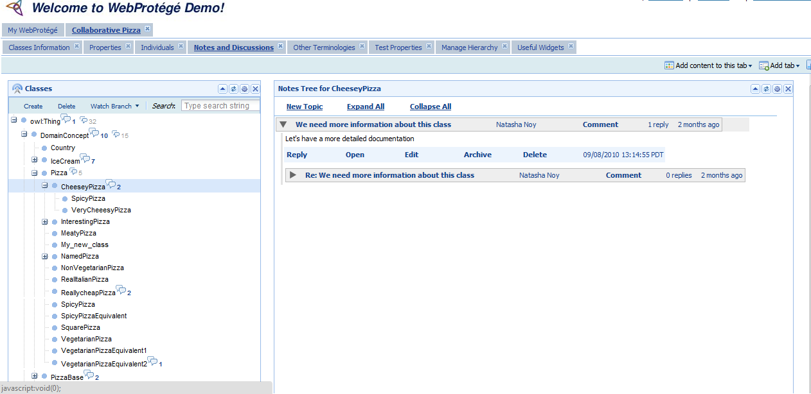
Notes and Discussion

Slide 13
Conclusion
Light weighted ontology web editor
Collaboration support during development
Easily customizable for each user
Simple to use, suitable for beginners

Slide 14
Thank you!

