Slide 1
SIOC -Semantically-Interlinked Online Communities
Student : Mateja Saković 3015/2011

Slide 2
Introduction
Semantic Web technology
Interconnecting online communities
such as blogs, forums and mailing lists to each other
The SIOC project was started in 2004 by John Breslin and Uldis Bojars at DERI, NUI Galway
The SIOC project consists of two main parts:
  The SIOC Ontology
  A set of applications, for both producing and consuming SIOC data

Slide 3
Online communities
Mailing lists
Bulletin boards
Social networks
Blogs
Wikis

Slide 4
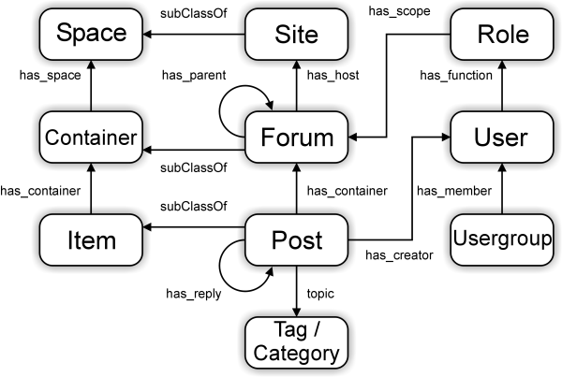
SIOC Ontology

Slide 5
Example
<sioc:Post rdf:about="http://johnbreslin.com/blog/2006/09/07/creating-connections-between-discussion-clouds-with-sioc/">
<dcterms:title>Creating connections between discussion clouds with SIOC</dcterms:title>
<dcterms:created>2006-09-07T09:33:30Z</dcterms:created>
<sioc:has_container rdf:resource="http://johnbreslin.com/blog/index.php?sioc_type=site#weblog"/>
<sioc:has_creator>
<sioc:UserAccount rdf:about="http://johnbreslin.com/blog/author/cloud/" rdfs:label="Cloud">
<rdfs:seeAlso rdf:resource="http://johnbreslin.com/blog/index.php?sioc_type=user&amp;sioc_id=1"/> </sioc:UserAccount>
</sioc:has_creator>
<sioc:content>SIOC provides a unified vocabulary for content and interaction description: a semantic layer that can co-exist with existing discussion platforms.</sioc:content>
<sioc:topic rdfs:label="Semantic Web" rdf:resource="http://johnbreslin.com/blog/category/semantic-web/"/>
<sioc:topic rdfs:label="Blogs" rdf:resource="http://johnbreslin.com/blog/category/blogs/"/>
<sioc:has_reply>
<sioc:Post rdf:about="http://johnbreslin.com/blog/2006/09/07/creating-connections-between-discussion-clouds- with-sioc/#comment-123928">
<rdfs:seeAlso rdf:resource="http://johnbreslin.com/blog/index.php?sioc_type=comment&amp;sioc_id=123928"/> </sioc:Post>
</sioc:has_reply>
</sioc:Post>

Slide 6
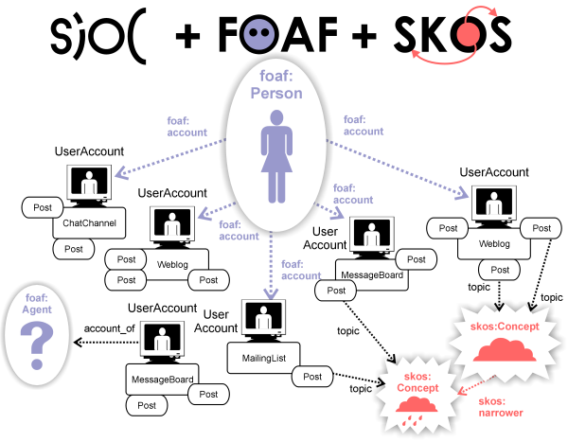
FOAF and SKOS
FAOF = Friend of a friend ontology
sioc:User
SKOS = Simple Knowledge Organisation Systems

Slide 7
SIOC modules
SIOC has 3 ontology modules:
  Access - defines simple classes and properties regarding the notions of Role and Permission to represent access rights and permissions in online communities websites

Slide 8
SIOC modules(2)
    Services - defines classes and properties to reprsent Web services related to online communities
  Types - defines advanced content-types to be used when defining user-generated content from online communities

Slide 9
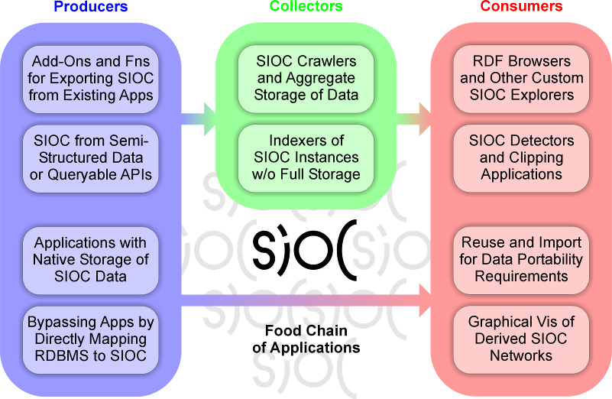
SIOC food-chain

Slide 10
Creating SIOC data
SIOC APIs:
  SIOC Export API for PHP
  SIOC API for Java
  SIOC API for Perl
Weblog, forum and CMS exporters
  WordPress SIOC Exporter
  phpBB SIOC Exporter
  vBulletin SIOC Exporter

Slide 11
Creating SIOC data(2)
Other exporters
  SWAML
  Mailing List Explorer
  Twitter2RDF

Slide 12
Using SIOC data
Querying SIOC data
  OpenLink Data Spaces
Browsing SIOC data
  SIOC Browser
  Buxon
  SIOC Explorer

Slide 13
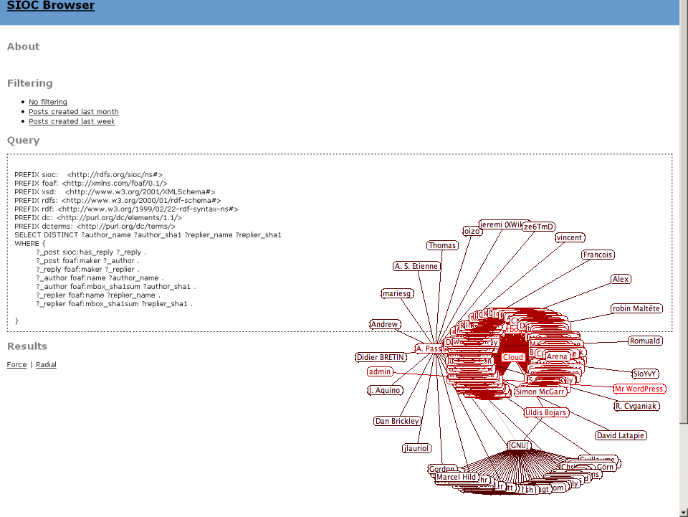
Using SIOC data(2)

Slide 14
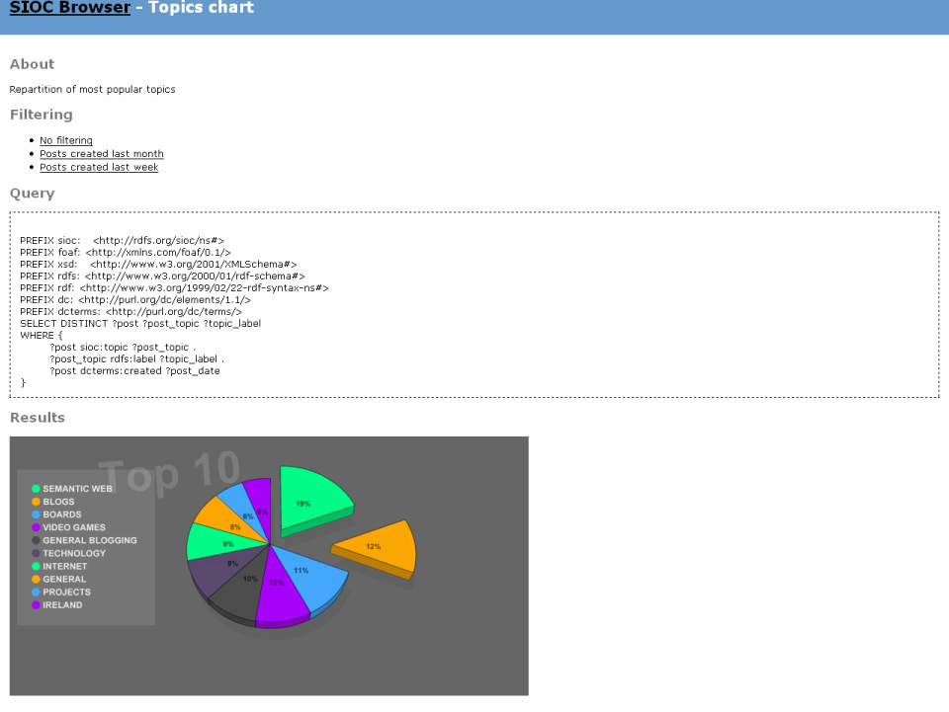
Using SIOC data(3)

Slide 15
References
Uldis Bojars, Alexandre Passant, John G. Breslin, Stefan Decker “The SIOC Project: Semantically-Interlinked Online Communities”
SIOC Core Ontology Specification
http://sw.deri.org
Wikipedia - http://www.wikipedia.org/

Slide 16
Thank you for attention!
Questions?

