Slide 1
PoolParty
Vasiljevic Vladica,
vv113314m@student.etf.rs

Slide 2
Introduction
PoolParty Thesaurus Manager (PPTM) is a web-based thesaurus management system which is completely built on top of W3C´s semantic web standards
Compared to other systems which still rely on relational databases PoolParty is ready to consume and to publish Linked Data out-of-the-box.

Slide 3
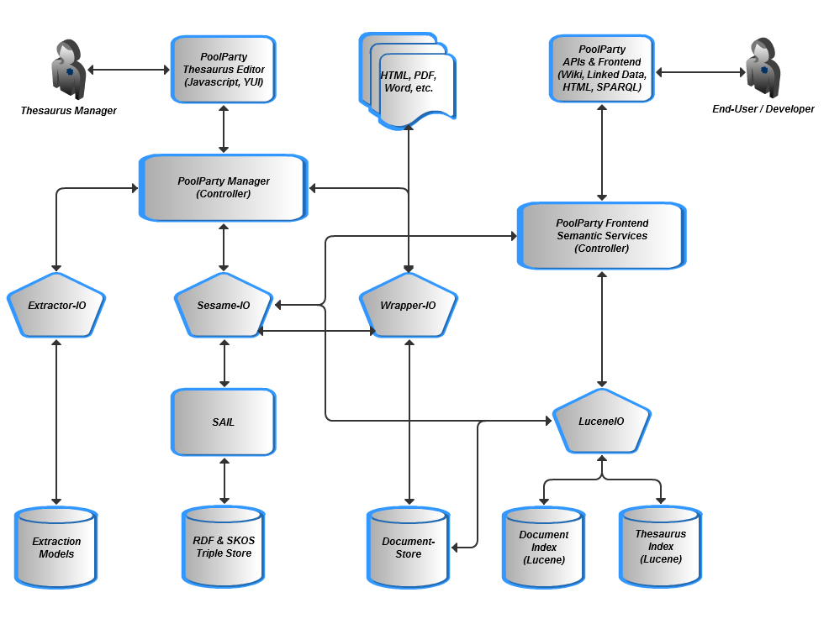
PoolParty Thesaurus Management System - Overview

Slide 4
Collaborative thesaurus management
Thesauri in the age of the web most often should be engineered and maintained in a collaborative manner. PoolParty is fully web-based
  administrators need only a web browser to do all typical CRUD operations like adding new concepts or relations
  Based on the linked data principles [9] thesauri can be maintained at different places but still can be connected to each other indicating that several concepts are similar or even identical to each other.

Slide 5
Thesaurus Management and Linked (Open & Closed) Data
PoolParty is not only a system serving government organisations but also enterprises with metadata management solutions, PoolParty´s Linked Data mechanisms can be used as a data integration technology also behind the corporate firewalls.
PoolParty also makes use of existing Linked Data sources, e.g. concepts can be aligned and enriched with additional information from sources like Dbpedia, Sindice or others.

Slide 6
PoolParty Enterprise Vocabulary and Metadata Management
PoolParty is an enterprise ready system, which offers high reliability, usability, performance and mechanisms like failover which guarantees smooth workflows and protection from loss of data. Typical enterprise systems like Linux or Windows servers are supported.
Enterprise Vocabulary and Metadata Management is fully supported and open standards guarantee a high investment security. The integration of PoolParty thesauri with enterprise systems can be realised on top of standard APIs.

Slide 7
Text Mining and Semantic Search
PoolParty offers a variety of options to ease thesaurus management by means of text mining as well as solutions to make semantic search solutions possible. PoolParty can analyse different text formats like HTML, PDF or Word and can detect significant terms within a document either based on existing thesauri or to serve as a new candidate term to further expand a thesaurus.
The PoolParty product family consists of two other components which together with thesaurus management are the basis for enterprise semantic search solutions.

Slide 8
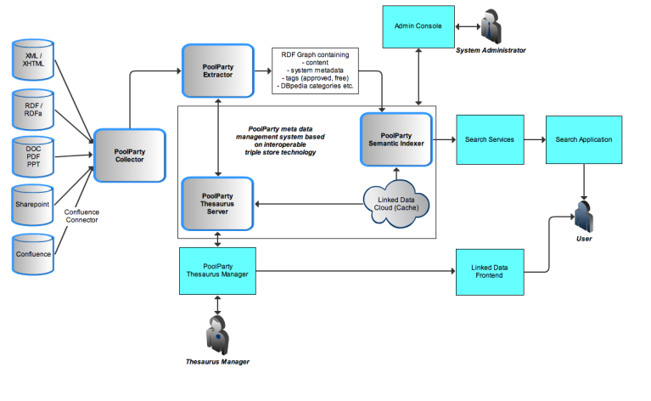
Vertical Search Solutions: PoolParty Product Family

Slide 9
Vertical Search Solutions: PoolParty Product Family
PoolParty product family consists of three components: PoolParty Thesaurus Management (PPTM), PoolParty Extractor (PPX) and PoolParty Semantic Search (PPSS).
Combined these elements form the basis for true semantic search and vertical search solutions. PoolParty can index unstructured, semi-structured and structured information and can integrate different sources on top of a semantic thesaurus.

Slide 10
Overview of the PoolParty GUI
The PoolParty GUI is divided into three parts.
Toolbar With the search bar and the main menu.
Hierarchy Tree Displaying the hierarchy tree of your project. You can watch it grow as you proceed with this guide.
Details View Displaying information for the selected node in the tree. In this case the project node is selected and in the details view you see the Metadata & Statistics tab for the project.

Slide 11
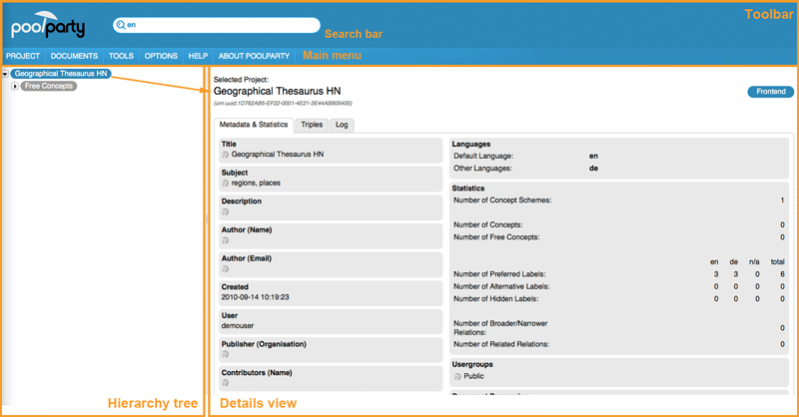
Overview of the PoolParty GUI

Slide 12
Relation Types Used in a Project
There are two types of relations used to relate concepts in a thesaurus:
Hierarchical relations (1) Saying that two concepts are in a kind of parent/child or better broader/narrower relationship. Hierarchical relationships are always inverse relationships. So if concept 'Germany' is broader than concept 'Berlin', concept 'Berlin' is narrower than concept 'Germany'.
Associative relations (2) Saying that two concepts are related in some sense. Associative relationships are always symmetric relationships. So if concept 'Berlin' is related to concept 'Free University of Berlin', concept 'Free University of Berlin' is automatically related to concept 'Berlin'. The Exact and Close matching relations are special relation types used for mapping concepts from different thesauri or mapping concepts of a thesaurus to concepts from other sources.

Slide 13
System Requirements
PoolParty works with Firefox 3.5 (or higher) Other browsers' JavaScript capabilities are not elaborate enough or have not been thoroughly tested yet.
PoolParty has been designed for a screen resolution of 1024x768 or higher.
It is recommended to have a DSL connection to the Internet, otherwise response times might be a bit slow.
Server Side
  Linux Server (Debian 6, CentOS 5 or 6, Red Hat Enterprise Linux 5 or 6, Ubuntu 10.04 LTS), 32bit/64bit or Windows Server (Windows Server 2008 R2)
  Sun/Oracle Java Development Kit 6 and
  Apache Tomcat 6,
  2 GB RAM minimum, 3.5 GB are recommended for JVM

Slide 14
Summary
PoolParty Product Family offers a wide variety of options to deploy semantic technologies. The big three topics are: Semantic Search, Thesaurus Management and Linked Data.
  PoolParty uses in its core Semantic Web technologies which are built around open standards and state-of-the art technologies
  PoolParty combines Semantic Web, text mining and collaborative knowledge engineering to make applications smarter.

Slide 15
References
http://www.poolparty.biz
http://www.w3.org/standards/semanticweb/
http://www.w3.org/RDF/

Slide 16
Thanks for watching!

