Slide 1
ECLAT
Jelena Stančić 3212/2015

Slide 2
Eclat
Equivalence Class Transformation
A Frequent Itemset Mining (FIM) algorithm scans the database, and finds item-sets that occur in transactions more frequently than a given threshold.
Scientific and industrial applications, including those in machine learning, computational biology, intrusion detection, web log mining, and e-business benefit from the use of frequent itemset mining.

Slide 3
Eclat
Transactions, originally stored in horizontal format,
are read from disk and converted to vertical format.
TID | Items
1 | Bread, Milk
2 | Bread, Diaper, Beer, Eggs
3 | Milk, Diaper, Beer, Coke
4 | Bread , Milk, Diaper, Beer
5 | Bread , Milk, Diaper, Coke
Bread
1
2
4
5
Milk
1
3
4
5
Diaper
2
3
4
5
Beer
2
3
4
Coke
3
5
Eggs
2

Slide 4
Eclat
The frequency of each item is counted and the infrequent items and their corresponding vertical lists are deleted from the vertical list.
Bread
1
2
4
5
Milk
1
3
4
5
Diaper
2
3
4
5
Bread
1
2
4
5
Milk
1
3
4
5
Diaper
2
3
4
5
Beer
2
3
4
Coke
3
5
Eggs
2
Beer
2
3
4
Minimum support = 3

Slide 5
Eclat
The Eclat algorithm is defined recursively.
The initial call uses all the single items with their tidsets.
In each recursive call, the function verifies each itemset-tidset pair with all the others pairs to generate new candidates.
If the new candidate is frequent, it is added to the set. Then, recursively, it finds all the frequent itemsets in the branch.

Slide 6
Eclat
Bread
1
2
4
5
Milk
1
3
4
5
Diaper
2
3
4
5
Beer
2
3
4

Slide 7
Eclat
Bread
1
2
4
5
Milk
1
3
4
5
Diaper
2
3
4
5
Beer
2
3
4

Slide 8
Eclat
Bread
1
2
4
5
Milk
1
3
4
5
Diaper
2
3
4
5
Beer
2
3
4
{Bread, Milk}
1
4
5
{Bread, Diaper}
2
4
5
{Bread, Beer}
2
4

Slide 9
Eclat
Bread
1
2
4
5
Milk
1
3
4
5
Diaper
2
3
4
5
Beer
2
3
4
{Bread, Milk}
1
4
5
{Bread, Diaper}
2
4
5
{Bread, Beer}
2
4

Slide 10
Eclat
Bread
1
2
4
5
Milk
1
3
4
5
Diaper
2
3
4
5
Beer
2
3
4
{Bread, Milk}
1
4
5
{Bread, Diaper}
2
4
5
{Bread, Beer}
2
4

Slide 11
Eclat
Bread
1
2
4
5
Milk
1
3
4
5
Diaper
2
3
4
5
Beer
2
3
4
{Bread, Milk}
1
4
5
{Bread, Diaper}
2
4
5
{Bread, Beer}
2
4
{Bread, Milk, Diaper}
4
5

Slide 12
Eclat
Bread
1
2
4
5
Milk
1
3
4
5
Diaper
2
3
4
5
Beer
2
3
4
{Bread, Milk}
1
4
5
{Bread, Diaper}
2
4
5
{Bread, Beer}
2
4
{Bread, Milk, Diaper}
4
5

Slide 13
Eclat
Bread
1
2
4
5
Milk
1
3
4
5
Diaper
2
3
4
5
Beer
2
3
4

Slide 14
Eclat
Bread
1
2
4
5
Milk
1
3
4
5
Diaper
2
3
4
5
Beer
2
3
4

Slide 15
Eclat
Bread
1
2
4
5
Milk
1
3
4
5
Diaper
2
3
4
5
Beer
2
3
4
{Milk, Diaper}
3
4
5
{Milk, Beer}
3
4

Slide 16
Eclat
Bread
1
2
4
5
Milk
1
3
4
5
Diaper
2
3
4
5
Beer
2
3
4
{Milk, Diaper}
3
4
5
{Milk, Beer}
3
4

Slide 17
Eclat
Bread
1
2
4
5
Milk
1
3
4
5
Diaper
2
3
4
5
Beer
2
3
4

Slide 18
Eclat
Bread
1
2
4
5
Milk
1
3
4
5
Diaper
2
3
4
5
Beer
2
3
4

Slide 19
Eclat
Bread
1
2
4
5
Milk
1
3
4
5
Diaper
2
3
4
5
Beer
2
3
4
{Diaper, Beer}
2
3
4

Slide 20
Eclat
Bread
1
2
4
5
Milk
1
3
4
5
Diaper
2
3
4
5
Beer
2
3
4

Slide 21
Eclat
Bread
1
2
4
5
Milk
1
3
4
5
Diaper
2
3
4
5
Beer
2
3
4
{Bread, Milk}
1
4
5
{Bread, Diaper}
2
4
5
{Milk, Diaper}
3
4
5
{Diaper, Beer}
2
3
4

Slide 22
Eclat
Uses vertical database – tidset(bitset) intersections.
Scans the database only once.
Depth-first search algorithm.

Slide 23
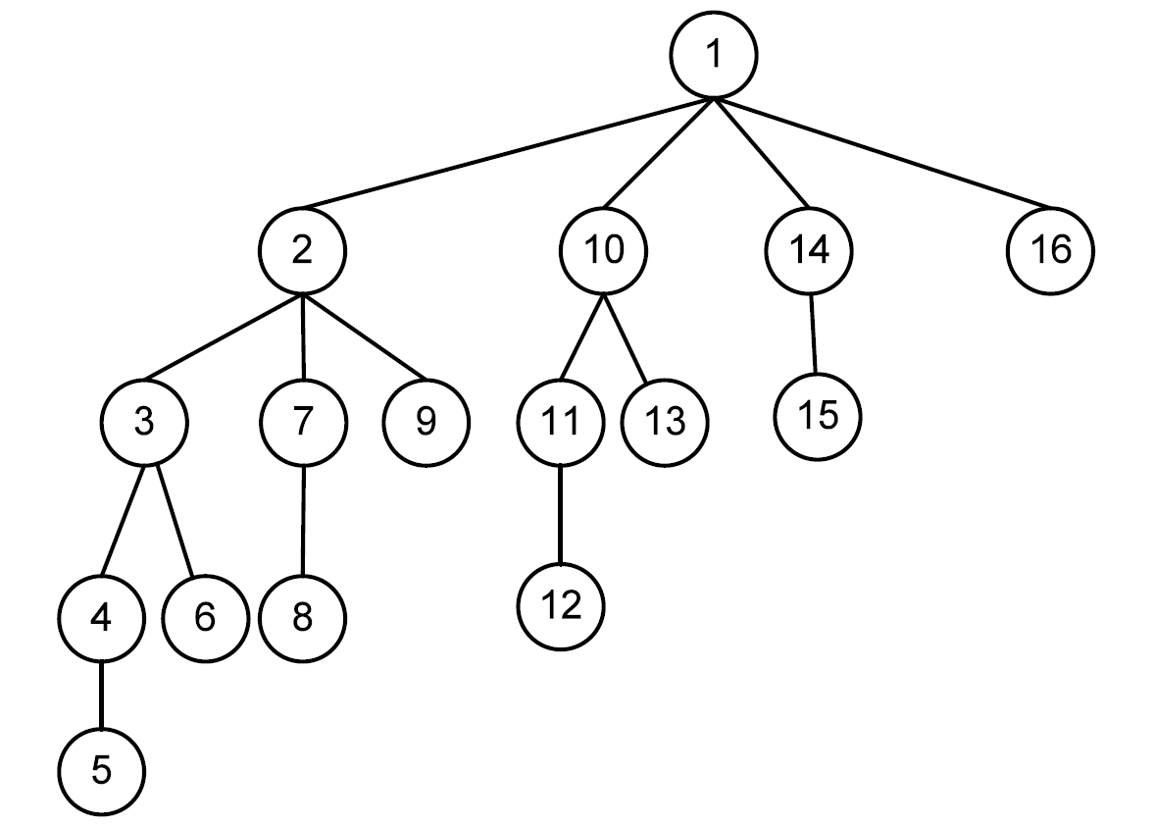
Eclat

Slide 24
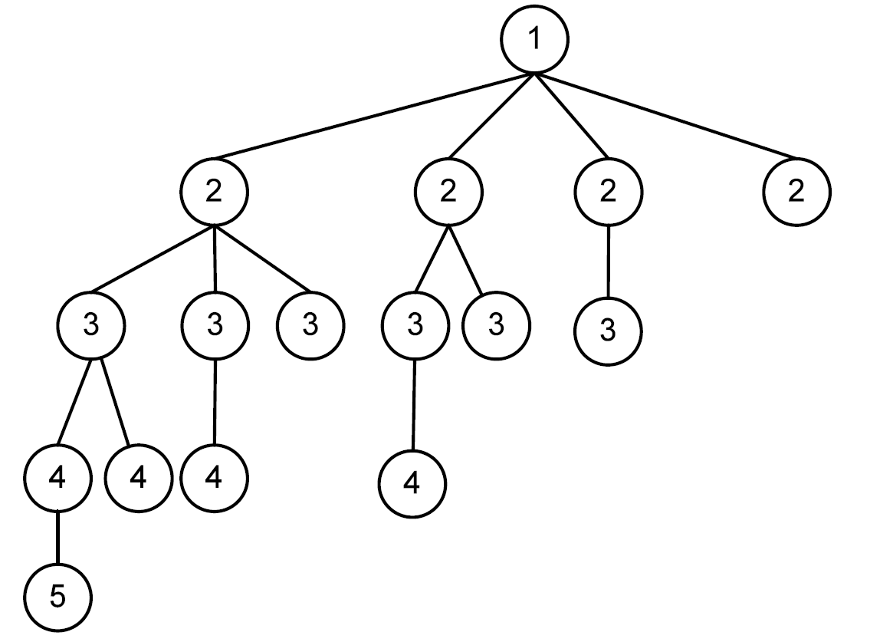
Eclat - parallel

Slide 25
Eclat - parallel
“Equivalent Class”, which can be defined by a set of candidates with the same size, assumed k, shared the common k−1 prefix.
{Bread, Milk}
{Bread, Diaper}
{Bread, Beer}
{Milk, Diaper}
{Milk, Beer}
{Diaper, Beer}

Slide 26
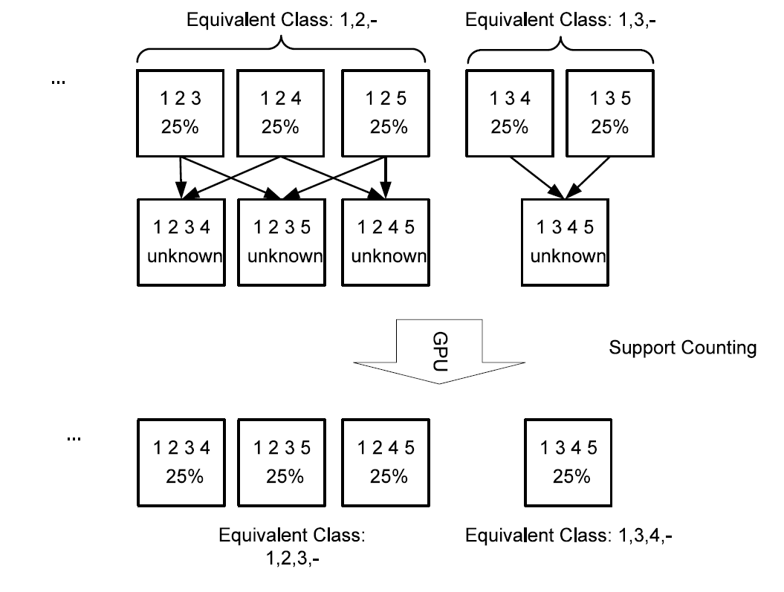
Eclat - parallel

Slide 27
Eclat – CPU implementation I
public class AlgoEclat{
....
public Itemsets runAlgorithm{
final Map<Integer, Set<Integer>> mapItemCount = new HashMap<Integer, Set<Integer>>();
int maxItemId = calculateSupportSingleItems(database, mapItemCount);
// (2) create the list of single items
List<Integer> frequentItems = new ArrayList<Integer>();
// for each item
for(Entry<Integer, Set<Integer>> entry : mapItemCount.entrySet()) {
Set<Integer> tidset = entry.getValue();
int support = tidset.size();
int item = entry.getKey();
if(support >= minsupRelative) {
frequentItems.add(item);
saveSingleItem(item, tidset, tidset.size());
}
}
Collections.sort(frequentItems, new Comparator<Integer>() {
public int compare(Integer arg0, Integer arg1) {
return mapItemCount.get(arg0).size() - mapItemCount.get(arg1).size();
}});
// For each frequent item I according to the total order
for(int i=0; i < frequentItems.size(); i++) {
Integer itemI = frequentItems.get(i);
// we obtain the tidset and support of that item
Set<Integer> tidsetI = mapItemCount.get(itemI);
int supportI = tidsetI.size();

Slide 28
Eclat – CPU implementation II
// We create empty equivalence class for storing all 2-itemsets starting with
List<Integer> equivalenceClassIitems = new ArrayList<Integer>();
List<Set<Integer>> equivalenceClassItidsets = new ArrayList<Set<Integer>>();
for(int j=i+1; j < frequentItems.size(); j++) {
int itemJ = frequentItems.get(j);
Set<Integer> tidsetJ = mapItemCount.get(itemJ);
int supportJ = tidsetJ.size();
Set<Integer> tidsetIJ = performANDFirstTime(tidsetI, supportI, tidsetJ, supportJ);
if(calculateSupport(2, supportI, tidsetIJ) >= minsupRelative){
equivalenceClassIitems.add(itemJ);
// We also keep the tidset of "ij".
equivalenceClassItidsets.add(tidsetIJ);
}
}
if(equivalenceClassIitems.size() > 0) {
// This is done by a recursive call. Note that we pass
// item I to that method as the prefix of that equivalence class.
itemsetBuffer[0] = itemI;
processEquivalenceClass(itemsetBuffer, 1, supportI, equivalenceClassIitems, equivalenceClassItidsets);
}
}
}
...
}

Slide 29
Eclat – CPU implementation III
private void processEquivalenceClass(int[] prefix, int prefixLength, int supportPrefix, List<Integer> equivalenceClassItems,
List<Set<Integer>> equivalenceClassTidsets) throws IOException {
int length = prefixLength+1;
if(equivalenceClassItems.size() == 1) {
int itemI = equivalenceClassItems.get(0);
Set<Integer> tidsetItemset = equivalenceClassTidsets.get(0);
save(prefix, prefixLength, itemI, tidsetItemset, calculateSupport(length, supportPrefix, tidsetItemset));
return;
}
if(equivalenceClassItems.size() == 2) {
int itemI = equivalenceClassItems.get(0);
Set<Integer> tidsetI = equivalenceClassTidsets.get(0);
int supportI = calculateSupport(length, supportPrefix, tidsetI);
save(prefix, prefixLength, itemI, tidsetI, supportI);
int itemJ = equivalenceClassItems.get(1);
Set<Integer> tidsetJ = equivalenceClassTidsets.get(1);
int supportJ = calculateSupport(length, supportPrefix, tidsetJ);
save(prefix, prefixLength, itemJ, tidsetJ, supportJ);
Set<Integer> tidsetIJ = this.performAND(tidsetI, tidsetI.size(), tidsetJ, tidsetJ.size());
int supportIJ = calculateSupport(length, supportI, tidsetIJ);
if(supportIJ >= minsupRelative) {
int newPrefixLength = prefixLength+1;
prefix[prefixLength] = itemI;
save(prefix, newPrefixLength, itemJ, tidsetIJ, supportIJ);
}
return; }

Slide 30
Eclat – CPU implementation IV
for(int i=0; i< equivalenceClassItems.size(); i++) {
int suffixI = equivalenceClassItems.get(i);
Set<Integer> tidsetI = equivalenceClassTidsets.get(i);
int supportI = calculateSupport(length, supportPrefix, tidsetI);
save(prefix, prefixLength, suffixI, tidsetI, supportI);
List<Integer> equivalenceClassISuffixItems= new ArrayList<Integer>();
List<Set<Integer>> equivalenceITidsets = new ArrayList<Set<Integer>>();
for(int j=i+1; j < equivalenceClassItems.size(); j++) {
int suffixJ = equivalenceClassItems.get(j);
Set<Integer> tidsetJ = equivalenceClassTidsets.get(j);
int supportJ = calculateSupport(length, supportPrefix, tidsetJ);
Set<Integer> tidsetIJ = performAND(tidsetI, supportI, tidsetJ, supportJ);
int supportIJ = calculateSupport(length, supportI, tidsetIJ);
if(supportIJ >= minsupRelative) {
equivalenceClassISuffixItems.add(suffixJ);
equivalenceITidsets.add(tidsetIJ);
}
}
if(equivalenceClassISuffixItems.size() >0) {
prefix[prefixLength] = suffixI;
int newPrefixLength = prefixLength+1; processEquivalenceClass(prefix, newPrefixLength, supportI, equivalenceClassISuffixItems, equivalenceITidsets);
}
}

Slide 31
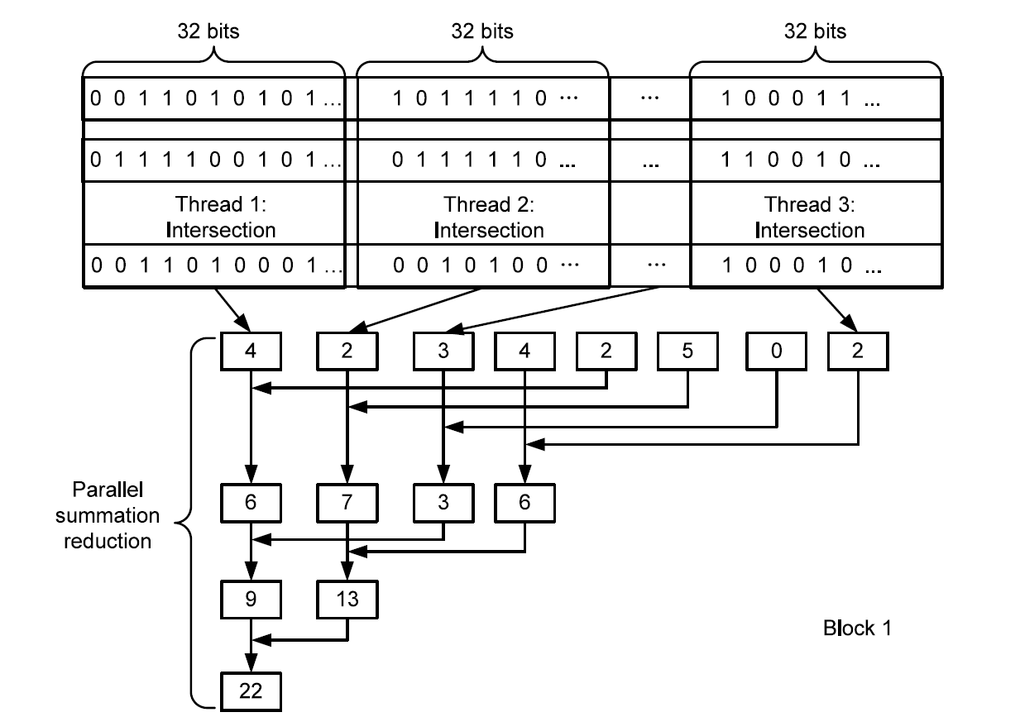
Eclat – GPU implementation I

Slide 32
Eclat – GPU implementation II
__global__ void kernel_calc( unsigned int** src_list_1, unsigned int** src_list_2,
unsigned int** dst_list,
unsigned int* result,
unsigned int list_len,unsigned int vlist_len) {
__shared__ unsigned int sup[MAX_THREAD];
unsigned int* psrc1;
unsigned int* psrc2;
unsigned int* pdst;
unsigned int iter, i, tmp;
unsigned int bound;
if (blockIdx.x >= list_len) return;
sup[threadIdx.x] = 0;
iter = (vlist_len - 1) / blockDim.x + 1;
psrc1 = src_list_1[blockIdx.x];
psrc2 = src_list_2[blockIdx.x];
pdst = dst_list[blockIdx.x];
__syncthreads();
for (i = 0; i < iter; i++) {
int thread_pos = i * blockDim.x + threadIdx.x;
if (thread_pos >= vlist_len) break;
tmp=psrc1[thread_pos] & psrc2[thread_pos];
sup[threadIdx.x]+=__popc(tmp);
pdst[thread_pos]=tmp;
}
__syncthreads();
for (bound = blockDim.x / 2; bound > 0; bound >>= 1) {
if (threadIdx.x < bound)
sup[threadIdx.x]+=sup[threadIdx.x+bound];
__syncthreads();
}
__syncthreads();
if(threadIdx.x == 0) {
*(result+current_block_pos)=sup[0];
}
}

Slide 33
Eclat – CPU vs GPU
System characteristics:
Processor: Intel(R) Core(TM) i5-5200 CPU @ 2.20 GHZ
Installed memory(RAM): 8.00 GB
System type: 64-bit Operating system, x64-based processor
GPU: NVIDIA GeForce 940M
OS: Windows 10
Chess Retail

Slide 34
Eclat – CPU vs GPU
Pumsb Accidents
Mushroom Connect

Slide 35
THANK YOU FOR YOUR ATTENTION! Questions?

