Slide 1
Apriori Algorithm in Social Networks
Author: Jovan Zoric 3212/2014
E-mail: jovan229@gmail.com
zj143212m@student.etf.rs
1/16

Slide 2
Introduction
This presentation gives some interesting ideas about how we use data mining in social networks.
In this case we will try to resolve some very often problems in life of one administrator of social page used the Apriori algorithm.
The vision of this research is to upgrade our page to higher level (increase number of members).
2/16

Slide 3
Problem
The general problem is: “How to find more members for our page?”
The second problem that results from the previous: “Where we advertise our page?”
Over the time we will have more members who liked our page, so the importance of this problem grows, because is getting much harder to find a new member.
3/16

Slide 4
About algorithm (1)
Apriori was proposed by R. Agrawal and R. Srikant in 1994.
Argawel and Srikant presented two algorithms in they work: “Fast Algorithms for Mining Association Rules”. [1]
They presented: 1. Apriori 2. AprioriTid 3. and their combination AprioriHybrid.
4/16

Slide 5
About algorithm(2)
These algorithms are algorithms of association rule mining.
Association Rule: An implication expression of the form A → (L - A), where L is itemsets and A is subsets of L.
Two subproblems of discovering all association rules:
1. Find all sets of items (itemsets) that have transaction support above minimum support. The support for an itemset is the number of transactions which is contain in the data base.
2. Use the large itemsets ( l ) to generate the desired rules. For every itemsets generate above, find all non-empty subsets of l.
For every subset a, output a rule if the ratio of support(l) to support(a) is at least minconf.
5/16

Slide 6
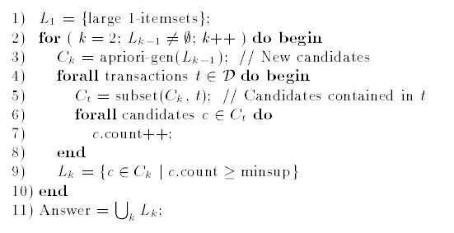
Apriori
First, the large itemsets
found in the (k - 1)th pass are used to generate
The first pass of the algorithm simply counts item occurrences to determine the large 1 – itemsets.
the candidate itemsets
,using the apriori-gen function.
Next, the database is scanned and the support of candidates in
is counted.
If support is higher than minsup candidate will be put in
A subsequent pass, say pass k,
consists of two phases.
6/16

Slide 7
Apriori Candidate Generation
ANY SUBSET OF SIZE K OF THAT IS NOT
FREQUENT CANNOT BE A SEBSET OF A FREQUENT ITEMSET OF SIZE k + 1!
The apriori-gen function takes as argument the set of all large (k - 1) itemsets.
It returns a superset of the set of all large k-itemsets.
The function has two steps: 1. Join step: Generate , the initial candidates of frequent itemsets of size k + 1 by taking the union of the two frequent itemsets of size k, and that have the first k – 1 elements in common.
2. Prune step: Check if all the itemsets of size k in are frequent and generate by removing those that do not pass this requirement from
7/16

Slide 8
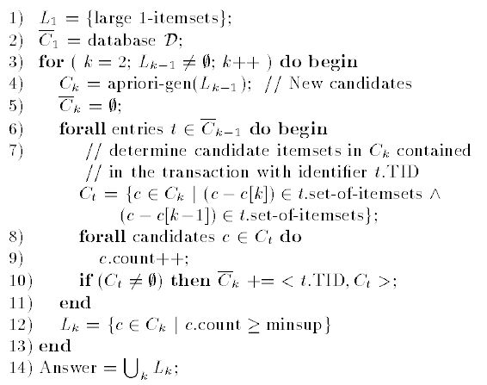
Apriori vs AprioriTid
For k = 1, corresponds to the database D,
although conceptually each item i is replaced by the itemset {i}. For k > 1, is genereted by the algorithm (step 10).
The database D is not used for counting support after the first pass. Rather than is used for this purpose.
Member of
Transaction identifier
Potentially large k-itemset
8/16

Slide 9
Market Basket Example – AprioriTid –
minsup = 2
Database
TID | Items
100 | Milk, Bread, Apple
200 | Salt, Bread, Beer
300 | Milk, Salt, Bread, Beer
400 | Salt, Beer
Support = minsup
Support > minsup
Support < minsup
Itemset | Support
{Milk} | 2
{Salt} | 3
{Bread} | 3
{Beer} | 3
TID | Set – of - Itemsets
100 | {{Milk}, {Bread}, {Apple}}
200 | {{Salt}, {Bread}, {Beer}}
300 | {{Milk}, {Salt}, {Bread}, {Beer}}
400 | {{Salt}, {Beer}}
9/16

Slide 10
Market Basket Example – AprioriTid –
minsup = 2
TID | Set – of - Itemsets
100 | {{Milk}, {Bread}, {Apple}}
200 | {{Salt}, {Bread}, {Beer}}
300 | {{Milk}, {Salt}, {Bread}, {Beer}}
400 | {{Salt}, {Beer}}
TID | Set-of-Itemsets
100 | {{Milk Bread}}
200 | {{Salt Bread}, {Salt Beer}, {Bread Beer}}
300 | {{Milk Salt}, {Milk Bread}, {Milk Beer}, {Salt Bread}, {Salt Beer}, Bread, Beer}
400 | {{Salt, Beer}}
?
Itemset | Support
{Milk Salt} | 1
{Milk Bread} | 2
{Milk Beer} | 1
{Salt Bread} | 2
{Salt Beer} | 3
{Bread Beer} | 2
Itemset | Support
{Milk} | 2
{Salt} | 3
{Bread} | 3
{Beer} | 3
10/16

Slide 11
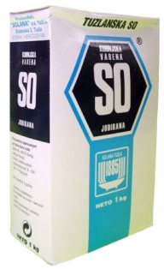
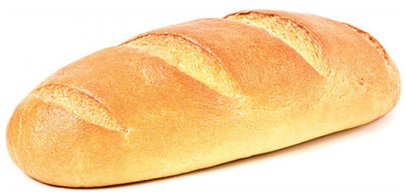
Market Basket Example – AprioriTid –
minsup = 2
Itemset | Support
{Milk Bread} | 2
{Salt Bread} | 2
{Salt Beer} | 3
{Bread Beer} | 2
minconf = 0.8
Itemset | Support
{Salt Bread Beer} | 2
TID | Set-of-Itemsets
200 | {{Salt Bread Beer}}
300 | {{Salt Bread Beer}}
Itemset | Support
{Salt Bread Beer} | 2
+
=
confidence = 1
11/16

Slide 12
Return to problem
For our example, we will use one facebook page, with name “World records in Athletics”, and we will try to increase a number of members.
Step one:
collecting a information about members of this page.
Step two:
applying the Apriori on information which were collected in step one and making association rules.
Step three: finding all pages who arising of rules generated in step two.
12/16

Slide 13
Step one
We will try to find people who liked this page and really interesting for page.
We collected next information about 100 members: gender, education, job, city of residence, favorite sport, favorite team, does the member like athlete.
13/16

Slide 14
Step two(1)
We defined:
the support of frequent itemsets on 10%
and the confidence on 90%.
And we got next not-so-interesting rules: People who like athletes are males who have faculty education and their favorite sport is athletics;
People who like athletes are athletic workers (males) and their favorite sport is also athletics.
14/16

Slide 15
Step two (2)
When we reduced the confidence on 80% we got the one new rule: People who like athletes are males, their favorite sport is athletics and their favorite team is unknown.
Because we don’t have permission for many information about our members we couldn’t have complete base.
Very interesting information about favorite team was missed.
Questionnaire – one of possible solutions!
15/16

Slide 16
References
[1] R. Agrawal, R. Srikant “Fast Algorithms for Mining Association Rules”, IBM Almaden Research Center, 1994, pp. 1 – 13
[2] X. Wu, V. Kumar, J. R. Quinlan, J. Ghosh, Q. Yang, H. Motoda, G. J. McLachlan, A. Ng, B. Liu, P. S. Yu, Z.-H. Zhou, M. Steinbach, D. J. Hand, D. Steinberg „Top 10 algorithms in data mining“, Knowledge Information Systems 14, 2008, pp. 12 – 15.
[3] N. Yilmaz, G. I. Alptekin “The Effect of Clustering in the Apriori Data Mining Algorithm: A Case Study”, Proceedings of the World Congress on Engineering, 2013, pp. 1 – 6.
[4] S.S. Phulari, P.U. Bhalchandra, Dr.S.D.Khamitkar & S.N. Lokhande “Understanding Rule Behavior through Apriori Algorithm over Social Network Data”, 2012, pp. 1 – 5.
16/16

