Slide 1
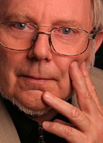

The Serbia Forum and Heritage Mining
Hermann Maurer
Professor at Graz University of Technology
Chair of the Informatics Section of Academia Europaea
Veljko Milutinovic
University of Belgrade
School of Electrical Engineering
Zoran Ognjanovic
The Mathematical Institute of SANU
III44006
+ MI SANU III44006
Special acknowledgements to Vladisav Jelisavcic and Aleksandar Mihajlovic
Notes:
1

Slide 2
How to Teach DataMining Effectively?
Animation (to explain the essence)
Math
Anecdote
Example
Homework
Discussion (by the best homework author)
Bottom of the Ice Berg: Practical Work!

Slide 3
Dimensions of DataMining:
DBs
Sensor Networks
Internet
Social Networks
Mind Mining
Life Mining
The basic 10 algorithms can be mutated 6 times!

Slide 4
Top of the Ice Berg: Heritage Mining
(all the six serving the history understanding)
Events can be omitted (imputation)
Events can be changed (mutation)
Events can be made up (amputation)
Enabler Technology = Heritage Portals
(cross comparison leading to real truth)

Slide 5
What are the currently available heritage portals?

Slide 6
What are the currently available heritage portals?
#1?

Slide 7
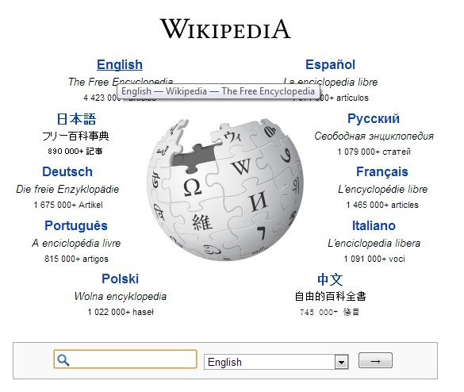
What are the currently available heritage portals?
#1?

Slide 8
Wikipedia:
A valuable resource to get up-to-date information
Available in many languages:
English: ~ 4,000.000 entries
German: ~2,000.000 entries
Serbian: ~200.000 entries
However,
most entries in the Serbian Wikipedia
do not (!) concentrate on Serbia
and are quite incomplete.
Our destiny must be in our hands!
8/29

Slide 9
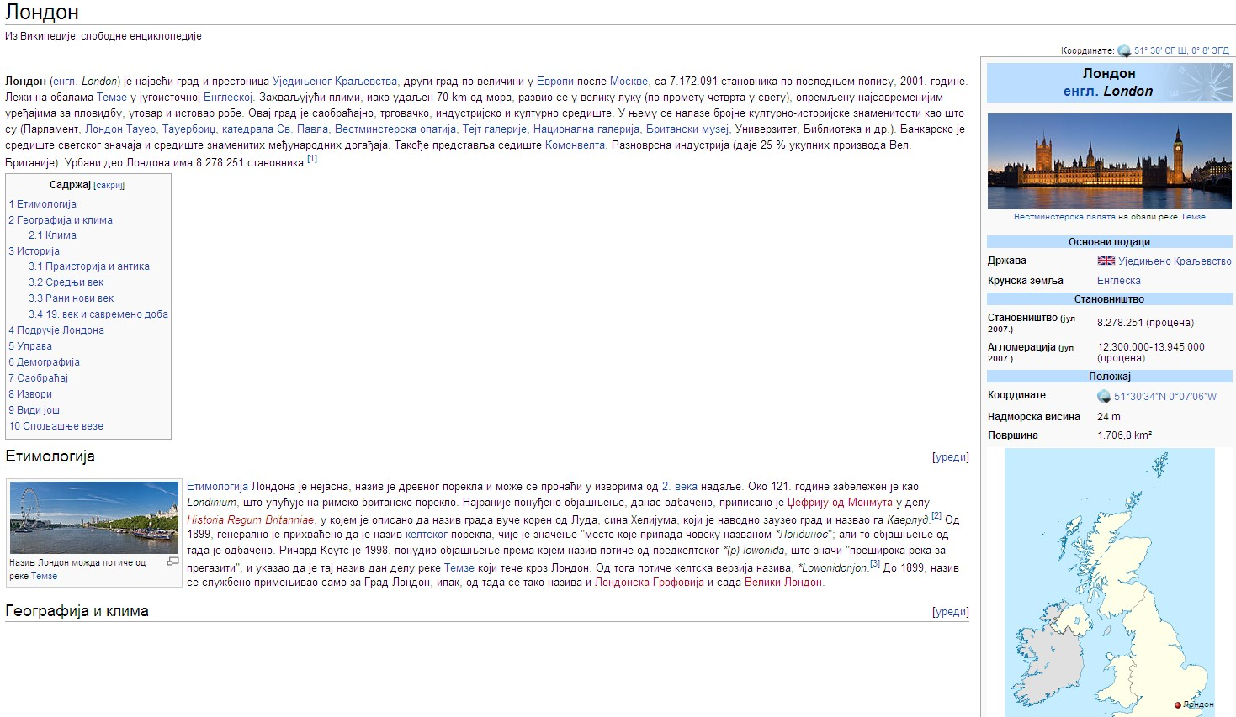
The majority of topics on the Serbian Wikipedia does not deal with Serbia (like the above) and is incomplete (links missing) as the red entries show.
9/29

Slide 10
Forum: Important points of heritage servers
(1) Information must be semantically searchable,
by metadata (both, in Forum, and via Google).
Next page shows:
We are searching for someone
whose name we don‘t know,
but we know he was born in Vienna (Wien),
was working in physics (Physik),
and died in Italy (Italien).
The one person fitting the description, Ludwig Boltzmann, is indeed found.
10/29

Slide 11
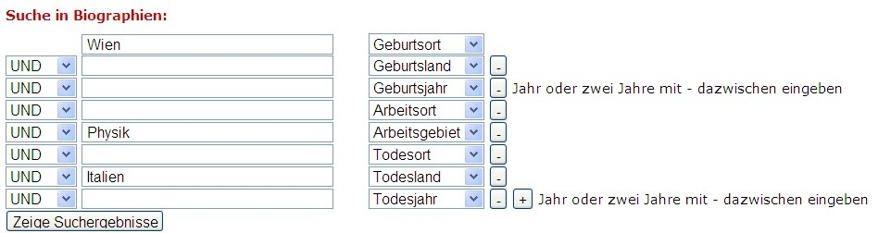

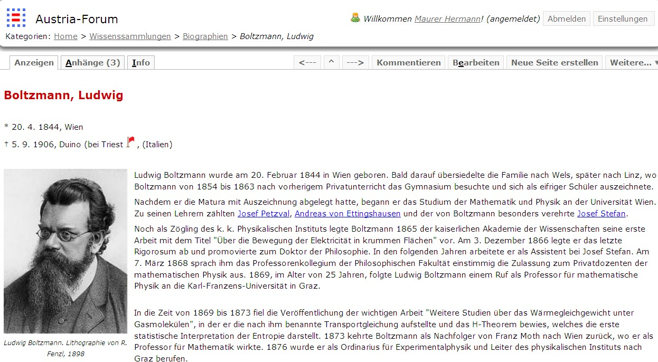
11/29

Slide 12
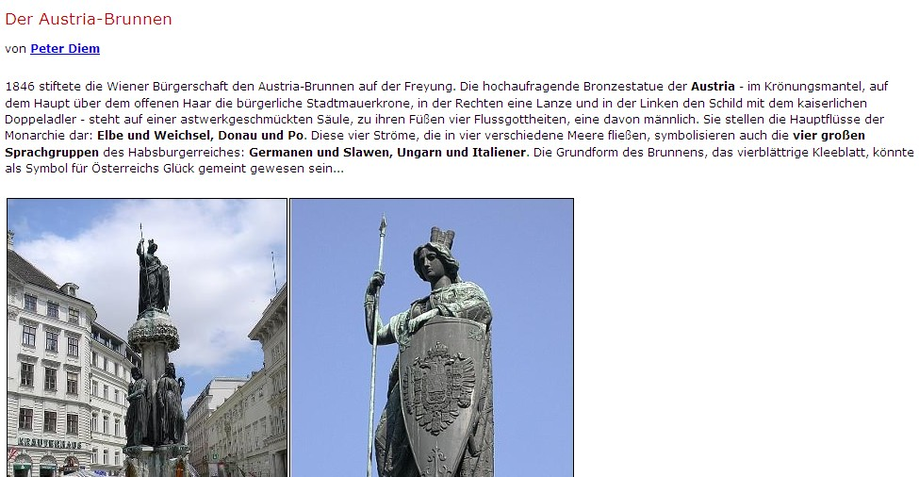
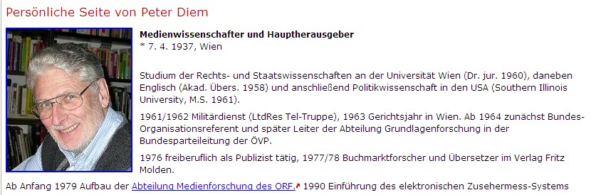
(2) Author Visibility: The source of the text must be always known!
Either the name of the author including CV,
or the book/archive it comes from!
12/29

Slide 13
(3) Evolution Tracking
Updating is dangerous:
It destroys previous information and hence history.
When, e.g. an old building is „updated“ (renovated),
one cannot experience what it was like before.
The same is true of information!
We believe in preservation of information,
allowing „time-travel“ by reading about the subject,
at various points in time.
13/29

Slide 14
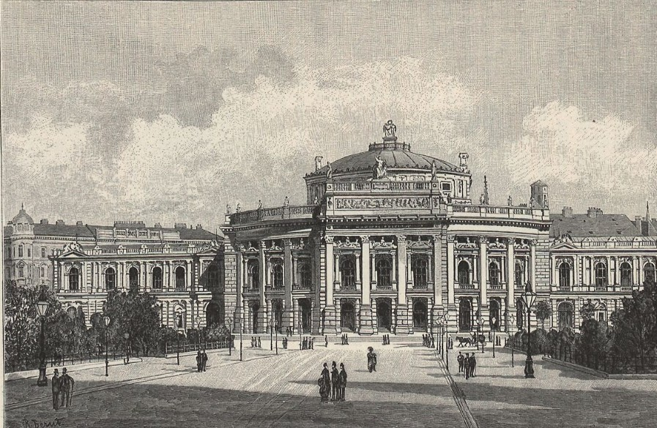
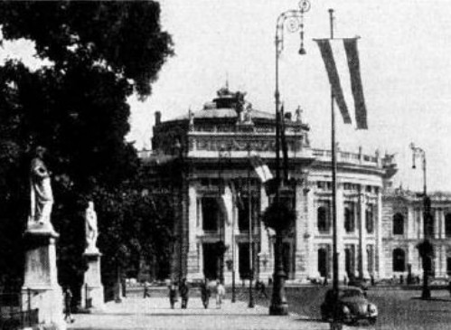
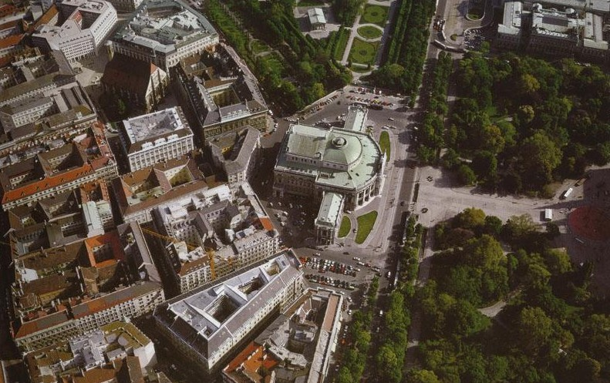
BurgTheaterWien
1900
1965
2000
14/29

Slide 15
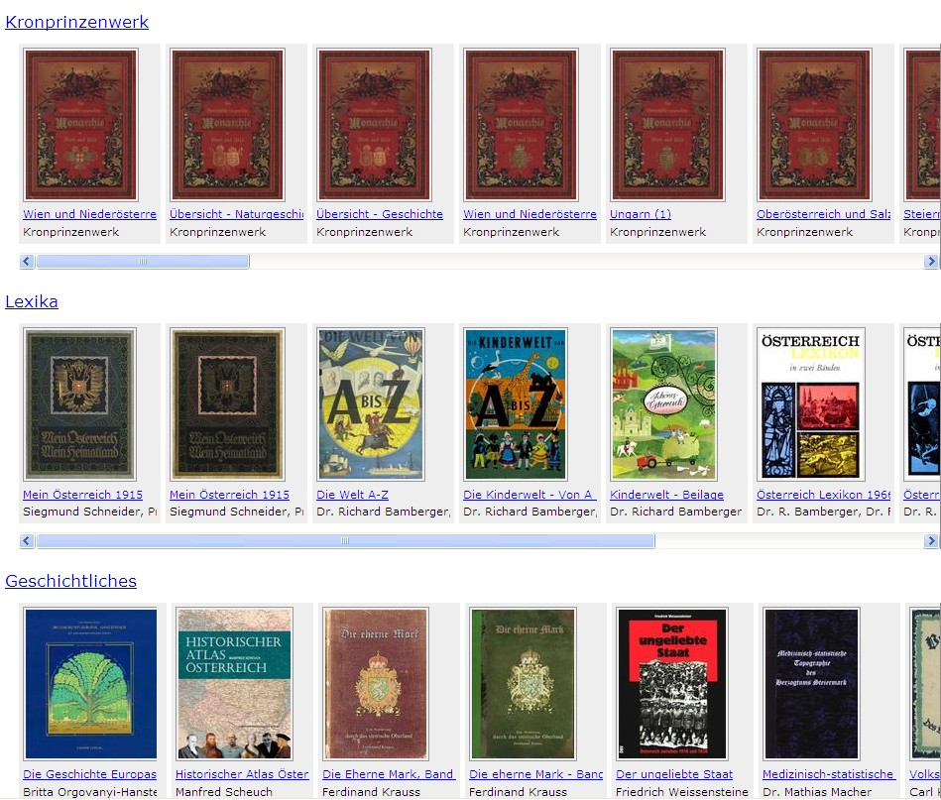
(4) Books are not just a source of information!
Web books behave like printed books
but also offer some new functions: links, bookmarks, …
15/29

Slide 16
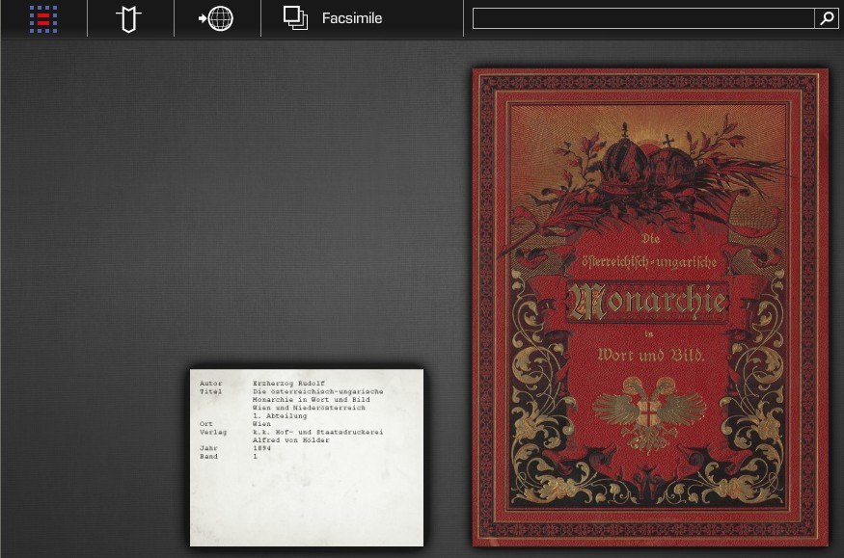
Clicking at book opens it.
Then one can turn pages or jump to an arbitrary page.
16/29

Slide 17
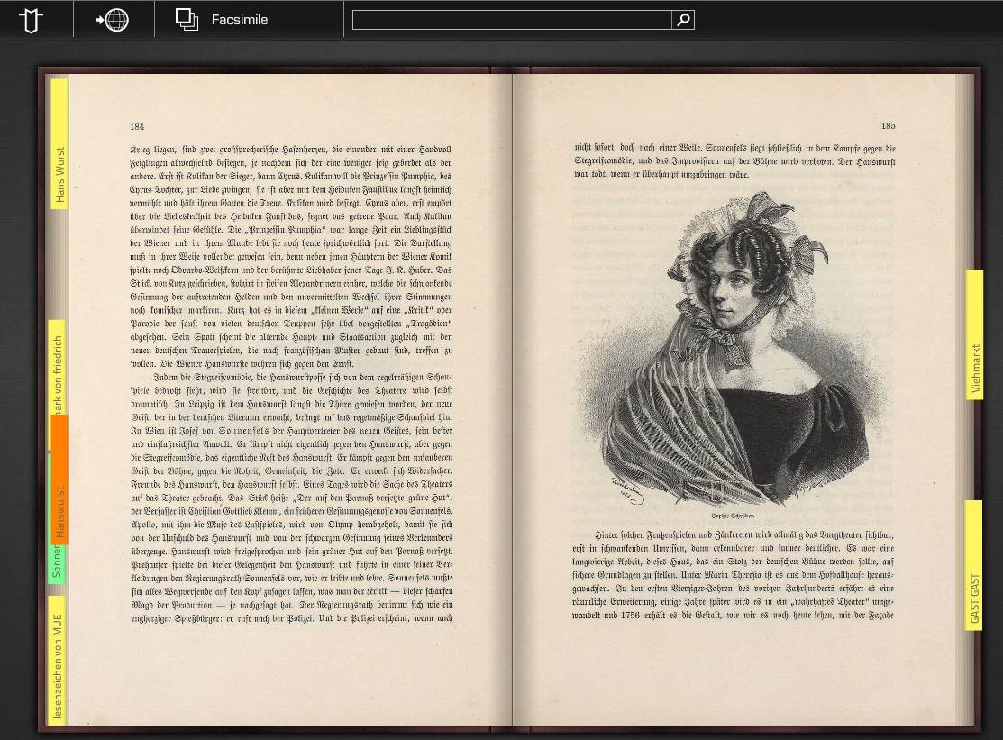
This screen-shot shows some bookmarks. This icon allows a switch, to an ordinary font. Clicking at one page, only that one is shown,
and one can then zoom in (see next page)
17/29

Slide 18
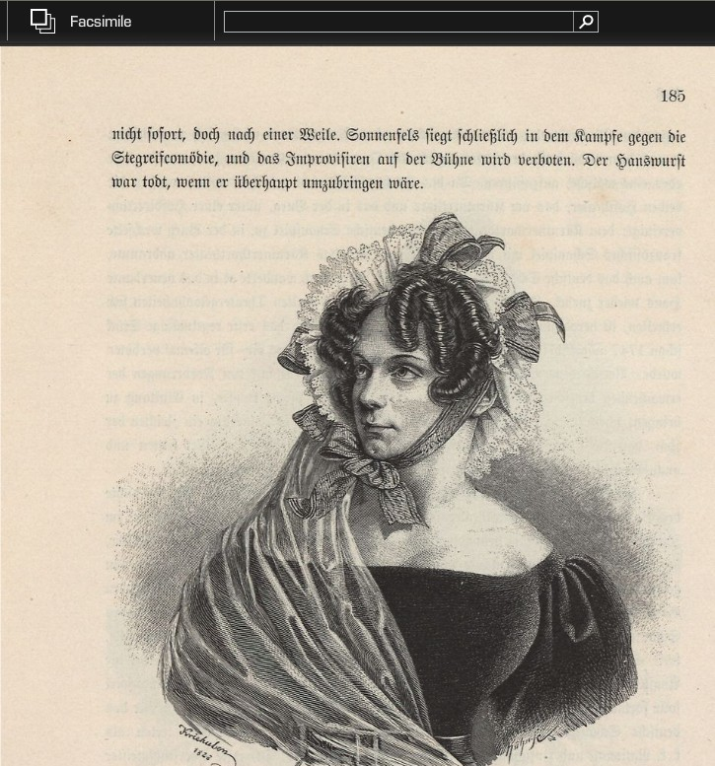
When choosing a
single page it can
be zoomed and moved
around arbitrarily
The enlarged picture. Note the field that allows full-text search!
18/29

Slide 19
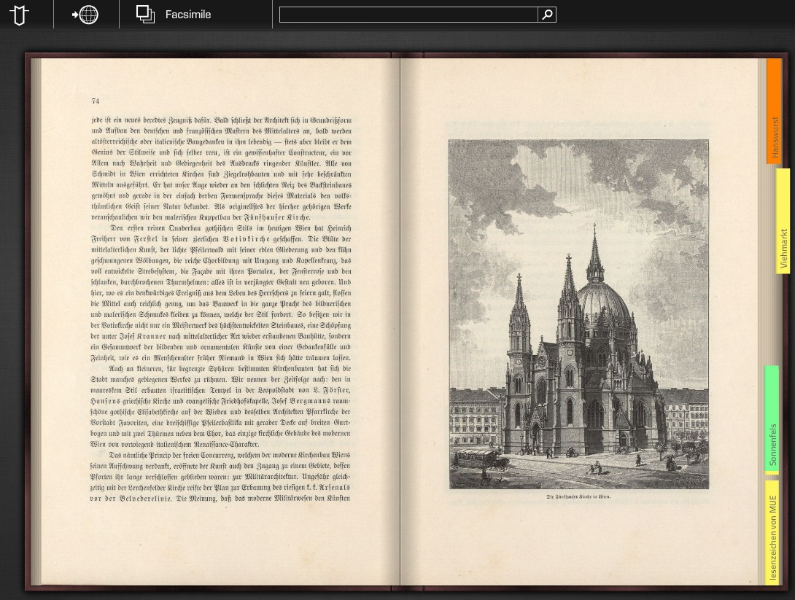
Bookmark and Link creation
19

Slide 20
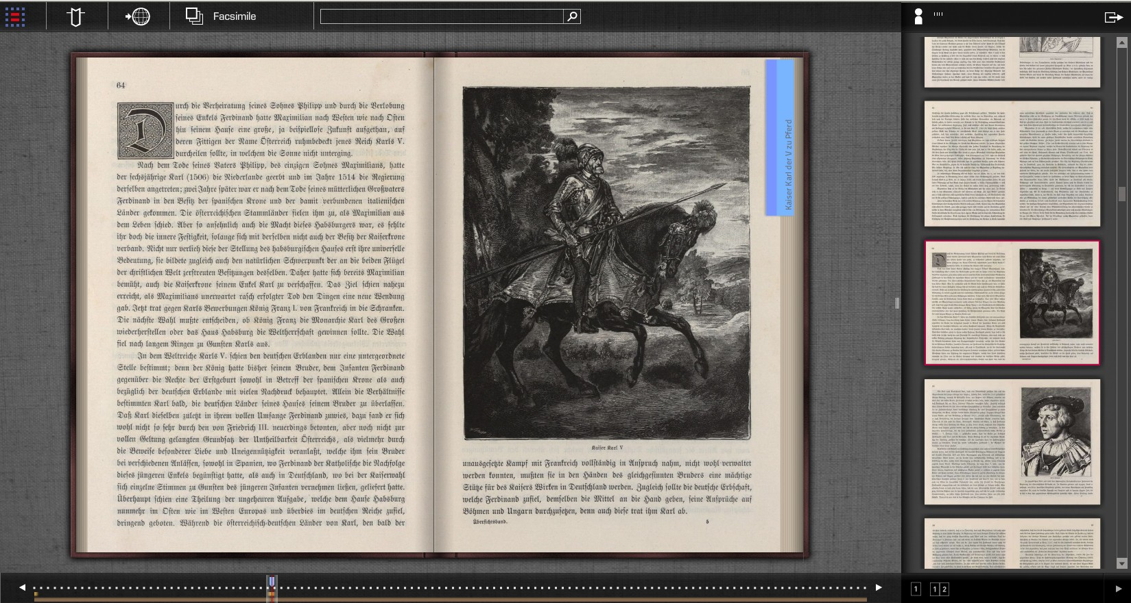
Full view of Web Book with other features:
Click here to see page number and preview
Preview of all pages (single page or double page as shown)
20/29

Slide 21
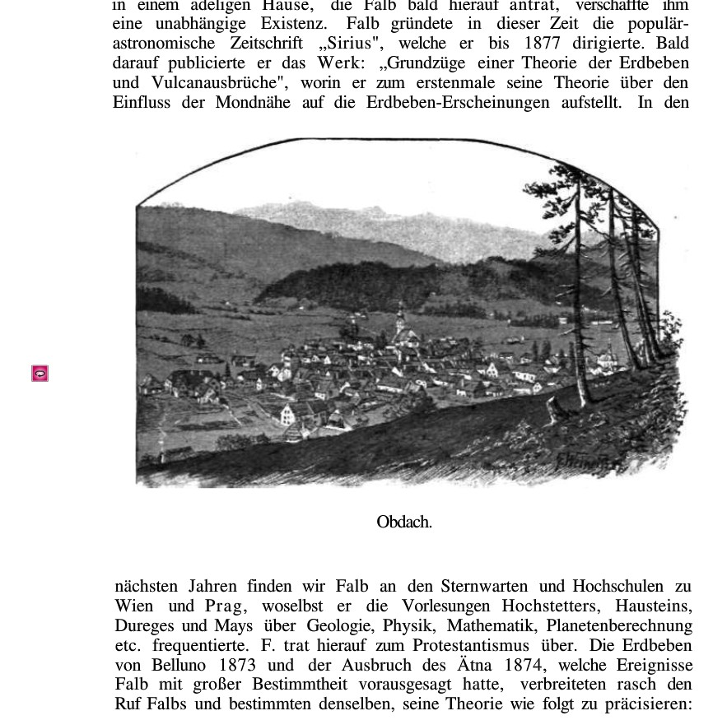
Page from old
book on a
village Obdach.
Clicking here
gives panoramic
view in our days
(next page)
21

Slide 22
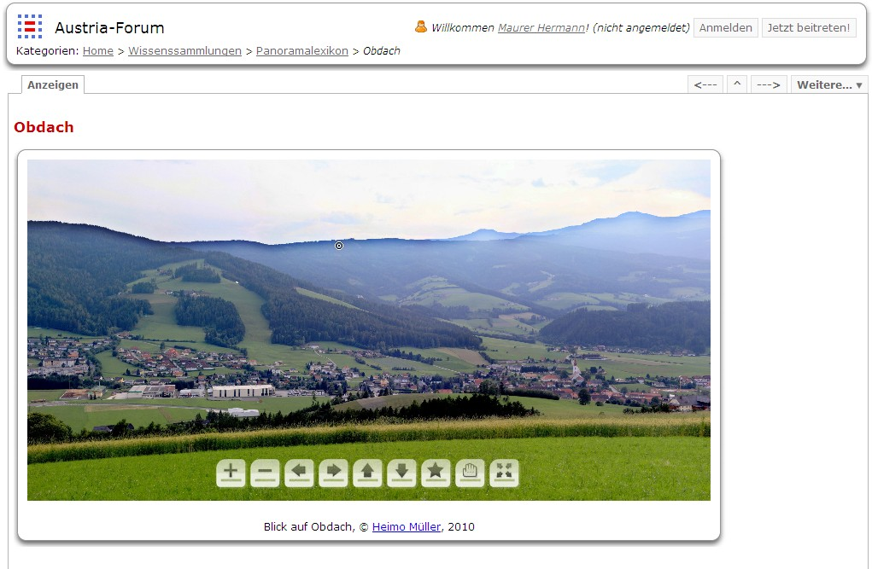
Of Course, Panoramic Pictures, Zoomable, and Moveable
22

Slide 23
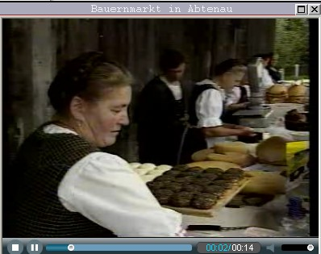
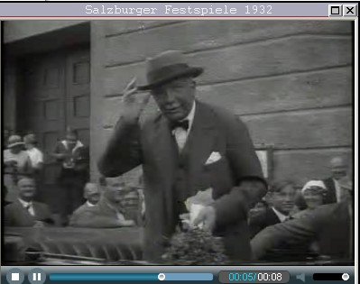
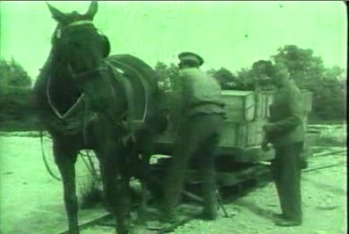
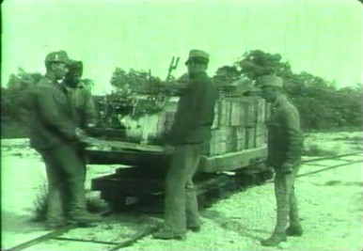
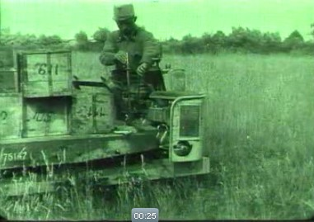
Of course heritage forums must also contain: Videoclips
Farmer‘s
Market
Famous
person in
1932
Changing from horse-railway to motorized railway cars (1914)
23
(Examples taken from the heritage server called www.austria-forum.org)

Slide 24
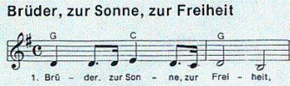
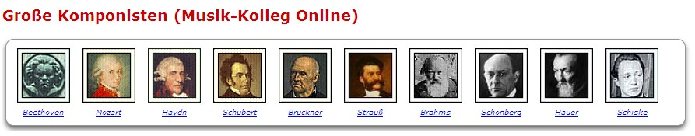
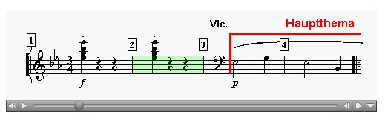
Of course heritage forums must also contain:
Samples of music
24/29

Slide 25
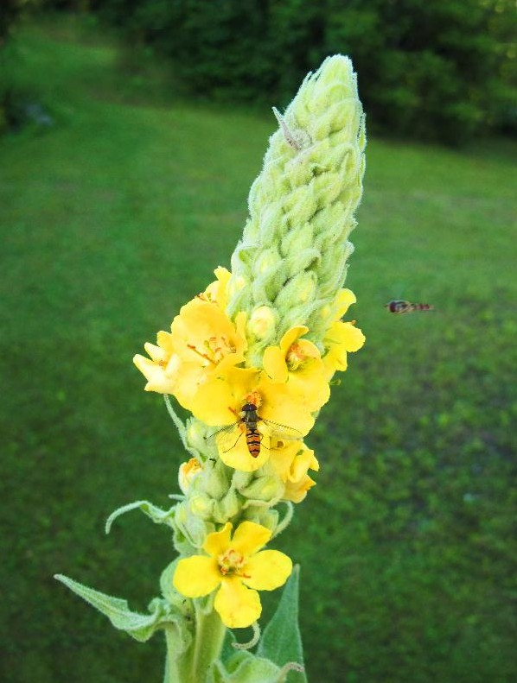
Of course heritage forums must also contain:
Zooming of pictures
25/29

Slide 26
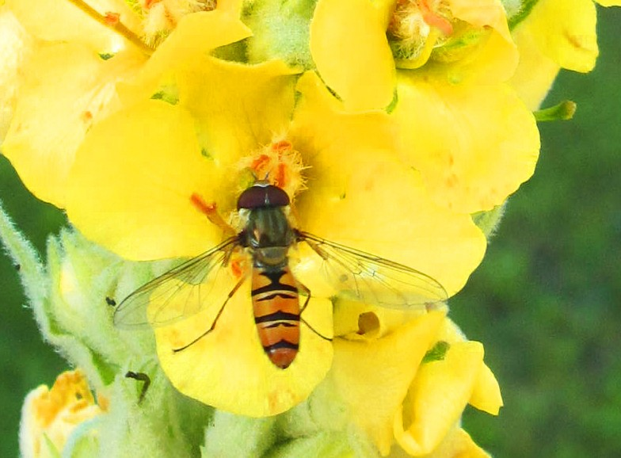
26

Slide 27








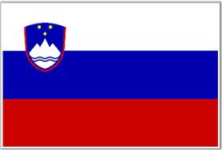
Fori in Works (FP7+H20):
(1) Academia Europaea, fully operational!
(2) Austria Forum, fully operational!
(3) Serbia Forum, fully operational!
(4) Germany
(5) England
(6) Portugal
(7) Italy
(8) Spain
(9) Slovenia
27/29

Slide 28

28/29

Slide 29
Axioms of Serbia Forum:
Secondary
Primary
29/29

Slide 30
Secondary Axioms of Serbia Forum:
Temporary differences compared to Wikipedia!
May dissappear over time!
(1) Semantic search
(2) Author visibility
(3) Evolution tracking
(4) Original commodities
30/29

Slide 31
Primary Axioms of Serbia Forum:
Essential differences compared to Wikipedia!
Will stay forever!
(1) National herritage owned by national institutions,
exposed by servers under control of these institutions!
(2) National herritage falls into a number of
different legal regulatories, not only CC!
(3) Stress on quality and ranking,
not quantity and chaos!
(4) Possible semantic culture-oriented translation
into a number of relevant foreign languages!
31/29

Slide 32
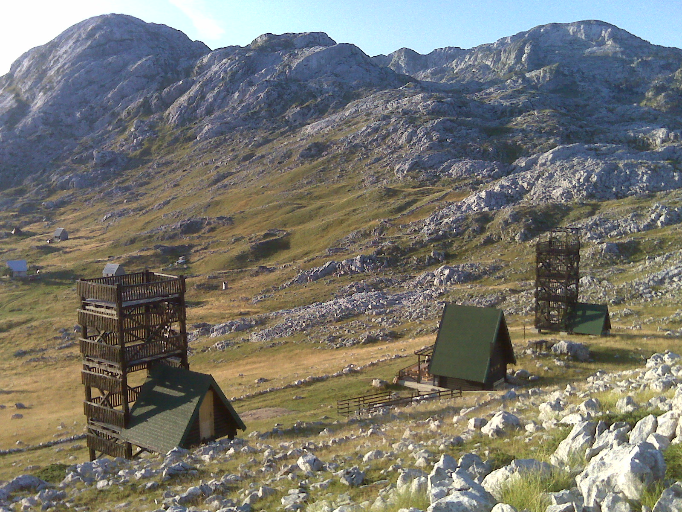
32

Slide 33
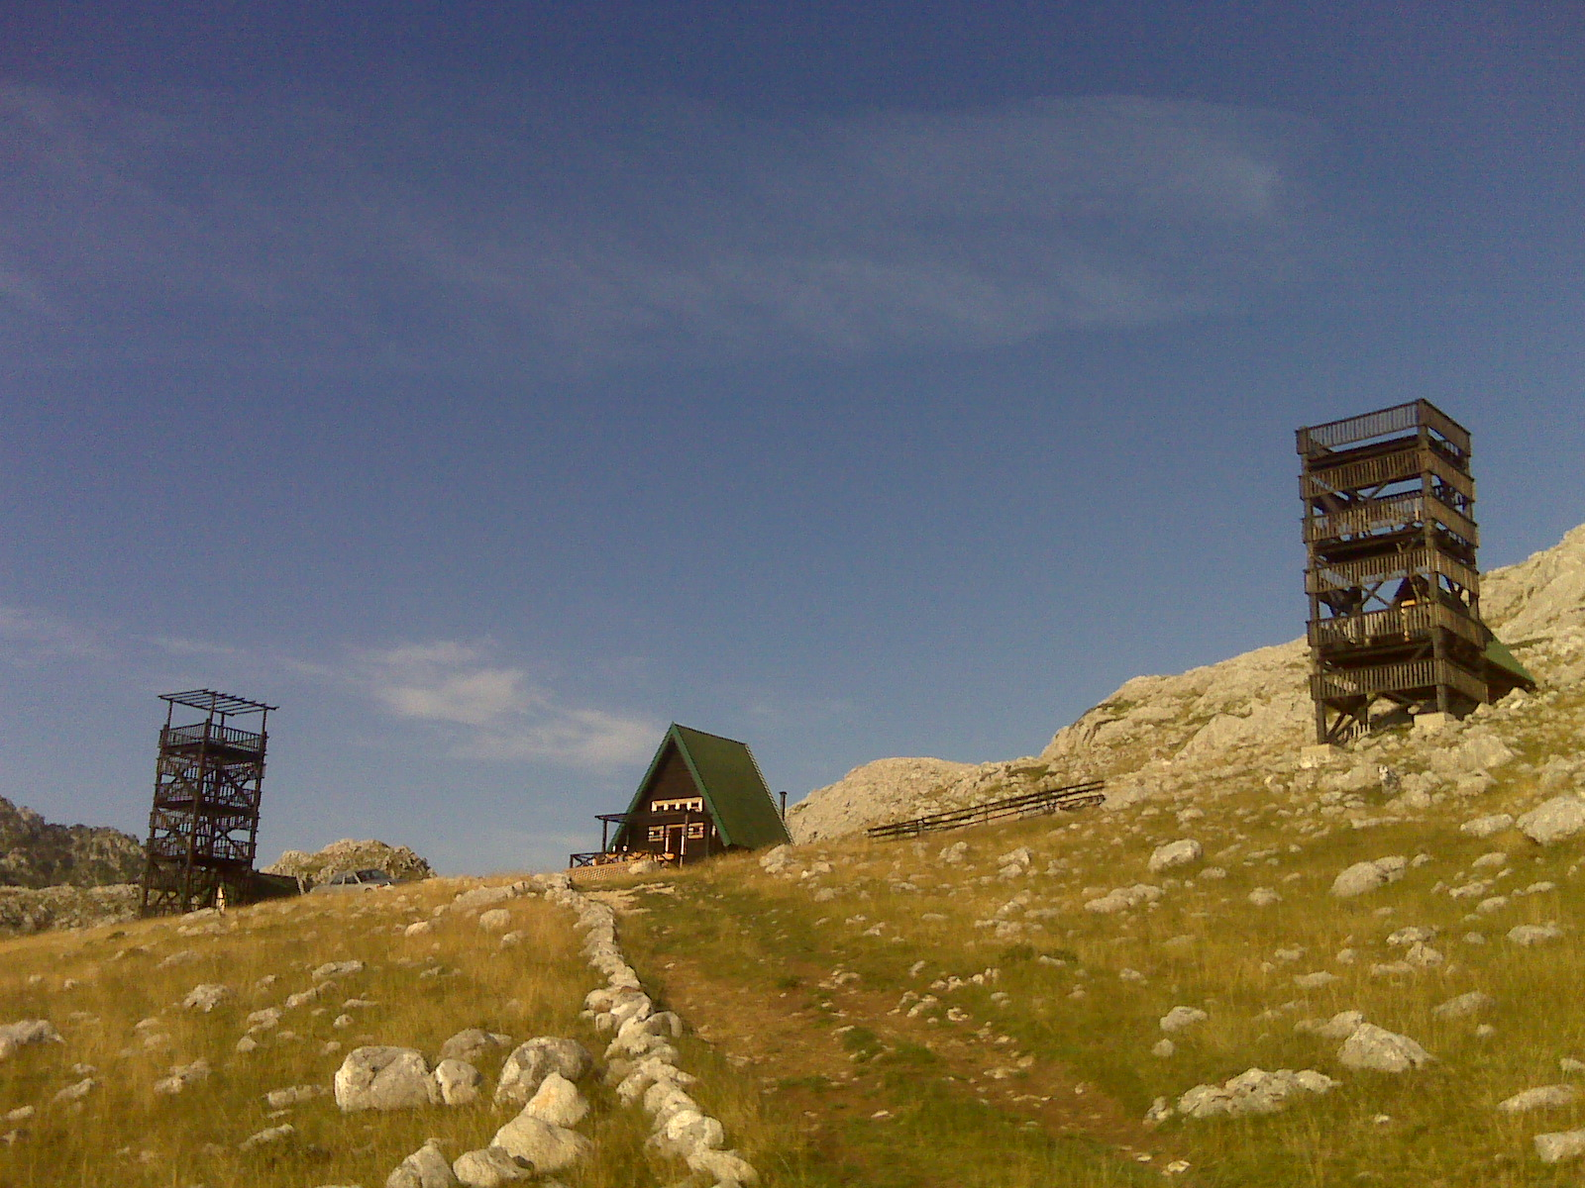
33
© H. Maurer

Slide 34
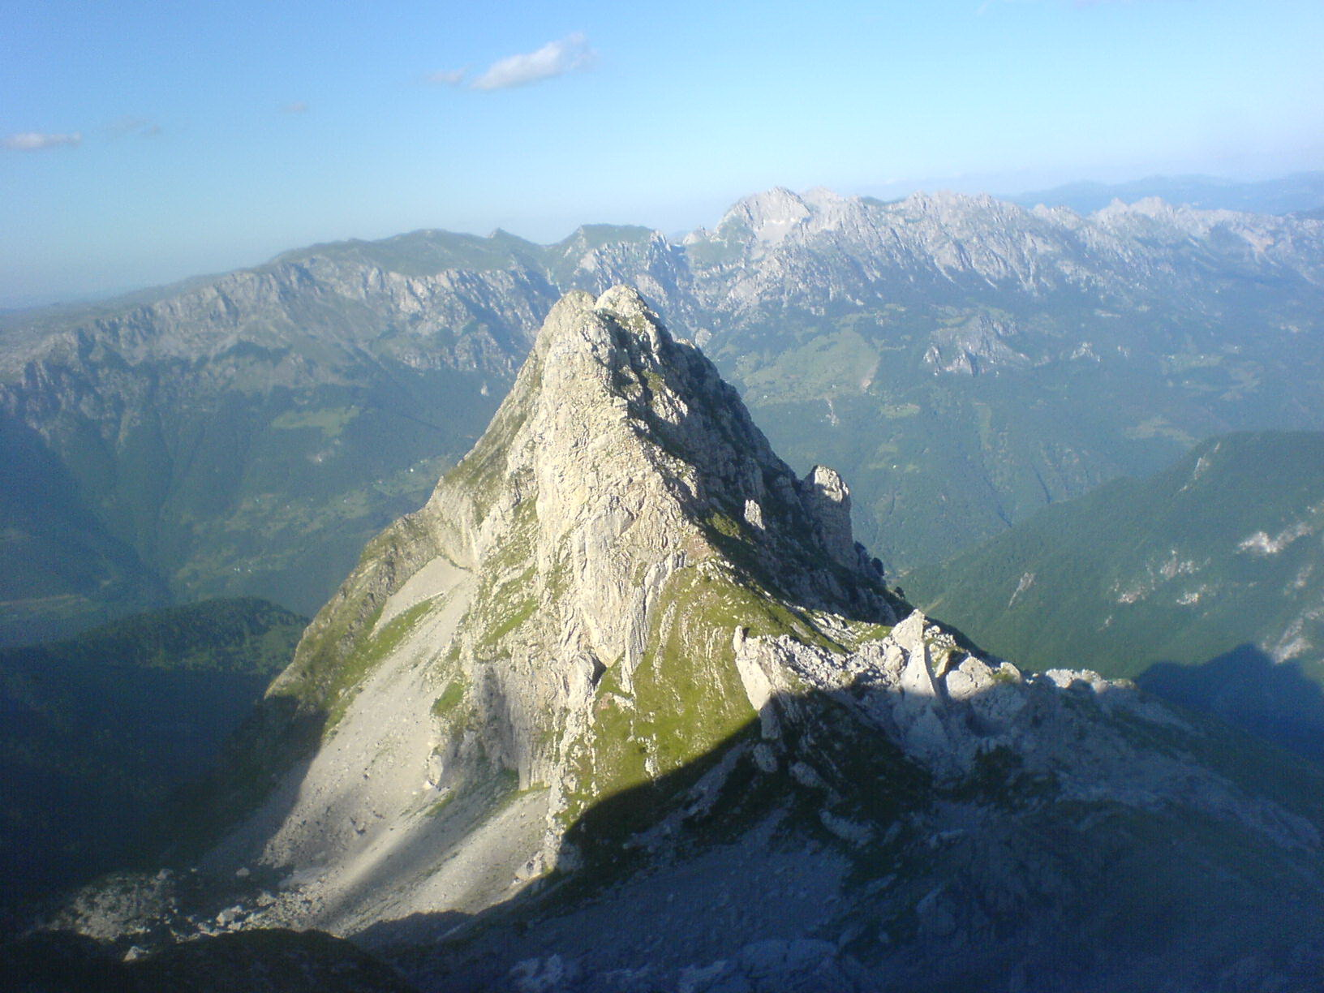
34
© H. Maurer

Slide 35
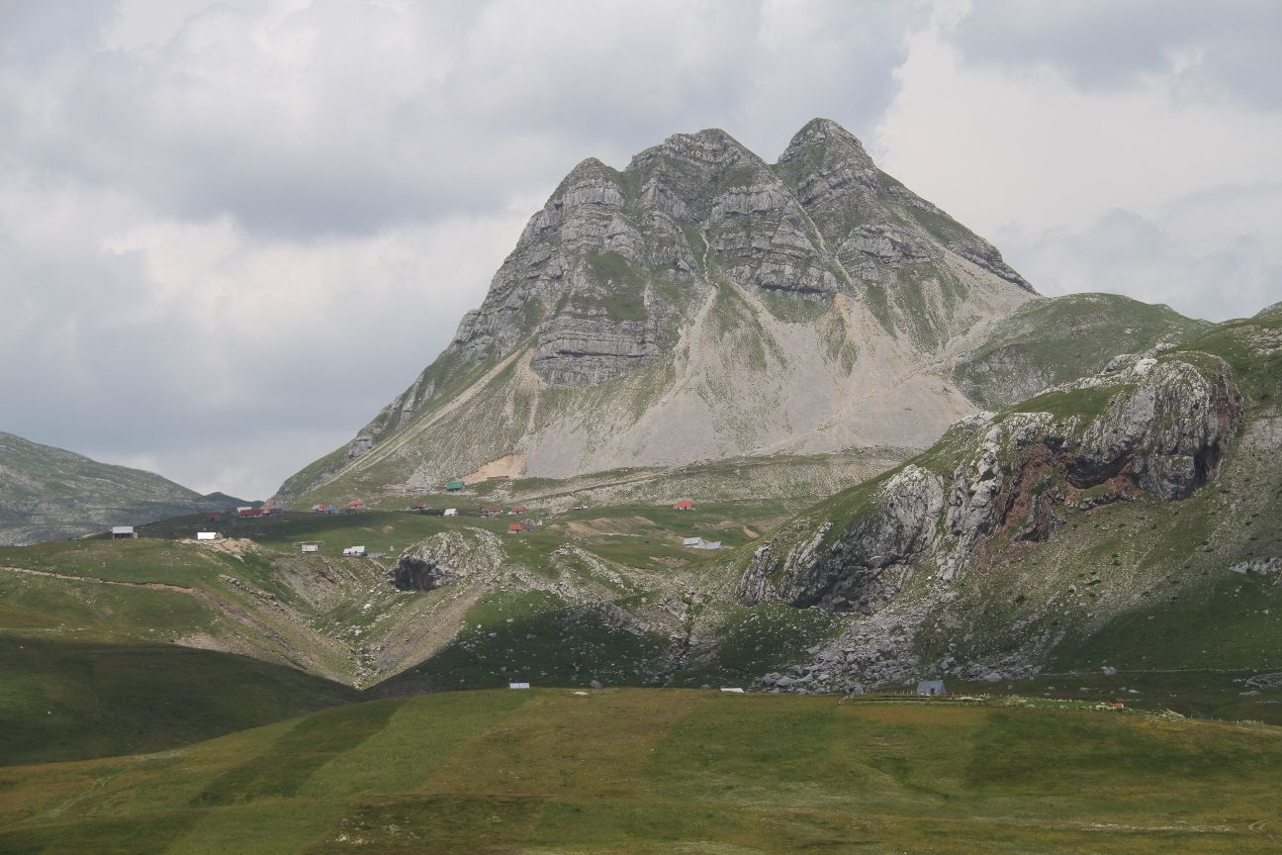
Q&A
vm@etf.rs
35
© H. Maurer

