Slide 1
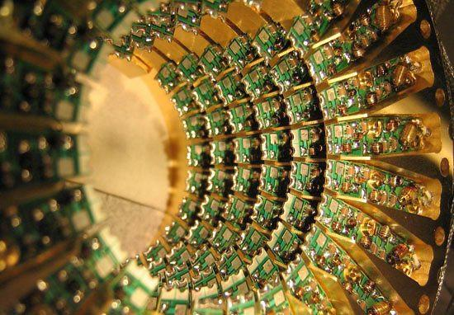
qC = Enabler Technology for Computational Genomics
Veljko Milutinovic and Nemanja Trifunovic

Slide 2
qC vs Turing Machine
1. Both: Skip on Condition 2. Simulated Annealing vs Binary Increment
What algorithms can be mapped, and how?
2/3

Slide 3
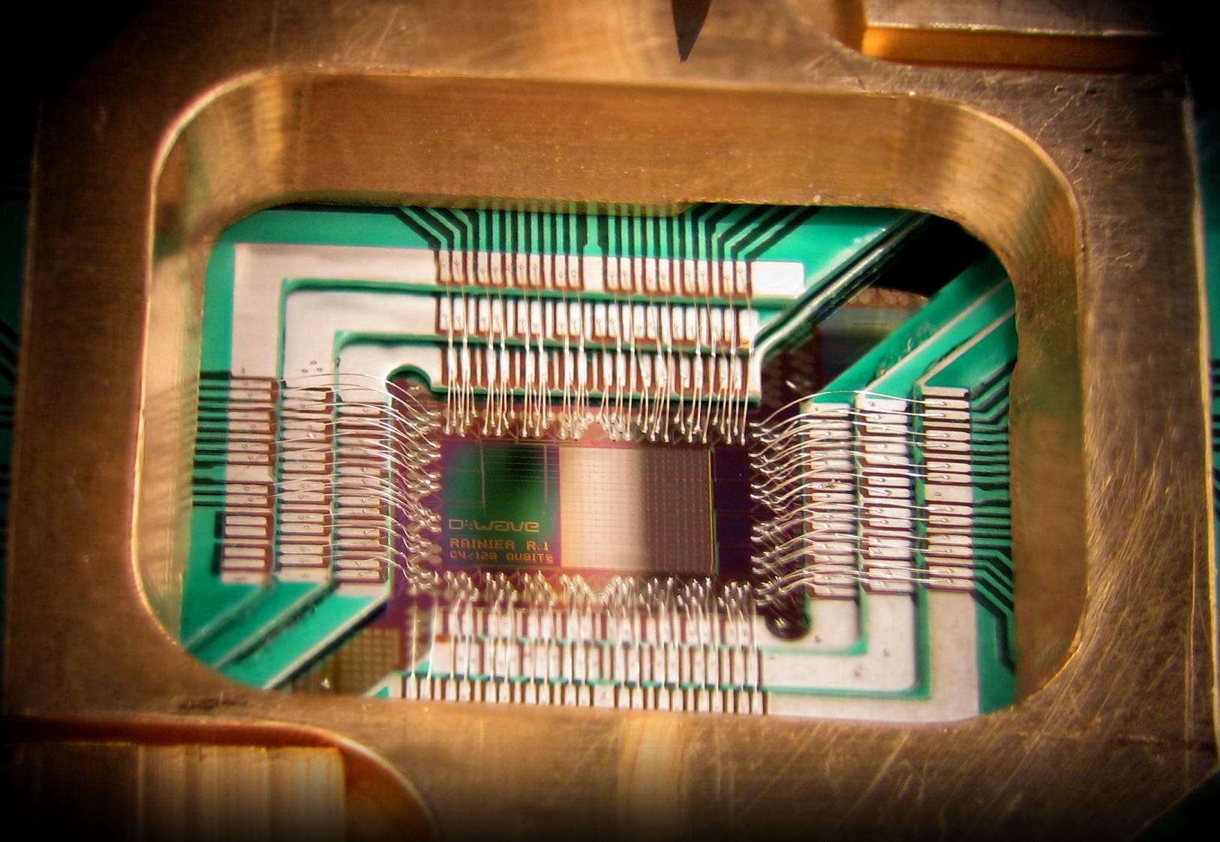
Q&A

